Slide 1
Software Engineering COMP 201
Lecturer: Sebastian Coope
Ashton Building, Room G.18
E-mail: coopes@liverpool.ac.uk
See Canvas for all notes
Lecture 1 – Module Introduction

Slide 2
What is SOFTWARE ENGINEERING
ENGINEERING
Making stuff
But
In a structured and disciplined manner!
Using tried and tested approaches
SOFTWARE
Code (instructions)
Data designs (data base schemas)

Slide 3
Why Software Engineering?
Software development is hard !
Important to distinguish :
“easy” systems (one developer, one user, experimental use only)
“hard” systems (multiple developers, multiple users, products)
Experience with “easy” systems is misleading
Single person techniques do not scale up
Analogy with bridge building:
Over a stream = easy, one person job
Over River Severn … ? (the techniques do not scale)

Slide 4
Why Software Engineering ?
The problem is complexity
There are many sources of complexity, but size is key:
The Linux kernel contains >13 million lines of code
Windows XP contains >40 million lines of code
Software engineering is about managing this complexity.

Slide 5
Why Software Engineering ?
Software failure can be very serious
Software controls safety critical systems
Software protects sensitive data
Software is involved in systems which handle money
Software Engineering has to
Produce software which has a very low chance of faulting
Be able to demonstrate/proof that software has very low chance of fault
Testing or program proving

Slide 6
Software engineering tasks
Define requirements
What should it do?
Design the product
Design how the product should look and be constructed
UI design, software module design, data design (what data?)
Implement and test
Coding, testing and validation
Managing the process
Software project management

Slide 7
Teaching Method
Lectures Online on Canvas
1 Hour/week seminar, tutorial
Practical work (3 Assignments)
----------------------- Course Assessment ----------------------
A two-hour examination: 60%
Coursework: 40%
-----------------------------------------------------------------------

Slide 8
COMP201 Practical
Practical slots: (from WEEK TWO)
1 hour/week
Use these sessions to do your coursework
COMP 201 Assignments
Assignment 1 – Part 1 Requirements Engineering (15%)
Use case analysis, non-functional requirements
Assignment 1 – Part 2 Design and implementation (5%)
Assignment 2 – Modelling with UML (20%)

Slide 9
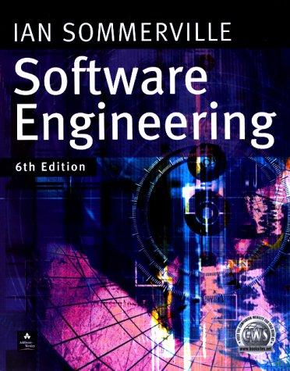

Recommended Course Textbooks
I. Sommerville (2001,2004, 2007)
Software Engineering 6th ,7th or 8th Edition,
Addison-Wesley, Harlow, Essex, UK
P. Stevens with R. Pooley (2000),
Using UML: Software Engineering with Objects and Components, 1st or 2nd Edition,
Addison-Wesley, Harlow, Essex, UK

Slide 10
Outline Syllabus
Introduction to Software Engineering
Software models
Software requirements
Formal Specification
Software Design and Implementation
UML (Unified Modeling Language)
Software verification, validation and testing
Management of Software Projects & Cost Estimation

Slide 11

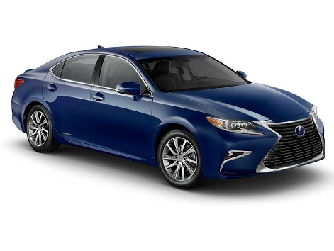


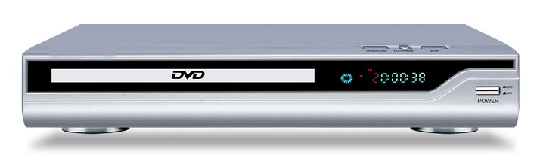
Software

Slide 12
Software Engineering
The economies of ALL developed nations are dependent on software.
More and more systems are software controlled
Software engineering is concerned with theories, methods and tools for professional software development.
Some software can be classified as critical (air traffic control, medical software, nuclear reactor control software..).

Slide 13
FAQs about Software Engineering
What is:
software?
a software process?
software engineering?
a software process model?

Slide 14



Examples of Software products
Programs
Games, servers, databases, languages, office applications
Crypto coin wallets
Apps, embedded systems
Documents
User manuals
Content
Designs and specifications

Slide 15
What is Software Engineering?
Software engineering is an engineering discipline which is concerned with all aspects of software production
Software engineers should
adopt a systematic and organised approach to their work
use appropriate tools and techniques depending on
the problem to be solved,
the development constraints and
the resources available

Slide 16
Good Software Engineers
Tend to
Not keep making the SAME mistakes again and again
(so document your mistakes)
Communicate well with others
Work well in teams
Document their work
Produce code which can be fixed/modified easily by others
Can predict their own productivity
Being a good software engineer
Is not very easy!

Slide 17
Major Software Failures
Therac-25 (1985-1987) : six people overexposed during treatments for cancer
Taurus (1993) : the planned automatic transaction settlement system for London Stock Exchange cancelled after five years of development
Ariane 5 (1996) : rocket exploded soon after its launch due error conversion (16 floating point into 16-bit integer leading to an exception)
The Mars Climate Orbiter : assumed to be lost by NASA officials (1999): different measurement systems (Imperial and metric)

Slide 18
What is a Software Process?
A Software Process is a set of activities whose goal is the development or evolution of software
Fundamental activities in all software processes are:
Specification - what the system should do and its development constraints
Development - production of the software system (design and implementation)
Validation - checking that the software is what the customer wants
Evolution - changing the software in response to changing demands

Slide 19
What are the Attributes of Good Software?
The software should deliver the required functionality and performance to the user and should be maintainable, dependable, efficient and usable.
Maintainability
Software must (easily) evolvable to meet changing needs
Dependability
Software must be trustworthy (work with all data)
Efficiency
Software should not make wasteful use of system resources
Usability
Software must be usable by the users for which it was designed

Slide 20
Professional and Ethical Responsibility
Software engineering involves wider responsibilities than simply the application of technical skills.
Software engineers must behave in an honest and ethically responsible way if they are to be respected as professionals.
Ethical behaviour is more than simply upholding the law.

Slide 21
Issues of Professional Responsibility
Confidentiality
Engineers should normally respect the confidentiality of their employers or clients even without a formal confidentiality agreement.
Competence
Engineers should not misrepresent their level of competence. They should not knowingly accept work which is beyond their competence.

Slide 22
Issues of Professional Responsibility
Intellectual property rights
Engineers should be careful to ensure that the intellectual property of employers and clients is protected and know the local laws governing IP.
Computer misuse
Software engineers should not use their technical skills to misuse other people’s computers.

Slide 23
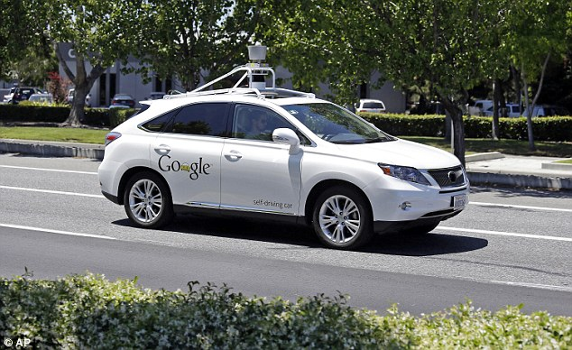
Ethics and software engineering

Slide 24
Ethics for the 21st Century
What if a robot you design the AI software for
Hurts (kills) someone, causes damage
Who is responsible?
You?
The owner of the robot?
The robot?
What if a robot you design and produce, designs and produces another robot? Etc. etc.

Slide 25
Lecture Key Points
We have seen the reasons for requiring solid software engineering principles in modern systems
Software engineering is an engineering discipline concerned with all aspects of software production.
Software products consist of developed programs and their associated documentation with several essential product attributes such as maintainability, dependability, efficiency and acceptability.
Software Engineers have responsibilities to the engineering profession and society and should not simply be concerned with technical issues.

Slide 26
Next Lecture
Use cases

