Slide 1
Chapter 4: Intermediate SQL

Slide 2
Chapter 4: Intermediate SQL
Join Expressions
Views
Integrity Constraints
Notes:
1

Slide 3
Joined Relations
Join operations take two relations and return another relation as a result.
A join operation is a Cartesian product which requires that tuples in the two relations match (under some condition).
The join operations are typically used as subquery expressions in the from clause.

Slide 4
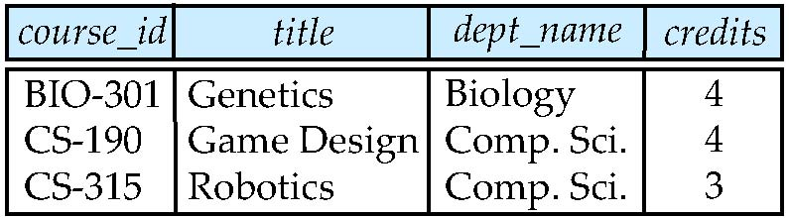
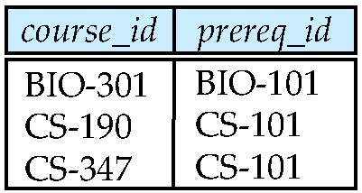
Join operations – Example
Relation course
Relation prereq
We want to know the courses and their prerequisites if any.
Note: prereq information missing for CS-315 and course information missing for CS-347.

Slide 5
Outer Join
An extension of the join operation that avoids loss of information.
Compute the join and then add tuples form one relation that does not match tuples in the other relation to the result of the join.
Use null values.

Slide 6
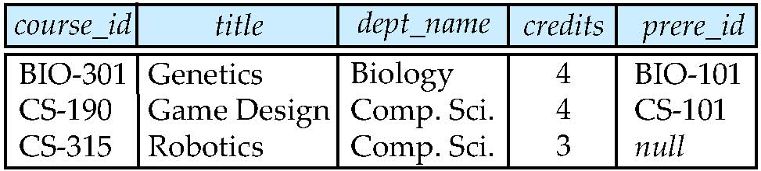
Left Outer Join
select * from (course natural left outer join prereq)
course
prereq
Note: read prere_id as prereq_id

Slide 7
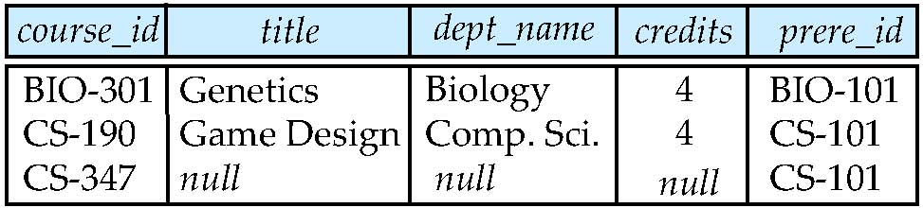
Right Outer Join
select * from (course natural right outer join prereq)
course
prereq

Slide 8
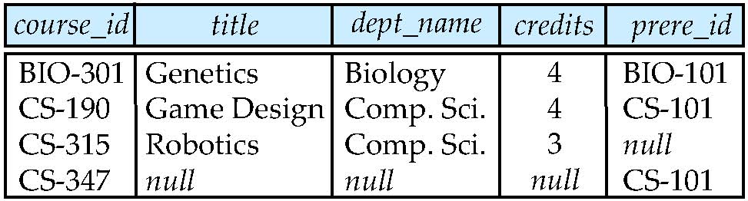
Full Outer Join
select * from (course natural full outer join prereq)
course
prereq

Slide 9
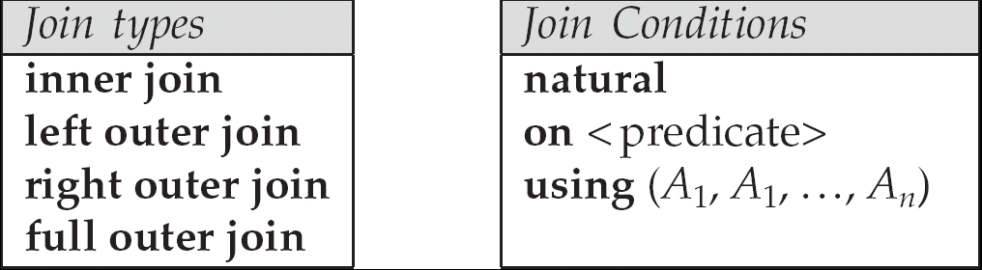
Joined Relations
Join operations take two relations and return a resulting relation.
These additional operations are typically used as subquery expressions in the from clause
Join condition: defines which tuples in the two relations match, and what attributes are present in the result of the join.
Join type: defines how tuples in each relation that do not match any tuple in the other relation (based on the join condition) are treated.

Slide 10
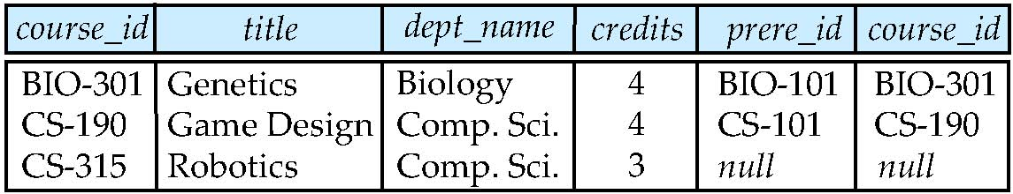
Joined Relations – Examples
course
prereq
select * from (course left outer join prereq on course.course_id = prereq.course_id)
There are two “course_id”. More precisely, one is course.course_id, and one is prereq.course.id
This is different from “select * from (course natural left outer join prereq)”. (Refer to the slide 4.8)

Slide 11
Joined Relations – Examples
select * from (course full outer join prereq using (course_id))
course
prereq

Slide 12
Views
In some cases, it is not desirable for all users to see the logical model (e.g., all the actual relations stored in the database.)
Consider a person who needs to know an instructors name and department, but not the salary. This person should see a relation described in SQL as below. select ID, name, dept_name from instructor
A view provides a mechanism to view data. For example, we only want to maintain a list of all course sections offered by the Physics department in the Fall 2009 semester. select course.course_id, sec_id, building, room_number from course, section where course.course_id = section.course_id and course.dept_name = ’Physics’ and section.semester = ’Fall’ and section.year = 2009

Slide 13
View Definition
Any relation that is made visible to a user as a “virtual relation” is called a view. SQL allows a “virtual relation” to be defined by a query using the create view statement
create view v as <query expression>
where <query expression> is any legal SQL expression. The view name is represented by v. The relation conceptually contains the result of the query.
Once a view is defined, the view name can be used to refer to the virtual relation that the view generates.
Creating view is not the same as creating a new relation by precomputing the query expression and storing its result.
A virtual relation is computed by executing the query whenever the virtual relation is used.

Slide 14
Example Views
A view of instructors without their salary create view faculty as select ID, name, dept_name from instructor
Find all instructors in the Biology department select name from faculty where dept_name = ‘Biology’
A view of department salary totals create view departments_total_salary(dept_name, total_salary) as select dept_name, sum(salary) from instructor group by dept_name;

Slide 15
Views Defined Using Other Views
create view physics_fall_2009 as select course.course_id, sec_id, building, room_number from course, section where course.course_id = section.course_id and course.dept_name = ’Physics’ and section.semester = ’Fall’ and section.year = 2009;
create view physics_fall_2009_watson as select course_id, room_number from physics_fall_2009 where building= ’Watson’;

Slide 16
View Expansion
Expand use of a view in a query/another view
create view physics_fall_2009_watson as
(select course_id, room_number
from (select course.course_id, building, room_number
from course, section
where course.course_id = section.course_id
and course.dept_name = ’Physics’
and section.semester = ’Fall’
and section.year = 2009)
where building= ’Watson’;)

Slide 17
Integrity Constraints
Integrity constraints guard against accidental damage to the database, by ensuring that authorized changes to the database do not result in a loss of data consistency.
A checking account must have a balance greater than $10,000.00.
A salary of a bank employee must be at least $4.00 an hour.
A customer must have a (non-null) phone number.
Specify integrity constraints when we create tables.

Slide 18
Constraints on a Single Relation
not null
primary key
unique
check (P), where P is a predicate

Slide 19
Not Null and Unique Constraints
not null
Declare name and budget to be not null
name char(20) not null budget numeric(12,2) not null
unique (A₁, A₂, …, A_{m})
The unique specification states that the attributes A₁, A₂, …, A_{m} form a candidate key.
Candidate keys are permitted to be null (in contrast to primary keys).

Slide 20
The check clause
check (P) where P is a predicate that every tuple in a relation must satisfy.
Example: ensure that semester is one of fall, winter, spring or summer:
create table section (
course_id varchar (8),
sec_id varchar (8),
semester varchar (6),
year numeric (4,0),
building varchar (15),
room_number varchar (7),
time_slot_id varchar (4),
primary key (course_id, sec_id, semester, year),
check (semester in (’Fall’, ’Winter’, ’Spring’, ’Summer’)) );

Slide 21
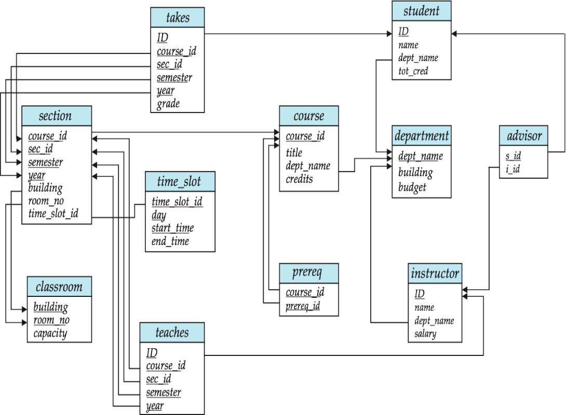
The check clause: Another Example
To check that the time_slot_id in each tuple in the section relation is the identifier of a time slot in the time_slot relation.
create table section (
course_id varchar (8),
sec_id varchar (8),
semester varchar (6),
year numeric (4,0),
building varchar (15),
room_number varchar (7),
time_slot_id varchar (4),
primary key (course_id, sec_id, semester, year),
check (semester in (’Fall’, ’Winter’, ’Spring’, ’Summer’)),
check (time_slot_id in (select time_slot_id from time_slot)));

Slide 22
Referential Integrity
To ensure that a value that appears in one relation for a given set of attributes also appears for a certain set of attributes in another relation.
Example: If “Biology” is a department name appearing in one of the tuples in the instructor relation, then there exists a tuple in the department relation for “Biology”.
Let A be a set of attributes. Let R and S be two relations that contain attributes A, where A is the primary key of S. A is said to be a foreign key of R if for any values of A appearing in R these values also appear in S.

Slide 23
Cascading Actions in Referential Integrity
create table course ( course_id char(5) primary key, title varchar(20), dept_name varchar(20) references department )
create table course ( … dept_name varchar(20), foreign key (dept_name) references department on delete cascade on update cascade, . . . )
alternative actions to cascade: set null or set default
department
dept_name | building | budget
SEEM | ERB | 2000
CSE | HSH | 1800
course
course_id | title | dept_name | credits
3550 | DB | SEEM | 3
2100 | Algo | CSE | 3

Slide 24
Assertion
An assertion is a predicate expressing a condition that the database always satisfies.
An assertion in SQL takes the form:
create assertion <assertion-name> check <predicate>
Example: for each tuple in the student relation, the value of the attribute tot_cred must equal the sum of credits of courses that the student has completed successfully. create assertion credits_earned_constraint check (not exists ( select student.ID from student where tot_cred <> (select sum(credits) from takes, course where takes.course_id = course.course_id and student.ID = takes.ID and grade is not null and grade <> ‘F’)))

Slide 25
Assertion: An Example
create assertion credits_earned_constraint check (not exists ( select student.ID from student where tot_cred <> (select sum(credits) from takes, course where takes.course_id = course.course_id and student.ID = takes.ID and grade is not null and grade <> ‘F’)))
student
ID | name | dept_name | tot_cred
8 | ABC | SEEM | 6
takes
ID | course_id | sec_id | semester | year | grade
8 | 3550 | 1 | 1 | 2018 | A
8 | 2100 | 1 | 2 | 2018 | A-
course
course_id | title | dept_name | credits
3550 | DB | SEEM | 3
2100 | Algo | CSE | 3

