Slide 1
Chapter 10: Storage and File Structure

Slide 2
Disk-Block Access
A relation is stored as a file on disk.
A file is a sequence of blocks, where a block is a fixed-length storage unit.
A block is a unit consisting of a fixed number of continuous sectors on disk.
Data is transferred between disk and main memory in units of blocks.
A block is also called a disk-page or page.

Slide 3
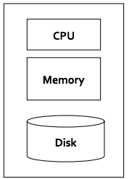
CPU cost vs I/O cost
The implementation Issues
There are two main costs, CPU cost and I/O (Input/Output) cost.
CPU cost is to process data in main memory.
I/O cost is to read/write data from/into disk.
The dominating cost is I/O cost. For query processing in DBMS, CPU cost can be ignored.
The key issue is to reduce I/O cost.
It is to reduce the number of I/O accesses.
What is I/O cost?
A block (or page) to be read/written from/into disk is one I/O access (or one disk-block/page access).

Slide 4
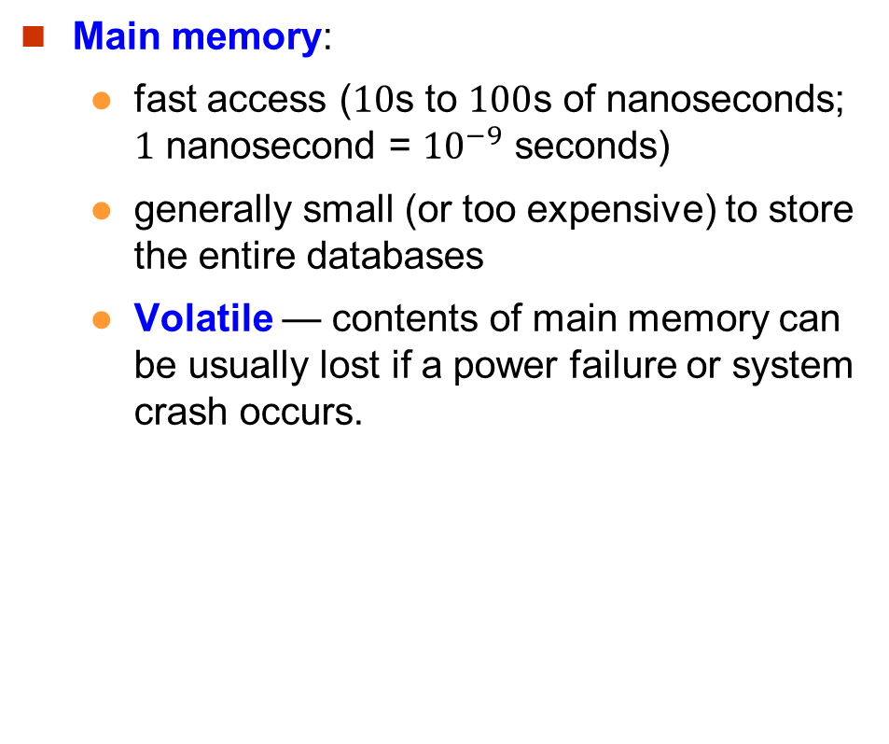
Primary Storage
Main memory:
fast access ($10$s to $100$s of nanoseconds; $1$ nanosecond = ${10}^{−9}$ seconds)
generally small (or too expensive) to store the entire databases
Volatile — contents of main memory can be usually lost if a power failure or system crash occurs.

Slide 5
Secondary Storage
Magnetic-disk
Data is stored on spinning disk, and is read/written magnetically
Primary medium for the long-term storage of data; typically stores entire database.
Data must be moved from disk to main memory for access, and written back for storage
Much slower access than main memory
direct-access – possible to read data on disk in any order.
Survives power failures and system crashes
disk failure can destroy data, but is rare

Slide 6
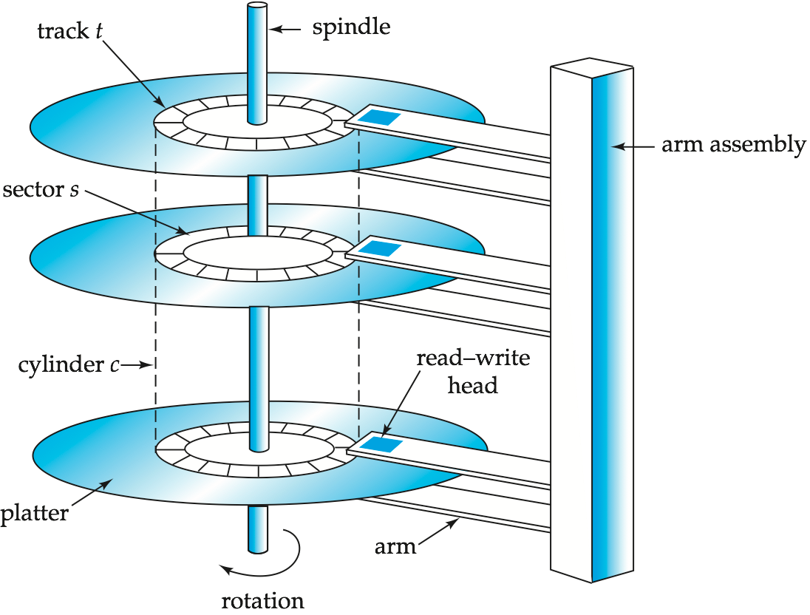
Magnetic Hard Disk Mechanism
NOTE: Diagram is schematic, and simplifies the structure of actual disk drives

Slide 7
Performance Measures of Disks
Access time – the time it takes from the time when a read or write request is issued to the time when data transfer begins.
Seek time – time it takes to reposition the arm over the correct track.
Average seek time is 1/2 the worst case seek time.
4 to 10 milliseconds on typical disks
Rotational latency – time it takes for the sector to be accessed to appear under the head.
Average latency is 1/2 of the worst case latency.
4 to 11 milliseconds on typical disks (5400 to 15000 rpm (revolutions per minute))
Data-transfer rate – the rate at which data can be retrieved from or stored to the disk.
25 to 100 MB per second max rate.

Slide 8
Managing a relation
From a relation to disk sectors
A relation is stored in a file in the database management system.
A file is managed by Operating System (OS) as a sequence of disk-pages.
A disk-page will be stored on disk as sectors.
From a relation to fields (attribute value or column value)
A relation is a sequence of records.
A record is a sequence of data fields.
There are fixed-length data fields (say using char(n))
There are variable-length data fields (say using varchar(n))
If all data fields are fixed-length, we use fixed-length records.
If at least one data field is variable-length, we use variable-length records.

Slide 9
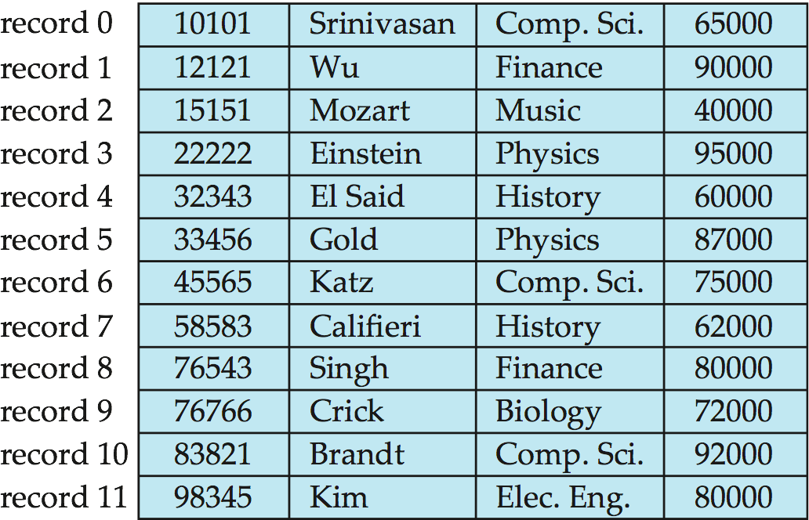
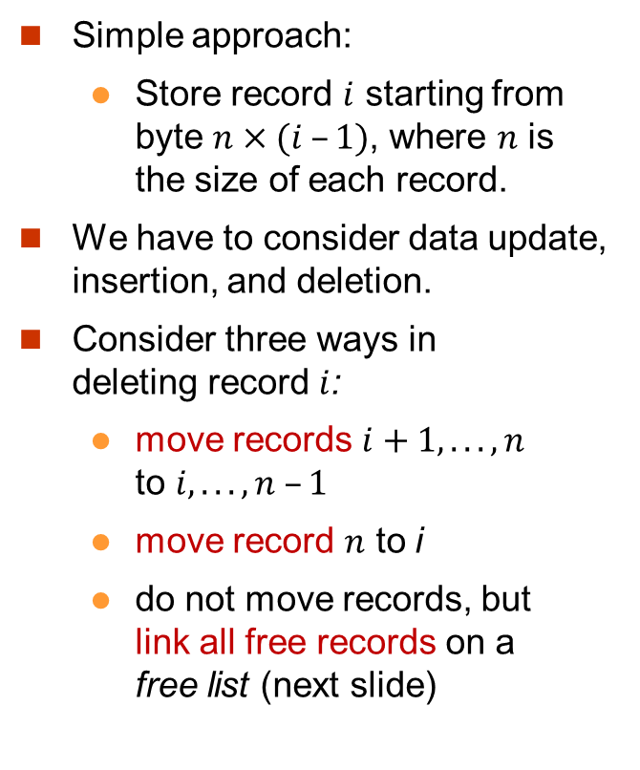
Fixed-Length Records
Simple approach:
Store record $i$ starting from byte $n×(i –1)$, where $n$ is the size of each record.
We have to consider data update, insertion, and deletion.
Consider three ways in deleting record $i$:
move records $i+1, . . ., n$ to $i, . . . , n –1$
move record $n$ to i
do not move records, but link all free records on a free list (next slide)

Slide 10
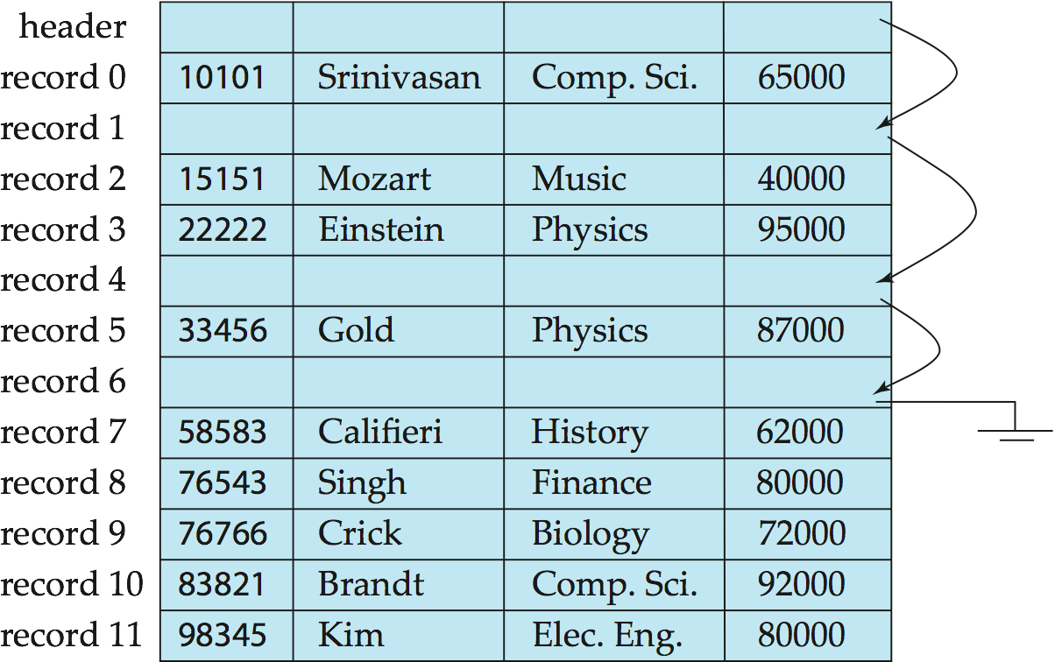
More about Insertion/Deletion: Free Lists
Store the address of the first deleted record in the file header.
Use the first deleted record to store the address of the second deleted record, and so on. Can think of these stored addresses as pointers since they “point” to the location of a record in a file.
More space efficient representation. Note that no pointers stored in in-use records (not deleted records).
Free space
Free space
Free space
The Last!

Slide 11
Variable-Length Records (1)
Variable-length records arise in database systems in several ways.
Attributes are stored in order.
For a variable-length record, we use the following format. (a) fixed-length part followed by variable-length part. (b) The fixed-length part is to tell where we can find the data if it is a variable-length data field. (c) The variable-length part is to store the data.
Variable length attributes are represented by fixed size (offset, length) in the fixed-length part, and keep attribute values in the variable-length part.
Fixed length attributes store attribute values in the fixed-length part.
Suppose there is a relation with 4 attributes: 2 fixed-length and 2 variable-length.
Fixed-length part
Variable-length part
Variable attribute | Variable attribute | Fixed attribute | Fixed Attribute

Slide 12
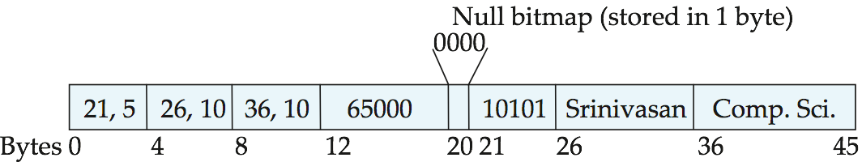
Variable-Length Records (2)
Example: a tuple of (ID, Name, DeptName, Salary) where the first three are variable length (e.g., by varchar).
Fixed-length part
Variable-length part
Variable attribute | Variable attribute | Fixed attribute | Fixed Attribute
ID Name DeptName
Offset = 21, length = 5

Slide 13
Null Value Handling
Null values represented by null-value bitmap.
Why do we need something additional to represent null values?
Example: a tuple of (ID, Name, DeptName, Salary).
→0001 means Salary is a null value
ID Name DeptName
Offset = 21, length = 5

Slide 14
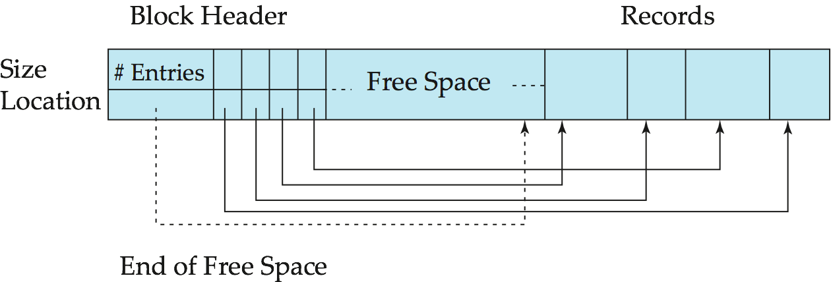
Slotted Page Structure for Variable-Length Records
data XYZ
offset/size
A slotted page is a page format to store variable-length records in a page (block). It can be used to store fixed-length records too.
Slotted page header contains:
number of record entries
end of free space in the block
offset and size of each record
Pointers should not directly point to record — instead they should point to the entry for the record in header.

Slide 15
Organization of Records in Files
Heap – a record can be placed anywhere in the file where there is a space.
Sequential – store records in sequential order, based on the value of the search key of each record.
Hashing – a hash function computed on some attribute of a record; the result specifies in which block of the file the record should be placed.
A hash function gives a “value” a rough location to find: f(data) → location.
We can generate a number for a string.
Suppose there are 10 blocks numbered from 0 to 9.
f(data) : the remaining divided by 10, which is in the range of [0,9].

Slide 16
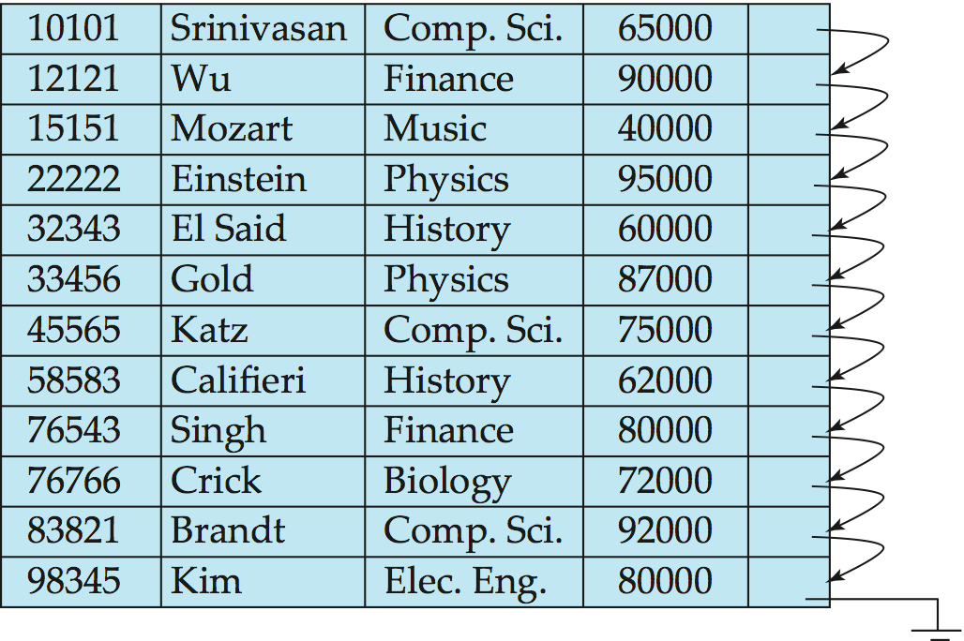
Sequential File Organization (1)
Suitable for applications that require sequential processing of the entire file
The records in the file are ordered by a search-key

Slide 17
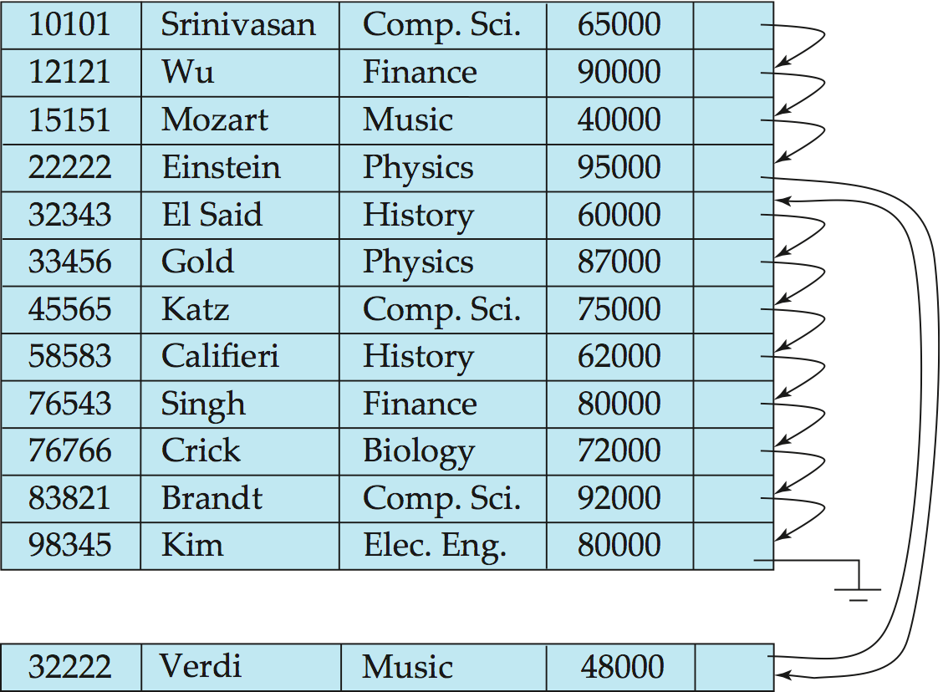
Sequential File Organization (2)
Deletion – use pointer chains
Insertion –locate the position where the record is to be inserted
if there is free space insert there
if no free space, insert the record in an overflow block
In either case, pointer chain must be updated
Need to reorganize the file from time to time to restore sequential order. Why?
overflow block

Slide 18
Storage Access
A database file is partitioned into fixed-length storage units called blocks. Blocks are units of both storage allocation and data transfer.
Database system seeks to minimize the number of block transfers between the disk and memory.
We can reduce the number of disk accesses by keeping as many blocks as possible in main memory.
Buffer – portion of main memory available to store copies of disk blocks.
Buffer manager – subsystem responsible for allocating buffer space in main memory.
Main Memory
Disk
Notes:
18

Slide 19
Buffer Manager
It calls on the buffer manager when it needs a block from disk.
If the block is already in the buffer, buffer manager returns the address of the block in main memory
If the block is not in the buffer, the buffer manager
allocates space in the buffer for the block
replacing (throwing out) some other block, if required, to make space for the new block.
replaced block written back to disk only if it was modified since the most recent time that it was written to/fetched from the disk.
reads the block from the disk to the buffer, and returns the address of the block in main memory to requester.
It can use pin operation to keep a block in memory that will not be evicted, and unpin to release it.
Main Memory
Disk
Notes:
19

Slide 20
Buffer-Replacement Policies
Most systems use least recently used (LRU) strategy
Idea behind LRU – use past pattern of block references as a predictor of future references
The one I used just now may be needed very soon.
An example: department (2 blocks) and instructor (4 blocks)
A buffer has 4 blocks.
An SQL
select * from department, instructor where department.dept_name = instructor.dept_name
department
D1 D2 D3 D4
instructor
D1 D4 D2 D3
D1 D2 D1 D4
Notes:
20

Slide 21
Buffer-Replacement Policies
SQL: select * from department D, instructor I where D.dept_name = I.dept_name
Algorithm: for each tuple t of department do for each tuple s of instructor do if the t and s have the same department name, then output all the attributes
department
instructor
D1 D2 D3 D4
D1 D4 D2 D3
D1 D2 D1 D4
b1
b2
b1
b2
b3
b4
Buffer
Now we need to access b4. But we need to replace it. Which do we replace? b1 ! Which one do we need next?
b1
b1
b2
b3
b1
Notes:
21

