Slide 1
Chapter 13: Query Optimization

Slide 2
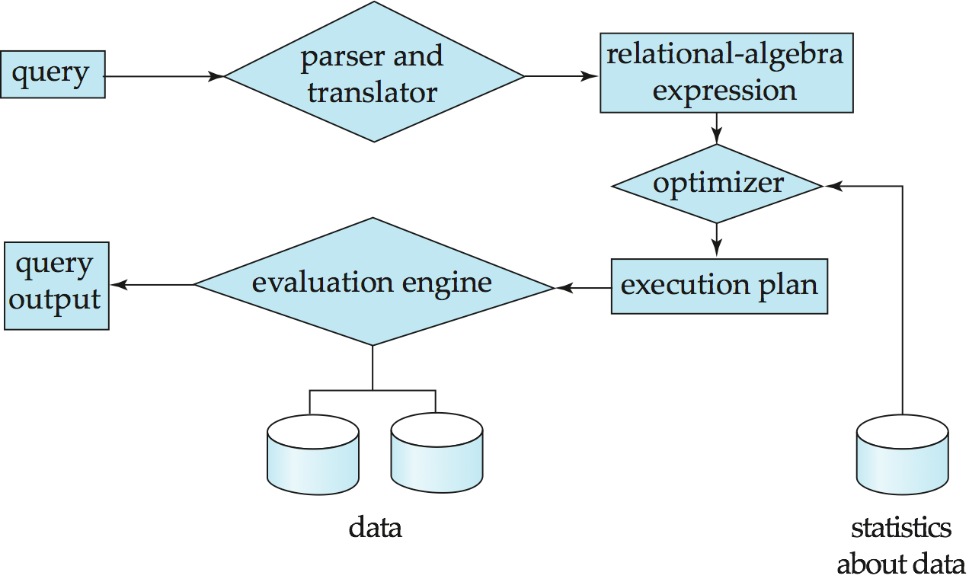
Basic Steps in Query Processing
1. Parsing and translation
2. Optimization
3. Evaluation

Slide 3
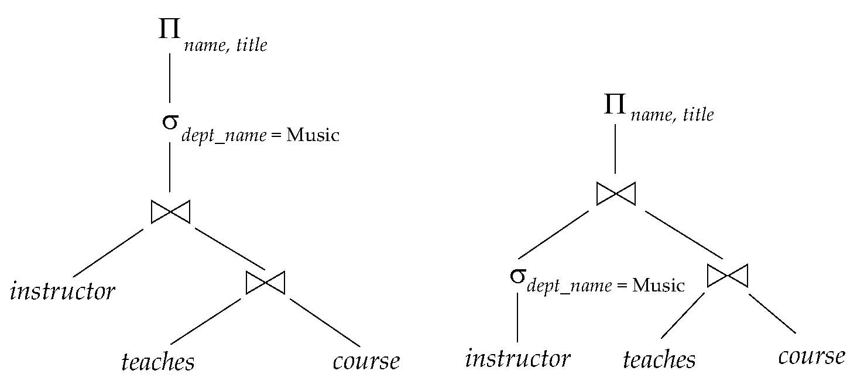
Introduction (1)
Alternative ways of evaluating a given query
Equivalent expressions
Different algorithms for each operation

Slide 4
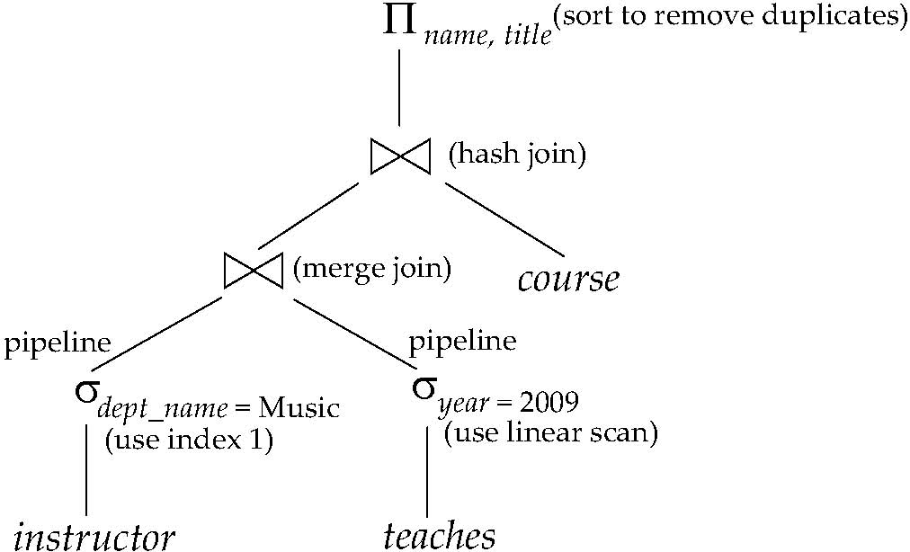
Introduction (2)
An evaluation plan defines exactly what algorithm is used for each operation, and how the execution of the operations is coordinated.

Slide 5
Introduction (3)
Cost difference between evaluation plans for a query can be enormous.
Steps in cost-based query optimization
Generate logically equivalent expressions using equivalence rules
Annotate resultant expressions to get alternative query plans
Choose the cheapest plan based on estimated cost
Estimation of plan cost based on:
Statistical information about relations.
number of tuples, number of distinct values for an attribute
Statistics estimation for intermediate results
to compute cost of complex expressions
Cost formulae for algorithms, computed using statistics

Slide 6
Transformation of Relational Expressions
Two relational algebra expressions are said to be equivalent if the two expressions generate the same set of tuples on every legal database instance
An equivalence rule says that expressions of two forms are equivalent
Can replace expression of first form by second, or vice versa

Slide 7
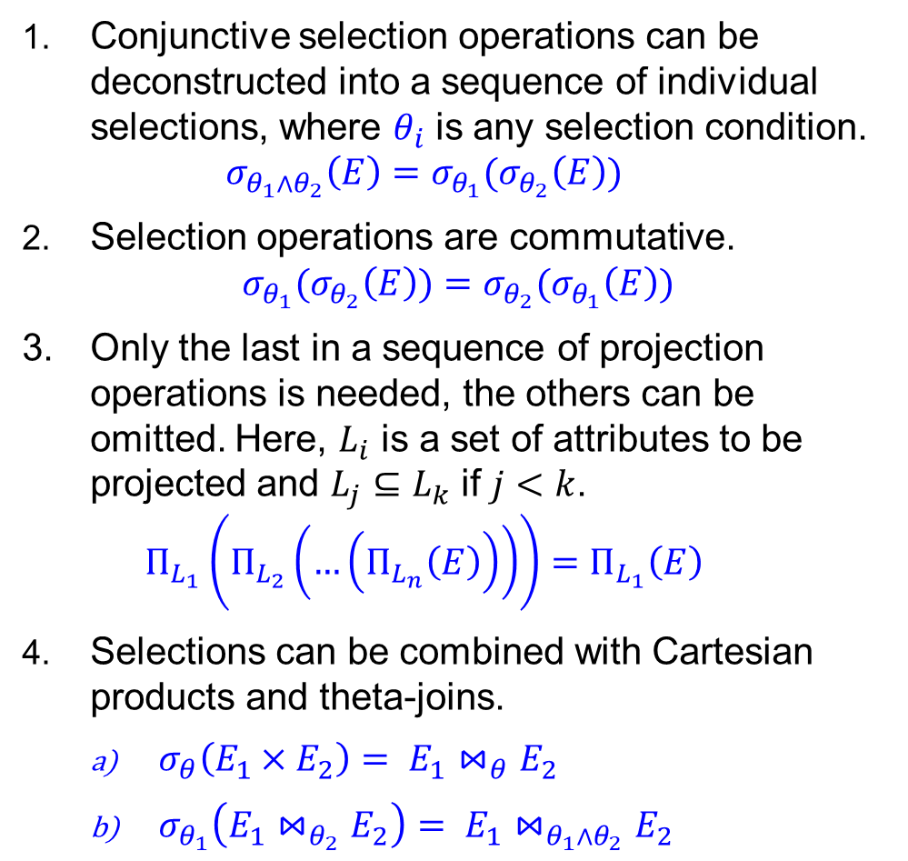
Equivalence Rules (1)
Conjunctive selection operations can be deconstructed into a sequence of individual selections, where $θ_{i}$ is any selection condition. $σ_{θ_{1}∧θ_{2}}\left(E\right)=σ_{θ_{1}}(σ_{θ_{2}}\left(E\right))$
Selection operations are commutative. $σ_{θ_{1}}(σ_{θ_{2}}\left(E\right))=σ_{θ_{2}}(σ_{θ_{1}}\left(E\right))$
Only the last in a sequence of projection operations is needed, the others can be omitted. Here, $L_{i}$ is a set of attributes to be projected and $L_{j}⊆L_{k}$ if $j<k$. $Π_{L_{1}}\left(Π_{L_{2}}\left(…\left(Π_{L_{n}}\left(E\right)\right)\right)\right)=Π_{L_{1}}\left(E\right)$
Selections can be combined with Cartesian products and theta-joins.
$σ_{θ}\left(E_{1}×E_{2}\right)= E_{1}⋈_{θ}E_{2}$
$σ_{θ_{1}}\left(E_{1}⋈_{θ_{2}}E_{2}\right)= E_{1}⋈_{θ_{1}∧θ_{2}}E_{2}$

Slide 8
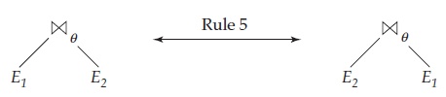
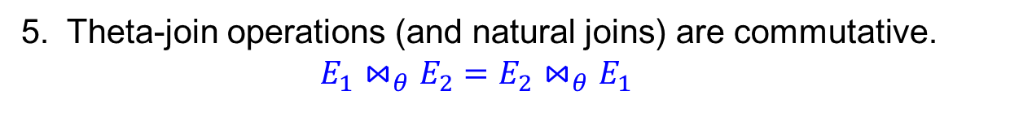
Equivalence Rules (2)
5. Theta-join operations (and natural joins) are commutative. $E_{1}⋈_{θ}E_{2}=E_{2}⋈_{θ}E_{1}$

Slide 9
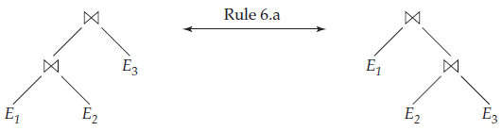
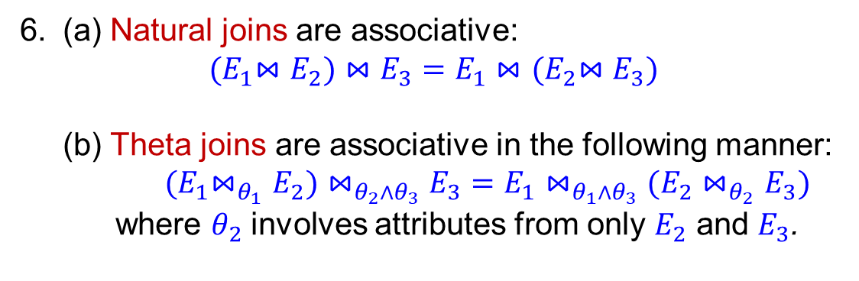
Equivalence Rules (3)
6. (a) Natural joins are associative: $${(E}_{1}⋈E_{2})⋈E_{3}=E_{1}⋈{(E}_{2}⋈E_{3})$$ (b) Theta joins are associative in the following manner: ${(E}_{1}⋈_{θ_{1}}E_{2})⋈_{θ_{2}∧θ_{3}}E_{3}=E_{1}{⋈_{θ_{1}∧θ_{3}}(E}_{2}⋈_{θ_{2}}E_{3})$ where $θ_{2}$ involves attributes from only $E_{2}$ and $E_{3}$.

Slide 10
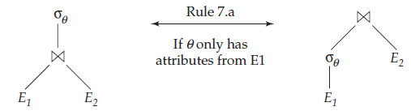
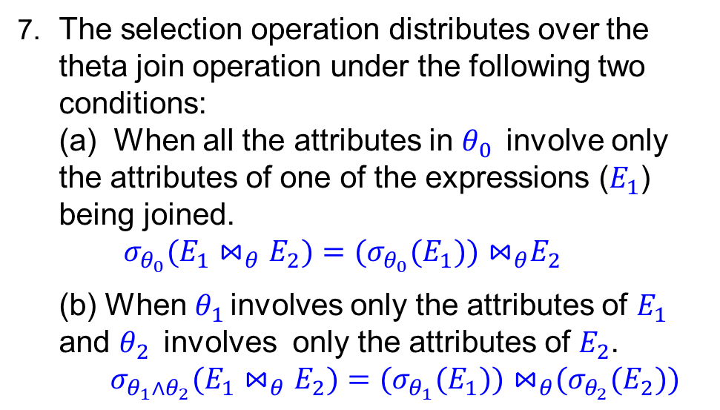
Equivalence Rules (4)
7. The selection operation distributes over the theta join operation under the following two conditions: (a) When all the attributes in $θ_{0}$ involve only the attributes of one of the expressions ($E_{1}$) being joined. $${σ_{θ_{0}}(E}_{1}⋈_{θ}E_{2})={(σ_{θ_{0}}(E}_{1}{))⋈}_{θ}E_{2}$$
(b) When $θ_{1}$ involves only the attributes of $E_{1}$ and $θ_{2}$ involves only the attributes of $E_{2}$. ${σ_{θ_{1}{∧θ}_{2}}(E}_{1}⋈_{θ}E_{2})={(σ_{θ_{1}}(E}_{1}{))⋈}_{θ}{(σ_{θ_{2}}(E}_{2}))$

Slide 11
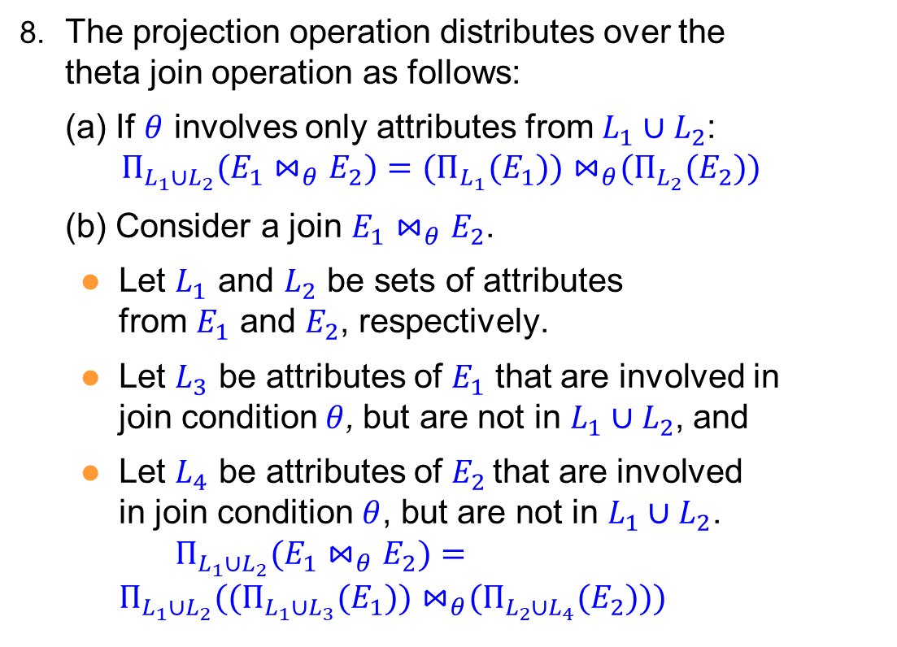
Equivalence Rules (5)
8. The projection operation distributes over the theta join operation as follows:
(a) If $θ$ involves only attributes from $L_{1}∪L_{2}$: ${Π_{L_{1}∪L_{2}}(E}_{1}⋈_{θ}E_{2})={(Π_{L_{1}}(E}_{1}{))⋈}_{θ}{(Π_{L_{2}}(E}_{2}))$
(b) Consider a join $E_{1}⋈_{θ}E_{2}$.
Let $L_{1}$ and $L_{2}$ be sets of attributes from $E_{1}$ and $E_{2}$, respectively.
Let $L_{3}$ be attributes of $E_{1}$ that are involved in join condition$θ$, but are not in $L_{1}∪L_{2}$, and
Let $L_{4}$ be attributes of $E_{2}$ that are involved in join condition $θ$, but are not in $L_{1}∪L_{2}$. ${Π_{L_{1}∪L_{2}}(E}_{1}⋈_{θ}E_{2})={Π_{L_{1}∪L_{2}}((Π_{L_{1}∪L_{3}}(E}_{1}{))⋈}_{θ}{(Π_{L_{2}∪L_{4}}(E}_{2})))$

Slide 12
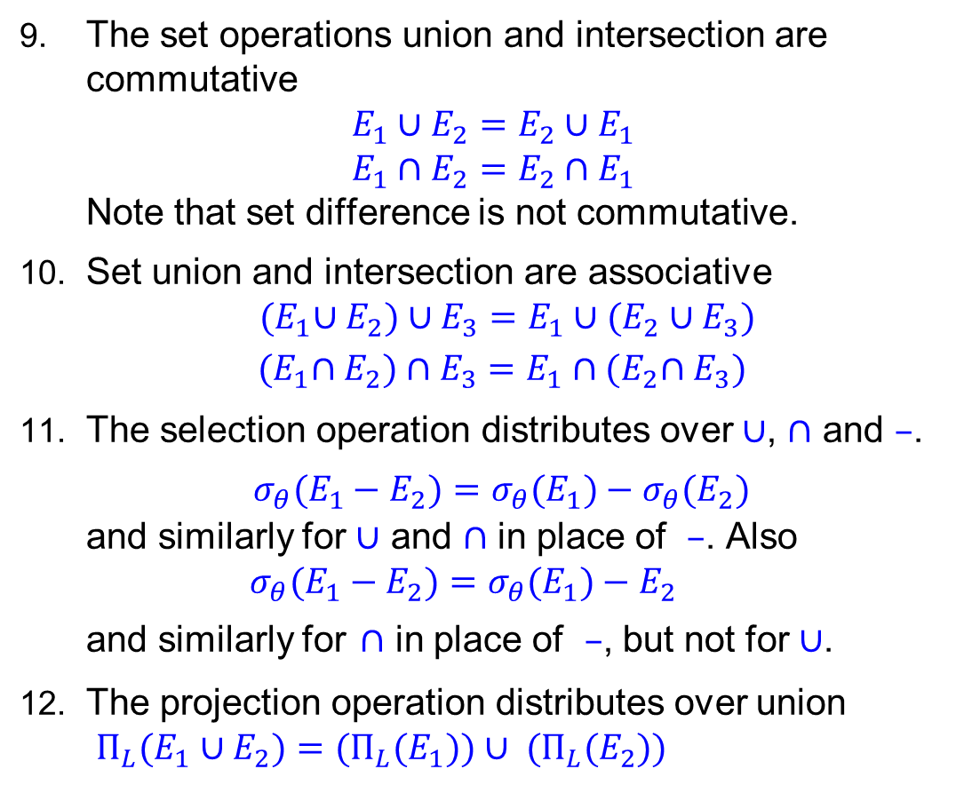
Equivalence Rules (6)
The set operations union and intersection are commutative $E_{1}∪E_{2}=E_{2}∪E_{1}$ $E_{1}∩E_{2}=E_{2}∩E_{1}$ Note that set difference is not commutative.
Set union and intersection are associative ${(E}_{1}∪E_{2})∪E_{3}=E_{1}∪{(E}_{2} ∪E_{3})$ ${(E}_{1}∩E_{2})∩E_{3}=E_{1}∩{(E}_{2}∩E_{3})$
The selection operation distributes over $∪$, $∩$ and $–$. ${σ_{θ}(E}_{1}−E_{2})={σ_{θ}(E}_{1})−{σ_{θ}(E}_{2})$ and similarly for $∪$ and $∩$ in place of $–$. Also ${σ_{θ}(E}_{1}−E_{2})={σ_{θ}(E}_{1})−E_{2}$ and similarly for $∩$ in place of $–$, but not for $∪$.
The projection operation distributes over union ${Π_{L}(E}_{1}∪E_{2})={(Π_{L}(E}_{1}))∪{ (Π_{L}(E}_{2}))$

Slide 13
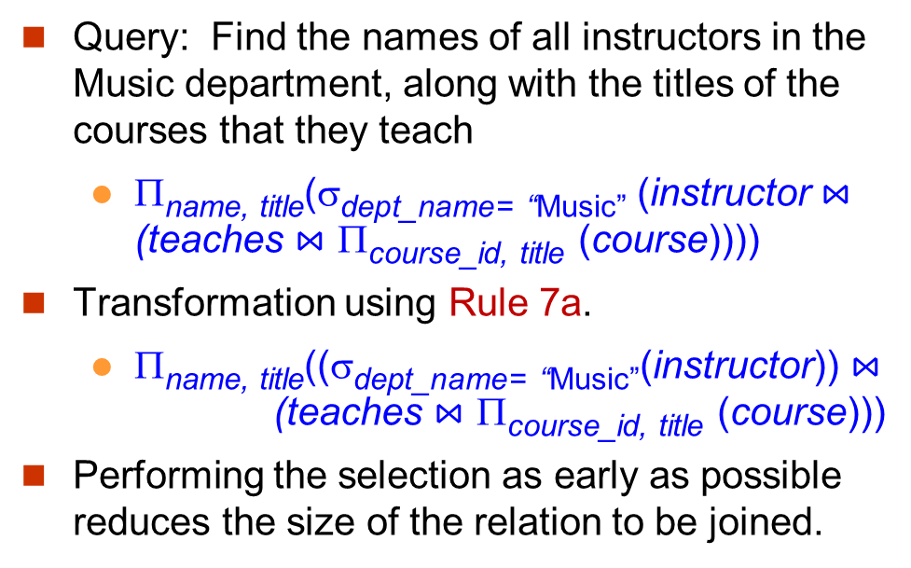
Transformation Example: Pushing Selections
Query: Find the names of all instructors in the Music department, along with the titles of the courses that they teach
Π_{name, title}(σ_{dept_name= “Music”} (instructor $⋈$ (teaches $⋈$ Π_{course_id, title} (course))))
Transformation using Rule 7a.
Π_{name, title}((σ_{dept_name= “Music”}(instructor)) $⋈$ (teaches $⋈$ Π_{course_id, title} (course)))
Performing the selection as early as possible reduces the size of the relation to be joined.

Slide 14
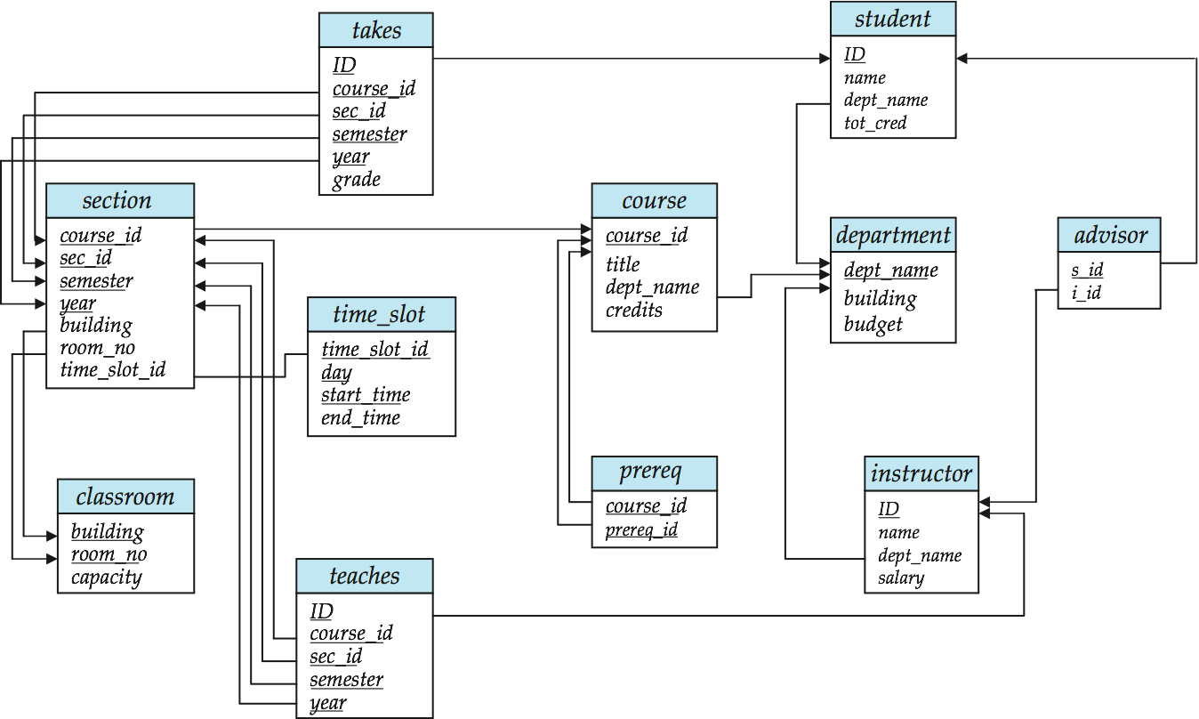
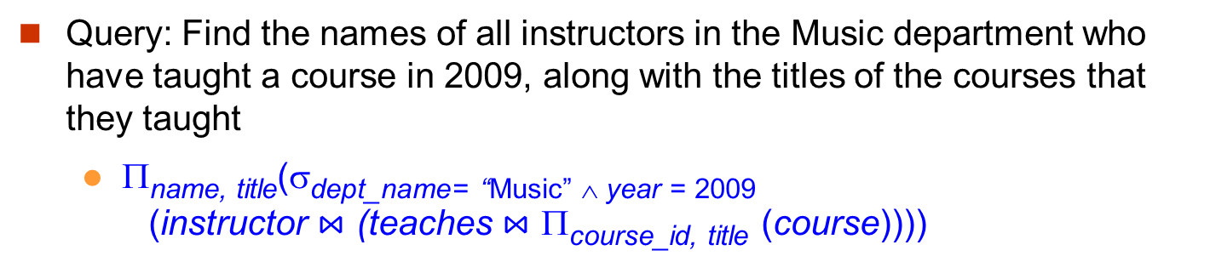
Multiple Transformations (1)
Query: Find the names of all instructors in the Music department who have taught a course in 2009, along with the titles of the courses that they taught
Π_{name, title}(σdept_name= “Music” ∧ year = 2009 (instructor $⋈$ (teaches $⋈$ Π_{course_id, title} (course))))

Slide 15
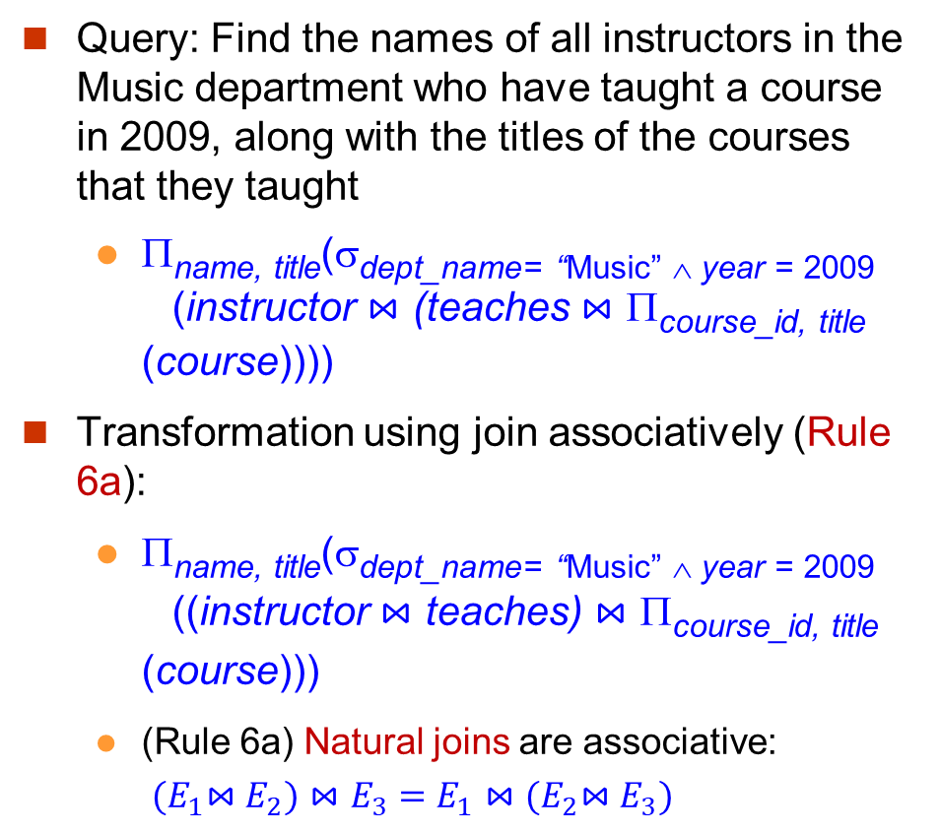
Multiple Transformations (2)
Query: Find the names of all instructors in the Music department who have taught a course in 2009, along with the titles of the courses that they taught
Π_{name, title}(σdept_name= “Music” ∧ year = 2009 (instructor $⋈$ (teaches $⋈$ Π_{course_id, title} (course))))
Transformation using join associatively (Rule 6a):
Π_{name, title}(σdept_name= “Music” ∧ year = 2009 ((instructor $⋈$ teaches) $⋈$ Π_{course_id, title} (course)))
(Rule 6a) Natural joins are associative: ${(E}_{1}⋈E_{2})⋈E_{3}=E_{1}⋈{(E}_{2}⋈E_{3})$

Slide 16
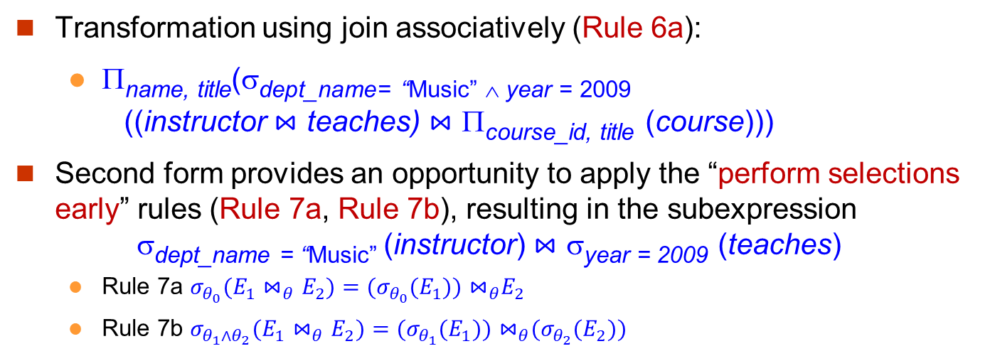
Multiple Transformations (3)
Transformation using join associatively (Rule 6a):
Π_{name, title}(σdept_name= “Music” ∧ year = 2009 ((instructor $⋈$ teaches) $⋈$ Π_{course_id, title} (course)))
Second form provides an opportunity to apply the “perform selections early” rules (Rule 7a, Rule 7b), resulting in the subexpression σ_{dept_name = “Music”} (instructor) $⋈$ σ_{year = 2009} (teaches)
Rule 7a ${σ_{θ_{0}}(E}_{1}⋈_{θ}E_{2})={(σ_{θ_{0}}(E}_{1}{))⋈}_{θ}E_{2}$
Rule 7b ${σ_{θ_{1}{∧θ}_{2}}(E}_{1}⋈_{θ}E_{2})={(σ_{θ_{1}}(E}_{1}{))⋈}_{θ}{(σ_{θ_{2}}(E}_{2}))$

Slide 17
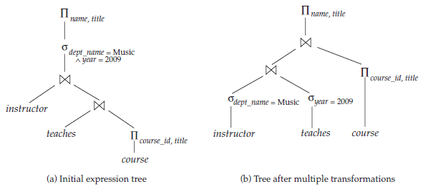
Multiple Transformations (4)

Slide 18
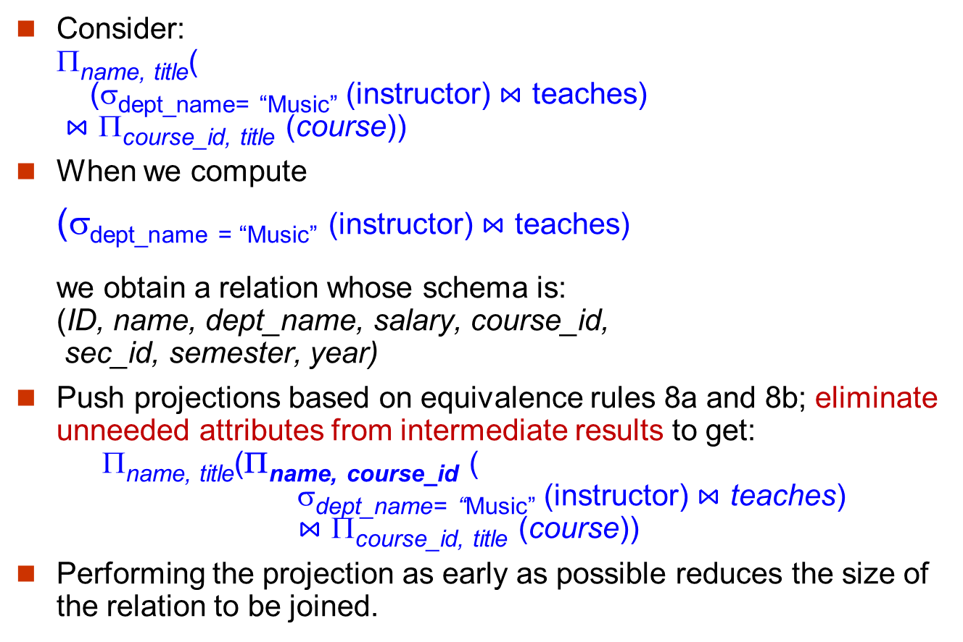
Another Transformation Example: Pushing Projections
Consider: Π_{name, title}( (σ_{dept_name= “Music”} (instructor) $⋈$ teaches) $⋈$ Π_{course_id, title} (course))
When we compute
(σ_{dept_name = “Music”} (instructor) $⋈$ teaches) we obtain a relation whose schema is: (ID, name, dept_name, salary, course_id, sec_id, semester, year)
Push projections based on equivalence rules 8a and 8b; eliminate unneeded attributes from intermediate results to get: Π_{name, title}(Π_{name, course_id} ( σ_{dept_name= “Music”} (instructor) $⋈$ teaches) $⋈$ Π_{course_id, title} (course))
Performing the projection as early as possible reduces the size of the relation to be joined.

Slide 19
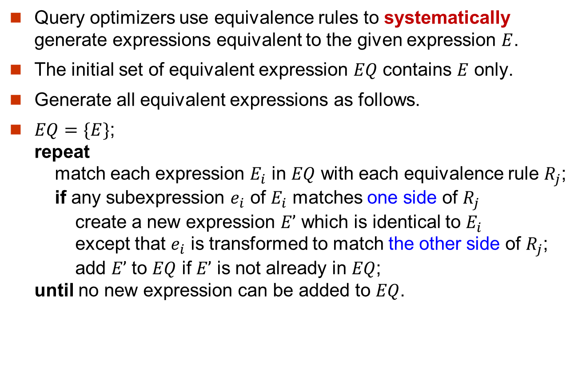
Equivalent Expressions Enumeration
Query optimizers use equivalence rules to systematically generate expressions equivalent to the given expression $E$.
The initial set of equivalent expression $EQ$ contains $E$ only.
Generate all equivalent expressions as follows.
$EQ=\{E\}$; repeat match each expression $E_{i}$ in $EQ$ with each equivalence rule $R_{j}$; if any subexpression $e_{i}$ of $E_{i}$ matches one side of $R_{j}$ create a new expression $E’$ which is identical to $E_{i}$ except that $e_{i}$ is transformed to match the other side of $R_{j}$; add $E’$ to $EQ$ if $E’$ is not already in $EQ$; until no new expression can be added to $EQ$.

Slide 20
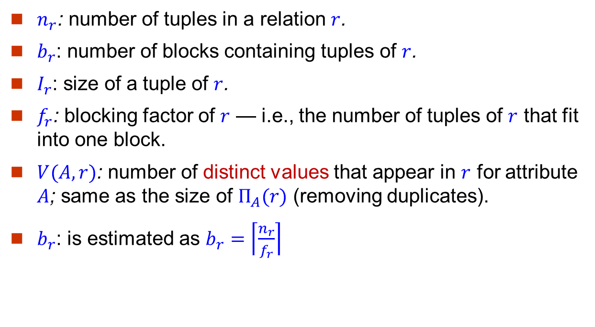
Statistical Information for Cost Estimation
$n_{r}$: number of tuples in a relation $r$.
$b_{r}$: number of blocks containing tuples of $r$.
$I_{r}$: size of a tuple of $r$.
$f_{r}$: blocking factor of $r$ — i.e., the number of tuples of $r$ that fit into one block.
$V(A, r)$: number of distinct values that appear in $r$ for attribute $A$; same as the size of $Π_{A}(r)$ (removing duplicates).
$b_{r}$: is estimated as $b_{r}=\left\lceil \frac{n_{r}}{f_{r}}\right\rceil$

Slide 21
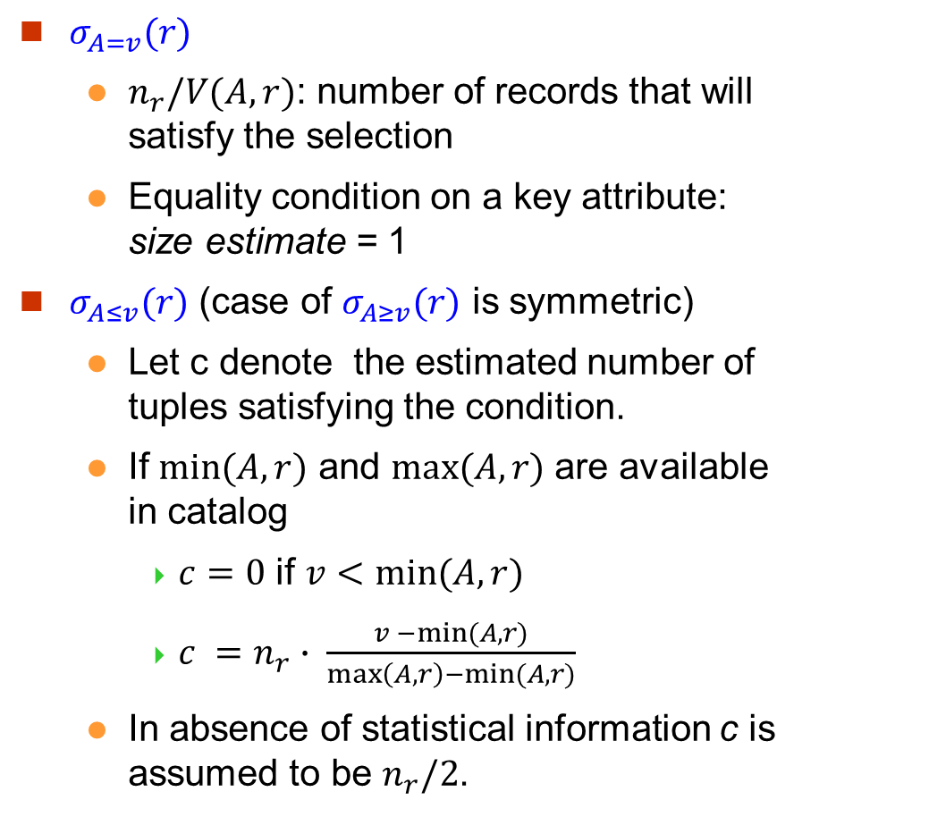
Selection Size Estimation
$σ_{A=v}(r)$
$n_{r}/V(A,r)$: number of records that will satisfy the selection
Equality condition on a key attribute: size estimate = 1
$σ_{A≤v}(r)$ (case of $σ_{A≥v}(r)$ is symmetric)
Let c denote the estimated number of tuples satisfying the condition.
If $min⁡(A,r)$ and $max⁡(A,r)$ are available in catalog
$c=0$ if $v<min⁡(A,r)$
$c =n_{r}∙ \frac{v −min⁡(A,r)}{\max\left(A, r\right)−min⁡(A, r)}$
In absence of statistical information c is assumed to be $n_{r}/2$.

Slide 22
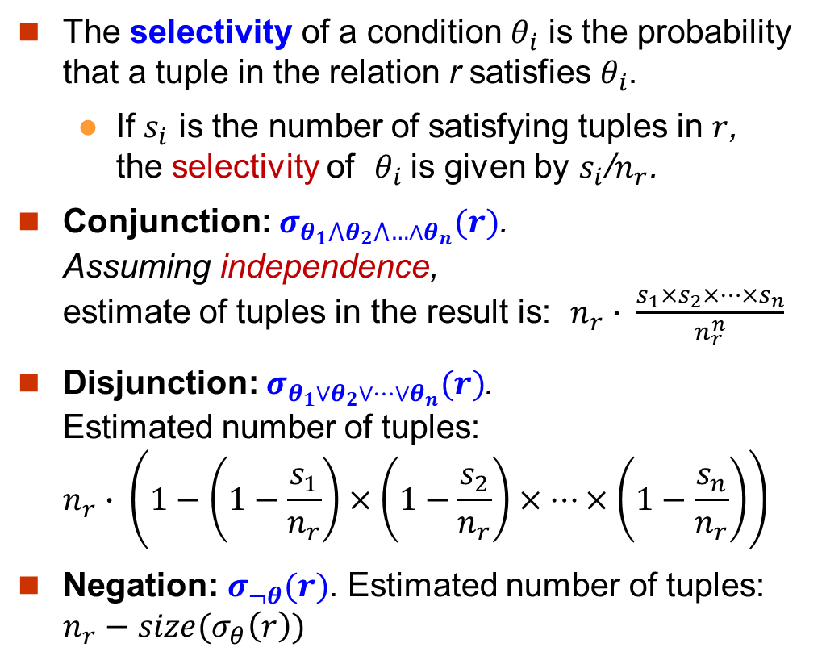
Size Estimation of Complex Selections
The selectivity of a condition $θ_{i}$ is the probability that a tuple in the relation r satisfies $θ_{i}$.
If $s_{i}$ is the number of satisfying tuples in $r$, the selectivity of $θ_{i}$ is given by $s_{i}$/$n_{r}$.
Conjunction: $σ_{θ_{1}⋀θ_{2}⋀…∧θ_{n}}(r)$. Assuming independence, estimate of tuples in the result is: $n_{r}∙ \frac{s_{1}×s_{2}×…×s_{n}}{n_{r}^{n}}$
Disjunction: $σ_{θ_{1}∨θ_{2}∨…∨θ_{n}}(r)$. Estimated number of tuples: $n_{r}∙ \left(1−\left(1−\frac{s_{1}}{n_{r}}\right)×\left(1−\frac{s_{2}}{n_{r}}\right)×…×\left(1−\frac{s_{n}}{n_{r}}\right)\right)$
Negation: $σ_{¬θ}(r)$. Estimated number of tuples: $n_{r}−size(σ_{θ}\left(r\right))$

Slide 23
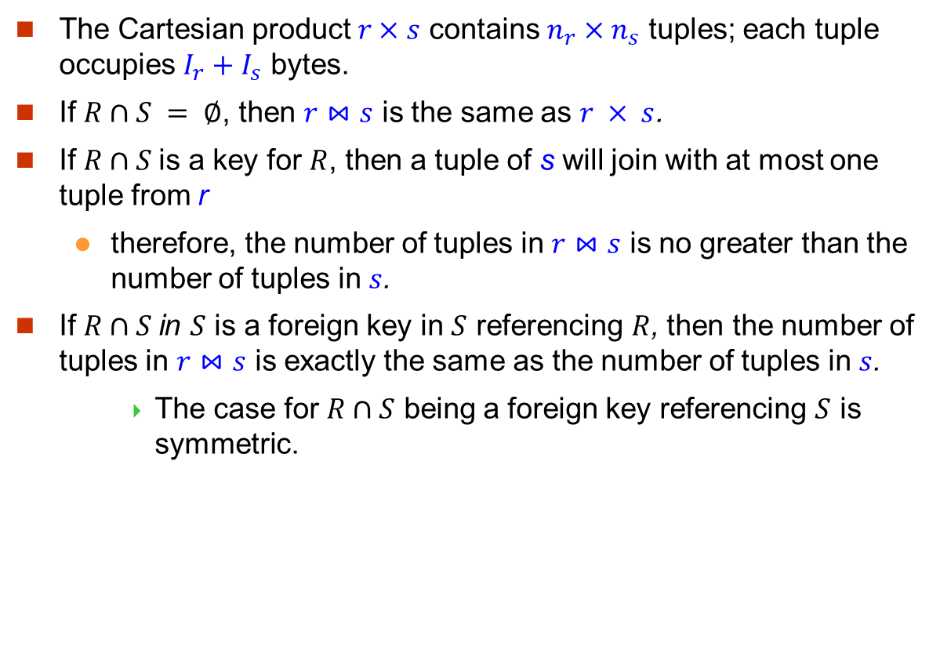
Estimation of the Size of Joins (1)
The Cartesian product $r×s$ contains $n_{r}×n_{s}$ tuples; each tuple occupies $I_{r}+I_{s}$ bytes.
If $R∩S = ∅$, then $r⋈s$ is the same as $r × s$.
If $R∩S$is a key for $R$, then a tuple of s will join with at most one tuple from r
therefore, the number of tuples in $r⋈s$ is no greater than the number of tuples in $s$.
If $R∩S$in $S$ is a foreign key in $S$ referencing $R$, then the number of tuples in $r⋈s$ is exactly the same as the number of tuples in $s$.
The case for $R∩S$ being a foreign key referencing $S$ is symmetric.

Slide 24
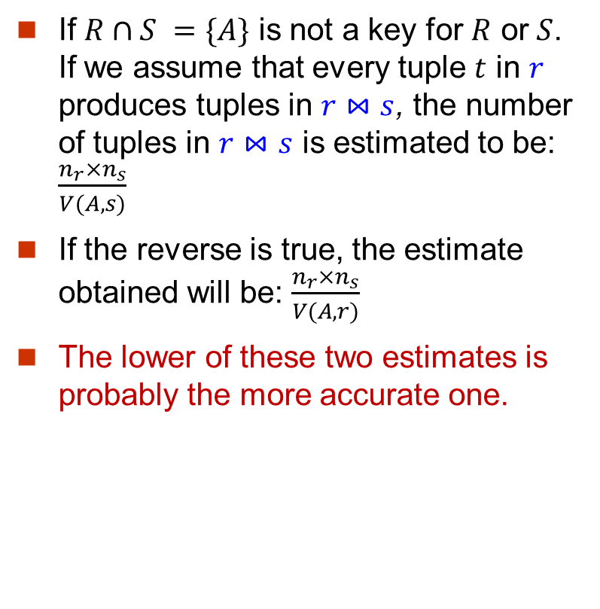
Estimation of the Size of Joins (2)
If $R∩S =\{A\}$ is not a key for $R$ or $S$. If we assume that every tuple $t$ in $r$ produces tuples in $r⋈s$, the number of tuples in $r⋈s$ is estimated to be: $\frac{n_{r}×n_{s}}{V(A,s)}$
If the reverse is true, the estimate obtained will be: $\frac{n_{r}×n_{s}}{V(A,r)}$
The lower of these two estimates is probably the more accurate one.

Slide 25
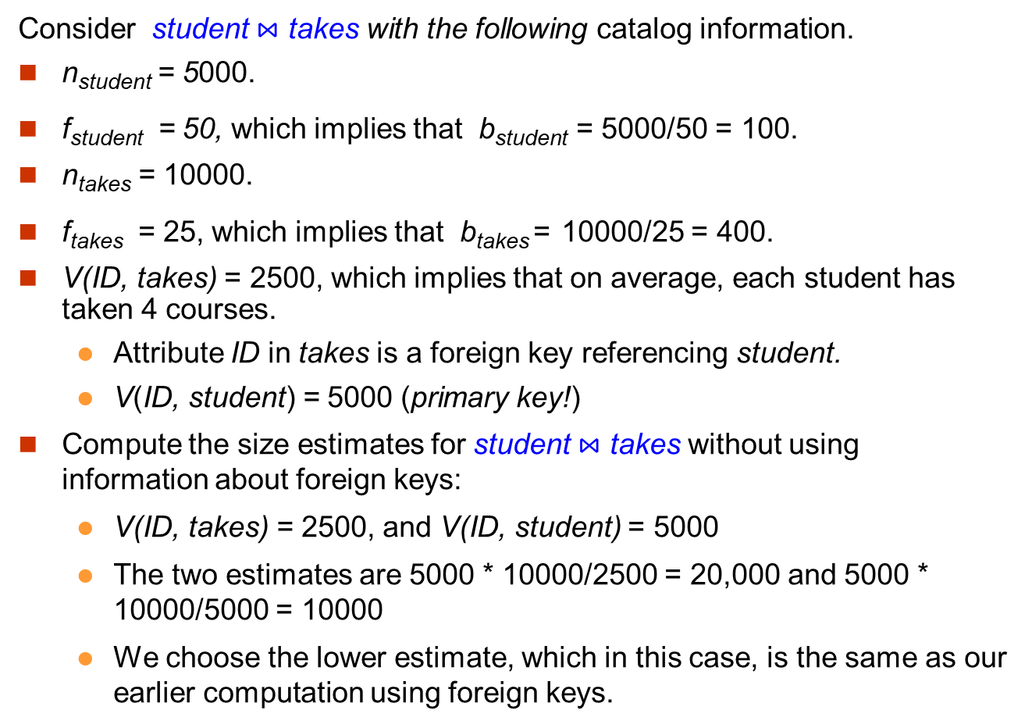
Join Operation: Running Example
Consider student $⋈$ takes with the following catalog information.
n_{student} = 5000.
f_{student} = 50, which implies that b_{student} = 5000/50 = 100.
n_{takes} = 10000.
f_{takes} = 25, which implies that b_{takes} = 10000/25 = 400.
V(ID, takes) = 2500, which implies that on average, each student has taken 4 courses.
Attribute ID in takes is a foreign key referencing student.
V(ID, student) = 5000 (primary key!)
Compute the size estimates for student $⋈$ takes without using information about foreign keys:
V(ID, takes) = 2500, and V(ID, student) = 5000
The two estimates are 5000 * 10000/2500 = 20,000 and 5000 * 10000/5000 = 10000
We choose the lower estimate, which in this case, is the same as our earlier computation using foreign keys.

Slide 26
Choice of Evaluation Plans
Must consider the interaction of evaluation techniques when choosing evaluation plans
choosing the cheapest algorithm for each operation independently may not yield best overall algorithm. E.g.
merge-join may not be the best in some cases in terms of the cost, but may provide a sorted output which reduces the cost if the next operation needs sorting.
Practical query optimizers incorporate elements of the following two broad approaches:
1. Search all the plans and choose the best plan in a cost-based fashion.
2. Uses heuristics to choose a plan.

Slide 27

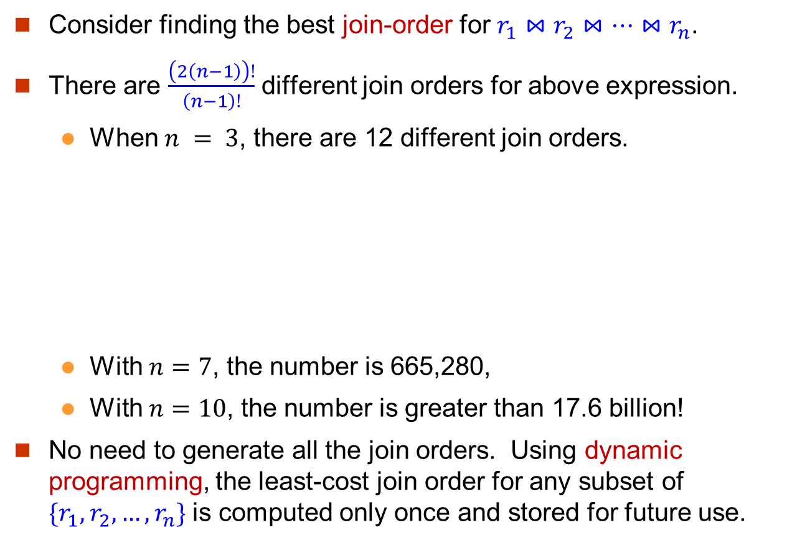
Cost-Based Optimization
Consider finding the best join-order for $r_{1}⋈r_{2}⋈…⋈r_{n}$.
There are $\frac{\left(2\left(n−1\right)\right)!}{\left(n−1\right)!}$ different join orders for above expression.
When $n = 3$, there are 12 different join orders.
With $n=7$, the number is 665,280,
With $n=10$, the number is greater than 17.6 billion!
No need to generate all the join orders. Using dynamic programming, the least-cost join order for any subset of ${\{r}_{1},r_{2},…,r_{n}\}$ is computed only once and stored for future use.

Slide 28
Dynamic Programming
Dynamic programming finds the optimal solution to a problem by solving its sub-problems followed by combining the optimal solutions of the sub-problems in a bottom-up manner.
The principle of optimality: If the optimal solution to a problem contains the optimal solutions to all its sub-problems.

Slide 29
Principle of Optimality
Query:
R1 R2 R3 R4 R5
Optimal Plan:
R5
R1
R4
R3
R2
Taken from the slides used in cps216 @ cs.duke.edu

Slide 30
Principle of Optimality
Query:
R1 R2 R3 R4 R5
Optimal Plan:
R5
R1
R4
R3
R2
Optimal plan for joining R3, R2, R4, R1
Taken from the slides used in cps216 @ cs.duke.edu

Slide 31
Principle of Optimality
Query:
R1 R2 R3 R4 R5
Optimal Plan:
R5
R1
R4
R3
R2
Optimal plan for joining R3, R2, R4
Taken from the slides used in cps216 @ cs.duke.edu

Slide 32
Exploiting Principle of Optimality
Query:
R1 R2 … Rn
R1
R2
R2
R3
R3
R1
Optimal for joining R1, R2, R3
Sub-Optimal for joining R1, R2, R3
Taken from the slides used in cps216 @ cs.duke.edu

Slide 33
Exploiting Principle of Optimality
Ri
Rj
Sub-Optimal for joining R1,…,Rn
R2
A sub-optimal sub-plan cannot lead to an optimal plan
R3
R1
Taken from the slides used in cps216 @ cs.duke.edu

Slide 34
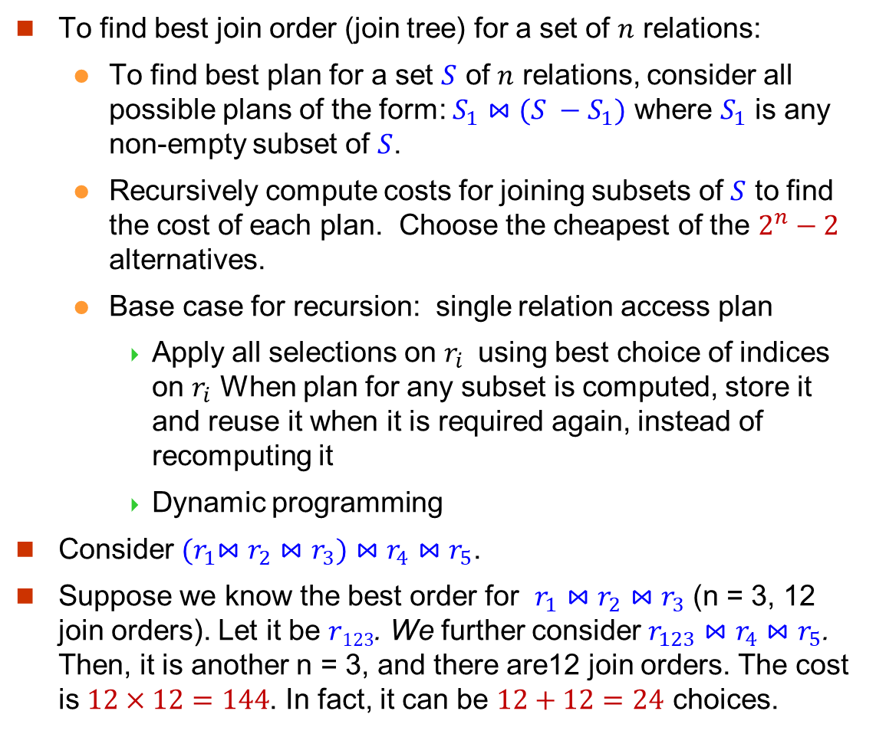
Dynamic Programming in Optimization
To find best join order (join tree) for a set of $n$ relations:
To find best plan for a set $S$ of $n$ relations, consider all possible plans of the form: $S_{1}⋈(S −S_{1})$ where $S_{1}$ is any non-empty subset of $S$.
Recursively compute costs for joining subsets of $S$ to find the cost of each plan. Choose the cheapest of the $2^{n}−2$ alternatives.
Base case for recursion: single relation access plan
Apply all selections on $r_{i}$ using best choice of indices on $r_{i}$ When plan for any subset is computed, store it and reuse it when it is required again, instead of recomputing it
Dynamic programming
Consider ${(r}_{1}⋈r_{2}⋈r_{3})⋈r_{4}⋈r_{5}$.
Suppose we know the best order for $r_{1}⋈r_{2}⋈r_{3}$ (n = 3, 12 join orders). Let it be $r123$. We further consider $r_{123}⋈r_{4}⋈r_{5}$. Then, it is another n = 3, and there are12 join orders. The cost is $12×12=144$. In fact, it can be $12+12=24$ choices.

Slide 35
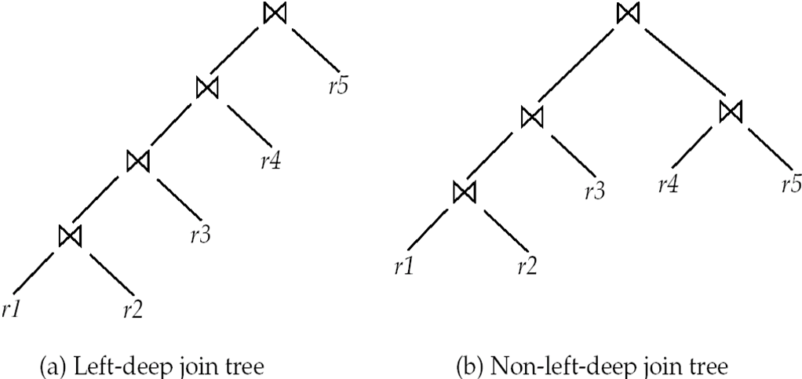
Left Deep Join Trees
In left-deep join trees, the right-hand-side input for each join is a relation, not the result of an intermediate join.

Slide 36
Left Deep Tree Join Order Optimization by Dynamic Programming
procedure findbestplan(S) if (bestplan[S].cost ≠ ∞) /* bestplan[S] already computed */ return bestplan[S] if (S contains only 1 relation) set bestplan[S].plan and bestplan[S].cost based on the best way of accessing S /* Using selections on S and indices on S */
else for each relation r in S let S1 = S – {r} P1 = findbestplan(S1) P2 = findbestplan(S - S1) A = best algorithm for joining results of P1 and P2 cost = P1.cost + P2.cost + cost of A if cost < bestplan[S].cost bestplan[S].cost = cost bestplan[S].plan = “execute P1.plan; execute P2.plan; join results of P1 and P2 using A” return bestplan[S]

Slide 37
An Example (Left Deep Tree)
Consider natural join of 4 relations:
r(A, B), s(B, C), t(C, D), and u(D, A).
findbestplan({r, s, t, u})
Consider the best plan among the following 4
join findbestplan({r, s, t}) and u, join findbestplan({r, s, u}) and t, join findbestplan({r, t, u}) and s, and join findbestplan({s, t, u}) and r
findbestplan({r, s, t})
Consider the best plan among the following 3
join findbestplan({r, s}) and t, join findbestplan({r, t}) and s, and join findbestplan({s, t}) and r

Slide 38
Reconsider the Example
Consider findbestplan({r, s, t, u}).
Here, we show a lattice where a node represents a set of input relations to findbestplan(), and an edge represents a function call.
{ r, s, t, u }
{ r, s, t }
{ r, s, u }
{ r, t, u }
{ s, t, u }
{ r, s }
{ r, t }
{ r, u }
{ s, t }
{ s, u }
{ t, u }
{ r }
{ s }
{ t }
{ u }

Slide 39
Heuristic Optimization
Cost-based optimization is expensive.
Systems may use heuristics to reduce the number of choices that must be made in a cost-based fashion.
Heuristic optimization transforms the query-tree by using a set of rules that typically (but not in all cases) improve execution performance:
Perform selection early (reduces the number of tuples)
Perform projection early (reduces the number of attributes)
Perform most restrictive selection and join operations (i.e. with smallest result size) before other similar operations.
Some systems use only heuristics, others combine heuristics with partial cost-based optimization.

