Slide 1
Chapter 6: Formal Relational Query Languages

Slide 2
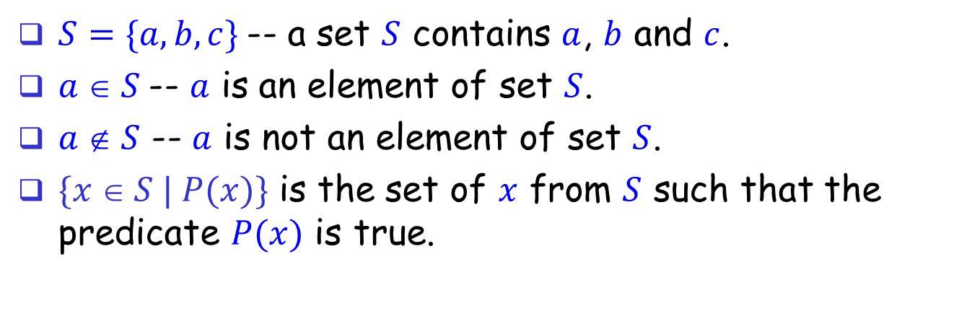
Sets
$S=\{a, b, c\}$-- a set $S$ contains $a$, $b$ and $c$.
$a  S$-- $a$ is an element of set $S$.
$a  S$ -- $a$ is not an element of set $S$.
$\{x  S | P(x)\}$ is the set of $x$ from $S$ such that the predicate $P(x)$ is true.

Slide 3
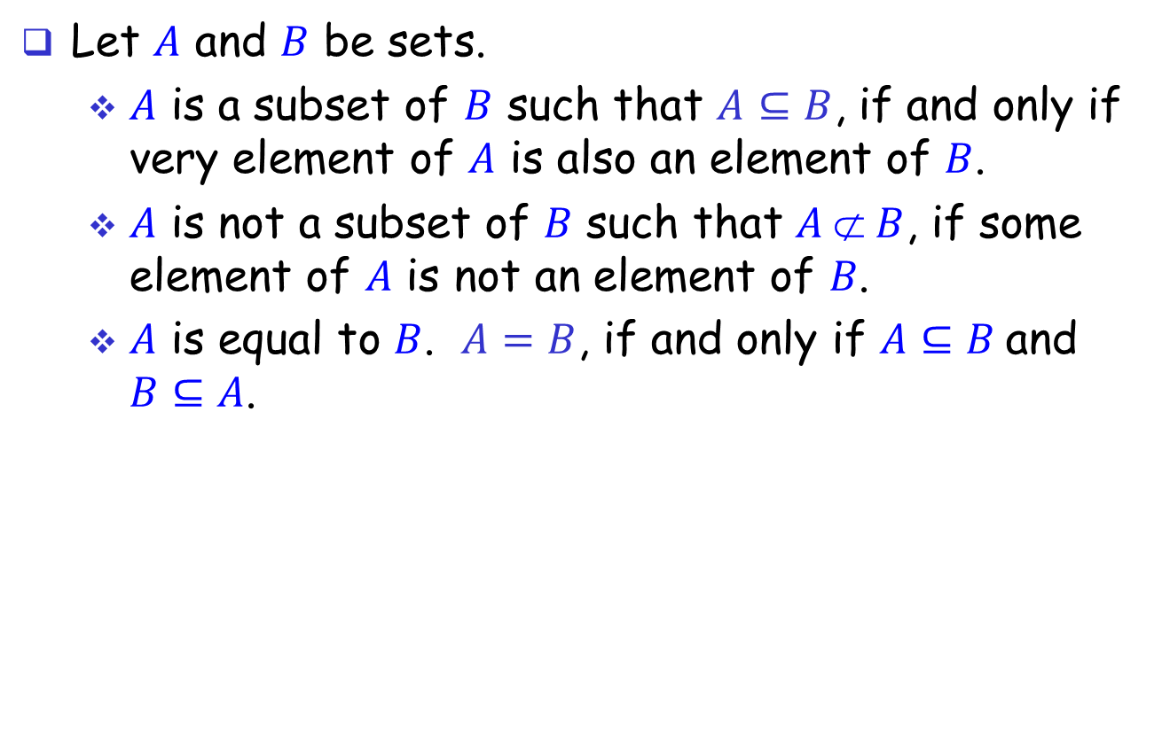
Relations between sets
Let $A$ and $B$ be sets.
$A$ is a subset of $B$ such that $A$ $⊆B$, if and only if very element of $A$ is also an element of $B$.
𝐴 is not a subset of 𝐵 such that $A  B$, if some element of 𝐴 is not an element of 𝐵.
$A$ is equal to $B$. $A=B$, if and only if $A⊆B$and $B⊆A$.

Slide 4
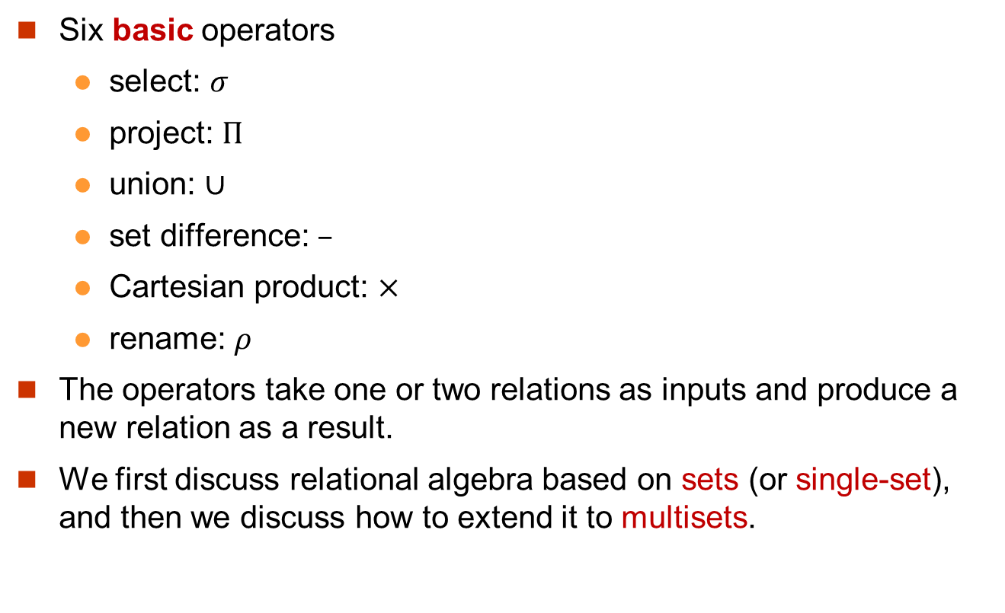
Relational Algebra
Six basic operators
select: $σ$
project: $Π$
union: $∪$
set difference: $–$
Cartesian product: $×$
rename: $ρ$
The operators take one or two relations as inputs and produce a new relation as a result.
We first discuss relational algebra based on sets (or single-set), and then we discuss how to extend it to multisets.

Slide 5
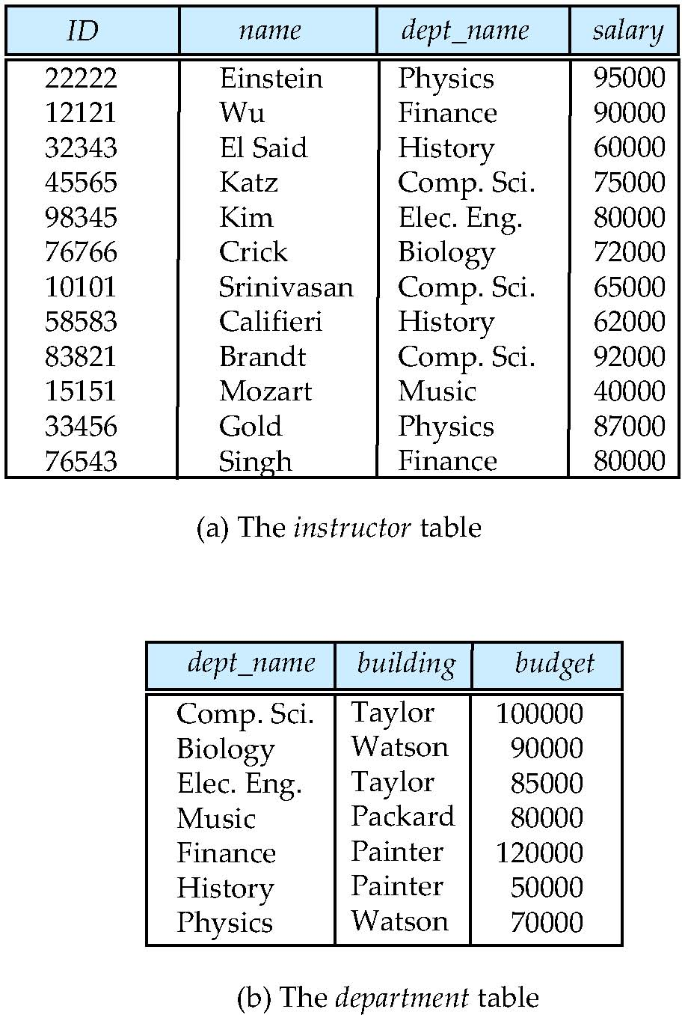
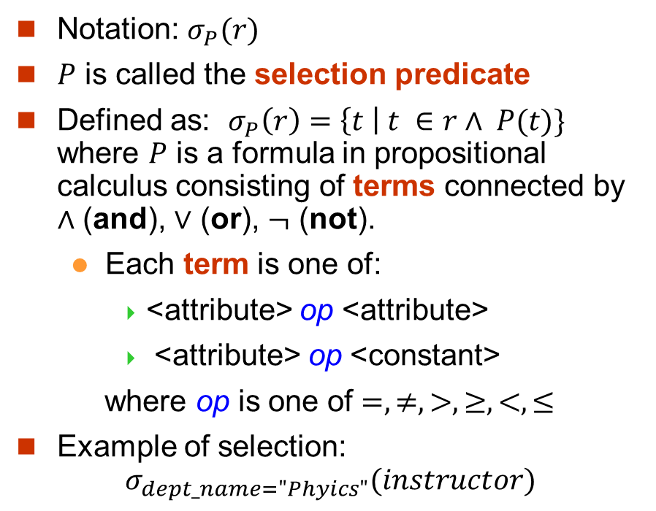
Select Operation
Notation: $σ_{P}(r)$
$P$ is called the selection predicate
Defined as: $σ_{P}\left(r\right)=\left\{t \right| t ∈r∧ P(t)\}$ where $P$ is a formula in propositional calculus consisting of terms connected by $∧$ (and), $∨$ (or), $¬$ (not).
Each term is one of:
<attribute> op <attribute>
<attribute> op <constant>
where op is one of $=, ≠, >, ≥, <, ≤$
Example of selection: $σ_{dept_name="Phyics"}(instructor)$

Slide 6
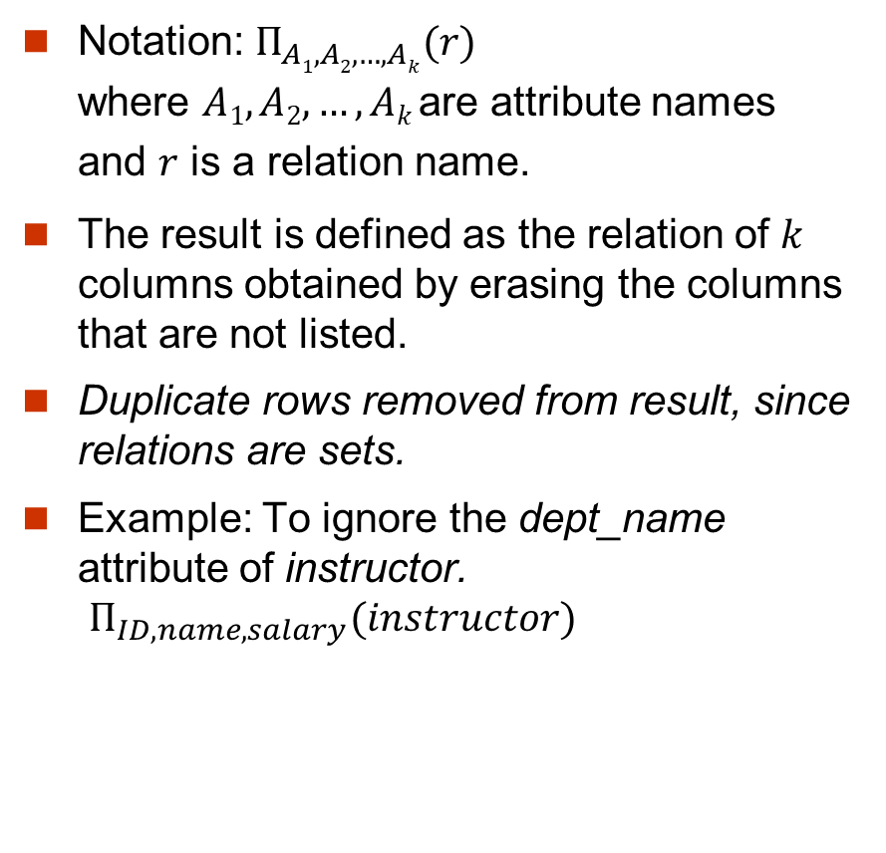
Project Operation
Notation: $Π_{A1, A2,…, Ak}(r)$ where $A1, A2,…, Ak$are attribute names and $r$ is a relation name.
The result is defined as the relation of $k$ columns obtained by erasing the columns that are not listed.
Duplicate rows removed from result, since relations are sets.
Example: To ignore the dept_name attribute of instructor. $Π_{ID,name,salary}(instructor)$

Slide 7
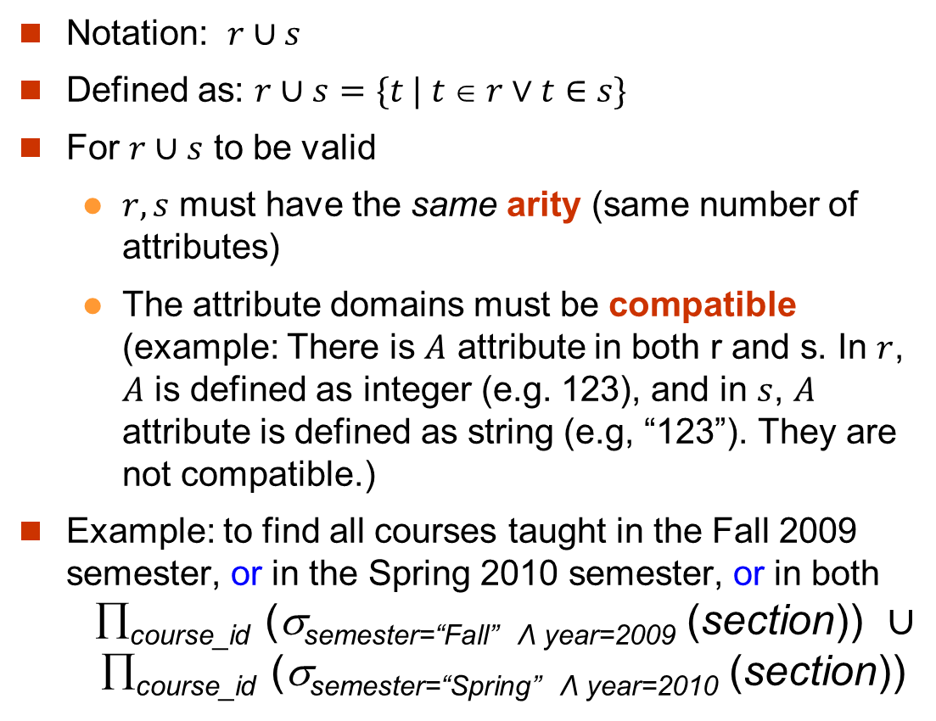
Union Operation
Notation: $r∪s$
Defined as: $r∪s=\{t | t  r∨t∈s\}$
For $r∪s$ to be valid
$r, s$ must have the same arity (same number of attributes)
The attribute domains must be compatible (example: There is $A$ attribute in both r and s. In $r$, $A$ is defined as integer (e.g. 123), and in $s$, $A$ attribute is defined as string (e.g, “123”). They are not compatible.)
Example: to find all courses taught in the Fall 2009 semester, or in the Spring 2010 semester, or in both ∏_{course_id} (σ_{semester=“Fall” Λ year=2009} (section)) $∪$ ∏_{course_id} (σ_{semester=“Spring” Λ year=2010} (section))

Slide 8
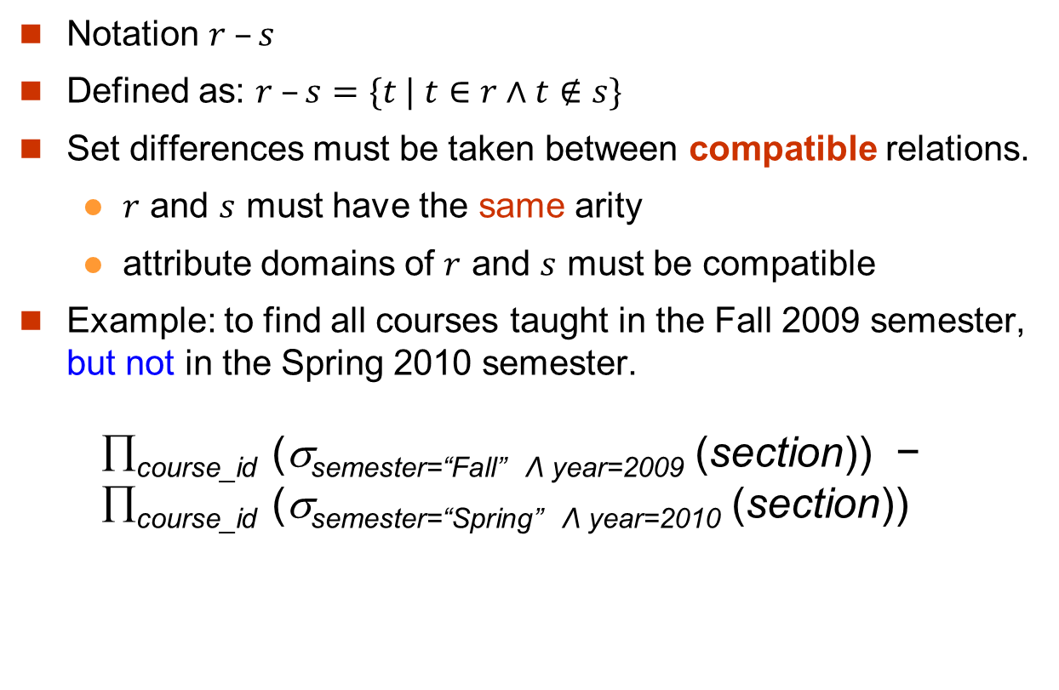
Set Difference Operation
Notation $r –s$
Defined as: $r –s=\{t | t∈r∧t∉s\}$
Set differences must be taken between compatible relations.
$r$ and $s$ must have the same arity
attribute domains of $r$ and $s$ must be compatible
Example: to find all courses taught in the Fall 2009 semester, but not in the Spring 2010 semester. ∏_{course_id} (σ_{semester=“Fall” Λ year=2009} (section)) − ∏_{course_id} (σ_{semester=“Spring” Λ year=2010} (section))

Slide 9
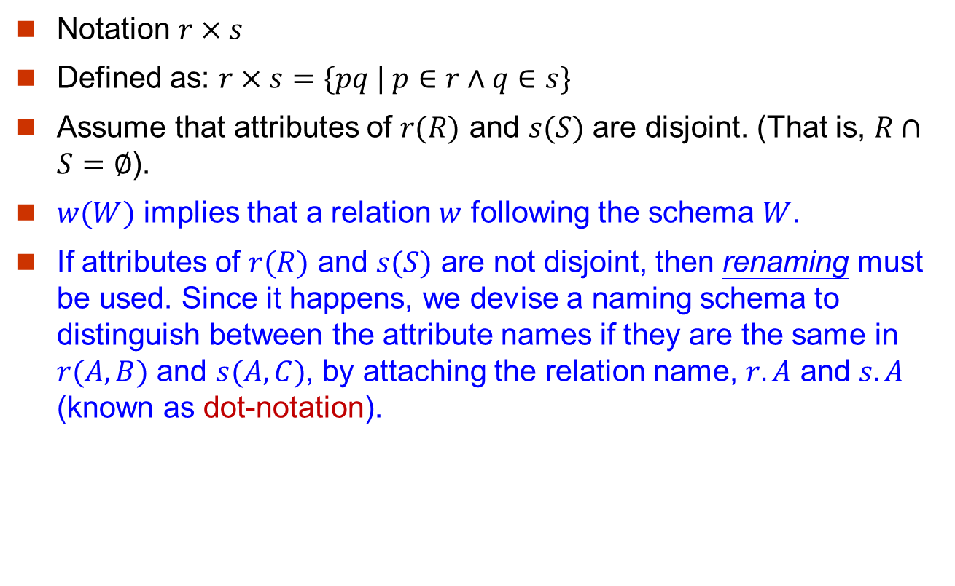
Cartesian-Product Operation
Notation $r×s$
Defined as: $r×s=\{pq | p∈r∧q∈s\}$
Assume that attributes of $r(R)$ and $s(S)$ are disjoint. (That is, $R∩S=∅$).
$w(W)$ implies that a relation $w$ following the schema $W$.
If attributes of $r(R)$ and $s(S)$ are not disjoint, then renaming must be used. Since it happens, we devise a naming schema to distinguish between the attribute names if they are the same in $r(A, B)$ and $s(A,C)$, by attaching the relation name, $r.A$ and $s.A$ (known as dot-notation).

Slide 10
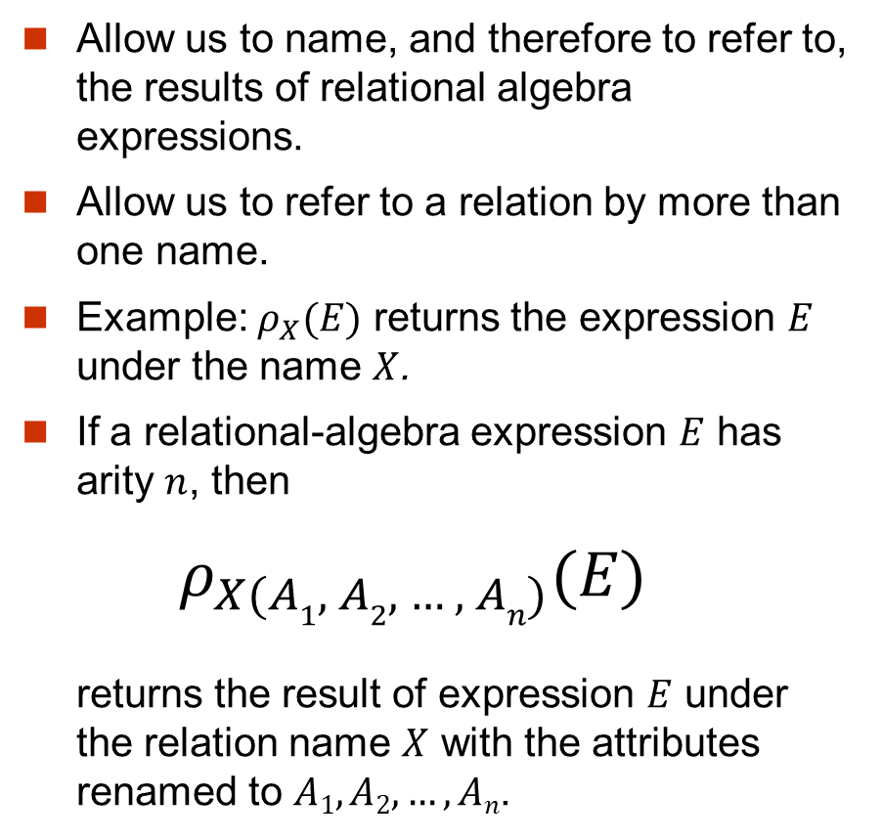
Rename Operation
Allow us to name, and therefore to refer to, the results of relational algebra expressions.
Allow us to refer to a relation by more than one name.
Example: $ρ_{X}(E)$ returns the expression $E$ under the name $X$.
If a relational-algebra expression $E$ has arity $n$, then
$ρ_{X(A1, A2, …, An)}(E)$ returns the result of expression $E$ under the relation name $X$ with the attributes renamed to $A1, A2, …,An$.

Slide 11
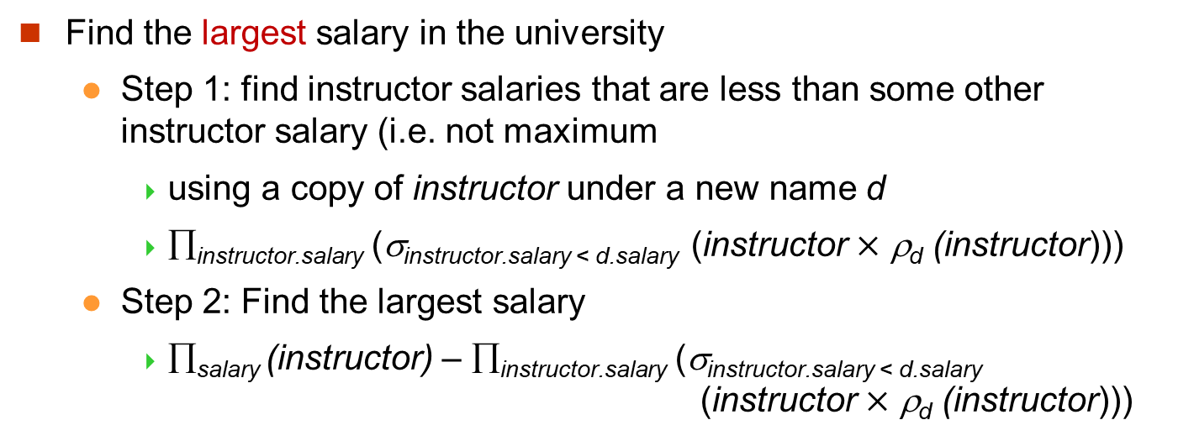
Example Query
Find the largest salary in the university
Step 1: find instructor salaries that are less than some other instructor salary (i.e. not maximum
using a copy of instructor under a new name d
∏_{instructor.salary} (σ_{instructor.salary < d.salary} (instructor $×$ ρ_{d} (instructor)))
Step 2: Find the largest salary
∏_{salary} (instructor) – ∏_{instructor.salary} (σ_{instructor.salary < d.salary} (instructor $×$ ρ_{d} (instructor)))
instructor
ID | name | dept_name | salary
8 | ABC | SEEM | 100
7 | XYZ | SEEM | 120
I.ID | I.name | I.dept_name | I.salary | d.ID | d.name | d.salary | d.salary
8 | ABC | SEEM | 100 | 8 | ABC | SEEM | 100
8 | ABC | SEEM | 100 | 7 | XYZ | SEEM | 120
7 | XYZ | SEEM | 120 | 8 | ABC | SEEM | 100
7 | XYZ | SEEM | 120 | 7 | XYZ | SEEM | 120

Slide 12
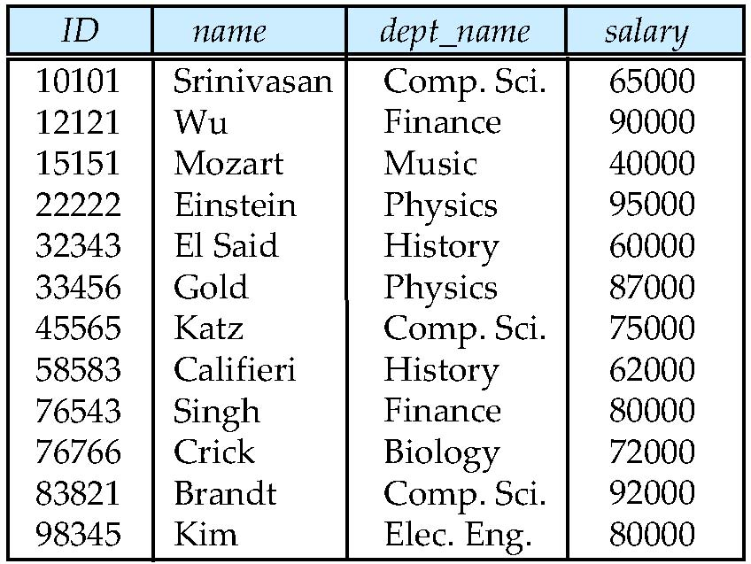
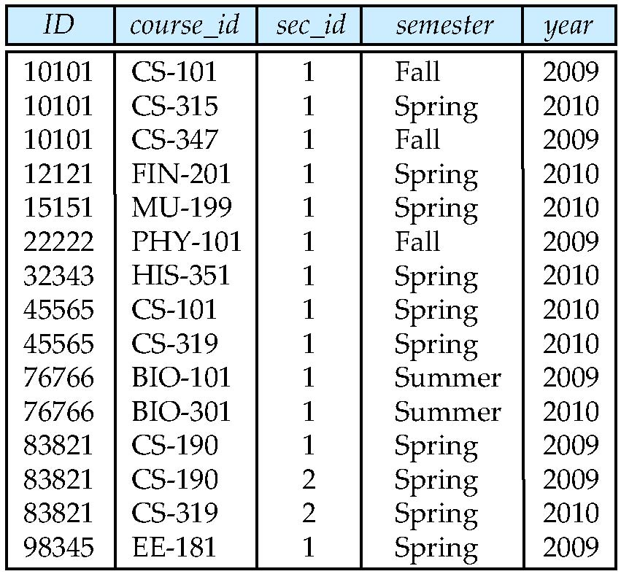
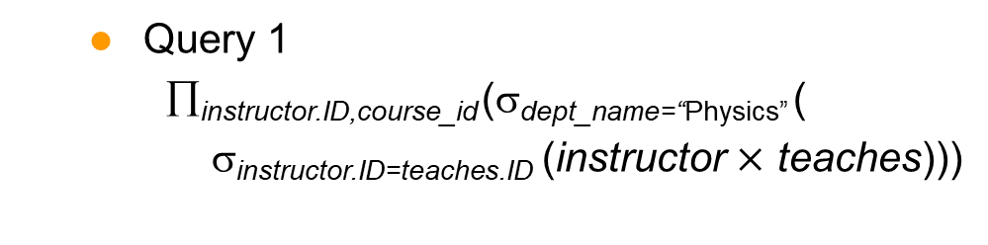
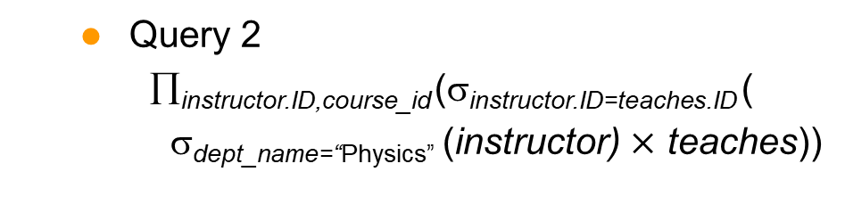
Example Queries
Find the names of all instructors in the Physics department, along with the course_id of all courses they have taught.
Query 1 ∏_{instructor.ID,course_id} (σ_{dept_name=“Physics”} ( σ_{instructor.ID=teaches.ID} (instructor $×$ teaches)))
Query 2 ∏_{instructor.ID,course_id} (σ_{instructor.ID=teaches.ID} ( σ_{dept_name=“Physics”} (instructor) $×$ teaches))
instructor
teaches

Slide 13
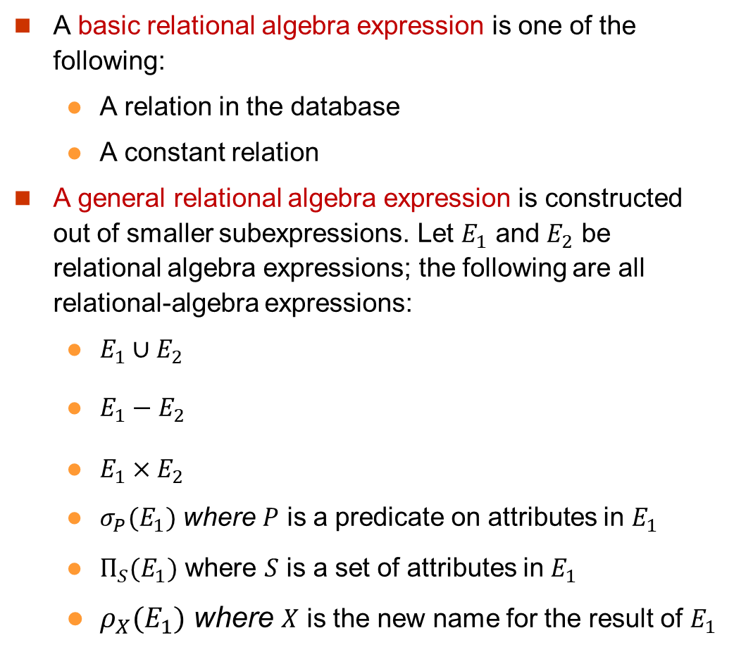
Formal Definition
A basic relational algebra expression is one of the following:
A relation in the database
A constant relation
A general relational algebra expression is constructed out of smaller subexpressions. Let $E_{1}$ and $E_{2}$ be relational algebra expressions; the following are all relational-algebra expressions:
$E_{1}∪E_{2}$
$E_{1}−E_{2}$
$E_{1}×E_{2}$
$σ_{P}(E_{1})$ where $P$ is a predicate on attributes in $E_{1}$
$Π_{S}(E_{1})$ where $S$ is a set of attributes in $E_{1}$
$ρ_{X}(E_{1})$ where $X$ is the new name for the result of $E_{1}$

Slide 14
Additional Operations
We define additional operations that do not add power to the relational algebra, but that simplify common queries.
Set intersection
Natural join
Assignment
Outer join

Slide 15
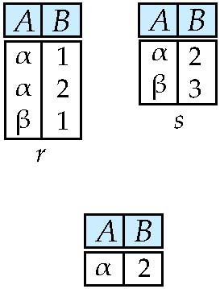
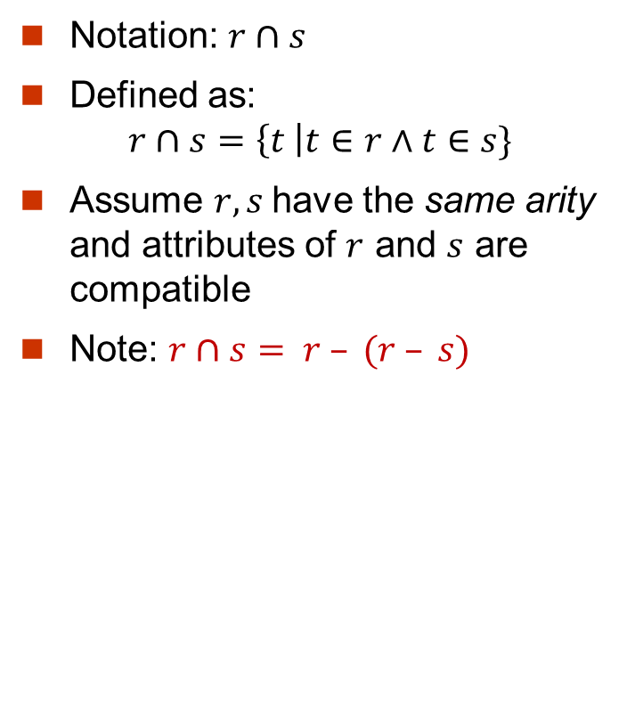

Set-Intersection Operation
Notation: $r∩s$
Defined as: $r∩s=\left\{t \right|t∈r∧t∈s\}$
Assume $r, s$have the same arity and attributes of $r$ and $s$ are compatible
Note: $r∩s= r – (r – s)$
$$r∩s$$

Slide 16
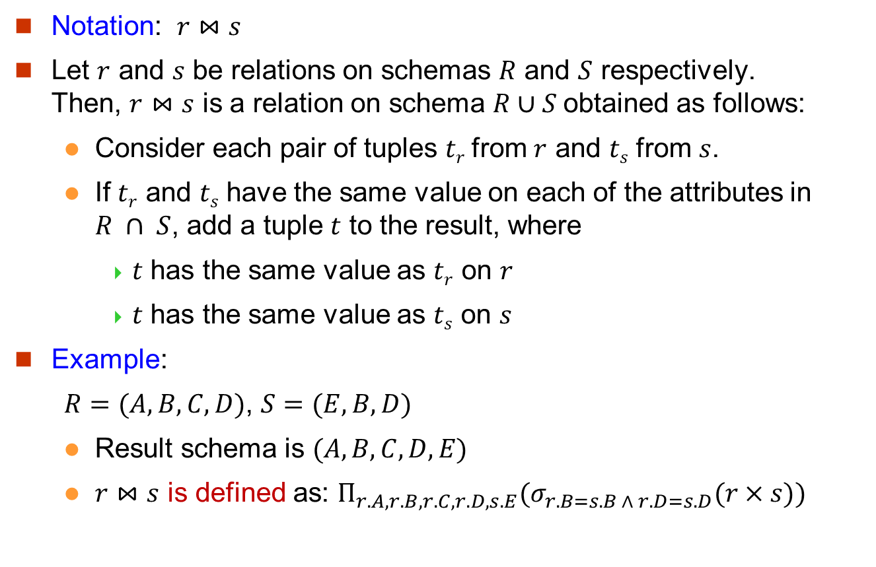
Natural-Join Operation
Notation: $r⋈s$
Let $r$ and $s$ be relations on schemas $R$ and $S$ respectively. Then, $r⋈s$ is a relation on schema $R∪S$obtained as follows:
Consider each pair of tuples $tr$from $r$ and $ts$ from $s$.
If $tr$ and $ts$ have the same value on each of the attributes in $R ∩ S$, add a tuple $t$ to the result, where
$t$ has the same value as $tr$ on $r$
$t$ has the same value as $ts$ on $s$
Example:
$R=(A, B, C, D)$, $S=(E, B, D)$
Result schema is $(A, B, C, D, E)$
$r⋈s$ is defined as: $Π_{r.A, r.B, r.C, r.D, s.E}(σ_{r.B=s.B ∧ r.D=s.D}(r×s))$

Slide 17
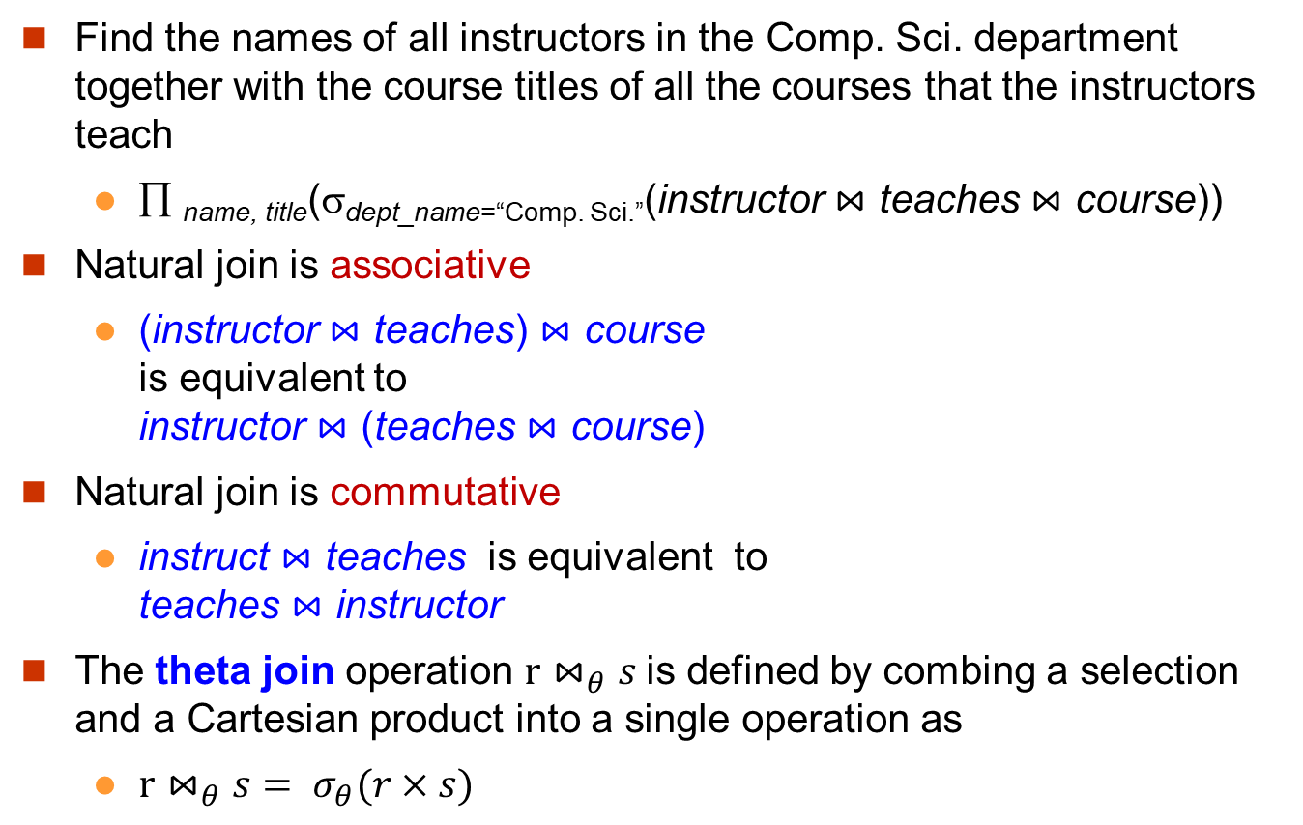
Natural Join and Theta Join
Find the names of all instructors in the Comp. Sci. department together with the course titles of all the courses that the instructors teach
∏ _{name, title}(σ_{dept_name=“Comp. Sci.”}(instructor $⋈$ teaches $⋈$ course))
Natural join is associative
(instructor $⋈$ teaches) $⋈$ course is equivalent to instructor $⋈$ (teaches $⋈$ course)
Natural join is commutative
instruct $⋈$ teaches is equivalent to teaches $⋈$ instructor
The theta join operation $r⋈_{θ}s$is defined by combing a selection and a Cartesian product into a single operation as
$r⋈_{θ}s= σ_{θ}(r×s)$

Slide 18
Assignment Operation
The assignment operation (←) provides a convenient way to express complex queries.
The evaluation of an assignment does not result in any relation. Rather, the result of the expression to the right of ← is assigned to the relation variable on the left of ←.
Write query as a sequential program consisting of
a series of assignments
followed by an expression whose value is displayed as a result of the query.
Assignment must always be made to a temporary relation variable.

Slide 19
Outer Join
An extension of the join operation that avoids loss of information.
Computes the join and then adds tuples form one relation that does not match tuples in the other relation to the result of the join.
Uses null values:
null signifies that the value is unknown or does not exist

Slide 20
Outer Join – Example
Relation instructor
Relation teaches
ID
name
dept_name
ID
course_id
10101
12121
15151
Srinivasan
Wu
Mozart
Comp. Sci.
Finance
Music
10101
12121
76766
CS-101
FIN-201
BIO-101
Join: instructor $⋈$ teaches
ID
name
dept_name
course_id
10101
12121
Srinivasan
Wu
Comp. Sci.
Finance
CS-101
FIN-201
Left Outer Join: instructor teaches
ID
name
dept_name
course_id
10101
12121
15151
Srinivasan
Wu
Mozart
Comp. Sci.
Finance
Music
CS-101
FIN-201
null

Slide 21
Outer Join – Example
Relation instructor
Relation teaches
ID
name
dept_name
ID
course_id
10101
12121
15151
Srinivasan
Wu
Mozart
Comp. Sci.
Finance
Music
10101
12121
76766
CS-101
FIN-201
BIO-101
Right Outer Join: instructor teaches
ID
name
dept_name
course_id
10101
12121
76766
Srinivasan
Wu
null
Comp. Sci.
Finance
null
CS-101
FIN-201
BIO-101
Full Outer Join: instructor teaches
ID
name
dept_name
course_id
10101
12121
15151
76766
Srinivasan
Wu
Mozart
null
Comp. Sci.
Finance
Music
null
CS-101
FIN-201
null
BIO-101

Slide 22

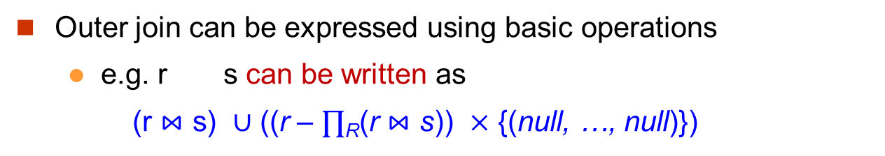


Outer Join using Joins
A single tuple constant relation for the attributes that only appear in S.
Outer join can be expressed using basic operations
e.g. r s can be written as
(r $⋈$ s) $∪$ ((r – $∏$_{R}(r $⋈$ s)) $×$ {(null, …, null)})
instructor (as $r(R)$)
teaches (as $s(S)$)
ID
name
dept_name
ID
course_id
10101
12121
15151
Srinivasan
Wu
Mozart
Comp. Sci.
Finance
Music
10101
12121
76766
CS-101
FIN-201
BIO-101
Join: instructor $⋈$ teaches
ID
name
dept_name
course_id
10101
12121
Srinivasan
Wu
Comp. Sci.
Finance
CS-101
FIN-201
ID
name
dept_name
course_id
10101
12121
15151
Srinivasan
Wu
Mozart
Comp. Sci.
Finance
Music
CS-101
FIN-201
null
Left Outer Join:
instructor teaches

Slide 23
Null Values
It is possible for tuples to have a null value, denoted by null, for some of their attributes
null signifies an unknown value or that a value does not exist.
The result of any arithmetic expression involving null is null.
Aggregate functions simply ignore null values (as in SQL)
For duplicate elimination and grouping, null is treated like any other value, and two nulls are assumed to be the same (as in SQL)

Slide 24
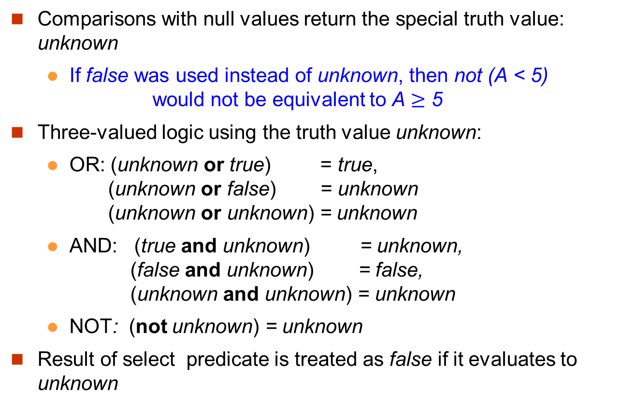
Null Values
Comparisons with null values return the special truth value: unknown
If false was used instead of unknown, then not (A < 5) would not be equivalent to A $≥$ 5
Three-valued logic using the truth value unknown:
OR: (unknown or true) = true, (unknown or false) = unknown (unknown or unknown) = unknown
AND: (true and unknown) = unknown, (false and unknown) = false, (unknown and unknown) = unknown
NOT: (not unknown) = unknown
Result of select predicate is treated as false if it evaluates to unknown

Slide 25
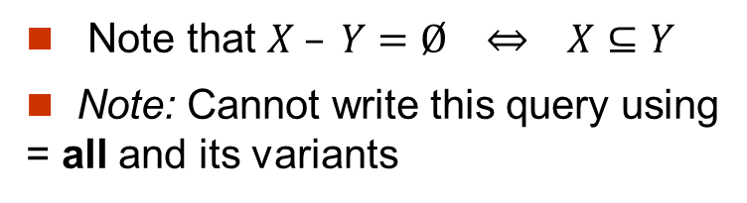
Reconsider the SQL
student
Find all students who have taken all courses offered in the Biology department.
ID | name
10 | A
20 | B
select distinct S.ID, S.name
from student as S
where not exists ( (select course_id
from course
where dept_name = ’Biology’)
except
(select T.course_id
from takes as T
where S.ID = T.ID));
takes
ID | course_id
10 | 100
10 | 200
10 | 300
20 | 200
course
course_id | dept_name
100 | CSE
200 | Biology
300 | Biology
Note that $X – Y=Ø ⇔ X⊆Y$
Note: Cannot write this query using = all and its variants

Slide 26
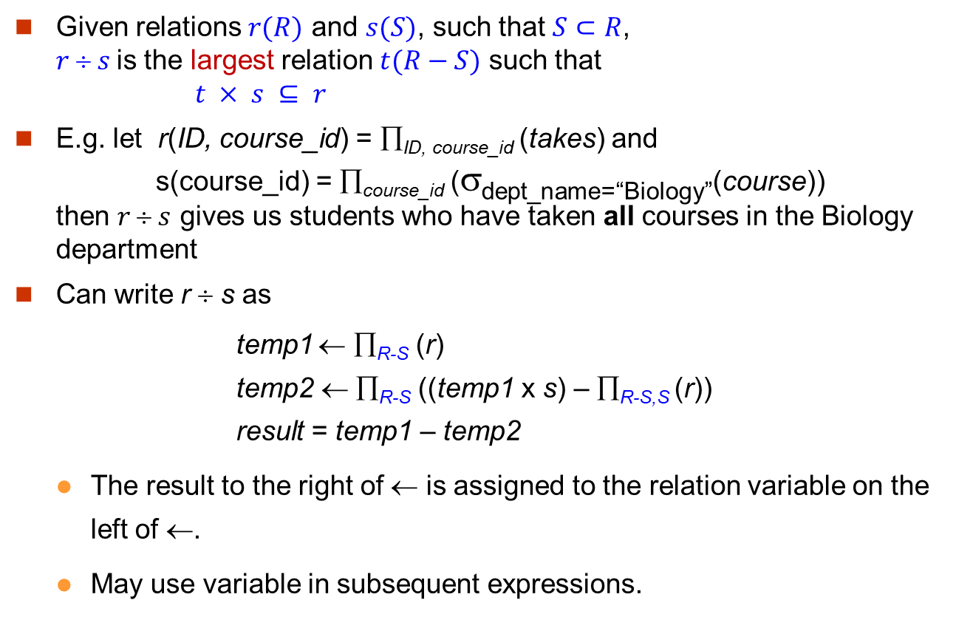



Division Operator
$$r(R)$$
$$s(S)$$
Given relations $r(R)$ and $s(S)$, such that $S⊂R$, $r  s$is the largest relation $t(R−S)$ such that $t × s ⊆ r$
E.g. let r(ID, course_id) = ∏_{ID, course_id} (takes) and s(course_id) = ∏_{course_id} (σ_{dept_name=“Biology”}(course)) then $r  s$ gives us students who have taken all courses in the Biology department
Can write r ÷ s as
temp1 ← ∏_{R-S} (r) temp2 ← ∏_{R-S} ((temp1 x s) – ∏_{R-S,S} (r)) result = temp1 – temp2
The result to the right of ← is assigned to the relation variable on the left of ←.
May use variable in subsequent expressions.
$$t(R−S)$$

Slide 27
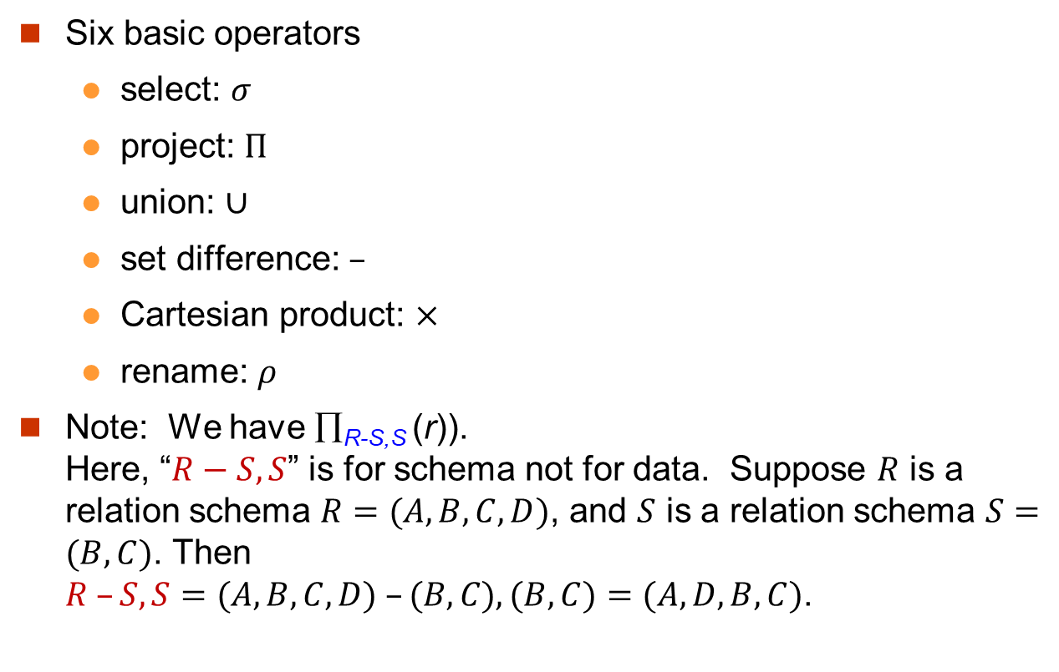
Relational Algebra
Six basic operators
select: $σ$
project: $Π$
union: $∪$
set difference: $–$
Cartesian product: $×$
rename: $ρ$
Note: We have ∏_{R-S,S} (r)). Here, “$R−S,S$” is for schema not for data. Suppose $R$ is a relation schema $R=(A,B,C,D)$, and $S$ is a relation schema $S=(B,C)$. Then $R –S, S=(A,B,C,D) –(B,C), (B,C)=(A,D,B,C)$.
A | B | C | D
5 | 9 | a | x
4 | 4 | b | z
2 | 4 | g | y
3 | 8 | d | x

Slide 28
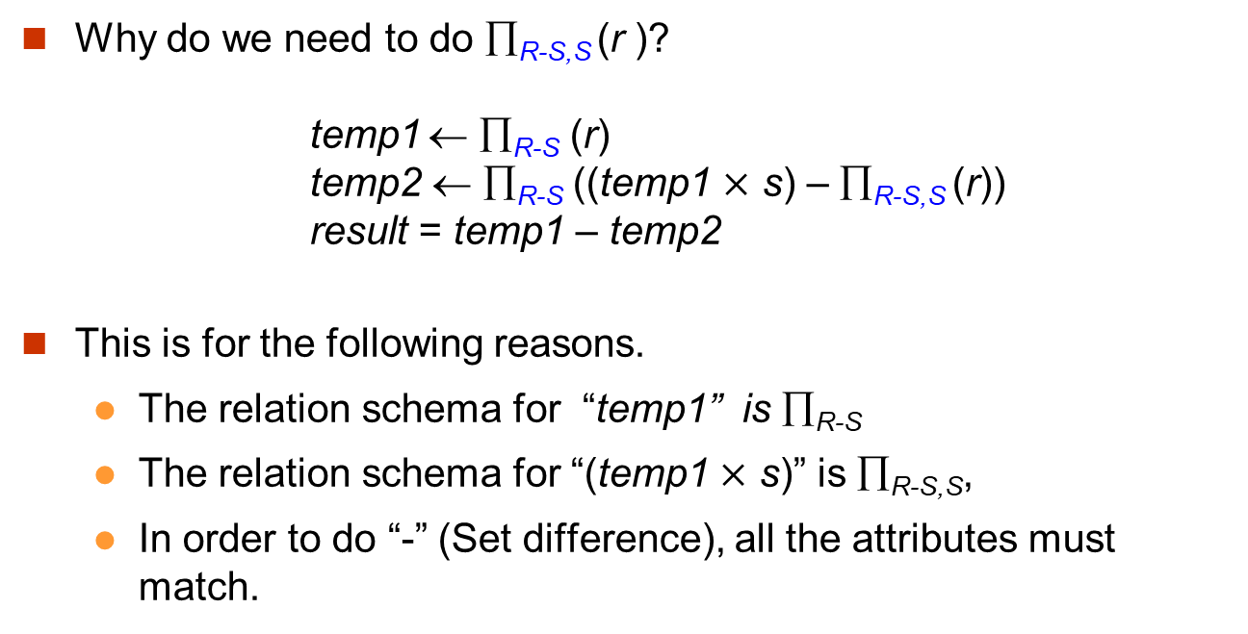
Division Operator
Why do we need to do ∏_{R-S,S} (r )? temp1 ← ∏_{R-S} (r) temp2 ← ∏_{R-S} ((temp1 $×$ s) – ∏_{R-S,S} (r)) result = temp1 – temp2
This is for the following reasons.
The relation schema for “temp1” is ∏_{R-S}
The relation schema for “(temp1 $×$ s)” is ∏_{R-S,S},
In order to do “-” (Set difference), all the attributes must match.

Slide 29
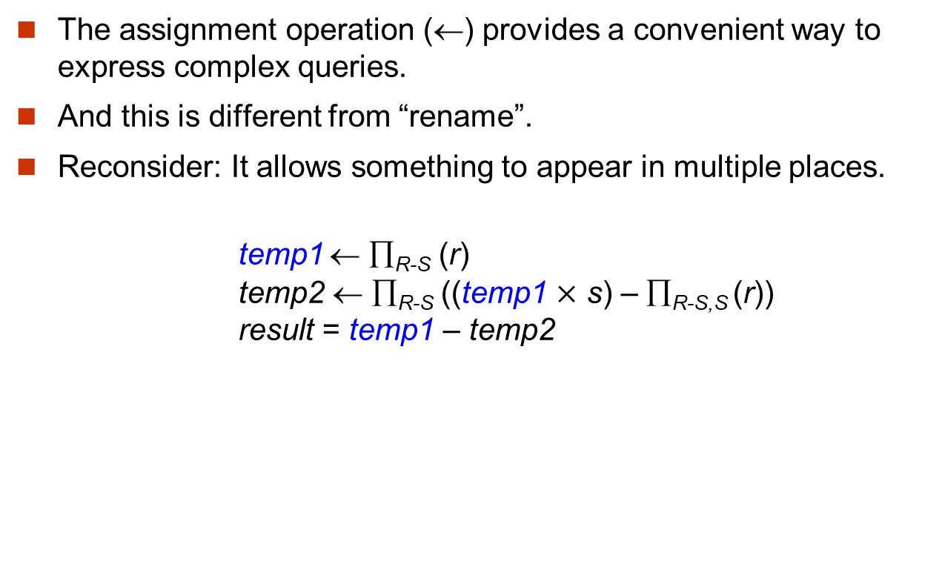
Assignment Operation
The assignment operation (←) provides a convenient way to express complex queries.
And this is different from “rename”.
Reconsider: It allows something to appear in multiple places. temp1 ← ∏_{R-S} (r) temp2 ← ∏_{R-S} ((temp1 $×$ s) – ∏_{R-S,S} (r)) result = temp1 – temp2

Slide 30
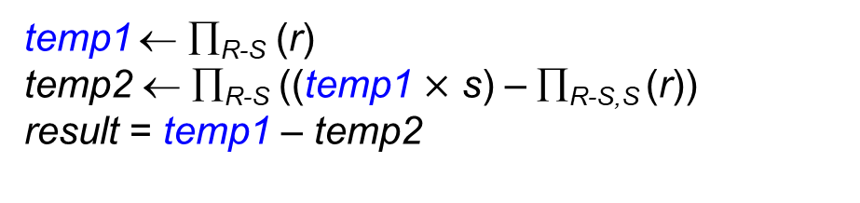
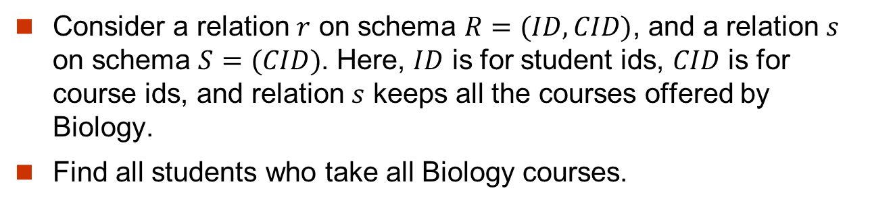
Consider an Example (1)
Consider a relation $r$ on schema $R=(ID, CID)$, and a relation $s$ on schema $S=(CID)$. Here, $ID$ is for student ids, $CID$ is for course ids, and relation $s$ keeps all the courses offered by Biology.
Find all students who take all Biology courses.
r
s
temp1 ← ∏_{R-S} (r) temp2 ← ∏_{R-S} ((temp1 $×$ s) – ∏_{R-S,S} (r)) result = temp1 – temp2
ID | CID
J | D
S | R
J | B
S | D
P | X
CID
D
B

Slide 31

Consider an Example (2)
r
s
temp1 ← ∏_{R-S} (r) temp2 ← ∏_{R-S} ((temp1 $×$ s) – ∏_{R-S,S} (r)) result = temp1 – temp2
ID | CID
J | D
S | R
J | B
S | D
P | X
CID
D
B

Slide 32
Extended Relational-Algebra-Operations
Generalized Projection
Aggregate Functions

Slide 33
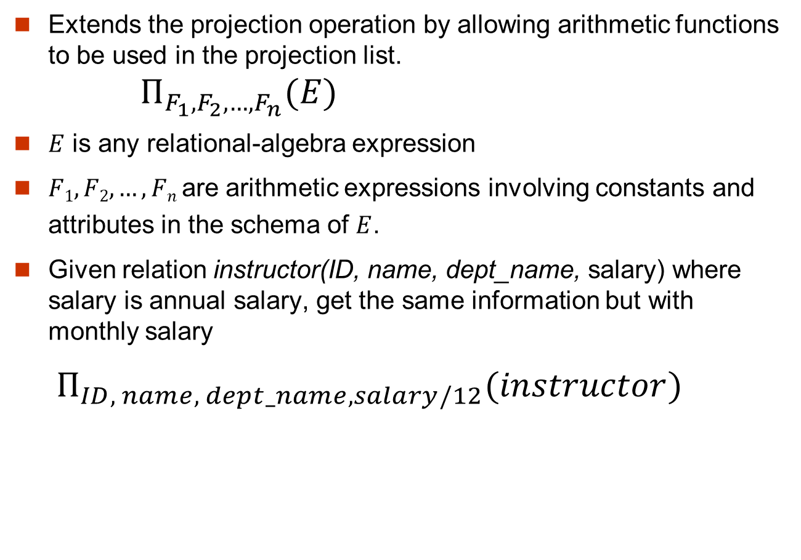
Generalized Projection
Extends the projection operation by allowing arithmetic functions to be used in the projection list. $Π_{F_{1},F_{2},…,F_{n}}(E)$
$E$ is any relational-algebra expression
$F1, F2, …, Fn$ are arithmetic expressions involving constants and attributes in the schema of $E$.
Given relation instructor(ID, name, dept_name, salary) where salary is annual salary, get the same information but with monthly salary
$Π_{ID, name, dept_name,salary/12}(instructor)$

Slide 34

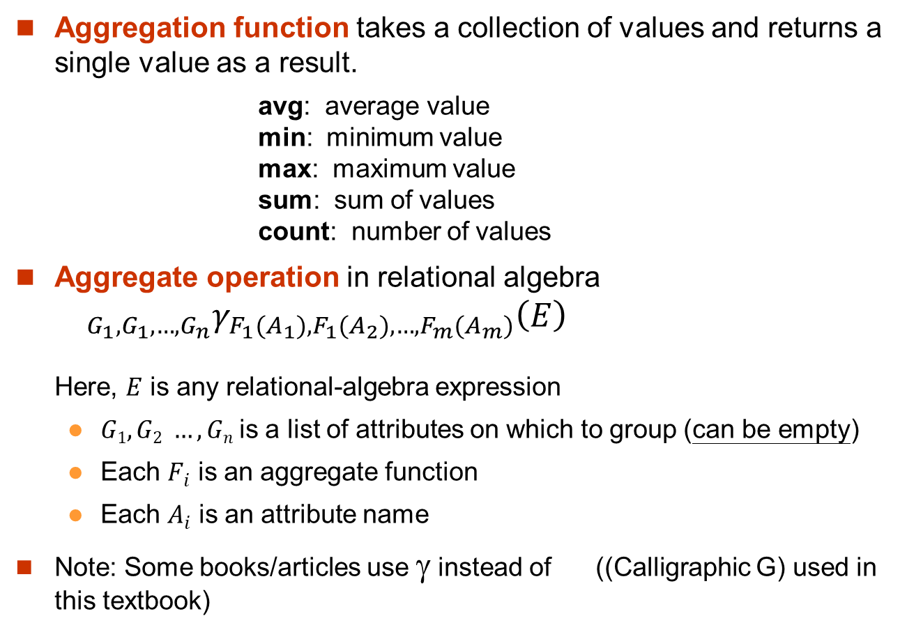
Aggregate Functions and Operations (1)
Aggregation function takes a collection of values and returns a single value as a result.
avg: average value min: minimum value max: maximum value sum: sum of values count: number of values
Aggregate operation in relational algebra ${}_{G_{1},G_{1},…,G_{n}}γ_{F_{1}{(A}_{1}),F_{1}{(A}_{2}),…,F_{m}{(A}_{m})}\left(E\right)$ Here, $E$ is any relational-algebra expression
$G1, G2 …, Gn$is a list of attributes on which to group (can be empty)
Each $Fi$ is an aggregate function
Each $Ai$ is an attribute name
Note: Some books/articles use $$ instead of ((Calligraphic G) used in this textbook)

Slide 35
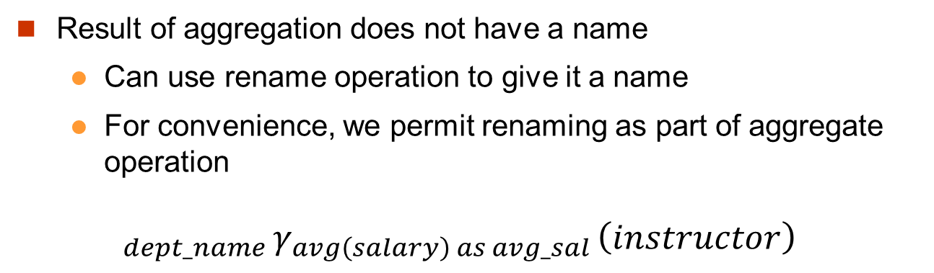
Aggregate Functions and Operations (2)
Result of aggregation does not have a name
Can use rename operation to give it a name
For convenience, we permit renaming as part of aggregate operation
$${}_{dept_name }γ_{avg\left(salary\right) as avg_sal }\left(instructor\right)$$

Slide 36
Modification of the Database
The content of the database may be modified using the following operations:
Deletion
Insertion
Updating
All these operations can be expressed using the assignment operator

Slide 37
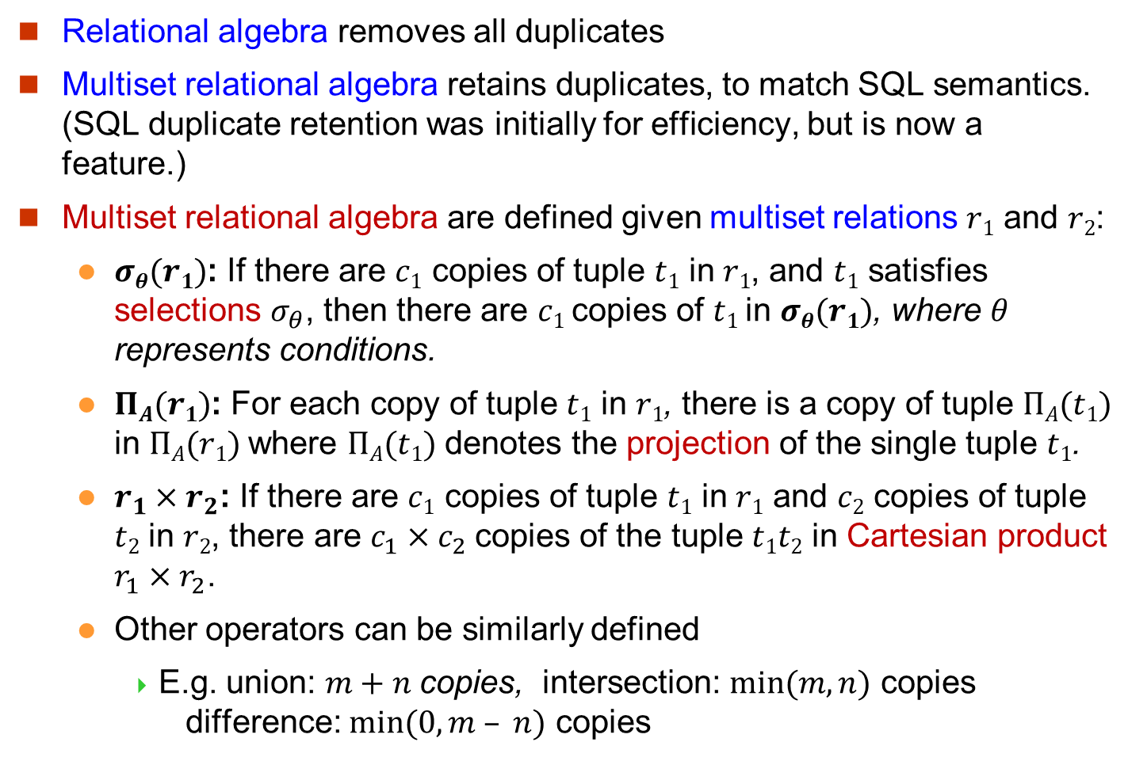
Multiset Relational Algebra
Relational algebra removes all duplicates
Multiset relational algebra retains duplicates, to match SQL semantics. (SQL duplicate retention was initially for efficiency, but is now a feature.)
Multiset relational algebra are defined given multiset relations $r1$ and $r2$:
$σθ(r1)$: If there are $c1$ copies of tuple $t1$ in $r1$, and $t1$ satisfies selections $σ_{θ}$, then there are $c1$ copies of $t1$in $σθ(r1)$, where $θ$ represents conditions.
$ΠA(r1)$: For each copy of tuple $t1$ in $r1$, there is a copy of tuple $ΠA(t1)$ in $ΠA(r1)$where $ΠA(t1)$ denotes the projection of the single tuple $t1$.
$r_{1}×r_{2}$: If there are $c1$ copies of tuple $t1$ in $r1$ and $c2$ copies of tuple $t2$ in $r2$, there are $c_{1}×c_{2}$copies of the tuple $t1t2$ in Cartesian product $r_{1}×r_{2}$.
Other operators can be similarly defined
E.g. union: $m+n$copies, intersection: $min⁡(m, n)$ copies difference: $min⁡(0, m – n)$ copies

Slide 38
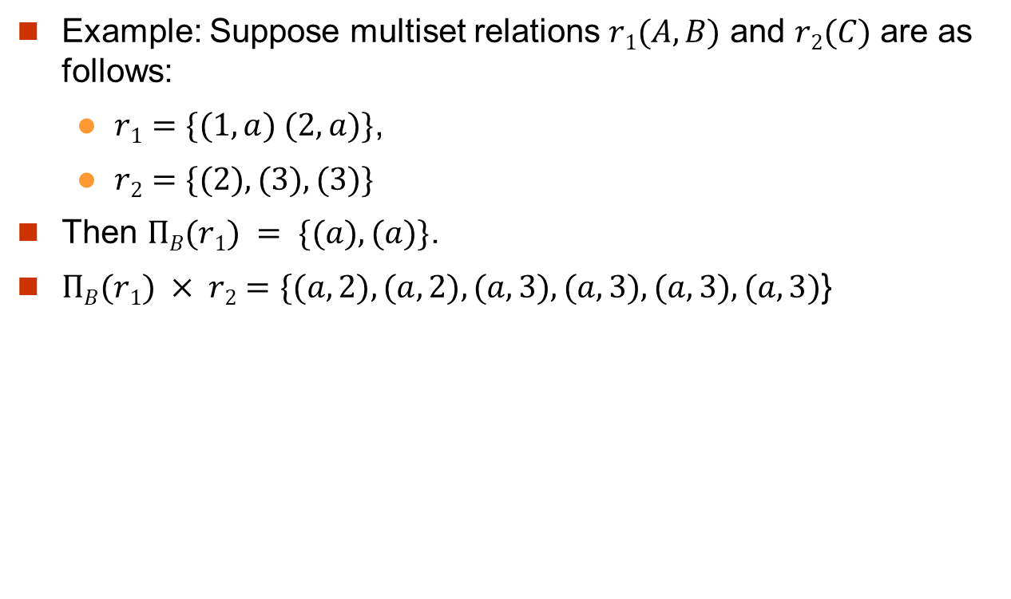
Multiset: An Example
Example: Suppose multiset relations $r1(A, B)$ and $r2(C)$ are as follows:
$r1=\{(1, a) (2,a)\}$,
$r2=\{(2), (3), (3)\}$
Then $ΠB(r1) = \{(a), (a)\}$.
$ΠB(r1) × r2=\{(a,2), (a,2), (a,3), (a,3), (a,3), (a,3)$}

Slide 39
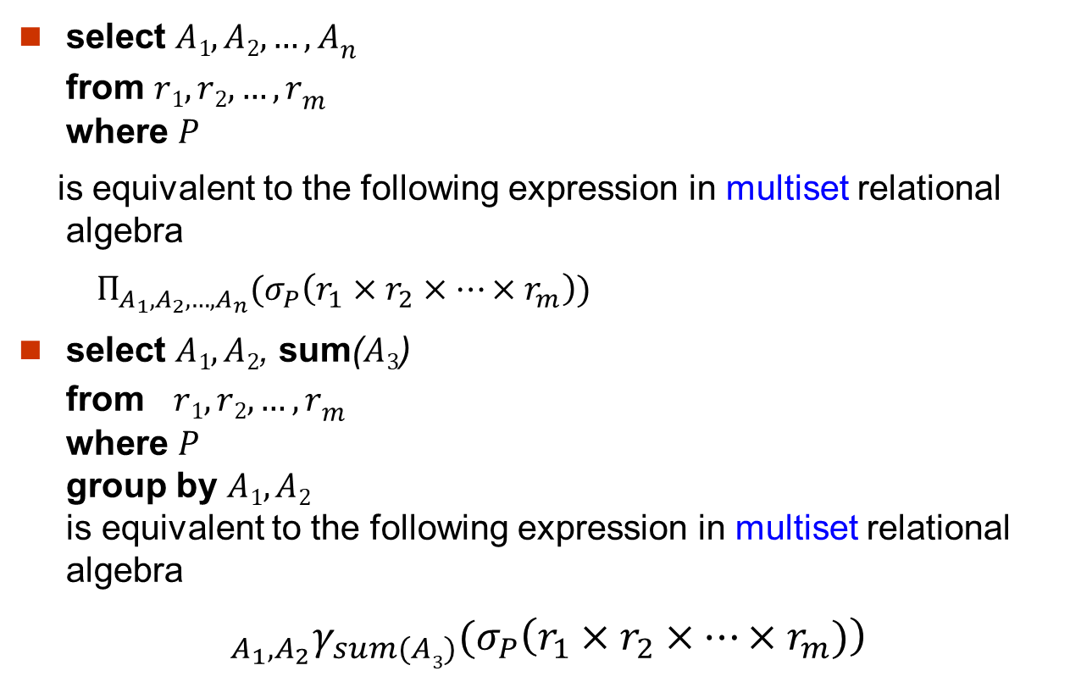
SQL and Relational Algebra
select $A1,A2, …, An$ from $r1, r2, …, rm$ where $P$
is equivalent to the following expression in multiset relational algebra
$Π_{A_{1},A_{2},…,A_{n}}(σ_{P}\left(r_{1}×r_{2}×…×r_{m}\right))$
select $A1,A2$, sum($A3$) from $r1, r2, …, rm$ where $P$ group by $A1,A2$ is equivalent to the following expression in multiset relational algebra
${{{}_{A_{1},A_{2}}γ}_{sum(A3)}(σ}_{P}\left(r_{1}×r_{2}×…×r_{m})\right)$

Slide 40
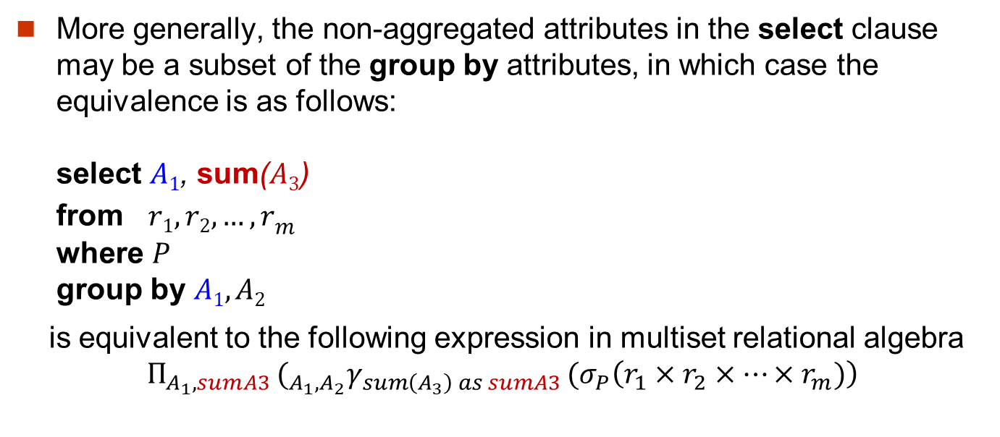
SQL and Relational Algebra
More generally, the non-aggregated attributes in the select clause may be a subset of the group by attributes, in which case the equivalence is as follows: select $A1$, sum($A3$) from $r1, r2, …, rm$ where $P$ group by $A1,A2$
is equivalent to the following expression in multiset relational algebra
$${{{Π_{A_{1},sumA3 }(}_{A_{1},A_{2}}γ}_{sum\left(A_{3}\right) as sumA3 }(σ}_{P}\left(r_{1}×r_{2}×…×r_{m})\right)$$

Slide 41
SQL vs Relational Algebra
SQL is a query language for users to access databases.
Relational algebra is used by the system to process queries.
SQL is built on top of relational algebra with some additional facilities to manipulate data.
For example, displaying data in order.
An SQL query is translated into a relational algebra expression to be processed.
In practice, an end-user does not need to write relational algebra. But the idea of algebra can help an end-user to write a good query.

