Slide 1
Database Administration
KIT712 Database Management Technology
Slides are adapted from Database Systems by Coronel, Morris and Rob

Slide 2
Data as a Corporate Asset
Data:
Valuable asset that requires careful management
Valuable resource that translates into information
Accurate, timely information triggers actions that enhance company’s position and generate wealth

Slide 3
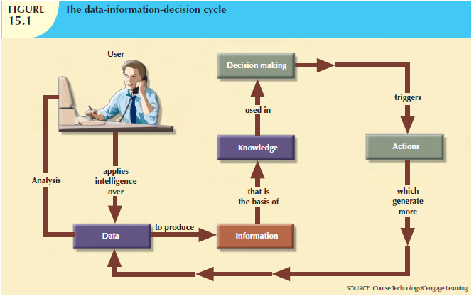

Slide 4
Data as a Corporate Asset (cont’d.)
Dirty data
Data that suffer from inaccuracies and inconsistencies
Threat to organizations
Causes?
Lack of enforcement of integrity constraints
Data entry errors and typographical errors
Data quality
Comprehensive approach to ensuring the accuracy, validity, and timeliness of the data
Notes:
Can you guess what type of data you might know can be dirty in context of university?

Slide 5
The Need for and Role of Databases in an Organization
Database’s predominant role is to support managerial decision making at all levels
DBMS facilitates:
Interpretation and presentation of data
Distribution of data and information
Preservation and monitoring of data
Control over data duplication and use

Slide 6
Introduction of a Database: Special Considerations
Introduction of a DBMS is likely to have a profound impact
Might be positive or negative, depending on how it is administered
Three aspects to DBMS introduction:
Technological : DBMS software and hardware
Managerial: Administrative functions
Cultural: Corporate resistance to change
One role of DBA department is to educate end users about system uses and benefits

Slide 7
The Evolution of the Database Administration Function
Data administration has its roots in the old, decentralized world of the file system
Advent of DBMS produced new level of data management sophistication
Data Processing (DP) department evolved into information systems (IS) department
Data management became increasingly complex
Development of database administrator (DBA) function
Notes:
IS facilitates data management support to end user
Application integration to provide information needs

Slide 8
The Database Environment’s Human Component
Even most carefully crafted database system cannot operate without human component
Effective data administration requires both technical and managerial skills
DA must set data administration goals
DBA is focal point for data/user interaction
Need for diverse mix of skills

Slide 9
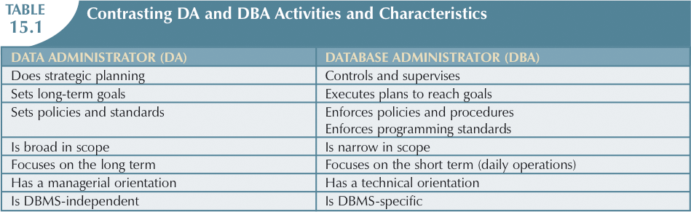
The Database Environment’s Human Component (continued)

Slide 10
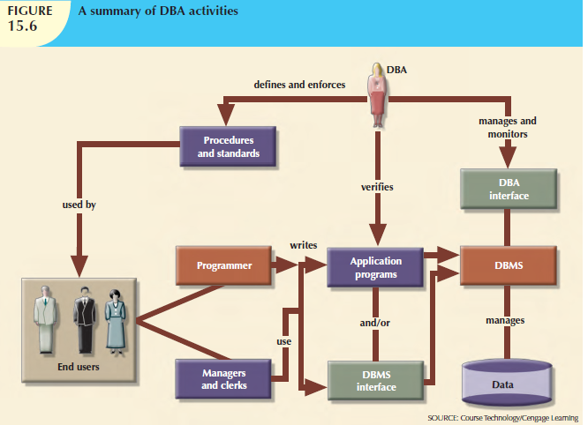

Slide 11
The DBA’s Managerial Role
DBA responsible for:
Coordinating, monitoring, allocating resources
Resources include people and data
Defining goals and formulating strategic plans
Interacts with end user by providing data and information
Enforces policies, standards, procedures

Slide 12
The DBA’s Managerial Role (cont’d.)
Manages security, privacy, integrity
Ensures data can be fully recovered
In large organizations, database security officer (DSO) responsible for disaster management
Ensures data is distributed appropriately
Makes it easy for authorized end users to access the database

Slide 13
The DBA’s Technical Role
Evaluates, selects, and installs DBMS and related utilities
Designs and implements databases and applications
Tests and evaluates databases and applications

Slide 14
The DBA’s Technical Role (cont’d.)
Operates DBMS, utilities, and applications
Trains and supports users
Maintains DBMS, utilities, and applications

Slide 15
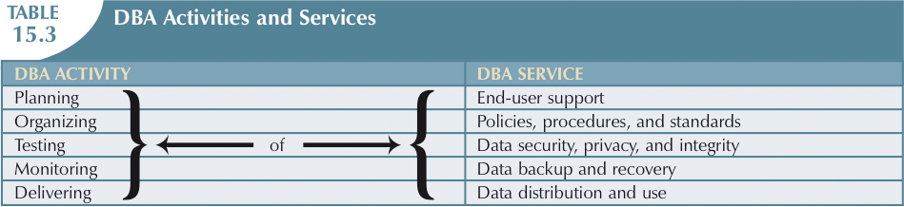
The DBA’s Managerial Role

Slide 16
The DBA’s Role in the Cloud
Cloud services provide:
DBMS installation and updates
Server/network management
Backup and recovery operations
DBA’s managerial role is largely unchanged
Technical role
Evaluation of services to use

Slide 17
Security
Securing data entails securing overall information system architecture
Confidentiality: data protected against unauthorized access
Integrity: keep data consistent and free of errors or anomalies
Availability: accessibility of data by authorized users for authorized purposes

Slide 18
Database Security
Refers to the use of DBMS features and other measures to comply with security requirements
DBA secures DBMS from installation through operation and maintenance
Authorization management
User access management
DBMS access control
DBMS usage monitoring

Slide 19
Security Policies
Database security officer secures the system and the data
Works with the database administrator
Security policy: collection of standards, policies, procedures to guarantee security
Ensures auditing and compliance
Security audit process identifies security vulnerabilities
Identifies measures to protect the system

Slide 20
Security Vulnerabilities
Security vulnerability: weakness in a system component
Could allow unauthorized access or cause service disruptions
Security threat: imminent security violation
Could occur at any time
Security breach yields a database whose integrity is either:
Preserved
Corrupted

Slide 21
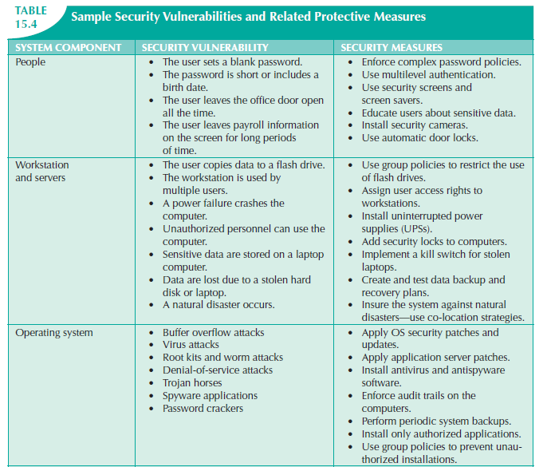

Slide 22
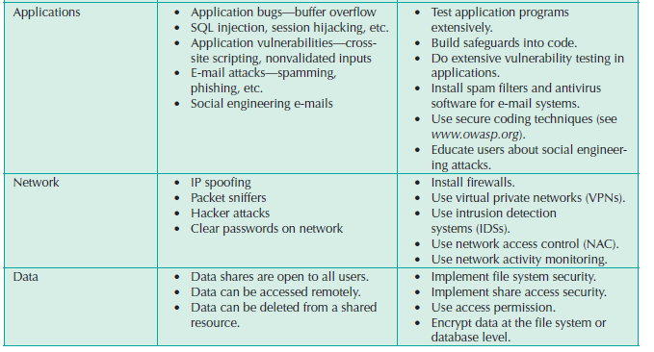

Slide 23
Database Administration Tools
Data dictionary
CASE tools

Slide 24
The Data Dictionary
Two main types of data dictionaries:
Integrated
Standalone
Main function-Store description of all objects that interact with database

Slide 25
The Data Dictionary (continued)
Possible to manage use and allocation of all organization’s information.
Metadata stored in data dictionary are often basis for monitoring database use and assignment of access rights to database users

Slide 26
CASE Tools
Computer-aided systems engineering
Automated framework for SDLC
Structured methodologies and powerful graphical interfaces
Front-end CASE tools provide support for planning, analysis, and design phases
Back-end CASE tools provide support for coding and implementation phases

Slide 27
CASE Tools (cont’d.)
Typical CASE tool has five components
Graphics for diagrams
Screen painters and report generators
Integrated repository
Analysis segment
Program documentation generator

Slide 28
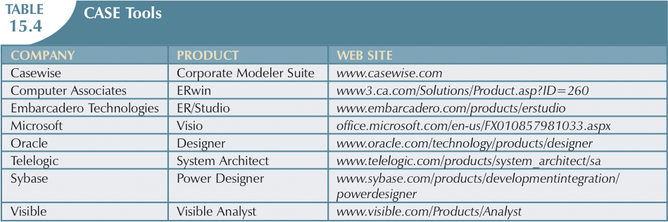
CASE Tools

Slide 29
The Default Login
Must connect to the database to perform administrative tasks
Username with administrative privileges
Oracle automatically creates SYSTEM and SYS user IDs with administrative privileges
Define preferred credentials by clicking on Preferences link, then Preferred Credentials
Username and passwords are database-specific

Slide 30
Ensuring that the RDBMS Starts Automatically
DBA ensures database access is automatically started when computer turned on
A service is a Windows system name for a special program that runs automatically
Part of the operating system
Database instance: separate location in memory reserved to run the database
May have several databases running in memory at the same time

Slide 31
Creating Tablespaces and Datafiles
Database composed of one or more tablespaces
Tablespace is a logical storage space
Physically stored in one or more datafiles
Datafile physically stores the database’s data
Each datafile can reside in a different directory on the hard disk
Database has 1:M relationship with tablespaces
Tablespace has 1:M relationship with datafiles

Slide 32
Managing the Database Objects: Tables, Views, Triggers, and Procedures
Database object: any object created by end users
Schema: logical section of the database that belongs to a given user
Schema identified by a username
Within the schema, users create their own tables and other objects
Normally, users are authorized to access only the objects that belong to their own schemas

Slide 33
Managing Users and Establishing Security
User: uniquely identifiable object
Allows a given person to log on to the database
Role: a named collection of database access privileges
Authorizes a user to connect to the database and use system resources
Profile: named collection of settings
Controls how much of a resource a given user can use

Slide 34
Customizing the Database Initialisation Parameters
Fine-tuning requires modification of database configuration parameters
Some are changed in real time using SQL
Some affect database instance
Others affect entire RDBMS and all instances
Initialization parameters reserve resources used by the database at run time
After modifying parameters, may need to restart the database

Slide 35
Summary
Data management is a critical activity for any organization
Data should be treated as a corporate asset
DBMS is the most commonly used electronic tool for corporate data management
DBMS has impact on organization’s managerial, technological, and cultural framework
Data administration function evolved from centralized electronic data processing

Slide 36
Summary (cont’d.)
Database administrator (DBA) is responsible for managing corporate database
Broader data management activity is handled by data administrator (DA)
DA is more managerially oriented than more technically oriented DBA
DA function is DBMS-independent
DBA function is more DBMS-dependent
When there is no DA, DBA executes all DA functions

Slide 37
Summary (cont’d.)
Managerial services of DBA function:
Supporting end-user community
Defining and enforcing policies, procedures, and standards for database function
Ensuring data security, privacy, and integrity
Providing data backup and recovery services
Monitoring distribution and use of data in database

Slide 38
Summary (cont’d.)
Technical role of DBA:
Evaluating, selecting, and installing DBMS
Designing and implementing databases and applications
Testing and evaluating databases and applications
Operating DBMS, utilities, and applications
Training and supporting users
Maintaining DBMS, utilities, and applications

Slide 39
Summary (cont’d.)
Security: ensures confidentiality, integrity, availability of information system and data
Security policy: collection of standards, policies, and practices
Security vulnerability: weakness in system component
Information engineering guides development of data administration strategy
CASE tools and data dictionaries translate strategic plans to operational plans

