Slide 1

KIT712: DATA MANAGEMENT TECHNOLOGY
User Creation and Management

Slide 2
DATABASE USER ACCOUNTS
Each database user account has:
  A unique username
  An authentication method
  A default tablespace
  A temporary tablespace
  A user profile
  A consumer group
  A lock status
Notes:
Oracle Database 10g: Administration Workshop I 6-<number>
Database User Accounts
To access the database, a user must specify a valid database user account and successfully authenticate as required by that user account. Each database user has his or her own database account. This is Oracle’s best practice recommendation to avoid potential security holes and provide meaningful data for certain audit activities. However, in rare cases, users share a common database account. In this case, operating system and applications must provide adequate security for the database. Each user account has:
A unique username: Usernames cannot exceed 30 bytes, cannot contain special characters, and must start with a letter.
An authentication method: The most common authentication method is a password, but Oracle Database 10g supports several other authentication methods, including biometric, certificate, and token authentication.
A default tablespace: This is a place where the user creates objects if he or she does not specify some other tablespace. Note that having a default tablespace does not imply that the user has the privilege of creating objects in that tablespace, nor does the user have a quota of space within that tablespace in which to create objects. Both these are granted separately.

Slide 3
PREDEFINED DBA ACCOUNTS
  SYS
    Owns most of tables needed to run SB, and data dictionary views
    Owns a host of packages and procedures built into DB
    Can perform high-level tasks (e.g., starting up and shutting down DB instance), and backup/recovery tasks
      Do not log on as SYS for routine tasks
  SYSTEM
    Owns some tables, packages, and procedures
    Has the DBA role: it can perform routine DB administration tasks
      Log on as SYSTEM to perform these routine tasks
Notes:
Oracle Database 10g: Administration Workshop I 6-<number>
Predefined Accounts: SYS and SYSTEM
The SYS and SYSTEM accounts have the database administrator (DBA) role granted to them by default.
The SYS account in addition has all privileges with ADMIN OPTION and owns the data dictionary. To connect to the SYS account, you must use the AS SYSDBA clause. Any user that is granted the SYSDBA privilege can connect to the SYS account by using the AS SYSDBA clause. Only “privileged” users, who are granted the SYSDBA or SYSOPER privilege, are allowed to start up and shut down the database instance.
The SYSTEM account is granted the DBA role by default, but not the SYSDBA privilege.
Best practice tip: Applying the principle of least privilege, these accounts are not used for routine operations. Users who need DBA privileges have separate accounts with the required privileges granted to them. For example, Jim has a low privilege account called jim and a privileged account called jim_dba. This method allows the principle of least privilege to be applied, eliminates the need for account sharing, and allows individual actions to be audited.
The SYS and SYSTEM accounts are required accounts in the database. They cannot be dropped.

Slide 4
USERS AND RESOURCE CONTROL
During DB creation, Oracle creates other users to help it install some DB features
  E.g., MDSYS owns objects related to Oracle Spatial
  After DB creation, these users are disabled to prevent anyone from logging to DB with their accounts
After the DB instance is up and running, you create users that own tables and other objects
  So system and user tables are in distinct logical groups
  You can limit the ability of each user to create objects
    You can create a profile, and assign it to any user
After creating users to own the business tables, you must create users who access these tables
ORACLE 10G DATABASE ADMINISTRATOR: IMPLEMENTATION AND ADMINISTRATION

Slide 5
CONTROLLING USER ACCESS
Database
administrator
Username and password
privileges
Users
Notes:
Controlling User Access
In a multiple-user environment, you want to maintain security of the database access and use. With Oracle Server database security, you can do the following:
Control database access
Give access to specific objects in the database
Confirm given and received privileges with the Oracle data dictionary
Create synonyms for database objects
Database security can be classified into two categories: system security and data security. System security covers access and use of the database at the system level, such as username and password, disk space allocated to users, and system operations allowed by the user. Database security covers access and use of the database objects and the actions that those users can have on the objects.

Slide 6
CREATING A USER
The CREATE USER command gives each user a user name and password
Oracle 11g: SQL

Slide 7
PRIVILEGES
  Database security:
    System security
    Data security
  System privileges: Gain access to the database
  Object privileges: Manipulate the content of the database objects
  Schema: Collection of objects, such as tables, views, and sequences
Notes:
Privileges
Privileges are the right to execute particular SQL statements. The database administrator is a high-level user with the ability to grant users access to the database and its objects. The users require system privileges to gain access to the database and object privileges to manipulate the content of the objects in the database. Users can also be given the privilege to grant additional privileges to other users or to roles, which are named groups of related privileges.
Schema
A schema is a collection of objects, such as tables, views, and sequences. The schema is owned by a database user and has the same name as that user.
For more information, see
Oracle Server Application Developer’s Guide, Release 8, “Establishing a Security Policy” section, and Oracle Server Concepts Manual, Release 8, “Database Security” topic.

Slide 8
ASSIGNING USER PRIVILEGES
There are two types of privileges
System privileges
  Allow access to the database and execution of DDL operations
Object privileges
  Allow a user to perform DML and query operations
Oracle 11g: SQL

Slide 9
ASSIGNING USER PRIVILEGES (CONTINUED)
Even with a valid user name and password, a user still needs the CREATE SESSION privilege to connect to a database
Oracle 11g: SQL

Slide 10
SYSTEM PRIVILEGES
Affect a user’s ability to create, alter, and drop objects
Use of ANY keyword with an object privilege (INSERT ANY TABLE) is considered a system privilege
List of all available system privileges available through SYSTEM_PRIVILEGE_MAP
Oracle 11g: SQL

Slide 11
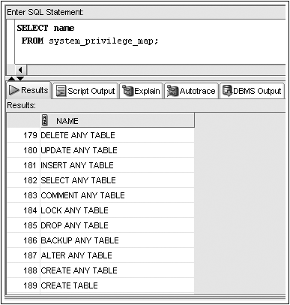
SYSTEM_PRIVILEGE_MAP
Oracle 11g: SQL

Slide 12
GRANTING SYSTEM PRIVILEGES
System privileges are given through the GRANT command
Oracle 11g: SQL

Slide 13
GRANTING SYSTEM PRIVILEGES (CONTINUED)
GRANT clause – identifies system privileges being granted
TO clause – identifies receiving user or role
WITH ADMIN OPTION clause – allows a user to grant privilege to other database users
Oracle 11g: SQL

Slide 14
OBJECT PRIVILEGES
SELECT – display data from table, view, or sequence
INSERT – insert data into table or view
UPDATE – change data in a table or view
DELETE – remove data from a table or view
ALTER – change definition of table or view
Oracle 11g: SQL

Slide 15
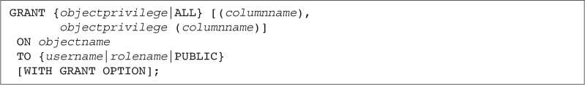
GRANTING OBJECT PRIVILEGES
Grant object privileges through the GRANT command
Oracle 11g: SQL

Slide 16
GRANTING OBJECT PRIVILEGES (CONTINUED)
GRANT clause – identifies object privileges
ON clause – identifies object
TO clause – identifies user or role receiving privilege
WITH GRANT OPTION clause – gives a user the ability to assign the same privilege to other users
Oracle 11g: SQL

Slide 17
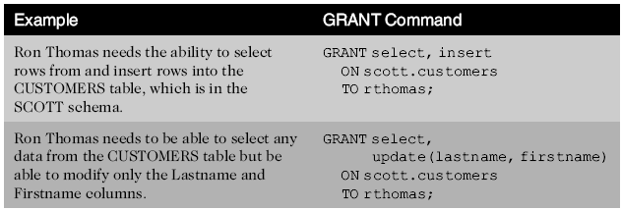
GRANT COMMAND EXAMPLES
Oracle 11g: SQL

Slide 18
PASSWORD MANAGEMENT
To change a user password, use the PASSWORD command or the ALTER USER command
Oracle 11g: SQL

Slide 19

WHAT IS A ROLE?
Users
Easier privilege management
Dynamic privilege management
Selective availability of privileges
Manager
Privileges
Allocating privileges
without a role
Allocating privileges
with a role
Notes:
What Is a Role?
A role is a named group of related privileges that can be granted to the user. This method makes granting and revoking privileges easier to perform and maintain.
A user can have access to several roles, and several users can be assigned the same role. Roles typically are created for a database application.
Creating and Assigning a Role
First, the DBA must create the role. Then the DBA can assign privileges to the role and users to the role.
Syntax
CREATE ROLE role;
where: role is the name of the role to be created
Now that the role is created, the DBA can use the GRANT statement to assign users to the role as well as assign privileges to the role.
Class Management Note
Discuss the four following points about roles:
Are named groups of related privileges
Can be granted to users
Simplify the process of granting and revoking privileges
Are created by a DBA

Slide 20
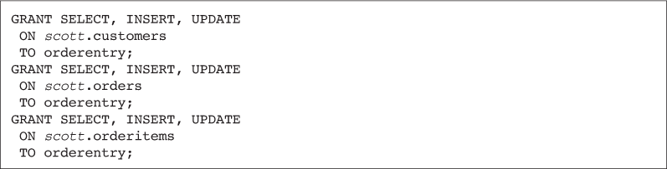
UTILIZING ROLES
A role is a group, or collection, of privileges
Oracle 11g: SQL

Slide 21
UTILIZING ROLES (CONTINUED)
Roles can be assigned to users or other roles
Oracle 11g: SQL

Slide 22
UTILIZING ROLES (CONTINUED)
A user can be assigned several roles
All roles can be enabled at one time
Only one role can be designated as the default role for each user
Default role can be assigned through the ALTER USER command
Oracle 11g: SQL

Slide 23
UTILIZING ROLES (CONTINUED)
Roles can be modified with the ALTER ROLE command
Roles can be assigned passwords
Oracle 11g: SQL

Slide 24
VIEWING PRIVILEGE INFORMATION
ROLE_SYS_PRIVS lists all system privileges assigned to a role
SESSION_PRIVS lists a user’s currently enabled roles
Oracle 11g: SQL

Slide 25
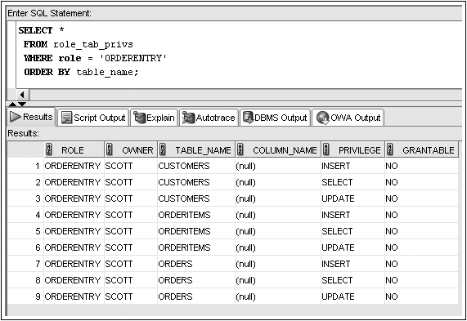
ROLE_TAB_PRIVS EXAMPLE
Oracle 11g: SQL

Slide 26
REMOVING PRIVILEGES AND ROLES
Revoke system privileges with the REVOKE command
Oracle 11g: SQL

Slide 27
REMOVING PRIVILEGES AND ROLES (CONTINUED)
Revoking an object privilege – if the privilege was originally granted using WITH GRANT OPTION, the effect cascades and is revoked from subsequent recipients
Oracle 11g: SQL

Slide 28
REMOVING PRIVILEGES AND ROLES (CONTINUED)
Oracle 11g: SQL

Slide 29
DROPPING A ROLE
Users receiving privileges via a role that is dropped will no longer have those privileges available
Oracle 11g: SQL

Slide 30
DROPPING A USER
The DROP USER command is used to remove a user account
Oracle 11g: SQL

Slide 31
PROFILES AND USERS
ORACLE 11G: SQL

Slide 32
INTRODUCTION TO PROFILES
Specify a profile when you create/alter a DB user
Profile: collection of settings that limits the use of system resources and the database
  A profile can be assigned to any number of users
    A user can be assigned only one profile at a time
      A newly assigned profile overrides the old one
        User’s current session isn’t affected by profile change
  DEFAULT profile has no resource or DB use limits
    As a system grows, resources may become stretched
  Profiles can be used for managing passwords too
ORACLE 10G DATABASE ADMINISTRATOR: IMPLEMENTATION AND ADMINISTRATION

Slide 33
CREATING PROFILES
CREATE PROFILE <profile> LIMIT
<password_setting> ...
<resource_setting> <limit> ...;
  Password settings:
    FAILED_LOGIN_ATTEMPTS, PASSWORD_LIFE_TIME, PASSWORD_REUSE_TIME, PASSWORD_REUSE_MAX, PASSWORD_LOCK_TIME, FAILED_LOGIN_ATTEMPTS, PASSWORD_GRACE_TIME, PASSWORD_VERIFY_FUNCTION
  You can limit nine resources:
    SESSSIONS_PER_USER, CPU_PER_SESSION, CPU_PER_CALL, CONNECT_TIME, IDLE_TIME, LOGICAL_READS_PER_SESSION, LOGICAL_READS_PER_CALL, PRIVATE_SGA, COMPOSITE_LIMIT
ORACLE 10G DATABASE ADMINISTRATOR: IMPLEMENTATION AND ADMINISTRATION

Slide 34
CREATING PROFILES (CONTINUED)
Examples:
  CREATE PROFILE PROGRAMMER LIMIT
  SESSIONS_PER_USER 2;
  CREATE PROFILE POWERUSER LIMIT
  PASSWORD_LIFE_TIME 60;
ORACLE 10G DATABASE ADMINISTRATOR: IMPLEMENTATION AND ADMINISTRATION

Slide 35
MANAGING PASSWORDS
There are three different areas to examine when working with passwords:
  Changing a password and making it expire
  Enforcing password time limits, history, and other settings
  Enforcing password complexity
    Uses a combination of a function and a profile
      Predefined SQL script to verify the complexity of a password
      Adjust the PASSWORD_VERIFY_FUNCTION setting in a profile and assign that profile to a user
ORACLE 10G DATABASE ADMINISTRATOR: IMPLEMENTATION AND ADMINISTRATION

Slide 36
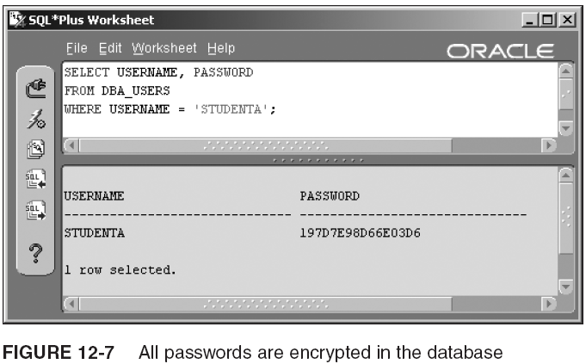
MANAGING PASSWORDS (CONTINUED)
ORACLE 10G DATABASE ADMINISTRATOR: IMPLEMENTATION AND ADMINISTRATION

Slide 37
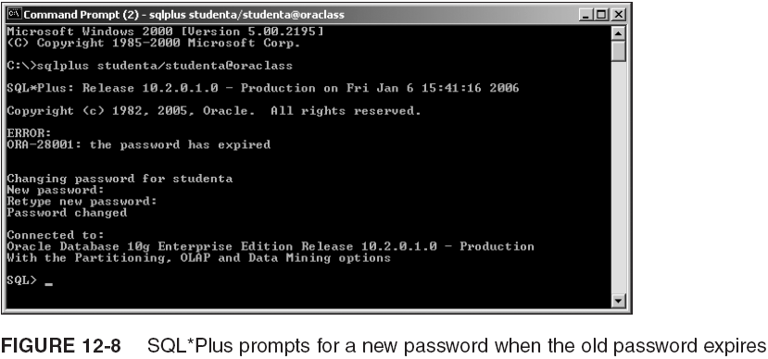
MANAGING PASSWORDS (CONTINUED)
ORACLE 10G DATABASE ADMINISTRATOR: IMPLEMENTATION AND ADMINISTRATION

Slide 38
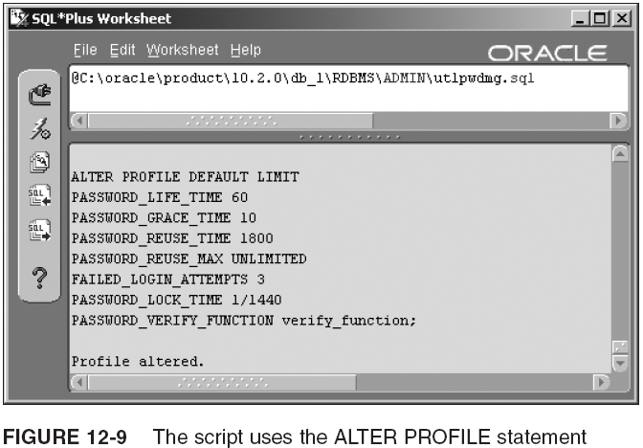
MANAGING PASSWORDS (CONTINUED)
ORACLE 10G DATABASE ADMINISTRATOR: IMPLEMENTATION AND ADMINISTRATION

Slide 39
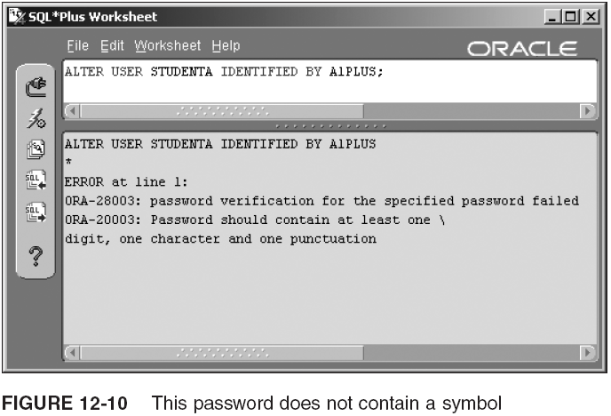
MANAGING PASSWORDS (CONTINUED)
ORACLE 10G DATABASE ADMINISTRATOR: IMPLEMENTATION AND ADMINISTRATION

Slide 40
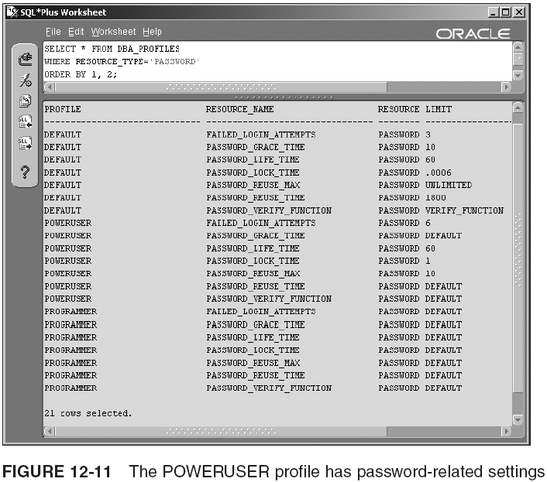
MANAGING PASSWORDS (CONTINUED)
ORACLE 10G DATABASE ADMINISTRATOR: IMPLEMENTATION AND ADMINISTRATION

Slide 41
CONTROLLING RESOURCE USAGE
ALTER PROFILE, with resource clauses listed:
  ALTER PROFILE <profile> LIMIT
  <password_setting> ...
  SESSIONS_PER_USER <concurrent sessions>
  CPU_PER_SESSION <hundredths of seconds>
  CPU_PER_CALL <hundredths of seconds>
  CONNECT_TIME <minutes>
  IDLE_TIME <minutes>
  LOGICAL_READS_PER_SESSION <data blocks>
  LOGICAL_READS_PER_CALL <data blocks>
  PRIVATE_SGA <bytes>
  COMPOSITE_LIMIT <service units>
Example:
  ALTER SYSTEM SET RESOURCE_LIMIT=TRUE;
  ALTER PROFILE PROGRAMMER LIMIT
  IDLE_TIME 15
  CPU_PER_CALL 100;
  ALTER RESOURCE COST
  CPU_PER_SESSION 1000
  PRIVATE_SGA 1;
ORACLE 10G DATABASE ADMINISTRATOR: IMPLEMENTATION AND ADMINISTRATION

Slide 42
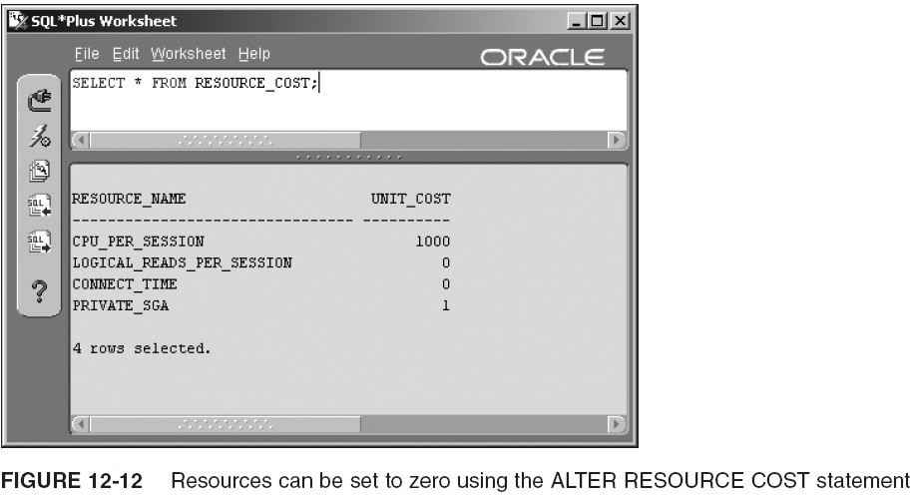
CONTROLLING RESOURCE USAGE (CONTINUED)
ORACLE 10G DATABASE ADMINISTRATOR: IMPLEMENTATION AND ADMINISTRATION

Slide 43
DROPPING A PROFILE
The syntax of DROP PROFILE is similar to the syntax for dropping a user in that it includes a CASCADE parameter:
  DROP PROFILE <profile> CASCADE;
You must add CASCADE if any users have been assigned the profile being dropped
  Oracle automatically resets these users to the DEFAULT profile
For example, if three users have been assigned to the ACCT_MGR profile, drop the profile like this:
  DROP PROFILE ACCT_MGR CASCADE;
ORACLE 10G DATABASE ADMINISTRATOR: IMPLEMENTATION AND ADMINISTRATION

Slide 44
OBTAINING USER, PROFILE, PASSWORD, AND RESOURCE DATA
You have already seen the following data dictionary views while going through this lecture:
  DBA_USERS
    View user profile, password expiration date, and account status
  DBA_TS_QUOTAS
    View the storage quotas of each user
  RESOURCE_COST
    View the weight setting for each resource used in calculating COMPOSITE_COST
  DBA_PROFILES
    View the settings for each profile
ORACLE 10G DATABASE ADMINISTRATOR: IMPLEMENTATION AND ADMINISTRATION

Slide 45
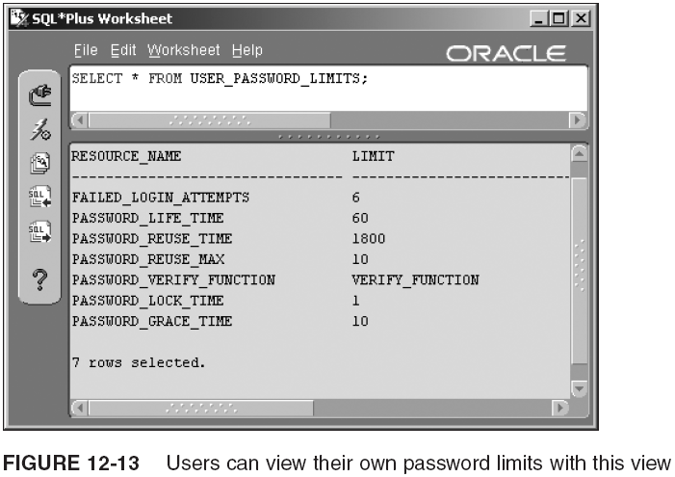
OBTAINING USER, PROFILE, PASSWORD, AND RESOURCE DATA (CONTINUED)
ORACLE 10G DATABASE ADMINISTRATOR: IMPLEMENTATION AND ADMINISTRATION

Slide 46
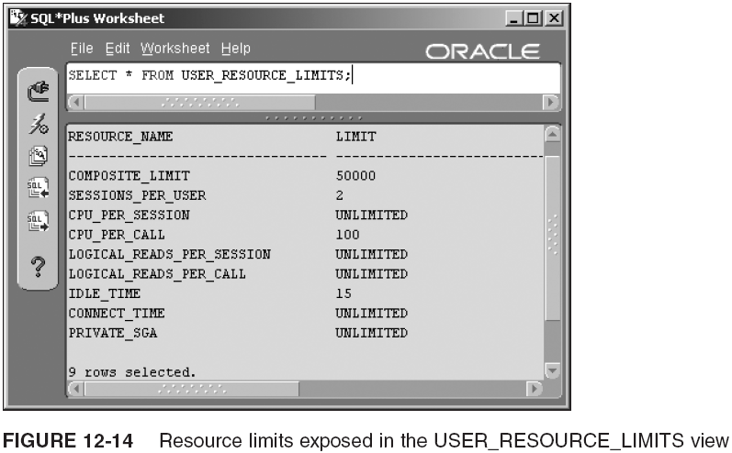
OBTAINING USER, PROFILE, PASSWORD, AND RESOURCE DATA (CONTINUED)
ORACLE 10G DATABASE ADMINISTRATOR: IMPLEMENTATION AND ADMINISTRATION

Slide 47
SUMMARY
Database account management is only one facet of data security
A new user account is created with the CREATE USER command
  The IDENTIFIED BY clause contains the password for the account
System privileges are used to grant access to the database and to create, alter, and drop database objects
The CREATE SESSION system privilege is required before a user can access his account on the Oracle server
The system privileges available in Oracle 11g can be viewed through the SYSTEM_PRIVILEGE_MAP
Oracle 11g: SQL

Slide 48
SUMMARY (CONTINUED)
Object privileges allow users to manipulate data in database objects
Privileges are given through the GRANT command
The ALTER USER command, combined with the PASSWORD EXPIRE clause, can be used to force a user to change her password upon the next attempted login to the database
The ALTER USER command, combined with the IDENTIFIED BY clause, can be used to change a user’s password
  Privileges can be assigned to roles to make the administration of privileges easier
Oracle 11g: SQL

Slide 49
SUMMARY (CONTINUED)
Roles are collections of privileges
The ALTER USER command, combined with the DEFAULT ROLE keywords, can be used to assign a default role(s) to a user
Privileges can be revoked from users and roles using the REVOKE command
Roles can be revoked from users using the REVOKE command
A role can be deleted using the DROP ROLE command
A user account can be deleted using the DROP USER command
Oracle 11g: SQL

