Slide 1

KIT712 Data Management Technology
Lecture 1 By
Dr. Saurabh Kumar Garg

Slide 2
Teaching Team
Unit Coordinator
Dr. Saurabh Garg
Lecturer in Hobart
Office: Cent 462 (ICT wing)
Email: Saurabh.Garg@utas.edu.au
Tutors
Ankur Lohachab
Xinyi Wang
Elisabeth Widjojo
Ranes Kumar Naha

Slide 3
Introduction to KIT712
Why should I learn this unit?
How will this unit operate?
What are expectations?

Slide 4
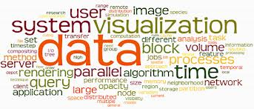
Motivation
What is Data toYou?

Slide 5
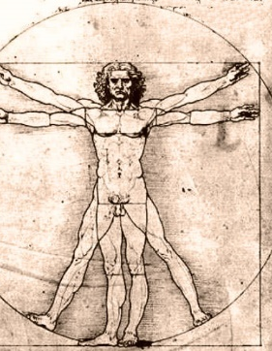



Our Data-driven World
Science
Data bases from astronomy, genomics, environmental data, transportation data, …
Humanities and Social Sciences
Scanned books, historical documents, social interactions data, new technology like GPS …
Business & Commerce
Corporate sales, stock market transactions, census, airline traffic, …
Entertainment
Internet images, Hollywood movies, MP3 files, …
Medicine
MRI & CT scans, patient records, …

Slide 6



How to Store Data?

Slide 7

Do we want to store like this?
Need Organization????
Why?
Notes:
Can anyone tell what is the problem in such storage?

Slide 8
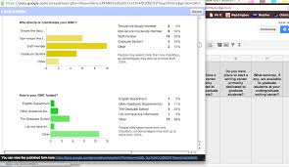

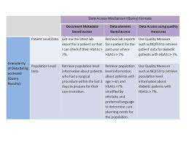
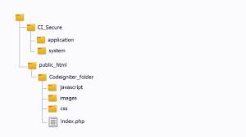
Need Organization Data models

Slide 9

Why learn this unit?
Several Job Opportunity (Salary > 100,000)
Database Engineer
Database Designer
Database Administrator
Database Developer
https://www.seek.com.au/database-jobs

Slide 10
Unit Outline
Very Important
Soft copy available on
MyLO under Information
Read It
Notes:
We’ll start by having a look at the Unit Outline, especially the important bits.
The unit outline IS important because it acts as the contract between you and the University.
Did anyone not get a unit outline on the way in?
When you log onto MyLO, you can click on the Information Button and it will take you to the electronic version of the Unit Outline.
I encourage you to read it. We’ll go through the major aspects of it in the lecture.

Slide 11
Teaching Pattern
This unit has:
Lectures – 2 hours per week (Tuesday 9am-11am)
Tutorials – 2 hours per week
Self-Study 3 hours per week
Self-Study Material
Work on assignments
Prepare for tutorials
Study/Revision/Self check quizzes

Slide 12
Prerequisites (Assumptions)
Basic SQL
Basic Programming
Hard Working
KT502/KIT506

Slide 13
Textbooks (Reference Only)
Database Systems: Design, Implementation and Management, by Cornell and Morris, Cengage Learning publisher.
Oracle 11g: SQL, by Joan Casteel, published 2010 by Course Technology, Cengage Learning
Oracle 11g: PL/SQL, by Joan Casteel, published 2010 by Course Technology, Cengage Learning

Slide 14
Learning Outcomes
LO1. Evaluate, critically analyse alternative techniques and data models for designing databases;
LO2. Adapt and apply techniques and processes for designing, implementing and administering an enterprise level relational database;
LO3. Design sophisticated SQL queries to efficiently retrieve information from relational databases;
LO4. Understand and appreciate data storage and retrieval issues with current trends and advances in database technologies.

Slide 15
Topics
Introduction to Systems and Databases;
Entity Relationship Model review and extension;
Conceptual, logical, physical Modelling;
SQL Review and advanced SQL;
SQL Query Optimisation;
Triggers, Procedures and Functions;
Database Administration.
Overview of NoSql Databases.

Slide 16
Tentative Tutorial Schedules
Week 2: ER Modelling and Relational Model
Week 3: Relational Algebra
Week 4: SQL Revision using Oracle
Week 5: SQL Revision +LAB TEST (+SQL Assignment due)
Week 6: SQL Query Optimisation I
Week 7: SQL Query Optimisation II
Week 8: PL/SQL 0 +LAB Test
Week 9: PL/SQL I
Week 10: PL/SQL II
WeeK 11: Database Administration 0+ LAB TEST
Week 12: Database Administration 1
Week 13: LAB TEST

Slide 17
Online Modules [Extra Readings]
Data Modelling
SQL Review (Oracle)
Advanced SQL (PL/SQL, Triggers, Cursors)
Query Optimizations
Database Administration

Slide 18
Assessment - Overview
In-Semester Assessment 60%
Final Exam 40%
To pass this unit need at least:
Pass all the learning outcomes
50% of the overall mark
45% in the in-semester assessments
45% in the exam
Notes:
Your final result in this unit is determined according to Academic Senate Rule 6 Admission, Assessment and Student
Progress and the College of Sciences and Engineering Procedure for Processing of Results.
Your overall mark in this unit will be determined by combining your results from each assessment task. These marks
are combined to reflect the percentage weighting of each task. You need to achieve an overall score of at least 50%
to successfully complete this unit. To be eligible to pass you will need to attain (gain at least 40% in) each Intended
Learning Outcome and gain a minimum of 45% in each of the examination and aggregated internal assessment tasks.
It is expected that you will seek help (from your lecturer in the first instance), well before the due date, if you are
unclear about the requirements for an assessment task

Slide 19
Assessment - In-Semester
60% of overall mark
MUST gain at least 45% of the total mark in this part to pass the unit
Assignments - tasks published on MyLO (10%)
Database Design
In- Semester Tests (conducted in the tutorial)
Database Implementation & SQL basics (15%)
Query Design and Optimization (15%)
Database Constraints Implementation (PL/SQL) (15%)
Database Administration and Modern Databases (5%)

Slide 20
Assessment - Assignments
For the assignment 1, you have to do it individually.
You may discuss the assignment specification with other students, and you may ask for help with learning the material covered in the unit, but you must not submit work which has been done by another person
If you give your work to another student and that student submits that work, then s/he and you are both guilty of Academic Misconduct
Notes:
All the assignments in this unit are individual assignments.
That doesn’t mean that you can’t talk with each other about the assignments. In fact, it’s a good idea to talk about the assignments to make sure that you’re understanding it properly.
But don’t hand in any work that was done by another student. You get in so much trouble, that it’s just not worth the trouble.
And it’s been my experience that if you’re so stupid that you need to cheat, you probably won’t do it very well. So don’t cheat. Ask me for help. Don’t cheat, and don’t just fail.
If you cheat off another student, you both go down.

Slide 21
Plagiarism…..
http://www.utas.edu.au/student-learning/for-students
Using words, ideas, computer code, or any work by someone else without giving proper credit is academic dishonesty.
Academic dishonesty is often referred to as plagiarism.
While studying at University you are expected to submit work that is your own.
The intentional copying of someone else’s work as one’s own is a serious offence punishable by penalties that may range from a fine or deduction/cancellation of marks and, in the most serious of cases, to exclusion from a unit, a course or the University.

Slide 22
Assessment – Assignments - Late Penalties
From the CIS Late Assessment Policy:
<paste>
Up to 24 hours after the due date. The assignment will be marked in the usual way and the mark recorded will be 80% of the actual mark obtained.
More than 24 hours and up to 7 days after the due date. The assignment will be marked in the usual way and the mark recorded will be 50% of the actual mark obtained
Later than 7 day after the due date – the assignment will not be marked. </paste>
Notes:
When assignments are late, the penalties are serious, and they’re laid out clearly on the school’s website.
If you’re late up to 24 hours, then you only get 80% of the recorded mark.
If you’re over 24 hours late and up to seven days later, then you get 50% of the recorded mark. (That means that you would have needed to get 100% on the assignment to pass).
After 7 days after the due date, we won’t even mark your assignment.
If you’re thinking about being late, you need to ask yourself if you can add more than 20% to your assignment by being late, because if you can’t, then just hand it in partially finished.
You’ll need to do a bit of a cost benefit analysis as to whether it’s worth handing something in late.

Slide 23
Assessment – Assignments - Extensions
If you want / need an extension for an assignment, you must complete the Extension Form available on the CIS Resources webpage http://www.utas.edu.au/engineering-ict/current-student-resources, and provide suitable supporting documentation
If possible, apply for an extension before the assignment is due
Notes:
If you want an extension, you need to fill out an extension form, which you can get from the CIS website.
You’ll need a medical certificate if you’re saying you’re sick. We’ll be much kinder to you if you apply before the due date.
We’ll give you an extension for the length of your medical certificate.

Slide 24
Assessment – Final Exam
40% of overall mark
At the end of semester during University Examination Period
Will cover whole semester's work
Minimum 45% marks to pass the unit
Notes:
The final exam is big and you’ll do it during the exam period.
You need to get 45% to pass the unit.
It will cover everything, and if you want examples, I think they’re up on MyLO already.
If you panic at exams, have a look now so you know what to expect.

Slide 25
Resources - Fellow Students
Discuss topics
Work together on tutorial exercises etc
Do not believe everything that other students tell you
Remember that assignment work must be the individual work of the student who submits it
Do not email your assignment work to other students
Do not edit other students’ assignment work
Notes:
Other resources – each other.
Talk about stuff with each other, working on tutes together is a great way to learn.
And don’t believe everything that other students tell you. You need to have some common sense!
Another reminder – the assignments need to be individual work, so do them individually. Don’t email your assignment to each other and don’t edit each others’ assignments.

Slide 26
Tips for Success - Overview
Attend all lectures and tutorials
Actively participate in the unit- Ask Questions
PRACTICE! PRACTICE! PRACTICE!
Do the work in the unit as it falls due
If you get into difficulties, seek help as soon as possible
Notes:
Now for some tips for success.
Participate. Participate in the tutes, in the lectures, in the assignments. If you participate you’ll learn everything, you’ll make friends and you’ll do well.
Keep on top of your work requirements – for all your subjects, not just this one.
And if you get into trouble, send me an email, come and see me. We’ll work something out.

Slide 27
Tips for Success - Tutorials
Try tutorial problems and study lecture slides before coming to tutorials
1
Follow up after (complete activities if necessary)
2
Seek Help Sooner!!
3
Notes:
For tutorials, it’s best to do your readings before the tutorials.
Please participate in tutorials, and if you don’t finish your tasks, finish them after the tutorials. If you do the work, it’ll make your assignments very easy.

Slide 28
Why you are doing this unit? Let us be honest!!
It is compulsory unit. I am here only for Permanent Residency (PR)
Consequence: Always distressed and may fail in the end
It is compulsory unit. I am forced to do this unit.
Consequence: Hard struggle and may pass
I will learn industry based technology and improve my skills
Consequence: Will enjoy the unit and will be eager for inputs
Notes:
Whatever is the reason!!..In the end you have to attend this unit. In the end you have to go to work…Database is basic technology in every company. So better to do it happily..

Slide 29
What do we expect from you?
Regular attendance of lectures:
Pay full attention, be enthusiastic, fully committed to learn new things, ask questions during the class, participate in discussions
Study Lecture Slides before coming to tutorials
Start on assignments as soon as they are announced
If you have some problem with the lecturer/lectures/unit/??, please discuss with me early.
Don’t take out your frustrations on me during eValuate☺

Slide 30
Engagement Check?
Attendance in tutorials weeks 2-4
Assignment submission in Week 3
If you do not demonstrate evidence of having engaged actively with this unit by completing these activities by Week 5 of the semester, your enrolment will be cancelled or you will be withdrawn from the unit.

Slide 31
Database Systems: Introduction
What is A database?
Why we need a database?

Slide 32
Data vs. Information
Data
Information
Raw facts
Raw data - Not yet been processed to reveal the meaning
Building blocks of information
Data management
Generation, storage, and retrieval of data
Produced by processing data
Reveals the meaning of data
Enables knowledge creation
Should be accurate, relevant, and timely to enable good decision making

Slide 33
What is a Database?
Shared, integrated computer structure that stores a collection of:
End-user data - Raw facts of interest to end user
Metadata: Data about data, which end-user data are integrated and managed
Describe data characteristics and relationships

Slide 34
Database management system (DBMS)
DBMs is a software that enables easy creation, access, and modification of databases
Enable efficient and effective database management
manages interaction between end users and database

Slide 35
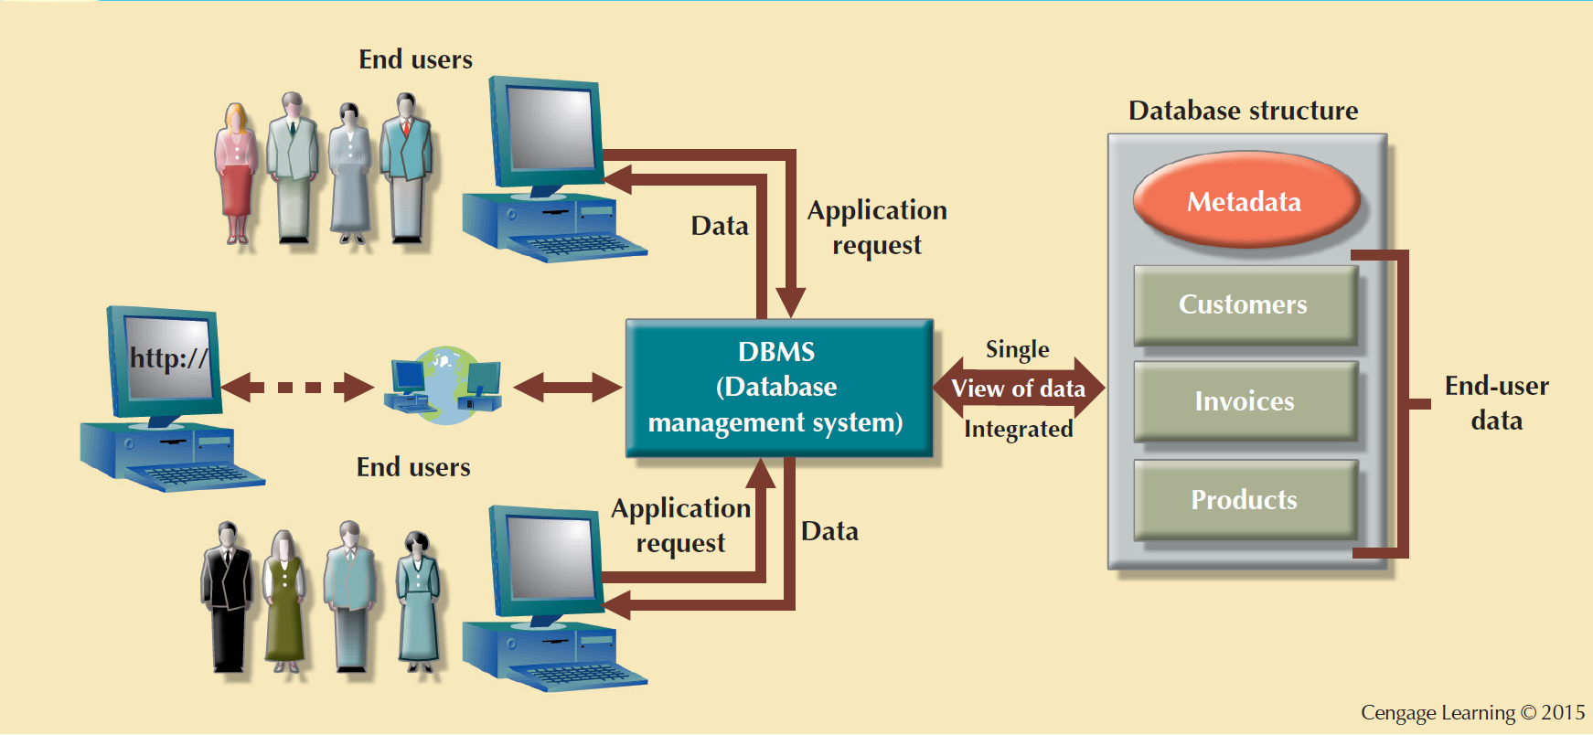
The DBMS manages the Interaction between the End User and the Database

Slide 36
Role of the DBMS
Intermediary between the user and the database
Enables data to be shared
Presents the end user with an integrated view of the data
Receives and translates application requests into operations required to fulfill the requests
Hides database’s internal complexity from the application programs and users

Slide 37
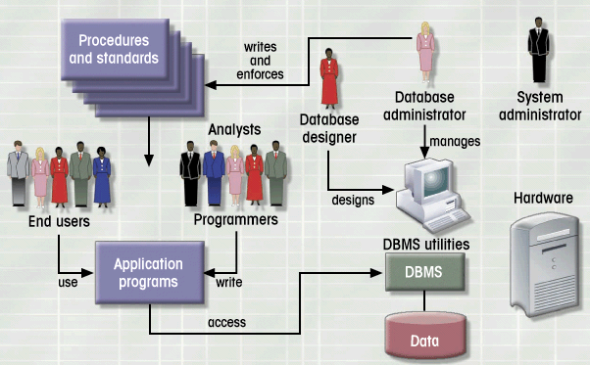
Database System Environment
Database Systems: Design, Implementation, & Management: Rob & Coronel

Slide 38
Advantages of the DBMS
Better data integration and less data inconsistency
Data inconsistency: Different versions of the same data appear in different places
Increased end-user productivity
Improved:
Data sharing
Data security
Data access
Decision making
Data quality: Promoting accuracy, validity, and timeliness of data

Slide 39
Database Life Cycle
Step 1: Planning & Analysis
Assess
Goal of the organization
Database environment
existing hardware, software, raw data, data processing procedures
Identify
Database needs
what database can do to further the goal of the organization
User needs and characteristics
who the users are, what they want to do, how they envision doing it
Database system requirements
what the database system should do to satisfy the database and user needs

Slide 40
Database Life Cycle
Step 2: Design
From conceptual design to a detailed system specification
Step 3: Implementation
Create the database
Step 4: Maintenance
Troubleshoot, update, streamline the database

Slide 41
Data Modelling

Slide 42
Need Organization Data models

Slide 43
Data Model: What’s a model?
A data model is a representation of reality in relatively simple (graphical) representations
It’s used to define the storage and manipulation of a data base.
Facilitate interaction among the designer, the applications programmer, and the end user
Data Models have three components:
Structure: the structure of the data stored within (such as entity, attributes and relationship in ER Diagrams)
Constraints : legal structure allowed to create
Operations: Facilities for manipulation of the data.

Slide 44
Evolution of Data Models
1960s
1970s
1980s
1990s
2000+
File-based
Hierarchical
Object-oriented
Network
Relational
Web-based
Entity-Relationship

Slide 45
File structures
field
A file: “STUDENT”
New Records are appended in serial
Search is sequential
ID Last First Grade
3 Smith Jane A
1 Wood Bob C
2 Kent Chuck B
4 Boone Dan B
record
Adapted from slides on Databases and DBMS by Todd S. Bacastow

Slide 46
File Structure
Is there any faster way to search?
Index in another file
Last Pointer
ID Last First Grade
Boone *
Kent *
Smith *
Wood *
1 Wood Bob C
2 Kent Chuck B
3 Smith Jane A
4 Boone Dan B
Adapted from slides on Databases and DBMS by Todd S. Bacastow

Slide 47
Problems with File structure?
Inconsistent data
Inflexibility
Limited data sharing
Poor enforcement of standards
Excessive program maintenance

Slide 48
File System: Inconsistent Data value example
CUSTOMER file
AGENT file
SALES file
- inconsistent data values
Tim Johnson
T. C. Johnson
T. Cindy Johnson

Slide 49
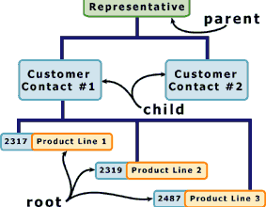
Hierarchical model
Developed in the 1960s to manage large amounts of data for complex manufacturing projects
Basic logical structure is represented by an upside-down “tree”
Adapted from slides on Databases and DBMS by Todd S. Bacastow

Slide 50
Hierarchical data model
Class
Parent-child relationship:
one-to-one
one-to-many
Student
Instructor
Grade
ID
Department
Adapted from slides on Databases and DBMS by Todd S. Bacastow

Slide 51
Hierarchical data model
Advantages
easy to search
add new branches easily
Disadvantages
Must establish the types of search prior to development of the hierarchical structure
Adapted from slides on Databases and DBMS by Todd S. Bacastow

Slide 52
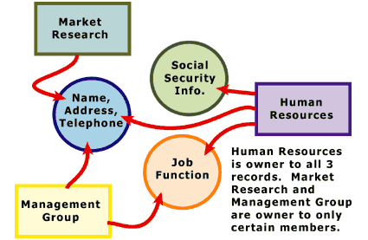
Network model
Created to
Represent complex data relationships more effectively
Improve database performance
Impose a database standard
In the network model, the entities are organized in a graph, in which some entities can be accessed through several paths
Adapted from slides on Databases and DBMS by Todd S. Bacastow

Slide 53
Network data model
Class
Relationships:
one-to-one
one-to-many
many-to-one
many-to-many
Student
Instructor
Grade
ID
Department
Adapted from slides on Databases and DBMS by Todd S. Bacastow

Slide 54
Network data model
Advantages
flexible, fast, efficient
Disadvantages
Lack of ad hoc query capability
Restructuring can be difficult because of changing all the pointers
Lot of programming effort even for simple queries
Adapted from slides on Databases and DBMS by Todd S. Bacastow

Slide 55
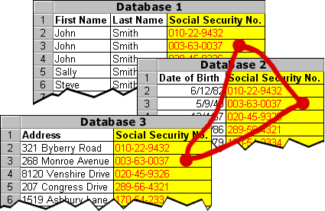
Relational database model
Stores both
Data about real world objects (entities) in tables
Relationships between the tables
Adapted from slides on Databases and DBMS by Todd S. Bacastow

Slide 56
Relational Model
E. F. Codd’s Relational Model proposal
Separated the notion of physical representation (machine-view) from logical representation (human-view)
Considered ingenious but computationally impractical in 1970
Relational Database Model
Dominant database model of today
Eliminated pointers and used tables to represent data
Tables
flexible logical structure for data representation
a series of row/column intersections
related by sharing common entity characteristic(s)

Slide 57
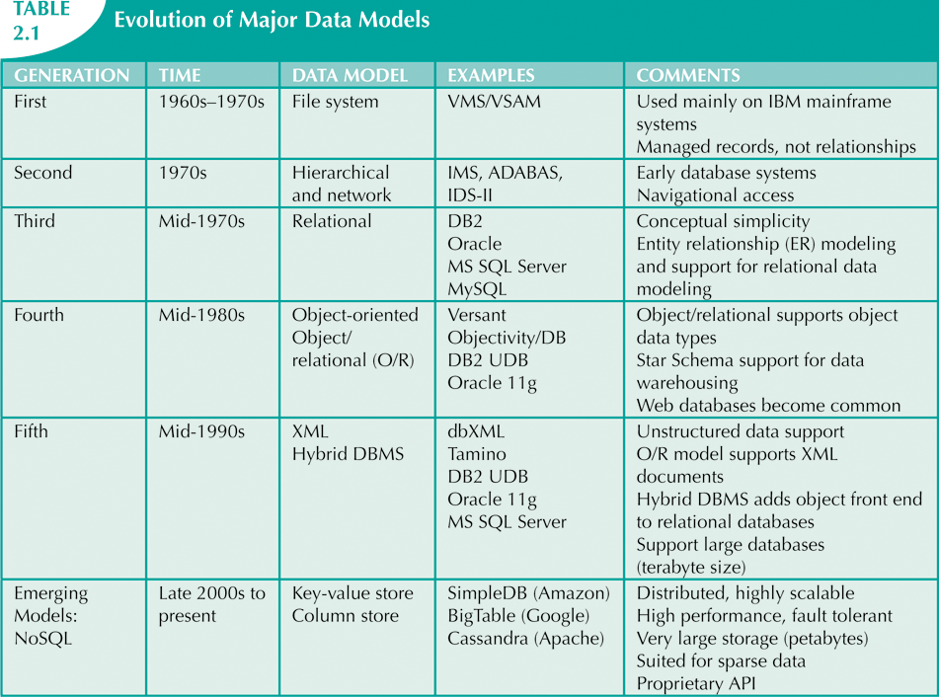
The Evolution of Data Models
Source: Database Systems , authors: Peter Rob and Carlos Coronel

Slide 58
Types of Databases

Slide 59
Types of Databases: User Count
Single-user database: Supports one user at a time
Desktop database: Runs on PC
Multiuser database: Supports multiple users at the same time
Workgroup databases: Supports a small number of users or a specific department
Enterprise database: Supports many users across many departments

Slide 60
Types of Databases: Location
Centralized database: Data is located at a single site
Distributed database: Data is distributed across different sites
Cloud database: Created and maintained using cloud data services that provide defined performance measures for the database

Slide 61
Types of Databases: Data Subject
General-purpose databases: Contains a wide variety of data used in multiple disciplines
Discipline-specific databases: Contains data focused on specific subject areas

Slide 62
Types of Databases: Support
Operational database: Designed to support a company’s day-to-day operations
Analytical database: Stores historical data and business metrics used exclusively for tactical or strategic decision making
Data warehouse: Stores data in a format optimized for decision support

Slide 63
Types of Databases: Types of Data
Unstructured data: It exists in their original state
Structured data: It results from formatting
Structure is applied based on type of processing to be performed
Semistructured data: Processed to some extent
Extensible Markup Language (XML)
Represents data elements in textual format

Slide 64
Database Design

Slide 65
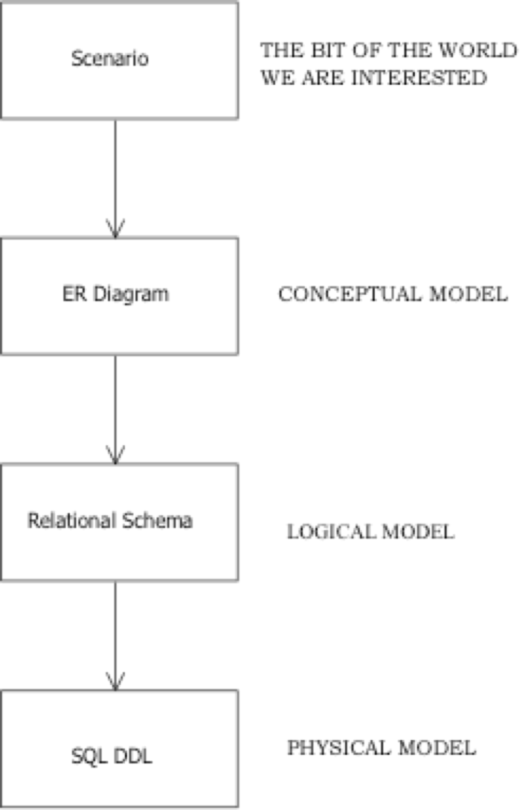
Creating a Database
Business Rules
Describes what system contains
describes HOW the system will be implemented
describes HOW the system will be implemented using a specific DBMS
Notes:
Here are the steps that we use to create a database.
We start with the real world issue and create a scenario.
Then we come up with a conceptual model – we can use an ER diagram for that.
Then we come up with the logical model – and we can use the relational schema for that, and then
We create the physical model, the We can use SQL Data Definition language for that.
Obviously we have some flexibility because an ER diagram is completely capable of creating the logical model in stead of using a relational schema.
And if you wanted you could use XML to create the physical model instead of SQL.

Slide 66
Designing Business Rules

Slide 67
Business Rules
What? Brief, precise, and unambiguous descriptions of operations in an organization
When? Are collected in the initial phase of database life cycle.
Key points for writing business rules:
Discover what company’s operational components are, how they function, how information flows between them and how they interact
Formal and informal information sources
Describe characteristics of data as viewed by the company
Source: Database Systems , authors: Peter Rob and Carlos Coronel

Slide 68
Examples
Customer can make many payments in the account
Each payment should be in multiple of 100
Working hours of the organization are between 8am-5pm

Slide 69
Why we need Business Rules?
Standardize company’s view of data
Communications tool between users and designers
Allow designer to understand the nature, role, and scope of data
Allow designer to understand business processes
Allow designer to develop appropriate relationship participation rules and constraints
Source: Database Systems , authors: Peter Rob and Carlos Coronel

Slide 70
Conceptual Database Modelling

Slide 71
Conceptual Model (Entity-Relationship (E-R) Models)
Graphical representation of entities and their relationships in a database structure
Widely accepted and adapted graphical tool for data modeling
Introduced by Chen in 1976
Many extensions/variations exist
Basis for most other modeling approaches

Slide 72
ER Model - Basic Building Blocks
Entity - anything about which data are to be collected and stored
Attribute - a characteristic of an entity
Relationship - describes an association among entities
Participation - a restriction placed on the data

Slide 73
CAUTION: Synonyms that are used on internet you should know…
Entity = class = relation = table
Attribute = column
Instance = row
columns
Understand Terminology used in this unit . Do
not get confused with multiple sources
table
rows

Slide 74
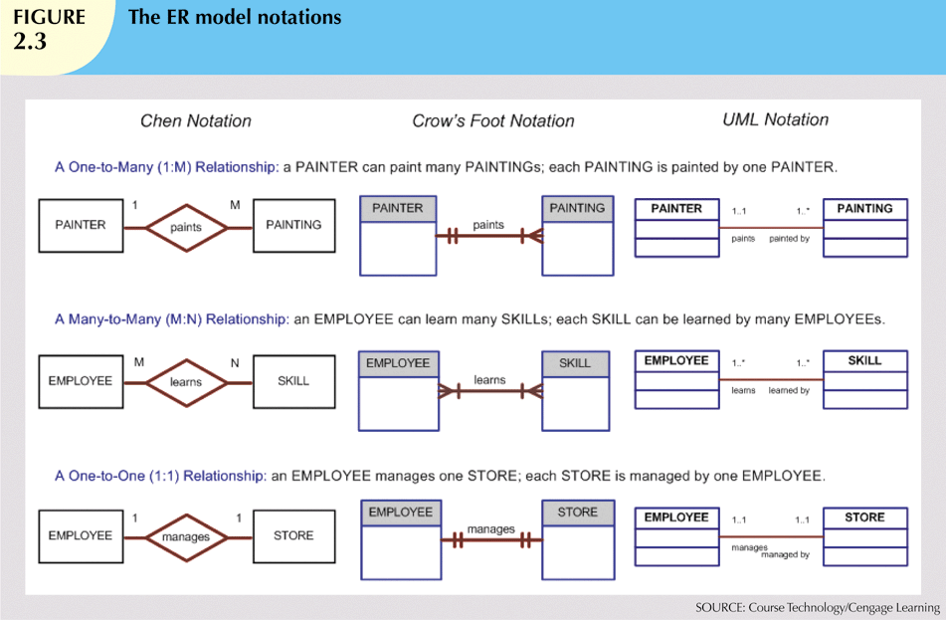
Many Conventions
We will useONLY CONVENTIONS as given in tutorial handout
Source: Database Systems , authors: Peter Rob and Carlos Coronel

Slide 75
Translating Business Rules into ERD Components
Nouns translate into entities
Verbs translate into relationships among entities
Relationships are bidirectional
Questions to identify the relationship type
How many instances of B are related to one instance of A?
How many instances of A are related to one instance of B?
Examples
How many classes can one student enroll in? Many
How many students can be enrolled in one class? Many
Relationship between Student and Class is: Many to Many, *-*

Slide 76
Naming Conventions
Entity names - Required to:
Be descriptive of the objects in the business environment
Use terminology that is familiar to the users
Attribute name - Required to be descriptive of the data represented by the attribute
Proper naming:
Facilitates communication between parties
Promotes self-documentation

Slide 77
CAR RENTAL ENTERPRISE

Slide 78
ER Conventions for KIT712
Diagramming Conventions
Naming Conventions
Notes:
Now, we’re going to go over the conventions that we’ll be using in this unit.

Slide 79
ER Modeling in KIT712
In this unit, students will be asked to draw simple (conceptual) ER diagrams to model given scenarios
Students should use the simple version of the Crows Feet conventions explained in the following lecture slides and tutorials
Students should not use the conventions from the Rob and Coronel book (or from any other source)

Slide 80
Diagramming Conventions
An Entity is represented by a rectangle
A Relationship is represented by a line joining two entities
Attributes are written in a list next to the entity or relationship to which they belong
Identifiers are placed at the top of the list of attributes and are underlined
Notes:
When we’re drawing them.
And entity is a rectangle.
A relationship is a line between two entities.
Attributes are written in a list next to the entity on relationship that they refer to.
Identifiers are at the top of thie list of attributes and they’re underlined.

Slide 81
Diagramming Conventions - Entity
An Entity is represented by a rectangle
The name of an entity should be a noun or a noun phrase
The name of an entity is written in UPPERCASE
The name of an entity is written inside the rectangle representing the entity
Notes:
Now, back to entity.
It is represented as a rectangle.
Its name should be a noun. – a naming word.
It should be written in upper case.
You write the name of the entity inside the rectangle of that entity.

Slide 82
Diagramming Conventions - Attributes
Attributes are written in a list next to the entity or the relationship to which they belong
The name of an attribute is usually a noun or a noun phrase – sometimes the name is an adjective
An attribute is written in Lowercase With Initial Capitals
Identifiers are placed at the top of the list of attributes and are Underlined
Notes:
For attributes – you write them in a list next to the entity or relationship.
An attribute’s is usually named with a noun – a nameing word, but sometimes its an adjective.
You captilise the first letter, but write the rest in lower case.
The identifiers are at the top of the list, and they are underlined.

Slide 83
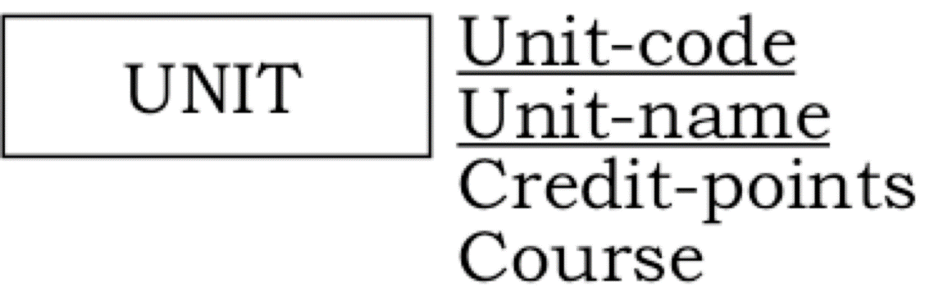
Example of an Entity
Modelling units offered at the University of Woolloomooloo
Note: This initial model is not necessarily perfect
Notes:
So, here is an example of an entity.
What is the Entity’s name?
What is the identifier? 2x
What are the attributes?

Slide 84
Diagramming Conventions - Relationship
A Relationship is represented by a line joining two entities
All relationships are binary (or recursive) - no n-nary (eg ternary) relationships
The name of a relationship should be a verb or a verb phrase
The name of a relationship is written in lowercase – preferably also in italics
The name of a relationship is near the line representing the relationship
Notes:
Now, a relationship is represented by a line joining two entities. Each relationship goes between two different entities, or just to itself. You can’t have it branching off anywhere.
The name of the relationship should be a verb.
You write it in lowercase and italics if you can.
You write it near the line that represents the relationship.

Slide 85
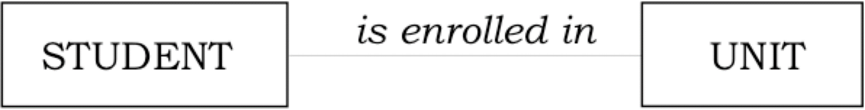
Example of a Relationship
Modelling the association between students and the units that they are enrolled in
Note: Because we are thinking about the relationship at this stage, I have not listed the attributes for the entities
Notes:
So, who can tell me what the relationship is?
And what are the entities?

Slide 86
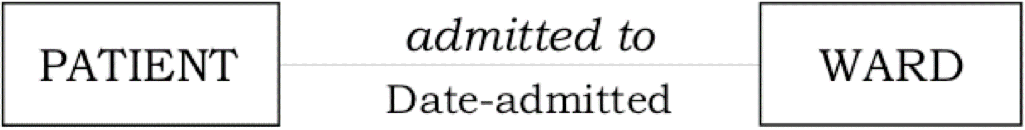
Another Example of a Relationship
Modelling the association between a hospital ward and the patients admitted to the ward
Note: The attribute Date-admitted belongs to the relationship
Notes:
So tell me what is Date-admitted? (it’s an attribute of the relationship: admitted to)

Slide 87
Diagramming Conventions – Relationship Cardinality
The cardinality of a relationship indicates the number of possible occurrences of an entity participating in a given relationship
We will add crows feet to relationship lines to indicate cardinality
Notes:
Now, relationship Cardinality indicates the number of possible occurrences of an entity in a relationship.
This is what the crows feet will show.

Slide 88
Diagramming Conventions – Crows Feet for Cardinality
Crows feet indicate that many (zero or more) instances of the entity adjacent to the crows feet may be associated with each instance of the entity at the other end of the relationship line
An absence of crows feet indicates that zero or one instances of the entity adjacent to the absence of crows feet may be associated with each instance of the entity at the other end of the relationship line
Notes:
If there are crows feet at the end of a relationship clutching onto an entity means that there are 0 or more entities in the crows foot for each entity at the other end.
If there is no crows foot, then it means there is 0 or 1 instance of the entity for each of the entities at the other end.

Slide 89
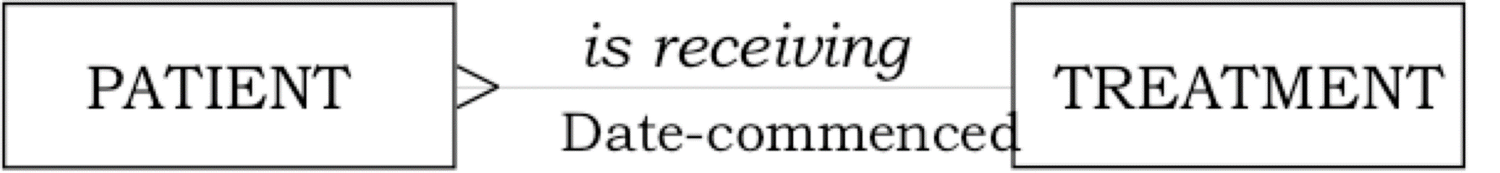
Example of Relationship Cardinality – one-to-many
Each patient is receiving, at most, one type of treatment
Each type of treatment may be received by many patients
Note: This initial model is not necessarily perfect
Notes:
The best way to do this is to imagine you’re standing on one of the entity boxes and look at the other end.
So, stand on the patient entity and look at treatment, I can see that each patient is receiving one treatment.

Slide 90
Example of Relationship Cardinality – many-to-many
Each patient is receiving many types of treatments
Each type of treatment is received by many patients
Notes:
So, each patient, can receive many treatments.
And each treatemtn can be received by many patients.

Slide 91
Diagramming Conventions – Relationship Participation
Participation indicates whether all, or only some, entity occurrences participate in a relationship
We use the | symbol on relationship lines to indicate mandatory participation
We use the O symbol on relationship lines to indicate optional participation
Notes:
Relationship participation refers to whether someone has to participate or not.
The Line symbol indicates mandatory and the circle indicates optional .

Slide 92
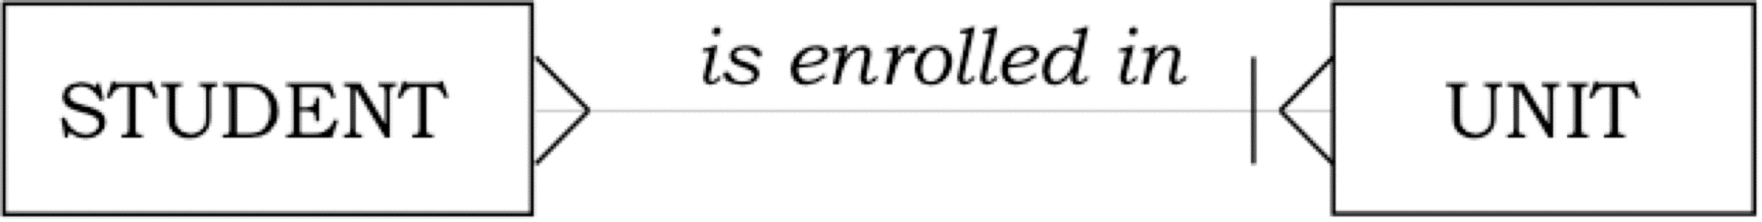
Another Example of Relationship Participation
If we wish to indicate that it is mandatory for a student to be enrolled in at least one unit, we add a stroke ( | ) at the end of the relationship line near the entity UNIT
Notes:
Stand on pateint, and you can see that a patient may receive many treatments.
Stand on treatment and you can see that the 0 to many treatments can be received by a patient.

Slide 93
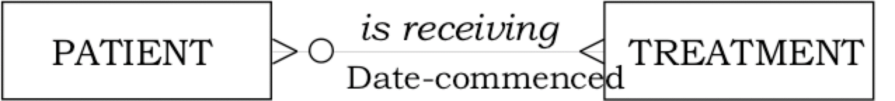
Example of Relationship Participation
If we wish to indicate that it is not necessary for a standardised treatment to be received by any patients, we add an O (for Optional) at the end of the line near the entity PATIENT
Notes:
Stand on patient and look at treatement. You can see that each pateint can receive 0 to many treatments. Stand on treatment and you can see that treatments can be received by 0 to many patients..

Slide 94

Updated Example of Relationship Participation
If we also wish to indicate that it is not necessary for a patient to be receiving any standardised treatments, we add an O (for Optional) at the end of the line near the entity PATIENT
Notes:
Stand on the Student box and look at the unit end. The stroke means it’s mandatory and the crows foot means many. So A student must enrol in at least one unit and up to many units.
Stand on the unit and look back at students and you see the crows foot, which means there are many students enrolled in a unit.

Slide 95
When to Indicate Participation
We will add O or | to our relationship lines only if the scenario specifically indicates that participation is optional or mandatory
Some people choose to mark every end of every relationship line with either | or O
Some people choose to use only | (mandatory) symbols
Notes:
You’ll have noticed that we haven’t always inlcuded the 0 or the line. We’ll only include them if they’ve been specifically indicated by our users.
Obviously, there are other ways to do it, marking all of them as optional or mandatory, or never using the optional ones, we’re going to use them when they say to.

Slide 96
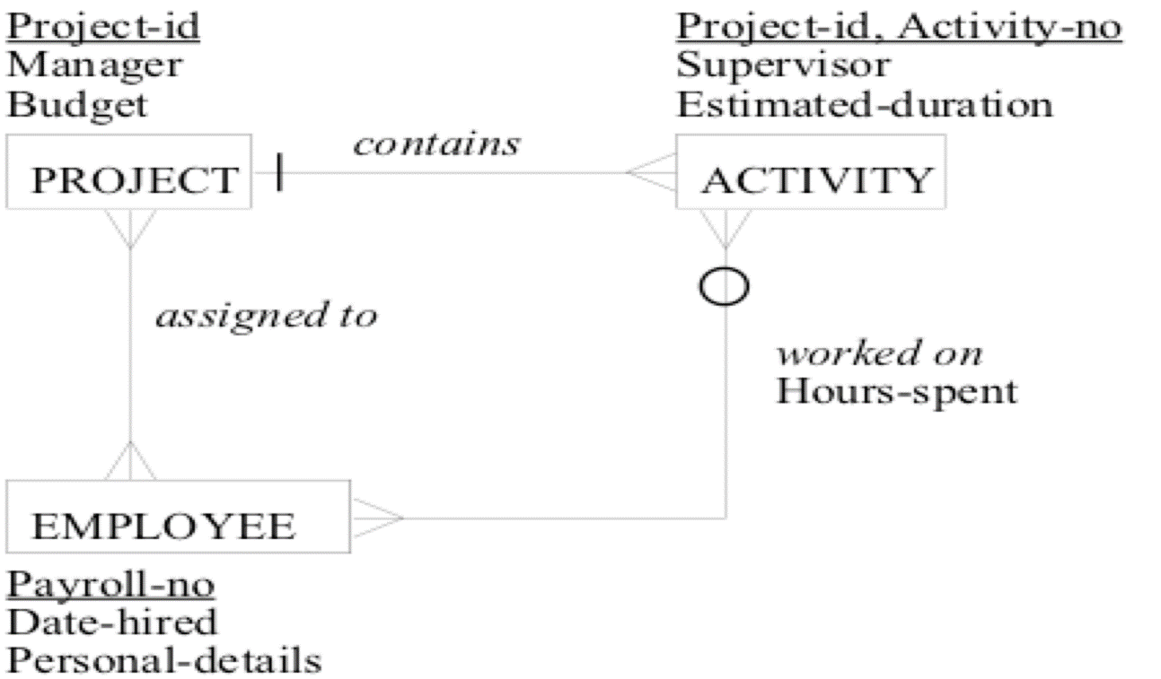
ER Diagram – Example 1
Finnegan’s Falderals Factory - Projects
Notes:
Here’s an ER diagram. Project contains many activities. An activity has many employees working on it. An employee may or may not be working on an activity. An employ will be assigned to many projects.

Slide 97
Notes on ER Diagram – Example 1
ACTIVITY is a subordinate entity (also called a weak entity)
Each instance of ACTIVITY must be associated with an instance of PROJECT
Note the mandatory symbol (|) near PROJECT
The identifier of ACTIVITY is derived from the identifier of PROJECT
The identifier of ACTIVITY is {Project-id, Activity-no}
The identifier of PROJECT is {Project-id}
Notes:
We call Activity a subordinate entity because it must be associated with a project. Without a project, the activity will not exist.
You can tell that by the mandatory symbol, but more importantly, you can tell from its primary key.
Project-ID, Activity-No, both together are required to uniquely identify the activity.

Slide 98
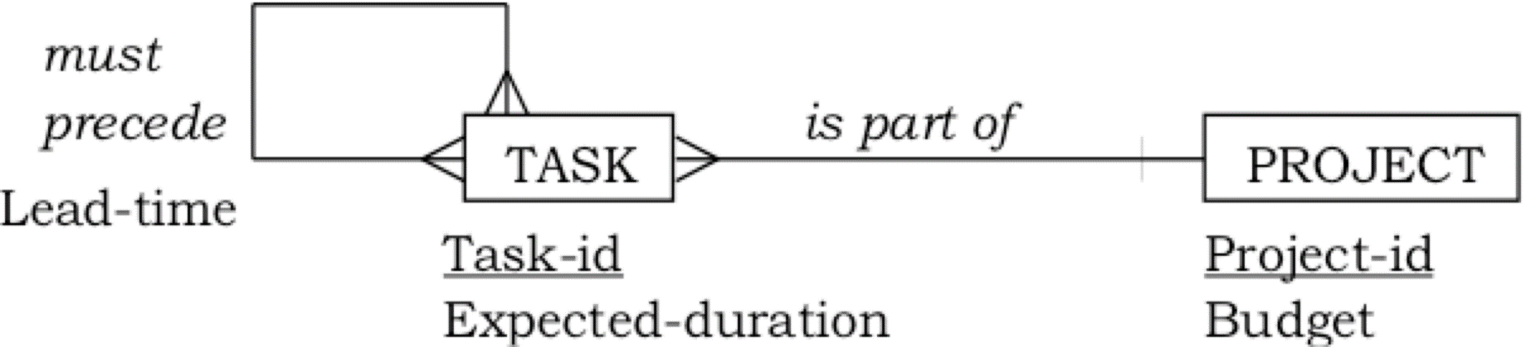
ER Diagram – Example 2
Fred Friendly’s Factory - Projects
Notes:
Here’s another example. This is pretty typical for exam questions because no one remembers what to do with recursive relationships.

Slide 99
Notes on ER Diagram – Example 2
must precede is a recursive relationship (also called a unary relationship)
Each instance of TASK may be associated with many instances of TASK
is part of is a binary relationship
The two entities in the relationship are TASK and PROJECT
Each instance of PROJECT may be associated with many instances of TASK
Notes:
We say that must precede is a recursive or unary relationship. For each task, there may be many other tasks associated with it.
Also, it’s part of a binary relationship because there are only two entities.

Slide 100
Our ER Naming Conventions for (Conceptual) ER Diagrams
The name of an entity is written in UPPERCASE (also known as ALL CAPITALS)
The name of a relationship is written in lowercase – preferably also in italics
The name of an attribute is written in Lowercase With Initial Capitals
Note that each type of name is written differently
Notes:
Now, when we write the entity name, we write it in upper case.
The name of a relationship will be written all in lowercase and in italics if you can.
Attributes will be written in lowercase with capitalised initial letters.
You’ll notice that each type of name has a different convention. Get them right. I’ll try to.

Slide 101
Creating an ER Diagram
Use the ER Conventions when drawing ER diagrams from scenarios
Give each ER Diagram a title eg
Finnegan’s Falderals Factory - Projects
University of Woolloomooloo
Unless explicitly told otherwise, include attributes on the diagram

Slide 102
ER Conventions for KIT712 - Handout
Contains more information and more examples
Available on MyLO

Slide 103
Example Scenario
Canterbury Cat Club has decided to create a database to store information about the cats that belong to its members.
Each cat is allocated a unique identifier. The Club also stores the following data about each cat: name, sex, age, and spayed status.
Each cat may have one or more owners, and each owner may own one or more cats. One owner is identified as the primary contact for each cat.
Each cat owner must be a member of the Club, therefore each owner has a unique Member Number. The Club also stores the following data about each owner: first name, surname, phone number, and address.
Each owner has only one address, but some owners share the same address.
The Club stores the following data about each address: street number, street name, suburb, state, and postcode.
Notes:
And now we’ll work our way through an example.

Slide 104
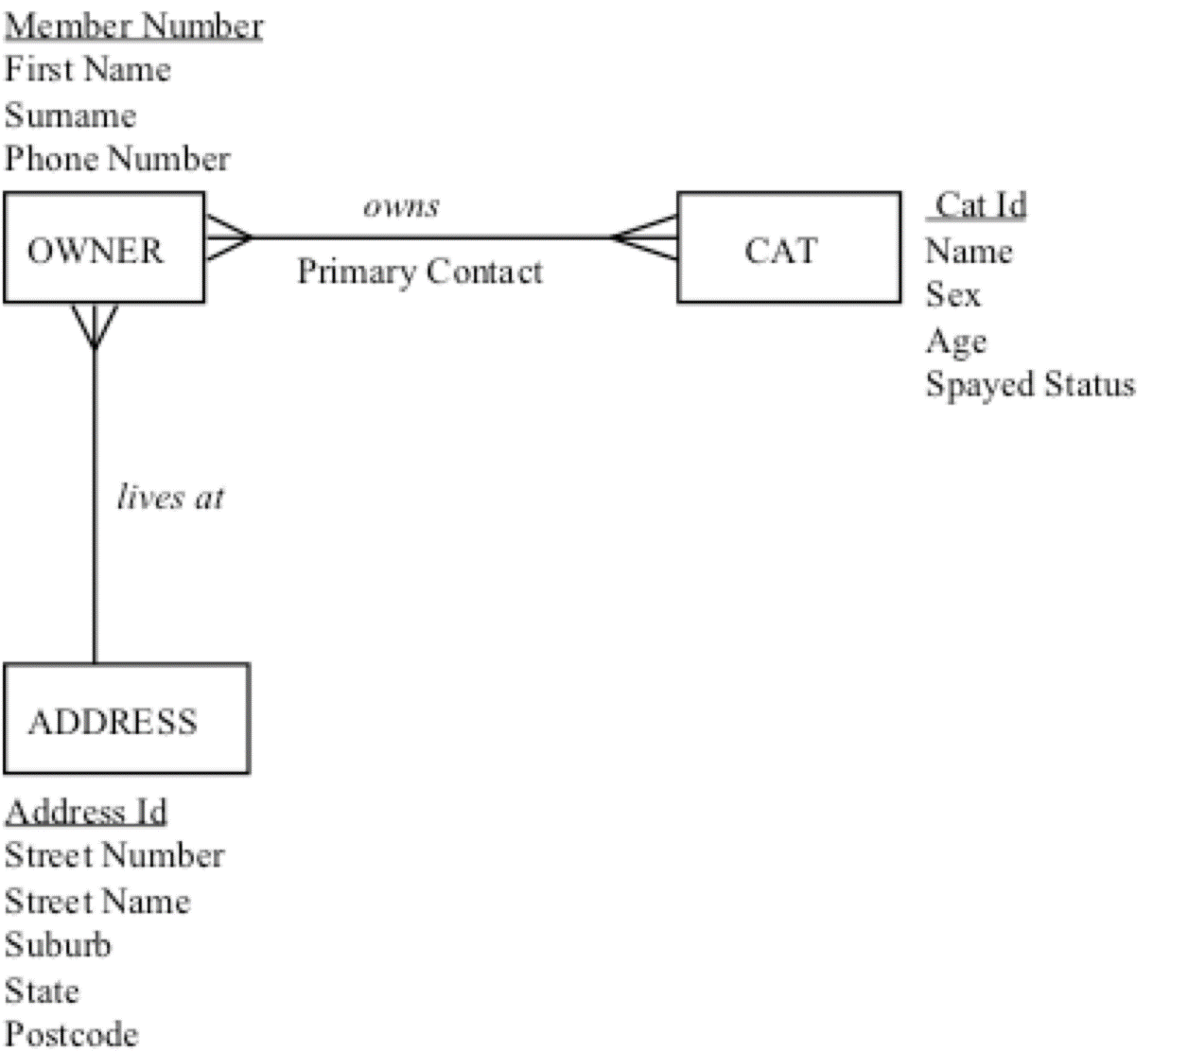
ER Diagram of Given Scenario (Conceptual Model)
Canterbury Cat Club
Notes:
Look at this What does this mean to you?

Slide 105
Bad Business Rules
Discussing implementation details such as foreign keys and Primary keys
Discussing what is entity or relationship
Not giving details as required

