Slide 1
DBMS Architecture
KIT712 Data Management Technology.

Slide 2
What is Database Administration?
A Function information technology (IT) department
Database Administrator (DBA)
Overall health / Performance
Manages Security
Setup Test and Dev. Environments

Slide 3
Duties of the DBA
Manage Database Objects – Tables / Views / Procedures
Database performance
Security – Logons /Users / Roles
Clone data from Production to Development or Test
Manage backups and carry out Data Replication plans.

Slide 4
DBA Tools in Oracle 11g
SQL*Plus provides an additional interface to your database so that you can:
Perform database management operations
Execute SQL commands to query, insert, update, and delete data in your database
SQL Developer:
Is a graphical user interface for accessing your instance of Oracle Database
Supports development in both SQL and PL/SQL
Is available in the default installation of Oracle Database

Slide 5
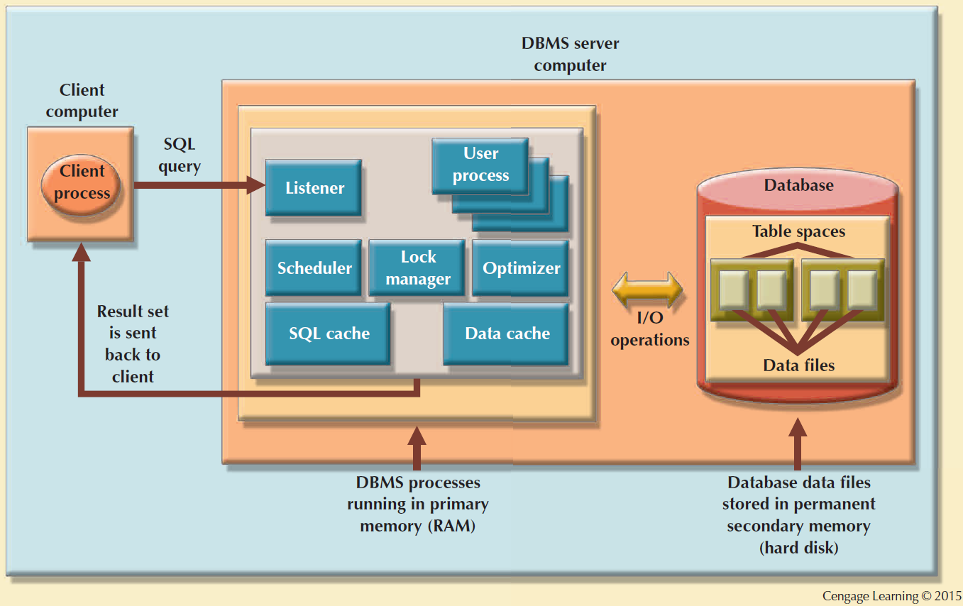
Basic DBMS Architecture

Slide 6
DBMS Architecture
All data in a database are stored in data files
Data files automatically expand in predefined increments known as extents
Data files are grouped in file groups or table spaces
Table space or file group: Logical grouping of several data files that store data with similar characteristics
Data cache or buffer cache: Shared, reserved memory area
Stores most recently accessed data blocks in RAM

Slide 7
DBMS Architecture
SQL cache or procedure cache: Stores most recently executed SQL statements or PL/SQL procedures
DBMS retrieves data from permanent storage and places them in RAM
Input/output request: Low-level data access operation that reads or writes data to and from computer devices
Data cache is faster than working with data files
Majority of performance-tuning activities focus on minimizing I/O operations

Slide 8
Oracle’s Architecture

Slide 9



Oracle 11g
Instance
PGA
Server process
Memory Structures
(System Global Area)
Server
Process Structures
User process
Database (Storage Structures)
Client

Slide 10
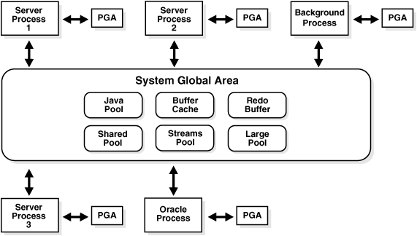
Oracle Instance
An Oracle database server consists of an Oracle database and an Oracle instance. Every time a database is started, a system global area (SGA) is allocated and Oracle background processes are started. The combination of the background processes and memory buffers is called an Oracle instance.

Slide 11
System Global Area (SGA)
The System Global Area (SGA) is a shared memory region that contains data and control information for one Oracle instance. Users currently connected to an Oracle database share the data in the SGA. The SGA contains the following memory structures :
Database Buffer Cache
Database buffers store the most recently used blocks of data. The set of database buffers in an instance is the database buffer cache. The buffer cache contains modified as well as unmodified blocks. Because the most recently (and often, the most frequently) used data is kept in memory, less disk I/O is necessary, and performance is improved.
Notes:
System Global Area
The System Global Area (SGA) is a shared memory region that contains data and control information for one Oracle instance. Oracle allocates the SGA when an instance starts and deallocates it when the instance shuts down. Each instance has its own SGA. Users currently connected to an Oracle database share the data in the SGA. For optimal performance, the entire SGA should be as large as possible (while still fitting in real memory) to store as much data in memory as possible and to minimize disk I/O.
The SGA contains the following memory structures :
Database Buffer Cache
Database buffers store the most recently used blocks of data. The set of database buffers in an instance is the database buffer cache. The buffer cache contains modified as well as unmodified blocks. Because the most recently (and often, the most frequently) used data is kept in memory, less disk I/O is necessary, and performance is improved.

Slide 12
System Global Area (cont’d)
Redo Log Buffer of the SGA
The redo log buffer stores redo entries—a log of changes made to the database. The redo entries stored in the redo log buffers are written to an online redo log, which is used if database recovery is necessary. The size of the redo log is static.
Shared Pool of the SGA
The shared pool contains shared memory constructs, such as shared SQL areas. A shared SQL area is required to process every unique SQL statement submitted to a database. A shared SQL area contains information such as the parse tree and execution plan for the corresponding statement.
Notes:
Redo Log Buffer of the SGA
The redo log buffer stores redo entries—a log of changes made to the database. The redo entries stored in the redo log buffers are written to an online redo log, which is used if database recovery is necessary. The size of the redo log is static.
Shared Pool of the SGA
The shared pool contains shared memory constructs, such as shared SQL areas. A shared SQL area is required to process every unique SQL statement submitted to a database. This area contains information such as the parse tree and execution plan for the corresponding statement. A single shared SQL area is used by multiple applications that issue the same statement, leaving more shared memory for other uses.

Slide 13
Program Global Area (PGA)
PGA is a memory buffer that contains data and control information for a server process. A server process is a process that services a client’s requests. A PGA is created by oracle when a server process is started. The information in a PGA depends on the oracle configuration. The PGA area is a non-shared area of memory created by oracle when a server process is started. The basic difference between SGA and PGA is that PGA cannot be shared between multiple processes in the sense that it is used only for requirements of a particular process whereas the SGA is used for the whole instance and it is shared.
PGA
Cursor
State
Sort Area
Hash Area
Stack
Space
User
Global
Area
Create Bitmap Area
User Session Data
Bitmap Merge Area
SQL
Working Areas
Notes:
PGA is a memory buffer that contains data and control information for a server process. A server process is a process that services a client’s requests. A PGA is created by oracle when a server process is started. The information in a PGA depends on the oracle configuration. The PGA area is a non-shared area of memory created by oracle when a server process is started. The basic difference between SGA and PGA is that PGA cannot be shared between multiple processes in the sense that it is used only for requirements of a particular process whereas the SGA is used for the whole instance and it is shared.

Slide 14
Instance vs. Database
Instance
(memory structures)
Database
(disk structures)

Slide 15
Multiple Instances for 1 Database
Instance A
(memory structures)
Instance B
(memory structures)
Database 1
(disk structures)

Slide 16
Multiple Databases for 1 Instance
Instance A
(memory structures)
Database 1
(disk structures)
Database 2
(disk structures)

Slide 17
Instance to Instance Communication
Instance A
(memory structures)
Instance B
(memory structures)
Via client
Or replication
process
Database 1
(disk structures)
Database 2
(disk structures)

Slide 18
Key structures and Processes
CLIENT
ORACLE INSTANCE
CLIENT
CLIENT
Database Buffer Cache
Redo Log Buffer
Shared Pool
Library
Cache
Network
LSTNR
Data Dictionary
Cache
SERVER
SERVER
SERVER
DBWR
SMON
PMON
CKPT
LGWR
ARCH
Background
Processes
Data
Files
(Inc. RB
Segments)
Control
Files
On-line
Redo
Log Files
Data
Files
(Inc. RB
Segments)
On-line
Redo
Log Files
Control
Files
On-line
Redo
Log Files

Slide 19
Oracle Processes
Background Processes
run on server
as separate processes on UNIX (ps –ef | grep <ORA_SID>)
As separate threads in single service on NT
Listener Process
one or more per server
listens for connection requests
hands off to server process (on diff. Port)
Server Processes
Run on server
Typically one process to support each connected user (unless MTS)
Client (“User”) Process
runs on client machine
communicates with a server process on server

Slide 20
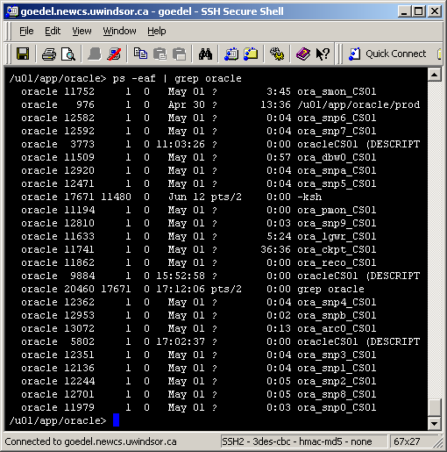

Slide 21
Logical and Physical Database Structures
Logical
Physical
Database
Tablespace
Data file
Segment
Storage System
SAN
NAS
Exadata
File System
NFS
ASM
RAW
Extent
Oracle data block
Notes:
Logical and Physical Database Structures
The database has logical structures and physical structures.
Databases, Tablespaces, and Data Files
The relationship among databases, tablespaces, and data files is illustrated in the slide. Each database is logically divided into two or more tablespaces. One or more data files are explicitly created for each tablespace to physically store the data of all segments in a tablespace. If it is a TEMPORARY tablespace, it has a temporary file instead of a data file. A tablespace's datafile can be physically stored on any supported storage technology.
Tablespaces
A database is divided into logical storage units called tablespaces, which group related logical structures or datafiles together. For example, tablespaces commonly group all of an application’s segments to simplify some administrative operations.
Data Blocks
At the finest level of granularity, an Oracle database’s data is stored in data blocks. One data block corresponds to a specific number of bytes of physical space on the disk. A data block size is specified for each tablespace when it is created. A database uses and allocates free database space in Oracle data blocks.

Slide 22
Managing Oracle 11g Data Storage
Like most DBMS’s the logical structures
Tables
Constraints
Views / Procedures
Can be stored in physical data structures
Files on disk
Dedicated drive partitions
RAM

Slide 23
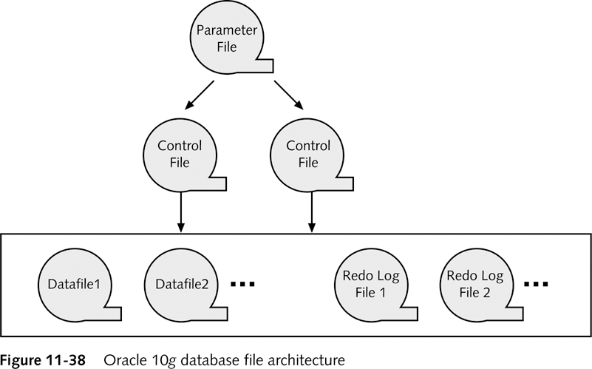
Oracle 11g Database File Architecture

Slide 24
Physical Structures
Datafiles (*.dbf)
The datafiles contain all the database data. The data of logical database structures, such as tables and indexes, is physically stored in the datafiles allocated for a database.
Control Files (*.ctl)
Every Oracle database has a control file. A control file contains entries that specify the physical structure of the database such as Database name and the Names and locations of datafiles and redo log files.
Redo Log Files (*.log)
The primary function of the redo log is to record all changes made to data. If a failure prevents modified data from being permanently written to the datafiles, then the changes can be obtained from the redo log, so work is never lost.
Notes:
Datafiles
Every Oracle database has one or more physical datafiles. The datafiles contain all the database data. The data of logical database structures, such as tables and indexes, is physically stored in the datafiles allocated for a database. One or more datafiles form a logical unit of database storage called a tablespace.
Data in a datafile is read, as needed, during normal database operation and stored in the memory cache of Oracle. For example, assume that a user wants to access some data in a table of a database. If the requested information is not already in the memory cache for the database, then it is read from the appropriate datafiles and stored in memory.
Modified or new data is not necessarily written to a datafile immediately. To reduce the amount of disk access and to increase performance, data is pooled in memory and written to the appropriate datafiles all at once, as determined by the database writer process (DBWn) background process.
Control Files
Every Oracle database has a control file. A control file contains entries that specify the physical structure of the database such as Database name and the Names and locations of datafiles and redo log files.
Oracle can multiplex the control file, that is, simultaneously maintain a number of identical control file copies, to protect against a failure involving the control file.
Every time an instance of an Oracle database is started, its control file identifies the database and redo log files that must be opened for database operation to proceed. If the physical makeup of the database is altered (for example, if a new datafile or redo log file is created), then the control file is automatically modified by Oracle to reflect the change. A control file is also used in database recovery.
Redo Log Files
Every Oracle database has a set of two or more redo log files. The set of redo log files is collectively known as the redo log for the database. A redo log is made up of redo entries (also called redo records).
The primary function of the redo log is to record all changes made to data. If a failure prevents modified data from being permanently written to the datafiles, then the changes can be obtained from the redo log, so work is never lost.
To protect against a failure involving the redo log itself, Oracle allows a multiplexed redo log so that two or more copies of the redo log can be maintained on different disks.
The information in a redo log file is used only to recover the database from a system or media failure that prevents database data from being written to the datafiles. For example, if an unexpected power outage terminates database operation, then data in memory cannot be written to the datafiles, and the data is lost. However, lost data can be recovered when the database is opened, after power is restored. By applying the information in the most recent redo log files to the database datafiles, Oracle restores the database to the time at which the power failure occurred.
The process of applying the redo log during a recovery operation is called rolling forward.

Slide 25
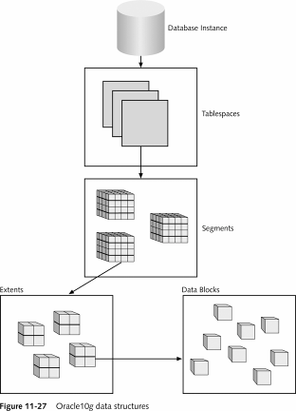
Oracle 11g Logical Data Structures
Tablespace
One or more Data Files
Segment
Partitioned Data
Extent
Growth rule for segment
Data block
Database storage data block
Operating system blocks

Slide 26
Logical Structures
Tablespaces
A database is divided into logical storage units called tablespaces, which group related logical structures together. One or more datafiles are explicitly created for each tablespace to physically store the data of all logical structures in a tablespace.
Oracle Data Blocks
At the finest level of granularity, Oracle database data is stored in data blocks. One data block corresponds to a specific number of bytes of physical database space on disk. The standard block size is specified by the DB_BLOCK_SIZE initialization parameter.
Notes:
Tablespaces
A database is divided into logical storage units called tablespaces, which group related logical structures together. For example, tablespaces commonly group together all application objects to simplify some administrative operations. One or more datafiles are explicitly created for each tablespace to physically store the data of all logical structures in a tablespace.
Every Oracle database contains a SYSTEM tablespace. Oracle creates them automatically when the database is created.
Oracle Data Blocks
At the finest level of granularity, Oracle database data is stored in data blocks. One data block corresponds to a specific number of bytes of physical database space on disk. The standard block size is specified by the DB_BLOCK_SIZE initialization parameter. A database uses and allocates free database space in Oracle data blocks. Oracle reads and writes data in blocks, so a larger block size could lead to more data transfer per I/O call. The default block size depends on the system architecture, but is generally 8k for UNIX systems. A larger block size is sometimes used for data warehouse systems which access data in larger chunks.

Slide 27
Typical Tablespaces:
Stores all database structures + data
Tables, data, views, sp’s etc…
SYSTEM 32464 E:\ORACLE\ORADATA\INSY\SYSTEM01.DBF
RBS 265600 E:\ORACLE\ORADATA\INSY\RBS01.DBF
USERS 89440 E:\ORACLE\ORADATA\INSY\USERS01.DBF
TEMP 10560 E:\ORACLE\ORADATA\INSY\TEMP01.DBF
TOOLS 1280 E:\ORACLE\ORADATA\INSY\TOOLS01.DBF
INDX 2560 E:\ORACLE\ORADATA\INSY\INDX01.DBF
DRSYS 2560 E:\ORACLE\ORADATA\INSY\DR01.DBF
OEM_REPOSITORY 3841 E:\ORACLE\ORADATA\INSY\OEM_REPOSITORY.ORA

Slide 28
Why multiple Tablespaces?
Reduce Disk Contention by spreading disk I/O over multiple spindles.
We control which TS objects are stored on
We control physical location of TS datafiles
Even if all disks are in use currently, the best practice is to keep major apps on different tablespaces to more easily allow for future movement.
Reduce performance degradation during on-line physical backups.
Allows different applications to have different physical parameters
block size
Fragmentation level
etc

Slide 29
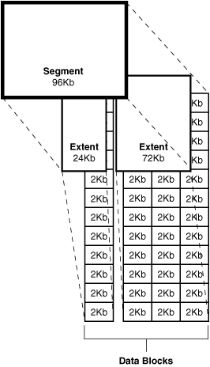
Logical Structures (cont’d)
Segments
After Tablespaces, the level of logical database storage is a segment. A segment is a set of extents allocated for a certain logical structure. The different types of segments are :
Data segment – stores table data
Index segment – stores index data
Temporary segment – temporary space used during SQL execution
Rollback Segment – stores undo information
Extents
The next level of logical database space is an extent. An extent is a specific number of contiguous data blocks, obtained in a single allocation, used to store a specific type of information.
Notes:
Extents
The next level of logical database space is an extent. An extent is a specific number of contiguous data blocks, obtained in a single allocation, used to store a specific type of information.
Segments
Above extents, the level of logical database storage is a segment. A segment is a set of extents allocated for a certain logical structure. The different types of segments are :
Data segment – stores table data
Index segment – stores index data
Temporary segment – temporary space used during SQL execution
Rollback Segment – stores undo information

Slide 30
Logical Structures (cont’d)
Schema Overview
A schema is a collection of database objects. A schema is owned by a database user and has the same name as that user. Schema objects are the logical structures that directly refer to the database's data. Schema objects include structures like tables, views, and indexes.
Notes:
Schema Overview
A schema is a collection of database objects. A schema is owned by a database user and has the same name as that user. Schema objects are the logical structures that directly refer to the database's data. Schema objects include structures like tables, views, and indexes. There is no relationship between a tablespace and a schema. Objects in the same schema can be in different tablespaces, and a tablespace can hold objects from different schemas.

Slide 31
How Table Data Is Stored
Columns
Blocks
Table A
Table B
Rows
Segment
Segment
Table
Tablespace
Row piece
Extent
Notes:
How Table Data Is Stored
When a table is created, a segment is created to hold its data. A tablespace contains a collection of segments.
Logically, a table contains rows of column values. A row is ultimately stored in a database block in the form of a row piece. It is called a row piece because, under some circumstances, the entire row may not be stored in one place. This happens when an inserted row is too large to fit into a single block (chained row) or when an update causes an existing row to outgrow the available free space of the current block (migrated row). Row pieces are also used when a table has more than 255 columns. In this case the pieces may be in the same block (intra-block chaining) or across multiple blocks.

Slide 32


Slide 33
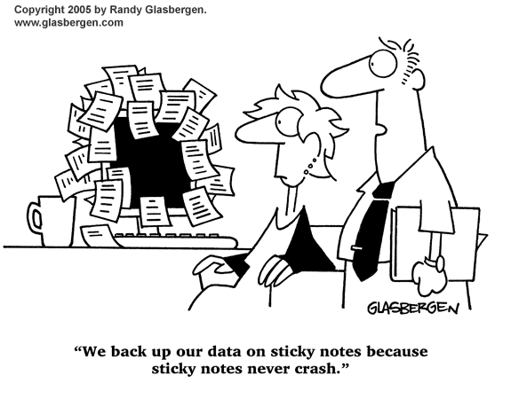

Slide 34
Backup Methods
Cold Backup (aka Consistent Backups)
The only way to make a consistent whole database backup is to shut down the database with the NORMAL, IMMEDIATE, or TRANSACTIONAL options and make the backup while the database is closed.
Advantage : No recovery is required after datafiles are restored – quicker restore
Disadvantage : No access to database during backup time (depends on size/system speed)
Notes:
A consistent backup of a database or part of a database is a backup in which all read/write datafiles and control files are checkpointed with the same SCN.
The only way to make a consistent whole database backup is to shut down the database with the NORMAL, IMMEDIATE, or TRANSACTIONAL options and make the backup while the database is closed. If a database is not shut down cleanly, for example, an instance fails or you issue a SHUTDOWN ABORT statement, then the database's datafiles are always inconsistent—unless the database is a read-only database.
The important point is that you can open the database after restoring a consistent whole database backup without needing recovery because the data is already consistent: no action is required to make the data in the restored datafiles correct. Hence, you can restore a year-old consistent backup of your database without performing media recovery and without Oracle performing instance recovery. Of course, when you restore a consistent whole database backup without applying redo, you lose all transactions that were made since the backup was taken. When this type of backup is restored and archived logs are available, you have the option of either opening the database immediately and losing transactions that were made since the backup was taken, or applying the archived logs to recover those transactions.
Advantage : No recovery is required after datafiles are restored – quicker restore
Disadvantage : No access to database during backup time (depends on size/system speed)

Slide 35
Backup Methods (cont’d)
Hot Backup (aka Inconsistent Backups)
If the database must be up and running 24 hours a day, seven days a week, then you have no choice but to perform inconsistent backups of the whole database. A backup of online datafiles is called an online backup. This requires that you run your database in ARCHIVELOG mode.
Advantage : Database remains open during backup
Disadvantage : Large databases may have performance impact during backup, recovery takes longer and is slightly more complex
Notes:
An inconsistent backup is a backup in which the files being backed up do not contain all the changes made at all the SCNs. In other words, some changes are missing. This means that the files in the backup contain data taken from different points in time. This can occur because the datafiles are being modified as backups are being taken. Oracle recovery makes inconsistent backups consistent by reading all archived and online redo logs, starting with the earliest SCN in any of the datafile headers, and applying the changes from the logs back into the datafiles.
If the database must be up and running 24 hours a day, seven days a week, then you have no choice but to perform inconsistent backups of the whole database. A backup of online datafiles is called an online backup. This requires that you run your database in ARCHIVELOG mode.
Advantage : Database remains open during backup
Disadvantage : Large databases may have performance impact during backup, recovery takes longer and is slightly more complex

Slide 36
Backup Methods (cont’d)
Logical backup (Export)
Logical backups are exports of schema objects, like tables and stored procedures, into a binary file. Oracle utilities are used to move Oracle schema objects in and out of Oracle.
Not recommended for backup of a whole database, but useful for backing up individual objects or schemas or moving data into another database
Notes:
Logical backup (Export)
Logical backups are exports of schema objects, like tables and stored procedures, into a binary file. Oracle utilities are used to move Oracle schema objects in and out of Oracle.
Not recommended for backup of a whole database, but useful for backing up individual objects or schemas or moving data into another database

Slide 37
Administrative Tasks
Daily Checks
Check database availability
Check logs / trace files
Check free space / resources
Check for invalid objects
Check for broken jobs
Verify backup
Notes:
Daily Checks
Check database availability
Make sure the database is available. Log into each instance and run daily reports or test scripts.
Check logs / trace files
Check alert_sid.log for ORA-* errors and investigate as required
Check free space / resources
Check server disk space and processor / memory utilization
Check for invalid objects
Run a query against dba_objects to make sure no objects have become invalidated. This can be caused by such things as failing jobs, new objects and changed passwords.
Check for broken jobs
Run a query against dbms_jobs to make sure there are no broken job. A job is a PLSQL program that is defined to run at a specified time.
Verify backup
Make sure whatever backup system is in place is working properly.

Slide 38
Administrative Tasks (cont’d)
Weekly Tasks
Collect statistics (database job)
Archive / delete log files
Run performance reports (statspack)
Notes:
Weekly Tasks
Collect statistics (database job)
Collecting statistics on database objects allows the optimizer to pick the most efficient query plan for sql statements. As the database changes the statistics become out of date and need to be refreshed. A job should be setup to gather new statistics each week or more often if the data changes frequently. Confirm that the job runs successfully.
Archive / delete log files
To save disk space and make it easier to find errors you should tar or zip up old log files. After a period of time they can be deleted.
Run performance reports (statspack)
Using these reports you will hopefully be able to see database performance issues before the user does. Save old reports and compare them to new ones to help point out system problems.

Slide 39
Administrative Tasks (cont’d)
Others
Applying patches
Database upgrades
New Database installations
Creating user accounts
Notes:
Others
Applying patches
Security patchsets are released quarterly from Oracle and should be applied as soon as possible after adequate testing has been performed.
Database upgrades
Upgrades to the base database release from Oracle should be applied after extensive testing has been performed.
New Database installations
Creating user accounts
Here it is automated through a script which checks the LDAP directory for students registered in 315/334

