Slide 1
KIT712: Database Management Technology
Lecture 9: plsql function, procedure, triggers

Slide 2
Review of Anonymous Blocks
Anonymous blocks:
Form the basic PL/SQL block structure
Initiate PL/SQL processing tasks from applications
Can be nested within the executable section of any PL/SQL block
[DECLARE -- Declaration Section (Optional)
variable declarations; ... ]
BEGIN -- Executable Section (Mandatory)
SQL or PL/SQL statements;
[EXCEPTION -- Exception Section (Optional)
WHEN exception THEN statements; ]
END; -- End of Block (Mandatory)
Notes:
Review of Anonymous Blocks
Anonymous blocks are typically used for:
Writing trigger code for Oracle Forms components
Initiating calls to procedures, functions, and package constructs
Isolating exception handling within a block of code
Nesting inside other PL/SQL blocks for managing code flow control
The DECLARE keyword is optional, but it is required if you declare variables, constants, and exceptions to be used within the PL/SQL block.
BEGIN and END are mandatory and require at least one statement between them, either SQL, PL/SQL, or both.
The exception section is optional and is used to handle errors that occur within the scope of the PL/SQL block. Exceptions can be propagated to the caller of the anonymous block by excluding an exception handler for the specific exception, thus creating what is known as an unhandled exception.

Slide 3
PL/SQL Named Program Units
PL/SQL blocks executed thus far have been anonymous blocks
Now we will assign a name to the block and save it in the database as a stored program unit
This makes program units reusable

Slide 4
Introduction to PL/SQL Procedures
Procedures are named PL/SQL blocks that perform a sequence of actions.
CREATE or REPLACE PROCEDURE getemp IS -- header
emp_id employees.employee_id%type;
lname employees.last_name%type;
BEGIN
emp_id := 100;
SELECT last_name INTO lname
FROM EMPLOYEES
WHERE employee_id = emp_id;
DBMS_OUTPUT.PUT_LINE('Last name: '||lname);
END;
/
Notes:
Introduction to PL/SQL Procedures
A procedure is a named PL/SQL block that is created by using a CREATE PROCEDURE statement. When called, or invoked, a procedure performs a sequence of actions. The anatomy of the procedure includes:
The header: “PROCEDURE getemp IS”
The declaration section: With variable declarations emp_id and lname
The executable section: Contains the PL/SQL and SQL statements used to obtain the last name of employee 100. The executable section makes use of the DBMS_OUTPUT package to print the last name of the employee.
The exception section: Optional and not used in the example
Note: Hard-coding the value of 100 for emp_id is inflexible. The procedure would be more reusable if used as a parameter to obtain the employee ID value. Using parameters is covered in the lesson titled “Creating Stored Procedures.”
To call a procedure by using an anonymous block, use:
BEGIN getemp; END;

Slide 5
Introduction to PL/SQL Functions
Functions are named PL/SQL blocks that perform a sequence of actions and return a value. A function can be invoked from:
Any PL/SQL block
A SQL statement (subject to some restrictions)
CREATE or REPLACE FUNCTION avg_salary RETURN NUMBER IS
avg_sal employees.salary%type;
BEGIN
SELECT AVG(salary) INTO avg_sal
FROM EMPLOYEES;
RETURN avg_sal;
END;
/
Notes:
Introduction to PL/SQL Functions
A function is a named PL/SQL block that is created with a CREATE FUNCTION statement. Functions are used to compute a value that must be returned to the caller.
PL/SQL functions follow the same block structure as procedures. However, the header starts with the keyword FUNCTION followed by the function name. The header includes the return data type after the function name (using the keyword RETURN followed by the data type). The example declares a variable called v_total_salary in the declaration section, and uses the RETURN statement to return the value retrieved from the SELECT statement. The value returned represents the total salary for all employees.
A function can be called from:
Another PL/SQL block where its return value can be stored in a variable or supplied as a parameter to a procedure
A SQL statement, subject to restrictions (This topic is covered in the lesson titled “Creating Stored Functions.”)
To call a function from an anonymous block, use the following:
BEGIN
dbms_output.put_line('Average Salary: ' ||
avg_salary);
END;

Slide 6
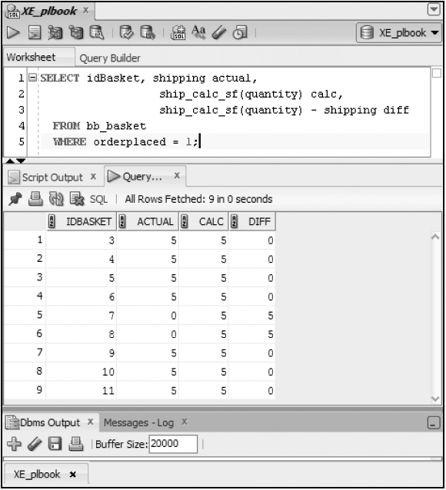
Use Function in SQL

Slide 7
Advantages of User-Defined Functions in SQL Statements
Can extend SQL where activities are too complex, too awkward, or unavailable with SQL
Can increase efficiency when used in the WHERE clause to filter data, as opposed to filtering the data in the application
Can manipulate data values
Notes:
Advantages of User-Defined Functions in SQL Statements
SQL statements can reference PL/SQL user-defined functions anywhere a SQL expression is allowed. For example, a user-defined function can be used anywhere a built-in SQL function, such as UPPER(), can be placed.
Advantages
Permits calculations that are too complex, awkward, or unavailable with SQL
Increases data independence by processing complex data analysis within the Oracle server, rather than by retrieving the data into an application
Increases efficiency of queries by performing functions in the query rather than in the application
Manipulates new types of data (for example, latitude and longitude) by encoding character strings and using functions to operate on the strings

Slide 8
Procedure and Functions
A procedure or a function may have 0 to many parameters.
Each has two parts:
The header portion, which comes before IS keyword (this contains the procedure name and the parameter list),
The body, which is everything after the IS keyword. Body is similar to anonymous block having variable declarations, begin and end.
The word REPLACE is optional.
When the word REPLACE is not used in the header of the procedure, in order to change the code in the procedure, it must be dropped first and then re-created.

Slide 9
Procedures vs Functions
Procedures
Receive multiple input parameters
May return multiple output values or return no output values [restricted way]
Perform action such as inserting, updating, or deleting database records
Functions
Receive multiple input parameters
Always returns single output value

Slide 10
What Are Parameters?
Parameters:
Are declared after the subprogram name in the PL/SQL header
Pass or communicate data between the caller and the subprogram
Are used like local variables but are dependent on their parameter-passing mode:
An IN parameter (the default) provides values for a subprogram to process.
An OUT parameter returns a value to the caller.
An IN OUT parameter supplies an input value, which may be returned (output) as a modified value.
Notes:
What Are Parameters?
Parameters are used to transfer data values to and from the calling environment and the procedure (or subprogram). Parameters are declared in the subprogram header, after the name and before the declaration section for local variables.
Parameters are subject to one of the three parameter-passing modes: IN, OUT, or IN OUT.
An IN parameter passes a constant value from the calling environment into the procedure.
An OUT parameter passes a value from the procedure to the calling environment.
An IN OUT parameter passes a value from the calling environment to the procedure and a possibly different value from the procedure back to the calling environment using the same parameter.
Parameters can be thought of as a special form of local variable, whose input values are initialized by the calling environment when the subprogram is called, and whose output values are returned to the calling environment when the subprogram returns control to the caller.

Slide 11
Using IN Parameters: Example
CREATE OR REPLACE PROCEDURE raise_salary
(id IN employees.employee_id%TYPE,
percent IN NUMBER)
IS
BEGIN
UPDATE employees
SET salary = salary * (1 + percent/100)
WHERE employee_id = id;
END raise_salary;
/
EXECUTE raise_salary(176,10)
Notes:
Using IN Parameters: Example
The example shows a procedure with two IN parameters. Running this first statement in iSQL*Plus creates the raise_salary procedure in the database. The second example invokes raise_salary and provides the first parameter value of 176 for the employee ID, and a percentage salary increase of 10% for the second parameter value.
To invoke a procedure in iSQL*Plus, use the following EXECUTE command:
EXECUTE raise_salary (176, 10)
To invoke a procedure from another procedure, use a direct call inside an executable section of the calling block. At the location of calling the new procedure, enter the procedure name and actual parameters. For example:
...
BEGIN
raise_salary (176, 10);
END;
Note: IN parameters are passed as read-only values from the calling environment into the procedure. Attempts to change the value of an IN parameter result in a compile-time error.

Slide 12
Using OUT Parameters: Example
CREATE OR REPLACE PROCEDURE query_emp
(id IN employees.employee_id%TYPE,
name OUT employees.last_name%TYPE,
salary OUT employees.salary%TYPE) IS
BEGIN
SELECT last_name, salary INTO name, salary
FROM employees
WHERE employee_id = id;
END query_emp;
DECLARE
emp_name employees.last_name%TYPE;
emp_sal employees.salary%TYPE;
BEGIN
query_emp(171, emp_name, emp_sal); ...
END;
Notes:
Using OUT Parameters: Example
In this example, you create a procedure with OUT parameters to retrieve information about an employee. The procedure accepts the value 171 for employee ID and retrieves the name and salary of the employee with ID 171 into the two OUT parameters. The query_emp procedure has three formal parameters. Two of them are OUT parameters that return values to the calling environment, shown in the code box at the bottom of the slide. The procedure accepts an employee ID value through the id parameter. The emp_name and emp_salary variables are populated with the information retrieved from the query into their two corresponding OUT parameters.
If you print the values returned into PL/SQL variables of the calling block shown in the second block of code, then the variables contain the following:
emp_name holds the value Smith.
emp_salary holds the value 7600.
Note: Make sure that the data type for the actual parameter variables used to retrieve values from OUT parameters has a size sufficient to hold the data values being returned.
Attempting to use or read OUT parameters inside the procedure that declares them results in a compilation error. The OUT parameters can be assigned values only in the body of the procedure in which they are declared.

Slide 13
Using IN OUT Parameters: Example
Calling environment
phone_no (before the call)
phone_no (after the call)
'8006330575'
'(800)633-0575'
CREATE OR REPLACE PROCEDURE format_phone
(phone_no IN OUT VARCHAR2) IS
BEGIN
phone_no := '(' || SUBSTR(phone_no,1,3) ||
')' || SUBSTR(phone_no,4,3) ||
'-' || SUBSTR(phone_no,7);
END format_phone;
/
Notes:
Using IN OUT Parameters: Example
Using an IN OUT parameter, you can pass a value into a procedure that can be updated. The actual parameter value supplied from the calling environment can return as either of the following:
The original unchanged value
A new value that is set within the procedure
Note: An IN OUT parameter acts as an initialized variable.
The example in the slide creates a procedure with an IN OUT parameter to accept a 10-character string containing digits for a phone number. The procedure returns the phone number formatted with parentheses around the first three characters and a hyphen after the sixth digit—for example, the phone string 8006330575 is returned as (800) 633-0575.
The following code uses the phone_no host variable of iSQL*Plus to provide the input value passed to the FORMAT_PHONE procedure. The procedure is executed and returns an updated string in the phone_no host variable.
VARIABLE phone_no VARCHAR2(15)
EXECUTE :phone_no := '8006330575'
PRINT phone_no
EXECUTE format_phone (:phone_no)
PRINT phone_no

Slide 14
Handled Exceptions in Procedures
Calling procedure
Called procedure
PROCEDURE
PROC1 ...
IS
...
BEGIN
...
PROC2(arg1);
...
EXCEPTION
...
END PROC1;
PROCEDURE
PROC2 ...
IS
...
BEGIN
...
EXCEPTION
...
END PROC2;
Exception raised
Exception handled
Control returns to calling procedure
Notes:
Handled Exceptions
When you develop procedures that are called from other procedures, you should be aware of the effects that handled and unhandled exceptions have on the transaction and the calling procedure.
When an exception is raised in a called procedure, the control immediately goes to the exception section of that block. An exception is considered handled if the exception section provides a handler for the exception raised.
When an exception occurs and is handled, the following code flow takes place:
1. The exception is raised.
2. Control is transferred to the exception handler.
3. The block is terminated.
4. The calling program/block continues to execute as if nothing has happened.
If a transaction was started (that is, if any data manipulation language [DML] statements executed before executing the procedure in which the exception was raised), the transaction is unaffected. A DML operation is rolled back if it was performed within the procedure before the exception.
Note: You can explicitly end a transaction by executing a COMMIT or ROLLBACK operation in the exception section.

Slide 15
Exceptions Not Handled
Calling procedure
Called procedure
PROCEDURE
PROC1 ...
IS
...
BEGIN
...
PROC2(arg1);
...
EXCEPTION
...
END PROC1;
PROCEDURE
PROC2 ...
IS
...
BEGIN
...
EXCEPTION
...
END PROC2;
Exception raised
Exception not handled
Control returned to exception section of calling procedure
Notes:
Exceptions Not Handled
As discussed, when an exception is raised in a called procedure, control immediately goes to the exception section of that block. If the exception section does not provide a handler for the raised exception, then it is not handled. The following code flow occurs:
1. The exception is raised.
2. The block terminates because no exception handler exists; any DML operations performed within the procedure are rolled back.
3. The exception propagates to the exception section of the calling procedure. That is, control is returned to the exception section of the calling block, if one exists.
If an exception is not handled, then all the DML statements in the calling procedure and the called procedure are rolled back along with any changes to any host variables. The DML statements that are not affected are statements that were executed before calling the PL/SQL code whose exceptions are not handled.

Slide 16
Introduction to PL/SQL Triggers
PL/SQL triggers are code blocks that execute when a specified application, database, or table event occurs.
The Oracle database automatically executes a trigger when specified conditions occur.
CREATE TRIGGER check_salary BEFORE INSERT OR UPDATE ON employees FOR EACH ROW
DECLARE
c_min constant number(8,2) := 1000.0;
c_max constant number(8,2) := 500000.0;
BEGIN
IF :new.salary > c_max OR
:new.salary < c_min THEN
RAISE_APPLICATION_ERROR(-20000,
'New salary is too small or large');
END IF;
END;
Notes:
Introduction to PL/SQL Triggers
A trigger is a PL/SQL block that executes when a particular event occurs.
A PL/SQL trigger has two forms:
Application triggers, which are created as blocks of code that execute when a nominated application event occurs in an Oracle Forms execution environment
Database triggers, which are named blocks of code that are associated and execute when a nominated database or table event occurs
The check_salary trigger example shows a database trigger that executes before either an INSERT or an UPDATE operation occurs on the EMPLOYEES table. The trigger code checks whether the salary column value is within an acceptable range. If the value is outside the specified range, then the code uses the RAISE_APPLICATION_ERROR built-in procedure to fail the operation. The :new syntax, which is used in the example, is a special bind/host variable that can be used in row-level triggers.
Triggers are covered in detail in the lesson titled “Creating Triggers.”

Slide 17
Why Trigger?
Database triggers can be used to perform any of the following:
Audit data modification
Log events transparently
Enforce complex business rules
Derive column values automatically
Implement complex security authorizations
Maintain replicate tables

Slide 18
Database Trigger Defined
Triggers are similar to procedures and functions but will execute automatically based on an event
Events are either DML statements or database system actions
Triggers will fire regardless of the source of the event
DML triggers are specifically associated with a table

Slide 19
Trigger Body
PL/SQL block
Must include a DECLARE clause if declarations needed
Can reference correlation identifiers using a preceding colon
Can include calls to other program units

Slide 20
Trigger Events
You can write triggers that fire (aka executes) whenever following operations occurs:
DML Statements: INSERT, UPDATE, DELETE
Use the OR operator to include more than one event in a trigger
DDL Statements: CREATE, ALTER, or DROP

Slide 21
Types of DML Triggers
The trigger type determines if the body executes for each row or only once for the triggering statement.
A statement trigger:
Executes once for the triggering event
Is the default type of trigger
Fires once even if no rows are affected at all
A row trigger:
Executes once for each row affected by the triggering event
Is not executed if the triggering event does not affect any rows
Is indicated by specifying the FOR EACH ROW clause
Notes:
Types of DML Triggers
You can specify that the trigger will be executed once for every row affected by the triggering statement (such as a multiple row UPDATE) or once for the triggering statement, no matter how many rows it affects.
Statement Trigger
A statement trigger is fired once on behalf of the triggering event, even if no rows are affected at all. Statement triggers are useful if the trigger action does not depend on the data from rows that are affected or on data provided by the triggering event itself (for example, a trigger that performs a complex security check on the current user).
Row Trigger
A row trigger fires each time the table is affected by the triggering event. If the triggering event affects no rows, a row trigger is not executed. Row triggers are useful if the trigger action depends on data of rows that are affected or on data provided by the triggering event itself.
Note: Row triggers use correlation names to access the old and new column values of the row being processed by the trigger.

Slide 22
Trigger Timing
You can specify the trigger timing as to whether to run the trigger before or after the event:
BEFORE event: Trigger executes before the triggering DML event on a table
AFTER: Trigger executes after the triggering DML event on a table.
ROW level or STATEMENT level
WHEN clause provides conditional processing

Slide 23
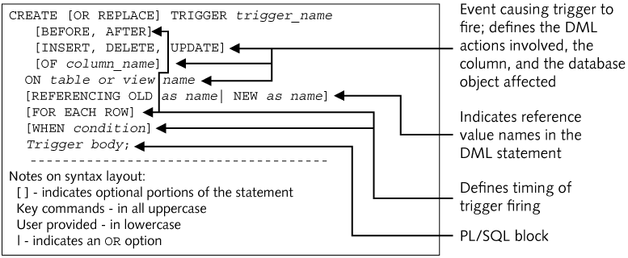
Create DML Trigger Syntax

Slide 24
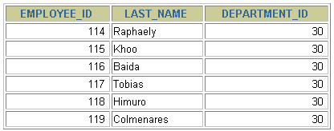
Trigger-Firing Sequence
Use the following firing sequence for a trigger on a table when many rows are manipulated:
UPDATE employees
SET salary = salary * 1.1
WHERE department_id = 30;
BEFORE statement trigger
BEFORE row trigger
AFTER row trigger
...
BEFORE row trigger
AFTER row trigger
...
AFTER statement trigger
Notes:
Trigger-Firing Sequence (continued)
When the triggering DML statement affects many rows, the statement trigger fires exactly once, and the row trigger fires once for every row affected by the statement.
Example
The SQL statement in the slide causes a row-level trigger to fire a number of times equal to the number of rows that satisfy the WHERE clause, that is, the number of employees reporting to department 30.

Slide 25
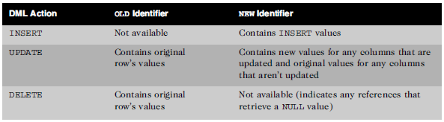
Using OLD and NEW Identifiers
When a row-level trigger fires, two data structures are created and populated
OLD: stores the original values of the record
NEW: stores the new values
Special bind variables associated with DML activity

Slide 26
Using OLD and NEW Qualifiers
CREATE OR REPLACE TRIGGER audit_emp_values
AFTER DELETE OR INSERT OR UPDATE ON employees
FOR EACH ROW
BEGIN
INSERT INTO audit_emp(user_name, time_stamp, id,
old_last_name, new_last_name, old_title,
new_title, old_salary, new_salary)
VALUES (USER, SYSDATE, :OLD.employee_id,
:OLD.last_name, :NEW.last_name, :OLD.job_id,
:NEW.job_id, :OLD.salary, :NEW.salary);
END;
/
Notes:
Using OLD and NEW Qualifiers
Within a ROW trigger, reference the value of a column before and after the data change by prefixing it with the OLD and NEW qualifiers.
Usage notes:
The OLD and NEW qualifiers are available only in ROW triggers.
Prefix these qualifiers with a colon (:) in every SQL and PL/SQL statement.
There is no colon (:) prefix if the qualifiers are referenced in the WHEN restricting condition.
Note: Row triggers can decrease the performance if you do a lot of updates on larger tables.

Slide 27
ALTER TRIGGER statement
Used to compile or disable/enable a trigger
ALTER TRIGGER trigger_name COMPILE;
ALTER TRIGGER trigger_name DISABLE|ENABLE;
ALTER TABLE table_name DISABLE|ENABLE ALL TRIGGERS;

Slide 28
Delete a Trigger
DROP TRIGGER trigger_name;
Note: If a table or view is dropped, any associated DML triggers will automatically be deleted

Slide 29
Data Dictionary
Same as other program units except for viewing the source code
USER_TRIGGERS to view trigger source code
Description column contains the header code
Trigger_body column contains the body code

Slide 30
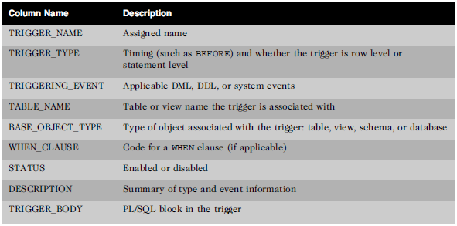
Data Dictionary
USER_TRIGGERS
columns

Slide 31
Execution Flow of SQL
All SQL statements in the database go through various stages:
Parse: pre-execution “is this possible?” checks including syntax, object existence, privileges and so on
Bind: getting the actual values of any variables referenced in the statement
Execute: the statement is executed
Fetch: results are returned to the user.
Some stages may not be relevant for all statements—for example, the fetch phase is applicable to queries but not DML.

Slide 32
Execution Flow of SQL in PL/SQL Subprograms
When a SQL statement is included in a PL/SQL subprogram, the parse and bind phases are normally done at compile time, ie when the procedure, function or package body is CREATEd.
What if the text of the SQL statement is not known when the procedure is created ? How could the Oracle server parse it ?
It couldn’t.
For example, suppose we want to DROP a table, but the user will enter the table name at execution time:

