Slide 1
KIT712: Database Management Technology
SQL Query Optimization/Tuning

Slide 2
TEST ----This Week
You must NOT communicate with your fellow students during the test
This is an INDIVIDUAL assessment
Cheating during the test could result in a FAIL
It is very very easy for us to know when you have cheated
Do not discuss the test at all during the test
If a friend asks you what their answer is do NOT tell them, do NOT share it with them
We can easily tell when something is cut n paste into a document or MyLO

Slide 3
Database Performance-Tuning Concepts
Goal of database performance is to execute queries as fast as possible
Database performance tuning
Set of activities and procedures designed to reduce response time of database system
All factors must operate at optimum level with minimal bottlenecks
Good database performance starts with good database design

Slide 4
Database Performance Problems
Inadequate consumable resources
CPU
I/O
Memory (may be detected as an I/O problem)
Data communications resources
Design limitations
Locking
Contention of resources
Notes:
Performance Problems
Performance problems occur when a task takes longer to perform than the time allowed. The problem occurs because a resource of a particular type is insufficient or inadequate. The resource may be a physical resource (such as available memory buffers that store data blocks) or an artificial resource (such as a lock).
Inadequate Consumable Resources
A resource may simply be inadequate to meet the need under any circumstances. For example, if you want a function to complete in less than one second, a network with a message turnaround time of two seconds will never meet the target.
If the limiting factor is a consumable resource (such as CPU power), all the users of that resource are affected.
Design Limitations
If the limiting factor is the contention of processes for a design resource (such as a lock), then only users of those specific processes are likely to be affected.
Locking
Contention due to locking by other transactions or applications might be a problem.

Slide 5
Excessive Demand
Performance of an application depends on the following:
How many clients are connected
How long they must wait for it
How long they hold it
Response time
Time to service completion
Acceptable
response time
Demand rate
Notes:
Critical Resource

Slide 6
Where to look for problem?
Hardware
Operating System
Database
Network
Application
Too often people attempt to improve database application performance by focusing on just the first three: hardware, OS and RDBMS …
???

Slide 7
Performance Problems
According to industrial experts
60% of the database’s
performance problems are caused by applications
Others
Application

Slide 8
Hardware Tuning Example
Problem:
Data load runtime 4+ hours
8 400-MHz 64-bit CPU’s
4 Gigabytes UNIX RAM
2 Gigabytes EMC Cache
RAID 5 (slower on writes)
Attempt #1:
Bought more hardware
16 400-MHz 64-bit CPU’s
8 Gigabytes UNIX RAM
4 Gigabytes EMC Cache
RAID 1 (faster on writes)
Runtime still 4+ hours !!!

Slide 9
Application Tuning
Attempt #2:
Redesigned application
Convert PL/SQL to Pro-C
Run 16 streams in parallel
Better utilize UNIX capabilities
Run time = 20 minutes !!!
Attempt #3:
Tuned the SQL code
Tune individual SQL statements
Use Dynamic SQL method
Prepare SQL outside loop
Execute Prep SQL in loop
Run time = 15 minutes !!!

Slide 10
Lesson Learned
Hardware:
Cost approximately $1,000,000
System downtime for upgrades
Zero runtime improvement
Loss of credibility with customer
Redesign:
4 hours DBA $150/hour = $600
20 hours Developer $100/hour = $2000
Total cost = $2600 or 385 times less
Golden Rule #1: Application redesign much
cheaper than hardware!

Slide 11
Where to look for problem in Application?
Most application performance problems result from an application’s poor general design or grossly inefficient SQL
You need to know how SQL Queries are executed and thus optimized:
Sub-queries (correlated and not)
Outer Joins
Minus
Union and Union-All
……..

Slide 12
Why don’t people tune their SQL?
Too busy now. I’ll do it later.
Is that what the Oracle optimizer is for?
I’m a Java, not an SQL, programmer.
I don’t know how.
Generated by Toplink, not my business.
It’s works. I’ve got my data. I’m happy.

Slide 13
Why does SQL need rewriting or tuning?
It is easy to write functional SQL.
It is harder to write efficient, high performing SQL.

Slide 14
DBMS Optimize - Find the best way to process your SQL Statements
Good
(Normally, but still be improved)
Very Bad
(most of time for complex SQL)
Very Good
(sometime for simple SQL)

Slide 15
What you should know?
Your database structure
How SQL statements work in general
How Database executes SQL
Database changes over time
Then it’s trial and error until you get a satisfactory result.

Slide 16
Query Processing
DBMS processes queries in three phases
Parsing
DBMS parses the query and chooses the most efficient access/execution plan
Execution
DBMS executes the query using chosen execution plan
Fetching
DBMS fetches the data and sends the result back to the client

Slide 17
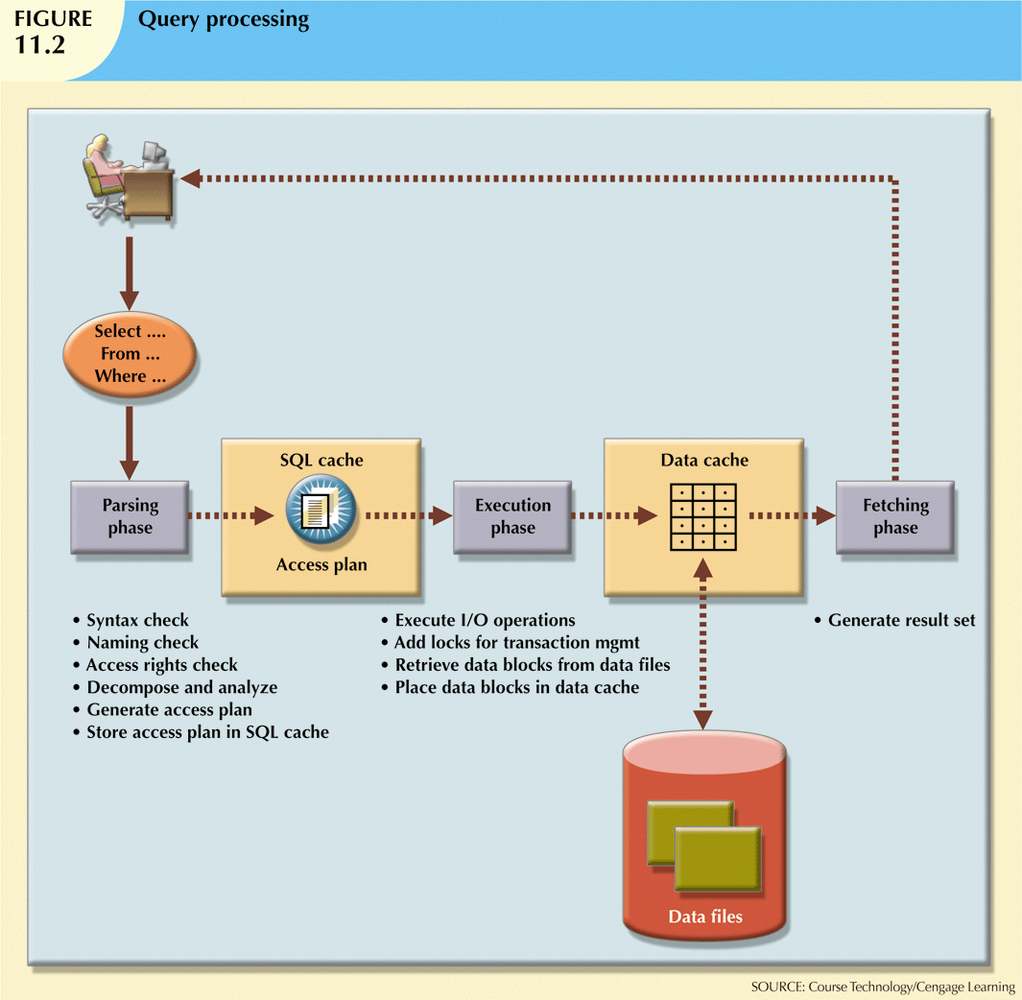

Slide 18
SQL Parsing Phase
Query is broken down into smaller units
Original SQL query is transformed into slightly different version of the original SQL code which is fully equivalent and more efficient
Query optimizer: Analyzes SQL query and finds most efficient way to access data
Access plans: DBMS-specific and translate client’s SQL query into a series of complex I/O operations
If access plan already exists for query in SQL cache, DBMS reuses it
If not, optimizer evaluates various plans and chooses one to be placed in SQL cache for use

Slide 19
SQL Execution Phase SQL Fetching Phase
All I/O operations indicated in access plan are executed
Locks acquired
Data retrieved and placed in data cache
Transaction management commands processed
Rows of resulting query result set are returned to client
DBMS may use temporary table space to store temporary data

Slide 20
Does it try every
possible way to
rewrite your SQL?
Plan 1
Internal rewrite & generation of multiple execution plans
SQL
Plan 2
Plan 3
Cost estimation
Plan 4
How accurate is
the cost estimation?
Plan 1 cost=1000
Plan 2 cost=3000
Plan 3 cost=4000
Execution
Plan 4 cost= 500

Slide 21
HOW TO TUNE
Review the access path, Join methods and index usage
Test response time through SQPLUS directly ( May mask performance )
Test response time through an Application front end ( Usually takes longer )
Test response time through a web interface

Slide 22
Indexes and Query Optimisation
Indexes
Crucial in speeding up data access
Facilitate searching, sorting, and using aggregate functions as well as join operations
Ordered set of values that contains index key and pointers
More efficient to use index to access table than to scan all rows in table sequentially
However, too many indexes itself is a problem!!why?

Slide 23
Indexes and Query Optimisation (cont’d.)
Data sparsity: number of different values a column could possibly have
Indexes implemented using:
Hash indexes
B-tree indexes
Bitmap indexes
DBMSs determine best type of index to use

Slide 24
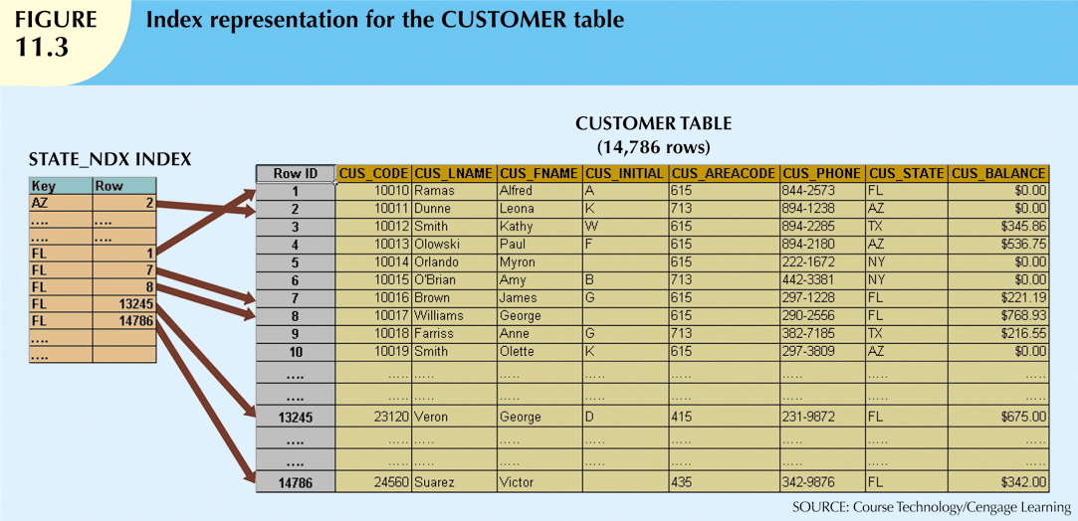

Slide 25
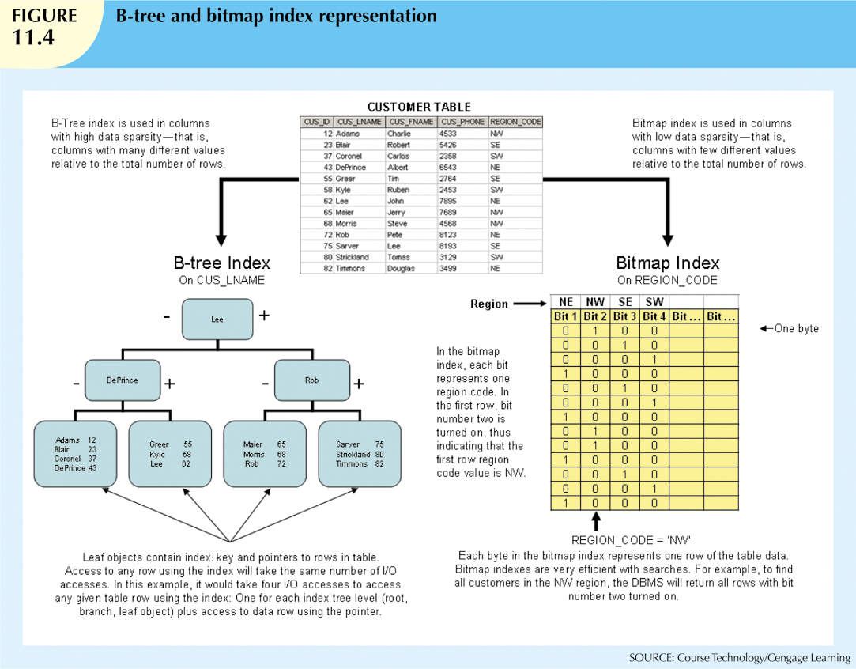

Slide 26
Index Selectivity
Indexes are used when:
Indexed column appears by itself in search criteria of WHERE or HAVING clause
Indexed column appears by itself in GROUP BY or ORDER BY clause
MAX or MIN function is applied to indexed column
Data sparsity on indexed column is high
Measure of how likely an index will be used

Slide 27
Index Selectivity (cont’d.)
General guidelines for indexes:
Create indexes for each attribute in WHERE, HAVING, ORDER BY, or GROUP BY clause
Do not use in small tables or tables with low sparsity
Declare primary and foreign keys so optimizer can use indexes in join operations
Declare indexes in join columns other than PK/FK

Slide 28
Indexed Fields
If you want the index used, don’t perform an operation on the field.
Replace
SELECT * from A
where SALARY +1000 = :NEWSALARY
with
SELECT * from A
where SALARY = :NEWSALARY -1000

Slide 29
Indexed Field
Index will not be used when a function is used.
SELECT * from A
where substr(name, 1, 3) = 'Wil'

Slide 30
Indexed Fields
WHERE clause
Avoid using
!= (not equal to)
Like '%SA%'

Slide 31
Indexed Fields
Do not have default value set to NULL.
If it is a number field and lowest value is 0, then:
Replace
SELECT * FROM A
WHERE NUMBER IS NOT NULL
with (normally faster response time)
SELECT * FROM A
WHERE NUMBER >0

Slide 32
Indexed Field
Replace Outer Join with Union.
If both A.State and B.State have a unique indexed:
Replace
SELECT A.CITY, B.CITY FROM A,B
WHERE A.STATE=B.STATE(+)
With
SELECT A.CITY, B.CITY FROM A,B
WHERE A.STATE=B.STATE
UNION
SELECT NULL, B.CITY FROM B
WHERE NOT EXISTS
(SELECT 'X' FROM A Where A.STATE=B.STATE)
Notes:
The Outer join on table B will do a full table scan.
Union can take advantage of the indexes. The table driving path can also be changed.

Slide 33
Join Order
Order in which tables are joined also impact the performance
R1 R2 …. Rn
Join tree:
A join tree represents a plan. An optimizer needs to inspect many (all ?) join trees
R3
R1
R2
R4

Slide 34
Example– customers, products, sales
join 2
Assume there are 10 Sales,100,000 Customers and 100,000 Products.
How many resulting rows in first join?
join 1
sales
customers
products
Adapted from Brown Bag
Slides on SQL Tuning
Notes:
The point of this example is to show a join order that is obviously bad. A cartesian join of customers and products would take forever if these were large tables. My simple example only has two rows in each table so it is fast, but in the real world with 100,000 customers and 100,000 products the resulting join would have 10 billion resulting rows

Slide 35
Why join path matter?
select * from A, B /* table A has 100,000 records */
where A.key = B.key /* table B has 1,000 records */
Path from table A to table B: which means that we open table A, looking at each row to then use an index to search for matching rows in table B:
Number of Operations (A→B) = 100,000 * RoundUp(LN(1000) / LN(2)) / 2 = 100,000 * 10 / 2 = 500,000
Path from table B to table A: which means that we open B table, looking at each row to then use an index to search for matching rows in table A:
Number of Operations (B→A) = 1000 * RoundUp(LN(100,000) / LN(2)) / 2 = 1000 * 17 / 2 = 8,500
Path from B→A is around 59 times faster than the speed of A→B

Slide 36
Join Methods
Join Method = way that data from two sources is joined
Nested Loops
Small number of rows in first table
Unique index on second large table
Hash Join
Smaller or equal number of rows in first table
No index required
Notes:
Two methods I mainly use when forcing a join method – nested loops or hash join. not talking about merge join for simplicity and because I really don’t use it.
nested loops – for each row in the first table probe the second table based on join columns
hash join – load rows from first table into a hash table, probe it with every row from second table
Key here is selectivity and cardinality. index on join columns is good for nested loops. unique index is just ideal, not required. Gives biggest improvement. Again, looking for big bang
hash join even large numbers of rows can be in hash table. mostly on disk but buffered in pga memory.

Slide 37
Automatic Optimizer
Query Optimization includes
Transforming queries
Estimating measures overall cost
Selectivity
Percentage of rows accessed versus total rows
Cardinality
Number of rows resulted from a SQL query or part of the query
Cost
the units of work or resource that are used
Generating plans

Slide 38
Using Hints to Affect Optimiser Choices
Optimiser might not choose best plan
Makes decisions based on existing statistics
Statistics may be old
Might choose less-efficient decisions
Optimiser hints: special instructions for the optimiser embedded in the SQL command text
SELECT /*+ INDEX (tablename indexname) */ …

Slide 39
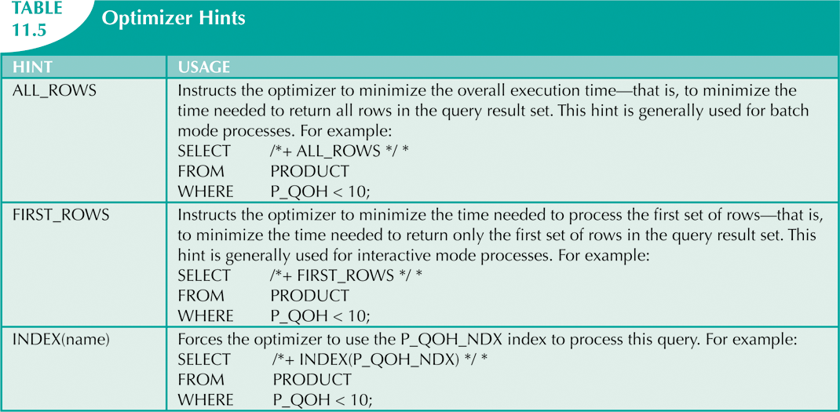

Slide 40
How to Tune and Identify the Problematic SQL
Identify slow programs.
Look at SQL in the program.
Use Explain Plan
Reviewing the Execution Plan

Slide 41
SQL Guidelines
Rule #1: Watch Indexed WHERE Conditions
Assume index on address (city, state)
non-leading index column references cannot use indexes
where state = 'TX' [Index Not used]
where city = 'DALLAS' [Index Used]
where state = 'TX' and city = 'DALLAS' [Index Used]
NOT, != and <> disable index use
where state not in ('TX', 'FL','OH') [Index Not used]
where state != 'TX' [Index Not used]
NULL value references can never use indexes
where state IS NULL [Index Not used]
where state IS NOT NULL [Index Not used]
expression references can never use indexes
where substr(city,1,3) = 'DAL' [Index Not used]
where city like 'DAL%' [Index Used]
where city || state = 'DALLASTX' [Index Not used]
where city = 'DALLAS' and state = 'TX‘ [Index Used]
where salary * 12 >= 24000 [Index Not used]
where salary >= 2000 [Index Used]
Adapted from Slides from Bert Scalzo on Advanced SQL Application Tuning: Find the Proverbial Needle in the Haystack

Slide 42
SQL Guidelines
Rule #2:Watch Non-Indexed WHERE Conditions
Oracle evaluates Non-Indexed conditions linked by AND bottom up
Bad: select * from address where
areacode = 972 and
type_nr = (select seq_nr from code_table where type = ‘HOME’)
Good: select * from address where
type_nr = (select seq_nr from code_table where type = ‘HOME’) and
areacode = 972
Oracle evaluates Non-Indexed conditions linked by OR top down
Bad: select * from address where
type_nr = (select seq_nr from code_table where type = ‘HOME’) or
areacode = 972
Good: select * from address where
areacode = 972 or
type_nr = (select seq_nr from code_table where type = ‘HOME’)
Adapted from Slides from Bert Scalzo on Advanced SQL Application Tuning: Find the Proverbial Needle in the Haystack

Slide 43
SQL Guidelines
Rule #3:Order Table in the FROM Clause
important under rule based optimizer, and won't hurt under cost based optimizer
order FROM clauses in descending order of table sizes based upon row counts
for example
select * from larger table, smaller table
select * from larger table, smaller table, smallest table
select * from larger table, smaller table, associative table
Note – rule based optimizer only
Adapted from Slides from Bert Scalzo on Advanced SQL Application Tuning: Find the Proverbial Needle in the Haystack

Slide 44
SQL Guidelines
Rule #4:Consider IN or UNION in place of OR
if columns are not indexed, stick with OR
if columns are indexed, use IN or UNION in place of OR
IN example
Bad: select * from address where
state = 'TX‘ or
state = 'FL‘ or
state = 'OH‘
Good: select * from address where
state in ('TX','FL','OH')
UNION example
Bad: select * from address where
state = ‘TX’ or
areacode = 972
Good: select * from address where
state = ‘TX’
union
select * from address where
areacode = 972
Adapted from Slides from Bert Scalzo on Advanced SQL Application Tuning: Find the Proverbial Needle in the Haystack

Slide 45
SQL Guidelines
Rule #5:Weigh JOIN versus EXISTS Sub-Query
use table JOIN instead of EXISTS sub-query
when the percentage of rows returned from the outer sub-query is high
select e.name, e.phone, e.mailstop
from employee e, department d
where e.deptno = d.deptno
and d.status = ‘ACTIVE’
use EXISTS sub-query instead of table JOIN
when the percentage of rows returned from the outer sub-query is low
select e.name, e.phone, e.mailstop
from employee e
where e.deptno in (select d.deptno
from department d
where d.status != ‘ACTIVE’)
Adapted from Slides from Bert Scalzo on Advanced SQL Application Tuning: Find the Proverbial Needle in the Haystack

Slide 46
SQL Guidelines
Rule #6:Consider EXISTS in place of DISTINCT
avoid joins that use DISTINCT, use EXISTS sub-query instead
Bad: select distinct deptno, deptname from emp, dept where
emp.deptno = dept.deptno
Good: select deptno, deptname from dept where
exists (select ‘X’ from emp where
emp.deptno = dept.deptno)
Note – only has to find one match
Adapted from Slides from Bert Scalzo on Advanced SQL Application Tuning: Find the Proverbial Needle in the Haystack

Slide 47
SQL Guidelines
Rule #7:Consider NOT EXISTS in place of NOT IN
avoid sub-queries that use NOT IN, use NOT EXISTS instead
Bad: select * from emp where
deptno not in (select deptno from dept where
deptstatus = ‘A’)
Good: select * from emp where
not exists (select ‘X’ from dept where
deptstatus = ‘A’ and
dept.deptno = emp.deptno)
Note – only has to find one non-match
Adapted from Slides from Bert Scalzo on Advanced SQL Application Tuning: Find the Proverbial Needle in the Haystack

Slide 48
SQL Guidelines
Rule #8:COUNT Using Indexed Column or Asterisk
when counting rows, use COUNT on indexed column or asterisk
select count(indexed_column) from table [Most Efficient]
select count(*) from table
Select count(non_indexed_column) from table
select count(1) from table
Note – rule based optimizer only
Adapted from Slides from Bert Scalzo on Advanced SQL Application Tuning: Find the Proverbial Needle in the Haystack

Slide 49
SQL Guidelines
Rule #9:Ordering Via the WHERE Clause
a dummy WHERE clause referencing an indexed column will
retrieve all records in ascending order (descending for descending index)
not perform a costly sort operation
Bad: select * from address
order by city
Good: select * from address where
city > ‘’
Adapted from Slides from Bert Scalzo on Advanced SQL Application Tuning: Find the Proverbial Needle in the Haystack

Slide 50
SQL Guidelines
Rule #10:Use PL/SQL to reduce network traffic
Utilize PL/SQL to group related SQL commands and thereby reduce network traffic
Bad:
select city_name, state_code
into :v_city, :v_sate
from zip_codes where zip_code = ‘75022’;
insert into customer (‘Bert Scalzo’,’75022’, :v_city, v_state);
Good:
begin
select city_name, state_code
into :v_city, :v_sate
from zip_codes where zip_code = ‘75022’;
insert into customer (‘Bert Scalzo’,’75022’, :v_city, v_state);
end;
/
Adapted from Slides from Bert Scalzo on Advanced SQL Application Tuning: Find the Proverbial Needle in the Haystack

