Slide 1

KIT712: Lecture 2 (Relational Model)
By Dr. Saurabh Garg

Slide 2
Business Rules
Is a brief, precise and unambiguous description of a policy, procedure or principle within an organization
“Students may use many books” and “A book is a used by only one student”
Two entities: STUDENT and BOOK
1-* Relationship (1 = student, * = book)
“A class must have at least 5 students and no more than 30”
Constraint , two entities and a relationship
Business Rules can be most easily discovered through targeted interviews
Iteratively!!

Slide 3
Bad Business Rules
Discussing implementation details such as foreign keys and Primary keys
Discussing what is entity or relationship
Not giving details as required

Slide 4
ER Diagram’s Basic Building Blocks
Entity: Unique and distinct object used to collect and store data
Attribute: Characteristic of an entity
Relationship: Describes an association among entities
One-to-many (1:M)
Many-to-many (M:N or M:M)
One-to-one (1:1)
The cardinality defines the relationship between the entities in terms of numbers.

Slide 5
E/R Design Principles
Schemas should not change often. So store frequently changing information as instances.
currently each project consists of 10 members. Since later projects may have more or less employees, do not hard code the 10 employees as 10 attributes of the project entity
Schemas should prevent representing the same facts multiple times (avoid redundancy).
An attribute/relationship is redundant if deleting it does not result in a loss of any information
redundancy may cause:
wastage of space in storing data
application programming to be more difficult -- applications need to update all instances of a fact else risk inconsistency of database
Consistent and clear naming policy for attributes, entities, and relationships

Slide 6
Redundant Attributes
Dept #
Mgr start date
manages
DEPARTMENT
Employee
Emp_ssno
Start_date
Managers start date stored twice -- redundancy.

Slide 7
Redundant Relationship
supplies
SUPPLIER
is-customer-of
used-by
PROJECT
ITEM
The fact that a project is-customer-of a supplier can be derived from the relationships between supplier and item and between item and project.
That is, a project is-customer-of a supplier if there is a item that the supplier supplies which is used by the project.
Redundancy analysis can be tricky -- if supplies is a N:N relationship, then schema does not contain redundancy.

Slide 8
Design 1: Bad design
Located-in
City.Name
Country.Population
Country.Name
City.Population
CITIES
STATES
State_Name
State_Population
capital
Country Population repeated for each city

Slide 9
Design 2 -- good design
Co.name
Co.Popu
Located - in1
COUNTRIES
STATES
Name
Popu
Belongs-to
capital
Ci.Name
Ci.Popu
CITIES

Slide 10
Logical Modelling (Relational Model)
The relational model was first introduced by Ted Codd of IBM Research in a classic paper, and attracted immediate attention due to its simplicity and mathematical foundation. The model uses the concept of a mathematical relation - which looks somewhat like a table of values - as its basic building block, and has its theoretical basis in set theory and first-order predicate logic.
Elmasri, R. and Navathe, S.B. (2007) Fundamentals of Database Systems

Slide 11
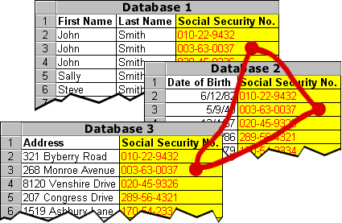
Relational database model
Stores both
Data about real world objects (entities) in tables
Relationships between the tables
Adapted from slides on Databases and DBMS by Todd S. Bacastow

Slide 12
Informal Definitions
Informally, a relation looks like a table of values.
A relation typically contains a set of rows.
The data elements in each row represent certain facts that correspond to a real world entity or relationship in ER Diagram
Rows are called tuples
Each column has a column header that gives an indication of the meaning of the data items in that column
In the ER model, the column header is called an attribute name (or just attribute)
Copyright © 2007 Ramez Elmasri and Shamkant B. Navathe

Slide 13
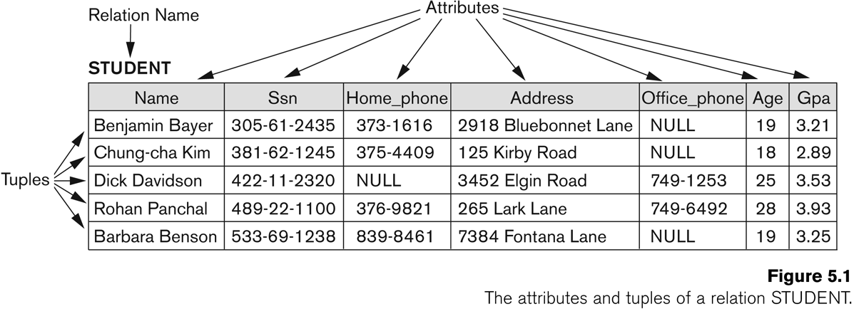
Example of a Relation
Copyright © 2007 Ramez Elmasri and Shamkant B. Navathe

Slide 14
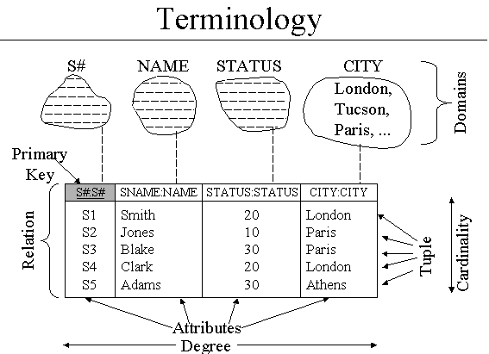

Slide 15
Terms
Table
A collection of relevant data relating to one type of real world objects.
Column
A specific place for one type of data relating to one type of real world objects.
Domain
Set of all possible values for a specific column.
Row
Collection of data describing one real world object.
Primary Key
Columns, which are part of the row and uniquely identify any one row.

Slide 16
Relational Terminology - Candidate and Primary Keys
A candidate key is a minimal subset of attributes in a relation which uniquely identifies each tuple in the relation
One of the candidate keys of a relation is chosen to be the primary key of the relation
If there is only one candidate key for a relation, then the candidate key automatically becomes the primary key
Each value taken by a primary key must be unique and must not be null
Notes:
A candidate key is a special type of superkey because it uniquely identifies each tuple in a relation.

Slide 17
Relational Terminology - Foreign Keys
Foreign keys are used to link tuples to represent a relationship between the tuples
A foreign key usually references a primary key (but may reference any set of attributes which has had a unique constraint applied to it)
Despite what some textbooks and websites say:
The primary key referenced by a foreign key may be in the same relation as the foreign key
A foreign key may be null
Notes:
Foreign keys link tuples in one relation with another to represent a relationship.
A primary key that is referenced by a foreign key can be in the same relation as the foreign key. Think unary relationship. Anyone remember what that is?
A foreign key may be null.
Now for those of you wondering what sort of questions could possibly be in an exam for this unit, this all seems pretty promising don’t you think? That is a hint.

Slide 18
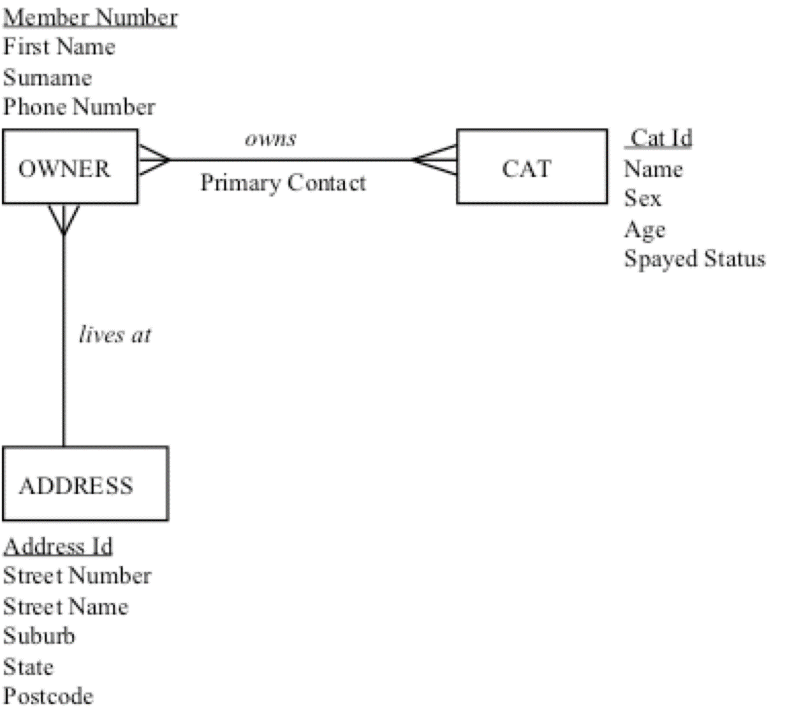
Database Relational Schema
Address (AddressId, [pk] StreetNumber, StreetName, Suburb, State, Postcode)
Cat (CatId, [pk] Name, Sex, Age, Spayed)
CatOwner (MemberNumber [fk1], CatId [fk2], [pk]PrimaryContact)
Owner (MemberNumber, [pk] FirstName, Surname, Phone, AddressId [fk])
Conversion
Notes:
So, what are the relations?
What are the primary keys?
What are the foreign keys?

Slide 19
Database Querying Theory

Slide 20
Database
We have a database containing a number of relations
The relations (tables) contains many data tuples
So what Next??
We need to extract data out of the database
Or create queries
Who are the employees who earn more than $50,000
Who earn the most in the Research department
What department pays the highest salary in the company

Slide 21
Relational Algebra
Theoretical way of manipulating table contents using relational operators
Structured Query Language (SQL) is used to accomplish relational algebra operators
Relational operators have the property of closure
Closure: Use of relational algebra operators on existing relations produces new relations

Slide 22
Relational Algebra
Basic operations:
Selection ( ) Selects a subset of rows from relation.
Projection ( ) Deletes unwanted columns from relation.
Cross-product ( ) Allows us to combine two relations.
Set-difference ( ) Tuples in reln. 1, but not in reln. 2.
Union ( ) Tuples in reln. 1 and in reln. 2.
Additional operations:
Intersection, join, division
Notes:
6

Slide 23
Select
Selects rows that satisfy selection condition.
Schema of result identical to schema of (only) input relation.
Result relation can be the input for another relational algebra operation! (Operator composition.)
Notes:
8

Slide 24
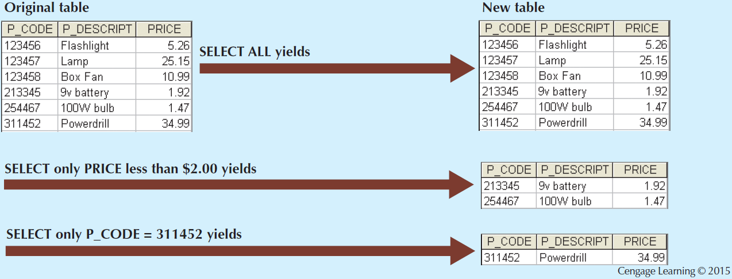
Select [σ_{row} _{condition} (table)]

Slide 25
Projection
Deletes attributes that are not in projection list.
Schema of result contains exactly the fields in the projection list, with the same names that they had in the (only) input relation.
Projection operator eliminates duplicates!
Note: real systems typically don’t do duplicate elimination unless the user explicitly asks for it. (Why not?)
Notes:
7

Slide 26
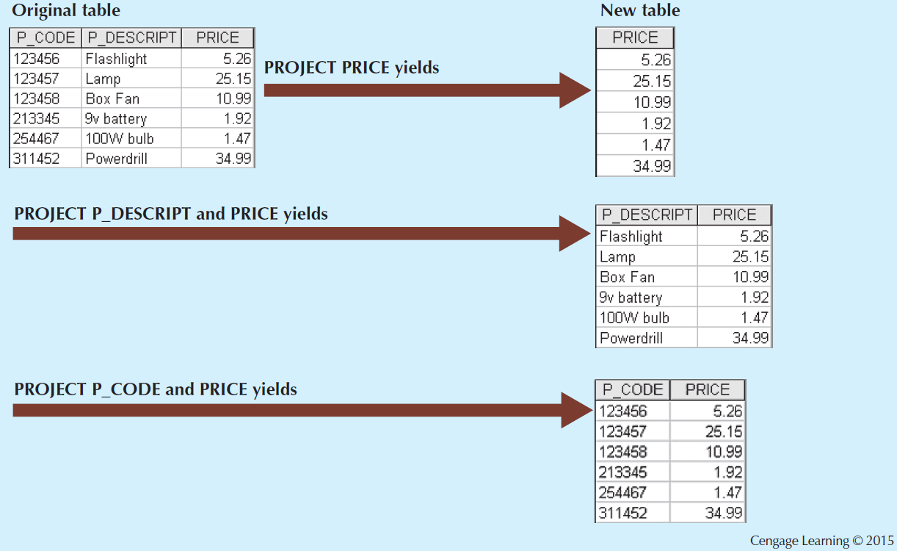
Project [π_{column1,column2}(table)]

Slide 27
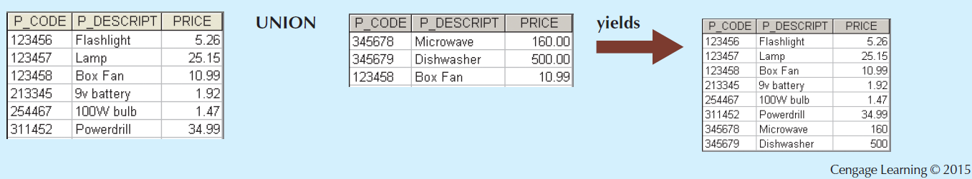
Union [R₁ ∪ R₂]
All of these operations take two input relations, which must be union-compatible:
Same number of fields.
`Corresponding’ fields have the same type.

Slide 28
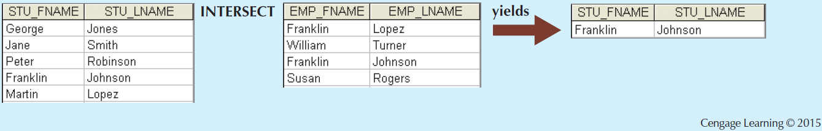
Intersect [R₁ ∩ R₂]

Slide 29
More Relational Set Operators
Difference [R₁ - R₂]
Yields all rows in one table that are not found in the other table
Tables must be union-compatible to yield valid results
Product [R₁ × R₂]
Yields all possible pairs of rows from two tables

Slide 30
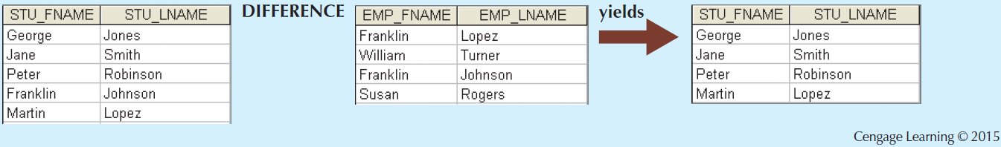
Difference

Slide 31
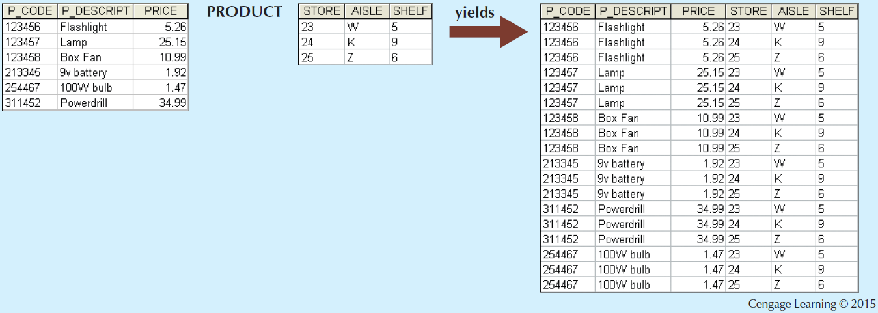
Product

Slide 32
Relational Set Operators
Join
Allows information to be intelligently combined from two or more tables
Divide
Uses one 2-column table as the dividend and one single-column table as the divisor
Output is a single column that contains all values from the second column of the dividend that are associated with every row in the divisor

Slide 33
Types of Joins
Natural join: Links tables by selecting only the rows with common values in their common attributes
Join columns: Common columns
Equijoin: Links tables on the basis of an equality condition that compares specified columns of each table

Slide 34
Types of Joins
Inner join: Only returns matched records from the tables that are being joined
Outer join: Matched pairs are retained and unmatched values in the other table are left null
Left outer join: Yields all of the rows in the first table, including those that do not have a matching value in the second table
Right outer join: Yields all of the rows in the second table, including those that do not have matching values in the first table

Slide 35
EXAMPLE JOIN
Natural Join, (Emp Dept)))
SS# | Name | Age | Salary | dno
1 | Joe | 24 | 20000 | 2
2 | Mary | 20 | 25000 | 1
3 | Bob | 22 | 27000 | 1
4 | Kathy | 30 | 30000 | 2
5 | Shideh | 4 | 4000 | 1
dno | dname | floor | mgrss#
1 | Toy | 1 | 5
2 | Shoe | 2 | 1
Dept
EMP
SS# | Name | Age | Salary | dno | dname | floor | mgrss#
1 | Joe | 24 | 20000 | 2 | Shoe | 2 | 1
2 | Mary | 20 | 25000 | 1 | Toy | 1 | 5
3 | Bob | 22 | 27000 | 1 | Toy | 1 | 5
4 | Kathy | 30 | 30000 | 2 | Shoe | 2 | 1
5 | Shideh | 4 | 4000 | 1 | Toy | 1 | 5
(dno)

Slide 36
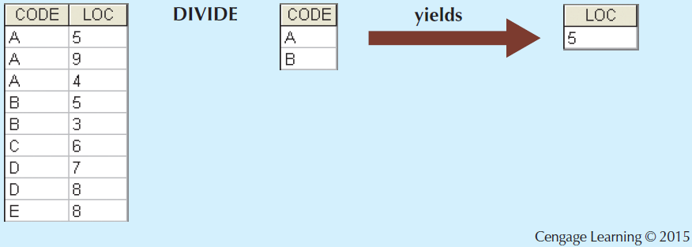
Divide

Slide 37
Examples of Division A/B
B1
B2
B3
A/B1
A/B2
A/B3
A
Notes:
14

Slide 38
Summary: Key points
Designing Database
Business rules
ER Diagram
Relational model
Extracting information from Relations
Relational Algebra

Slide 39
Assignment 1: Database Design
Scenario: You have been asked by Amazon Web services (AWS) to design database for their Cloud Marketplace i.e. their website-> https://aws.amazon.com/marketplace
Phase 1: Business Rules Collection & Reflection [Submission ]
You need to write business rules after studying https://aws.amazon.com/marketplace .Word limit is 400 words.
Submit them on Mylo by 26 July Monday 11.55pm
You will get 1 Marks for your submission
Write reflection on your submission based on the business rules provided on Mylo by unit coordinator. You need to write what you got right and what you got wrong. It should not be more than 150 words
The business rules given by unit coordinator will be available on 27 July Morning
You will be given 1.5 mark for this depending on how accurate your analysis is.
Phase 2: Using Business rules provided by unit coordinator to conceptual and logical model
Submission on Mylo by 9th August 1 PM
Final Submission include-your reflection on business rules, conceptual model i.e. ER diagram, conversion steps to logical model, your final relational model.

