Slide 1
SQL Intro
KIT712 Lecture 3

Slide 2
Announcements
Consultation hours are already advertised this week
Communication through emails should be short.
Discussion boards will be enabled soon..

Slide 3
Last Week
Data Models
Relational Model
Conversion from conceptual model to Relational model
Relational Algebra

Slide 4
Quiz
Which of the following data models allows one to many relationships?
Network Model
Hierarchical Model
File Structure
None of the above

Slide 5
Quiz
Which of the data model is the most inflexible in comparison to other choices?
Network Model
Hierarchical Model
File Structure
Relational Model

Slide 6
is there any difference between following two ER diagrams?
STUDENT
UNIT
Yes or No?
STUDENT
UNIT

Slide 7
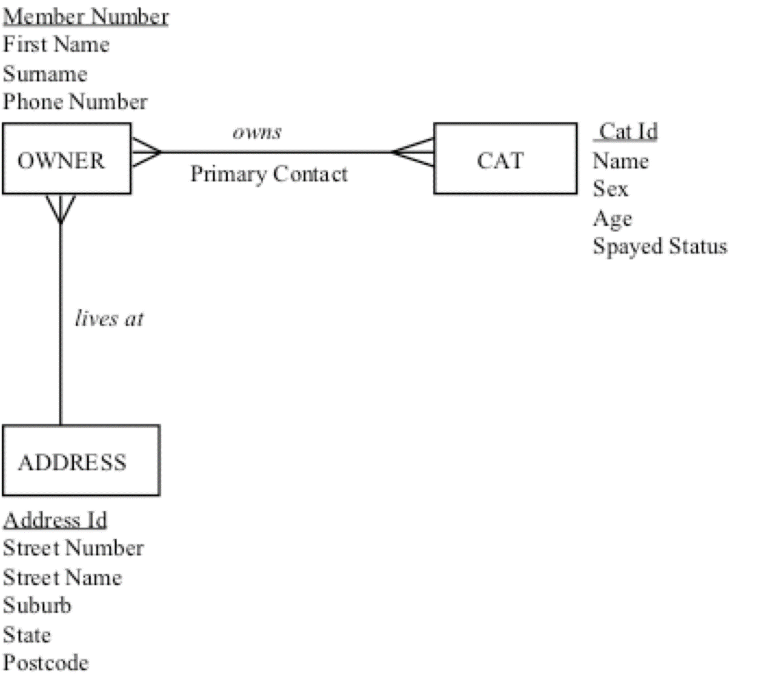
How many relations following conceptual model will results in after conversion?
Three
Four
Five
Two

Slide 8
Let us assume relation A (has 4 attributes and 5 rows) and B (has 2 attributes and 3 rows). Let C=A X B. What will be number of attributes and rows in the C relation?

Slide 9
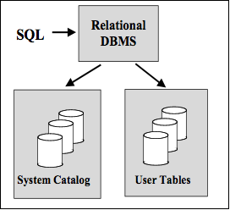
Role of SQL (Structured Query Language)
A database programming language
A database administration language
Has components for DDL, DML
DDL Data Definition Language
CREATE, ALTER, RENAME, DROP
DML Data Manipulation Language
SELECT, INSERT, UPDATE, DELETE
Notes:
SQL is central to all of those relational database management systems.
SQL is a database programming language., a database administration language, a client/server language, and a distributed database language.
You just use SQL to interact with the RDBMS, and it does the rest of the work for you.

Slide 10
Creating Tables
Example of simple create table statement:
create table “tablename”
(“column1” “data type”,
“column2” “data type”,
“column3” “data type”);
The create table statement is used to create a new table.
The data types specify what the type of data can be for that particular column.

Slide 11
Creating Tables cont…
Problem: Create a table for a new company that contains the following information about your new employees: first name, last name, title, age, and salary.
Answer:
Create table myemployees
(firstname varchar(30),
lastname varchar(30),
title varchar (30),
age number(2),
salary number(8, 2));

Slide 12
Drop a Table
The drop table command is used to delete a table and all rows in the table.
drop table is different from deleting all of the records in the table. Dropping the table removes the table definition as well as all of its rows.
Example:
Drop table “tablename”

Slide 13
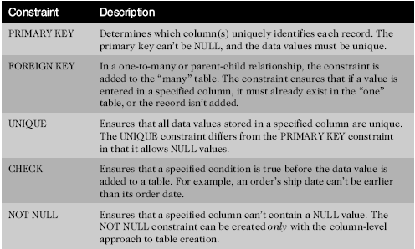
Constraints
Rules used to enforce business rules, practices, & policies
Rules used to ensure accuracy & integrity of data
Oracle 11g: SQL

Slide 14
Creating Constraints
Use the optional CONSTRAINT keyword during creation to assign a name
Let the server name the constraint using the default format SYS_Cn
Informative names can assist in debugging [& marking!]
Oracle 11g: SQL

Slide 15
Creating Constraints (continued)
When
During table creation
After table creation, by modifying the existing table
How
Column level approach
Table level approach
Oracle 11g: SQL

Slide 16
Creating Constraints at the Column Level
If a constraint is being created at the column level, the constraint applies to the column specified
Oracle 11g: SQL

Slide 17
Creating Constraints at the Table Level
Approach can be used to create any constraint type except NOT NULL
Required if constraint is based on multiple columns
Oracle 11g: SQL

Slide 18
Enforcement of Constraints
All constraints are enforced at the table level
If a data value violates a constraint, the entire row is rejected
Oracle 11g: SQL

Slide 19
Adding Constraints to Existing Tables
Constraints are added to an existing table with the ALTER TABLE command
Add a NOT NULL constraint using MODIFY clause
All other constraints are added using ADD clause
Oracle 11g: SQL

Slide 20
Using the PRIMARY KEY Constraint
Ensures that columns do not contain duplicate or NULL values
Only one per table is allowed
Oracle 11g: SQL

Slide 21
Using the FOREIGN KEY Constraint
Requires a value to exist in the referenced column of another table
NULL values are allowed
Enforces referential integrity
Maps to the PRIMARY KEY in parent table
Oracle 11g: SQL

Slide 22
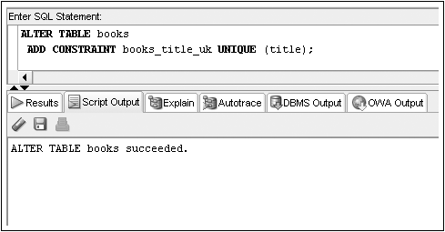
Using the UNIQUE Constraint
No duplicates are allowed in the referenced column
NULL values are permitted
Oracle 11g: SQL

Slide 23
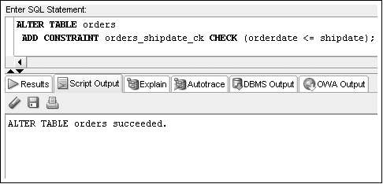
Using the CHECK Constraint
Updates & additions must meet specified condition
Oracle 11g: SQL

Slide 24
Using the NOT NULL Constraint
The NOT NULL constraint is a special CHECK constraint with IS NOT NULL condition
Can only be created at column level
Included in output of DESCRIBE command
Can only be added to an existing table using ALTER TABLE…MODIFY command
Oracle 11g: SQL

Slide 25

SQL for Data Retrieval
SQL allows a user or an application program to retrieve stored data from the database and to manipulate the data
Retrieves data from one or more rows
Each SELECT statement produces a table of query results (the “target” table) containing zero or more rows with one or more columns
Operates on one or more tables at a time, not on a record at a time
Notes:
As you’ve probably guessed by now, you can retrieve and manipulate data from a database using SQL.
To do this, you use the SELECT statement. It displays a table of query results with one or more columns and 0 or more rows.
It works on one or more tables at a time, rather than on each record.

Slide 26
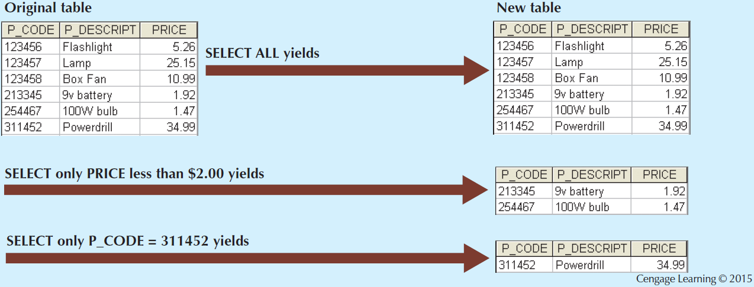
Select [σ_{row} _{condition} (table)]

Slide 27
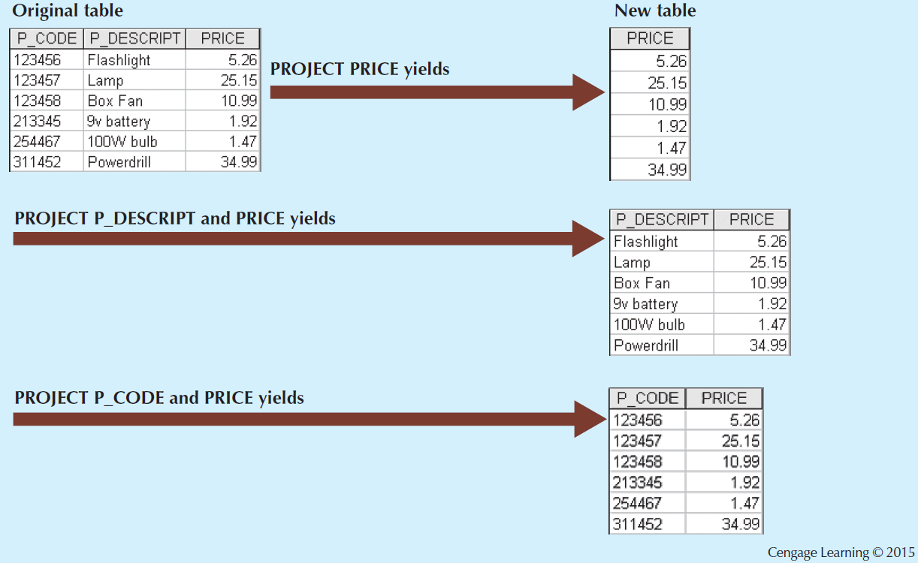
Project [π_{column1,column2}(table)]

Slide 28
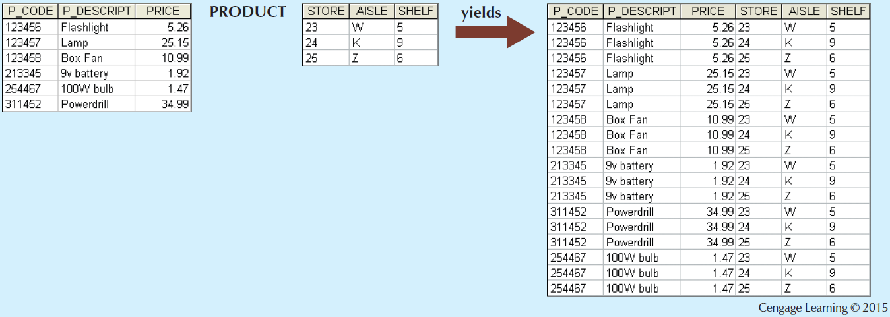
Product(‘x’)

Slide 29
SQL as a Query Language
Column names
Table names
Basic SQL Query:
select A1, A2, …, An from T1 , T2, … , Tm
where < sel-cond> ;
Conditions
Adapted from Naveen Ashish’s Slides on SQL

Slide 30
Example
Relations: E(ename, dno, proj#, sal, location) -> contains name of employee, department number, project number, salary and location
D(dno, dname, mgr)->contains department number, department name and manager name
Query: find employees and the department name they work for
SQL
Select ename, dname
from E, D
where D.dno = E.dno;
SELECT Operation
Projection Operation
Product Operation
dno | dname | mgr
2 | HR | Harry
3 | Eng | Harry
Conditions
Ename | dno | Proj# | Sal | location
Ram | 3 | 234 | 50000
John | 2 | 237 | 2000
Adapted from Naveen Ashish’s Slides on SQL

Slide 31
Where Clause
Ename | dno | Proj# | Sal | location
Ram | 3 | 234 | 50000
John | 2 | 237 | 2000
case sensitive constants
select *
from E
where E.location = ‘Jakarta’
list all the information in E about employees in Jakarta.
where clause is optional
select *
from D
List all the information in D.
dno | dname | mgr
2 | HR | Harry
3 | Eng | Harry
conjunction and disjunctions
select ename
from E, D
where E.dno = D.dno AND
D.mgr = ‘Sally’ AND
sal < 10000;
Who works for Sally and has a salary < 10K
Adapted from Naveen Ashish’s Slides on SQL

Slide 32
More comparison operators
mysql> select * from Cat where Age between 2 and 4;
+-------+----------------+-----+------+--------+
| CatId | Name | Sex | Age | Spayed |
+-------+----------------+-----+------+--------+
| 7 | Max | M | 3 | Y |
| 8 | Nermal | M | 2 | N |
| 12 | Suzi Marmalade | F | 3 | N |
| 14 | Lucky | M | 4 | Y |
| 18 | Jerry | M | 4 | Y |
| 19 | Pinky | F | 3 | Y |
+-------+----------------+-----+------+--------+
mysql> select * from Cat where Age in (2, 3, 4);
+-------+----------------+-----+------+--------+
| CatId | Name | Sex | Age | Spayed |
+-------+----------------+-----+------+--------+
| 7 | Max | M | 3 | Y |
| 8 | Nermal | M | 2 | N |
| 12 | Suzi Marmalade | F | 3 | N |
| 14 | Lucky | M | 4 | Y |
| 18 | Jerry | M | 4 | Y |
| 19 | Pinky | F | 3 | Y |
+-------+----------------+-----+------+--------+
BETWEEN .. AND .. checks if the value in the column is in a range of values
WHERE Age BETWEEN 2 AND 5
IN (list) checks if the value in the column matches any value in a list of values
WHERE Age IN (2, 3, 4, 5)

Slide 33
Special Comparison Operator
IS [NOT] NULL
WHERE Age IS NULL
WHERE Age IS NOT NULL
You should not write WHERE Age = NULL
Some SQLs will look for a column called NULL
You should not write WHERE Age = 'NULL'
Some SQLs will look for the text string NULL in the column Age
mysql> select * from Cat where Age is null;
Empty set (0.00 sec)
mysql> select * from Cat where Age is not null;
+-------+----------------+-----+------+--------+
| CatId | Name | Sex | Age | Spayed |
+-------+----------------+-----+------+--------+
| 1 | Binky | M | 6 | Y |
| 2 | Mischief | M | 5 | Y |
| 3 | Trouble | M | 9 | Y |
| 4 | Usagi | M | 8 | Y |
| 5 | Mayhem | M | 1 | Y |
| 6 | Xylene | F | 5 | N |
| 7 | Max | M | 3 | Y |
| 8 | Nermal | M | 2 | N |
| 9 | Garfield | M | 15 | Y |
+-------+----------------+-----+------+--------+
18 rows in set (0.01 sec)
Notes:
And then there is NULL.
Where Age is Null or Where age is Not null.
You don’t write Where Age = null. If you’re using a different type of sQL, then it will make a comparison with a table called NULL.
And you shouldn’t write NULL in quotes either. It will look for the word NULL.

Slide 34
Disambiguating Attribute Names
Relation-name.attribute-name used to disambiguate when attribute appears in multiple relation schemas
select ename, dname, D.dno
from E, D
where E.dno = D.dno;
List all employees, their departments name and department number.
Adapted from Naveen Ashish’s Slides on SQL

Slide 35
Table Alias
as clause can be used in the from clause to define tuple variables. Tuple variables used to disambiguate multiple references to the same relation in the from clause.
select E1.ename
from E as E1, D, E as E2
where E1.dno = D.dno AND
D.mgr = E2.ename AND
E1.sal > E2.sal;
Who makes more than their manager ?
E
ename | dno | Proj# | sal | location
Ram | 3 | 234 | 2000
John | 2 | 237 | 5000
dno | dname | mgr
2 | HR | Harry
3 | Eng | Harry
D
Adapted from Naveen Ashish’s Slides on SQL

Slide 36
Ordering the Display of Tuples
select *
from E
order by dno, sal desc, ename;
Print out E. Order the tuples by dept #. Within each dept, order from highest to lowest salary.
For salary ties, use alphabetical order on last name
ename dno sal location
Susan 1 30K Hob
Mary 1 20K Hob
Jane 1 19K Hob
Jim 2 15K Melb
John 2 15K Melb
ename | dno | Proj# | sal | location
Ram | 3 | 234 | 2000 | Melb
John | 2 | 237 | 5000 | Hob
E
dno | dname | mgr
2 | HR | Harry
3 | Eng | Harry
D
Adapted from Naveen Ashish’s Slides on SQL

Slide 37
Aggregate Functions
SQL provides useful functions that can:
Count
Find minimum and maximum values
Calculate averages
SQL allows user to limit queries
SQL also allows string and arithmetic operations such as +, -, /, sqrt() etc

Slide 38
Aggregate Functions
What is the minimum, maximum, average salary of employees in the toy department ?
Functions: min, max, sum, count, avg
input: collection of numbers/strings (depending on operation)
output: relation with a single attribute with single row
select min(sal), max(sal), avg(sal)
from E, D
where E.dno = D.dno and D.dname = “Toy”;
Except count, all aggregations apply to a single attribute
SELECT Count(*)
FROM Purchase
Adapted from Naveen Ashish’s Slides on SQL

Slide 39
GROUP BY - Example
GROUP BY ... is used when you want to apply a function (count, sum, avg) to a group of rows having a common characteristic.
Transcript
Attributes:
-student’s Id
-avg grade
-number of courses
1234
1234
1234
1234
1234 3.3 4
SELECT T.StudId, AVG(T.Grade), COUNT (*)
FROM Transcript T
GROUP BY T.StudId
Adapted from Prof Sin-Min Lee slides on SQL

Slide 40
Multiple Table Queries

Slide 41
Exercise
How can we find the population of the capital city for each country?
Country
Code (PK)
Name
Continent
Region
SurfaceArea
Population
GNP
LocalName
CapitalCity_ID
City
ID (PK)
Name
CountryCode District
Population
Two Ways:
get capital id from country table and then search in city table? (Subqueries)
Join two tables and search in that joined table

Slide 42
Table Joins
Query data from more than one table
Write the join condition in the WHERE clause
Specify which rows to keep
Field(s) in one table must match field(s) in the other table in some way
“Match” is usually equality
Cartesian product is formed when the join condition is missing
All rows from one table are joined to all rows in the other table(s)
Notes:
Joins allow you to query data from more than one table.
You put the join condition in the WHERE clause.
You can tell it which rows to keep.
The fields in one table must match the fields in the other table, and matching usually means that they’re equal.
If you don’t put in a join condition then you get the Cartesian product, where all the rows from one table are joined to all the rows of the other table, and that’s generally not that useful.

Slide 43
Join Expressions
SQL provides several versions of joins.
These expressions can be stand-alone queries or used in place of relations in a FROM clause.
Types of Join
Natural Join/Inner Join
Outer Join
Adapted from Naveen Ashish’s Slides on SQL

Slide 44
EXAMPLE JOIN (Natural/Inner Join)
Select * from EMP inner join Dept on Emp.dno=Dept.dno
dno | dname | floor | mgrss#
1 | Toy | 1 | 5
2 | Shoe | 2 | 1
SS# | Name | Age | Salary | dno
1 | Joe | 24 | 20000 | 2
2 | Mary | 20 | 25000 | 1
3 | Bob | 22 | 27000 | 1
4 | Kathy | 30 | 30000 | 2
5 | Shideh | 4 | 4000 | 1
Dept
EMP
SS# | Name | Age | Salary | dno | dname | floor | mgrss#
1 | Joe | 24 | 20000 | 2 | Shoe | 2 | 1
2 | Mary | 20 | 25000 | 1 | Toy | 1 | 5
3 | Bob | 22 | 27000 | 1 | Toy | 1 | 5
4 | Kathy | 30 | 30000 | 2 | Shoe | 2 | 1
5 | Shideh | 4 | 4000 | 1 | Toy | 1 | 5

Slide 45
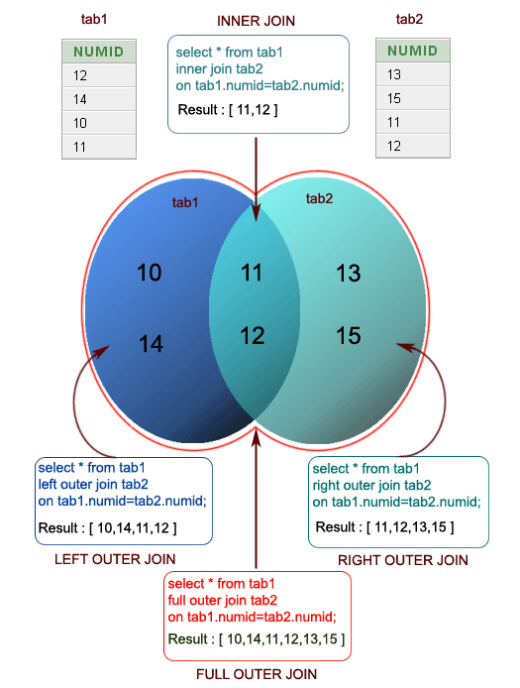
Summary Join

Slide 46
Question 1:
If Owner table has 8 rows and Address table has 5 rows, how many rows following query will display?
Select * from Owner, Address;

Slide 47
Subqueries
Remember each operation on the database:
Acts on one or more tables
Produces a “target table” as a result
We use the result table as an operand in another operation
Notes:
And then there are subqueries.
Whenever we do an operation, it creates a target table as a result.
With a sub query, we can do queries on that sub table.

Slide 48
Subqueries – Simplified Syntax
SELECT select_list FROM (SELECT select_list FROM table) AS alias WHERE condition(s);
Subquery in FROM clause
Subquery in WHERE clause
SELECT select_list FROM table WHERE column operator (SELECT select_list FROM table);
Notes:
So, we can do a sub query in the from or the where clauses.
In he first one, we’re selecting from a sub-list from t a table.
In the second one we’re using the where statement as a condition, where a select statement is that condition
Confusing, but examples will help.

Slide 49
Subqueries Producing One Value
Usually subqueries produce a relation as an answer. However, sometimes we expect them to produce single values
SubQuery
SELECT Purchase.product
FROM Purchase
WHERE buyer =
(SELECT name
FROM Person
WHERE social-security-number = “123 – 45-6789”);
In this case, the subquery returns one value.
If it returns more, it’s a run-time error.

Slide 50
Thank You!! Any Questions?

