Slide 1
COMP220: Software Development Tools COMP285: Computer Aided Software Development
Sebastian Coope Room LG18
coopes@liverpool.ac.uk
All Materials, assessments and submissions are via Canvas

Slide 2
Delivery
Lectures
Weekly lectures 3 Hours
Lab sessions
1 Hour/week (see timetable for details)

Slide 3
Assessments
COMP220
80% Canvas test examination
20% continuous assessment:
Class Test (Online canvas test) 10%
Lab Test (2 hours, practical test) 10%
COMP285
50% Lab Test (same as for COMP220)
50% Practical Assignment

Slide 4
Module aims
To explore software development tools and new methodologies of Software Development
To examine the techniques for implementing some Extreme Programming practices such as
Automated Testing,
Continuous Integration and
Test Driven Programming
To provide an insight into Eclipse (Integrated Development Environment)

Slide 5
Contents
Methodology of Extreme Programming
(brief, methodological part)
Software testing theory and practice
Introduction to software tools
Source code control
Java Development with Eclipse
Ant
Junit

Slide 6
Other tools that will be introduced
Source code (svn and git)
Build (Maven)
ORM (Hibernate)

Slide 7
Recommended texts
Java Development with Ant – E. Hatcher & S.Loughran. Manning Publications, 2003 (ISBN:1-930110-58-8)
Ant in Action, Second Edition of Java Development with Ant Steve Loughran and Erik Hatcher July, 2007 (ISBN: 1-932394-80-X)
Eclipse in Action, A Guide for Java Developers, – D.Gallardo, E.Burnette, & R.McGovern. Manning Publications, 2003 (ISBN:1-930110-96-0)
JUnit in Action, Second edition(!! For New version of JUnit (4); Old version of JUnit 3 will not be considered. ), P. Tahchiev, F. Leme, V. Massol, G. Gregory, Manning Publications, 2011. (ISBN: 9781935182023)

Slide 8
Extra reading
Java Tools for Extreme Programming – R.Hightower & N.Lesiecki. Wiley, 2002 (ISBN:0-471-20708-X)
Professional Java Tools for Extreme Programming – R.Hightower et al. Wiley, 2004 (ISBN:0-7645-5617-7)
Test Driven Development – K.Beck. Addison-Wesley, 2003 (ISBN:0-321-14653-0)

Slide 9
Lab sessions
Labs will be devoted to simple exercises helping to really understand how the software development tools (discussed on lectures) work in practice
Inseparable from the lectures
The best and easiest way to prepare to the Exam and Class Test (for COMP220) during the semester
Without doing labs well you will be unable to do and pass Lab Test (for both COMP220 and COMP285).
COMP285 will have additional Practical Assignment and no exam. Thus, labs are invaluable for you

Slide 10
Lecture 1
Introduction to CASE tools
Why bother?
What types?
How they work in practise?

Slide 11
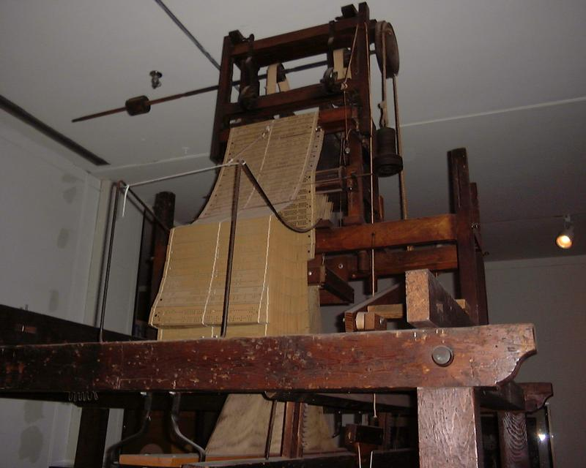
Computer Aided Software Engineering
Well what would be Software Engineering without computers?
Jacquard machine (loom)

Slide 12
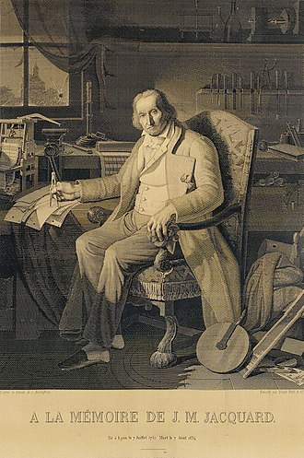
Output

Slide 13
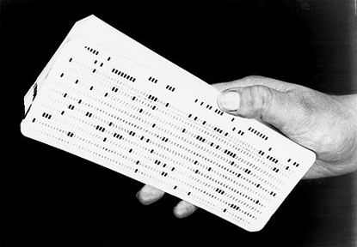
Early days
Software Engineering Stone Age style
All programs verified by hand

Slide 14
Early days
Code written in machine code
Not enough memory for debug code addition
CPU time too slow for debugger
No compile stage, so 1 mistake often means program just has fatal crash
Limited output display

Slide 15
CASE definition
“Computer-aided software engineering (CASE) is the application of computer-assisted tools and methods in software development to ensure a high-quality and defect-free software.”
CASE tools can be
General purpose, example build/test tools (language neutral)
Specialist e.g. Load testing/DoS tool like Low Orbit Ion Cannon
Built yourself (test harness)

Slide 16
Are these tools
High Level Language Compilers/Interpreters
Object Relational Management software
Example Hibernate
Profilers
Debuggers
Code analysers

Slide 17
Why tools?
Would you hire a building company who used?
No power tools (productivity cost)
No measuring instruments (accuracy)
No spirit levels or electrical testing tools (quality)
Proper scaffolding/access control (safety)
With software, these issues also matter
Productivity, accuracy, quality, safety

Slide 18
Why use CASE?
Used properly
You will become a better software engineer
You will work better with others
Your code will be tested more
You will do things, you wouldn’t normally bother to do (e.g. re-factoring code)
Your life as a software engineering will be slightly less stressful

Slide 19
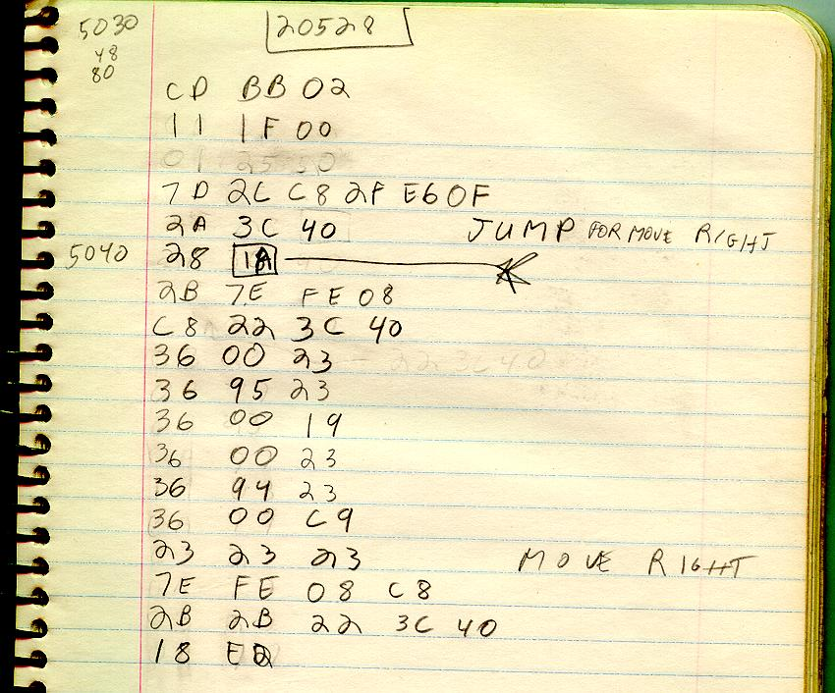
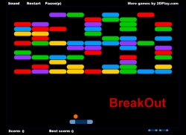
Think of CASE as a series of developments
Machine language (no real CASE)
Seb 1983 Apple II

Slide 20
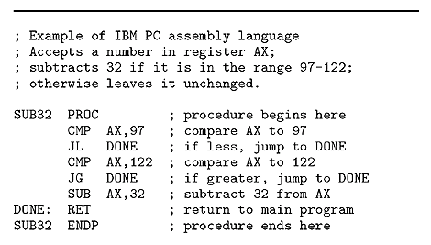
Assembly language
Simple case tool called an assembler translates to machine code, 1 to 1 relation to machine code
No type check, complex data types, all abstraction in programmers head

Slide 21
High Level Language Compilers
Translate from abstract (non machine language) to machine language of intermediary code
Abstractions are constructed as part of the language, e.g. int, long, String, Person, BankManager
Code is capable of
Being structured
Being tested as part of compilation

Slide 22
Interpreters
Programs which run programs, like JVM for Java (Forth, Basic)
Interpreters can be
Source code based (execute the code directly) e.g. Java script interpreters
Fast turnaround time, no-precompile check, only checks running code
Intermediary code based
e.g. Java byte code, slower turnaround, supports pre-compile check

Slide 23
Interpreter features
Program can be debugged by facilities in JVM
JVM can run time check code for
Errors (array out of bounds)
Type conversion issues
Garbage collection (contentious, see iOS debate)
JVM can be ported to different hardware, making object code portable

Slide 24
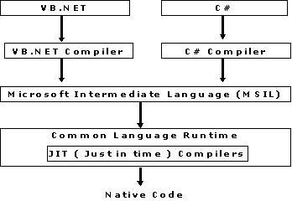
Intermediary code systems
Allows for multiple languages to easily integrate, parts of code can be written in language of choice
Good or bad thing?

Slide 25
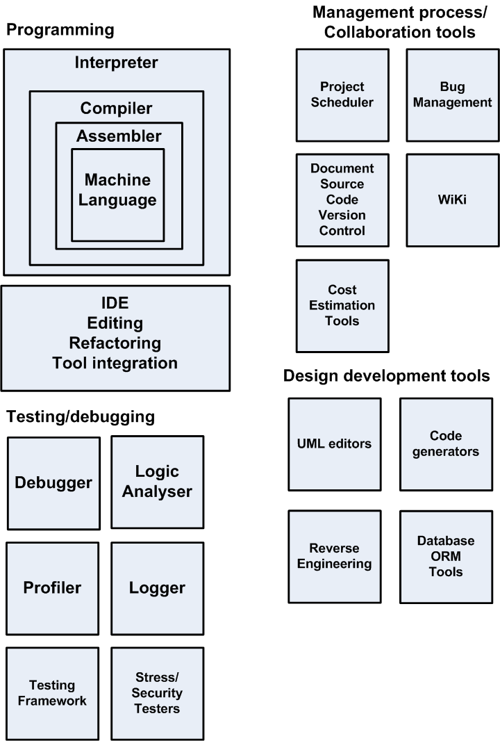
CASE in perspective

Slide 26
Development IDEs
General purpose
Eclipse (Java, C, C#, C++) etc
Specialist
PHP Storm
Benefits
Improves productivity
Code generation
Integrated debugging
Re-factoring
Integration with other tools

Slide 27
Some case tools
Software Debugger
Allows for
Program to be stepped
Variables to be examined
Reading of stack
Inspect event listeners
Focused on specific programming languages
JavaScript in Chrome (can run via remote cable to Android)
Java debugger in Eclipse

Slide 28

In circuit emulator
Does all functions of software debugger but at machine instruction level
ICE replaces CPU in target motherboard
Very useful for embedded debugging e.g. smartphone, DVD player etc.
ICE
CPU socket
Motherboard

Slide 29
ICE features
Breakpoint before instruction execution
Breakpoint on complex conditions
Write particular data value to memory location
Write/read from I/O
Hardware interrupt
Difference to software debugger
Faster (runs at full CPU speed)
Can break on a full range of hardware conditions at the CPU level (example register access)

Slide 30
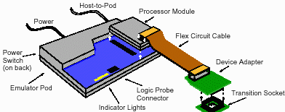
ICE example

Slide 31
ICE tracing
Instruction trace
The ICE can record all the instructions executed up to the breakpoint (how we got here)
Jump trace
The ICE can trace all flow of control instructions going to a certain point

Slide 32
Logic analyser
Does not need to emulate CPU
Can work with any CPU or circuit that probe can connect to
Can read all hardware activity
Read only
Data+address info
Host machine
CPU
Probe
Machine code + source code here
CPU socket
Motherboard

Slide 33
Logic analyser
Can
Take snapshot of code execution include with trace of code (define usually by break condition)
Run the code at full speed
Not require debug code added
Debug race conditions (speed sensitive)
Monitor hardware/software interaction
Decompile the code to original C/C++ if source code loaded into target
Debug hardware + software

Slide 34
Logic analyser
Cannot
Step sopt and then step code line by line (code has already executed)
Can
Allows the host emulator to emulate the code execution after it has finished execution
Can
Be connected to any part of the hardware DMA, network card, external bus (USB e.g.)

Slide 35

Kernel mode soft debugging
Same functions as ICE but uses debug features of CPU, driver loaded into OS
Can be used to debug device drivers
Examples
Windbug kernel mode for windows
Debug console
Target
machine

Slide 36
Profiler
Calculates how much
Time is used by different parts of your code
Memory is used by different parts of code
Useful for
Code optimization for
Faster code
Code to use smaller memory footprint

Slide 37
Logger
Used to record all activities of program
Logged can record activity to
File
Database
Email account
Can be used for
Security logging (e.g. everytime bad password)
Financial logging (everytime a credit card is used)
Debug logging (entry and exit to methods)

Slide 38
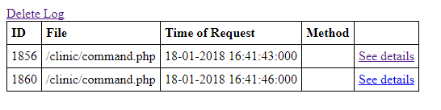
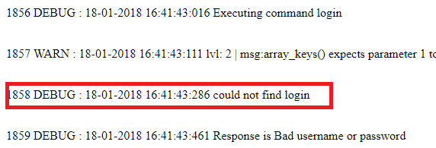
Logger
In code…
trace ('could not find login',Logger::DEBUG);
On screen: (http://test.dunes-software.com:81/clinic/trace.php)

Slide 39
Testing Frameworks
Junit
Allows for testing of code and production of test reports
Integrated for Eclipse in form of Junit Wizard and plug
PHP Unit
Same for PHP
All use assertions to test if code is correct
Using testing framework is important part of Test Driven Development (see next lecture)

Slide 40
Stress Testing tools
Mysqlslap
Sends heavy load to MySQL server
Website load testing tools
Many choices (LOIC simple, Neoload (more complex)
Have to be able to simulate complex real transactions (not just send random traffic)
Benefits
Optimise the performance of website
Determine maximum user load
Determine what happens when system reaches heavy load

Slide 41
Code development tools
Code translators
Example Java to JavaScript
Jsweet (http://www.jsweet.org)
Support for browser DOM objects like
Writing to fields in webpage
Support for HTML canvas
The whole web app active code can be written in Java
Example code is here:
http://cgi.csc.liv.ac.uk/~coopes/dokuwiki/doku.php?id=jsweet

Slide 42
Benefits of Cross compiling
Have single code base for project
So encryption algorithm server side can be cross compiled to equivalent code for client side
Use higher level language
Java supports type checking (not in JavaScript), private, final, interface definitions
Can use Java libraries (if cross compiled)
Can use Java programmers

Slide 43
Project management tools
Zoho
https://www.zoho.eu/projects/
Online co-ordinate group project activitiy
(includes scheduling, charts, issue tracking)
Bug management/issue tracking
Active online database for tracking and chasing bugs
WiKi
Easy to edit website (good for general system documentation)

Slide 44
Cost Estimation tools
Some tools developed for Cocomo
Agile
Uses poker planning cost estimation
Not many software tools used for this, is mostly a manual process

Slide 45
Version document control
Allows
To keep all old versions of files
To allow more than 1 person to change a file at the same time and merge results
To provide access to old versions
To be able to track changes to files
Examples
svn, git
Note
All documents need some kind of version control

Slide 46
UML editors
Tools to allow UML diagrams to be produced electronically
Benefits
Higher quality diagrams
Allows hierarchical diagram linking
Things like class diagrams can be used to generate code automatically
Examples
Argo UML, Rational Rose, Papyrus (Eclipse plug-in)

Slide 47
Reverse engineering
Takes object code and converts to source code
Used to
Determine how product works
Determine if code is infringing IPR
Hack in, break copy protection
Examples
JD Project (Java decompiler) http://jd.benow.ca/
Disassembler (simplistic)
C decompilers
Process needs symbols lists to make sense of code

Slide 48
ORM relational manangement
Used to save objects directly to database with programmer having to write MySQL statements
Benefits
Saves programming time
Reduces MySQL errors
Improves performance (code can include performance enhances such as sharding)
Allows validation of parameters such as database table names

Slide 49
ORM Examples
Hibernate (Java based)
nHiberante (C# based)
Example class…
public class Stock implements java.io.Serializable {
private Integer stockId;
private String stockCode;
private String stockName;
private StockDetail stockDetail;
//constructor & getter and setter methods
}

Slide 50
ORM example code
<hibernate-mapping>
<class name="com.mkyong.stock.Stock" table="stock" catalog="mkyongdb">
<id name="stockId" type="java.lang.Integer">
<column name="STOCK_ID" />
<generator class="identity" />
</id>
<property name="stockCode" type="string">
<column name="STOCK_CODE" length="10" not-null="true" unique="true" />
</property>
<property name="stockName" type="string">
<column name="STOCK_NAME" length="20" not-null="true" unique="true" />
</property>
<one-to-one name="stockDetail" class="com.mkyong.stock.StockDetail"
cascade="save-update"></one-to-one>
</class>
</hibernate-mapping>

Slide 51
Processes with/without case
No CASE
Tester sends bug report to programmer via email, programmer looks at code, fixes code, sends new source back to tester
Problems
No proper record of bug and fix
Visibility of process limited (team leader manager)
Easy for bugs to get lost
Hard to but priority on bug

Slide 52
Bug fix with CASE
Tested finds bug and records on bug management tool (example Bugzilla) and assigns bug to programmer
Bug management tool sends email to programmer
Programmer logs into bug management tool and accepts/rejects bug and adds comment
Programmer updates latest source code from source code control system
Programmer fixes/tests bug using debugger
Programmer re-commits code back to source code control with comment, which links back to bug id
Programmer adds comment from source code control log and comment about how to test bug to bug control system
Team leader downloads all source code and makes new build

Slide 53
Bug fixing with CASE support
Looks a lot more work, but most of the CASE processes take v.little time
Allows bugs to be properly assigned to staff
Gives a clear view of the process to the management of the project
One can look back and find out which bugs were fixed on which versions of files
Makes sure that bug reports are filled in correctly

Slide 54
Summary
Using CASE can make you
Quicker
Better team working
More controlled
Many tools to choose from
Using IDE will encourage best practise
We will be looking in more detail at some of these tools in the next lecture

