Slide 1
Software Development
COMP220/COMP285
Seb Coope
Ant: Structured Build
These slides are mainly based on “Java Development with Ant” - E. Hatcher & S.Loughran. Manning Publications, 2003
Notes:
Lect 6 - Lect 7???

Slide 2
Imposing Structure
In the build process discussed in the previous lecture and considered in a Lab sessions:
source files, output files, and build file were in the same directory.
These were files Main.java, Main.class and build.xml in C:\comp220_285\lecture007
(In Labs you will use H: instead of C:)

Slide 3
Imposing Structure
In a bigger project, things could get out of hand.
We want to automate the cleanup in Ant.
If done wrong, this could accidentally delete source files.
Thus, let us separate source and generated files into different directories.

Slide 4
Imposing Structure
We also want to place Java source file into a Java package.
We want to create a JAR file containing the compiled code.
We should be able to clean up the directories with compiled files and this JAR file before starting the next build.
Hence, use (de facto) standard directory names as in the next table:

Slide 5
STANDARD DIRECTORY NAMES
Directory name | Function
src | source files
build\classes (or bin – a default in Eclipse) | intermediate output (generated; cleanable)
dist | distributable files (generated; cleanable)
Let these directories be sub-directories of a new
base directory:
C:\comp220_285\lecture007
Notes:
dist (or bin)

Slide 6
STANDARD DIRECTORY NAMES
Thus, we will have the following
directory structure:
C:\comp220_285\lecture007\src
\build\classes
\dist
which will be further extended.
Please relate all the following considerations and your Lab exercises exactly with the directory structure suggested in these slides
(except your personal directory structure under src related with your personal packages – to be discussed below).

Slide 7
Packages
Keep files together with close associations
Related to scope
Stops naming collisions
Relation with domain names
Reversed
comp220.csc.liv.ac.uk
dunes-software.com
Package could be
uk.ac.liv.csc.comp220.utils
com.dunes-software.utils

Slide 8
Laying out the source directories and source files
When working on a project it makes sense to add some (your personal) package declaration to our java classes such as Main.java considered in the previous lecture (and a Lab):
package org.example.antbook.lesson1; //package declaration
public class Main {
public static void main(String args[]) {
for(int i=0;i<args.length;i++) {
System.out.println(args[i]);
}
}
}
In this case we should also put so modified Main.java into the sub-…-sub-directory of src: src\org\example\antbook\lesson1
corresponding to (or matching) the above package name.

Slide 9
Laying out the source directories and source files
Recall that Java packages and “contained” in these packages Java classes are always organized in such a way:
– package names of Java classes exactly match directory system where to find them (also in JAR files).
That is, we use traditional agreement that any Java class declaring its package
package aaa.bbb.ccc;
MUST be contained in a corresponding sub-sub-…-directory
...\aaa\bbb\ccc

Slide 10
Laying out the source directories and source files
Recall also that packages give an appropriate level of access to their classes and methods.
It is quite reasonable that related classes are in the same package (i.e. have the same package declaration).
Packages also allow to use “qualified” class and method names specific to these packages like
org.example.antbook.lesson1.Main
- without any conflict even with possibly identical names in some other projects within other packages.

Slide 11

Compilation from command line
TRY the following:
Compile our renewed java class with the full name
C:\Antbook\ch02\secondbuild\src\ org\example\antbook\lesson1\Main.java
by the command
javac option -d ..\build\classes specifies directory (full or relative name) where to place generated class files .
org\example\antbook\lesson1\Main.java
is source file to be compiled:
this should be either full name or a name relative to the current directory C:\comp220_285\lecture007\src.

Slide 12
Compilation from command line
Then the resulting compiled Main.class will have the corresponding full path:
C:\Antbook\ch02\secondbuild\build\classes\
org\example\antbook\lesson1\Main.class
provided that the subdirectories
build\classes
exist.
Check that existence of these directories is really necessary!

Slide 13
Compilation from command line
Summarise that, the general form of compile command is:
javac –d [where to compile] [what to compile]
Package declaration aaa.bbb.ccc of the compiled class shows the path aaa\bbb\ccc for the compiled class relatively to [where to compile]
Notes:
SELF-STUDY – omitted.

Slide 14
Compilation from command line
TRY the same command again, but with commented package declaration in Main.java:
// package org.example.antbook.lesson1;
In which directory the compiled Main.class will appear? (Use time stamps to identify.)
TRY the same command again with a different package declaration in the class Main.java
package org.example2.antbook.lesson1;
Where now the compiled class Main.class will appear? (Use time stamps to identify.)
RECOVER the original package name!!!

Slide 15
Summary on compiling with package declarations in source files
The general form of compile command is:
javac –d [directory where to compile] [what to compile]
Package declaration in a .java file says where to put the resulting compiled class relatively to a directory (-d [directory]).
When the Java compiler compiles the files, it always places the output files in a directory path that matches the package declaration.
Notes:
Summary on compiling with package declarations in source files

Slide 16
<javac> task, laying out directories and dependency checking
Recall that in Ant build file:
<javac> task means compiling.
The next time <javac> task runs, it does dependency checking :
looks at the directories tree of generated class files and
compares them to the source files
- whether they are up-to date and should be recompiled.
When doing dependency checking, it relies on matching the source tree to the destination tree.

Slide 17
<javac> task, laying out directories and dependency checking
For Java source dependency checking to work, you MUST lay out source Java files in a directory tree that matches the package declarations in the source files.
When the source file has no package declaration (the empty package) you must place this file in the base of the source tree (typically, the directory src).
If Ant keeps on unnecessary recompiling your Java files every time you do a build, it is probably because you have not placed them correctly in the package hierarchy.
Unnecessary recompiling, even if done automatically, is time consuming!
That is, if the package name aaa.bbb.ccc of the source File.java does not match with its directory path, e.g., ...\aaa\bbbbb\ccc\File.java (by your mistake) then the directory path leading to ...\aaa\bbb\ccc\File.class will be different from that of the source and <javac> will not be able to compare time stamps of these files.
Notes:
and expect <javac> to track dependencies properly

Slide 18
Comments on laying out directories
It may seem inconvenient to rearrange your files into a system of subdirectories.
But on a large project, such a layout is critical to separating and organizing classes.
Modern Integrated Development Environments (IDE) (such as Eclipse) also prefer and supports using this layout structure, as does the underlying Java compiler javac (as we have already seen).
Recall again that correctly laid out directories also serve for dependency checking of <javac> which consists in comparing the timestamps of the source and destination files. In big projects this saves time!

Slide 19
Adding dependency checks
Besides dependency check by <javac> task, there is an additional <depend> task to do more advanced dependency checking.
The <javac> dependency logic (to insure that out of date classes are not recompiled during incremental builds) implements a rudimentary check that only passes .java files to the compiler if the corresponding .class file is older or nonexistent.
It does not rebuild classes when the files that they depend upon change, such as a parent class or an imported class.
The latter problem is resolved by the <depend> task
Notes:
From P.241 of Ant Book
Even then, a regular clean build with well laid out directories is a good practice.

Slide 20
Laying out the build and dist directories
Imagine that you have a huge project where we should create
many intermediate files,
as well as delivered or deployed files
Taking into account our previous discussion, the directories for a project may look like in the following slide.

Slide 21
Laying out the build and dist directories
base
A source tree (branch) is separated from the build and distribution output.
All the shaded directories and files are created by Ant during the build automatically!
Note, that in our case base directory is secondbuild
Red colour and darker shade correspond to the package name
build.xml
src
build
dist
org
classes
project.jar
example
org
antbook
example
lesson1
antbook
lesson1
Main.Java
Main.class

Slide 22
The directory layout
Assume putting all intermediate files into the build directory tree.
Recall that Java compiler lays out compiled *.class files into a (darker shaded above) directory structure that matches the package declarations in the source files.
The compiler will create the appropriate directories under build/classes subdirectory automatically, so we do not need to create them manually and therefore to bother too much about this.
After deciding on package name and creating corresponding directories under src, we need to prescribe in the build file (only once) that the following directories be generated:
the top level build directory, and the classes subdirectory,
as well as the dist directly for deployed (JAR, Zip, tar, WAR, etc.) archive files.
Notes:
Web archive (WAR) files
A Web application is a group of HTML pages, JSP pages, servlets, resources and source file, which can be managed as a single unit. A Web archive (WAR) file is a packaged Web application. WAR files can be used to import a Web application into a Web server.

Slide 23
The directory layout
Note that the dist directories are usually much simpler than the intermediate file directories under build.
All these (shaded above) files and directories will be created automatically (and even can be automatically deleted before any new build) by Ant.
So, we are not worrying about them.
We only should write in the build file:
<mkdir dir="build/classes" />
<mkdir dir="dist" />

Slide 24
Create the build file structured.xml
C:\lecture007\structured.xml
<?xml version="1.0" ?>
<project name="structured" default="archive" >
<target name="init">
<mkdir dir="build/classes" />
<mkdir dir="dist" />
</target>
<target name="compile" depends="init" >
<javac srcdir="src"
destdir="build/classes"
includeAntRuntime="no"/>
</target>
Creates the output directories
Compiles into the output directories
(continues)

Slide 25
Creating the build file structured.xml
(continued)
<target name="archive" depends="compile" >
<jar destfile="dist/project.jar"
basedir="build/classes" />
</target>
<target name="clean" depends="init">
<delete dir="build" />
<delete dir="dist" />
</target>
</project>
Creates the Java archive from all compiled classes
Cleans the output directories
(when invoked)

Slide 26
Creating the build file structured.xml (continued)
The meaning of all these targets is evident.
Let us note only that:
the Ant task <javac> compiles all Java source from src directory and all its subdirectories.
the Ant task <jar> creates JAR file containing all files in and below the build/classes directory, which in this case means:
all *.class files created by compile target.

Slide 27
Target dependencies in structured.xml
Here clean depends upon init;
archive depends on compile directly and on init indirectly (via compile ).
The target archive is declared as default in the build file structured.xml
init
compile
clean
archive

Slide 28
Running the new build file
Recall that the command
ant
runs, by default, the build file named as build.xml
In the case of a different build file, like our structured.xml, we should use the following form of the command:
ant -f structured.xml

Slide 29
Running the new build file
Since the target archive is default one in structured.xml, the command
ant -f structured.xml
will run only the chain of targets
init -> compile -> archive
structured.xml calls archive which calls compile which calls init
In this run clean target will not be executed since it will not be called.
Now,
DELETE build and dist directories to start on a clean space, and
RUN the above command.
Notes:
C:\Antbook\ch02\secondbuild> ant -f structured.xml

Slide 30
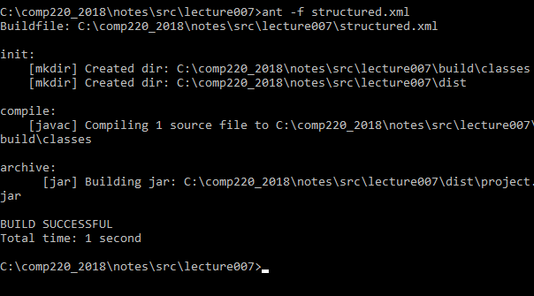
Running the build

Slide 31
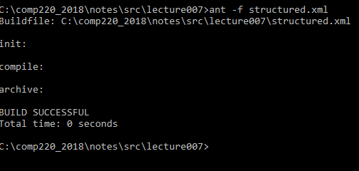
Rerunning the build again
Why no real action, but BUILD SUCCESSFUL?

Slide 32
Rerunning the build again
None of the tasks <mkdir>, <javac>, <jar> say that they are doing any real work.
All of these tasks check their dependencies:
<mkdir> does not create directories that already exist;
<javac> compares source and class file timestamps:
if up to date – do actually nothing;

Slide 33
Rerunning the build again
<jar> compares the time of all files to be added to the archive with the time of the .jar file itself.
If the resulting files are up to date, these tasks, although invoked,
do actually nothing.
TRY the same in -verbose or –v mode to see the similar comments from Ant.

Slide 34
Clean it!
Finally, TRY the command
ant -f structured.xml clean
which deletes build and dist directories.
Hence, you can start build process again on a clean place (after changing something in your source files under src).

Slide 35
What if…?
What if our subdirectories under src were laid out wrongly, not according to the package declaration in Main.java?
TRY to change the package declaration in our source file
src\org\example\antbook\lesson1\Main.java
to
and RUN repeatedly the command
ant -f structured.xml
Check that Ant really keeps on unnecessary recompiling Main.java every time you do a build because you have not placed them correctly in the package hierarchy.
RECOVER the original package name!!!
package org.example2.antbook.lesson1;

Slide 36
Multiple targets on the command line
The command with multiple targets as arguments
ant -f structured.xml compile archive
is equivalent to running Ant twice:
ant -f structured.xml compile
ant -f structured.xml archive
The resulting sequence of targets will be:
init -> compile, and then
init -> compile -> archive
Thus, for multiple targets called, repetitions of targets are possible in the resulting sequence!!
TRY it!
Notes:
C:\Antbook\ch02\secondbuild> ant -f structured.xml compile archive
(on –verbose mode???).

Slide 37
Multiple dependencies in build file
When a target lists multiple dependencies
then Ant executes them in the order listed :
It first calls archive and then clean.
Note that archive will also call its dependencies, that is,
init -> compile -> archive will be executed.
Then clean will be called, but now init will not be repeated:
init -> compile -> archive -> clean -> all
When Ant build file runs in itself, i.e. one or no targets is called from the command line, then targets are not repeated
TRY to check this by adding the above target all to structured.xml; use the command
ant -f structured.xml all
<target name= "all" depends= "archive,clean" />
Notes:
C:\Antbook\ch02\secondbuild> ant -f structured.xml all
TRY it again for changed target with swapped dependencies:
<target name=“all” depends=“clean,archive”/>
and explain the resulting sequence:

Slide 38
Running Java Program from inside Ant
We now have a structured build process that compiles Java files and creates the JAR file from the Java compiled classes.
The next question is:
How to run a Java program with Ant?

Slide 39
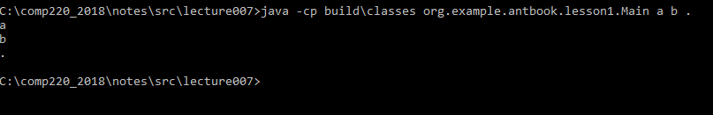
First, Executing from Command Line
To execute our program Main.class we should first compile Main.java. (See Main.java on Slide 7)
Then we could just call our program Main.class as usually
from the command line (or on console) by stating
the classpath (showing where to find Main.class),
the qualified class name (using the package name) and
the arguments “a“, “ b“, and “.“ :
Three inputs
Three identical outputs
This program Main.class just types the argument values.
Notes:
C:\Antbook\ch02\secondbuild> java -cp build\classes org.example.antbook.lesson1.Main a b .

Slide 40
Why execute from inside Ant?
Running this program from the build file provides
some benefits in comparison with command line :
no need to split program compilation from execution
a target to run depends upon the compilation target, so we know we always
- run the latest version of the code
easy to pass complex arguments to the program
easier to set up the classpath
the program can run inside Ant’s own JVM:
- it loads faster
Notes:
You can halt a build if the return code of the program is not zero

Slide 41
Adding an execute target
Extend the previous build file structured.xml to
new file execute.xml by adding target
<target name="execute" depends="compile">
<java
classname="org.example.antbook.lesson1.Main"
classpath="build/classes" >
<arg value="a"/>
<arg value="b"/>
<arg file="."/>
</java>
</target>
See below on the difference
between value and file
attributes of <arg>
<java> task executes the program Main.class with the arguments specified.
Notes:
<arg file="."/> ???
includeAntRuntime="no"??????
Do not mix <java> with <javac> which compiles Main.java.

Slide 42
<arg> tags
<arg value="somevalue"> adds a command-line argument somevalue.
The action of this task is evident (with the value attribute).
The last argument is of another kind:
<arg file="."/>
It tells Ant to resolve the file attribute "." (meaning “this directory”) to an absolute build file location (more precisely, to an absolute base directory location) and consider this location as an argument value before calling the program.
The latter differs from the ordinary
<arg value="."/>
used implicitly in the above command line running (Slide 38).

Slide 43
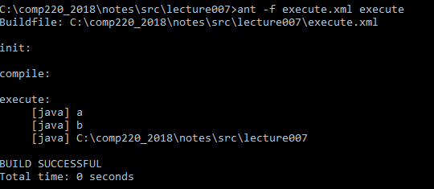
Running <java> task in the <execute> target
TRY it! Try it also with
<arg file="abcd/pqr.txt"/>
Notes:
C:\Antbook\ch02\secondbuild> ant -f execute.xml execute

Slide 44
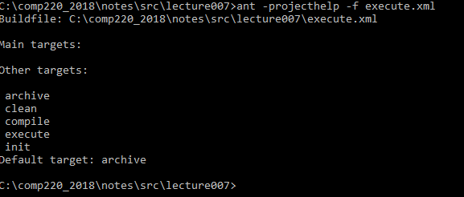
For the Lab: Getting information about the project
-projecthelp lists the main and other targets in a project build file.
Here Ant lists no main targets because
main targets are those which contain the optional description attribute, as these are the
targets intended for public consumption.
Notes:
C:\Antbook\ch02\secondbuild> ant -projecthelp -f execute.xml

Slide 45
For the Lab: Getting information about the project
The above example is not very informative, which is our fault for not documenting the file.
Add a description attribute to each target of execute.xml, such as
description= "Compiles the source code"
for the compile target.
Add also a <description> element right under the <project> opening tag.
Look at the resulting build.xml file (downloadable from corresponding Lab Web page).
Notes:
C:\Antbook\ch02\secondbuild> ant -projecthelp

Slide 46
Summary
Ant build file needs structure to help organise project
As many processes as possible needed to be automated
You can execute programs from within Ant to ensure consistent testing environment

