Slide 1
TESTING PRINCIPLES AND PRACTISE

Slide 2
Testing Principles
Testing shows presence of errors
Not their absence
Exhaustive testing is not possible/practical
In most cases
Test early and regularly
Early testing reduces multiple bug/defect relation and avoids bug masking
Error clustering
Errors are not evenly distributed
Typically 20% of modules contain 80% of defects

Slide 3
Testing Principles
Pesticide paradox
Unless tests change they often become invalid, as functionality changes so must tests
If we continue to use old tests, only bugs associated with old specification are removed
Example browser compatibility testing (iPhone, Android)
Context dependency
Medical system → Safety testing
Website → Performance/load testing
Banking application → Security testing
False conclusion: no errors equals usable system

Slide 4
What is testing
Determining the software conforms to the user’s requirements
Can include
Verification (against the spec.)
Validation (using customer or internal)
Performance
Security
Usability
Regulatory testing
Statistical testing

Slide 5
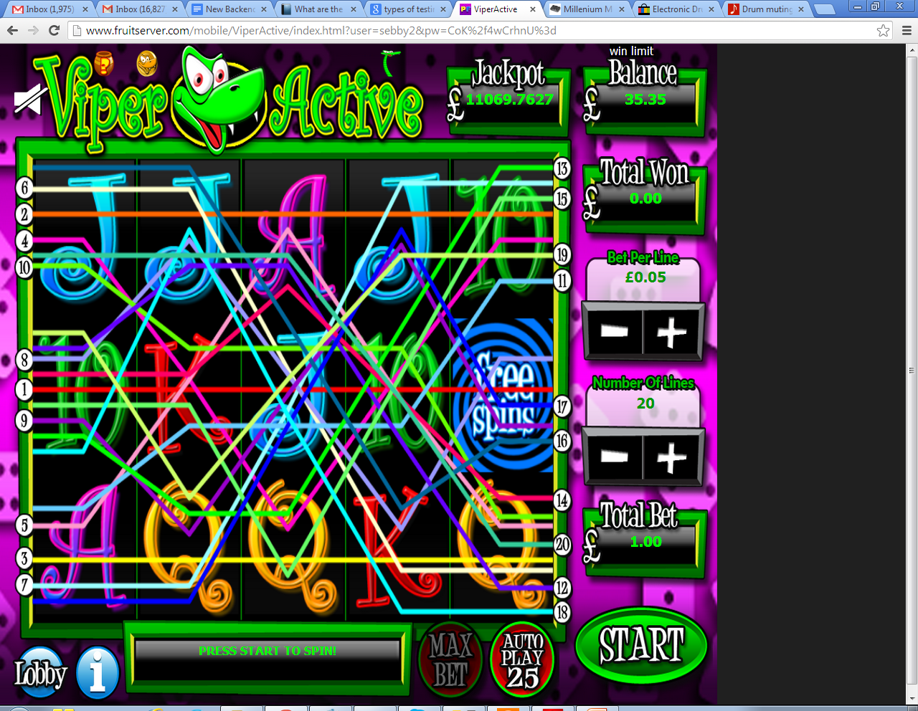
Case study.. game (how to test?)
UI testing
Performance testing
Functional testing
Regulatory testing
Statistical testing

Slide 6
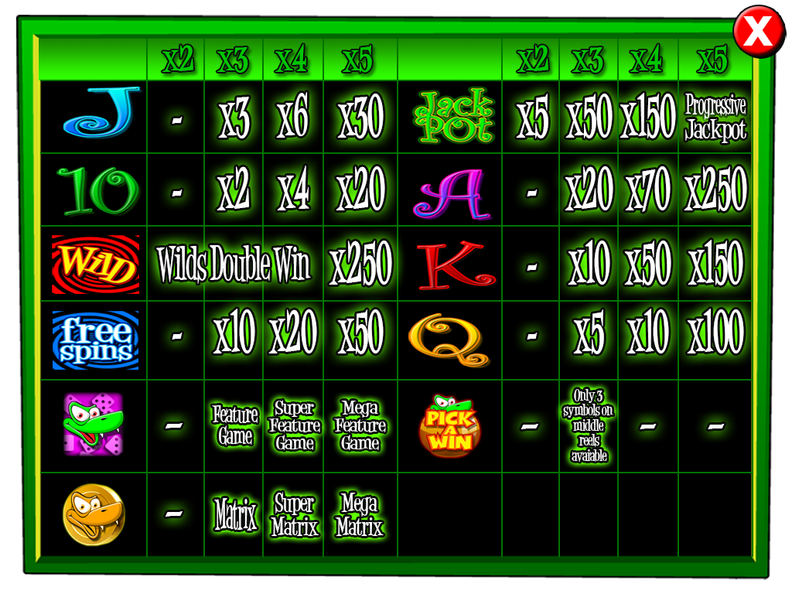
Win structure

Slide 7
Some Details
Each reel has 256 symbols
5 Reels
How many possible combinations?
(256)^5 = 1,099,511,627,776
10,000 spins/second = 636 days
Bigger problem
How to write 1,099,511,627,776 test cases?

Slide 8
Statistical testing
Execute a subset of the tests for the game (500 million games) and determine
Each win’s probability
Total payout of game
If payout is within expected range
Plus or minus 2 standard deviations from mean

Slide 9
Win structures and payout rules
TEN TEN TEN // 3 inline wins
WILDS substitute
So TEN WILD TEN pays a 3 x TEN win
Four line wins
TEN TEN TEN TEN
TEN TEN WILD TEN
How about
WILD WILD J TEN

Slide 10
Rules
Wilds substitute for other symbols
20 pay lines, following from left to right
2, 3, 4, 5 in line possible wins
Stake can be changed for each spin

Slide 11
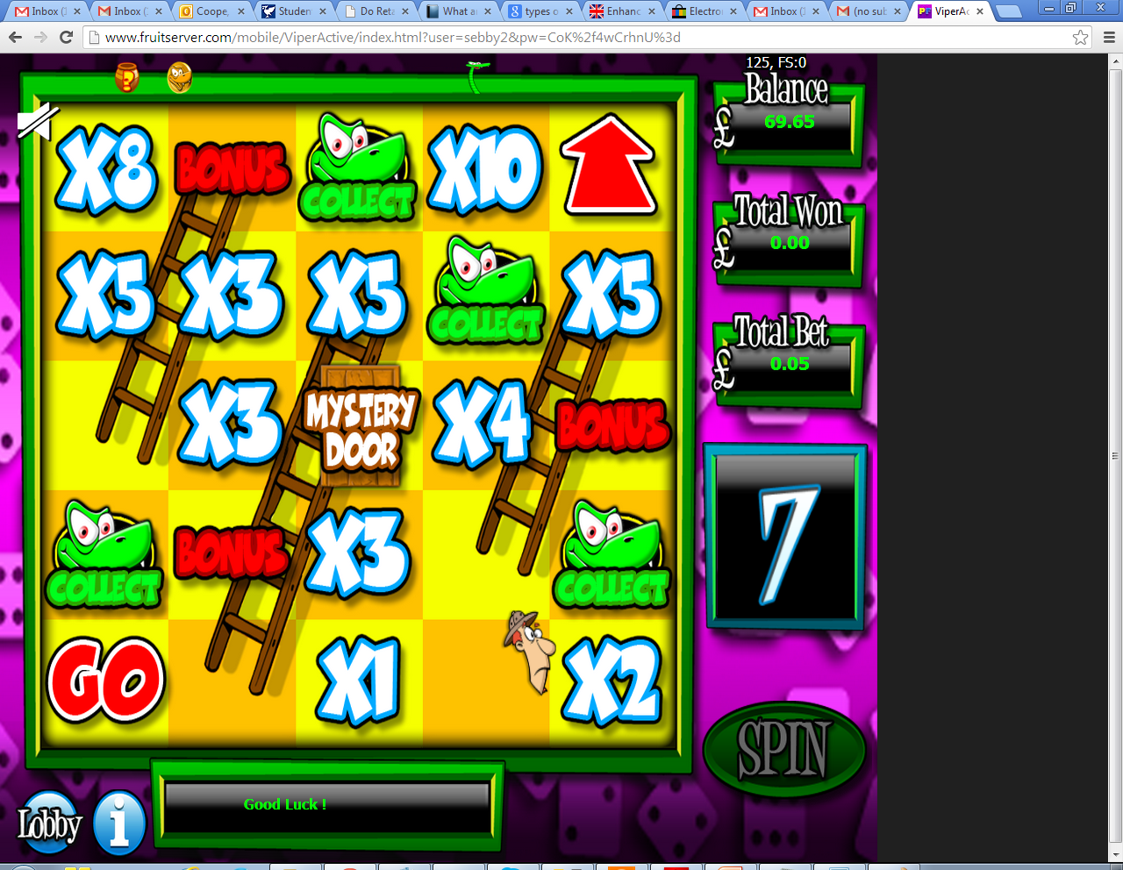
Special features
Some wins give a game within a game, this is called a feature…

Slide 12




Scattered symbols
Some symbols appear anywhere in the window, so below generates 4 symbol feature win.
How many
Combinations give 4 snakes?

Slide 13
Exercise
How many combinations give 4 snakes?
What combinations give 4 snakes?
Can we test them all?
Use software to generate test cases?
Write a small Java program to generate these test cases

Slide 14
Feature wins
Generate a range of random prizes
Testing issues
Distribution of prizes
Average prize distribution
Maximum prize
Minimum prize

Slide 15
Target code
int getWinValue(int stake,int symbols[][])
stake is amount of money awarded per payline
stake is in pence/cents
Symbols
5 x 3 array displaying symbols in window
1= TEN, 2 = J, 3 = Q

Slide 16
Testing approach
At least orthogonal
So each range of data but not every combination of each range
Each win type including/excluding wilds
For a given win, choose a range of stakes
Ensure the multiplier works
Try on each different payline

Slide 17
Orthogonal testing and modes
Function
countDaysTill(int day,int month,int year)
Bug might appear in test case for particular
day, month, year (triple mode fault)
Year (single mode fault)
day, month (double mode fault)
Exhaustive testing of some single mode faults is sometimes possible

Slide 18
Orthogonal array testing
Imagine you have a method with 3 integer arguments
Arg1 range 1-10
Arg2 range 2-20
Arg3 range 5,6 or 7
You want to catch all single mode errors
How many tests need?
What tests?

Slide 19
Orthogonal array testing
Total test count (single mode)
10 for arg1 + 19 for arg2 + 3 for arg3
= 10+19+3 = 32 tests (actually only 30, some are redundant)
Single mode errors
Number of tests is order of N (where N is argument levels)
Triple mode errors
Number of tests is order of N^3
In the case above 570 tests (10x19x3)

Slide 20
Orthogonal array testing
Tests for single mode
Test | Arg1 | Arg2 | Arg3
1 | 1 | 2 | 5
2 | 2 | 2 | 5
3 | 3 | 2 | 5
4 | 4 | 2 | 5
5 | 5 | 2 | 5
6 | 6 | 2 | 5
7 | 7 | 2 | 5
8 | 8 | 2 | 5
9 | 9 | 2 | 5
10 | 10 | 2 | 5
11 | 1 | 3 | 5
12 | 1 | 4 | 5
13 | 1 | 5 | 5
14 | 1 | 6 | 5
15 | 1 | 7 | 5
16 | 1 | 8 | 5
17 | 1 | 9 | 5
18 | 1 | 10 | 5
19 | 1 | 11 | 5
20 | 1 | 12 | 5
21 | 1 | 13 | 5
22 | 1 | 14 | 5
23 | 1 | 15 | 5
24 | 1 | 16 | 5
25 | 1 | 17 | 5
26 | 1 | 18 | 5
27 | 1 | 19 | 5
28 | 1 | 20 | 5
29 | 1 | 20 | 6
30 | 1 | 20 | 7

Slide 21
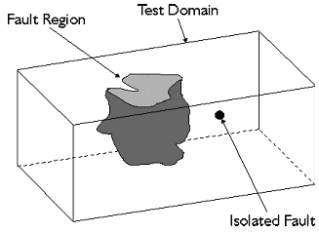
Defect density, clustered or isolated

Slide 22
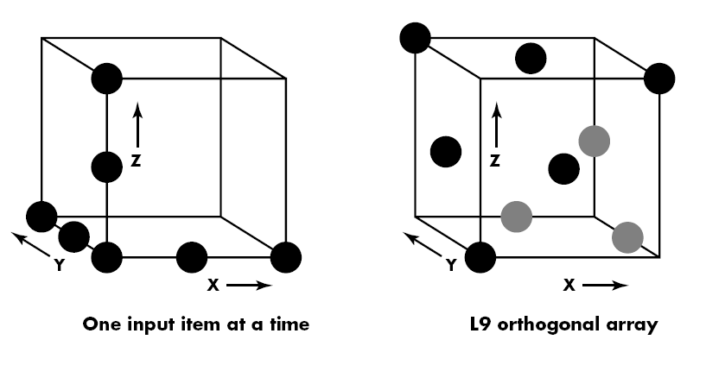
In practise
Most recommendations is for at least all pair-wise combinations (this is what most people will call orthogonal array test)
Use a tool to generate test array, then complete by hand
My generating the “other” values randomly for each test, you distribute your tests around the state space

Slide 23
Orthogonal testing for our game
So if stake can be
10p,50p,100p,200p,500p
Single mode test for stake could use the following test cases
STAKE | REEL1 | REEL 2 | REEL 3 | REEL 4 | REEL 5 | Output
10 | TEN | TEN | TEN | JACK | JACK | 30
50 | TEN | TEN | TEN | JACK | JACK | 150
100 | TEN | TEN | TEN | JACK | JACK | 300
200 | TEN | TEN | TEN | JACK | JACK | 600
500 | TEN | TEN | TEN | JACK | JACK | 1500

Slide 24
Orthogonal testing
Now test 3 in line TEN wins (keep stake constant)
STAKE | REEL1 | REEL 2 | REEL 3 | REEL 4 | REEL 5 | Output
10 | TEN | TEN | TEN | JACK | JACK | 30
10 | WILD | TEN | TEN | JACK | JACK | 30
10 | TEN | WILD | TEN | JACK | JACK | 30
10 | TEN | TEN | WILD | JACK | JACK | 30
10 | WILD | WILD | TEN | JACK | JACK | 30
10 | WILD | TEN | WILD | JACK | JACK | 30
10 | TEN | WILD | WILD | JACK | JACK | 30

Slide 25
More testing of the machine
Do we/Can we testing all losing lines?
Alternatives?
Statistics
Random test generation
Rand = random (but no Wild, no Ten)
STAKE | REEL1 | REEL 2 | REEL 3 | REEL 4 | REEL 5 | Output
10 | TEN | TEN | TEN | Rand | Rand | 30
10 | WILD | TEN | TEN | Rand | Rand | 30
10 | TEN | WILD | TEN | Rand | Rand | 30
10 | TEN | TEN | WILD | Rand | Rand | 30
10 | WILD | WILD | TEN | Rand | Rand | 30
10 | WILD | TEN | WILD | Rand | Rand | 30
10 | TEN | WILD | WILD | Rand | Rand | 30

Slide 26
Adding in random numbers
Teases out rarer bugs
Can do different tests across Q&A phases
Increases assurance
Can be used to make statistical inference

Slide 27
Testing calculations
If bug effects 0.01% of positions, evenly distributed and we test 10,000 positions randomly, what is the chance of a false positive
Chance of test giving false positive
Chance of passing bug for each test is
1 – (0.0001) = 0.9999
Chance of not finding bug is
(0.9999)^10,000 = 0.36 or 36%

Slide 28
Testing calculations
Assuming confidence of 1% (i.e. assuming we might be wrong 1% of time)
If we do 1,000,000 random tests what is maximum error density
(1-chance_of_bug)^10,000,000<0.01
So
10,000,000log(1-chance_of_bug)<log(0.01)
Log(1-chance_bug)<log(0.01)/10,000,000
1-chance_bug<10^(log(0.01)/10,000,000)
chance_bug=1-10^(log(0.01)/10,000,000)
0.0000046 defect density

Slide 29
Testing levels
At unit level
Confirming the following all function correctly
All methods provide primary function
All constructors and methods validate input
Exceptions are caught or thrown as required
Coding by contract
Each method has a required range of appropriate values
Use of methods should conform with contract

Slide 30
Test Example
class Person.java
Constructor takes name and Date of birth
Has methods
int getAgeInYears() // whole number of years old
boolean isAdult() // true if Person is adult
Is meant to provide validation checking of its attributes

Slide 31
Testing example code (boundary cases)
private void testYears() {
Calendar dobCal = Calendar.getInstance(); // set up current time
dobCal.setTimeInMillis(System.currentTimeMillis()); // set up time
int testAge=18;
dobCal.add(Calendar.YEAR,-testAge);
setDateOfBirth(dobCal.getTime());
if (getAgeInYears()!=testAge) {
throw new TestFailException("Failed Age test Birthday today");
}

Slide 32
Fundamental problem with test code
Code is being written to test code
So if a bug happens
Is the bug in
The target code
The test code
Answers
Have 2 teams (test code team, testing team)
Use simple identities sqr(x) x sqr(x) = x

Slide 33
Testing Example
dobCal.add(Calendar.DAY_OF_MONTH, 1); // move to tommorow
setDateOfBirth(dobCal.getTime());
if (getAgeInYears()!=testAge-1) {
throw new TestFailException("Failed Age test Birthday tommorow");
}

Slide 34
Test Example
dobCal.add(Calendar.DAY_OF_MONTH, -2); // move to yesterday
setDateOfBirth(dobCal.getTime());
if (getAgeInYears()!=testAge) {
throw new TestFailException("Failed Age test Birthday yesterday");

Slide 35
Testing and debugging
Bug report
Date, product name, platform (Windows, Linux, Chrome IE?)
Description
Logs (? Java console dump?), server trace log
Version of software (see svn version)
How to re-create the bug

Slide 36
Server logs (web debugging)
[10:07:23 AM] Cometa.Core.Server.CommandsNew.CommandGameInit.Execute. Begin...
,Arcadia 0.013215312 0.000165
[10:07:23 AM] Cometa.Core.Server.CommandsNew.CommandBase.AuthenticatePlayer. Begin...
,Arcadia 0.013653376 0.000438
[10:07:23 AM] Cometa.Core.Server.CommandsNew.AuthenticatePlayer. Loading user with login of sebby2
,Arcadia 0.01406112 0.000408
[10:07:23 AM] ExecuteDataset: Select * from $(user) Where LCASE(Login)='sebby2'
,Arcadia 0.014521312 0.000460
[10:07:23 AM] Cometa.Core.Server.CommandsNew.AuthenticatePlayer. User loaded okay, is valid, is in user role, is not blocked.
,Arcadia 0.019047712 0.004526
[10:07:23 AM] Cometa.Core.Server.CommandsNew.AuthenticatePlayer. Password matched.
,Arcadia 0.019882992 0.000835
[10:07:23 AM] ResponseMessageManager::GetMessageByShortCode: Begin...
,Arcadia

Slide 37
Validation testing (error case checking)
Calendar dobCal = Calendar.getInstance(); // set up current time
dobCal.setTimeInMillis(System.currentTimeMillis()); // set up time
dobCal.add(Calendar.DAY,1); // move to tomorrow
Person person=new Person();
Boolean testFailed=true;
try {
person.setDateOfBirth(badDate);
} catch (Exception) {
testFailed=false;
}
This could equally be done and should be done with constructor
Person p=new Person(“test”,”test”,”test”,”test”,”test”,badDate);

Slide 38
Need for automation
Many tests
Requirement for continuous regression testing
Rapid implementation of new functions
Less human error
Cost
High up front cost in time/money

Slide 39
Summary
Hard to test all cases
Automation is essential to make testing effective
Orthogonal approach can be worth while to get coverage of modal bugs

