Slide 1
SOURCE CODE CONTROL

Slide 2
Code Management
Have you ever?
Made a change to code, realised it was a mistake and wanted to go back?
Lost code or had a backup that was too old?
Had to maintain multiple versions of a product?
Wanted to see the difference between two (or more) versions of your code?
Wanted to prove that a particular change broke or fixed some piece of code?
Wanted to submit a change (patch) to someone else's code?
Wanted to see how much work is being done (where/when/who)?
Wanted to experiment with a new feature without interfering with working code?

Slide 3
What does it do?
Provides safe access to files of any sort but initially designed for source code
Allows you to track the changes in a file or document (control the versions)
Allows you to go back to previous versions
Allows you to view what modifications were made to a file between versions
Provides locking/merging facilities
Allows a team to work on a set of shared files

Slide 4
Which source code tool
Not Visual Source Safe
Repository corruption, no atomic commits
svn
Widely used and good tool support, example tortoise svn
Git
Distributed architecture (clones of central repository stored locally)
Faster, less server bound than svn
Merging is better
Complex and powerful, sometimes hard to learn
Perforce
Commercial product
High performance for large projects

Slide 5
Subversion in this subject
Had to pick one
Widely used
Fairly easy to understand model
Very good free booking on svn
svnbook.red-bean.com
Note most of the principles/techniques also apply to other source code alternatives
Git is as good a choice, just use some VCS

Slide 6
Source code control Rule 1
If it’s not in source control it doesn’t exist
If it’s one your local machine, that code will be gone as soon as someone steals it from your house/flat/apartment… gone forever
So commit your code!

Slide 7
Concepts
Revision
A particular version of a particular file
Working copy
A copy of the file on your system
Update
Download a revision of a file to your machine, which you can read/edit
Commit
Write file(s) back to the repository, this process generally creates a new revision of the file or files

Slide 8
Working copies
Local copies of the file
Can be different from the controlled version
Based on a revision “checked out” from the repository
Each working copy has
Timestamp of last update, revision id
File can be
Unchanged and current
Changed and current
Unchanged and out-of-date
Locally changed and out-of-date

Slide 9
Problems with shared source code
Alice make’s change to file Person.java, e.g.
int min_age=18;
Bob make’s change to file Person.java,
int min_age=21; // same line
Alice then writes her modifications back to repository
Bob then writes his modifications back to repository
Alice’s modifications are lost!!

Slide 10
Problem with lost updates
If this was a conventional file system, Alice’s modifications would be lost and worse nobody might know this!
Source code sharing solutions
Locking
Only 1 user gets a copy of the file to edit at once
Shared writing and merging
2 user’s get a copy and the file modifications are merged together

Slide 11
Basic source control operation
Setting up repository
Use import to copy files into repository
Getting new working copies
Use checkout
Update/edit/commit
Update ensures you have the latest copies
Edit
Commit your changes

Slide 12
File locking “lock-modify-unlock”
Alice updates file Person.java and locks it for edit
If Bob does an update on the file, he won’t be able to modify it (it will be read only) (the working copy might be modified but write back to the repository will be denied)
Later after Alice has committed her changes, Bob can try and check out for edit and he will get the file with her modifications in
Now Bob can decide if he want’s to write over Alice’s modifications or chat with her to decide what to do

Slide 13
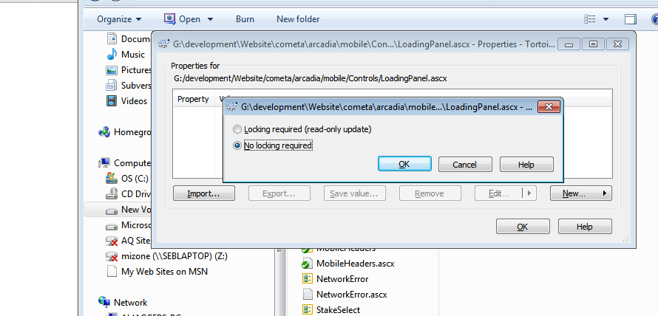
How to force locking
In svn set the read-only update property

Slide 14
File locking problems
Administrative
People lock files and go away for the day, file must be unlocked by admin, delays, frustration
Serialization restriction
Quite possible to people to be working on different parts of file which are not dependent
False sense of security
2 classes can be dependent on one another and each one locked by different coders

Slide 15
File locking in practise
Locks
Piece of svn meta data
Marks file as owned for exclusive write
You can request a lock (with comment)
Release a lock
Usually automatic with commit (but can be manually override)
Discover lock status (svn status)
Break a lock (use force option)
Steal a lock (break and request lock in 1)
Needs-lock
Marks locked files as read only if your not the owner

Slide 16
Shared editing and merging
Both Alice and Bob checkout Person.java for edit
Alice and Bob then commit the file back to svn
Svn then merges Alice and Bob’s changes together to form a new file and update their working copy with the new merged file

Slide 17
How does source control deal with this?
In this case it really depends on timing…
For example
Alice and Bob both update (download) file
Person.java is now revision 2201 for both A&B
Alice make’s changes and commit’s file, file will now be revision 2202
Bob will try and now commit his working copy 2201, the server knows that the current revision is already 2202 and therefore Bob’s changes will need merging

Slide 18
Merge rule
If (revision@server>revision_working_copy)
Commit by merge
else
Commit by writing back
Merging algorithm
Many source code control systems use an algorithm called diff3
Diff3 compares the 2 new files with the original
If differences are distinct the can be applied to original otherwise it generates a conflict

Slide 19
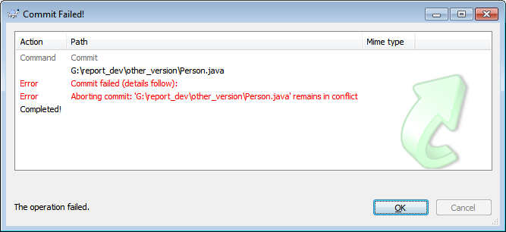
Conflicts
Where 2 sets of changes to an original file clash with each other
4 files
Person.java (conflicted marked file)
Person.java.mine (your work file)
Person.java.2184 (original as checked out)
Person.java.2185 (conflicting version)

Slide 20
Conflict dump (Person.java)
public class Person {
<<<<<<< .mine
private static final int ADULT_AGE=16;
=======
private static final int ADULT_AGE=21;
>>>>>>> .r2185
}

Slide 21
Resolving conflicts
Scrap your changes, go with the other
svn revert Person.java
svn update Person.java
Dump your collegues changes
cp Person.java.mine Person.java
svn resolved Person.java
Edit Person.java
Remove conflicts
svn resolved Person.java

Slide 22
Merging issues
Diff3 only checks for change conflicts
But programs do have dependencies
E.g. all the 3 following lines, can have impact on if statement
int age=15;
age=18;
age=21;
If (age>=21) {
}
It is possible for code to have a logical conflict even if they don’t have a typographic conflict

Slide 23
Merging and dependency
Research into merging and intelligent merge analysis
Dependency trees are developed for all 3 code(s) original1, original 2 and merge
Program slicing is used to analyse how the program behaves
Check for preservation of the old slices in new code

Slide 24
Good Merging procedures
Edit file as working copy
Test file with build
Merge file with all latest updates
Remove any conflicts
Test file with updated build
This ensures that code changes work with other code changes (merge works)

Slide 25
When not to use merge
Image files
Make’s no sense and source code will just throw up conflict
Documents in word or PDF
Again will throw up conflicts
If you need to merge text documents keep them a text files, build word documents from text source

Slide 26
Merging and doc files
In general svn will not do the merging… but
Word itself has merging features
Disadvantages
Spend time merging formatting as well as content
Merging not shown as part of svn repository

Slide 27
Rule 2 Commit early, commit often
Possible approach
As soon as you have a new working version, commit
Benefits
Roll backs can be back by hours instead of days
Merges will be easier
Testing with others will be earlier
Forces fragmentation of task (which improves code quality)

Slide 28
What to store
All documentation
All source code and source files
Everything that requires human production
Source, images, sound files, XML
All dependency files
JAR libraries, DLLs
If open source, store latest build source
Database images and schema
Anything else needed to build the project
Anything needed to run the project (e.g. example Web.config files, certificates (security issue here!)
If your project depends on external downloaded code, do not rely on it being their

Slide 29
Versioning the database
At minimum you need to keep the schema up to date
mysqldump -d -u someuser -p mydatabase > mydatabase.sql
If standard configuration is build into database, write config tables as well

Slide 30
What NOT to store
Try not to make your repository messy
Don’t store
Object files (this can cause problems with other builds)
Debug stuff
Confusing
Unused files
Confusing
Local config files
Will write over other users config. Leading to application error

Slide 31
Revision numbering
On SVN revision numbers are global to the repository
Every time the repository is written to the revision number increases
This means that all writes in 1 commit will have the same revision number
Git does not have this concept of revision number, this can cause issues if you need it as part of your work practise

Slide 32
Adding revision information to source code
String rev=“$Revision$” // java
String date=“$Date$”
String author=“$Author”
// in web page, comments
<!--
$Revision$
$Date$
$Author$
-->
// web page, display
<div style="display: none" id=“fileRevision">
$Revision$</div>

Slide 33
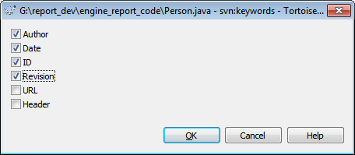
Enabling Version information properties
Tortoise SVN
Right click ..
Tortoise Svn/Properties/Key Words

Slide 34
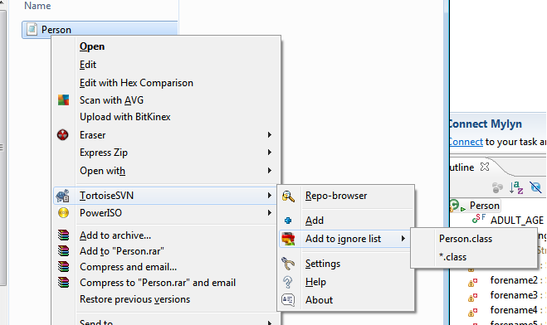
Other useful properties
svn:ignore
Describes files to ignore by default
So for Java project (keep svn clean of objects)
svn propset svn:ignore *.class *.jar

Slide 35
Committing source code
If code testing fail
At end of the day, still commit, remember rule 1 (slide 4)
Do not commit to main trunk, make branch
Functionality
If done in parts, commit but don’t integrate
If any chance of snagging main project, keep in branch or separate build file
Remember breaking the trunk build may stop new features being put into next release
Bug fixes
Commit with comment for tester, link to bug report
Have old version of code, with re-producible bug

Slide 36
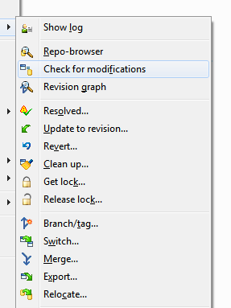
Commit reviews
Use svn check for modifications

Slide 37
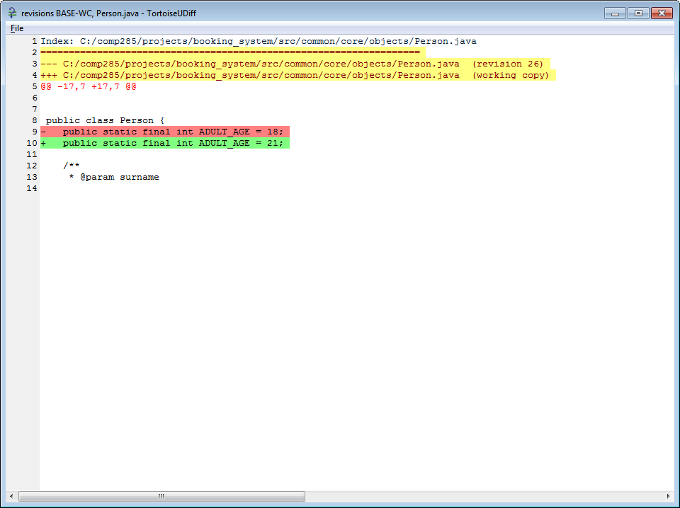
Reviewing modifications (unified diff)

Slide 38
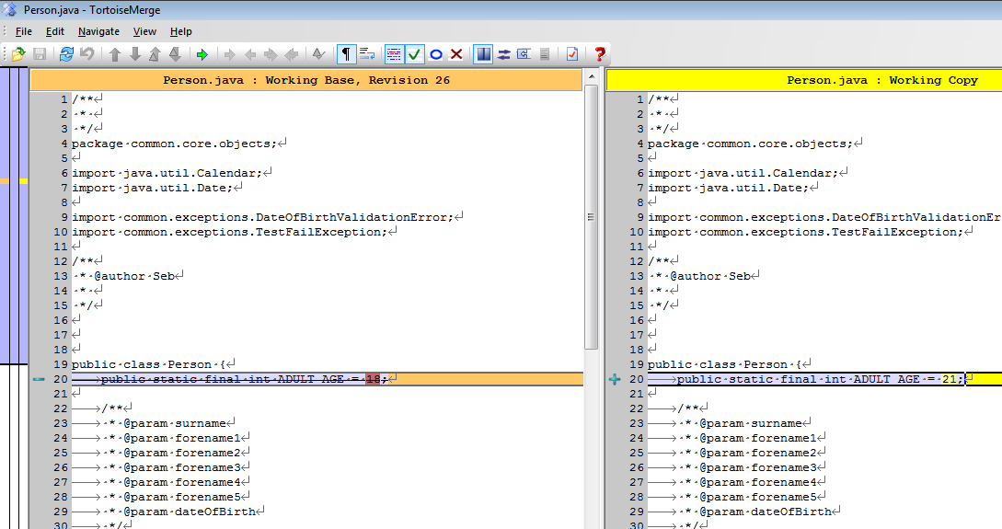
Compare with base

Slide 39
Autoversioning
Imagine you have a number of document writers working, who don’t want to understand version control, but need it
Auto version
Svn repository mounted as a directory (like a network drive), using protocol such as WebDav “Web Distributed Authoring and Versioning”
When a file is opened by the first user it is locked as read-only for others
Every write is then done as an auto-commit

Slide 40
Problems with Autoversioning
Many commits
Some editors such as Word will do auto saving
Makes the change log, very long hard to follow
Enforced locking
Lock problems with sequential working etc.
No comments
User has to add comments to document itself, if they want to track changes
Not useful for code development

Slide 41
Branches and tags
Branch
New version of trunk which is used for development
Can be merged back to trunk when finished
Tag
Snap shot of trunk
Not developed with
Often seen as release candidates or archives

Slide 42
Branching and merging how to
Update current working trunk (svn update)
Commit all current changes
Using svn copy make copy of trunk to branch directory
svn cp svn://svnserver.com/svn/repository/trunk svn://svnserver.com/svn/repository/branches/cluster_support_version -m "Branching from trunk to support clustering "
Now switch your local trunk to this new branch
svn switch svn://svnserver.com/svn/repository/branches/clustering_support_version
You can now work on this new version, without causing problems with the main branch

Slide 43
Managing your branch
Regularly update your branch from main tree and test and resolve conflicts
If not it will be harder to merge back later
Merging from trunk
svn merge svn://svnserver.com/svn/repository/trunk
Resolve all conflicts or revert
Build and test
Re-commit merged working copy to branch repository

Slide 44
Merging back to the trunk
First do a merge from trunk to your branch as done before
Test new build
Once build has completed tests
Get working copy of trunk from svn
svn checkout
Now merge your branch with that working copy
svn merge --reintegrate ^/svn/repository/branches/cluster_support_version

Slide 45
Integration/development styles
Feature branches
Branch for each feature
Integration can be complex
Testing is isolated
Continuous integration with trunk
Keeps testing tight
Brings up integration problems early
Breaks the trunk build
Feature toggles
All features are switchable on/off so that problematic features can be isolated
Test mode verses live mode

Slide 46
Release branches
At countdown to release
Copy trunk to release branch, release 1.0
Two teams
Test/develop work on debug/test of 1.0, feature list is frozen
Developer’s work on new features on trunk
After release, 1.0 is marked as snapshot
Trunk is then copied to 2.0 and process start’s again

Slide 47
Multiple branching issues
Each branch can develop conflicts with other branches without knowing it
Due to branches synching with trunk not each other
Can lead to duplication of work
Communication issues
Ideally need for
Highly de-coupled code and architecture

Slide 48
Change lists
Allows you to group files together for operations and status
Change list example
Fix css style sheets to iPhone display
svn changelist css-iphone main.css ui.css
svn changelist css-iphone game.css
You can now use the change list to commit the files together
svn commit -m "Fix style sheets for iPhone." --changelist css-iphone

Slide 49
Hooks
Can be used to automatically send email or other notifications when svn receives commons
Example
Post or pre-commit hooks can keep development team updated on updates
Hooks are usually web call backs, you need a script (php or aspx) to process the command

Slide 50
Email hook code aspx example
protected void Page_Load(object sender, EventArgs e)
{
String body="Changed files "+Request.Params["changed"];
body=body+" Revision "+Request.Params["youngest"]+" description :"+Request.Params["description"]+" log :"+Request.Params["log"];
String subject = "Commit from " + Request.Params["author"] + " for project " + Request.Params["project"];
String from = "sebcoope1@gmail.com";
String to = "coopes@liv.ac.uk";
System.Net.Mail.MailMessage mess = new System.Net.Mail.MailMessage(from, to,subject,body);
SmtpClient client = new SmtpClient("smtp.gmail.com", 587);
NetworkCredential Credentials = new NetworkCredential("sebcoope1@gmail.com", “secret"); // put your gmail creditials here!
client.Credentials = Credentials;
client.EnableSsl=true;
client.Send(mess);
}

Slide 51
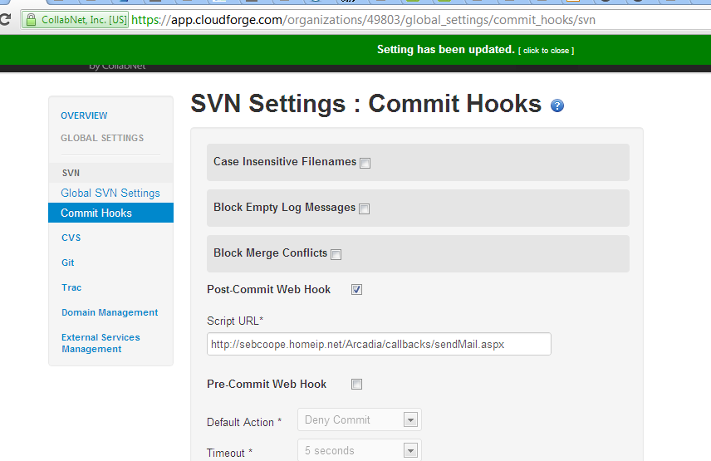
Configuring the commit hook

Slide 52
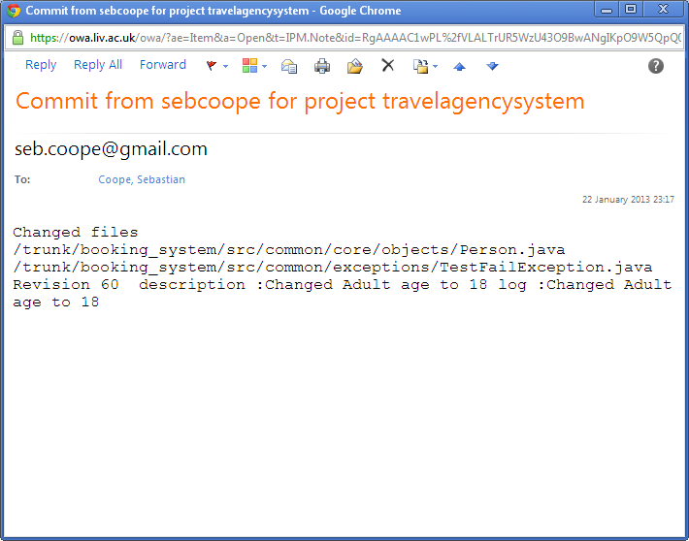
Email hooks

Slide 53
Summary
Source code control essential for any large scale project
Provides code security and communications
Not a substitute for talking to others in your team
Makes it easier to manage
Change
Bugs
Releases
Needs effective work practises to be useful
Different modes of use, lock or merge

