Slide 1
NUMERIC TESTING

Slide 2
Numeric functions
Used for
Financial calculations
Real time control
Braking distance
Flight control parameters
Often depend on
Estimated and sampled data
Statistics

Slide 3
Testing numeric functions
Two basic categories
Integer functions
Real number functions
Discrete integer functions
Large but finite space
In theory possible to test every case
e.g. multiple 2 8 bit numbers, 2^16=65,536 cases
Floating point inputs
Infinite domain mapped to finite address space

Slide 4
Integer space
8-bit 0-255 or -128 to +127
32-bit 0- 4,294,967,295 or
-2,147,483,648 to 2147483647
64-bit space
0 to 18,446,744,073,709,551,616

Slide 5
Binary representation recap
For integers representation as follows:
2^8 2^7 2^6 2^5 2^4 2^3 2^2 2^2 2^0
128 64 32 16 8 4 2 1
For fractions
2^-1 2^-2 2^-3 2^-4 2^-5
½ ¼ 1/8 1/32 1/64

Slide 6
Converting from decimal to binary
For integer part
10
10 is even so first digit 0 then /2 -> 0
5 is odd so next digit 1 then /2 -> 10
2 is even so next digit 0 then /2 -> 010
1 is odd so next digit 1 then /2 -> 1010
0 means no more digits
So 10₁₀ = 1010₂ binary

Slide 7
Converting from decimal to binary fractions
0.625 decimal
X 2 = 1.25 is odd, digit is 1 -> 0.1
X 2 = 2.5 is even, digit is 0 -> 0.10
X2 = 5 is odd, digit is 1 -> 0.101
You can also throw away the integer part each time you convert
0.625 x 2 -> 1.25 Digit = 1 (0.1)
0.25 x 2 -> 0.5 Digit = 0 (0.10)
0.5 x 2 -> 1.0 Digit = 1 (0.101)

Slide 8
In previous examples it’s assumed storage has no loss
0.15625 stored in 4-bit storage
0.15625 x 2 = 0.3125 -> 0.0
0.3125 x 2 = 0.625 -> 0.00
0.625 x 2 = 1.25 -> 0.001
0.25 x 2 = 0.5 -> 0.0010
0.5 x 2 = 1.0 -> 0.00101
Stored in 4-bits = 0.0011 = 0.1875 (rounded)
Loss of precision = |0.1875-0.15625| =
0.03125 or 20% (loss from original)

Slide 9
Precision loss
Some numbers cannot be stored with perfect precision in binary
Convert 0.2
0.2 x 2 = 0.4 -> 0.0
0.4 x 2 = 0.8 -> 0.00
0.8 x 2 = 1.6 -> 0.001
0.6 x 2 = 1.2 -> 0.0011
0.2 x 2 = 0.4 -> 0.00110 (start again..)
0.4 x 2 = 0.8 -> 0.001100
0.8 x 2 = 1.6 -> 0.0011001

Slide 10
Precision loss 0.2
If storing in 10-bits (fixed point)
0.00110011001100110011001100110011001100110011
Get truncated to
0.0011001100₂ =
(½ ^ 3)+ (½ ^4) + (½^7) + (½ ^ 8) = 0.19921875₁₀
So the loss is 0.00078125
or 1.95%
If we round instead
Stored = 0.0011001101₂ = 0.2001953125₁₀
And loss is 0.0001953125 = 0.09%
So round if relevant..

Slide 11
Rounding in binary
If next digit = 0 then round down (store as truncated)
If next digit = 1 then round up

Slide 12
Floating point review
Mantissa (fixed point) x 2^exponent
For example if we had 2-bytes floating point
Mantissa = 1.1111111₂ to 0.0000000₂
Exponent = -128 to 127 (2’s complement)
1.0010000 x 2^8 = 100100000₂ =288₁₀

Slide 13
Normalization
To make sure that precision is maximised, floating point numbers are normalized, then leading zero is stripped out
0.0001000 x 2^5 = 1.0000000 x 2^1
The 1 has floated right 4 places (floating point..)
For 0.2
0.0011001100110011001100110011001100110
0.0011001101 x 2^0 = 1.1001101 x 2⁻³
Notice we get 3-extra sig bits by dropping
0.00 from storage
Notice in this case, we only need 7-bits

Slide 14
Floating point review
Mantissa (fraction) x 2^exponent
Implications
Mantissa is fixed size in decimal points
So worst error is proportional to exponent size
e.g. 8-bits, smallest number is (½)^8
As the exponent increases the error increases

Slide 15
IEEE 754
Representation made up of 3 parts
Sign bit + or –
Exponent 2^ (8-bits for single precision, 11-bits for double)
Exponent includes bias of +127 for single and +1023 for double
So -3 will be stored as 124 for single and 1020 for double
Mantissa or fraction
23-bit single, 52-bit double
Numbers normalised with m.s.b. discarded

Slide 16
IEEE 754 example
Storing 0.2 in single precision
0.0011001100110011001100110011001100110
=1.10011001100110011001101x2 ⁻³
Stored as 10011001100110011001101
Storing 23-bits in fraction and Exponent= 124 (127 + -3)
Notice number is rounded in last place
Storage of mantissa = 10011001100110011001101

Slide 17
IEEE 754 example continued
We can now calculate the error in storage;
1.10011001100110011001101x2 ⁻³
⁼ 0.20000000298023223876953125
Error in storage =
0.20000000298023223876953125-0.2
= 0.00000000298023223876953125
= 2.98023223876953125 x 10⁻⁹

Slide 18
Issues for calculations
Looking at the following statement
A = B – C;
B !=C → B-C !=0 → A !=0
If B is very close to C, A will be very small
If A cannot be stored as non-zero then this is called underflow

Slide 19
Overflow
If A+B > Largest number storable
→ Overflow
But overflow != infinity but is returned the same in IEEE 754
Note 1/0 = Infinity
If A very large and B very small
B is de-normalized before subtraction
Possible after de-normalization
A-B = A (even if B!=0)

Slide 20
Floating point issues
Imagine we have 5 bit exponent range -16 to +15
Normalization
0.00001 x 2^-10
Represented as
1 x 2^-15
If number is too small result will be de-normalized
0.0000001x 2^-10
Normalizes to 1x2^-17 (overflow exponent)
So we can only go to 0.1x 2^-16
In IEEE the denormalised format is
0.m x 2^exp (where exp=-126 or -1022)
Denormalized storage generally means loss of expected precision

Slide 21
Testing and errors
Limits to precision of inputs/outputs
0.2 = 0.11 recurring
PI irrational
Floating point distribution is discrete input with spacing relative to logx
Voltage sampled at a particular bit accuracy
Significance for testing
Inputs are rounded leading to error on input
Outputs are rounded leader to error when storing or returning output

Slide 22
Unit of least precision
The smallest amount a number can be changed by in a given representation
For int long etc ULP = 1
For fixed point with 3-binary fraction digits ULP = ½ ^ 3
For floating point ULP changes with the number, small numbers have small ULP large numbers have large ULP

Slide 23
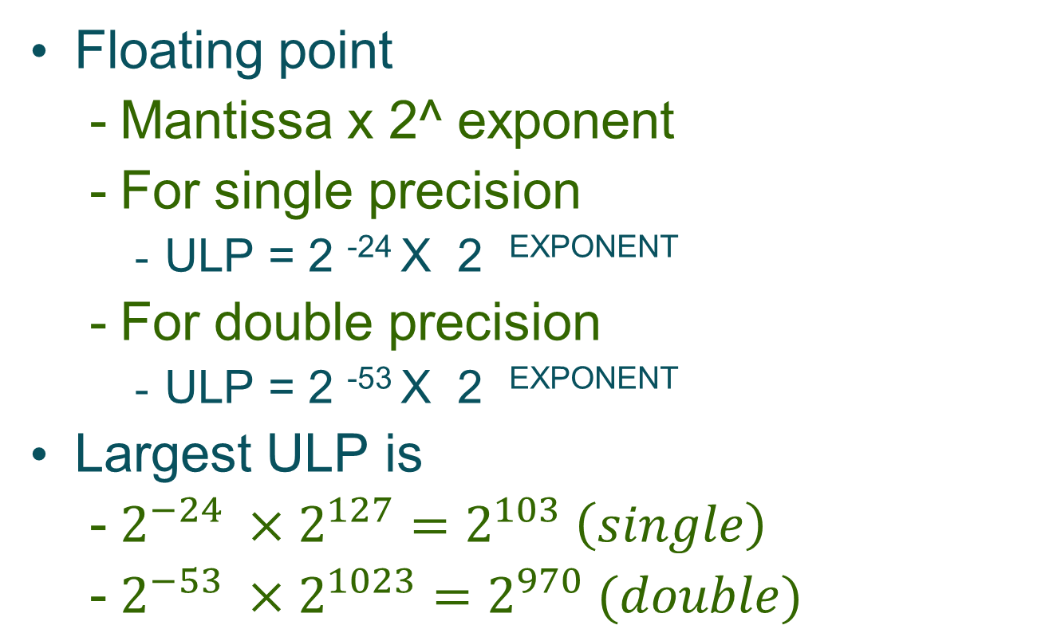
Floating point distribution

Slide 24
Conditioning number
Error
output
Error
output
error
error

Slide 25
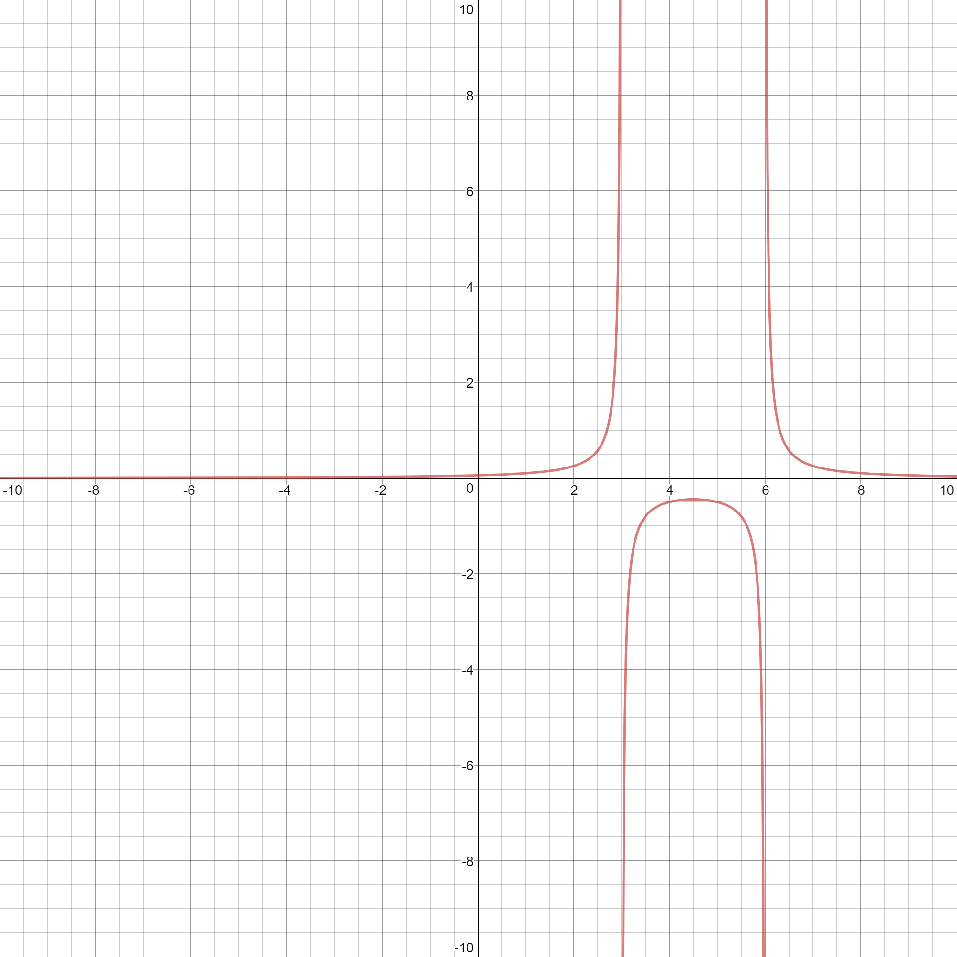
1/(x-3)(x-6) see where the function poorly conditioned

Slide 26
Condition number
Change in output/change in input
(f(x+error)-f(x))/error
For any given function the condition number is a function of x and error
If error is small the condition number approximates to dx/dy (first order differential)

Slide 27
Condition number examples
f(x) = x/(1-x)
X=0.998 error = 0.0001
F(x+error) = 0.9981/(1-0.9981) = 525.3
F(x) = 0.998/(1-0.998) = 499
F(x+error)-F(x) = 26.315789
C(0.998) = 26.315789/0.0001 = 263,158
X=0.999 error = 0.0001
F(x+error) = 0.9991/(1-0.9991) = 1110.1
F(x) = 0.999/(1-0.999) = 999
F(x+error)-F(x) = 111.11
C(0.999) = 111.11 /0.0001 = 1,111,111

Slide 28
Conditioning implications
Example
When solving linear equations, the system is called ill-conditioned if a small change in the input causes a large change in solution
So ill-conditioned designs/algorithms can cause
Instability of output
Problems with the behaviour of physical systems, imagine electronic circuit, each component can have a range of values due to component tolerances
Example V = Vin x (5-R) is R value is close to 5 small change in R lead to large change in V

Slide 29
Conditioning in algorithmic steps
y1=1/(1-x)
y2=y1 x (1-x)*(1+x)
y2 should equal?
y2=(1+x) if x=1 y2=2
but does it?

Slide 30
Conditioning number and testing
If 1 of your calculation steps has high condition number, this can lead to large errors on result
Possible to have well conditioned function but with poorly conditioned step in algorithm

Slide 31
Testing numeric functions
| Fcalc(x)- Ftrue(x) | < tolerance
Fcalc(x) is the value produce by our program
To calculate Ftrue we can use a arbitary precision maths package such as GMP
gmplib.org
But what about the tolerance

Slide 32
Tolerance
Error in storage = ULP
Function of Unit of Least Precision
This is dependent on X
Function of the condition number
The greater the condition number, the greater the effect of loss of precision
In general
Tolerance <= Cn(x) x ULP

Slide 33
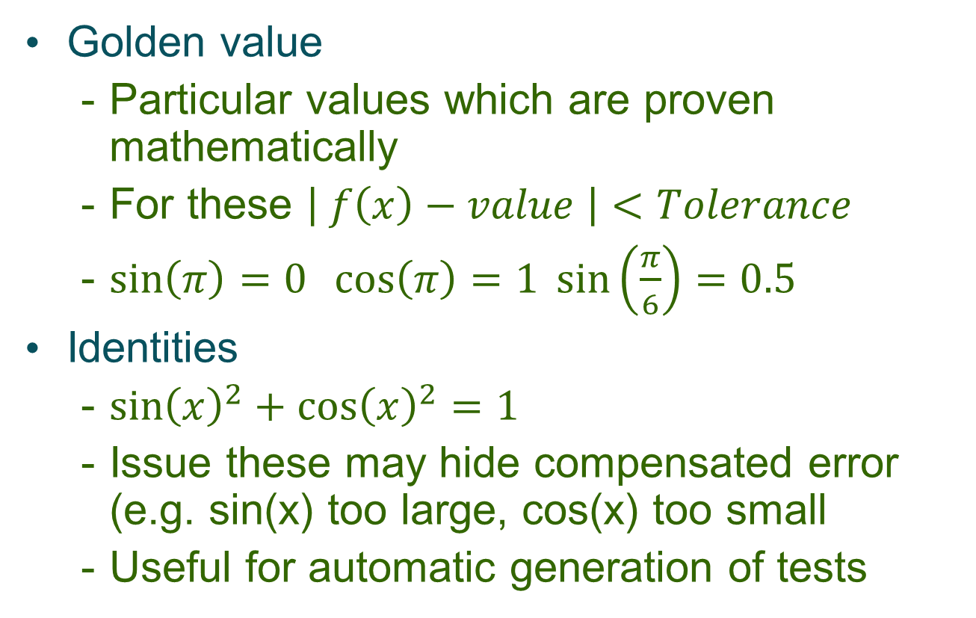
Types of function test

Slide 34
Numeric test examples
Log10 function
Log10(1)=0 (true for all logs)
Log10(10)=1
Log10(100)=2
Log10(sqrt(10)) = 0.5
Log10(0.1)=-1
Log10(0)=Error
Log10(-1)=Error

Slide 35
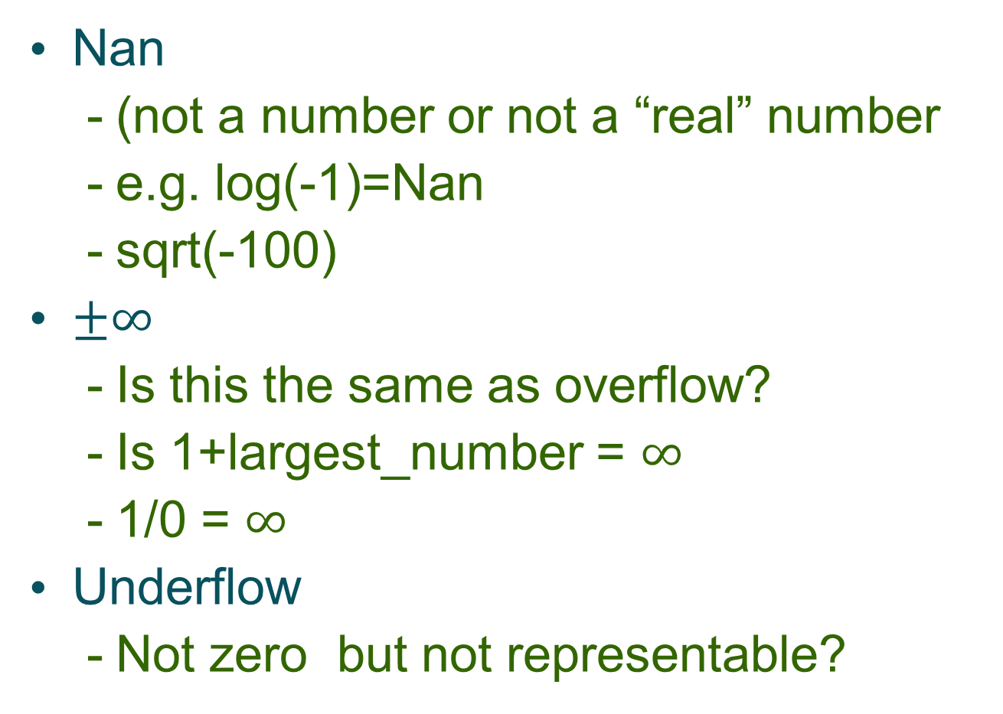
Special values

Slide 36
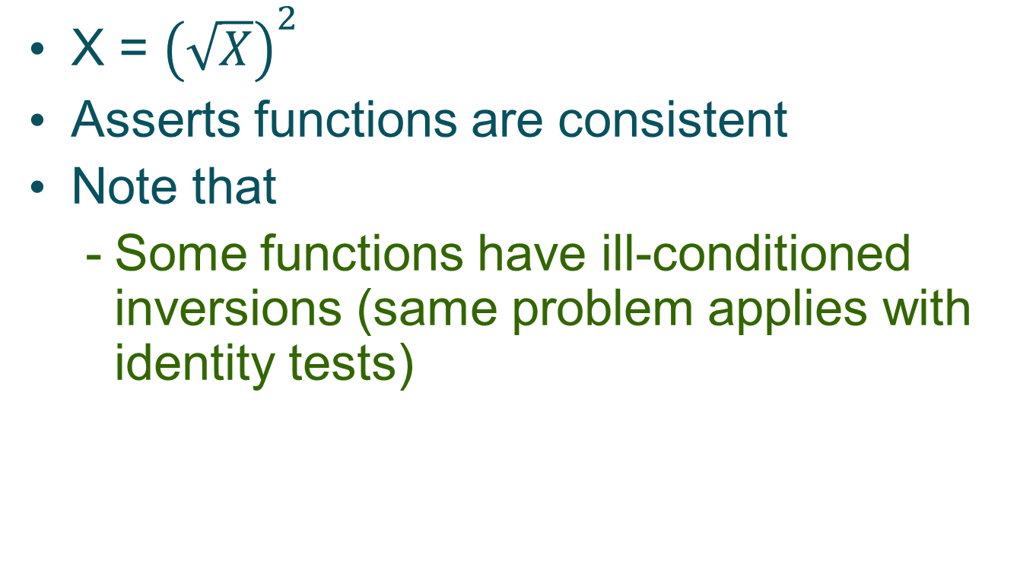
Inverse function tests

Slide 37
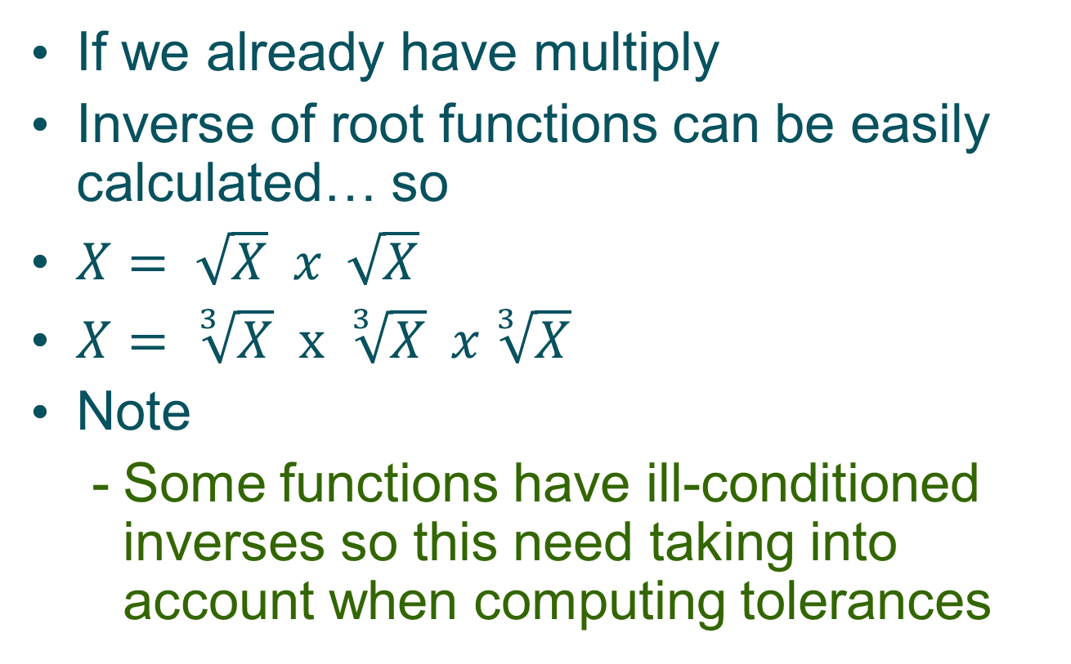
Inverse functions

Slide 38
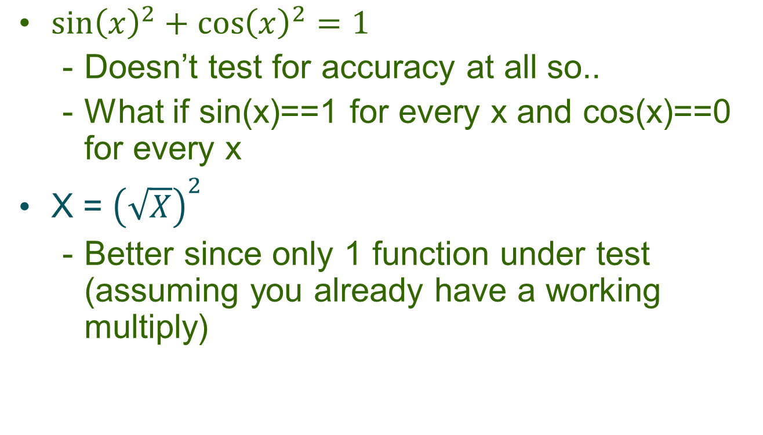
Limitations of identities

Slide 39
Junit tolerance
public static void assertEquals(double expected, double actual, double delta)
Delta = tolerance
If expected = Nan , actual = Nan then test passes
If expected = infinite, delta not ignored

Slide 40
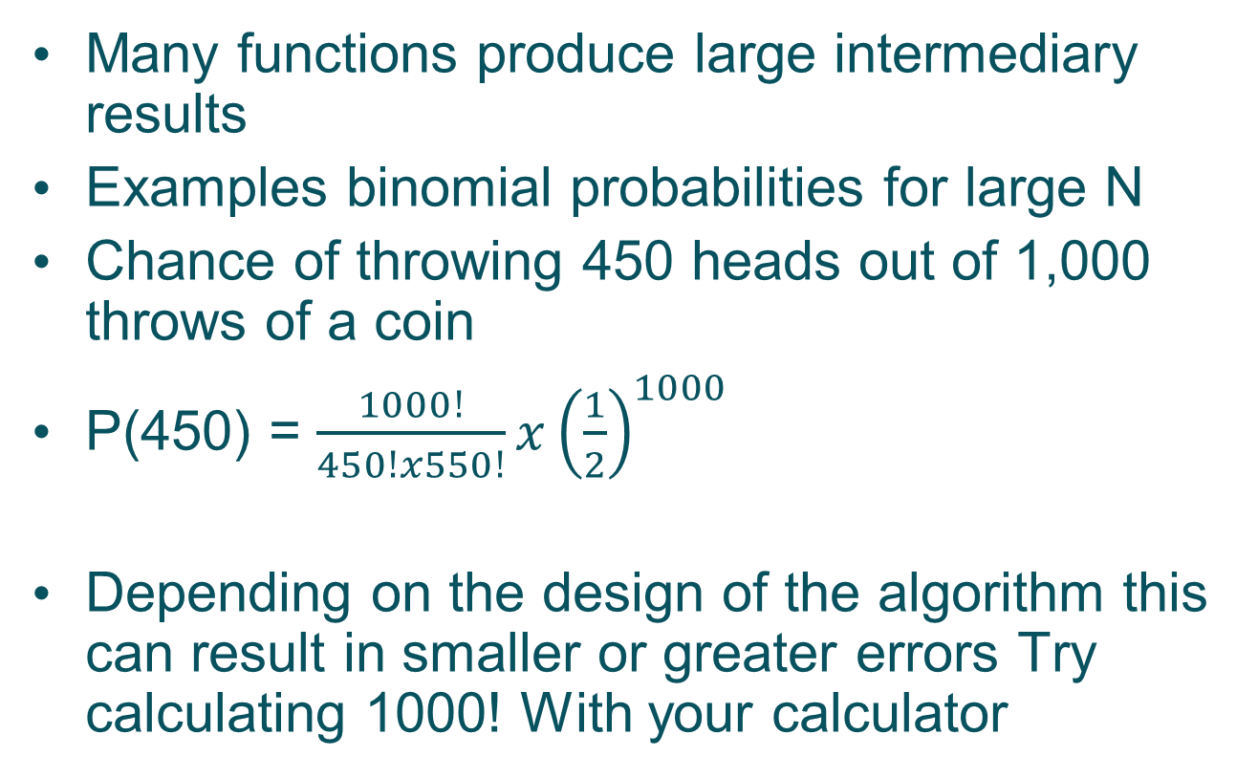
Intermediary results

Slide 41
Computing chances ill-conditioned
public double coinProb(int n,int c) {
double prob=0.5;
double answer=1.0;
double fact1=factorial(n);
double fact2=factorial(n-c);
double fact3=factorial(c);
answer=(fact1/(fact2*fact3))*(Math.pow(prob, n));
return(answer);
}

Slide 42
Computing chance adjust algorithm
public double coinProb1(int n,int c) {
double answer=1.0; double prob=0.5; int totalMul=n;
int idx2=1;
for (int idx=n;idx>(n-c);idx--) {
answer=answer*idx;
if (idx2<c+1) {
answer=answer/idx2;
idx2++;
}
while ((answer>1) && (totalMul>0)) {
answer=answer*prob;
totalMul--;
}
}
while(idx2<c+1) {
answer=answer/idx2;idx2++;
}
while (totalMul>0) {
answer=answer*prob;totalMul--;
}
return(answer);

Slide 43
Back to back testing
Random rnd=new Random(System.currentTimeMillis());
for (int tests=0;tests<20;tests++) {
int n=5+rnd.nextInt(5); // pick random n
int c=rnd.nextInt(n); // pick random c
assertEquals("Back to back test for n="+n+" c="+c,calculator.coinProb(n, c),calculator.coinProb1(n, c),0.00000000001);
}

Slide 44
Summary
Numeric function testing relies on
The properties of the function being tested (condition number, argument type)
Having proper values for
Correct function output
Tolerance for the test

Slide 45
Summary
Functions can
Special values golden values
Linked together to give identities
Be tested using a previously tested inverse function

Slide 46
Review test
Assume your are storing in 8-bits fixed decimal storage, what will be the error when storing
0.1
0.25
0.3
Assuming you are testing the function log(x-4)
Calculate the tolerance for testing x=3, assuming the error on input = 0.0002

Slide 47
Produce a set of tests for Log2
Assume you have the Math.pow function
Produce a full range of tests

