Slide 1
REFACTORING
AND REFACTORING TOOLS
COMP 285/220
© University of Liverpool
slide <number>
Notes:
<Program Title>

Slide 2
Why refactor
Improve code quality
  Readability
  Testing framework
  OO structure
  Re-usability
  Efficiency
  Allow for new functionality
COMP220
© University of Liverpool
slide <number>

Slide 3

Code smell
Problems with code but not bugs
Examples..
  Duplicated code
  Long method
  Long argument list
  Large class
  Excessively long identifiers
  Excessively short identifiers
  Inappropriate intimacy
COMP220
© University of Liverpool
slide <number>

Slide 4
Duplicated code
Why is code cloned
  Adapting code for new purpose without breaking original
  Borrowing code, without importing class and class dependencies (de-coupling)
Bug fixing, feature changes difficult
More code to maintain
Harder to test
COMP220
© University of Liverpool
slide <number>

Slide 5
Long methods
Harder to read
Cannot use fragments of functionality
Example on next slide…
COMP220
© University of Liverpool
slide <number>
Notes:
<Program Title>

Slide 6
class Sorter
public void bubbleSort(Student students[]) {
for (int idx=0;idx<students.length-1;idx++) {
Student student1=students[idx];Student student2=students[idx+1];
boolean swap=false;
if (student1.getMark()>student2.getMark()) {
swap=true;
} else {
if (student2.getMark()==student1.getMark()) {
if ((student1.getName().compareTo(student2.getName()))<0) {
swap=true;
}
}
}
if (swap) {
students[idx]=student2;
students[idx+1]=student1;
}
}
}
If we want to change to quickSort this compare/swap code could be useful
COMP220
© University of Liverpool
slide <number>

Slide 7
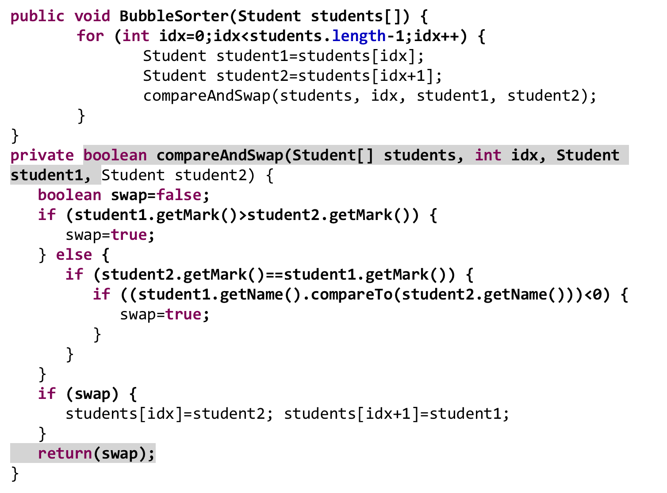
COMP220
© University of Liverpool
slide <number>

Slide 8
Better to embed compare/swap code in Student class Improved coherence
public class Student {
private boolean compareAndSwap(Student[] students, int idx,
Student student2) {
boolean swap=false;
if (getMark()>student2.getMark()) {
swap=true;
} else {
if (student2.getMark()==getMark()) {
if ((getName().compareTo(student2.getName()))<0) {
swap=true;
}
}
}
if (swap) {
students[idx]=student2;students[idx+1]=this;
}
return(swap);
}
COMP220
© University of Liverpool
slide <number>
Notes:
<Program Title>

Slide 9
Now sort looks like this..
public class Sorter {
public void BubbleSorter(Student students[]) {
for (int idx=0;idx<students.length-1;idx++) {
Student student1=students[idx];
Student student2=students[idx+1];
student1.compareAndSwap(students, idx, student2);
}
}
}
COMP220
© University of Liverpool
slide <number>

Slide 10
More improvements
Add an interface for items that can be sorted… notice this interface is generic
public interface ISortable <T> {
public boolean compareAndSwap(T[] list, int idx,
T item2);
}
This is better than…
public interface ISortable {
public boolean compareAndSwap(Object[] list, int idx, Object item2);
}
But why??
COMP220
© University of Liverpool
slide <number>

Slide 11
Implement interface in student class
public class Student implements ISortable<Student> {
public boolean compareAndSwap(Student[] students, int idx,
Student student2) {
boolean swap=false;
if (getMark()>student2.getMark()) {
swap=true;
} else {
if (student2.getMark()==getMark()) {
if ((getName().compareTo(student2.getName()))<0) {
swap=true;
}
}
}
if (swap) {
students[idx]=student2;
students[idx+1]=this;
}
return(swap);
}
COMP220
© University of Liverpool
slide <number>

Slide 12
Adapt sorter to work generically
public class Sorter2 {
public void BubbleSort(ISortable list[]) {
for (int idx=0;idx<list.length-1;idx++) {
ISortable item1=list[idx];
ISortable item2=list[idx+1];
item1.compareAndSwap(list, idx, item2);
}
}
}
COMP220
© University of Liverpool
slide <number>

Slide 13
Problems with attributes
static attributes
For Java if not static final
  Shared data, thread safety issues
  State is initialized before class is used
static int a=25; // Very bad.. Don’t do unless you have to!
Errors due to
  Final keyword missing
  Assumption of initial state
COMP220
© University of Liverpool
slide <number>

Slide 14
Problems with attributes and temporary data
Example… class
class Compression {
    Dictionary codeBook=new Dictionary();
}
If the same instance is used by different threads, again thread safety issue
Method temporary data is good to have as local reference
COMP220
© University of Liverpool
slide <number>

Slide 15
Temporary data
class Compression {
  String compress(String text) {
    Dictionary codeBook=new Dictionary();
    // Local variable
}
Now the codeBook is on stack, since this data is only used in method compress, this is much better .. Always thread safe
COMP220
© University of Liverpool
slide <number>

Slide 16
Other examples…
Service provider code
  Connect to database MySQL,Oracle, MS-SQL
  Email (gmail, hotmail, yahoo)
  Instant messaging
  SMS
  Card payments
Many styles of API for 1 service
COMP220
© University of Liverpool
slide <number>

Slide 17
Another example … service providers
class SQLHelper {
private $con = null;
function open() {
if ($this->con == null) {
$this->con = mysqli_connect ( "localhost", "root", “password", "test1" );
}
if (mysqli_connect_errno ()) {
if ($this->debug) {
echo "Failed to connect to MySQL: " . mysqli_connect_error ();
}
} else {
if ($this->debug) {
echo "Connected ok";
}
COMP220
© University of Liverpool
slide <number>

Slide 18
Executing SQL
function doSQL($sql) {
$this->error = FALSE;
if ($this->sqlDebug) {
echo "Trying to execute ... " . $sql;
}
$this->open ();
if ($this->results = mysqli_query ( $this->con, $sql )) {
// echo "SQL Executed OK";
} else {
$this->error = TRUE;
if ($this->debug) {
echo "Error executing : " . mysqli_error ( $this->con );
}
}
return ($this->results);
}
COMP220
© University of Liverpool
slide <number>

Slide 19
First re-factor Add in arguments
function open() {
if ($this->con == null) {
$this->con = mysqli_connect ( "localhost", "root", “password", "test1" );
}
->
function open() {
if ($this->con == null) {
$this->con = mysqli_connect ( $host, $username, $password, $table );
}
COMP220
© University of Liverpool
slide <number>

Slide 20
Adding new Server type (Oracle)
function doSQL($sql) {
switch ($this->serverType) {
case MYSQL : mysqli_query ( $this->con, $sql )) ;
break;
case ORACLE :
$stid = oci_parse($this->con, $sql);
oci_execute($stid);
break;
}
COMP220
© University of Liverpool
slide <number>

Slide 21
Problem with case switch
Different API code being interleaved
Concerns all jumbled together (no clear seperation)
Code getting longer and longer as more databases/services added
Hard to follow
Hard to test
Easy to get wrong (many case statements to get wrong)
COMP220
© University of Liverpool
slide <number>

Slide 22
Different approach
Have standard interface, like this
interface ISQLHelper {
function open();
function doSQL($sql);
function close();
function get_Error();
}
COMP220
© University of Liverpool
slide <number>

Slide 23
For MySQL and Oracle have specific code .. here is mySQL open
class MySQLHelper implements ISQLHelper {
function open() {
if ($this->con == null) {
$this->con = mysqli_connect ($this->host,$this->username,$this->password,$this->database ); // MySQL open
}
COMP220
© University of Liverpool
slide <number>

Slide 24
Oracle open
class OracleHelper implements ISQLHelper {
function open() {
if ($this->con == null) {
$this->con = oci_connect ( $this->username, $this->password, $this->host . "/" + $host->database );
} // Oracle code, note different name and syntax from MySQL code
COMP220
© University of Liverpool
slide <number>

Slide 25
doSQL MySQL method
function doSQL($sql) {
$this->open ();
if (!$this->con)
return(false);
$this->results = mysqli_query ( $this->con, $sql ));
return ($this->results);
}
COMP220
© University of Liverpool
slide <number>

Slide 26
doSQL Oracle method
function doSQL($sql) {
$this->error = FALSE;
$this->open ();
if (!$this->con)
return(false);
$this->stid = oci_parse ( $this->$con, $sql );
$ok = oci_execute ( $stid );
return($ok);
}
COMP220
© University of Liverpool
slide <number>

Slide 27
The Connection manager
class SQLHelperManager {
const MYSQL = 1;
const ORACLE = 2;
const serverType = self::MYSQL;
const username = "root";const password = “password";
const host = "localhost";const database = "test1";
static function getHelper() {
switch (self::serverType) {
case self::MYSQL :
return new MySQLHelper(self::host,self::username,self::password,self::database);
case self::ORACLE :
return new OracleHelper(self::host,self::username,self::password,self::database);
}
}
}
COMP220
© University of Liverpool
slide <number>

Slide 28
Calling the code
$sql="select * from users where validationID='" . $id . "';";
$helper=SQLHelperManager::getHelper();
$helper->doSQL($sql);
Note, now the concerns of MySQL and Oracle are neatly separated
COMP220
© University of Liverpool
slide <number>

Slide 29
Argument lists
Constructor examples…
  Person(String surname) // what does it mean?
  Person(String surname,String forename) // ordering
  Person(String surname,int age)
  Person(String forename,String surname,int age) // order changed!
More secure to use setters, getters
  Person p=new Person();
  p.setSurname(“Coope”);
  p.setForename(“Seb”);
COMP220
© University of Liverpool
slide <number>

Slide 30
Long argument lists
makeCardPayment(String cardNo,String cardName,int expiryMonth,int expiryYear, int startDate,int startYear, String securityCode,String postcode)
A longer the list the more likely to get wrong
Better … wrap arguments into class
makeCardPayment(CardDetails details)
COMP220
© University of Liverpool
slide <number>

Slide 31
CardDetails
public class CardDetails {
private String cardName;
private String cardNumber;
private int expiryMonth;
private int expiryYear;
public String getCardName() {
return cardName;
}
public void setCardName(String cardName) {
this.cardName = cardName;
}
public String getCardNumber() {
return cardNumber;
}
public void setCardNumber(String cardNumber) {
this.cardNumber = cardNumber;
}
public int getExpiryMonth() {
return expiryMonth;
}
}
COMP220
© University of Liverpool
slide <number>
Notes:
<Program Title>

Slide 32
Wrapping arguments into CardDetails
Gives us one place to validate card arguments
Makes sure arguments don’t get swapped
Makes the code easier to read
Provides a hook to allow certain details to be not stored but entered by the UI
COMP220
© University of Liverpool
slide <number>

Slide 33
Have extended security
public class CardDetails {
public String getSecurityCode(String password) {
return(Decrypt(code,password));
}
COMP220
© University of Liverpool
slide <number>

Slide 34
Refactoring in Eclipse
Rename method/attribute
  Changes name to improve meaning and abstraction
  Change from w
  To
    weight_in_kilos
  Improves readability and reliability of usage
COMP220
© University of Liverpool
slide <number>

Slide 35
Refactoring in Eclipse
Encapsulate field
  Change
      public float weightInKilos;
  To
      private float weightInKilos;
      public int getWeightInKilos () {
        return(weightInKilos);
      }
      public void setWeightInKilos(float weightInKilos ) {
        this.weightInKilos=weightInKilos;
      }
COMP220
© University of Liverpool
slide <number>

Slide 36
Why encapsulate?
You can validate the field (defensive code)
public void setAge(int weightInKilos) {
  if (weightInKilos<0) {
    Throw new badValueException();
  }
  this.weightInKilos=weightInKilos;
}
COMP220
© University of Liverpool
slide <number>

Slide 37
Encapsulation benefit added functionality
Embed persistence
public void setAge(int weightInKilos) {
if (this.weightInKilos!=weightInKilos) {
String sql=“update table patient set weight=“+weightInKilos+” where id=‘“+id+”’”;
dbaseHelper.execute(sql);
}
this.weightInKilos=weightInKilos;
}
COMP220
© University of Liverpool
slide <number>

Slide 38
Extracting a method Eclipse
Take segment of code and removes it into another method
Segment of code is replaced by call to code
Benefits
  Helps readability
  Improves re-use
COMP220
© University of Liverpool
slide <number>

Slide 39
Extracting a method example…
public final void rc4_crypt(byte data[])
{
int i = 0;
int j = 0;
for (int dindex = 0; dindex < data.length; dindex++)
{ // encrypt the whole data array
i = (i + 1) % 256;
j = (j + boxes[i]) % 256;
int t = boxes[i];
boxes[i] = boxes[j];
boxes[j] = t; // do the swap
int index = (boxes[i] + boxes[j]) % 256;
data[dindex] = (byte) (data[dindex] ^ boxes[index]); }
}
Refactor
Extract method
COMP220
© University of Liverpool
slide <number>

Slide 40
Code after extract method
public final void crypt(byte data[])
{
int i = 0;
int j = 0;
for (int dindex = 0; dindex < data.length; dindex++)
{
i = (i + 1) % 256;
j = rc4EncryptIteration(data, i, j, dindex);
}
}
private int rc4EncryptIteration(byte[] data, int i, int j, int dindex) {
j = (j + boxes[i]) % 256;
int t = boxes[i];
boxes[i] = boxes[j];
boxes[j] = t; // do the swap
int index = (boxes[i] + boxes[j]) % 256;
data[dindex] = (byte) (data[dindex] ^ boxes[index]);
return j;
}
COMP220
© University of Liverpool
slide <number>

Slide 41
Extract interface Eclipse
From concrete class
  Generate interface for general methods
  Example was seen with SQLHelper
Benefits
  Allows software to build up a set of related classes which provide same functionality in different ways
COMP220
© University of Liverpool
slide <number>

Slide 42
Extract interface re-factor Eclipse
You have class which makes payments for particular card provider e.g. Paypal
Extract interface for all card providers
Develop concrete classes using interface for
  HSBC
  Metacharge
  Worldpay
COMP220
© University of Liverpool
slide <number>

Slide 43
Pull up method Eclipse
If you want to share method between multiple sub-classes move it into super class
Example card provider....
You have method
boolean luhn_check in class
paypalProvider
Pull up into super class cardProvider
Benefits
  Improved code re-use, easier to maintain
COMP220
© University of Liverpool
slide <number>

Slide 44
Push down
If method needs to be modified for different subclasses.. move down into sub-classes
For example..
  Class Transport has attribute engine type (petrol, diesel, electric)
  No good for Bicycle, Horse
  Have sub-class MotorisedTransport
    Push down into MotorisedTransport
COMP220
© University of Liverpool
slide <number>

Slide 45
Extract superclass
A bit like extract interface allows generalization of concrete class
Benefits
  Can break a class into a general and specialized elements
    Ready for more concrete sub-classes
Benefits
  Improves readability
  Promotes code re-use
COMP220
© University of Liverpool
slide <number>

Slide 46
Extract superclass example
Imagine you have class Doctor with lots of methods
      setName, setDob, setStaffID, setSalary
Refactor to new class structure
DbaseObject
setDob
Person
setSalary
Staff
Patient
Doctor
Nurse
COMP220
© University of Liverpool
slide <number>

Slide 47
Summary
Why re-factor
  Make code high quality
  Improve readability, re-use, structure, simplicity, flexibility
Why use a tool such as Eclipse
  It’s easier so you will bother doing it
  It won’t make a mistake
  It will keep everything neat
COMP220
© University of Liverpool
slide <number>

