Slide 1
Selenium Practical

Slide 2
Review
Selenium is a browser remote control testing tool for web apps
2 Parts
IDE
Allows recording/playing of test cases using Firefox and Chrome
API (3 options)
Selenium Remote Control
Selenium Web Driver (Browser direct control)
Selenium Grid (Controls browser on array of remote machines)

Slide 3
Web driver
Needs API
https://www.selenium.dev/downloads/
Pick WebDriver Java binding…
Download the jar files
Create lib directory
Java SDK
Use version 1.8
Eclipse
Version not critical I am currently on Eclipse Photon (for other compatibility reasons)

Slide 4
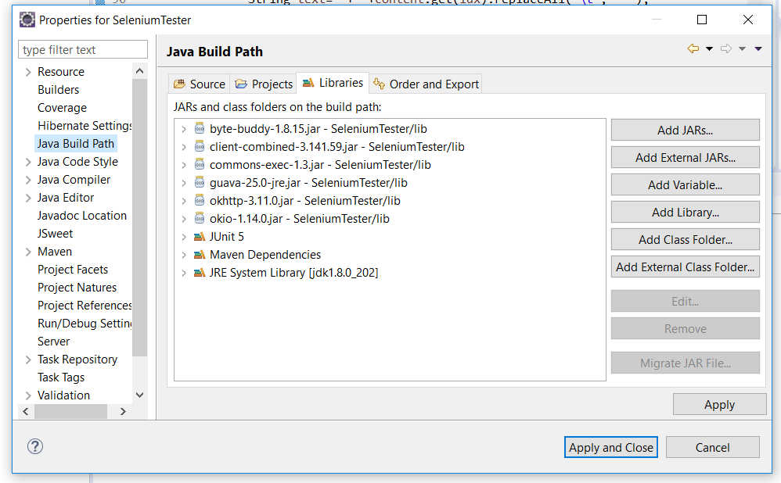
Setting up class path
Right click on Project name, properties, Java build path, Add Jars, Find jars in lib directory

Slide 5
Recording your test..
Use IDE…
Export as Junit test
Save in Eclipse
Run as Junit test

Slide 6
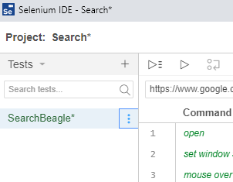
Exporting

Slide 7
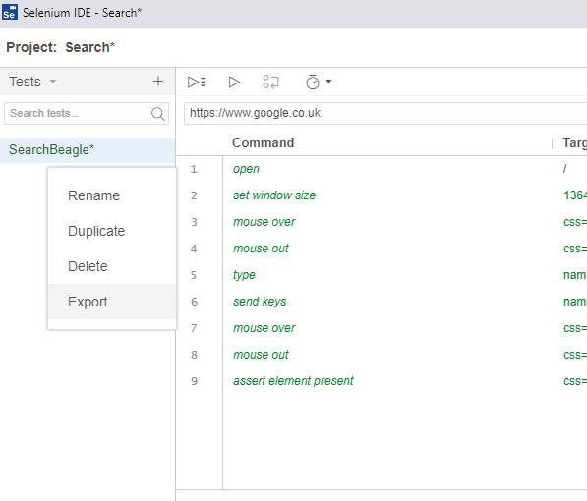
Exporting

Slide 8
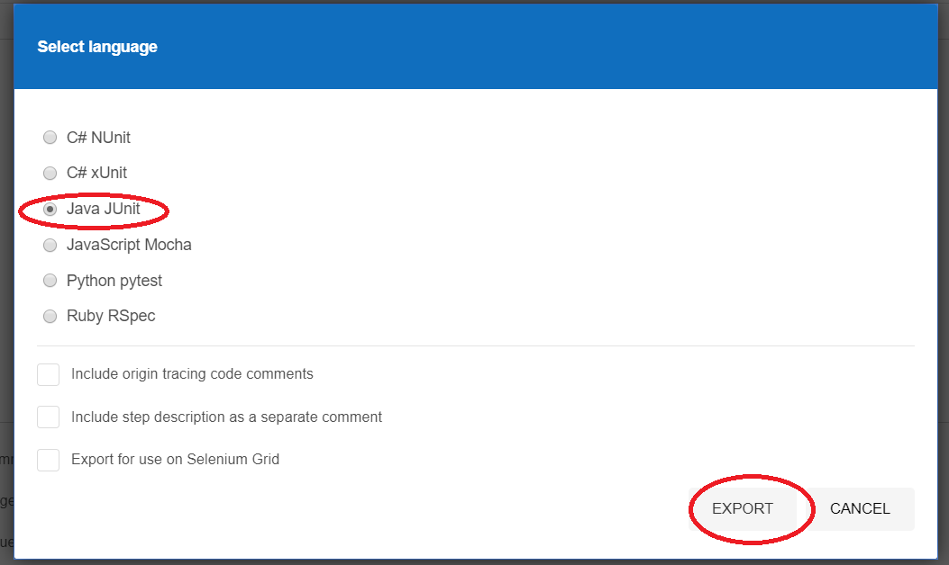
Exporting

Slide 9
This will produce a Junit class which you can add to your Eclipse project..
You will have to tell the set up routine where to find the Chrome Driver, this is the software that sits between your code and the actual browser.
Add this line in…
public void setUp() {
System.setProperty("webdriver.chrome.driver", "C:\\comp220_1920\\chromedriver_win32\\chromedriver.exe");

Slide 10
Running as Junit test
Right click on test case
Run As Junit Test
The project for this is zipped up on Vital… it’s called SeleniumTester

