Slide 1
Chapter 3: Introduction to SQL

Slide 2
Chapter 3: Introduction to SQL
Overview of the SQL Query Language
Data Definition
Basic Query Structure
Additional Basic Operations
Set Operations
Null Values
Aggregate Functions
Nested Subqueries
Modification of the Database
Notes:
1

Slide 3
Domain Types in SQL
char(n): Fixed length character string, with user-specified length n.
varchar(n): Variable length character strings, with user-specified maximum length n.
int: Integer (a finite subset of the integers that is machine-dependent).
smallint: Small integer (a machine-dependent subset of the integer domain type).
numeric(p,d): Fixed point number, with user-specified precision of p digits, with d digits to the right of decimal point.
real, double precision: Floating point and double-precision floating point numbers, with machine-dependent precision.
float(n): Floating point number, with user-specified precision of at least n digits.

Slide 4
Create Table Construct
A relation is defined using the create table command:
create table r (A₁ D₁, A₂ D₂, ..., A_{n} D_{n}, (integrity-constraint₁), ..., (integrity-constraint_{k}))
r is the name of the relation
each A_{i} is an attribute name in the schema of relation r
D_{i} is the data type of values in the domain of attribute A_{i}
Example:
create table instructor ( ID char(5), name varchar(20) not null, dept_name varchar(20), salary numeric(8,2))
insert into instructor values (‘10211’, ’Smith’, ’Biology’, 66000);
insert into instructor values (‘10211’, null, ’Biology’, 66000);

Slide 5
Integrity Constraints in Create Table
not null
primary key (A_{i}, ..., )
foreign key (A_{j}, ..., ) references r
Example: Declare branch_name as the primary key for branch
create table instructor ( ID char(5), name varchar(20) not null, dept_name varchar(20), salary numeric(8,2), primary key (ID), foreign key (dept_name) references department)
primary key declaration on an attribute automatically ensures not null

Slide 6
Basic Query Structure
A typical SQL query has the form: select A₁, A₂, ..., A_{n} from r₁, r₂, ..., r_{m} where P
A_{i} represents an attribute
r_{i} represents a relation
P is a predicate.
The result of an SQL query is a relation.
Notes:
2

Slide 7
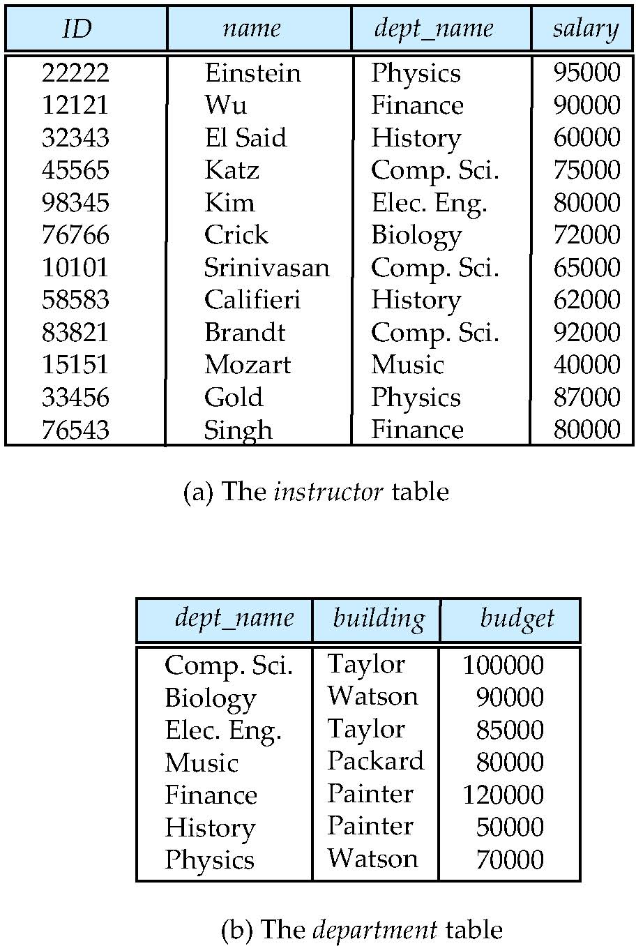
The select Clause
The select clause lists the attributes desired in the result of a query
corresponds to the projection operation of the relational algebra
Example: find the names of all instructors: select name from instructor
Notes:
3

Slide 8
The select Clause (Cont.)
SQL allows duplicates in relations as well as in query results.
To force the elimination of duplicates, insert the keyword distinct after select.
Find the names of all departments with instructor, and remove duplicates
select distinct dept_name from instructor
The keyword all specifies that duplicates not to be removed.
select all dept_name from instructor
Notes:
4

Slide 9
The select Clause (Cont.)
An asterisk in the select clause denotes “all attributes”
select * from instructor
The select clause can contain arithmetic expressions involving the operation, +, –, ∗, and /, and operating on constants or attributes of tuples.
The query:
select ID, name, salary/12 from instructor
would return a relation where the value of the attribute salary is divided by 12.
Notes:
5

Slide 10
The where Clause
The where clause specifies conditions that the result must satisfy
Corresponds to the selection predicate of the relational algebra.
To find all instructors in Comp. Sci. dept with salary > 80000
select name from instructor where dept_name = ‘Comp. Sci.' and salary > 80000
Comparison results can be combined using the logical connectives and, or, and not.
Comparisons can be applied to results of arithmetic expressions.
Notes:
6

Slide 11
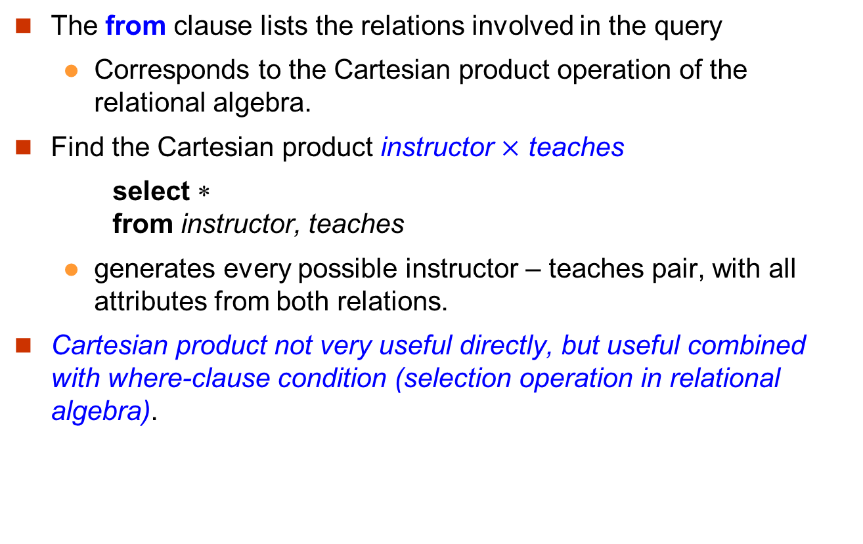
The from Clause
The from clause lists the relations involved in the query
Corresponds to the Cartesian product operation of the relational algebra.
Find the Cartesian product instructor $×$ teaches
select ∗ from instructor, teaches
generates every possible instructor – teaches pair, with all attributes from both relations.
Cartesian product not very useful directly, but useful combined with where-clause condition (selection operation in relational algebra).
Notes:
8

Slide 12
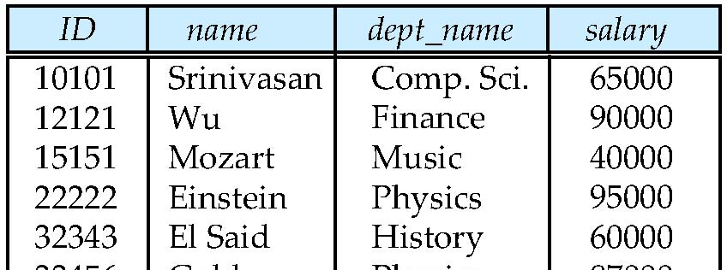
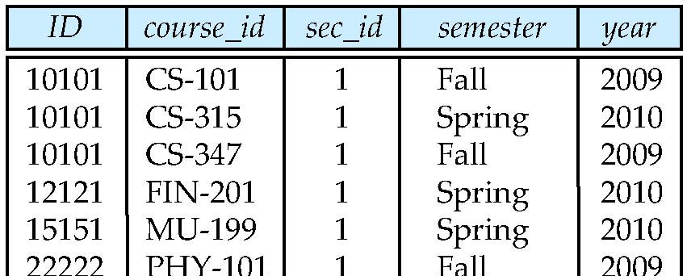
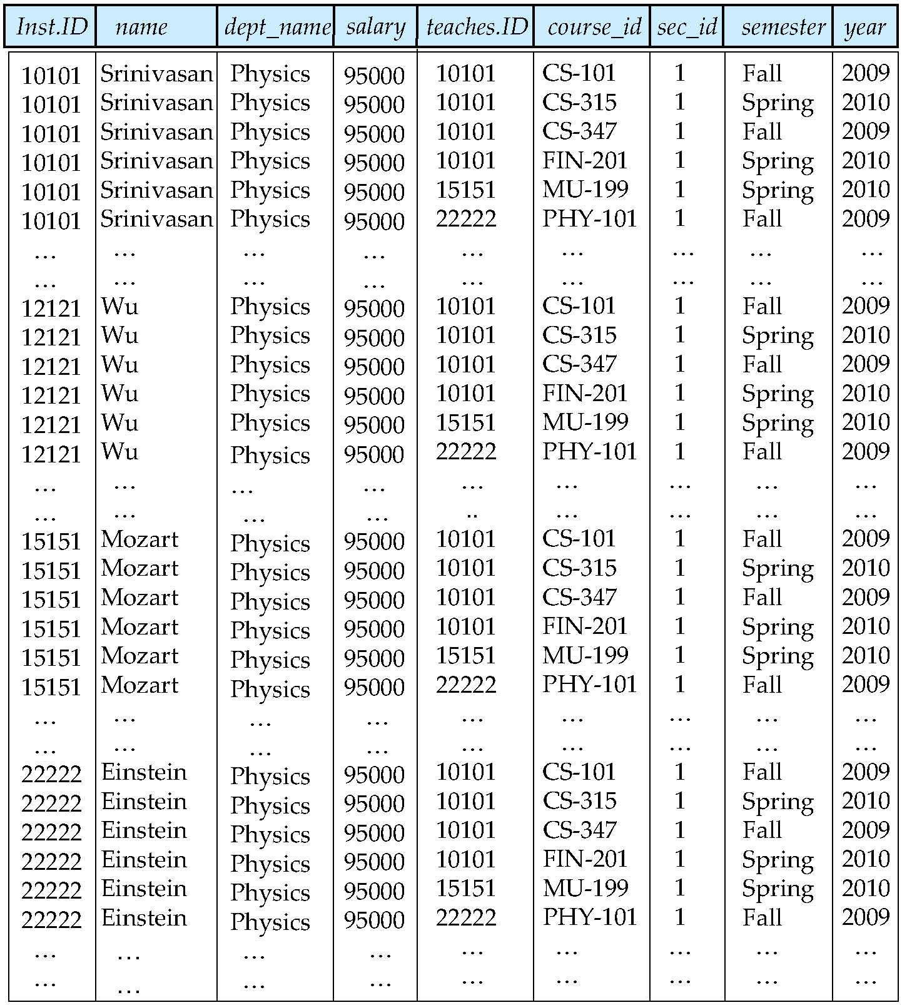
Cartesian Product
instructor
teaches
Comp. Sci
Comp. Sci
Comp. Sci
Comp. Sci
Comp. Sci
Comp. Sci
…
…
Finance
Finance
Finance
Finance
Finance
Finance
…
65000
65000
65000
65000
65000
65000
…
…
90000
90000
90000
90000
90000
90000
…
12121
12121

Slide 13
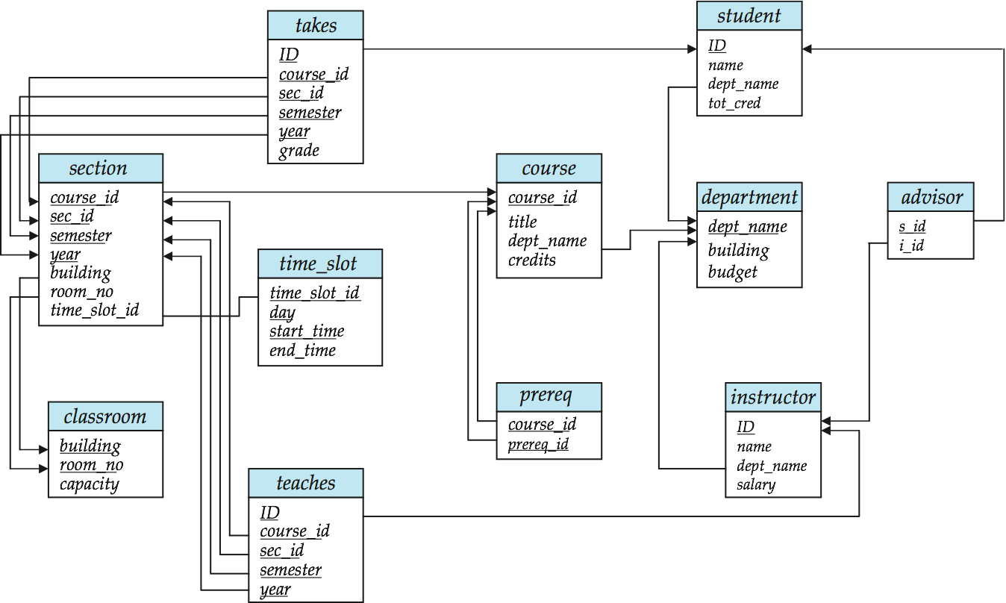
Schema Diagram for University Database

Slide 14
Joins (1)
For all instructors who have taught courses, find their names and the course ID of the courses they taught.
select name, course_id from instructor, teaches where instructor.ID = teaches.ID
instructor
teaches

Slide 15
Joins (2)
Find instructor names and the courses they taught in 2010.
select name, course_id from instructor, teaches where instructor.ID = teaches.ID and year = 2010
instructor
teaches

Slide 16
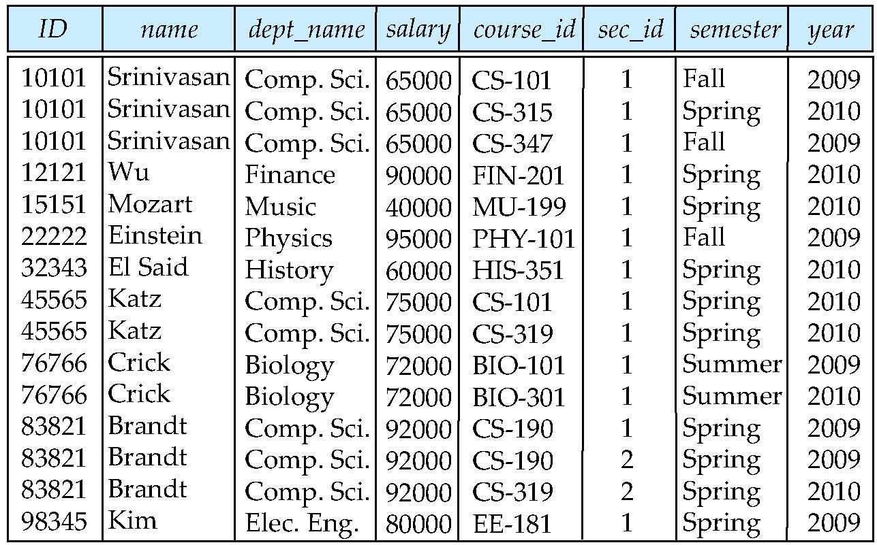
Natural Join (1)
Natural join matches tuples with the same values for all common attributes, and retains only one copy of each common column
select * from instructor natural join teaches;
instructor
teaches

Slide 17
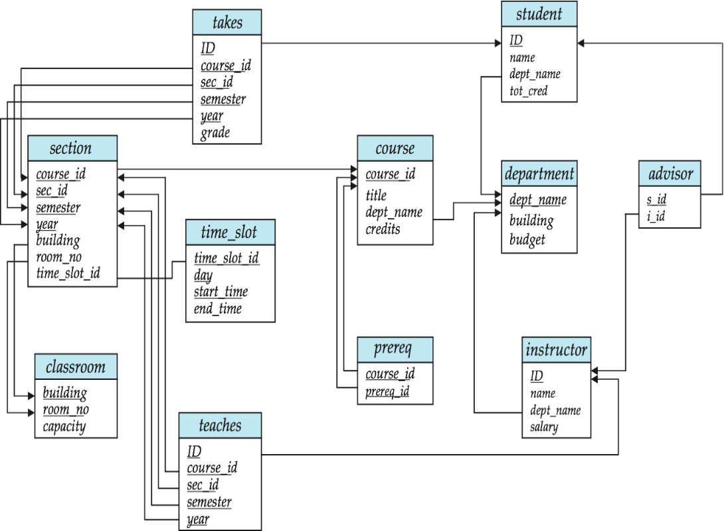
Natural Join (2)
Danger in natural join: beware of unrelated attributes with same name which get equated incorrectly
List the names of instructors along with the titles of courses that they teach
Incorrect version
select name, title from instructor natural join teaches natural join course;
Correct version
select name, title from instructor natural join teaches, course where teaches.course_id = course.course_id;
Another correct version
select name, title from (instructor natural join teaches) join course using(course_id);

Slide 18
Natural Join (3)
List the names of instructors along with the titles of courses that they teach
Incorrect version select name, title from instructor natural join teaches natural join course;
instructor
ID | name | dept_name | salary
8 | ABC | SEEM | 100
7 | XYZ | SEEM | 120
teaches
ID | course_id | sec_id | semester | year
7 | 3550 | 1 | 1 | 2018
8 | 2100 | 1 | 2 | 2018
course
course_id | title | dept_name | credits
3550 | DB | SEEM | 3
2100 | Algo | CSE | 3

Slide 19
Natural Join (4)
List the names of instructors along with the titles of courses that they teach
Correct version
select name, title from instructor natural join teaches, course where teaches.course_id = course.course_id;
instructor
ID | name | dept_name | salary
8 | ABC | SEEM | 100
7 | XYZ | SEEM | 120
teaches
ID | course_id | sec_id | semester | year
7 | 3550 | 1 | 1 | 2018
8 | 2100 | 1 | 2 | 2018
course
course_id | title | dept_name | credits
3550 | DB | SEEM | 3
2100 | Algo | CSE | 3

Slide 20
Natural Join (5)
List the names of instructors along with the titles of courses that they teach
Another correct version
select name, title from (instructor natural join teaches) join course using(course_id);
instructor
ID | name | dept_name | salary
8 | ABC | SEEM | 100
7 | XYZ | SEEM | 120
teaches
ID | course_id | sec_id | semester | year
7 | 3550 | 1 | 1 | 2018
8 | 2100 | 1 | 2 | 2018
course
course_id | title | dept_name | credits
3550 | DB | SEEM | 3
2100 | Algo | CSE | 3

Slide 21
The Rename Operation (1)
The SQL allows renaming relations and attributes using the as clause: old-name as new-name
Keyword as is optional and may be omitted instructor as T ≡ instructor T
An example
select ID, name, salary/12 as monthly_salary from instructor
Notes:
9

Slide 22
The Rename Operation (2)
The SQL allows renaming relations and attributes using the as clause: old-name as new-name
Find the names of all instructors who have a higher salary than some instructor in ‘Comp. Sci’.
A quick attempt?
select distinct name from instructor, instructor where salary > salary and dept_name = ‘Comp. Sci.’
The solution
select distinct T.name from instructor as T, instructor as S where T.salary > S.salary and S.dept_name = ‘Comp. Sci.’
Notes:
9

Slide 23
String Operations
SQL includes a string-matching operator for comparisons on character strings. The operator “like” uses patterns that are described using two special characters:
percent (%). The % character matches any substring.
underscore (_). The _ character matches any character.
Find the names of all instructors whose name includes the substring “dar”.
select name from instructor where name like '%dar%'
Match the string “100 %”
like ‘100 \%' escape '\'
SQL supports a variety of string operations such as
concatenation (using “||”)
converting from upper to lower case (and vice versa)
finding string length, extracting substrings, etc.

Slide 24
Like Predicate
Find the names of all instructors whose name …
select name from instructor where P
P: name like '%dar%'
Match “dar”, “abcdar”, “darabc”, “abcdarabc”
P: name like ‘_dar_'
Match “xdary”, but does not match “dar”, “cdar”, “dara”, “abcdarabc”
P: name like ‘100 \%' escape '\' (the same as name = ‘100 %’)
Match “100 %”, but does not match anything else
P: name like ‘100 \%'
Match “100 \%”, “100 \abc”

Slide 25
Ordering the Display of Tuples
List in alphabetic order the names of all instructors select distinct name from instructor order by name
We may specify desc for descending order or asc for ascending order. The default is ascending order.
Example: order by name desc
Can sort on multiple attributes
Example: order by dept_name, name
Didn’t we said that relations are unordered?

Slide 26
Where Clause Predicates
SQL includes a between comparison operator
Example: Find the names of all instructors with salary between $90,000 and $100,000 (that is, ≥ $90,000 and ≤ $100,000)
select name from instructor where salary between 90000 and 100000
Notes:
7

Slide 27
Set Operations
Find courses that ran in Fall 2009 or in Spring 2010
(select course_id from section where sem = ‘Fall’ and year = 2009) union (select course_id from section where sem = ‘Spring’ and year = 2010)
Find courses that ran in Fall 2009 and in Spring 2010
(select course_id from section where sem = ‘Fall’ and year = 2009) intersect (select course_id from section where sem = ‘Spring’ and year = 2010)
Find courses that ran in Fall 2009 but not in Spring 2010
(select course_id from section where sem = ‘Fall’ and year = 2009) except (select course_id from section where sem = ‘Spring’ and year = 2010)

Slide 28
Set Operations
Set operations union, intersect, and except
Each of the above operations automatically eliminates duplicates
To retain all duplicates use the corresponding multiset versions union all, intersect all and except all.
Suppose a tuple occurs m times in r and n times in s, then, it occurs:
m + n times in r union all s
min(m,n) times in r intersect all s
max(0, m – n) times in r except all s

Slide 29
Null Values
It is possible for tuples to have a null value, denoted by null, for some of their attributes
null signifies an unknown value or that a value does not exist.
The result of any arithmetic expression involving null is null
Example: 5 + null returns null
The predicate is null can be used to check for null values.
Example: Find all instructors whose salary is null.
select name from instructor where salary is null

Slide 30
Null Values and Three Valued Logic
Any comparison with null returns unknown
Example: 5 < null, null <> null, null = null
Three-valued logic using the truth value unknown:
OR: (unknown or true) = true, (unknown or false) = unknown, (unknown or unknown) = unknown
AND: (true and unknown) = unknown, (false and unknown) = false, (unknown and unknown) = unknown
NOT: (not unknown) = unknown
“P is unknown” evaluates to true if predicate P evaluates to unknown
Result of where clause predicate is treated as false if it evaluates to unknown

Slide 31
Null Values
select A3 from R where A1 + 5 > A2 and A4 = ‘x’
When it evaluates the second tuple:
Null + 5 → Null (for A1 + 5)
Null > 4 → Null (for A1 + 5 > A2)
Null = ‘x’ → Null (for A4 = ‘x’)
Null and Null → Null (for A1 + 5 > A2 and A4 = ‘x’)
Where clause results false since it is Null. So it does not output “beta”
A1 | A2 | A3 | A4
5 | 9 | alpha | x
 | 4 | beta
2 | 4 | gamma
3 |  | delta | x
What about the following? select A3 from R where (A1 + 5 > A2 and A4 = ‘x’) is unknown

Slide 32
Aggregate Functions (1)
These functions operate on the multiset of values of a column of a relation, and return a value
avg: average value min: minimum value max: maximum value sum: sum of values count: number of values

Slide 33
Aggregate Functions (2)
Find the average salary of instructors in the Computer Science department
select avg (salary) from instructor where dept_name= ’Comp. Sci.’;

Slide 34
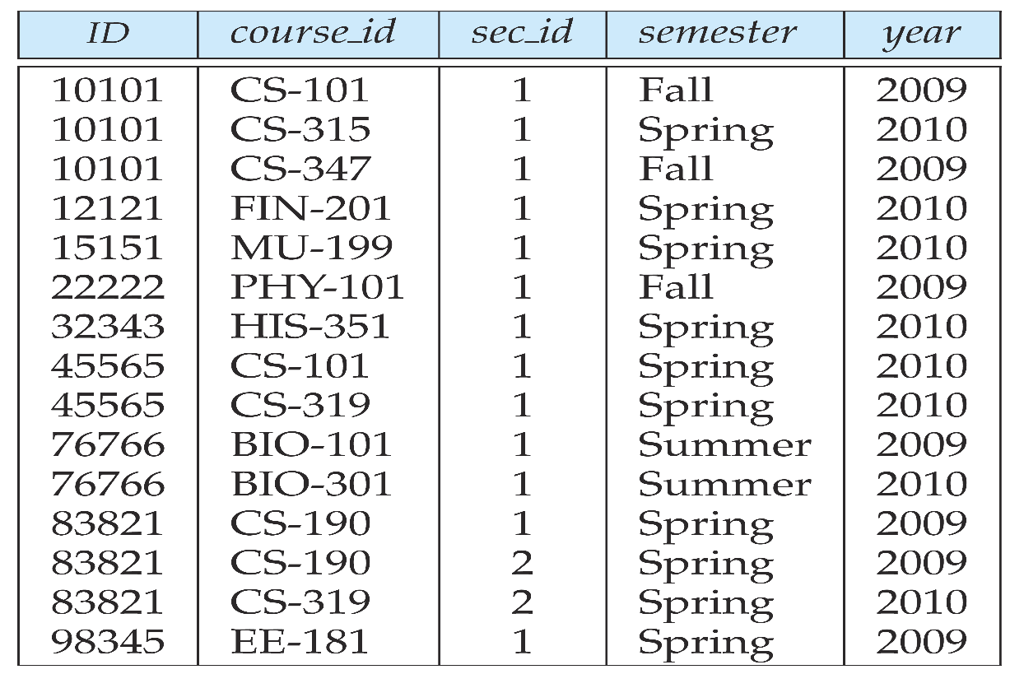
Aggregate Functions (3)
Find the total number of instructors who teach a course in the Spring 2010 semester
select count (distinct ID) from teaches where semester = ’Spring’ and year = 2010

Slide 35
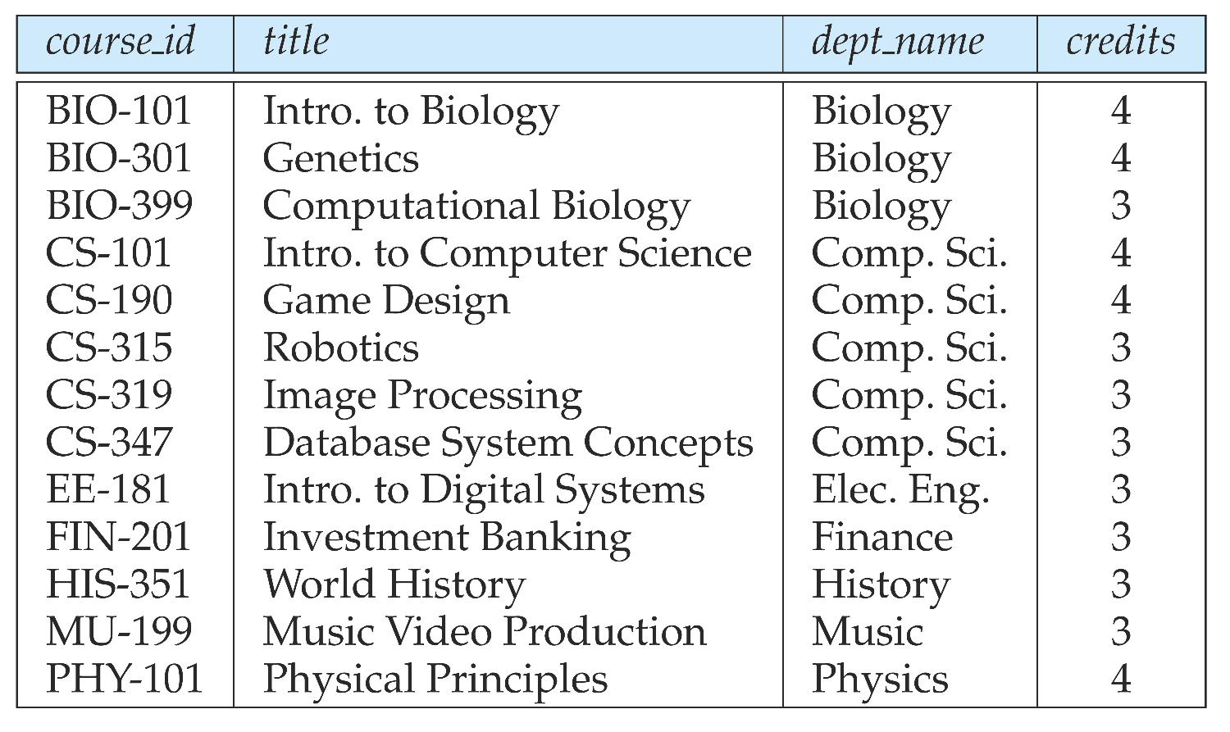
Aggregate Functions (4)
Find the number of tuples in the course relation
select count (*) from course;

Slide 36
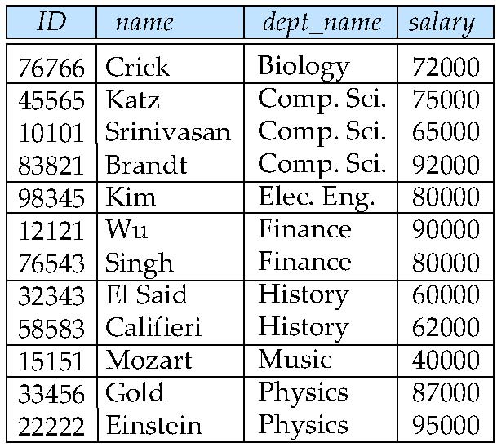
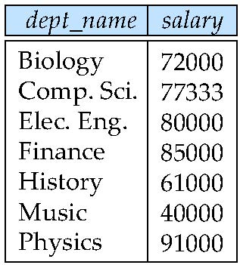
Aggregate and Group By (1)
Find the average salary of instructors in each department
select dept_name, avg (salary) from instructor group by dept_name;

Slide 37
Aggregate and Group By (2)
Attributes in select clause outside of aggregate functions must appear in group by list
/* erroneous query */ select dept_name, ID, avg (salary) from instructor group by dept_name;

Slide 38
Aggregate Functions – Having Clause
Find the names and average salaries of all departments whose average salary is greater than 42000
select dept_name, avg (salary)
from instructor
group by dept_name
having avg (salary) > 42000;
Note: predicates in the having clause are applied after the formation of groups whereas predicates in the where clause are applied before forming groups

Slide 39
Null Values and Aggregates
Total all salaries
select sum (salary ) from instructor
Above statement ignores null amounts
Result is null if there is no non-null amount
All aggregate operations except count(*) ignore tuples with null values on the aggregated attributes
What if collection has only null values?
count returns 0
all other aggregates return null
http://www-cs-students.stanford.edu/~wlam/compsci/sqlnulls

Slide 40
Aggregation & Null Values by MySQL
select count(A1) from R
The answer is 3.
select count(distinct A1) from R
The answer is 3.
As specified by MySQL
Count(*) counts null and non-null tuples
Count(attribute) counts all non-null tuples
A1 | A2 | A3 | A4
5 | 9 | alpha | x
 | 4 | beta
2 | 4 | gamma
3 |  | delta | x

Slide 41
Nested Subqueries
SQL provides a mechanism for the nesting of subqueries.
A subquery is a select-from-where expression that is nested within another query.
A common use of subqueries is to perform tests for set membership, set comparisons, and set cardinality.

Slide 42
Example Query
Find courses offered in Fall 2009 and in Spring 2010
select distinct course_id
from section
where semester = ’Fall’ and year = 2009 and course_id in (select course_id
from section
where semester = ’Spring’ and year = 2010);
Find courses offered in Fall 2009 but not in Spring 2010
select distinct course_id
from section
where semester = ’Fall’ and year = 2009 and course_id not in (select course_id
from section
where semester = ’Spring’ and year = 2010);

Slide 43
Example Query
Find the total number of (distinct) students who have taken course sections taught by the instructor with ID 10101
select count (distinct ID)
from takes
where (course_id, sec_id, semester, year) in (select course_id, sec_id, semester, year
from teaches
where teaches.ID = 10101);
Note: Above query can be written in a much simpler manner. The formulation above is simply to illustrate SQL features.

Slide 44
Set Comparison
Find names of instructors with salary greater than that of some (at least one) instructor in the Physics department.
select distinct T.name
from instructor as T, instructor as S
where T.salary > S.salary and S.dept name = ’Physics’;
Same query using > some clause
select name
from instructor
where salary > some (select salary
from instructor
where dept name = ’Physics’);

Slide 45
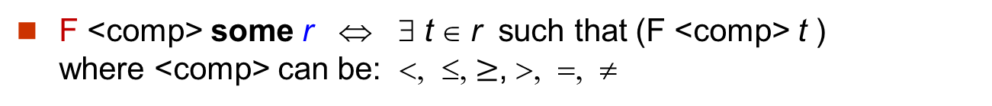
Definition of Some Clause
F <comp> some r ⇔ ∃ t ∈ r such that (F <comp> t ) where <comp> can be: <, ≤, $≥$, >, =, ≠
0
(5 < some
5
) = true
(read: 5 < some tuple in the relation)
6
select name
from instructor
where salary > some (select salary
from instructor
where
dept name = ’Physics’);
0
(5 < some
5
) = false
0
(5 = some
) = true
5
0
(5 ≠ some
5
) = true (since 0 ≠ 5)
(= some) ≡ in
However, (≠ some) ≡ not in

Slide 46
Example Query
Find the names of all instructors whose salary is greater than the salary of all instructors in the Physics department.
select name
from instructor
where salary > all (select salary
from instructor
where dept name = ’Physics’);

Slide 47
Definition of all Clause
F <comp> all r ⇔ ∀ t ∈ r (F <comp> t)
0
(5 < all
5
) = false
6
select name
from instructor
where salary > all (select salary
from instructor
where
dept name = ’Physics’);
6
(5 < all
) = true
10
4
(5 = all
) = false
5
4
(5 ≠ all
) = true (since 5 ≠ 4 and 5 ≠ 6)
6
(≠ all) ≡ not in
However, (= all) ≡ in

Slide 48
Test for Empty Relations
The exists construct returns the value true if the argument subquery is nonempty.
exists r ⇔ r ≠ Ø
not exists r ⇔ r = Ø

Slide 49
Correlation Variables
Yet another way of specifying the query “Find all courses taught in both the Fall 2009 semester and in the Spring 2010 semester”
Recall the section relation is (course_id, sec_id, semester, year, building, room_no, time_slot_id)
select course_id from section as S where semester = ’Fall’ and year = 2009 and exists (select * from section as T where semester = ’Spring’ and year= 2010 and S.course_id= T.course_id);
Correlated subquery
Correlation name or correlation variable

Slide 50
Not Exists
student
Find all students who have taken all courses offered in the Biology department.
ID | name
10 | A
20 | B
select distinct S.ID, S.name
from student as S
where not exists ( (select course_id
from course
where dept_name = ’Biology’)
except
(select T.course_id
from takes as T
where S.ID = T.ID));
takes
ID | course_id
10 | 100
10 | 200
10 | 300
20 | 200
course
course_id | dept_name
100 | CSE
200 | Biology
300 | Biology
Note that X – Y = Ø ⇔ X ⊆ Y
Note: Cannot write this query using = all and its variants

Slide 51
Test for Absence of Duplicate Tuples
The unique construct tests whether a subquery has any duplicate tuples in its result.
Find all courses that were offered at most once in 2009
select T.course_id from course as T where unique (select R.course_id from section as R where T.course_id= R.course_id and R.year = 2009);

Slide 52
Derived Relations
SQL allows a subquery expression to be used in the from clause
Find the average instructors’ salaries of those departments where the average salary is greater than $42,000.”
select dept_name, avg_salary from (select dept_name, avg (salary) as avg_salary from instructor group by dept_name) where avg_salary > 42000;
Note that we do not need to use the having clause.
Another way to write above query
select dept_name, avg_salary from (select dept_name, avg (salary) from instructor group by dept_name) as dept_avg (dept_name, avg_salary)
where avg_salary > 42000;

Slide 53
With Clause
The with clause provides a way of defining a temporary view whose definition is available only to the query in which the with clause occurs.
Find all departments with the maximum budget with max_budget (value) as (select max(budget) from department) select budget from department, max_budget where department.budget = max_budget.value;
department

Slide 54
Modification of the Database – Deletion
Delete all instructors
delete from instructor
Delete all instructors from the Finance department delete from instructor where dept_name= ’Finance’;
Delete all tuples in the instructor relation for those instructors associated with a department located in the Watson building.
delete from instructor where dept_name in (select dept_name from department where building = ’Watson’);

Slide 55
Example Query
Delete all instructors whose salary is less than the average salary of instructors
delete from instructor
where salary < (select avg (salary) from instructor);
Problem: as we delete tuples from instructor, the average salary changes
Solution used in SQL:
First, compute avg salary and find all tuples to delete
Next, delete all tuples found above (without recomputing avg or retesting the tuples)

Slide 56
Modification of the Database – Insertion
Add a new tuple to course
insert into course values (’CS-437’, ’Database Systems’, ’Comp. Sci.’, 4);
or equivalently
insert into course (course_id, title, dept_name, credits) values (’CS-437’, ’Database Systems’, ’Comp. Sci.’, 4);
Add a new tuple to student with tot_creds set to null
insert into student values (’3003’, ’Green’, ’Finance’, null);

Slide 57
Modification of the Database – Insertion
Add all instructors to the student relation with tot_creds set to 0
insert into student select ID, name, dept_name, 0 from instructor
The select from where statement is evaluated fully before any of its results are inserted into the relation (otherwise queries like insert into table1 select * from table1 would cause problems)

Slide 58
Modification of the Database – Updates
Increase salaries of instructors whose salary is over $100,000 by 3%, and all others receive a 5% raise
Write two update statements:
update instructor set salary = salary * 1.03 where salary > 100000; update instructor set salary = salary * 1.05 where salary <= 100000;
The order is important

