Slide 1
Chapter 5: Advanced SQL

Slide 2
Chapter 5: Advanced SQL
Recursive Queries
Advanced Aggregation Features
Ranking
Windowing

Slide 3
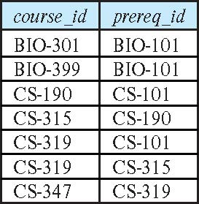
Recursion in SQL
prereq
SQL permits recursion.
Example: find which courses are a prerequisite, whether directly or indirectly, for a specific course with recursive c_prereq(course_id, prereq_id) as ( select course_id, prereq_id from prereq union select c_prereq.course_id, prereq.prereq_id from c_prereq, prereq where prereq.course_id = c_prereq.prereq_id ) select ∗ from c_prereq;
In this example, c_prereq is called the transitive closure of the prereq relation
Consider CS-347.
Initial c_prereq

Slide 4
The Power of Recursion
Recursion makes it possible to write queries, such as transitive closure queries, that cannot be written without recursion.
Intuition: Without recursion, a non-recursive query can perform only a fixed number of joins of prereq with itself
This can give only a fixed number of levels of managers
Given a fixed non-recursive query, we can construct a database with a greater number of levels of prerequisites on which the query will not work
Recursion is required to be monotonic. That is, if we add tuples to prereq the view c_prereq contains all of the tuples it contained before, plus possibly more.

Slide 5
Ranking (1)
Ranking is done in conjunction with an order by specification.
Suppose we are given a relation student_grades(ID, GPA) with the grade-point average of each student.
Find the rank of each student.
select ID, rank() over (order by GPA desc) as s_rank from student_grades
An extra order by clause is needed to get them in sorted order
select ID, rank() over (order by GPA desc) as s_rank from student_grades order by s_rank
Ranking may leave gaps: e.g. if 2 students have the same top GPA, both have rank 1, and the next rank is 3
dense_rank does not leave gaps, so next dense rank would be 2
student_grades
ID | GPA
10 | 3.8
20 | 3.7
30 | 3.5
40 | 3.7
Notes:
5

Slide 6
Ranking (2)
Ranking can be done using basic SQL aggregation, but resultant query is very inefficient
select ID, (1 + (select count(*) from student_grades B where B.GPA > A.GPA)) as s_rank from student_grades A order by s_rank;
ID | GPA
10 | 3.8
20 | 3.7
30 | 3.5
40 | 3.7
student_grades

Slide 7
Ranking (3)
Ranking can be done within partition of the data.
Suppose we are given a relation dept_grades(ID, dept_name, GPA) with the grade-point average of each student.
Find the rank of students within each department.
select ID, dept_name, rank () over (partition by dept_name order by GPA desc) as dept_rank from dept_grades order by dept_name, dept_rank;
Ranking and partition by are done after applying group by.

Slide 8
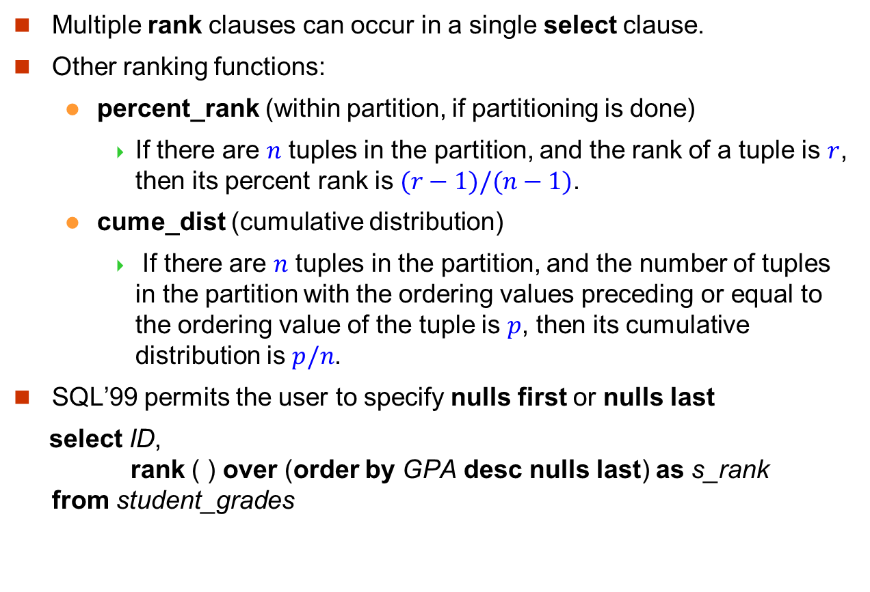
Ranking (4)
Multiple rank clauses can occur in a single select clause.
Other ranking functions:
percent_rank (within partition, if partitioning is done)
If there are $n$ tuples in the partition, and the rank of a tuple is $r$, then its percent rank is $(r−1)/(n−1)$.
cume_dist (cumulative distribution)
If there are $n$ tuples in the partition, and the number of tuples in the partition with the ordering values preceding or equal to the ordering value of the tuple is $p$, then its cumulative distribution is $p/n$.
SQL’99 permits the user to specify nulls first or nulls last
select ID, rank ( ) over (order by GPA desc nulls last) as s_rank from student_grades
Notes:
8

Slide 9
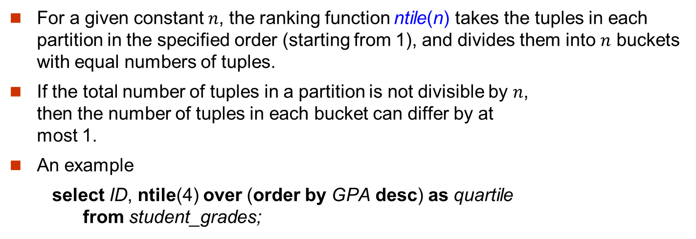
Ranking (5)
For a given constant $n$, the ranking function ntile(n) takes the tuples in each partition in the specified order (starting from 1), and divides them into $n$ buckets with equal numbers of tuples.
If the total number of tuples in a partition is not divisible by $n$, then the number of tuples in each bucket can differ by at most 1.
An example
select ID, ntile(4) over (order by GPA desc) as quartile from student_grades;
ID | GPA
10 | 3.8
20 | 3.7
40 | 3.7
30 | 3.5
50 | 3.3
60 | 3.0
70 | 2.9
80 | 2.9
90 | 2.8
99 | 2.5
student_grades
Notes:
9

Slide 10
Windowing (1)
Window queries compute an aggregate function over ranges of tuples.
Consider moving average.
Given sales values for each date, calculate for each date the average of the sales on that day, the previous day, and the next day.
Consider a relation tot_credits(year, num_credits) which gives the total number of credits taken by students in each year.
select year, avg(num_credits) over (order by year rows 3 preceding) as avg_total_credits from tot_credits
select year, avg(num_credits) over (order by year rows unbounded preceding) as avg_total_credits from tot_credits
year | Num_credits
2011 | 100
2012 | 120
2013 | 160
2014 | 200
2015 | 400
2016 | 300
2017 | 300
2018 | 320
2019 | 360
2020 | 280
tot_credits
Notes:
10

Slide 11
Windowing (2)
select year, avg(num_credits) over (order by year rows between 3 preceding and 2 following) as avg_total_credits from tot_credits
select year, avg(num_credits) over (order by year rows range between year-4 and year) as avg_total_credits from tot_credits
select year, avg(num_credits) over (order by year rows between 3 preceding and current row) as avg_total_credits from tot_credits
year | Num_credits
2011 | 100
2012 | 120
2013 | 160
2014 | 200
2015 | 400
2016 | 300
2017 | 300
2018 | 320
2019 | 360
2020 | 280
tot_credits
Notes:
11

