Slide 1
GENERAL PRESENTATION
a Distributed Messaging System for Log Processing
--Name
--ID

Slide 2

Introduction Of Kafka
Kafka is a distributed messaging system that is used to collect and deliver high volumes of log data with low latency.
Notes:
Log processing has become a critical component of the data pipeline for consumer internet companies

Slide 3
Introduction Of Kafka
Messaging system
A messaging system is responsible for transferring data from one application to another.
Using queue to transfer messages.
Distributed
The application sends data and receives data usually distributed.
Log processing
A large amount of “log” data generated at any time, log processing always need to collect and consume, and log data always very large.
Notes:
Log processing has become a critical component of the data pipeline for consumer internet companies

Slide 4
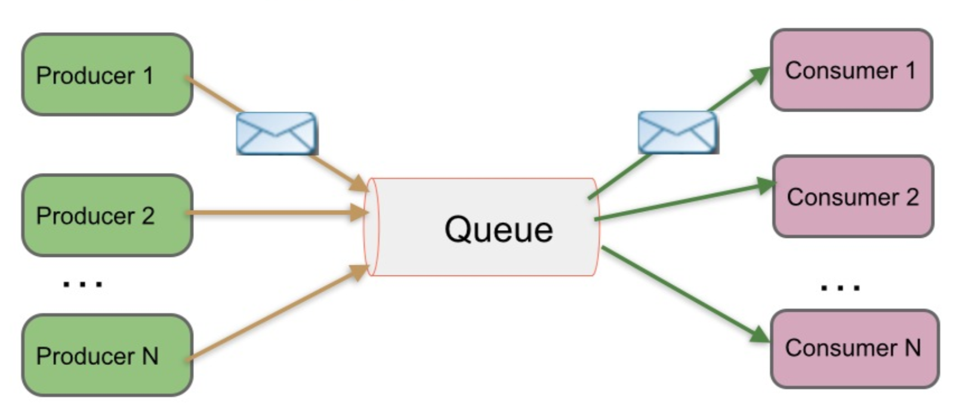
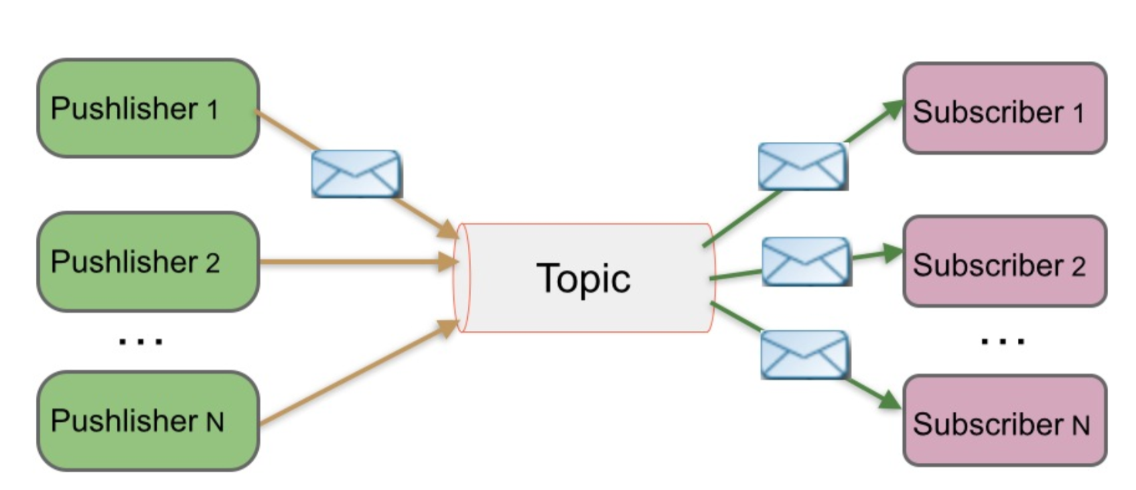
Introduction Of Kafka
Messaging system
Notes:
Log processing has become a critical component of the data pipeline for consumer internet companies

Slide 5
Introduction Of Kafka
Distributed
consumer
producer
Los Angeles
New york
Notes:
Log processing has become a critical component of the data pipeline for consumer internet companies

Slide 6
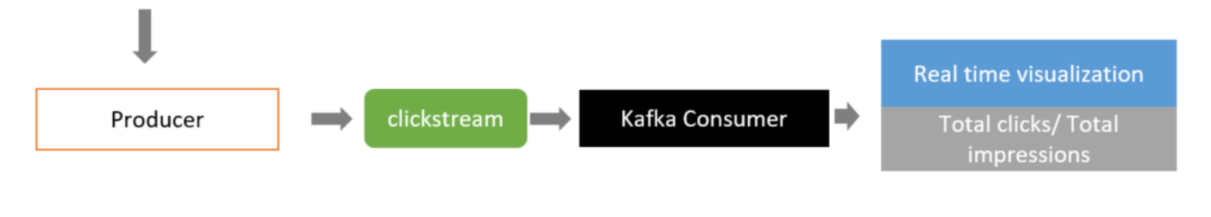
Introduction Of Kafka
Log processing
Such as logins clickstream, likes clickstreams and search clickstreams…
Notes:
Log processing has become a critical component of the data pipeline for consumer internet companies

Slide 7
Kafka Architecture
General terms of Kafka
Topics¶
Every message that is feed into the system must be part of some topic. The topic is nothing but a stream of records. The messages are stored in key-value format. Each message is assigned a sequence, called Offset. The output of one message could be an input of the other for further processing.
Producers
Producers are the applications responsible to publish data into Kafka system. They publish data on the topic of their choice.
Consumers
The messages published into topics are then utilized by Consumer applications. A consumer gets subscribed to the topic of its choice and consumes data.
Broker
Every instance of Kafka that is responsible for message exchange is called a Broker. Kafka can be used as a stand-alone machine or a part of a cluster.

Slide 8
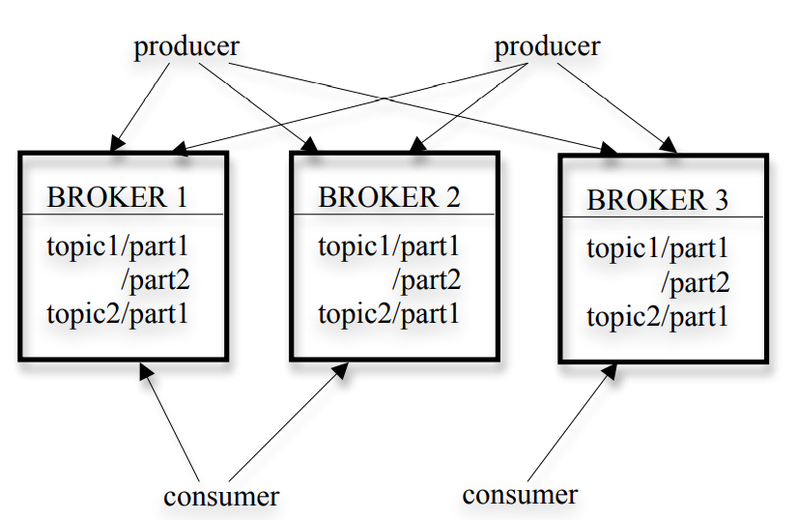
Kafka Architecture

Slide 9
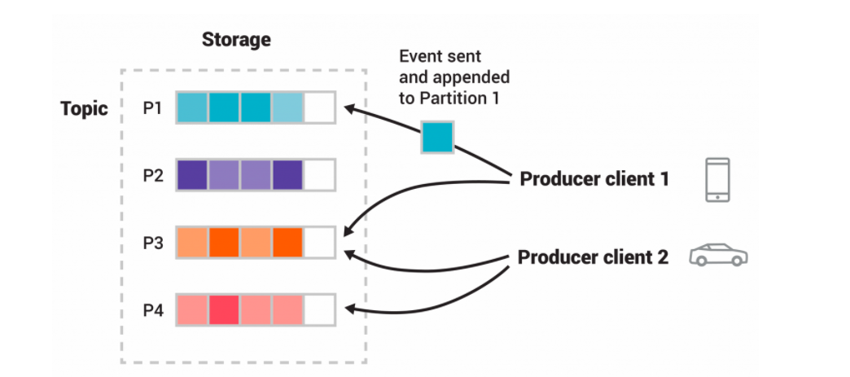
Kafka Architecture
Notes:
A stream of messages of a particular type is defined by a topic. Here is P1, P2, P3 and P4 A producer client called “my phone” which publish messages to topic P1, P3. The published messages are sent and appended to P1, P3 then stored at a set of servers called brokers. Another producer client called “my car” which publish messages to topic P3, P4. The published messages are sent and appended to Partition P3, P4. and then stored at a set of servers.

Slide 10
Kafka Architecture
Efficiency on a Single Partition
Simple storage:
Each partition of a topic corresponds to a logical log.
Every time a producer publishes a message to a partition.
Each message is addressed by its logical offset in the log.
Consumer acknowledges a particular message offset, means the consumer has received all messages prior to that offset in the partition.

Slide 11
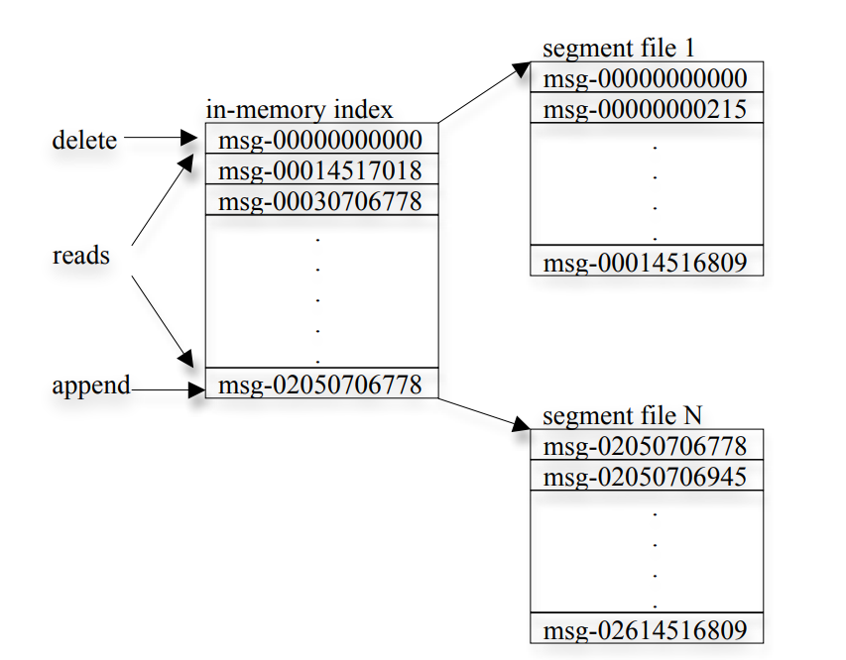
Kafka Architecture

Slide 12
Kafka Architecture
Efficiency on a Single Partition
Efficient transfer:
Messages are only cached in the page cache.
Both the producer and the consumer access the segment files sequentially.

Slide 13
Kafka Architecture
Efficiency on a Single Partition
Stateless broker:
The broker doesn’t maintain how much the consumer has consumed.
Reduces the complexity and the overhead on the broker.
SLA policy: A message is automatically deleted if it has been retained in the broker longer than a certain period, typically 7 days.
Consumer can deliberately rewind back to an old offset and re-consume data

Slide 14
Kafka Architecture
Distributed Coordination
Consumer groups
Each consumer group consists of one or more consumers that jointly consume a set of subscribed topics.
Different consumer groups each independently consume the full set of subscribed messages and no coordination is needed across consumer groups.
At any given time, all messages from one partition are consumed only by a single consumer within each consumer group.

Slide 15
Kafka Architecture
Distributed Coordination
Consumer groups
Consumers coordinate among themselves in a decentralized fashion.
Use Zookeeper:
(1) detecting the addition and the removal of brokers and consumers
(2) triggering a rebalance process in each consumer when the above events happen
(3) maintaining the consumption relationship and keeping track of the consumed offset of each partition.

Slide 16
Kafka Architecture
Delivery Guarantees
Kafka guarantees that messages from a single partition are delivered to a consumer in order.
No guarantee on the ordering of messages coming from different partitions.
Kafka stores a CRC for each message in the log.

Slide 17
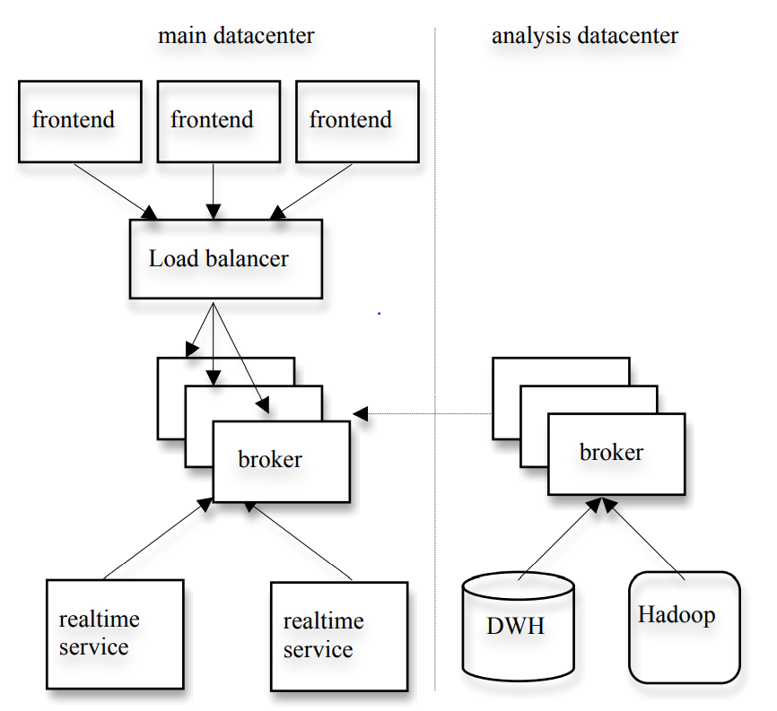
Kafka Usage

Slide 18
Kafka Usage
A cluster of Kafka in a separate datacenter for offline analysis, located geographically.
Runs a set of embedded consumers to pull data from the Kafka instances in the live datacenters.
Run data load jobs to pull data from this replica cluster of Kafka into Hadoop and data warehouse, where there are various reporting jobs and analytical process on the data.
Use Kafka cluster for prototyping and have the ability to run simple scripts against the raw event streams for ad hoc querying.

Slide 19
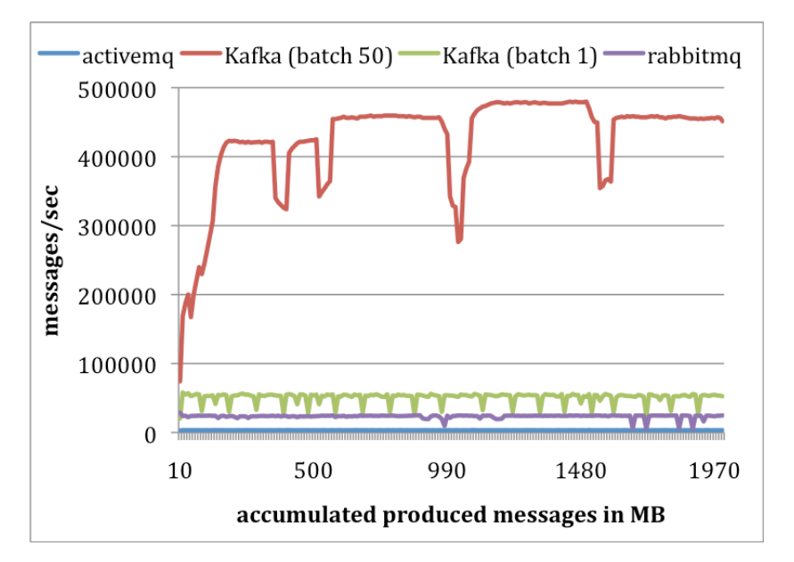
Experiments
Producer performance

Slide 20
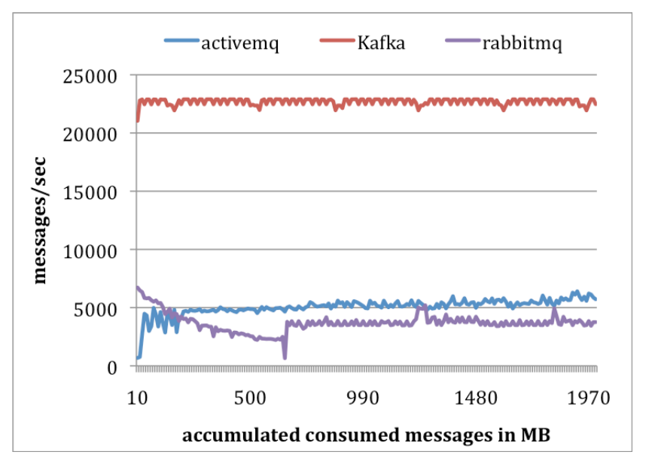
Experiments
Consumer performance

Slide 21
Summary
A messaging system.
Pull-based consumption model.
Higher throughput on log processing.
Integrated distributed support and can scale out.
Both online and offline.

Slide 22
Thank you~

