Slide 1
Data Analysis Part II: Calibration and Imaging
Zhilei Xu
MIT
CHAMP Bootcamp
June 10, 2022
University of Pennsylvania

Slide 2
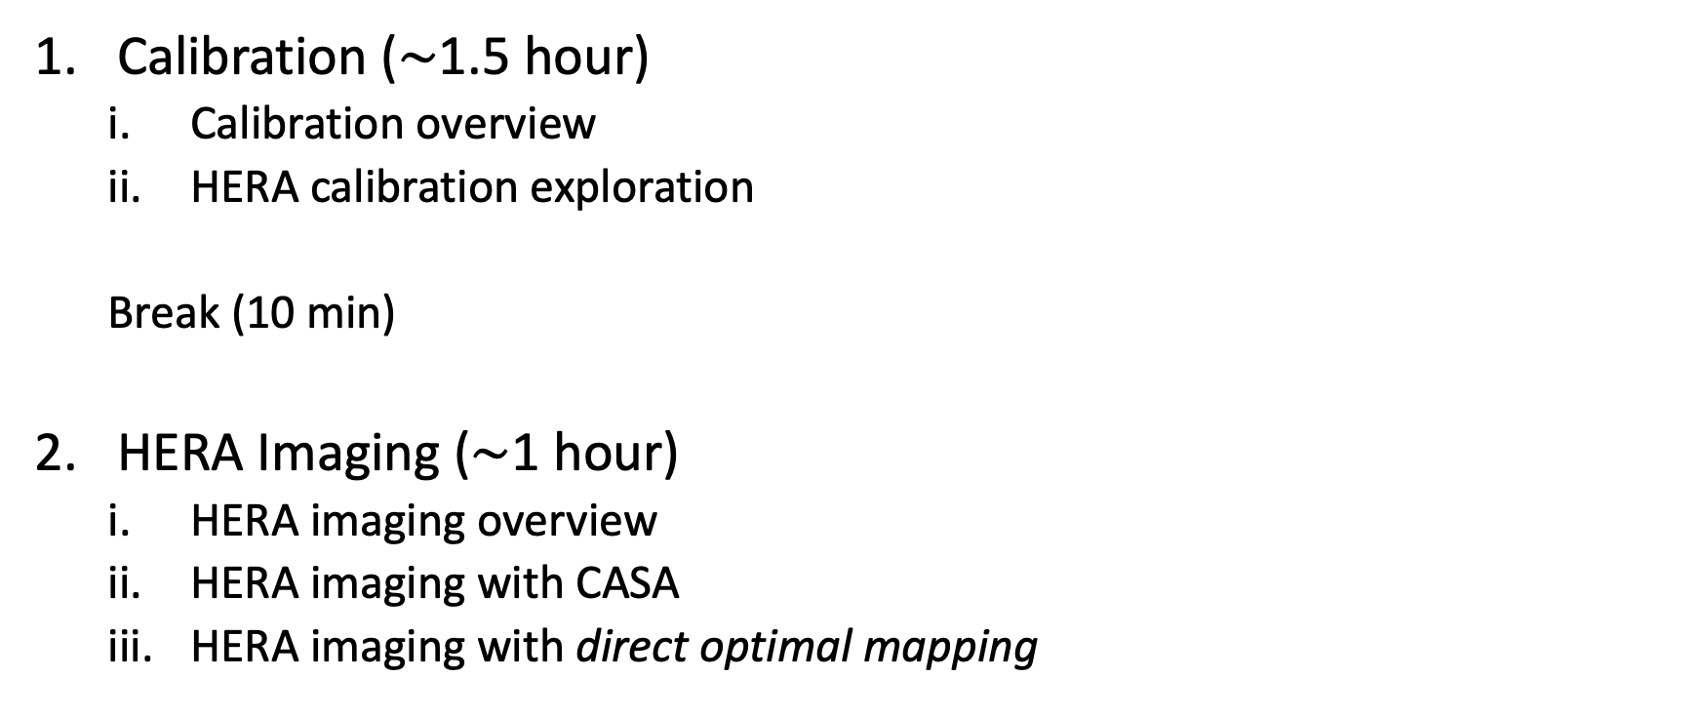
Lesson Overview
Calibration ($\sim$1.5 hour)
Calibration overview
HERA calibration exploration
Break (10 min)
HERA Imaging ($\sim$1 hour)
HERA imaging overview
HERA imaging with CASA
HERA imaging with direct optimal mapping

Slide 3
Learning Objectives
Gain a basic understanding of what calibration is, and explore applying calibration to real data
Become familiar with HERA’s imaging capability
Learn how to perform basic imaging of HERA data with CASA and direct optimal mapping

Slide 4
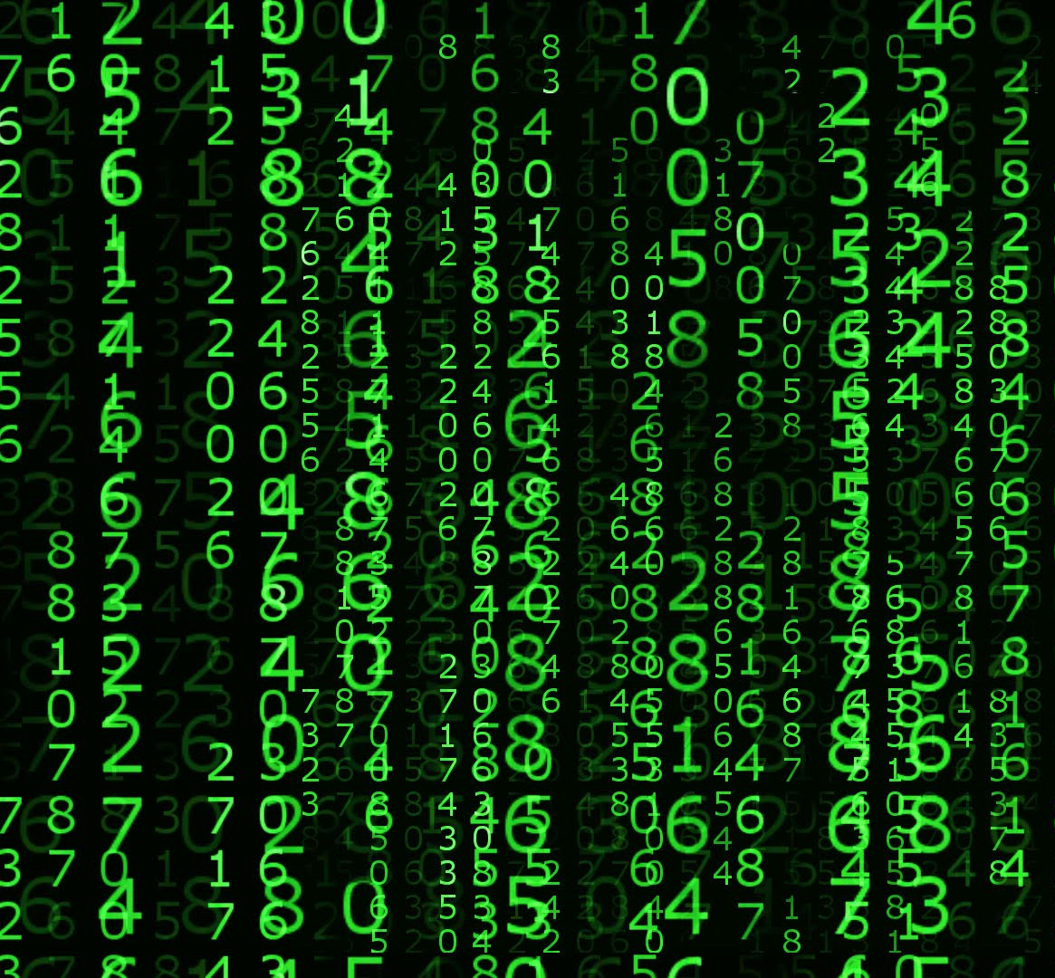
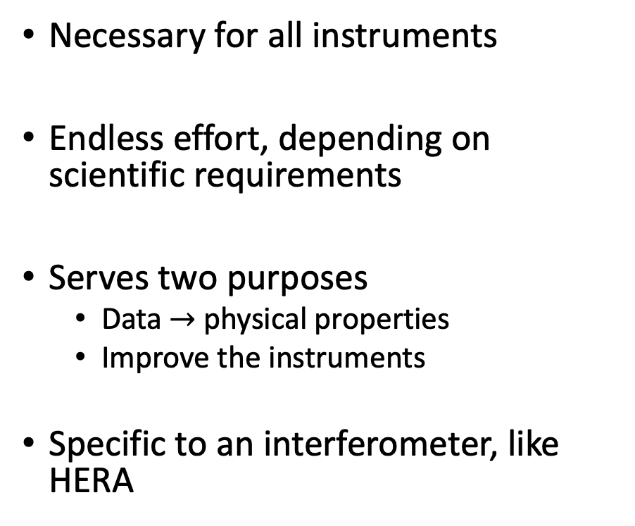
What is calibration?
Know your instrument!
Necessary for all instruments
Endless effort, depending on scientific requirements
Serves two purposes
Data $→$ physical properties
Improve the instruments
Specific to an interferometer, like HERA

Slide 5
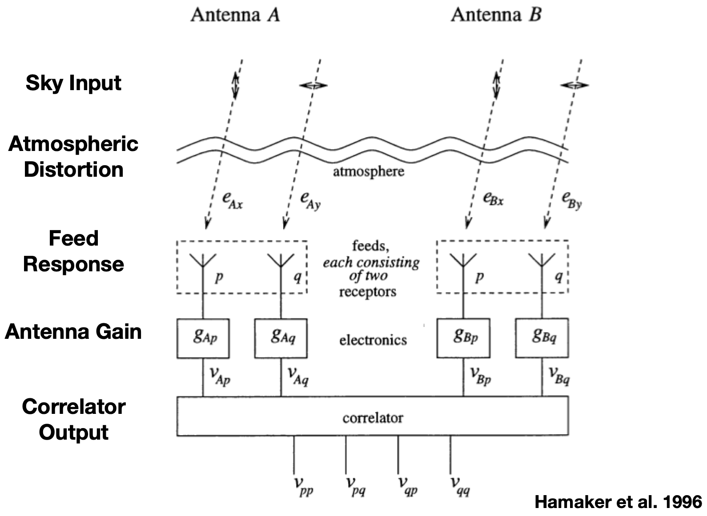

Slide 6
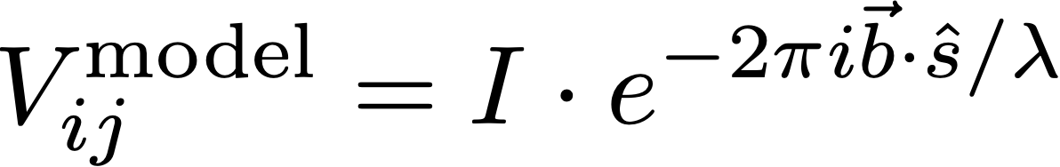
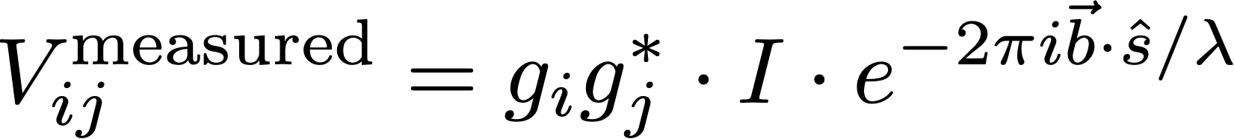
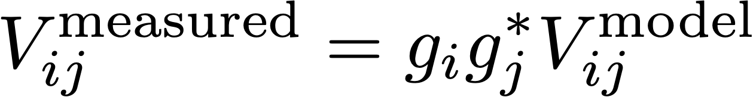
Measurement Equation
Ideal Scenario
Practical Scenario
Antenna-Based Calibration Equation

Slide 7
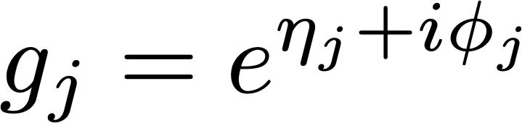
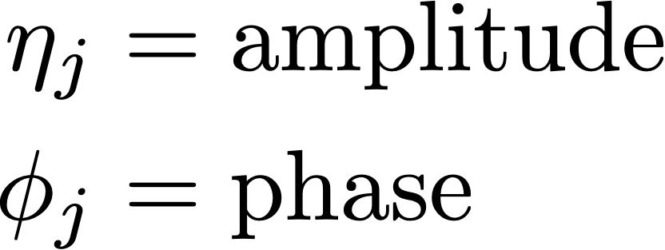


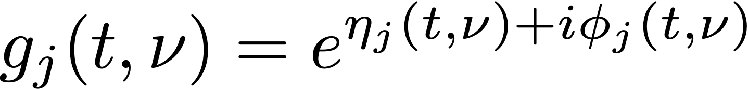
Breaking down Antenna Gains
Antenna gain is a complex quantity, defined by an amplitude and phase
imag
real
Gains are also in principle time and frequency dependent:

Slide 8
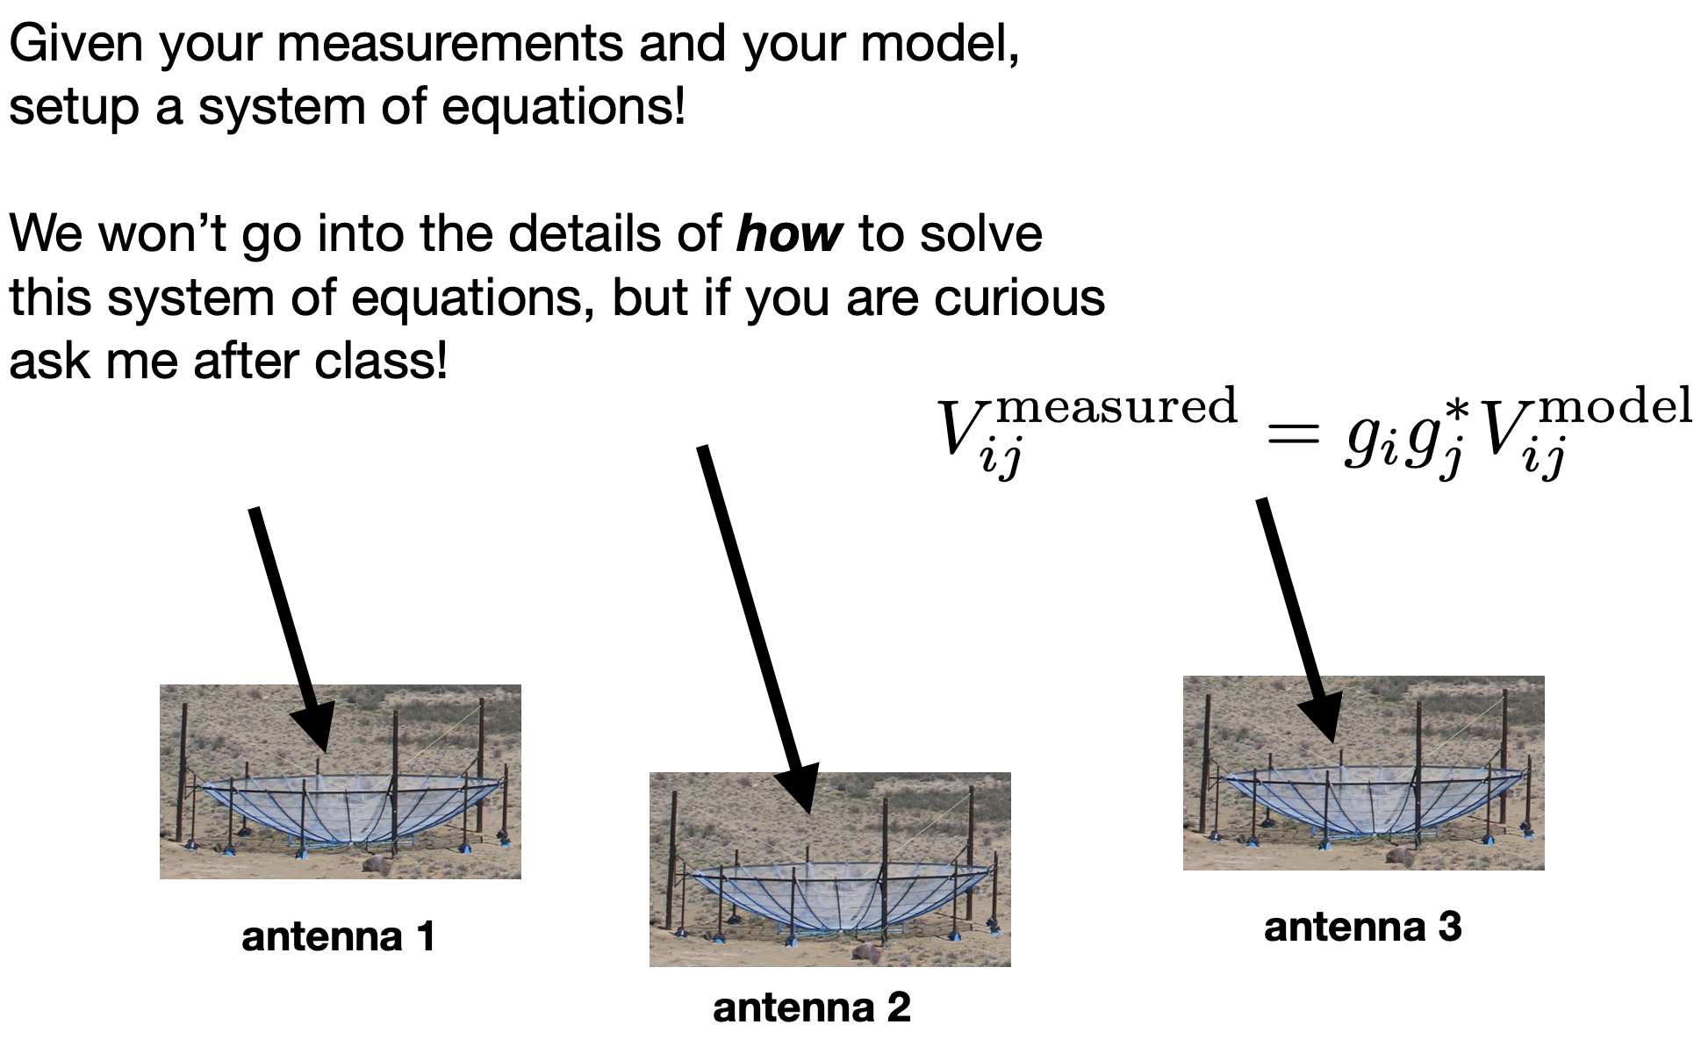
Solving for Gains

Slide 9
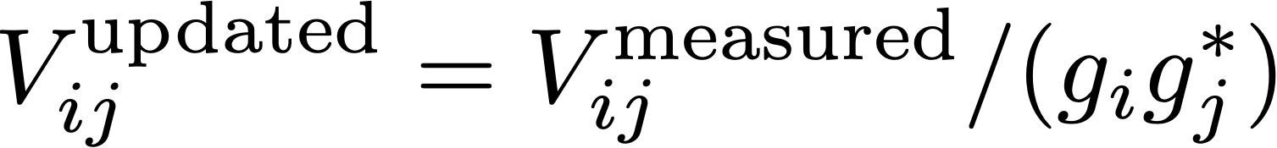
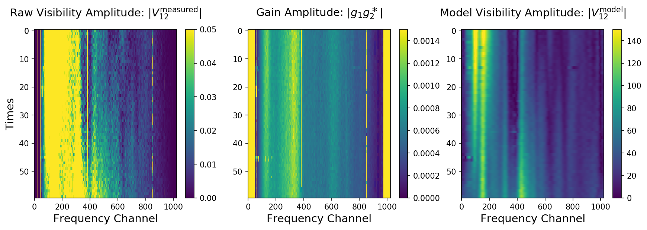
Applying Application

Slide 10
HERA Calibration Exploration Time…

Slide 11
2. HERA Imaging Specs

Slide 12
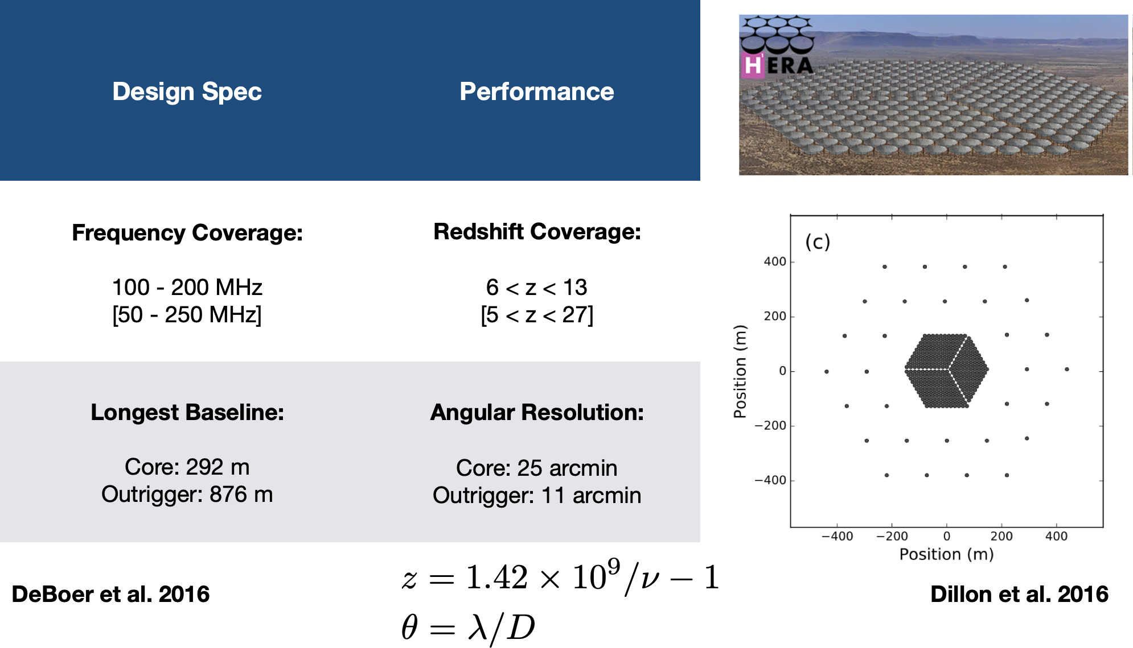

Slide 13
3. HERA Imaging

