Slide 1
Clean/Onion/Hexagonal Architecture
Infrastructure Layer
A Subdomain (A Vertical Slice)
Application Layer
Repo-
sitories
HTTP
Service
Clients
Domain Layer
Application Class
Aggregate Root + ValueObjects
Direction of Dependencies (inwards)
I/O Adapters
File
Systems
UIs
Repo-
sitories
Aggregate Root + ValueObjects
Value
Objects
Application Class
Aggregate Root + ValueObjects
Aggregate Root + ValueObjects
Resource
DTOs +
primitives
CLIs
HTTP
Service
Clients
I/O Adapters
Application Class
Application Class
Server less
The
Internet
Repo-
sitories
Repo-
sitories
REST
APIs
HTTP
Service
Clients
HTTP
Service
Clients
3rd Party
APIs
I/O Adapters
I/O Adapters
Read Models
Data
bases
Event Stores

Slide 2





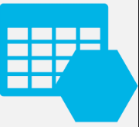
















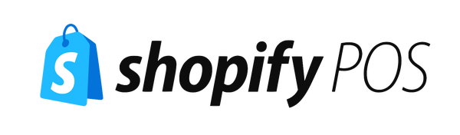







Web Browsers
Mobile Apps
IOS/Android
3rd
Party API Integrations
Chrome, Firefox, etc
API Gateway
3rd Party
Infrastructure
Plugins
+ Card Capture
APMs
(Logs, Crashes, Metrics)
JSON
App Insights
BackEnd API
(Modular Monolith)
Events
(Events)
Azure SQL
Event Store
Backend
4FrontEnd
Data
(State)
AuthN API
CSS,JS,HTML
Product Specific APIs
Ancillary API
Azure SQL
Table Storage
Redis
Reverse Proxy
Organization API
Identity API
EndUser API
Image API
Subscription API
UserProfile API
Blobs
(Images, Binaries)
Blob Storage
Azure
DataLake
+Emails / Usages / Audits
+Emails/Audits/Usages/Events
Bus &Queues
Functions
3rd Party
Integration
Plugins
Payments
Billing Subscriptions
Product Metrics
Feature Flags
Email Delivery
Avatars
Single Sign On
Auth Provider
+Events
AuthN API
Another?
Another?
Another?
Another?
Another?
Another?
Another?
Another?

Slide 3








Web Browsers
Mobile Apps
IOS/Android
3rd
Party API Integrations
Chrome, Firefox, etc
API Gateway
3rd Party
Infrastructure
Plugins
+ Card Capture
APMs
(Logs, Crashes, Metrics)
JSON
CloudWatch
BackEnd API
(Modular Monolith)
Events
(Events)
RDS
Dyna
moDB
Event Store
Backend
4FrontEnd
Data
(State)
AuthN API
CSS,JS,HTML
Product Specific APIs
Ancillary API
RDS
Dyna
moDB
Redis
Reverse Proxy
Organization API
Identity API
EndUser API
Image API
Subscription API
UserProfile API
Blobs
(Images, Binaries)
S3 Buckets
Data
Lake
+Emails / Usages / Audits
+Emails/Audits/Usages/Events
SNS & SQS
Lambdas
3rd Party
Integration
Plugins
Payments
Billing Subscriptions
Product Metrics
Feature Flags
Email Delivery
Avatars
Single Sign On
Auth Provider
+Events
AuthN API
Another?
Another?
Another?
Another?
Another?
Another?
Another?
Another?

Slide 4
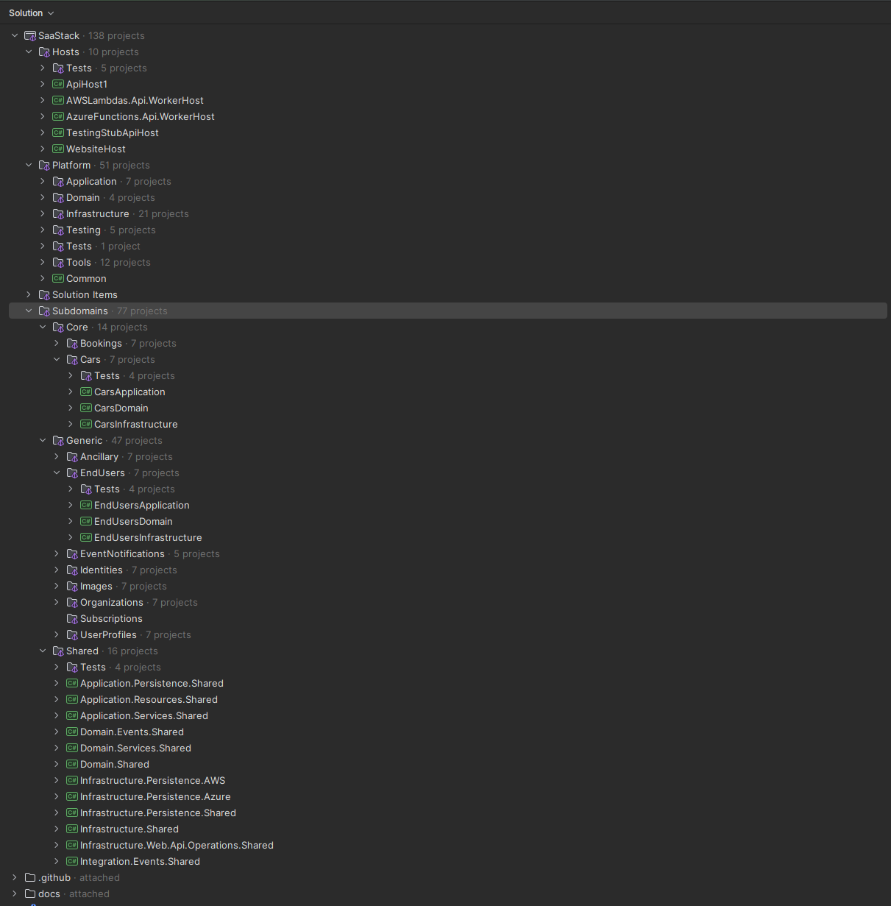
Deployable Hosts (API & UI)
Libraries (per Layer) & Developer Tooling
the “core” subdomains/modules
of your product
the “generic” subdomains,
that every product has
“shared” subdomain
types & components
comprehensive documentation!

Slide 5
Bounded Contexts
Subdomains
The “Domain” is “Car Sharing”
Child
Entities
/ ValueObjects
Generic Subdomains
Core Subdomains
Organizations
Organizations
Cars
End Users
Settings
Unavailabilities
EndUsers
Jurisdictions
Memberships
Subscriptions
TimeSlots
UserProfiles
Billing
Bookings
Profiles
Identities
Trips
SSOUsers
PwdCreds
Ancillary
APIKeys
EmailDeliveries
Audits
Images
EventNotifications
DomainEvents

Slide 6
Use case in an Aggregate
load aggregate state (into mem)
invoke use case (method call)
validate
(method parameters)
raise event (RaiseChangeEvent)
saves event as a change
consume event (OnStateChanged)
set state
(property setters)
validate invariants
(EnsureInvariants)

Slide 7
Use case in an Aggregate
with child/descendant Entity
load aggregate state (into mem)
Root: invoke use case (method call)
Root: validate
(method params)
Root: invoke method on entity instance
Entity: validate (method params)
Entity: raise event (RaiseChangeEvent)
Entity: consume event (OnStateChanged)
Entity: set state
(property setters)
Entity: validate invariants
(EnsureInvariants)
Root: saves event as a change
Root: consume event (OnStateChanged)
Root: set state
(property setters)
Root: validate invariants
(EnsureInvariants)
Entity: raise event to root
(RootEventHandler)

Slide 8
Azure SQL
RDS/Postgres?
Relational DB
Table
NoSQL Document
Azure table Storage
Dynamo DB
A Use Case
Event Stream
EventStore DB
A Read
Model
Message Bus
Azure Service Bus
SNS
An Application
(Application)
Message Queue
Azure Queues
SQS
A Repository
(Infrastructure)
A State
Store
Data
Blob Container
Azure Blob Storage
S3 Buckets
Data Lake Container
Azure Data Lake
S3 Buckets
An
Other
Data
Cache
Redis Cache
File System
JSON Files
An
Aggregate
(Domain)
In-Memory
In-Memory DB
Implementation (Adapters)
Abstractions (Ports)
Technologies

Slide 9
Snapshotting Persistence – Flows
API
Application
Repository
Service A
Application A
Repository A
Command
Fetch property values
Rehydrate()
Fetch Aggregate from Persistence
Check existence
Perform command on Aggregate (TellDontAsk)
Save Aggregate back to Repository
Map Aggregate to DTO
Return DTO
Domain
Read/Write
IDataStore
Aggregate A
Perform operation
Update internal state in memory
Rehydrate()
Dehydrate()
Response
Repository A
Dehydrate()
Persist property values
Read
Data Stores
Message Broker
1…n Projections /
Notifications

Slide 10
EventSourcing Persistence - Flows
API
Application
Repository
All
Events
Service A
Application A
Repository A
Command
Fetch events
Rehydrate() Aggregate
Replay all events 1..n
Fetch Aggregate from Persistence
Check existence
Perform command on Aggregate (TellDontAsk)
Save Aggregate back to Repository
Map Aggregate to DTO
Return DTO
Event Store
IEventStore
Domain
Aggregate A
Raise Event(s)
Update internal state
Save Event(s)
Rehydrate()
OnStateChanged()
GetChanges()
Latest
Events
Response
Repository A
Get Aggregate latest events
Save latest events
Publish events to event broker
Read
Data Stores
Message Broker
1…n Projections /
Notifications

Slide 11
Querying Persistence - Flows
API
Application
Repository
Service A
Application A
Repository A
Query
Fetch data properties
Instantiate ReadModel
Populate ReadModel
Fetch Read Models from Repository
Convert ReadModels to DTOs
Return DTOs
Read Store
IReadModelStore
Response

Slide 12

Snapshotting Persistence + CQRS
BookingsApplication
BookingsApplication
.SearchAllBookingsAsync()
BookingsApplication.RescheduleBookingAsync()
Search!
Get!
Do!
Save!
BookingRepository
BookingRoot
BookingRepository
BookingRoot
BookingRepository
BookingRoot
*
UpdateBookingAsync()
SearchAllBookingsAsync()
BookingRoot
GetBookingAsync()
Reschedule()
ISnapshottingQueryStore
<ReadModels.Booking>.
QueryAsync()
ISnapshottingDddCommandStore <BookingRoot>.
GetAsync()
Rehydrate()
ISnapshottingDddCommandStore <BookingRoot>.
UpsertAsync()
Dehydrate()
IDataStore.
QueryAsync()
IDataStore.
RetrieveAsync()
IDataStore.
ReplaceAsync()
Query!
Read!
Write!
e.g. Azure SQL Server
snapshot_Bookings

Slide 13
EventSourcing Persistence + CQRS
CarsApplication
CarsApplication
.SearchAllAsync ()
CarsApplication.ScheduleMaintenanceAsync()
Search!
Load!
Do!
Save!
CarRepository
CarRoot
CarRepository
CarRoot
CarRepository
*
Events
SearchAllCarsAsync()
CarRoot
LoadAsync()
ScheduleMaintenance()
29
SaveAsync()
30
31
32
ISnapshottingQueryStore
<ReadModels.Car>.
QueryAsync()
IEventSourcingDddCommandStore<CarRoot>.
LoadAsync()
OnStateChanged(event) x28
IEventSourcingDddCommandStore<CarRoot>.
SaveAsync()
IDataStore.
QueryAsync()
IEventStore.
GetEventStreamAsync()
IEventStore.
AddEventsAsync()
Project Stream!
Query!
CarProjection.
ProjectEventAsync()
Load Stream!
Append Stream!
e.g. Azure SQL Server
readmodel_AllCars_v1
events_Cars
readmodel_AvailableCars_v1
car_123abc
1
2
3
4
5
6
7
8
9
.
.
28

Slide 14
Eventing
How we persist state
How we capture changes in state
How we communicate state change
Event Sourcing
Domain Events
Event Driven Architecture

Slide 15
Eventing Flows – “Generic” Subdomains
Organizations
EndUsers
Images
Organizations
UserProfiles
Subscriptions
Member
Invited
Guest Invitation Created
Billing
Subscriber Changed
Buyer
Subscribed
Organization
Created
Membership Added
Membership Added
Setting Created
Default Membership Changed
Default Organization Changed
Subscription
Transferred
Member
UnInvited
Membership Removed
Membership Removed
Subscription
Deleted
Organization
Deleted
UserProfile
Created
EndUser Registered
Notifies
Image
Deleted
Role Assigned
Membership Role Assigned
Avatar Removed
Contact Address Changed
Originating
Event
Subscription
Plan Changed
Originating & Handled
Event
Role Unassigned
Membership
Role Unassigned
Avatar Removed
Billing Subscribed
Handled
Event
Membership
Features
Reset
Subscription
Created

Slide 16

Eventing Flows – Brokering (Azure)
BackEnd API Host (1)
IDomainEventConsumerService
BackEnd API Host (1)
ApiHost1
IpAddress
EventNotifications API
IDomainEventNoificationConsumer
AsynchronousQueue
ConsumerRelay
IDomainEventNoificationConsumer
Azure Service Bus
Subscriber: ApiHost1
Function
ISubDomainApplication
IDomainEventing
MessageBusTopic
Subscriber: ApiHost2
BackEnd API Host (2)
domain_events
Function
IDomainEventConsumerService
ApiHost2
IpAddress
EventNotifications API
IDomainEventNoificationConsumer
IDomainEventNoificationConsumer
ISubDomainApplication

Slide 17

Eventing Flows – Brokering (AWS)
BackEnd API Host (1)
IDomainEventConsumerService
BackEnd API Host (1)
ApiHost1
IpAddress
EventNotifications API
IDomainEventNoificationConsumer
AsynchronousQueue
ConsumerRelay
IDomainEventNoificationConsumer
SNS
Subscriber: ApiHost1
Lambda
ISubDomainApplication
IDomainEventing
MessageBusTopic
Subscriber: ApiHost2
BackEnd API Host (2)
domain_events
Lambda
IDomainEventConsumerService
ApiHost2
IpAddress
EventNotifications API
IDomainEventNoificationConsumer
IDomainEventNoificationConsumer
ISubDomainApplication

Slide 18
An Aggregate raises one or more IDomainEvent (s)
1. Projections
IReadModelProjection
A ReadModel
IEventNotifyingStoreProjectionRelay
Application saves the aggregate
IReadModelProjection
IEventSourcingDddCommandStore<TAggregate>.SaveAsync()
IReadModel Projector
A ReadModel
IReadModelProjection
Event CheckPoint Store
A ReadModel
Note: This part of the process must complete atomically and reliably
Event
Store
IEventStore.
AddEventsAsync()
Publish Events
(in order)
2. Notifications
IEventNotificationRegistration
IEventNotifyingStore
NotificationRelay
A Message
Broker
IIntegrationEvent
Notification
Translator
IEvent
Notification
MessageBroker
IDomainEventConsumerRelay
“integration_events”
IEventNotificationNotifier
Topic
Eventing
IEventNotificationRegistration
IIntegrationEvent
Notification
Translator
IEvent
Notification
MessageBroker
“domain_events”
Topic
IDomainEventConsumerRelay

Slide 19
Recording - Azure
Backend 4FrontEnd Host
+ Traces/Crashes/Measures
Audits/Usages
Web Browsers
Any APIs
+Traces/PageViews
/Usages
HostRecorder
Recording API
+Traces/Crashes
/Measures
APMs
Chrome, Firefox, etc
App Insights
Backend API Host (2)
+ Traces/Crashes/Measures
Audits/Usages
Other APIs
HostRecorder
Queues
Functions
+Audits/Usages
Data
BackEnd API Host (1)
+Audits
Azure SQL
Table Storage
Other APIs
+ Traces/Crashes/Measures
Audits/Usages
HostRecorder
Recording API
Product Metrics
+ Usages / Audits
+ Usages/Measures
Ancillary API
+Usages
+ Usages/Audits
Another?

Slide 20
Recording - AWS
Backend 4FrontEnd Host
+ Traces/Crashes/Measures
Audits/Usages
Web Browsers
Any APIs
+Traces/PageViews
/Usages
HostRecorder
Recording API
+Traces/Crashes
/Measures
APMs
Chrome, Firefox, etc
CloudWatch
Backend API Host (2)
+ Traces/Crashes/Measures
Audits/Usages
Other APIs
HostRecorder
SQS
Lambdas
+Audits/Usages
Data
BackEnd API Host (1)
+Audits
RDS
Dyna
moDB
Other APIs
+ Traces/Crashes/Measures
Audits/Usages
HostRecorder
Recording API
Product Metrics
+ Usages / Audits
+ Usages/Measures
Ancillary API
+Usages
+ Usages/Audits
Another?

Slide 21





Email Delivery (Azure)
Reliable Message Sending
Web Browsers
Backend
4FrontEnd
Host
BackEnd API Host (1)
INotificationsService
+EmailMessages
Any API
Any API
Queues
Functions
EmailNotificationsService
Chrome, Firefox, etc
IEmailSchedulingService
+5 replays
Ancillary API
IEmailDeliveryRepository
Email Delivery
IEmailDeliveryService
e.g.Mailgun API
+Email Data
Message Delivery Confirmation
IEmailDeliveryRepository
Another?
+ Webhook Events

Slide 22












Authenticating a Person with Credentials
3rd
Party API Integrations
JSON: access_token,
refresh_token
(username
+ password)
Sign-in
Backend
4FrontEnd
Host
(username + password)
(username + password)
BackEnd API Host (1)
IPasswordCredentials
.Authenticate
Username:
AuthN API
Identity API
Password:
Bake cookies
IEndUsersService
Cookie: auth-tok
Cookie: auth-reftok
JSON: access_token,
refresh_token
Lookup User
access_token,
refresh_token
VerifyPassword
IAuthTokensService
CreateJWTTokens
Data
Azure SQL
Table Storage

Slide 23












3rd
Party API Integrations
/oauth/token
?client_id=
&client_secret=
&grant_type=authorization_code
&redirect_uri=/login
&code=
Authenticating a Person with SSO
Single Sign On
(OAuth2 code
+ secret)
JSON: access_token,
refresh_token
Another?
(OAuth2 code
+ provider)
Sign-in
Backend
4FrontEnd
Host
(OAuth2 code + provider)
(OAuth2 code + provider)
BackEnd API Host (1)
ISSOAuthenticationProvider.Authenticate
Username:
AuthN API
Identity API
(auth tokens)
Verify AuthCode
Password:
Bake cookies
Cookie: auth-tok
Cookie: auth-reftok
JSON: access_token,
refresh_token
ISSOProviderService
.SaveUserInfo
access_token,
refresh_token
Save OAuth2 Tokens
IAuthTokensService
OAuth2
Authorization
Code Flow w/
3rd party
CreateJWTTokens
/authorize
?client_id=
&response_type=code
&redirect_uri=/login
Data
Azure SQL
Table Storage

Slide 24
Authenticating a Person with MFA (first time)
Authenticator App
Mobile Phone
Email Inbox
Person
Client UI
Identity API
3rd Party
email + password
POST /passwords/auth
+ Username+Password
401 – “mfa_required” + MfaToken
GET /passwords/mfa + MfaToken
200 – “no authenticators”
Choose 2nd Factor
Chosen Authenticator Type
Associate!
POST /passwords/mfa/authenticators
+ MfaToken+Type
Send SMS/Email Message
OOB SMS/Email
Prompt to read SMS/email
200 – OobCode+recoverycodes
Reads 6-digits
Displays 6-digits
Copy/Paste 6-Digit Code
POST /passwords/mfa/authenticators/oobEmail/confirm
+ MfaToken+OobCode+ConfirmationCode
Display Recovery Codes
200 – tokens
Confirm!
Access App
TOTP Authenticator
Scans BarCode
Prompts user to scan BarCode
200 –barCodeUri+secret+recoverycodes
Displays 6-Digit Code
Copy/Paste 6-Digit Code
POST /passwords/mfa/authenticators/TotpAuthenticator/confirm
+ MfaToken+ConfirmationCode
Display Recovery Codes
200 – tokens
Confirm!
Access App

Slide 25
Authenticating a Person with MFA
Authenticator App
Mobile Phone
Email Inbox
Person
Client UI
Identity API
3rd Party
email + password
POST /passwords/auth
+ Username+Password
401 – “mfa_required” + MfaToken
GET /passwords/mfa + MfaToken
200 – “some authenticators”
Choose Authenticator
Chosen Authenticator
Challenge!
POST /passwords/mfa/authenticators/{AuthenticatorId}/challenge
+ MfaToken
Send SMS/Email Message
OOB SMS/Email
Prompt to read SMS/email
202 – OobCode
Reads 6-digits
Displays 6-digits
Copy/Paste 6-Digit Code
POST /passwords/mfa/authenticators/oobEmail/verify
+ MfaToken+OobCode+ConfirmationCode
Access App
200 – tokens
Verify!
202
TOTP Authenticator
Prompt to use Authenticator App
Displays 6-Digit Code
Copy/Paste 6-Digit Code
POST /passwords/mfa/authenticators/TotpAuthenticator/verify
+ MfaToken+ConfirmationCode
Access App
200 – tokens
Verify!
202
Recovery Codes
Copy/Paste 6-Digit Code
POST /passwords/mfa/authenticators/TotpAuthenticator/verify
+ MfaToken+ConfirmationCode
Access App
200 – tokens
Verify!

Slide 26
Authorizing with a token
3rd
Party API Integrations
JSON: data
(Authorization: access_token)
Cookie: auth-tok
Cookie: auth-reftok
Any Page
Backend
4FrontEnd
Host
(Authorization: access_token)
BackEnd API Host (1)
ASP.NET Authorization Handlers + Policies
Any API
Any API
ICallerContext
Cookie: auth-tok
Cookie: auth-reftok
JSON: data
Verify Claims + Policies

Slide 27

BEFFE - Reverse Proxy
Cookie: auth-tok
Cookie: auth-reftok
Cookie: anti-csrf-tok
Header: anti-csrf-tok
Backend
4FrontEnd
Host
Any Page
Any API
BuiltIn Endpoints
(Authorization: access_token)
BackEnd API Host (1)
ASP.NET Authorization Handlers + Policies
Any API
Reverse
Proxy
ICallerContext
Cookie: auth-tok
Cookie: auth-reftok
Cookie: anti-csrf-tok
JSON: data
Verify Claims + Policies

Slide 28
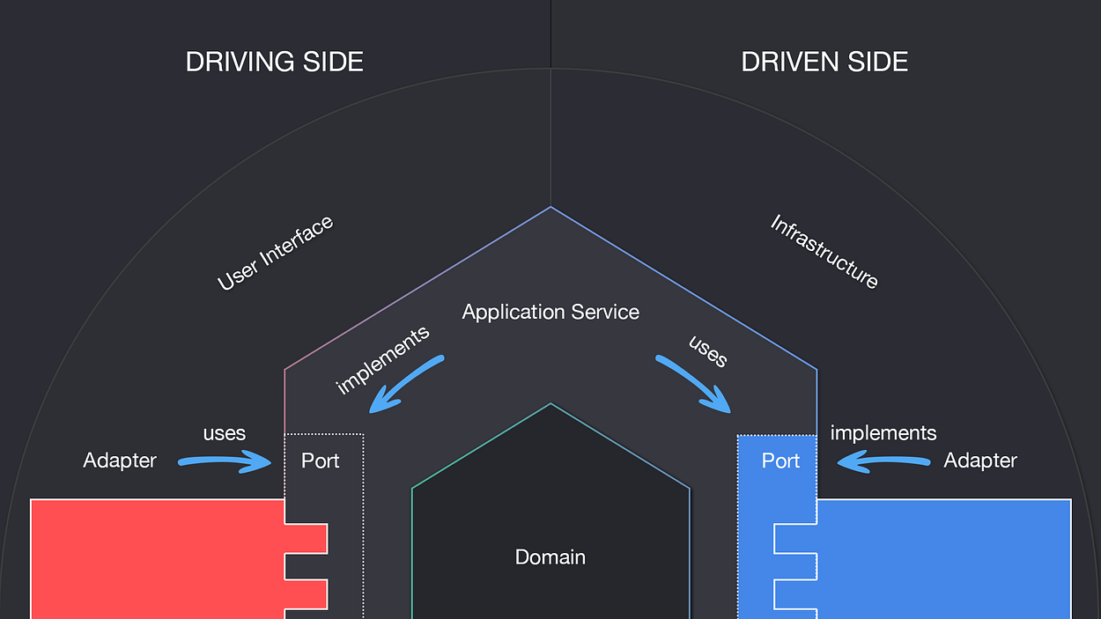
Ports & Adapters – Hexagonal Architecture
Credit: Pablo Martinez: https://medium.com/ssense-tech/hexagonal-architecture-there-are-always-two-sides-to-every-story-bc0780ed7d9c

Slide 29
Multitenancy Identity Model
Identity
UserProfile
(root)
APIKey
(root)
Id
UserId
EmailAddress
Address
TimeZone
Id
UserId
ApiKey
Description
ExpiresOn
UserId
UserId
Multitenancy
EndUser
(root)
AuthTokens
(root)
Id
Roles
Features
Classification
Access
Status
Memberships
UserId
Id
UserId
AccessToken
AccessTokenExpiresOn
RefreshToken
RefreshTokenExpiresOn
Membership
(entity)
SSOUser
(root)
Id
UserId
OrganizationId
Roles
Features
IsDefault
OrganizationId
Id
UserId
ProviderName
Address
EmailAddress
Name
Tokens
Organization
(root)
Id
CreatedById
Name
Ownership
Settings
SubscriptionId
SubscriptionId
PasswordCredential
(root)
Id
UserId
Login
Password
Registration
Verification
MfaOptions
Subscription
(root)

Slide 30
EndUser Lifecycle
Person
InviteGuest
EmailAddress
Register
EmailAddress,
FirstName, LastName, TZ, CC
Invitation
Token?
yes
Email Known?
yes
Error!
no
no
yes
Already
Registered?
yes
Email Known?
yes
Already
Registered?
yes
Email Known?
Accepted
Machine
no
no
no
no
Register
Name,
TZ, CC
Notifications
Notifications
UserProfiles
Sent Invitation
Email +InvitationToken
Sent Courtesy
Email
Create
Organizations
CreatePersonal
Status = “UnRegistered”
No UserProfile No Organizations
Status = “Registered” Has a UserProfile (Type = Person or Machine)
Has a Default Organization

Slide 31
Stub Queue/MessageBus Triggers
AnyTestingOnlyStore
IQueueStoreTrigger.
FireQueueMesage
IMessageNotificationHandler.
HandleMessageArrivedOnQueue()
IMonitoredMessageQueues.
AddQueueName()
IMessageBusStoreTrigger.
FireTopicMessage
IMessageNotificationHandler.
HandleMessageArrivedOnBusTopic()
IMonitoredMessageBusTopics.
AddTopicName()
StubCloudWorkerService
(background service)
Polling loops
IMonitoredMessageQueues.
NextQueueName()
IMonitoredMessageBusTopics.
NextTopicName()
ServiceClient.
Post<DrainAllQueueMessages>()
ServiceClient.
Post<DrainAllSubscriberMessages>()
Ancillary
API
EventNotifications API

Slide 32
Effort
When to Integrate with a BMS?
Cost of Building a BMS Integration
Start using the built-in Billing Provider
Costs of Changing Pricing Model + Cost of Up-Selling existing customers to Maximize Revenue
Revenue
Maximize this time before
installing an integration
with another Billing provider
(e.g. Chargebee), ~1-2 years
Start Charging
Time

Slide 33
Billing Providers - Flows
SimpleBillingProvider
ACustomBillingProvider
Setup: All Members with ‘PaidTrial’ features
Organization
Created
Setup: All Members with ‘PaidTrial’ features
Organization
Created
Subscription
Created
Subscription
Created
Setup:
buyer = org_creator
Tier = ‘Standard’
Downgrade
Plan
Setup:
buyer = org_creator
Tier = ‘Standard’
Upgrade
Plan
Cancel
Plan
Upgrade
Plan
Upgrade
Plan
Cancel
Plan
Upgrade
Plan
Force-Unsubscribe
Force-Unsubscribe
Tier = `Unsubscribed`
Tier = `Professional`
Tier = `Unsubscribed`
Upgrade
Plan
Downgrade
Plan
Upgrade
Plan
Cancel
Plan
Upgrade
Plan
Tier = `Enterprise`
Force-Unsubscribe
Upgrade/Cancel are manual actions by the Buyer
Force-Cancel is manual by Operator
Downgrade/Force-unsubscribe are not possible
Upgrade/Downgrade/Cancel are manual actions by the Buyer,
or by Administrator in BMS
Force-Cancel is manual by Operator
Force-Unsubscribe when Administrator in BMS deletes subscription/plan

Slide 34


JavaScript Actions
Browser
Online
Status
«(embedded-on)»
offline
«listens-to»
A Web Page
<Form/>
online
The Action
A Control 1
<FormControl/>
«disabled when ‘offline’»
A Control 2
<FormControl/>
A Control 3
<FormControl/>
«bound-to»
A Validation Error
<Error/>
«disabled when»
An XHR
API call
A Submit Button
<Submit/>
«busy
& disabled while»
«defines»
An XHR Error
<UnexpectedError/>
An API URL
An HTTP Request
An Error Map
Expected HTTP Codes
Unexpected HTTP Codes
Success Code
«displayed when ‘unexpected’»
BEFFE

