Slide 1
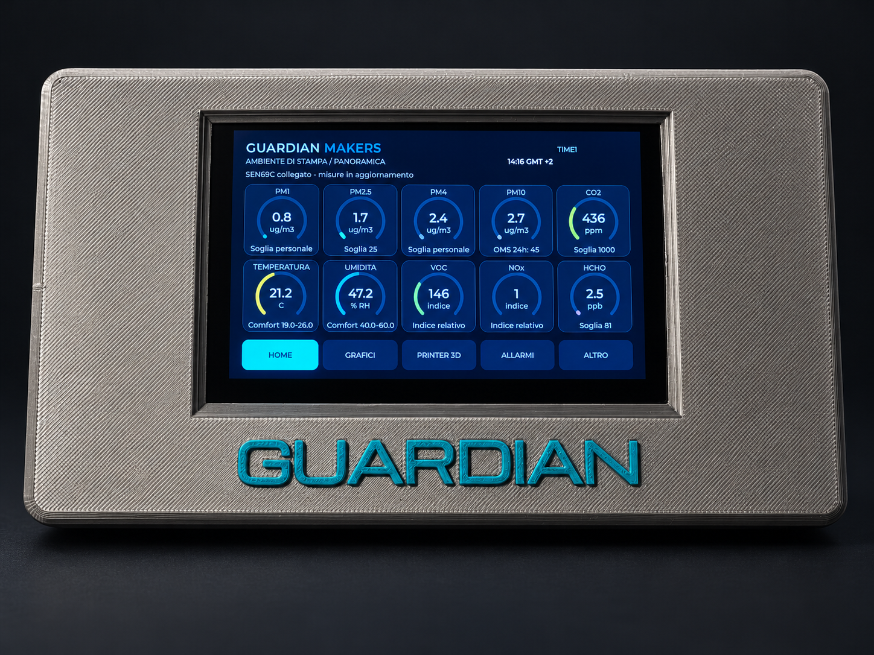
GUARDIAN
MAKERS
The environment during
3D printing
Environmental monitoring
for maker workspaces
Product presentation
October 2026
01
GUARDIAN MAKERS / OCTOBER 2026
Notes:
GUARDIAN: presentazione prodotto. Fotografie fornite dal proprietario. Copertina elaborata fotograficamente, schermate aggiornate fornite dal proprietario; rete, credenziali e seriali sostituiti con dati dimostrativi. Fonti complete nelle slide finali e nel manuale: https://sensirion.com/resource/datasheet/SEN6x ; https://www.who.int/publications/i/item/9789240034228 ; https://www.who.int/publications-detail-redirect/9789289002134 ; https://www.epa.gov/chemical-research/3d-printing-research-epa . Dichiarazioni dei componenti non equivalgono a certificazione GUARDIAN.

Slide 2
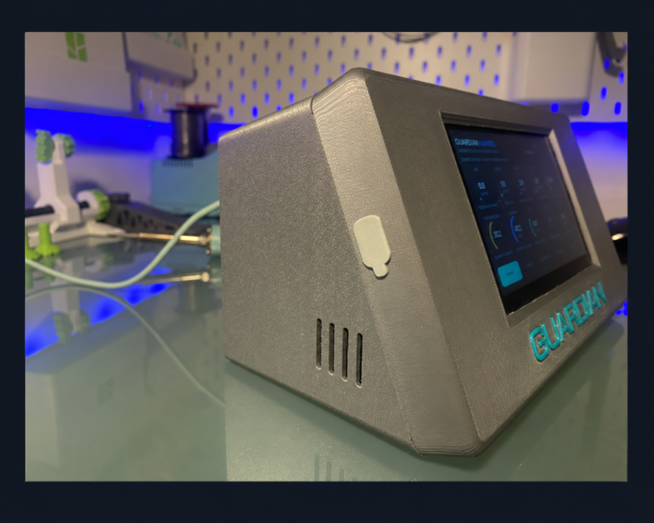
PROJECT IDENTITY
Designed for the workbench
Observe
Follow environmental changes while working and compare different
moments within the same session.
Document
Save readings in CSV files alongside print status and filament
information reported by the printer.
Interpret with care
GUARDIAN is an environmental monitor, not a reference
instrument, a safety detector or proof of healthy air.
02
GUARDIAN MAKERS / OCTOBER 2026
Notes:
GUARDIAN: presentazione prodotto. Fotografie fornite dal proprietario. Copertina elaborata fotograficamente, schermate aggiornate fornite dal proprietario; rete, credenziali e seriali sostituiti con dati dimostrativi. Fonti complete nelle slide finali e nel manuale: https://sensirion.com/resource/datasheet/SEN6x ; https://www.who.int/publications/i/item/9789240034228 ; https://www.who.int/publications-detail-redirect/9789289002134 ; https://www.epa.gov/chemical-research/3d-printing-research-epa . Dichiarazioni dei componenti non equivalgono a certificazione GUARDIAN.

Slide 3
MONITORED PARAMETERS
Ten parameters in one overview
Parameter | Unit | Interpretation
PM1 / PM2.5 / PM4 / PM10 | µg/m³ | Optically estimated mass concentrations by particle-size fraction.
CO2 | ppm | Helps interpret ventilation and room occupancy.
Temperature / humidity | °C / % RH | Personal comfort ranges, separate from alerts.
VOC / NOx | Index | Relative indicators, not concentrations of individual substances.
HCHO | ppb | Formaldehyde; a 30-minute average is also available.
Integrated Sensirion SEN69C sensor. Specifications and limitations: S1, S4, S19. It does not directly measure the ultrafine particles typical of some 3D-printing emissions.
03
GUARDIAN MAKERS / OCTOBER 2026
Notes:
GUARDIAN: presentazione prodotto. Fotografie fornite dal proprietario. Copertina elaborata fotograficamente, schermate aggiornate fornite dal proprietario; rete, credenziali e seriali sostituiti con dati dimostrativi. Fonti complete nelle slide finali e nel manuale: https://sensirion.com/resource/datasheet/SEN6x ; https://www.who.int/publications/i/item/9789240034228 ; https://www.who.int/publications-detail-redirect/9789289002134 ; https://www.epa.gov/chemical-research/3d-printing-research-epa . Dichiarazioni dei componenti non equivalgono a certificazione GUARDIAN.

Slide 4
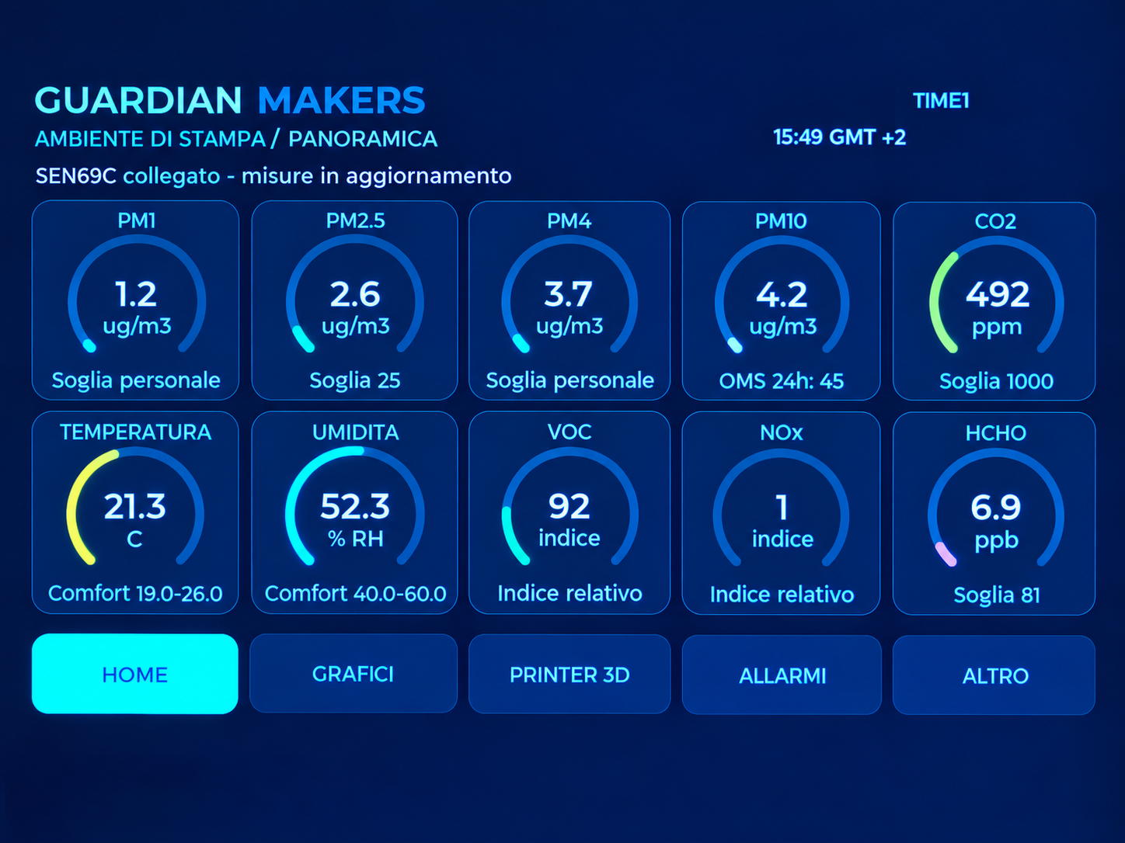
GUARDIAN INTERFACE
HOME: readings at a glance
Values and units
Ten panels bring together measurements, indices
and status indicators.
Thresholds and comfort
Personal thresholds are separate from
temperature and humidity comfort ranges.
Simple navigation
HOME, CHARTS, PRINTER 3D, ALERTS and
OTHER remain accessible.
04
GUARDIAN MAKERS / OCTOBER 2026
Notes:
GUARDIAN: presentazione prodotto. Fotografie fornite dal proprietario. Copertina elaborata fotograficamente, schermate aggiornate fornite dal proprietario; rete, credenziali e seriali sostituiti con dati dimostrativi. Fonti complete nelle slide finali e nel manuale: https://sensirion.com/resource/datasheet/SEN6x ; https://www.who.int/publications/i/item/9789240034228 ; https://www.who.int/publications-detail-redirect/9789289002134 ; https://www.epa.gov/chemical-research/3d-printing-research-epa . Dichiarazioni dei componenti non equivalgono a certificazione GUARDIAN.

Slide 5
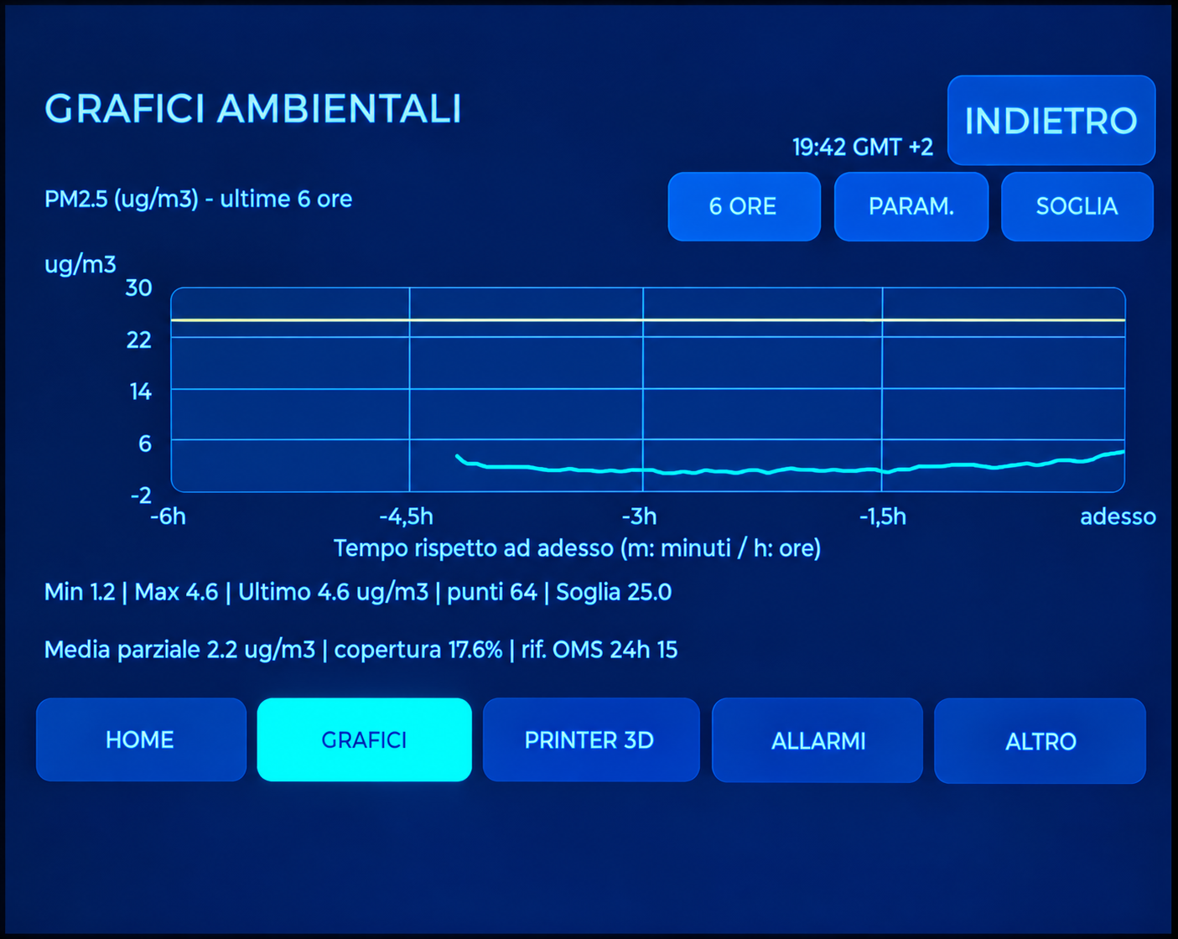
GUARDIAN INTERFACE
Charts: following the trends
Time windows
2, 6, 12 and 24-hour views, with a light grid and
integer labels on the vertical axis.
Information retained
The current reading, statistics and reference
information remain below the chart.
Relevant averages
PM2.5 and PM10: 24 hours. HCHO: 30 minutes.
Incomplete periods are identified.
Chart history uses volatile memory; microSD provides persistent recording. Averaging does not make the device a regulatory instrument.
05
GUARDIAN MAKERS / OCTOBER 2026
Notes:
GUARDIAN: presentazione prodotto. Fotografie fornite dal proprietario. Copertina elaborata fotograficamente, schermate aggiornate fornite dal proprietario; rete, credenziali e seriali sostituiti con dati dimostrativi. Fonti complete nelle slide finali e nel manuale: https://sensirion.com/resource/datasheet/SEN6x ; https://www.who.int/publications/i/item/9789240034228 ; https://www.who.int/publications-detail-redirect/9789289002134 ; https://www.epa.gov/chemical-research/3d-printing-research-epa . Dichiarazioni dei componenti non equivalgono a certificazione GUARDIAN.

Slide 6
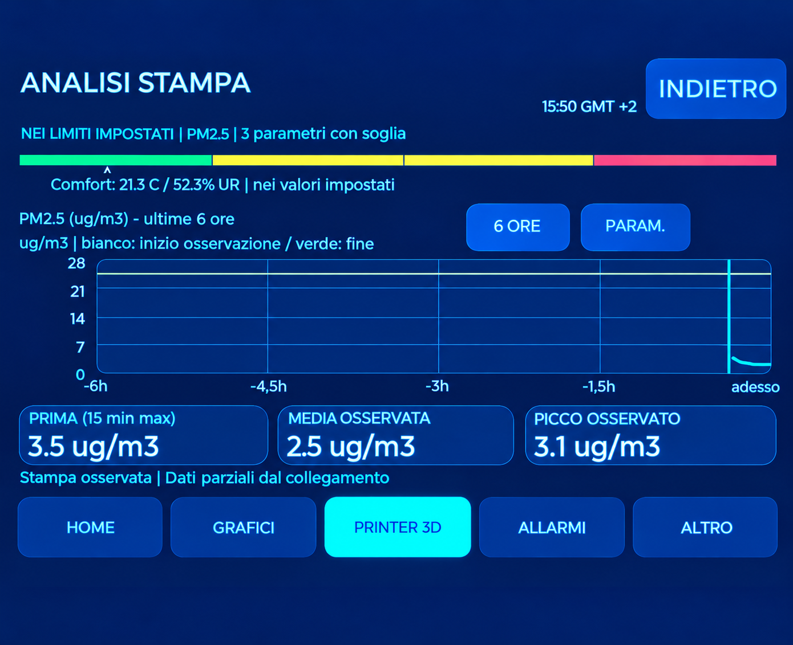
GUARDIAN INTERFACE
Printing in its environmental context
Before, during and peak
Compare the selected parameter with the
preceding period and the session readings.
Overall status
A bar summarises assessable parameters
against the configured thresholds.
Interpreting a correlation
Simultaneous changes do not prove the printer is
the only cause.
A session started after printing began, or containing data gaps, is identified as partial.
06
GUARDIAN MAKERS / OCTOBER 2026
Notes:
GUARDIAN: presentazione prodotto. Fotografie fornite dal proprietario. Copertina elaborata fotograficamente, schermate aggiornate fornite dal proprietario; rete, credenziali e seriali sostituiti con dati dimostrativi. Fonti complete nelle slide finali e nel manuale: https://sensirion.com/resource/datasheet/SEN6x ; https://www.who.int/publications/i/item/9789240034228 ; https://www.who.int/publications-detail-redirect/9789289002134 ; https://www.epa.gov/chemical-research/3d-printing-research-epa . Dichiarazioni dei componenti non equivalgono a certificazione GUARDIAN.

Slide 7
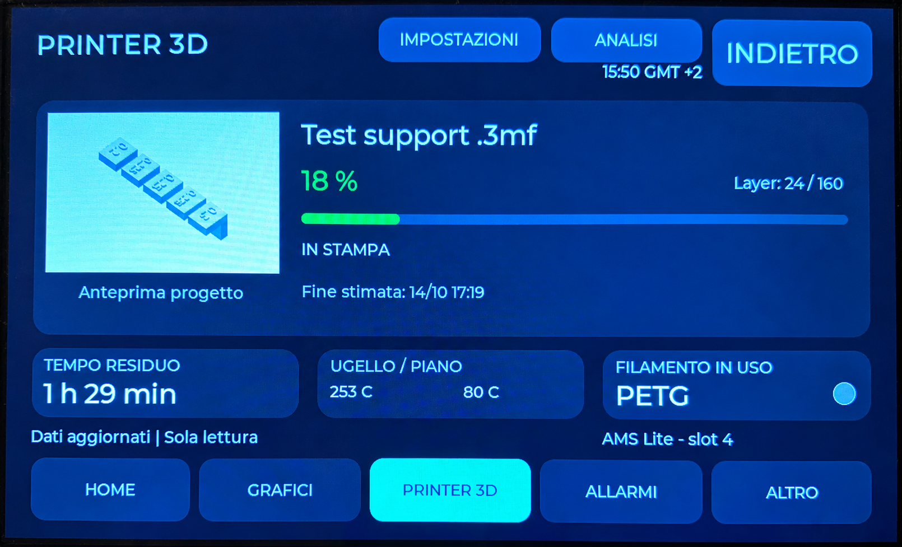
GUARDIAN INTERFACE
The complete PRINTER 3D page
Tested printer
One Bambu Lab on the local network. A1 tested; X1 Carbon connectivity verified.
Print information
Preview, progress, layers, remaining time,
temperatures and filament, when available.
Data continuity
After a disconnection, retained readings remain
distinguishable from fresh data.
The connection is for monitoring: GUARDIAN does not stop the printer. Preview and job name depend on the data and file available on the printer.
07
GUARDIAN MAKERS / OCTOBER 2026
Notes:
GUARDIAN: presentazione prodotto. Fotografie fornite dal proprietario. Copertina elaborata fotograficamente, schermate aggiornate fornite dal proprietario; rete, credenziali e seriali sostituiti con dati dimostrativi. Fonti complete nelle slide finali e nel manuale: https://sensirion.com/resource/datasheet/SEN6x ; https://www.who.int/publications/i/item/9789240034228 ; https://www.who.int/publications-detail-redirect/9789289002134 ; https://www.epa.gov/chemical-research/3d-printing-research-epa . Dichiarazioni dei componenti non equivalgono a certificazione GUARDIAN.

Slide 8
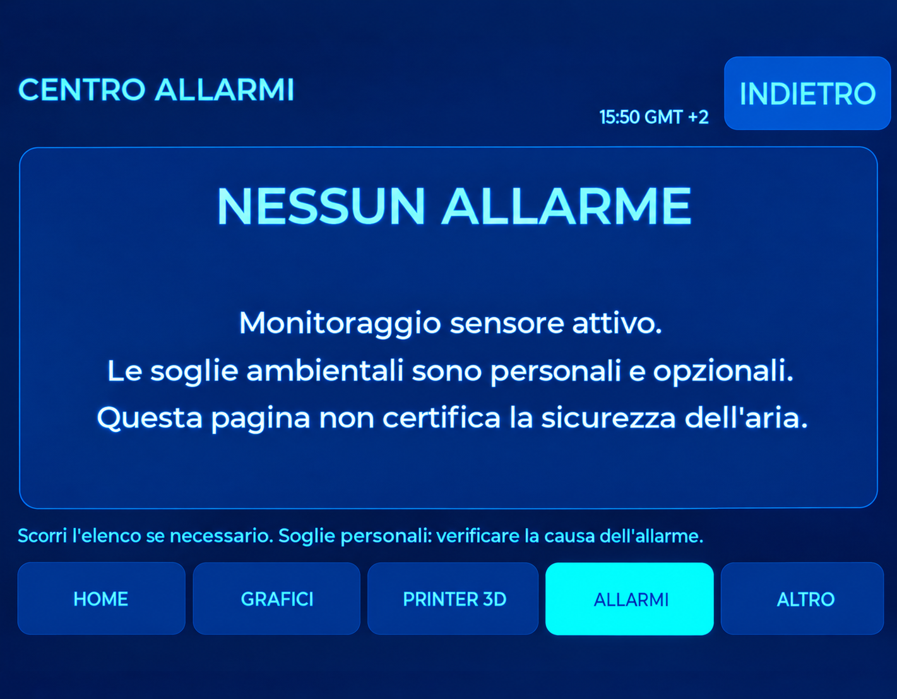
GUARDIAN INTERFACE
Alerts and comfort serve different purposes
Alert centre
Collects events and shows threshold
exceedances and conditions requiring attention.
Personal thresholds
User-defined operating values are not certified
health limits.
Comfort indication
Temperature or humidity outside the personal
range generates a comfort indication.
A normally switched-off or idle printer is not treated as a fault. Loss of data during a print is a separate condition.
08
GUARDIAN MAKERS / OCTOBER 2026
Notes:
GUARDIAN: presentazione prodotto. Fotografie fornite dal proprietario. Copertina elaborata fotograficamente, schermate aggiornate fornite dal proprietario; rete, credenziali e seriali sostituiti con dati dimostrativi. Fonti complete nelle slide finali e nel manuale: https://sensirion.com/resource/datasheet/SEN6x ; https://www.who.int/publications/i/item/9789240034228 ; https://www.who.int/publications-detail-redirect/9789289002134 ; https://www.epa.gov/chemical-research/3d-printing-research-epa . Dichiarazioni dei componenti non equivalgono a certificazione GUARDIAN.

Slide 9
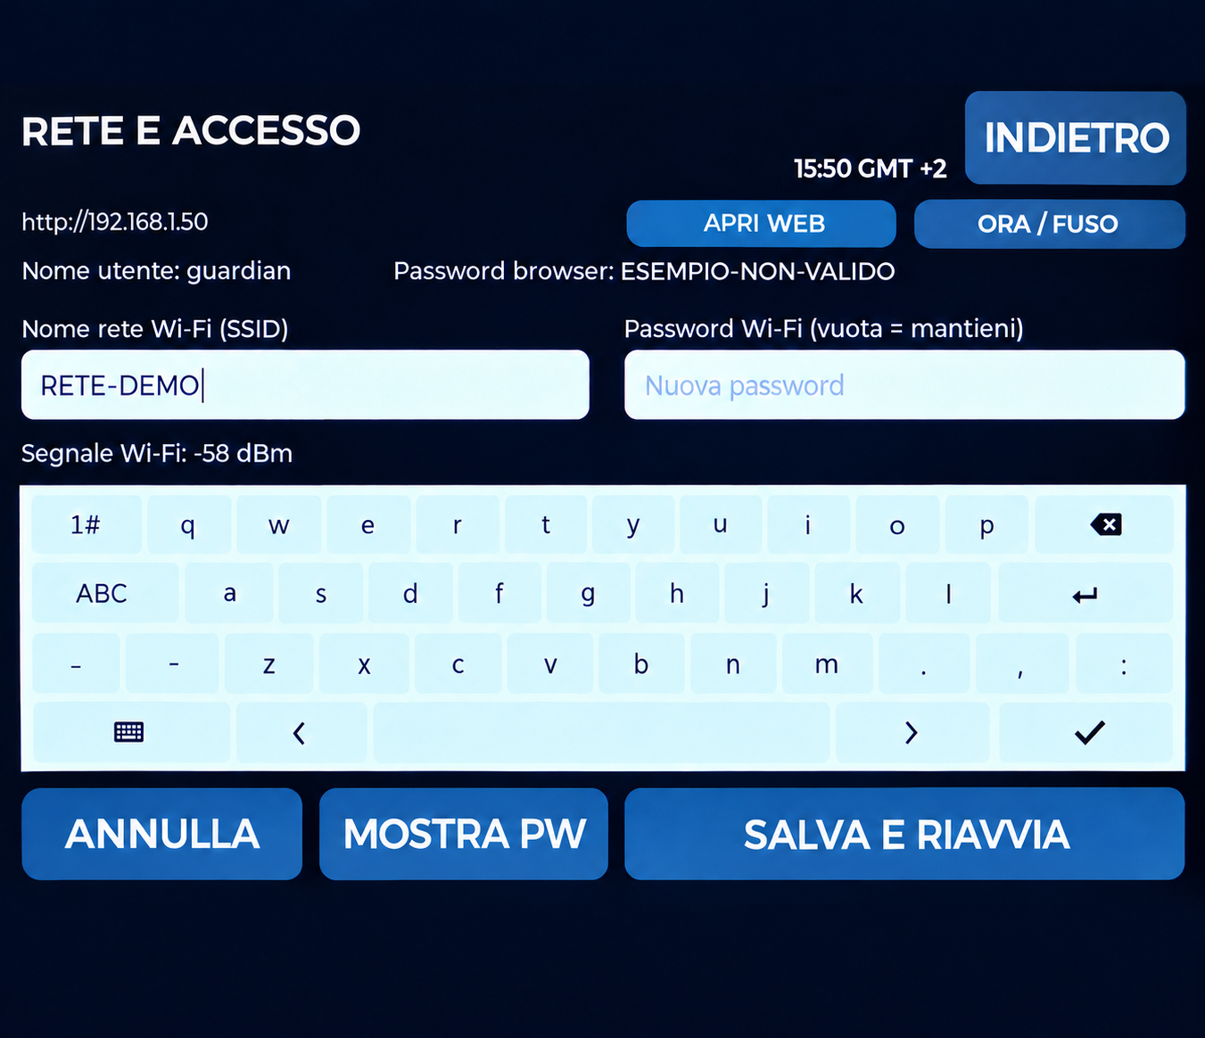
GUARDIAN INTERFACE
Viewing beyond the device
PC and smartphone
Browser access on the local network; remote
access through your network VPN.
Configuration
Network, time, lighting and the settings available
in the web interface.
Device identification
The NETWORK page shows the device address
and numerical Wi-Fi signal strength.
Anonymised photograph with example details. The local web service uses HTTP: do not expose it directly to the Internet.
09
GUARDIAN MAKERS / OCTOBER 2026
Notes:
GUARDIAN: presentazione prodotto. Fotografie fornite dal proprietario. Copertina elaborata fotograficamente, schermate aggiornate fornite dal proprietario; rete, credenziali e seriali sostituiti con dati dimostrativi. Fonti complete nelle slide finali e nel manuale: https://sensirion.com/resource/datasheet/SEN6x ; https://www.who.int/publications/i/item/9789240034228 ; https://www.who.int/publications-detail-redirect/9789289002134 ; https://www.epa.gov/chemical-research/3d-printing-research-epa . Dichiarazioni dei componenti non equivalgono a certificazione GUARDIAN.

Slide 10
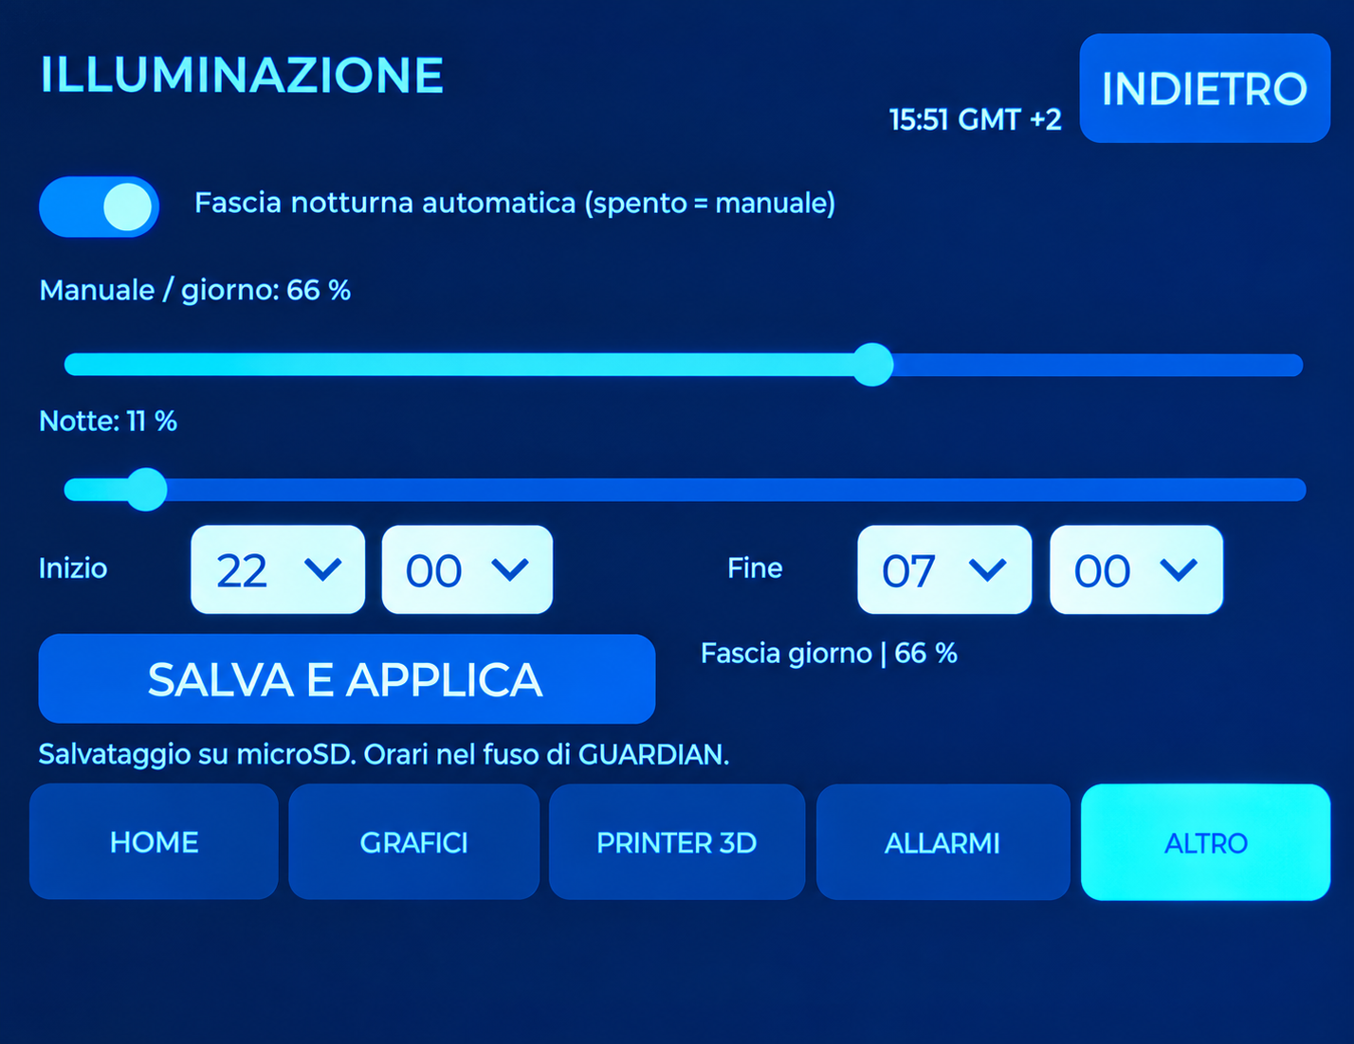
GUARDIAN INTERFACE
Lighting and time settings
Manual
Adjust brightness from the display or smartphone
browser.
Automatic
Day/night brightness with start and stop times,
including periods crossing midnight.
Time zone
Select a time-zone profile; daylight saving follows
the selected profile.
10
GUARDIAN MAKERS / OCTOBER 2026
Notes:
GUARDIAN: presentazione prodotto. Fotografie fornite dal proprietario. Copertina elaborata fotograficamente, schermate aggiornate fornite dal proprietario; rete, credenziali e seriali sostituiti con dati dimostrativi. Fonti complete nelle slide finali e nel manuale: https://sensirion.com/resource/datasheet/SEN6x ; https://www.who.int/publications/i/item/9789240034228 ; https://www.who.int/publications-detail-redirect/9789289002134 ; https://www.epa.gov/chemical-research/3d-printing-research-epa . Dichiarazioni dei componenti non equivalgono a certificazione GUARDIAN.

Slide 11
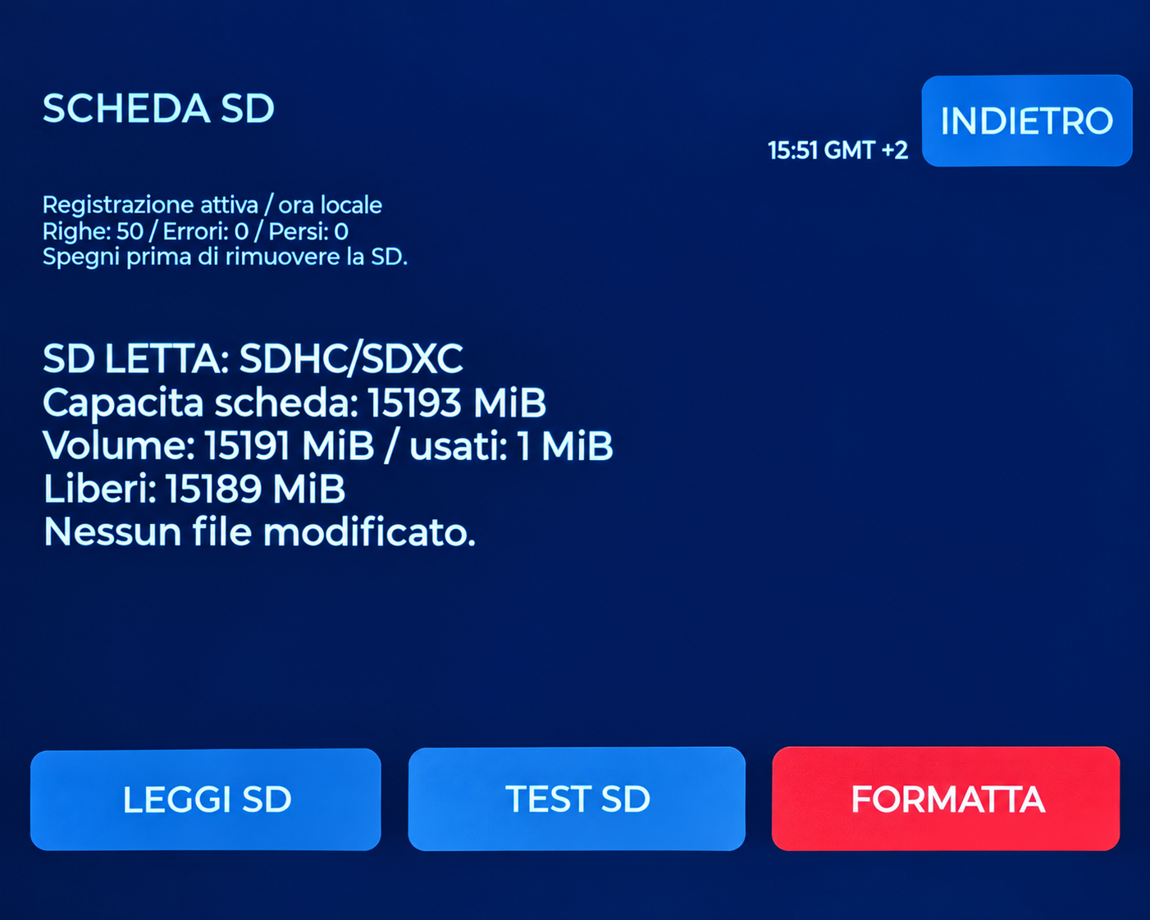
GUARDIAN INTERFACE
Keeping a record of the data
microSD
Periodic CSV recording with units and session
context.
Browser download
A dedicated current-CSV link and subsequent
pages for historical files.
Local management
Read, test and format the card, with explicit
confirmation.
FORMAT erases every file on the microSD card.
11
GUARDIAN MAKERS / OCTOBER 2026
Notes:
GUARDIAN: presentazione prodotto. Fotografie fornite dal proprietario. Copertina elaborata fotograficamente, schermate aggiornate fornite dal proprietario; rete, credenziali e seriali sostituiti con dati dimostrativi. Fonti complete nelle slide finali e nel manuale: https://sensirion.com/resource/datasheet/SEN6x ; https://www.who.int/publications/i/item/9789240034228 ; https://www.who.int/publications-detail-redirect/9789289002134 ; https://www.epa.gov/chemical-research/3d-printing-research-epa . Dichiarazioni dei componenti non equivalgono a certificazione GUARDIAN.

Slide 12
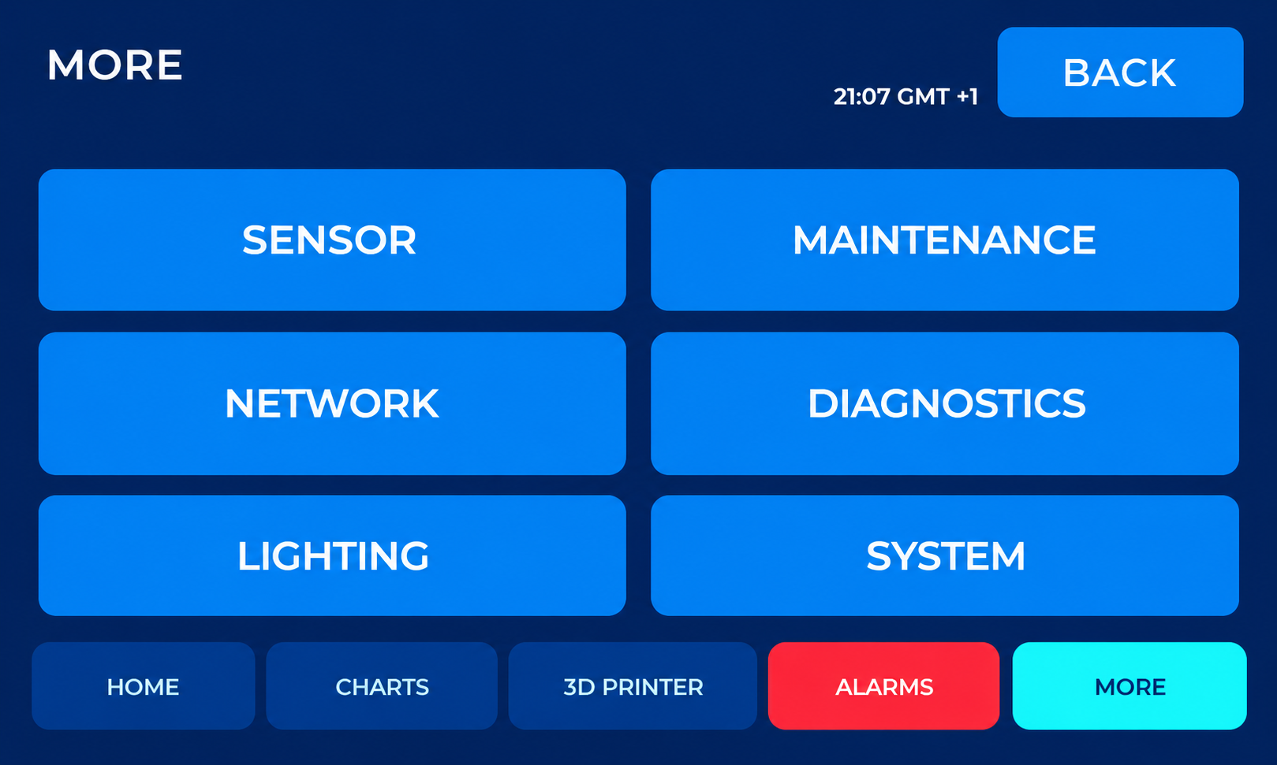
GUARDIAN 1.1.0 / VERIFY & CORRECT
A clear technical workflow
Open MORE → MAINTENANCE → VERIFY & CORRECT.
First check SEN69C presence and status on the SENSOR page.
This edition describes GUARDIAN 1.1.0 and the functions tested in build TEST4 FIX1.
Cleaned demonstration screen based on a real photograph.
DEMO/2026 · Example, not certification
Notes:
Open MORE → MAINTENANCE → VERIFY & CORRECT. Measurement settings are grouped in a protected area, separate from everyday viewing.
First check SEN69C presence and status on the SENSOR page. Inspect wiring only with the power disconnected.
This edition describes GUARDIAN 1.1.0 and the functions tested in build TEST4 FIX1. Readings and DEMO/2026 report identifiers are examples, not laboratory results.

Slide 13
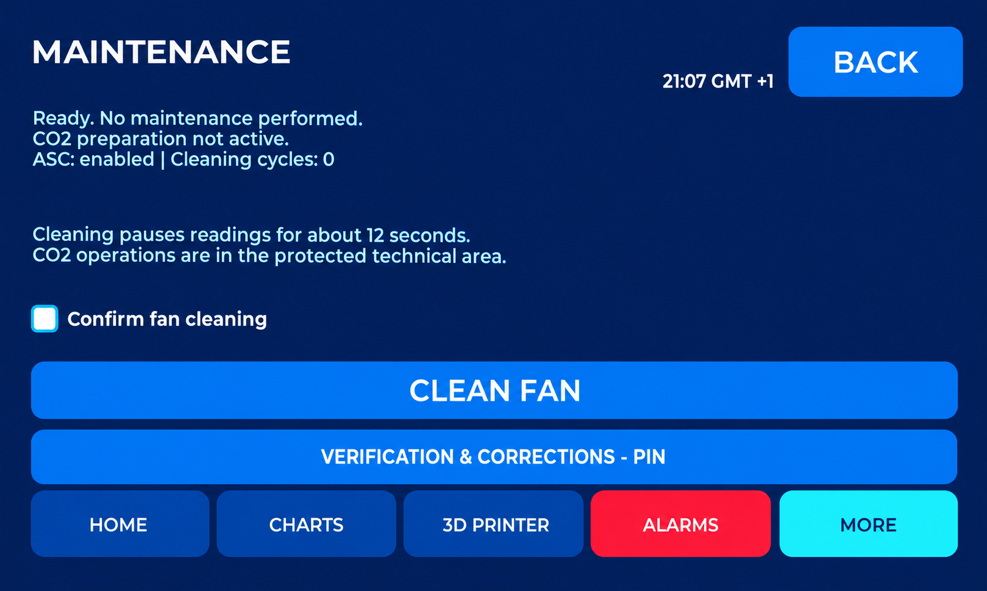
GUARDIAN 1.1.0 / VERIFY & CORRECT
Maintenance and preliminary checks
Fan cleaning is a sensor maintenance operation.
Before comparing instruments, allow stabilisation and record placement, environmental conditions, sampling interval and reference instrument.
Compare the same quantity and unit.
Cleaned demonstration screen based on a real photograph.
DEMO/2026 · Example, not certification
Notes:
Fan cleaning is a sensor maintenance operation. Start the cycle and wait for measurements to resume. Completion does not certify cleaning effectiveness.
Before comparing instruments, allow stabilisation and record placement, environmental conditions, sampling interval and reference instrument.
Compare the same quantity and unit. For particulate matter, aerosol composition also affects the comparison. Do not compensate for an assembly fault with a correction coefficient.

Slide 14
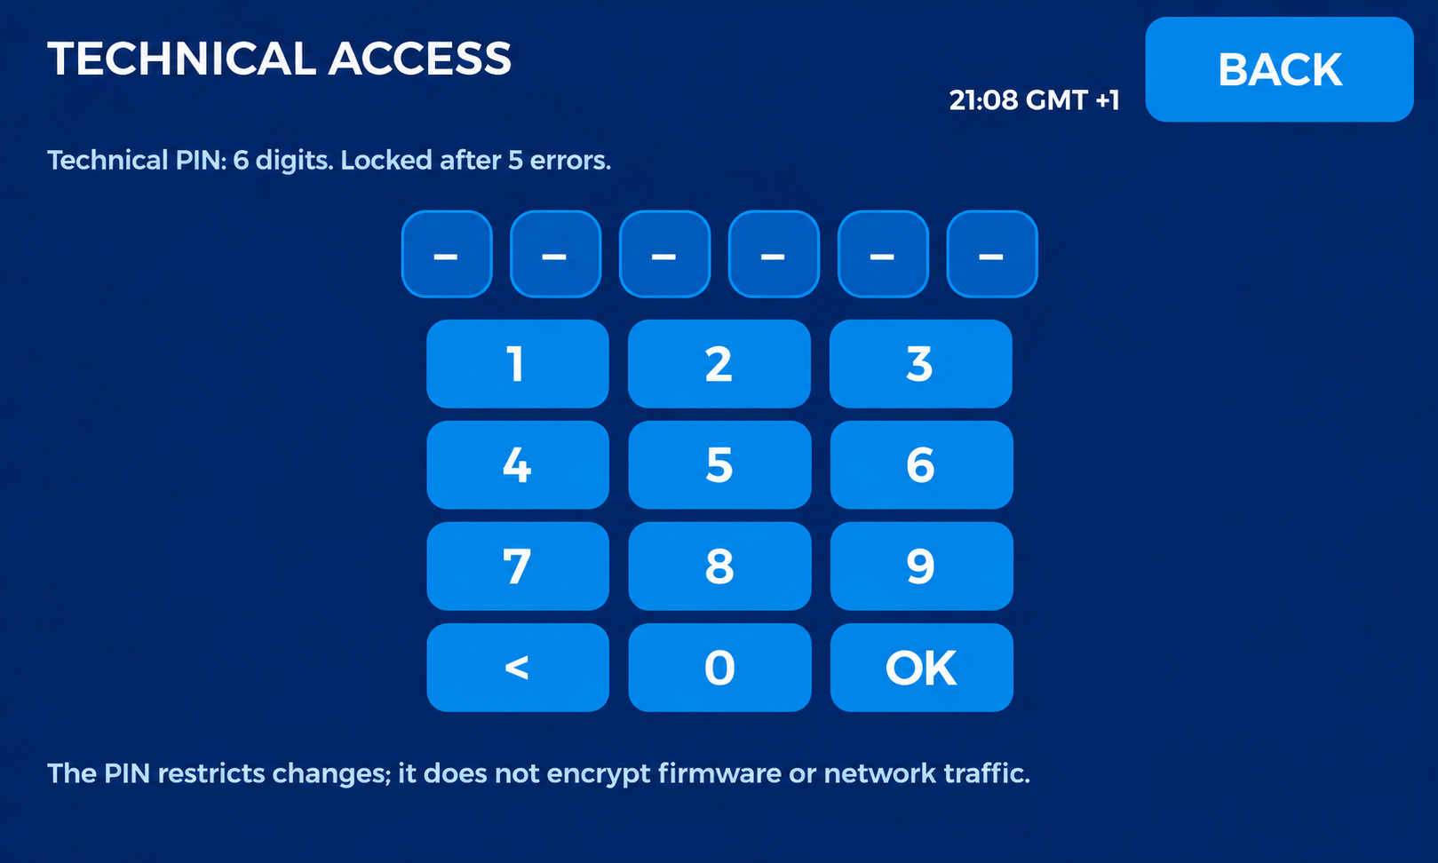
GUARDIAN 1.1.0 / VERIFY & CORRECT
Technical access: six-digit PIN
On first access, choose a six-digit PIN and enter it twice.
After five incorrect attempts, wait 60 seconds before retrying.
The PIN restricts interface changes; it does not encrypt memory or enable Secure Boot.
Cleaned demonstration screen based on a real photograph.
DEMO/2026 · Example, not certification
Notes:
On first access, choose a six-digit PIN and enter it twice. The technical PIN is separate from network credentials and web access.
After five incorrect attempts, wait 60 seconds before retrying. Technical access expires after five minutes of inactivity. Keep the PIN safely.
The PIN restricts interface changes; it does not encrypt memory or enable Secure Boot. Do not change corrections merely to obtain more reassuring readings.

Slide 15
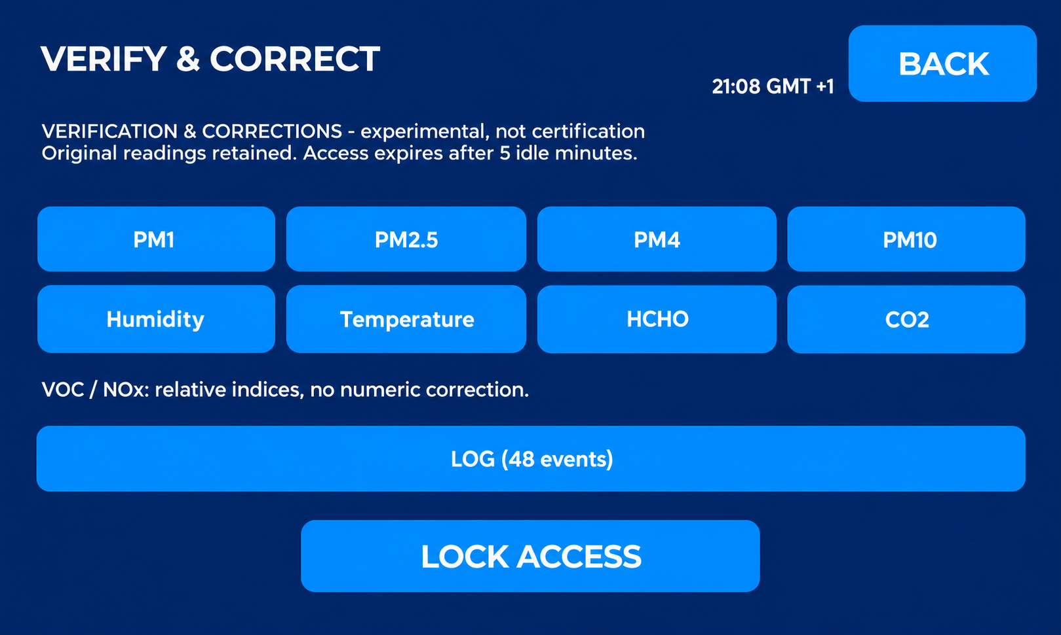
GUARDIAN 1.1.0 / VERIFY & CORRECT
Which parameters can be corrected
PM1, PM2.5, PM4, PM10, temperature, relative humidity, HCHO and CO2 are available.
Each parameter has a profile containing comparisons, factor or offset, valid range and report reference.
Particulate channels use a multiplicative factor; the other channels use an additive offset.
Cleaned demonstration screen based on a real photograph.
DEMO/2026 · Example, not certification
Notes:
PM1, PM2.5, PM4, PM10, temperature, relative humidity, HCHO and CO2 are available. VOC and NOx are relative indices and have no user correction in this function.
Each parameter has a profile containing comparisons, factor or offset, valid range and report reference. Up to eight comparisons can be retained per parameter.
Particulate channels use a multiplicative factor; the other channels use an additive offset. The function documents a comparison; it does not itself certify the product.

Slide 16
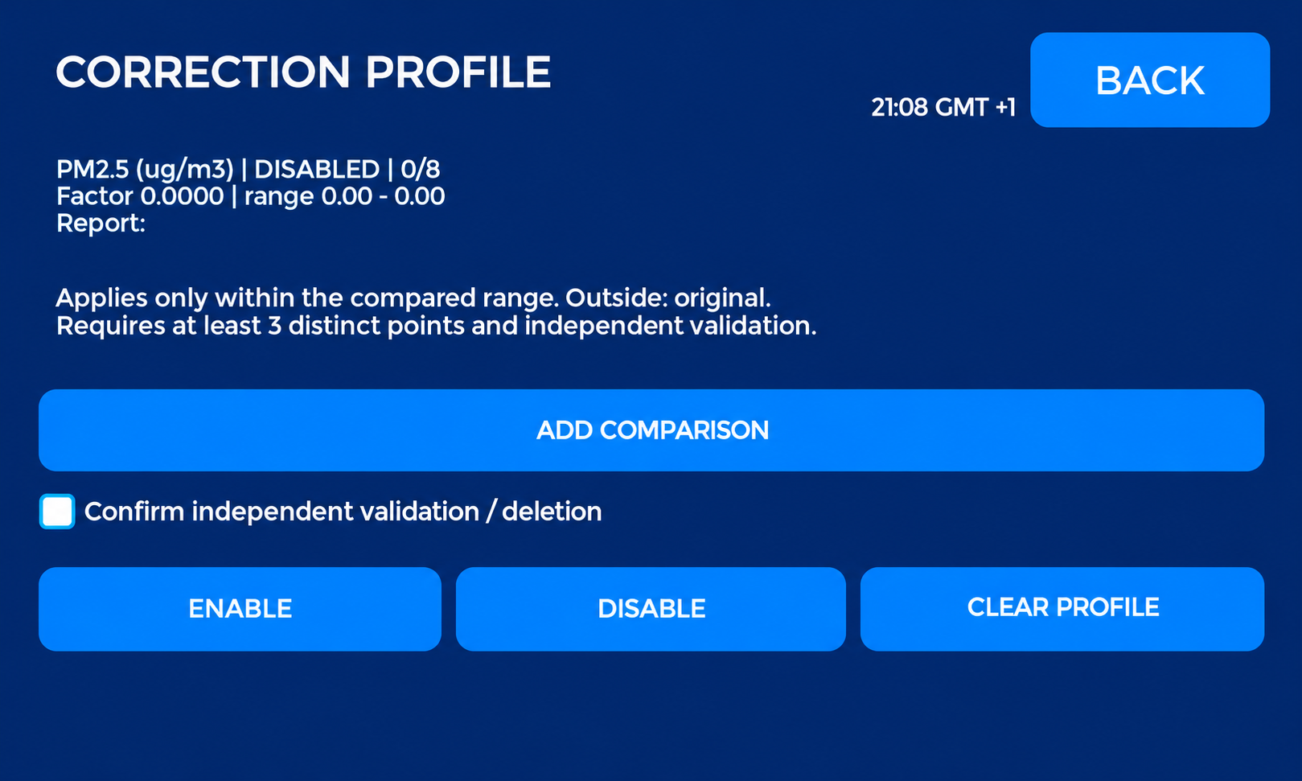
GUARDIAN 1.1.0 / VERIFY & CORRECT
Profile: enabling and valid range
Enabling a correction requires at least three distinct original readings, a report identifier and confirmation of independent verification.
Correction applies only within the range of the compared original readings.
DISABLE retains comparisons but suspends correction.
Cleaned demonstration screen based on a real photograph.
DEMO/2026 · Example, not certification
Notes:
Enabling a correction requires at least three distinct original readings, a report identifier and confirmation of independent verification. These are software requirements, not a complete metrological procedure.
Correction applies only within the range of the compared original readings. Outside that range, the original reading is returned.
DISABLE retains comparisons but suspends correction. CLEAR PROFILE deletes points and the coefficient after confirmation. An asterisk indicates an enabled profile, not proof that the current reading is within its valid range.

Slide 17
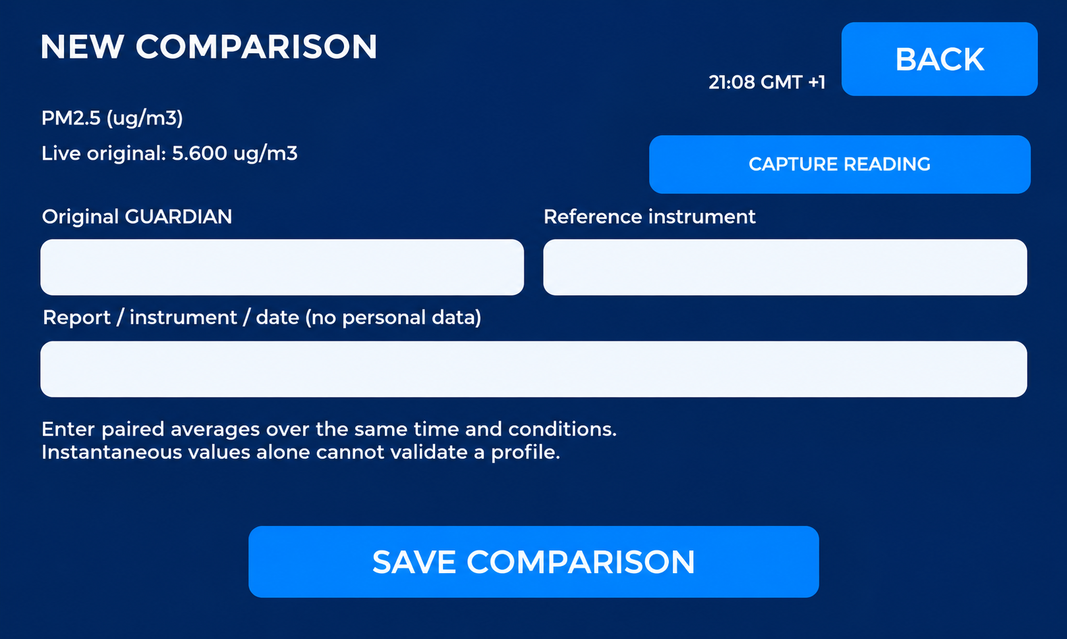
GUARDIAN 1.1.0 / VERIFY & CORRECT
New comparison: original and reference
GUARDIAN ORIGINAL shows the current reading before GUARDIAN software correction.
Capture the reading into the comparison field, then enter the reference instrument reading in the same unit.
The report field accepts /, for example DEMO/2026.
Cleaned demonstration screen based on a real photograph.
DEMO/2026 · Example, not certification
Notes:
GUARDIAN ORIGINAL shows the current reading before GUARDIAN software correction. It is not a first-start reading and does not undo internal SEN69C calibration.
Capture the reading into the comparison field, then enter the reference instrument reading in the same unit. Prefer averages over the same interval, with stable conditions and comparable placement.
The report field accepts /, for example DEMO/2026. For an actual verification, enter the real report reference. Save and check that the comparison count has increased.

Slide 18
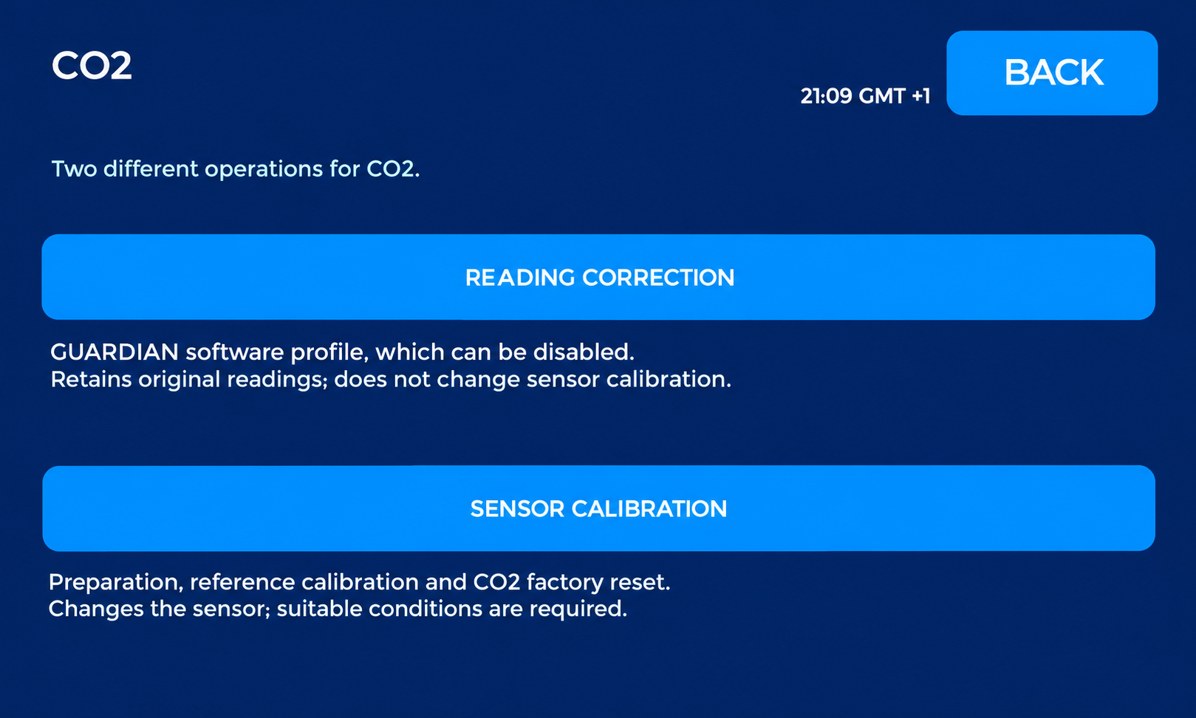
GUARDIAN 1.1.0 / VERIFY & CORRECT
CO2: two different operations
The CO2 entry groups the software correction profile and internal sensor operations.
Software correction adds an offset within the verified range and can be disabled.
Do not stack the two operations: disable the software CO2 correction before internal calibration.
Cleaned demonstration screen based on a real photograph.
DEMO/2026 · Example, not certification
Notes:
The CO2 entry groups the software correction profile and internal sensor operations. Choose the path appropriate to the intended verification.
Software correction adds an offset within the verified range and can be disabled. Internal calibration instead changes the sensor’s CO2 channel.
Do not stack the two operations: disable the software CO2 correction before internal calibration. Always record which operation was performed and the reference used.

Slide 19
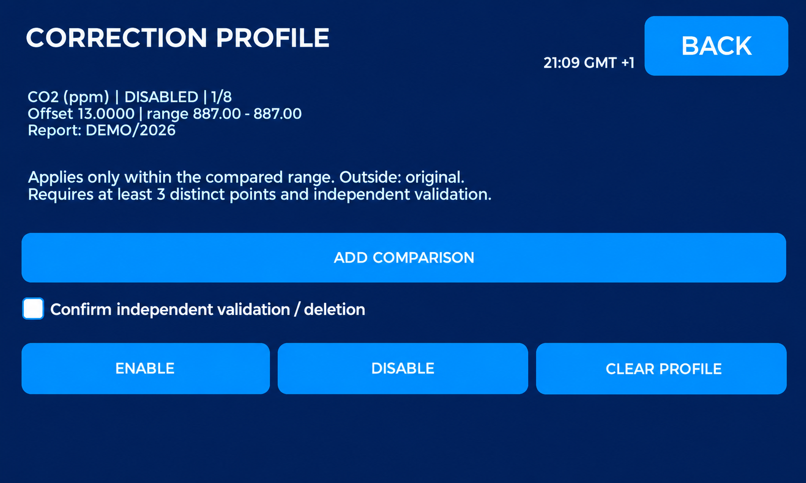
GUARDIAN 1.1.0 / VERIFY & CORRECT
CO2 example: one point is not enough
The screen shows one comparison: an original reading of 887 ppm and a calculated +13 ppm offset.
The software enabling requirements are not yet met.
Select points representative of intended use within a suitable comparison plan.
Cleaned demonstration screen based on a real photograph.
DEMO/2026 · Example, not certification
Notes:
The screen shows one comparison: an original reading of 887 ppm and a calculated +13 ppm offset. The profile is DISABLED and its range is limited to that single point.
The software enabling requirements are not yet met. At least three distinct original points, a report and independent verification are needed; repeating the same reading does not extend the range.
Select points representative of intended use within a suitable comparison plan. A laboratory can define points, repeats, uncertainty and acceptance criteria.

Slide 20
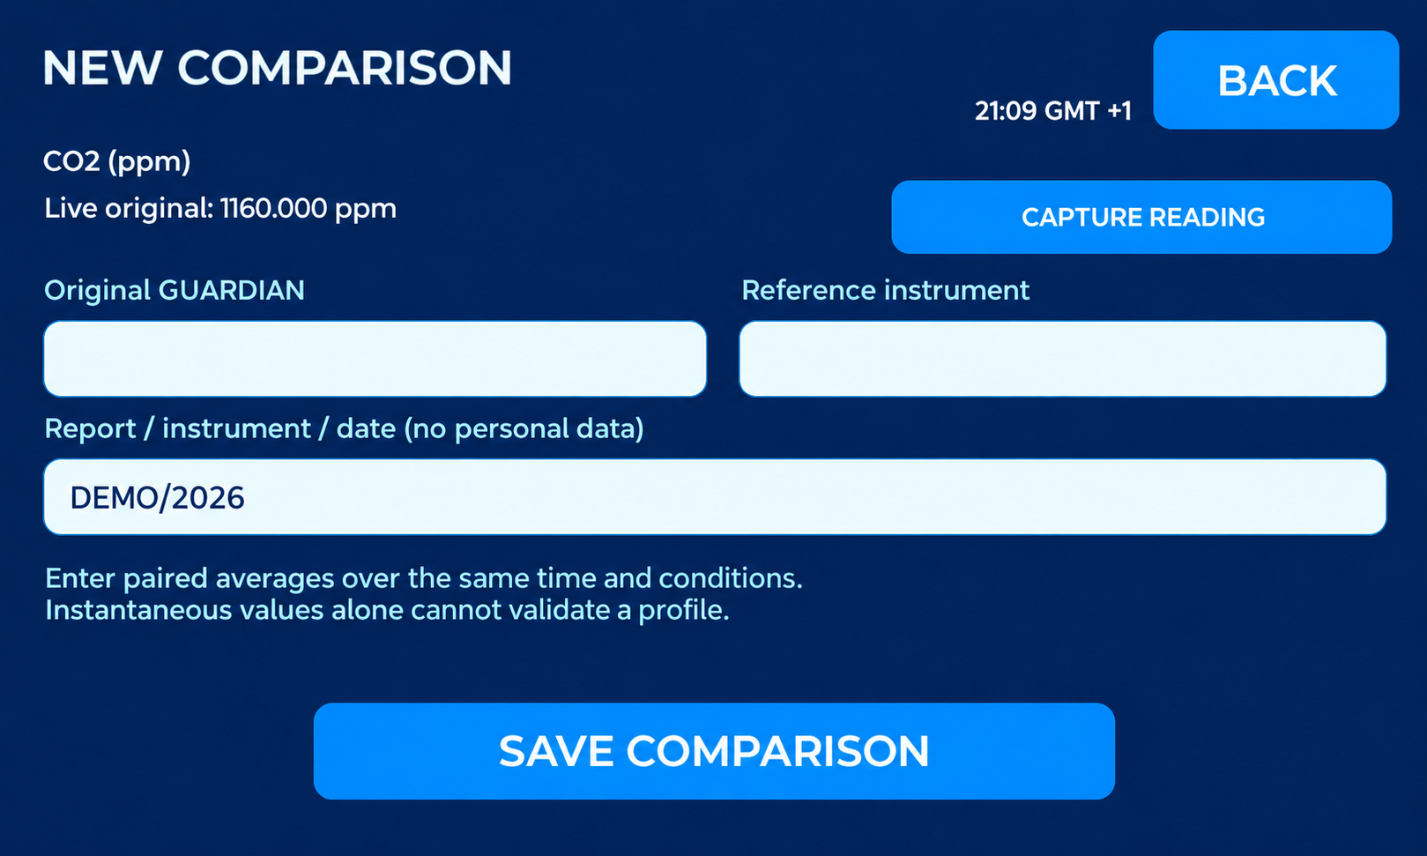
GUARDIAN 1.1.0 / VERIFY & CORRECT
CO2 comparison and data retention
The original reading continues updating; the captured comparison value remains the selected value.
Profiles and the technical log are stored on microSD.
Restarting preserves the PIN and profiles.
Cleaned demonstration screen based on a real photograph.
DEMO/2026 · Example, not certification
Notes:
The original reading continues updating; the captured comparison value remains the selected value. Check the reference before saving.
Profiles and the technical log are stored on microSD. A present, working card is required to retain changes; wait for the save result.
Restarting preserves the PIN and profiles. Export data before formatting: formatting is separate from GUARDIAN reset and deletes card files. Recheck active profiles after any intervention.

Slide 21
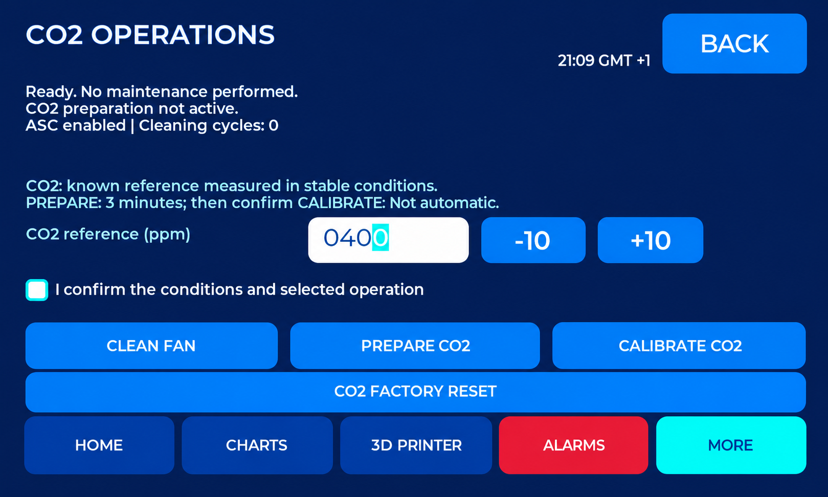
GUARDIAN 1.1.0 / VERIFY & CORRECT
CO2 operations: prepare and verify
Use a reliable, known reference within the allowed 400–2000 ppm range.
PREPARE starts a three-minute wait.
CO2 RESET concerns the sensor channel, not the whole GUARDIAN.
Cleaned demonstration screen based on a real photograph.
DEMO/2026 · Example, not certification
Notes:
Use a reliable, known reference within the allowed 400–2000 ppm range. Outdoor air does not automatically mean 400 ppm. Avoid breath and local sources and wait for stable conditions.
PREPARE starts a three-minute wait. READY alone does not guarantee equilibrium: verify conditions, confirm and start CALIBRATE. Wait for the result and resumed measurements.
CO2 RESET concerns the sensor channel, not the whole GUARDIAN. After success, the software CO2 profile is also cleared. Allow stabilisation and repeat the comparison. The command does not issue a certificate.

Slide 22
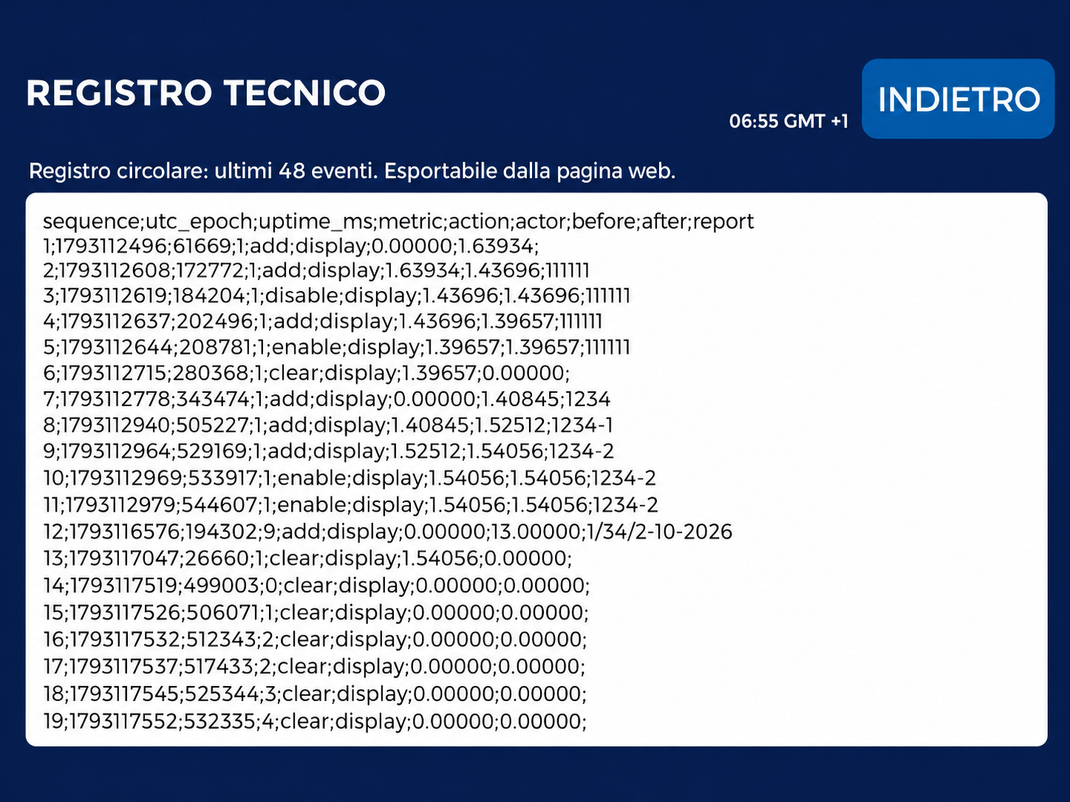
GUARDIAN 1.1.0 / VERIFY & CORRECT
Technical log and traceability
The log retains the last 48 events: comparison additions, profile enabling, disabling and clearing.
To export: open the browser on the same network, MAINTENANCE > Verification & corrections (PIN).
Columns show sequence, UTC, uptime, parameter, action, origin, before/after and report.
17;1793117537;517423;2;clear;display;0.00000;0.00000;
Log: new optimized photo (Italian display).
DEMO/2026 · Example, not certification
Notes:
The log retains the last 48 events: comparison additions, profile enabling, disabling and clearing.
To export: open the browser on the same network, MAINTENANCE > Verification & corrections (PIN). Enter the technical PIN and select UNLOCK. Scroll to Change log and select DOWNLOAD CSV. GUARDIAN_technical_audit.csv is saved in Downloads; exporting does not clear the log.
Columns show sequence, UTC, uptime, parameter, action, origin, before/after and report. Before/after means factor or offset. Keep the CSV with the laboratory report: it is not an immutable archive or a certificate. The new photo is optimized for readability; the display is in Italian.

Slide 23
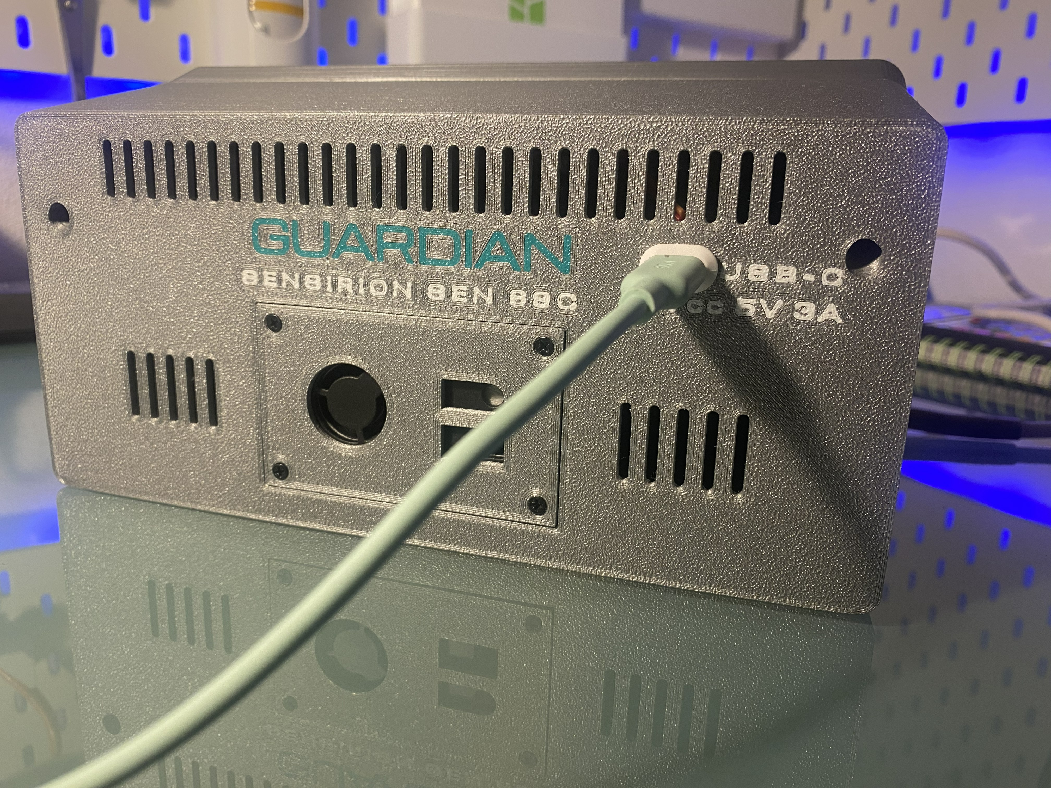
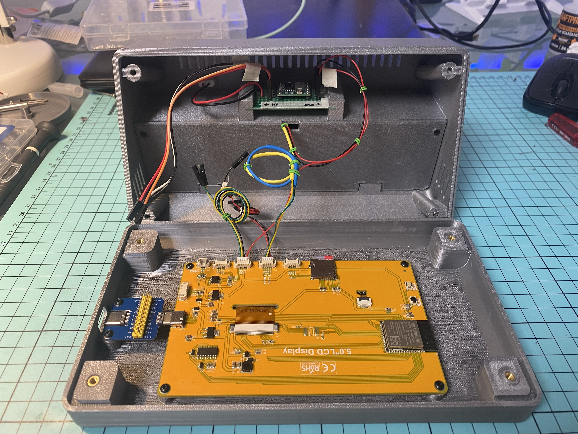
CONSTRUCTION
Accessible and serviceable
Two USB-C access points
Rear socket for power; side socket for programming, protected by a TPU cap.
Sensor and electronics compartments
Rear-mounted SEN69C, removable support and internal partition. Keep the airflow paths clear and separate.
23
GUARDIAN MAKERS / OCTOBER 2026
Notes:
GUARDIAN: presentazione prodotto. Fotografie fornite dal proprietario. Copertina elaborata fotograficamente, schermate aggiornate fornite dal proprietario; rete, credenziali e seriali sostituiti con dati dimostrativi. Fonti complete nelle slide finali e nel manuale: https://sensirion.com/resource/datasheet/SEN6x ; https://www.who.int/publications/i/item/9789240034228 ; https://www.who.int/publications-detail-redirect/9789289002134 ; https://www.epa.gov/chemical-research/3d-printing-research-epa . Dichiarazioni dei componenti non equivalgono a certificazione GUARDIAN.

Slide 24
MEASUREMENTS, AVERAGES AND LIMITS
Understanding the references
Indication | Reference | Correct use
PM2.5 | WHO 2021: 15 µg/m³ / 24 h | Complete after 24 hours of valid recording; earlier averages are partial.
PM10 | WHO 2021: 45 µg/m³ / 24 h | Complete after 24 hours of valid recording; earlier averages are partial.
HCHO | WHO 2010: 0.1 mg/m³ / 30 min | About 81 ppb at 25 °C and 1 atm; conversion depends on conditions.
CO2, VOC, NOx | Ventilation / relative indices | They do not detect every pollutant or establish safe air on their own.
S6, S7, S10. WHO guidelines do not certify GUARDIAN or replace assessment of occupational exposure.
24
GUARDIAN MAKERS / OCTOBER 2026
Notes:
GUARDIAN: presentazione prodotto. Fotografie fornite dal proprietario. Copertina elaborata fotograficamente, schermate aggiornate fornite dal proprietario; rete, credenziali e seriali sostituiti con dati dimostrativi. Fonti complete nelle slide finali e nel manuale: https://sensirion.com/resource/datasheet/SEN6x ; https://www.who.int/publications/i/item/9789240034228 ; https://www.who.int/publications-detail-redirect/9789289002134 ; https://www.epa.gov/chemical-research/3d-printing-research-epa . Dichiarazioni dei componenti non equivalgono a certificazione GUARDIAN.

Slide 25
USE AND LIMITATIONS
Interpreting measurements correctly
Continuous monitoring
GUARDIAN combines environmental readings, history, microSD recording, web access and printer information in one interface.
Accuracy and operating conditions
Readings also depend on placement, ventilation and thermal conditions. Independent metrological validation of the complete device
is not available.
Limits that remain relevant
Optical PM does not directly measure the entire ultrafine fraction. Gas indices do not identify every compound. Low readings do not
automatically mean safe air. [S1, S8, S9]
25
GUARDIAN MAKERS / OCTOBER 2026
Notes:
GUARDIAN: presentazione prodotto. Fotografie fornite dal proprietario. Copertina elaborata fotograficamente, schermate aggiornate fornite dal proprietario; rete, credenziali e seriali sostituiti con dati dimostrativi. Fonti complete nelle slide finali e nel manuale: https://sensirion.com/resource/datasheet/SEN6x ; https://www.who.int/publications/i/item/9789240034228 ; https://www.who.int/publications-detail-redirect/9789289002134 ; https://www.epa.gov/chemical-research/3d-printing-research-epa . Dichiarazioni dei componenti non equivalgono a certificazione GUARDIAN.

Slide 26
TECHNICAL DOCUMENTATION
Calibration and conformity
Sensirion statement
Sensirion states that each device in the listed families, including SEN69C, is individually tested after calibration. The statement covers
SEN5x/SEN6x particulate-matter sensors; the original is attached to the manual. It is not an individual GUARDIAN calibration report or
certification of all its channels. [S2]
The complete product
Component REACH/RoHS documents contribute to the technical file; they are not a declaration of conformity for the whole device. [S16]
Before any commercial distribution
Determine the obligations applicable to the finished product and assess safety, radio/EMC and documentation. RED, RoHS, WEEE and
REACH are references to assess; no completed certification is claimed here. [S11–S15]
26
GUARDIAN MAKERS / OCTOBER 2026
Notes:
GUARDIAN: presentazione prodotto. Fotografie fornite dal proprietario. Copertina elaborata fotograficamente, schermate aggiornate fornite dal proprietario; rete, credenziali e seriali sostituiti con dati dimostrativi. Fonti complete nelle slide finali e nel manuale: https://sensirion.com/resource/datasheet/SEN6x ; https://www.who.int/publications/i/item/9789240034228 ; https://www.who.int/publications-detail-redirect/9789289002134 ; https://www.epa.gov/chemical-research/3d-printing-research-epa . Dichiarazioni dei componenti non equivalgono a certificazione GUARDIAN.

Slide 27
OCTOBER 2026 EDITION
Display lighting: validated update
25 kHz backlight PWM
The owner confirmed that the 5 kHz whine disappeared after the change to 25 kHz. Manual brightness and the automatic day/night schedule
were tested successfully.
Version identification
This edition describes bilingual GUARDIAN with the 25 kHz modification. The tested sketch is labelled 1.0.0-rc3-pwm25-test1; this identifier
may still appear on the device and in the browser.
Settings and updates
Brightness remains adjustable from the display and browser. This change requires neither a factory reset nor microSD formatting.
Scope of testing
Functional checks on the owner’s prototype support retaining this setting. They do not constitute metrological validation or certification of the
complete product.
27
GUARDIAN MAKERS / OCTOBER 2026
Notes:
GUARDIAN: presentazione prodotto. Fotografie fornite dal proprietario. Copertina elaborata fotograficamente, schermate aggiornate fornite dal proprietario; rete, credenziali e seriali sostituiti con dati dimostrativi. Fonti complete nelle slide finali e nel manuale: https://sensirion.com/resource/datasheet/SEN6x ; https://www.who.int/publications/i/item/9789240034228 ; https://www.who.int/publications-detail-redirect/9789289002134 ; https://www.epa.gov/chemical-research/3d-printing-research-epa . Dichiarazioni dei componenti non equivalgono a certificazione GUARDIAN.

Slide 28
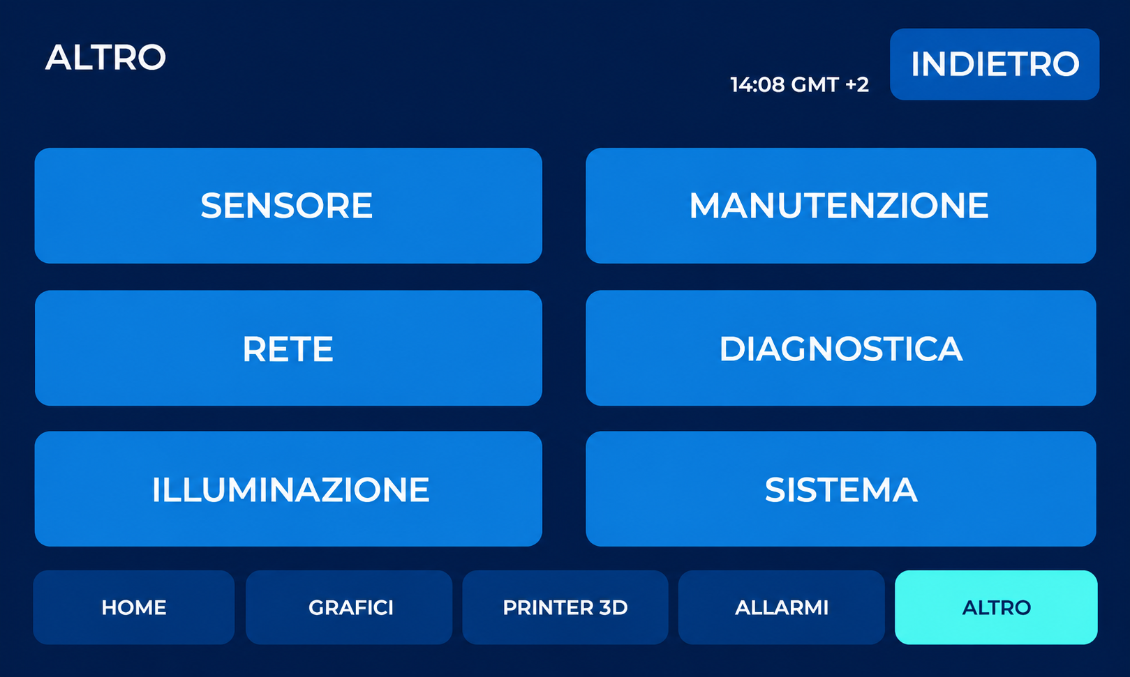
DISPLAY CONTROLS
The OTHER menu
Select SYSTEM (SISTEMA) to choose the language or access restart and reset.
Retouched from the supplied photograph: reflections removed and perspective corrected. Original labels and controls retained.
28
GUARDIAN MAKERS / OCTOBER 2026
Notes:
GUARDIAN: presentazione prodotto. Fotografie fornite dal proprietario. Copertina elaborata fotograficamente, schermate aggiornate fornite dal proprietario; rete, credenziali e seriali sostituiti con dati dimostrativi. Fonti complete nelle slide finali e nel manuale: https://sensirion.com/resource/datasheet/SEN6x ; https://www.who.int/publications/i/item/9789240034228 ; https://www.who.int/publications-detail-redirect/9789289002134 ; https://www.epa.gov/chemical-research/3d-printing-research-epa . Dichiarazioni dei componenti non equivalgono a certificazione GUARDIAN.

Slide 29
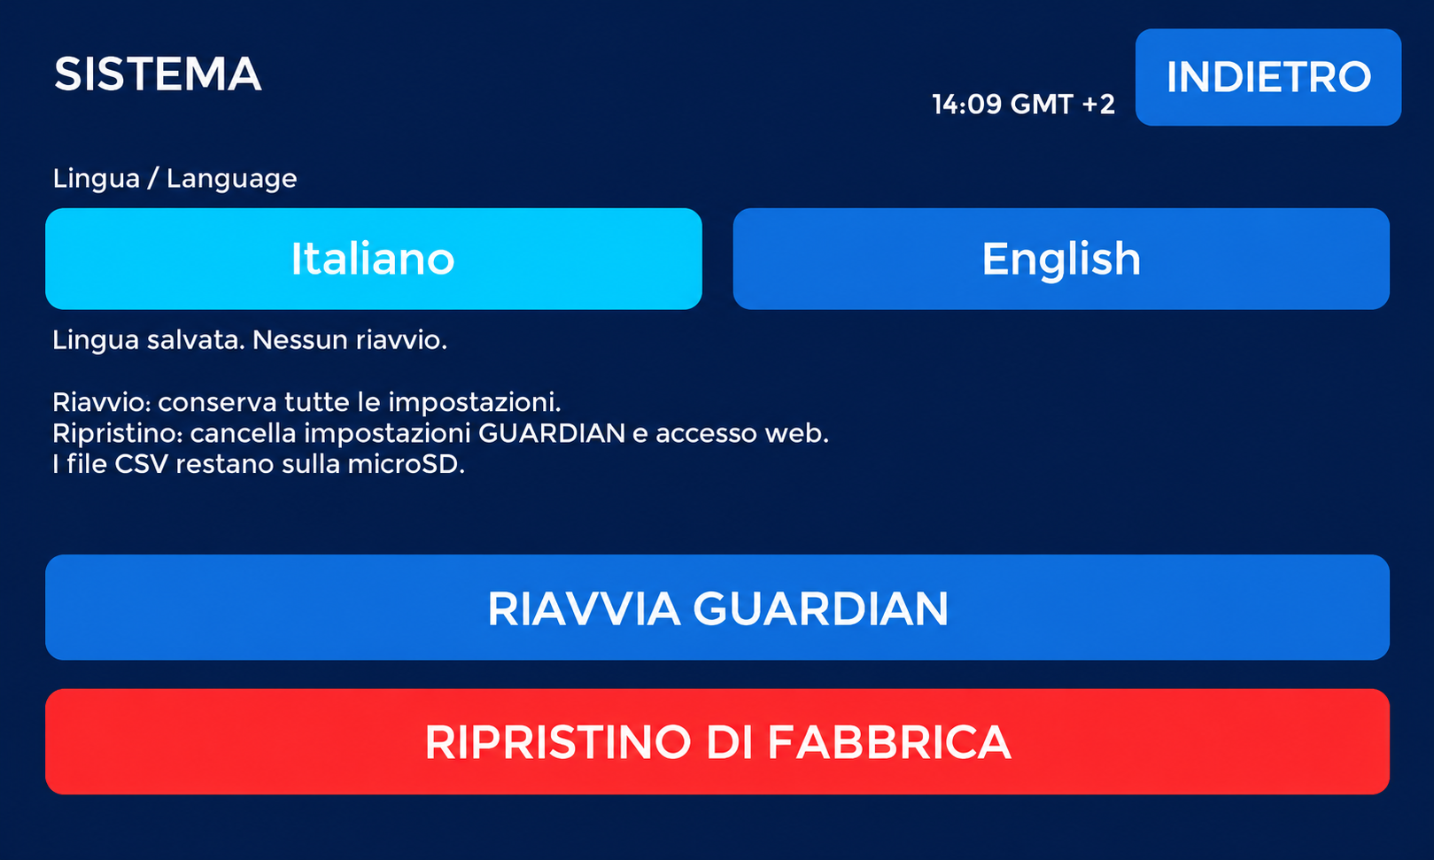
DISPLAY CONTROLS
System and interface language
Choose Italiano or English: the language is saved without restarting. RESTART keeps settings; FACTORY RESET clears GUARDIAN settings and web
access. CSV files remain on microSD.
Retouched from the supplied photograph: reflections removed and perspective corrected. Original labels and controls retained.
29
GUARDIAN MAKERS / OCTOBER 2026
Notes:
GUARDIAN: presentazione prodotto. Fotografie fornite dal proprietario. Copertina elaborata fotograficamente, schermate aggiornate fornite dal proprietario; rete, credenziali e seriali sostituiti con dati dimostrativi. Fonti complete nelle slide finali e nel manuale: https://sensirion.com/resource/datasheet/SEN6x ; https://www.who.int/publications/i/item/9789240034228 ; https://www.who.int/publications-detail-redirect/9789289002134 ; https://www.epa.gov/chemical-research/3d-printing-research-epa . Dichiarazioni dei componenti non equivalgono a certificazione GUARDIAN.

Slide 30
INTERFACE LANGUAGE
Italian and English on the same device
Selection on the display
OTHER → SYSTEM: choose Italiano or English. The choice is saved without restarting. With no saved preference, the initial language is
Italian.
PC and smartphone
They follow the display language by reloading within about three seconds while reachable. Save open forms before changing language.
After restarting
The choice is retained. A GUARDIAN factory reset restores Italian. Job names, user-entered data and the CSV format remain unchanged.
30
GUARDIAN MAKERS / OCTOBER 2026
Notes:
GUARDIAN: presentazione prodotto. Fotografie fornite dal proprietario. Copertina elaborata fotograficamente, schermate aggiornate fornite dal proprietario; rete, credenziali e seriali sostituiti con dati dimostrativi. Fonti complete nelle slide finali e nel manuale: https://sensirion.com/resource/datasheet/SEN6x ; https://www.who.int/publications/i/item/9789240034228 ; https://www.who.int/publications-detail-redirect/9789289002134 ; https://www.epa.gov/chemical-research/3d-printing-research-epa . Dichiarazioni dei componenti non equivalgono a certificazione GUARDIAN.

Slide 31
IMAGE CONTEXT
Real readings and compatibility
24 hours for a complete average
A complete PM2.5 / PM10 average requires 24 hours of valid recording. Earlier averages cover only the available period and are partial. HCHO
uses a separate 30-minute period.
Photographs and demonstrations
Display photographs show real readings collected over partial periods, not complete 24-hour averages. Network details and credentials are
examples. Firmware reconstructions are identified separately.
Printer used for testing
A1 tested; X1 Carbon connectivity verified. GUARDIAN uses Bambu Lab protocols; other models require verification. Other brands require investigation
and possible adaptation.
Bilingual edition
This documentation describes the Italian and English interface. The owner reports successful initial functional testing; software testing is not
metrological validation.
31
GUARDIAN MAKERS / OCTOBER 2026
Notes:
GUARDIAN: presentazione prodotto. Fotografie fornite dal proprietario. Copertina elaborata fotograficamente, schermate aggiornate fornite dal proprietario; rete, credenziali e seriali sostituiti con dati dimostrativi. Fonti complete nelle slide finali e nel manuale: https://sensirion.com/resource/datasheet/SEN6x ; https://www.who.int/publications/i/item/9789240034228 ; https://www.who.int/publications-detail-redirect/9789289002134 ; https://www.epa.gov/chemical-research/3d-printing-research-epa . Dichiarazioni dei componenti non equivalgono a certificazione GUARDIAN.

Slide 32
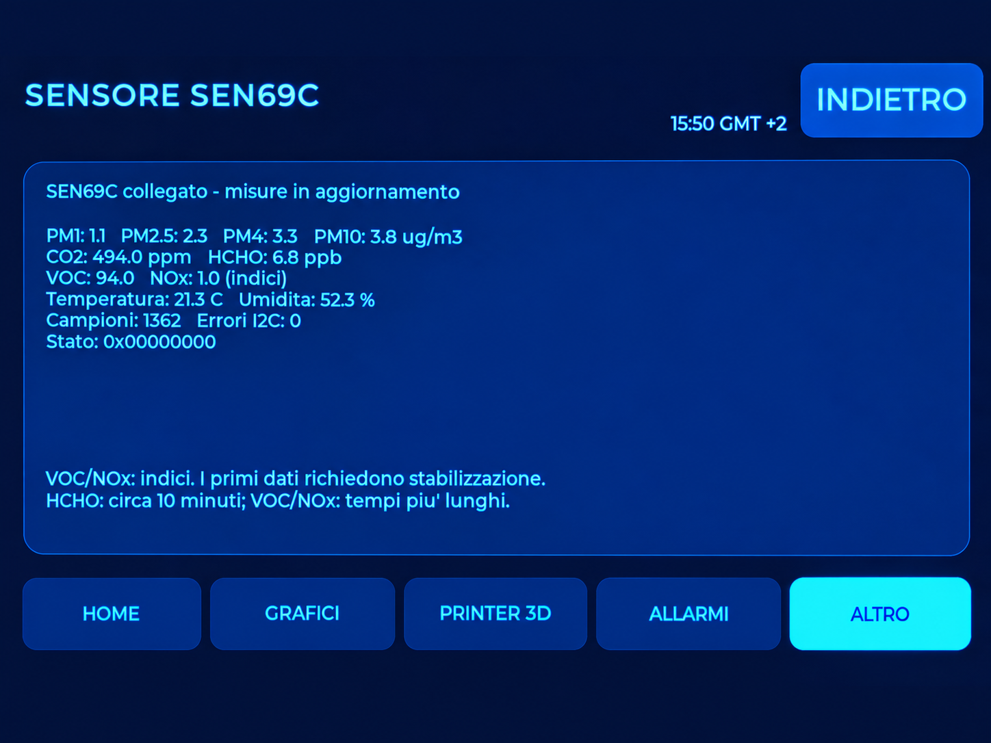
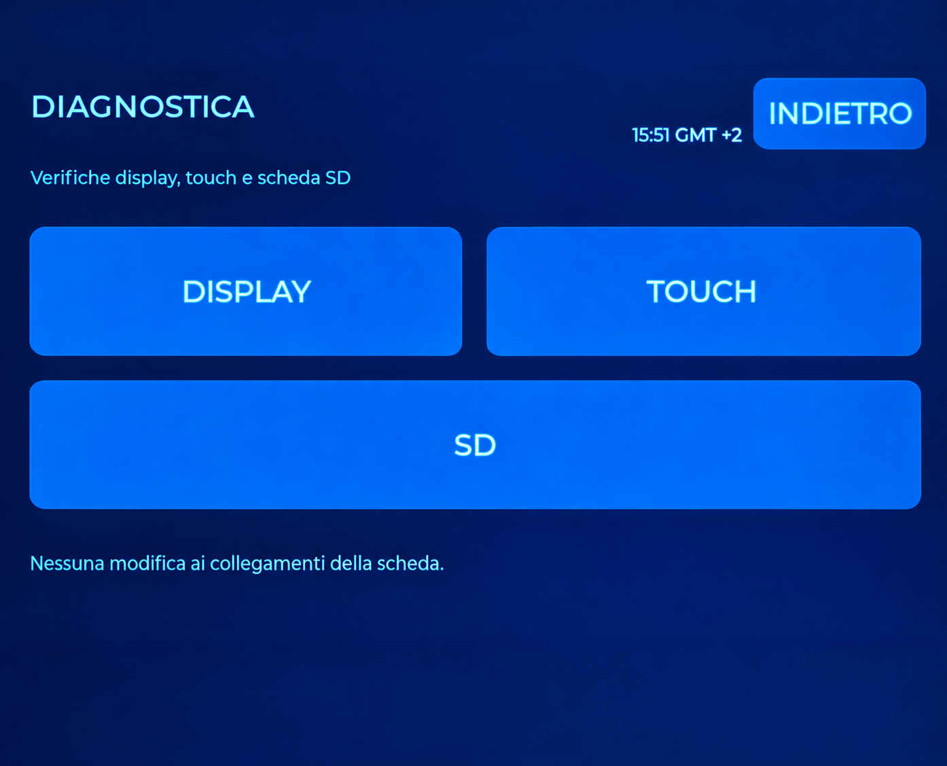
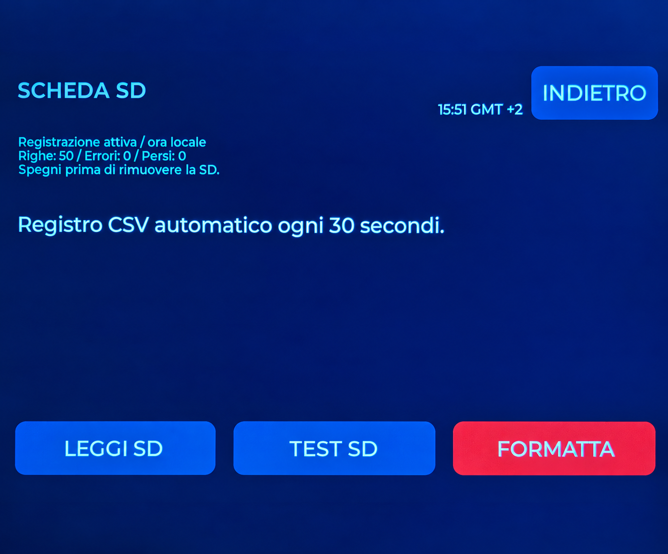
SCREEN ATLAS
Other service screens
OTHER
SENSOR
Access to additional functions.
Module presence and status information.
DIAGNOSTICS
SD CARD
Display, touch and SD tests.
Recording status and local commands.
32
GUARDIAN MAKERS / OCTOBER 2026
Notes:
GUARDIAN: presentazione prodotto. Fotografie fornite dal proprietario. Copertina elaborata fotograficamente, schermate aggiornate fornite dal proprietario; rete, credenziali e seriali sostituiti con dati dimostrativi. Fonti complete nelle slide finali e nel manuale: https://sensirion.com/resource/datasheet/SEN6x ; https://www.who.int/publications/i/item/9789240034228 ; https://www.who.int/publications-detail-redirect/9789289002134 ; https://www.epa.gov/chemical-research/3d-printing-research-epa . Dichiarazioni dei componenti non equivalgono a certificazione GUARDIAN.

Slide 33
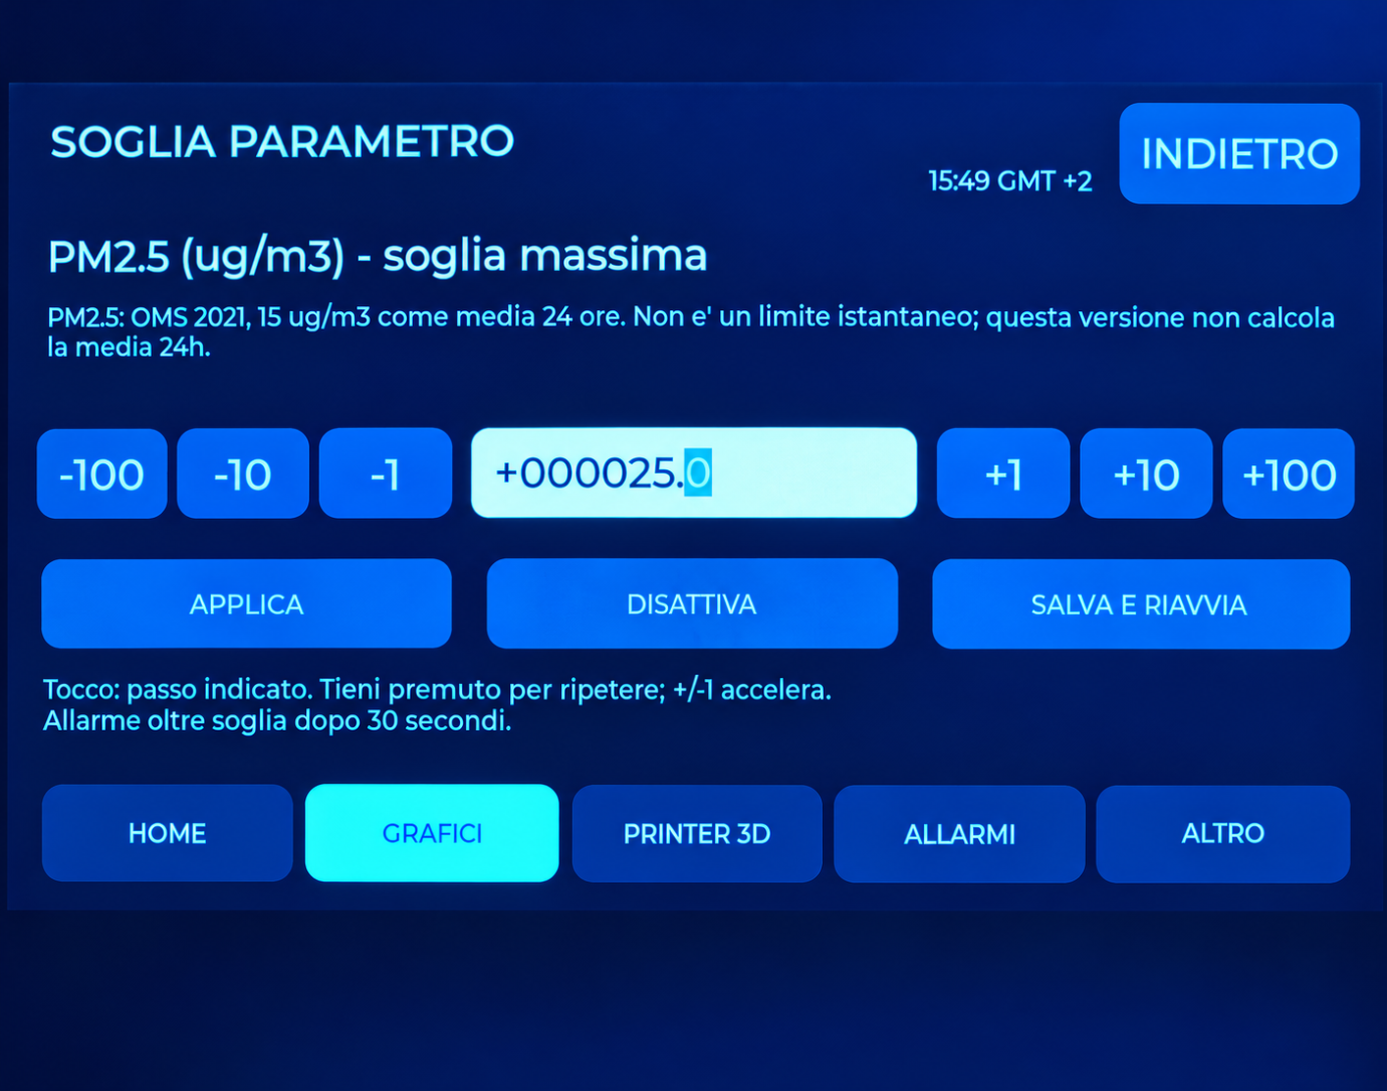
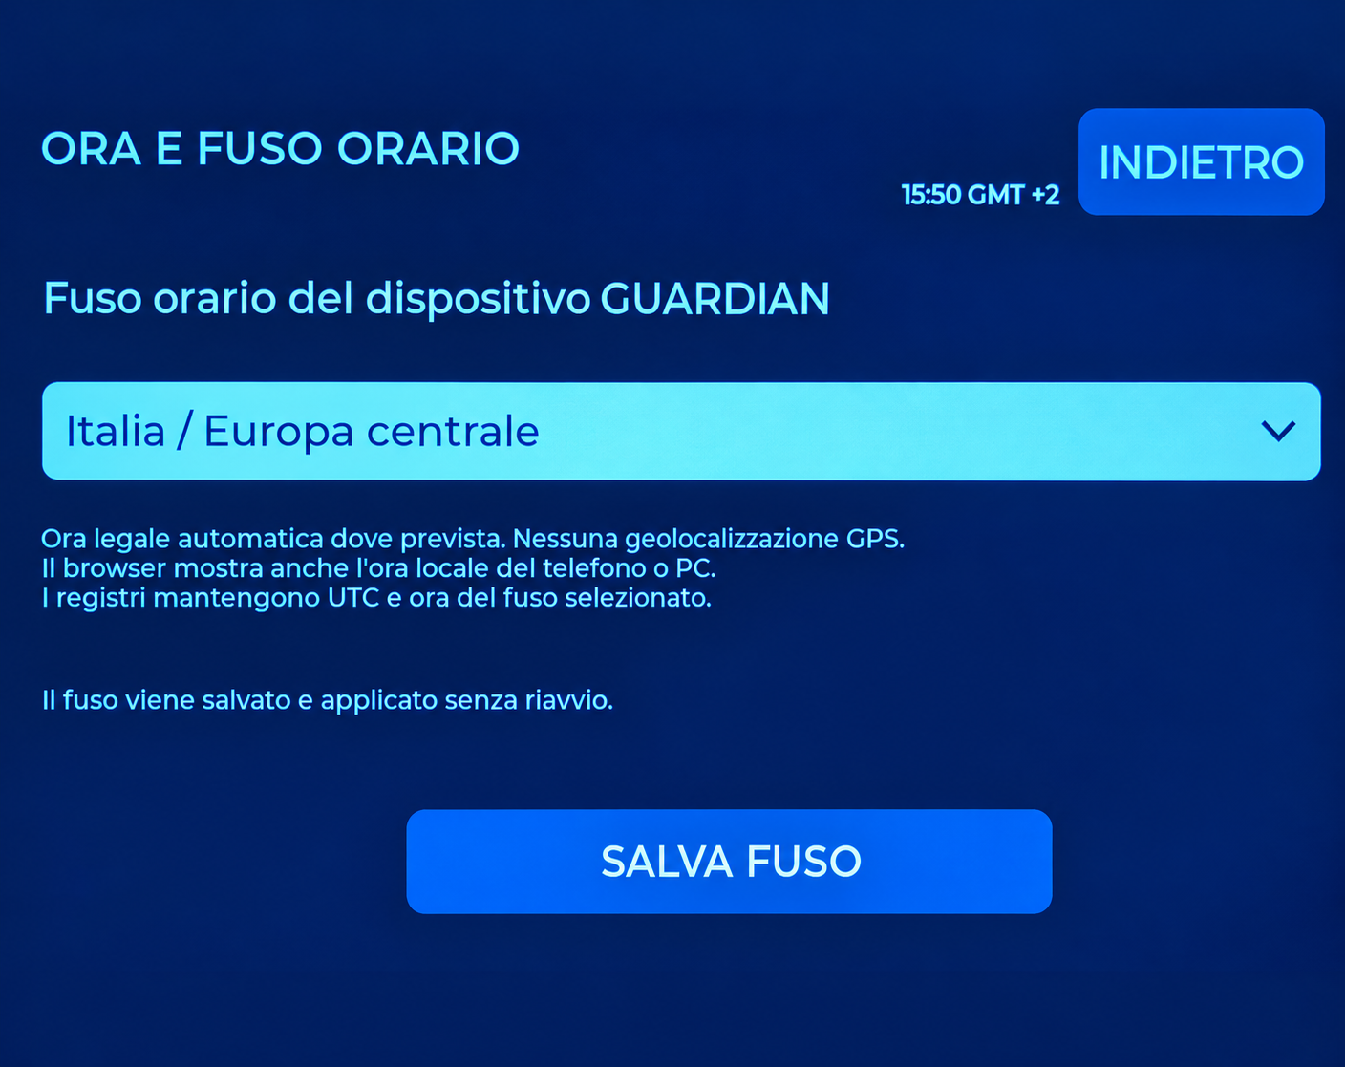
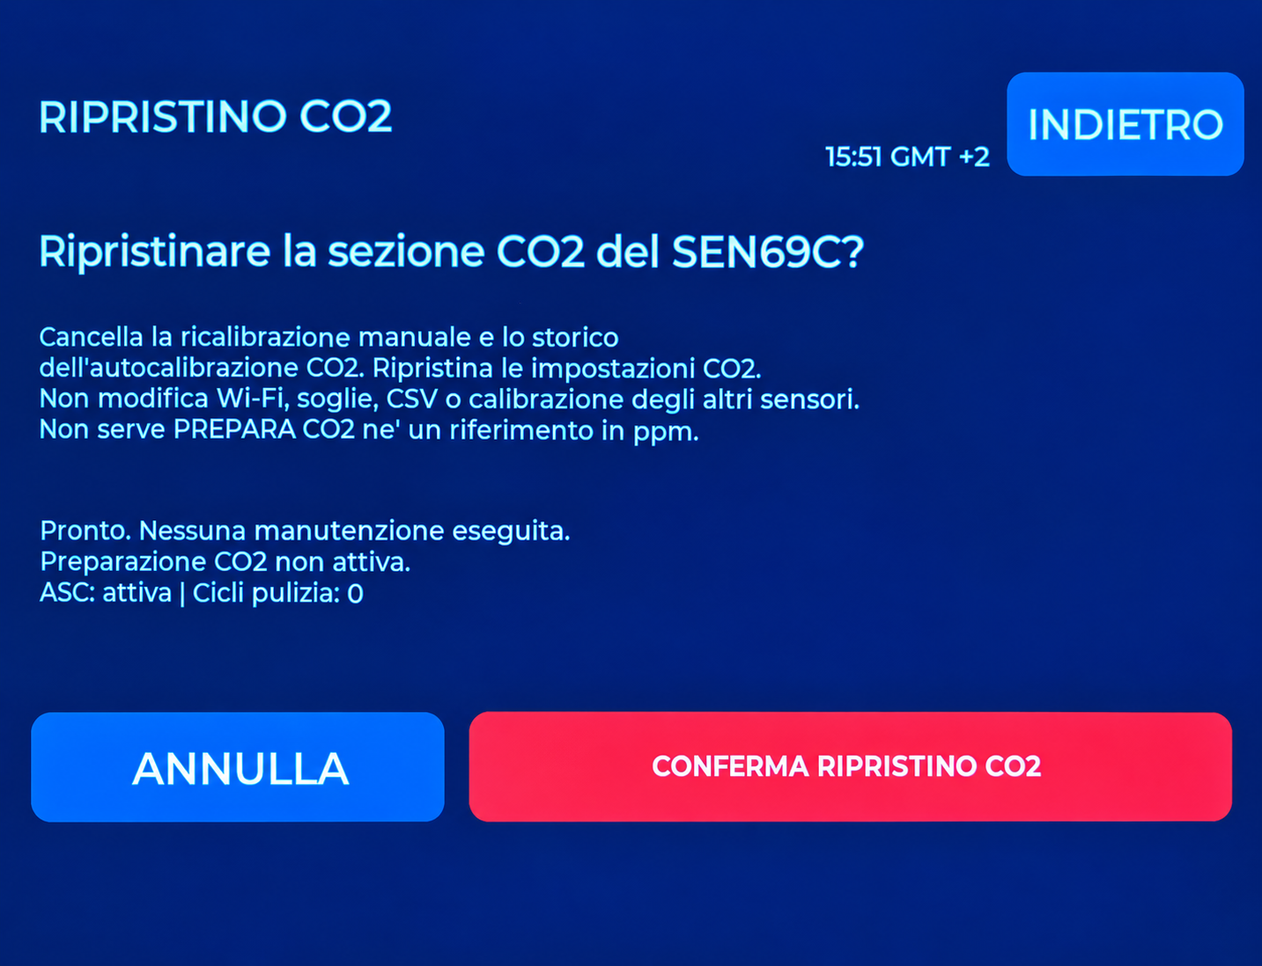
SCREEN ATLAS
Controls and configuration
PARAMETER THRESHOLD
TIME AND TIME ZONE
Set a personal operating threshold.
Geographical clock profile.
CO2 RESET
SYSTEM
Separate confirmation for the CO2 channel.
Restart or reset GUARDIAN.
33
GUARDIAN MAKERS / OCTOBER 2026
Notes:
GUARDIAN: presentazione prodotto. Fotografie fornite dal proprietario. Copertina elaborata fotograficamente, schermate aggiornate fornite dal proprietario; rete, credenziali e seriali sostituiti con dati dimostrativi. Fonti complete nelle slide finali e nel manuale: https://sensirion.com/resource/datasheet/SEN6x ; https://www.who.int/publications/i/item/9789240034228 ; https://www.who.int/publications-detail-redirect/9789289002134 ; https://www.epa.gov/chemical-research/3d-printing-research-epa . Dichiarazioni dei componenti non equivalgono a certificazione GUARDIAN.

Slide 34
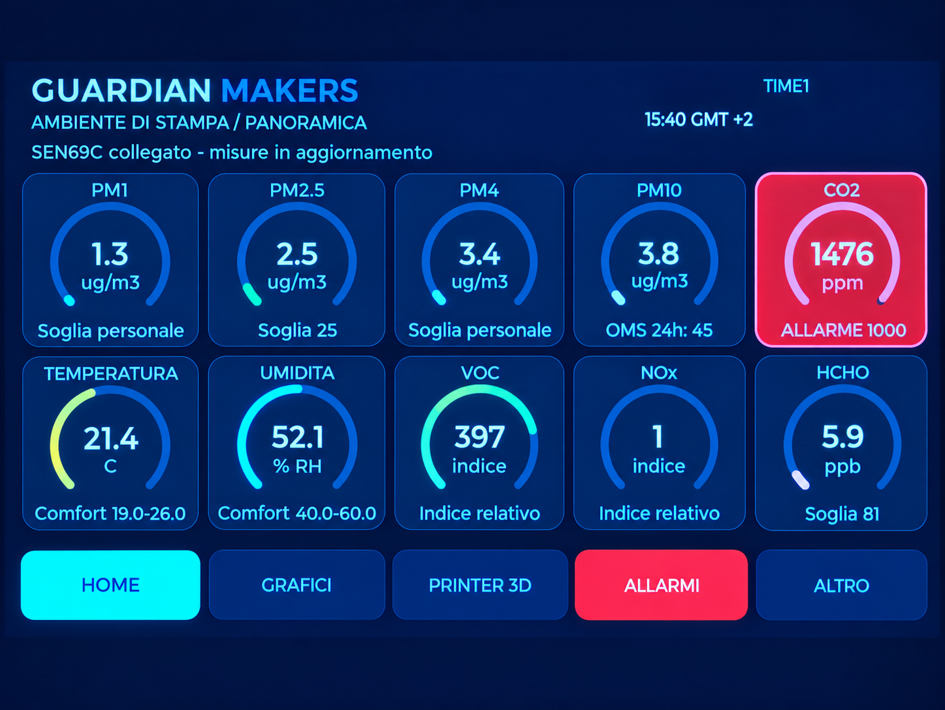
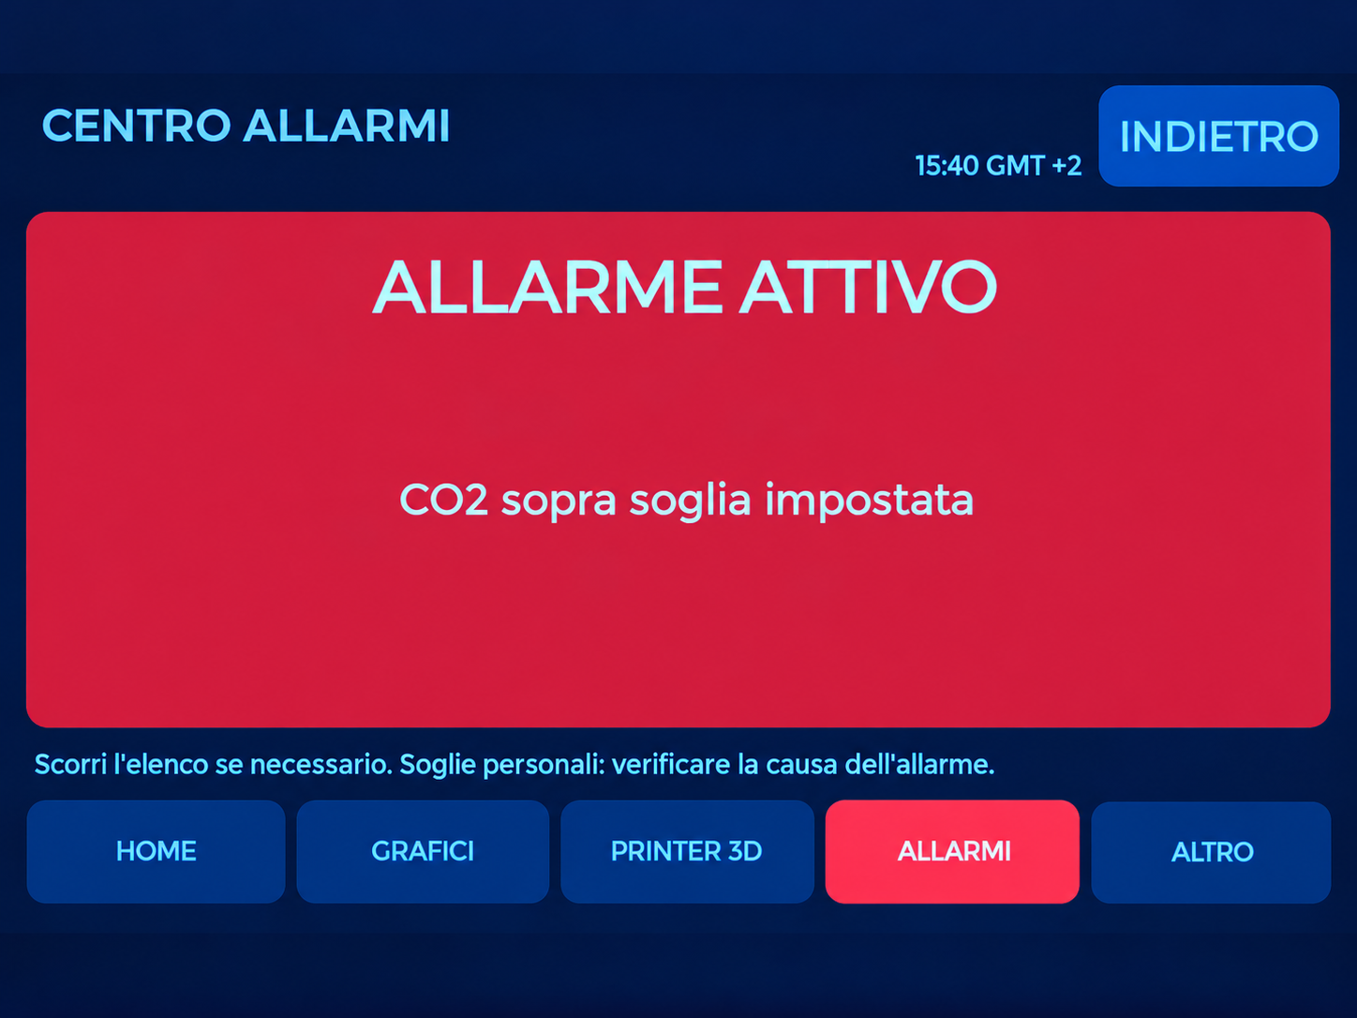
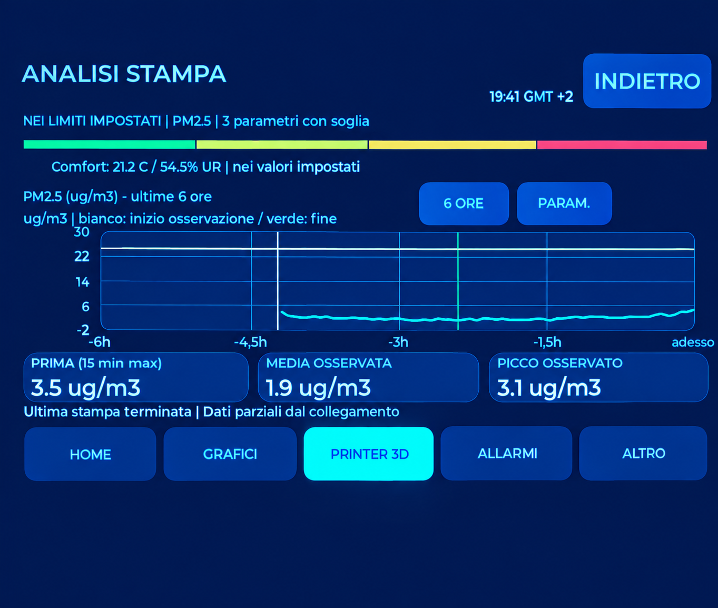
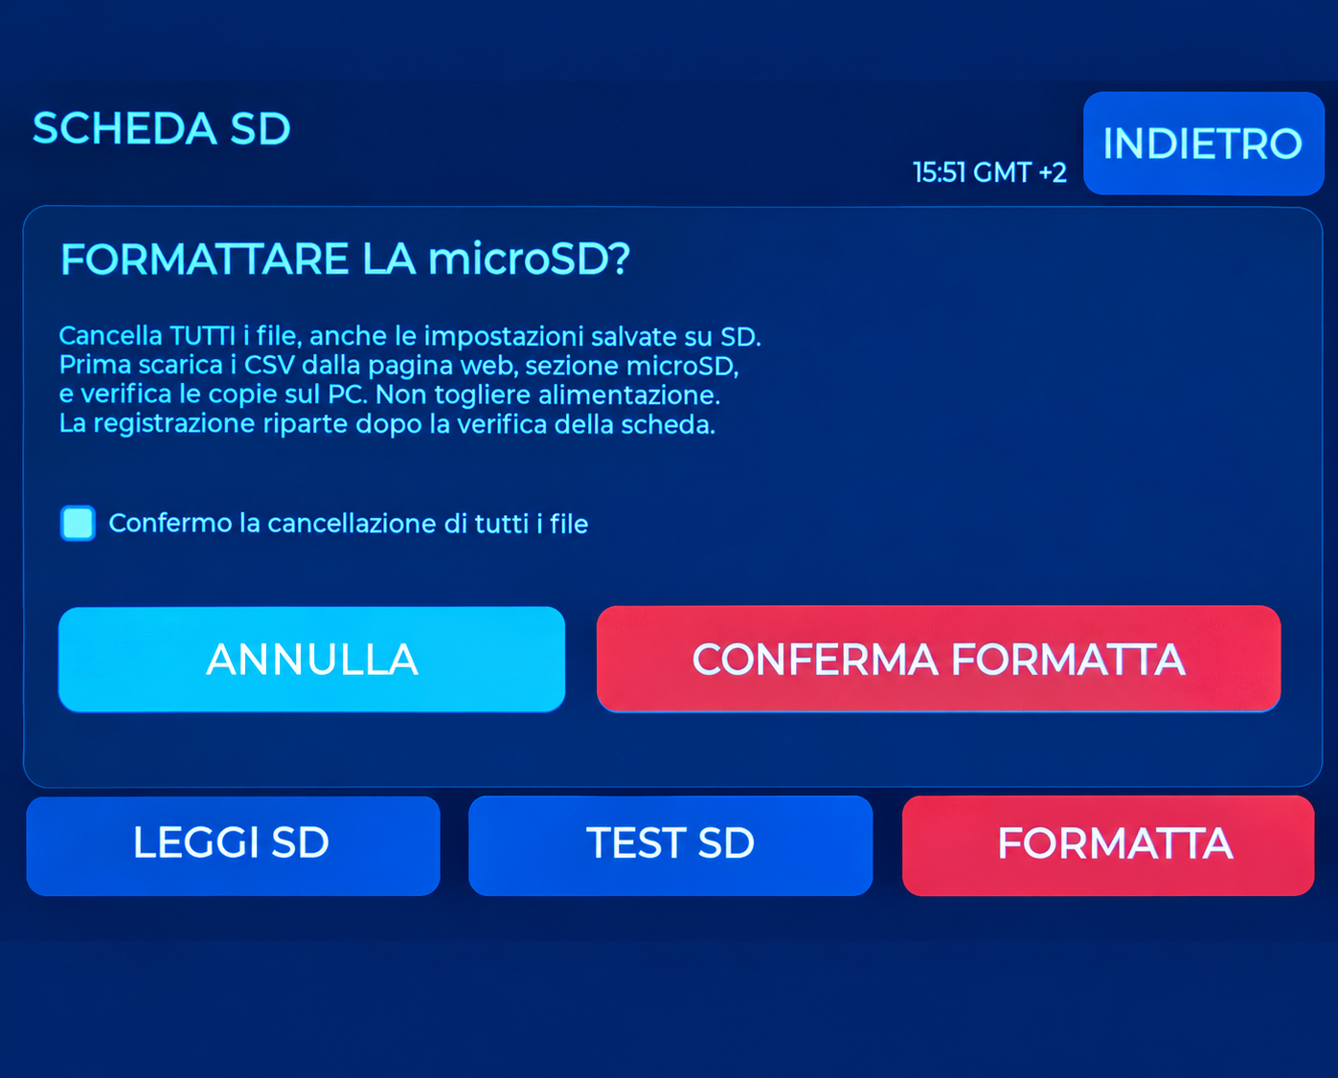
SCREEN ATLAS
Recognising environmental states
HOME: CO2 alert
ALERT CENTRE
Colour indicates the state against the configured threshold.
Read the cause and current value; alerts are informational.
ANALYSIS: print completed
FORMAT: confirmation
Session summary and available samples.
Erases all card files; back up first.
34
GUARDIAN MAKERS / OCTOBER 2026
Notes:
GUARDIAN: presentazione prodotto. Fotografie fornite dal proprietario. Copertina elaborata fotograficamente, schermate aggiornate fornite dal proprietario; rete, credenziali e seriali sostituiti con dati dimostrativi. Fonti complete nelle slide finali e nel manuale: https://sensirion.com/resource/datasheet/SEN6x ; https://www.who.int/publications/i/item/9789240034228 ; https://www.who.int/publications-detail-redirect/9789289002134 ; https://www.epa.gov/chemical-research/3d-printing-research-epa . Dichiarazioni dei componenti non equivalgono a certificazione GUARDIAN.

Slide 35
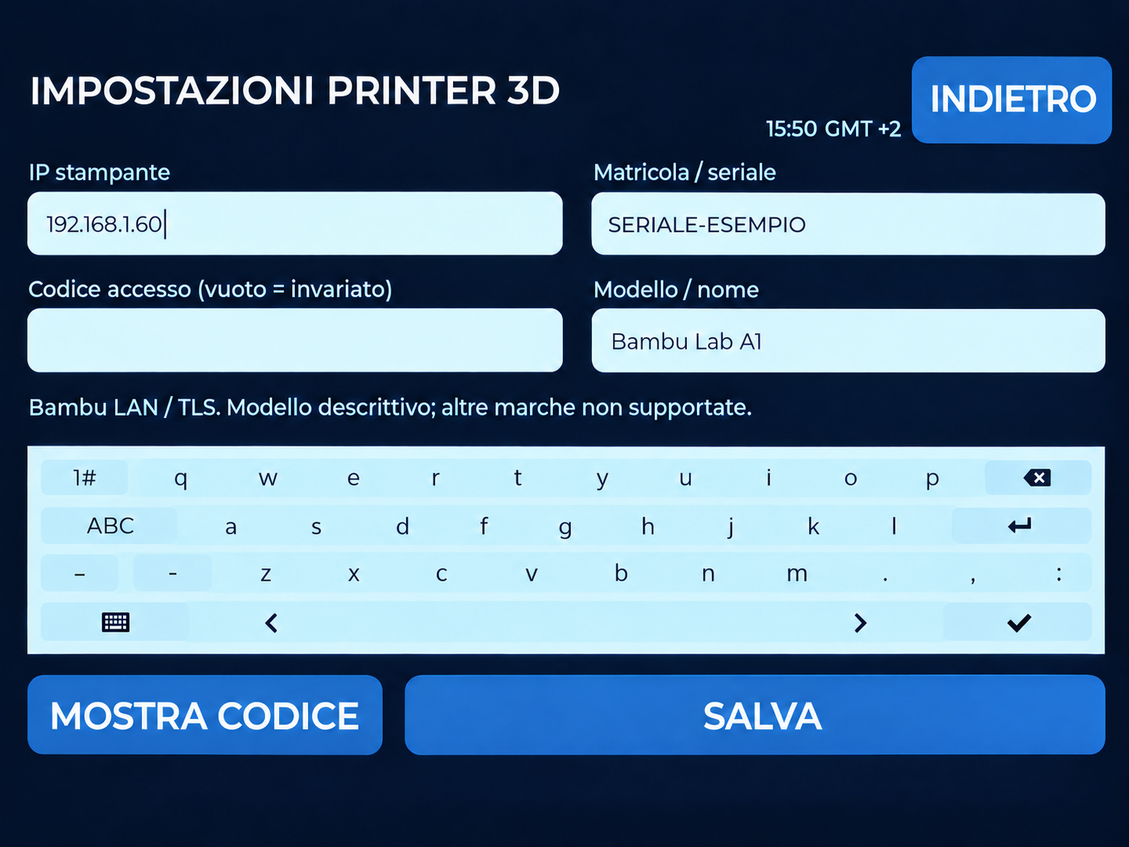
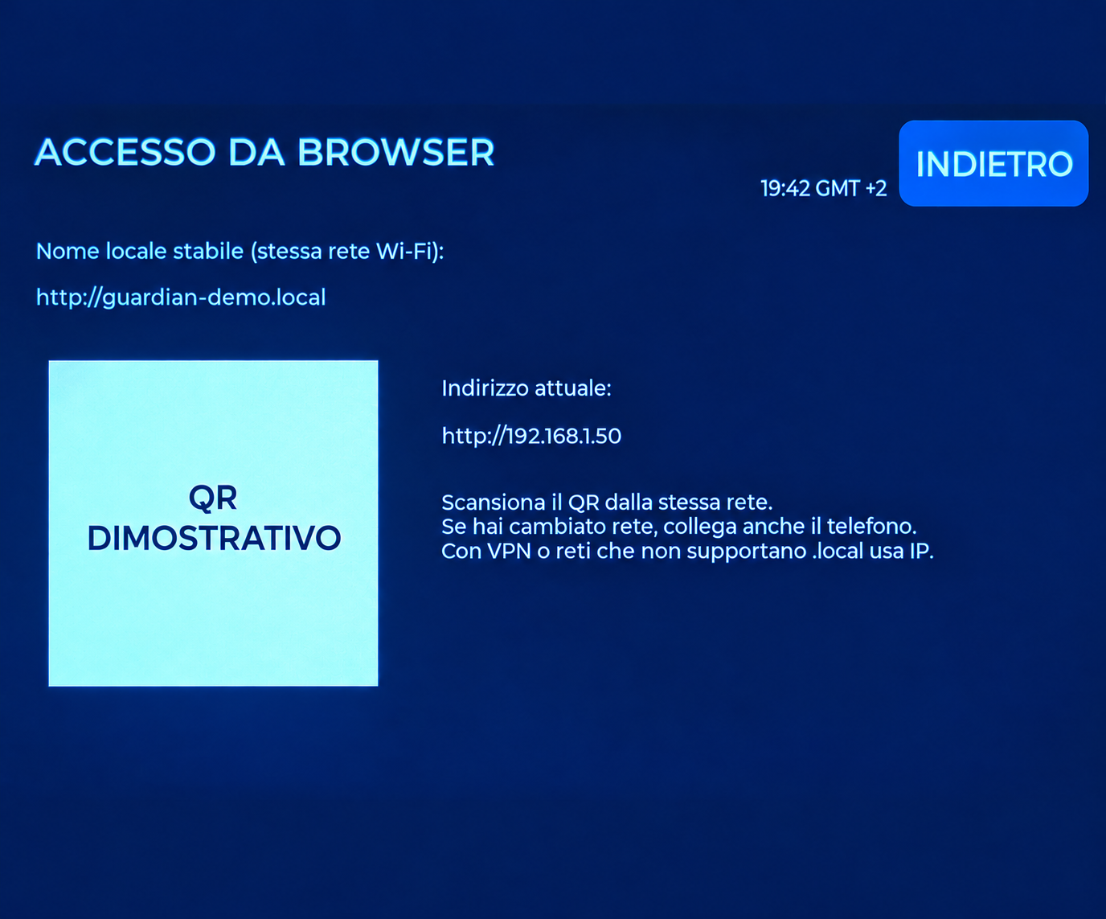
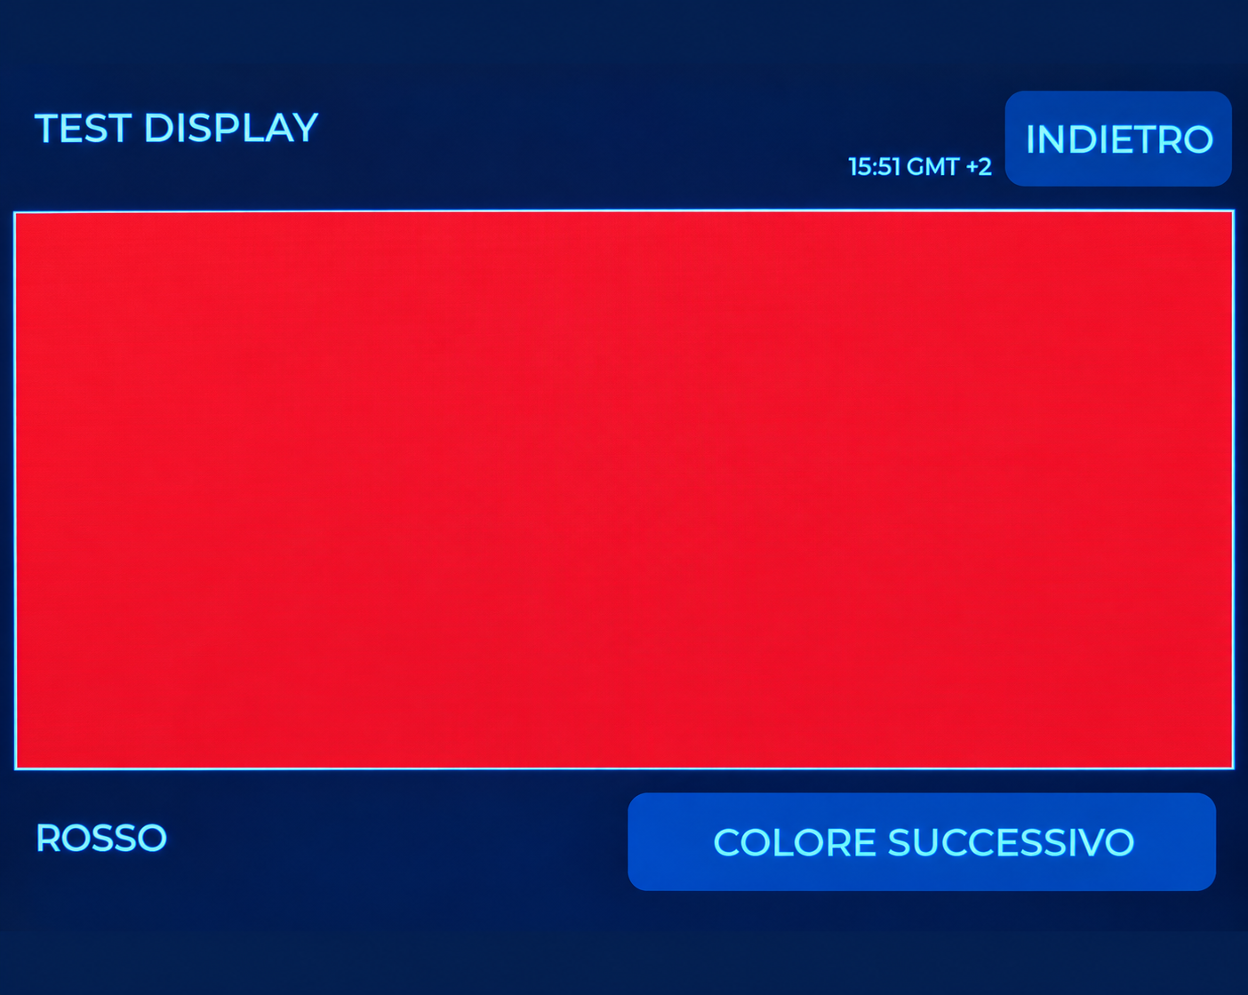
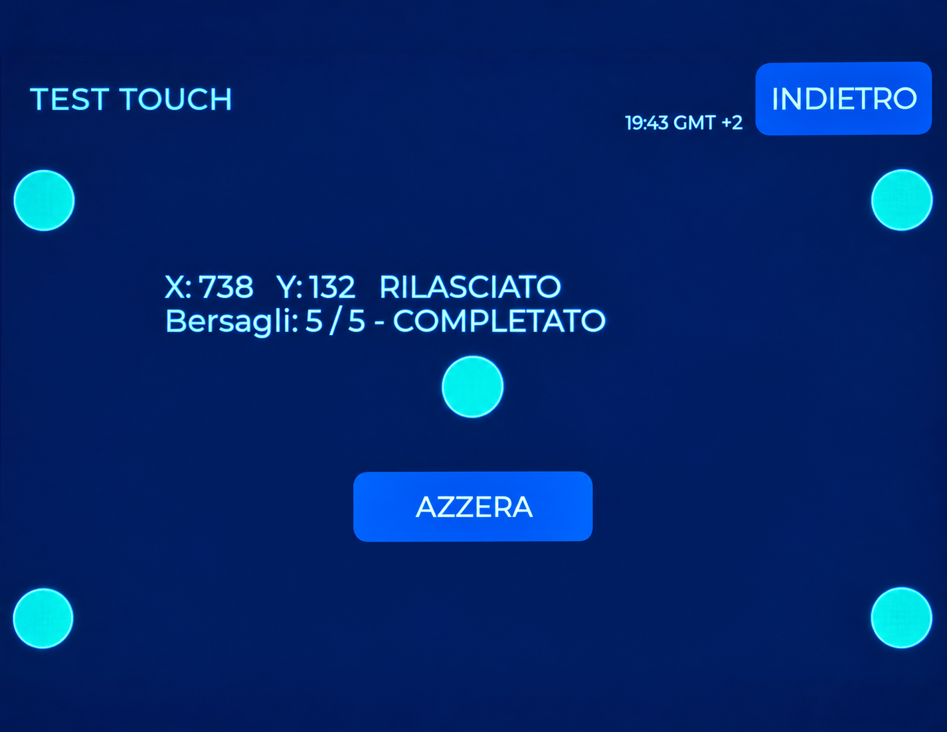
SCREEN ATLAS
Access and local checks
PRINTER SETTINGS
BROWSER ACCESS
Your printer’s IP, serial number and local code. Example details shown.
Use your monitor’s address. The QR code shown was replaced.
DISPLAY TEST
TOUCH TEST
Check uniformity and persistent defects.
Check response at different screen positions.
35
GUARDIAN MAKERS / OCTOBER 2026
Notes:
GUARDIAN: presentazione prodotto. Fotografie fornite dal proprietario. Copertina elaborata fotograficamente, schermate aggiornate fornite dal proprietario; rete, credenziali e seriali sostituiti con dati dimostrativi. Fonti complete nelle slide finali e nel manuale: https://sensirion.com/resource/datasheet/SEN6x ; https://www.who.int/publications/i/item/9789240034228 ; https://www.who.int/publications-detail-redirect/9789289002134 ; https://www.epa.gov/chemical-research/3d-printing-research-epa . Dichiarazioni dei componenti non equivalgono a certificazione GUARDIAN.

Slide 36
GUARDIAN INTERFACE
Adjusting thresholds quickly
Small or large steps
±1, ±10 and ±100 buttons: increase by 100 with
one tap on +100.
Press and hold
Repeats the change; holding ±1 accelerates the
step.
Apply and retain
Check the command result. In the browser, enter
the value directly.
Personal operating thresholds are not certified health limits.
36
GUARDIAN MAKERS / OCTOBER 2026
Notes:
GUARDIAN: presentazione prodotto. Fotografie fornite dal proprietario. Copertina elaborata fotograficamente, schermate aggiornate fornite dal proprietario; rete, credenziali e seriali sostituiti con dati dimostrativi. Fonti complete nelle slide finali e nel manuale: https://sensirion.com/resource/datasheet/SEN6x ; https://www.who.int/publications/i/item/9789240034228 ; https://www.who.int/publications-detail-redirect/9789289002134 ; https://www.epa.gov/chemical-research/3d-printing-research-epa . Dichiarazioni dei componenti non equivalgono a certificazione GUARDIAN.

Slide 37
EVERYDAY USE
Display and browser
An organised sequence
ENVIRONMENTAL TRENDS → ENVIRONMENTAL AVERAGES; PRINT ANALYSIS → 3D PRINTING on PC and smartphone pages.
Readable job names
“tappo in tpu + tappo in tpu” appears as “tappo in tpu”. Different names remain visible. The original print file is not renamed.
MAINTENANCE
The menu uses the full label. CO2 preparation, calibration and cleaning remain separate procedures.
Data and images
The model preview is available on the monitor. Screens in this guide are examples; network details, credentials and serial numbers were
replaced with demonstration values.
37
GUARDIAN MAKERS / OCTOBER 2026
Notes:
GUARDIAN: presentazione prodotto. Fotografie fornite dal proprietario. Copertina elaborata fotograficamente, schermate aggiornate fornite dal proprietario; rete, credenziali e seriali sostituiti con dati dimostrativi. Fonti complete nelle slide finali e nel manuale: https://sensirion.com/resource/datasheet/SEN6x ; https://www.who.int/publications/i/item/9789240034228 ; https://www.who.int/publications-detail-redirect/9789289002134 ; https://www.epa.gov/chemical-research/3d-printing-research-epa . Dichiarazioni dei componenti non equivalgono a certificazione GUARDIAN.

Slide 38
TRACEABLE SOURCES
Sources and reference documents
S1 · Sensirion — SEN6x datasheet (v1.0, October 2026)
Open original document
S2 · Sensirion — SEN5x / SEN6x factory calibration
Open original document
S3 · Sensirion — SEN6x mechanical integration
Open original document
S4 · Sensirion — specification statement
Open original document
S5 · Sensirion — temperature compensation
Open original document
S6 · WHO — Global Air Quality Guidelines, 2021
Open original document
S7 · WHO — Indoor Air Quality: selected pollutants, 2010
Open original document
Accessed: 13 October 2026. Component documents do not certify the complete GUARDIAN device. The photographs show example readings, not metrological validation results.
38
GUARDIAN MAKERS / OCTOBER 2026
Notes:
GUARDIAN: presentazione prodotto. Fotografie fornite dal proprietario. Copertina elaborata fotograficamente, schermate aggiornate fornite dal proprietario; rete, credenziali e seriali sostituiti con dati dimostrativi. Fonti complete nelle slide finali e nel manuale: https://sensirion.com/resource/datasheet/SEN6x ; https://www.who.int/publications/i/item/9789240034228 ; https://www.who.int/publications-detail-redirect/9789289002134 ; https://www.epa.gov/chemical-research/3d-printing-research-epa . Dichiarazioni dei componenti non equivalgono a certificazione GUARDIAN.

Slide 39
TRACEABLE SOURCES
Sources and reference documents
S8 · EPA — research on 3D-printing emissions
Open original document
S9 · EPA — Air Sensor Toolbox
Open original document
S10 · UBA — CO2 and ventilation
Open original document
S11 · Radio Equipment Directive 2014/53/EU
Open original document
S12 · RoHS Directive 2011/65/EU
Open original document
S13 · Delegated Directive (EU) 2015/863 — RoHS
Open original document
S14 · WEEE Directive 2012/19/EU
Open original document
Accessed: 13 October 2026. Component documents do not certify the complete GUARDIAN device. The photographs show example readings, not metrological validation results.
39
GUARDIAN MAKERS / OCTOBER 2026
Notes:
GUARDIAN: presentazione prodotto. Fotografie fornite dal proprietario. Copertina elaborata fotograficamente, schermate aggiornate fornite dal proprietario; rete, credenziali e seriali sostituiti con dati dimostrativi. Fonti complete nelle slide finali e nel manuale: https://sensirion.com/resource/datasheet/SEN6x ; https://www.who.int/publications/i/item/9789240034228 ; https://www.who.int/publications-detail-redirect/9789289002134 ; https://www.epa.gov/chemical-research/3d-printing-research-epa . Dichiarazioni dei componenti non equivalgono a certificazione GUARDIAN.

Slide 40
TRACEABLE SOURCES
Sources and reference documents
S15 · REACH Regulation (EC) 1907/2006
Open original document
S16 · Sensirion — REACH / RoHS statement
Open original document
S17 · Espressif — Arduino ESP32 installation
Open original document
S18 · Freenove — FNK0115 repository
Open original document
S19 · Sensirion — SEN69C product information
Open original document
Accessed: 13 October 2026. Component documents do not certify the complete GUARDIAN device. The photographs show example readings, not metrological validation results.
40
GUARDIAN MAKERS / OCTOBER 2026
Notes:
GUARDIAN: presentazione prodotto. Fotografie fornite dal proprietario. Copertina elaborata fotograficamente, schermate aggiornate fornite dal proprietario; rete, credenziali e seriali sostituiti con dati dimostrativi. Fonti complete nelle slide finali e nel manuale: https://sensirion.com/resource/datasheet/SEN6x ; https://www.who.int/publications/i/item/9789240034228 ; https://www.who.int/publications-detail-redirect/9789289002134 ; https://www.epa.gov/chemical-research/3d-printing-research-epa . Dichiarazioni dei componenti non equivalgono a certificazione GUARDIAN.

