Slide 1
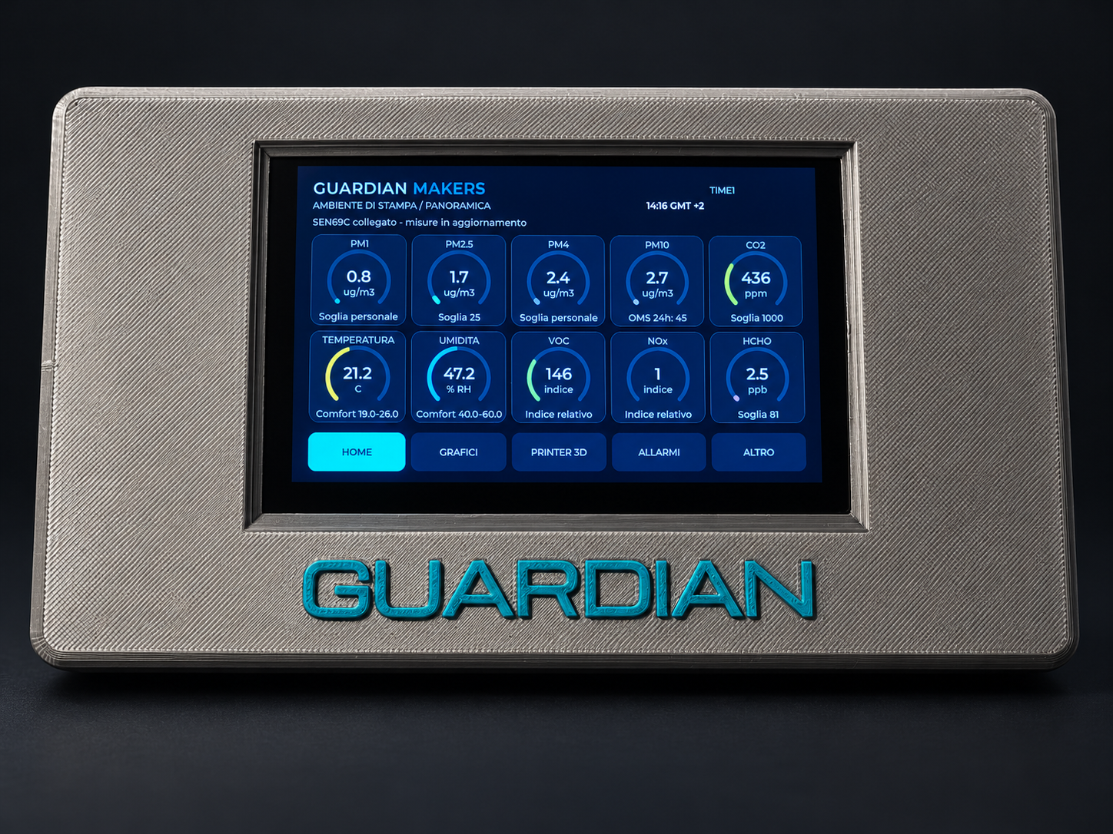
GUARDIAN
MAKERS
The environment during
3D printing
Environmental monitoring
for maker workspaces
Product presentation
October 2026
01
GUARDIAN MAKERS / OCTOBER 2026
Notes:
GUARDIAN: presentazione prodotto. Fotografie fornite dal proprietario. Copertina elaborata fotograficamente, schermate aggiornate fornite dal proprietario; rete, credenziali e seriali sostituiti con dati dimostrativi. Fonti complete nelle slide finali e nel manuale: https://sensirion.com/resource/datasheet/SEN6x ; https://www.who.int/publications/i/item/9789240034228 ; https://www.who.int/publications-detail-redirect/9789289002134 ; https://www.epa.gov/chemical-research/3d-printing-research-epa . Dichiarazioni dei componenti non equivalgono a certificazione GUARDIAN.

Slide 2
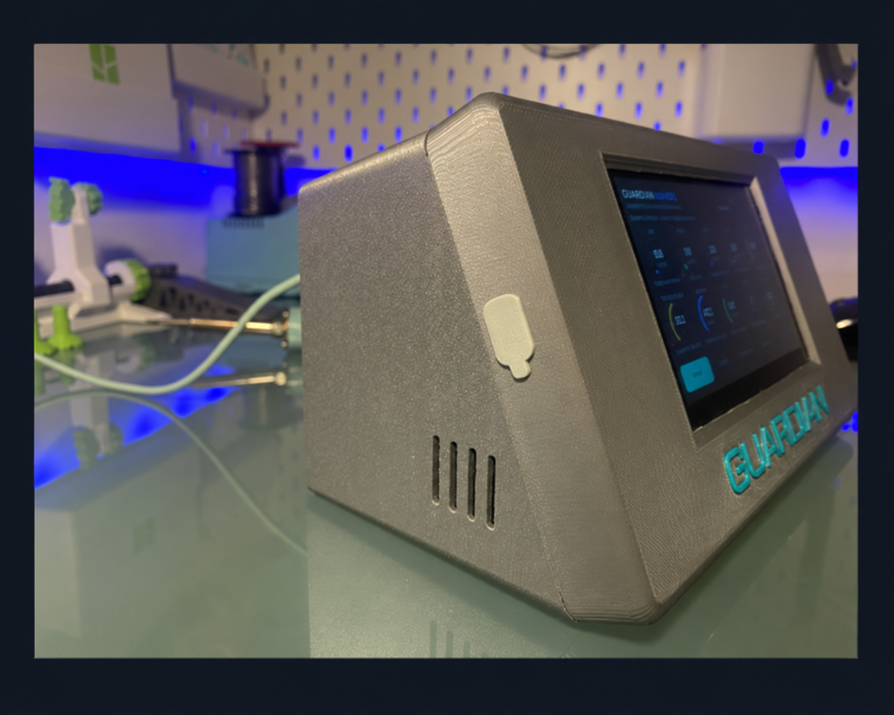
PROJECT IDENTITY
Designed for the workbench
Observe
Follow environmental changes while working and compare different
moments within the same session.
Document
Save readings in CSV files alongside print status and filament
information reported by the printer.
Interpret with care
GUARDIAN is an environmental monitor, not a reference
instrument, a safety detector or proof of healthy air.
02
GUARDIAN MAKERS / OCTOBER 2026
Notes:
GUARDIAN: presentazione prodotto. Fotografie fornite dal proprietario. Copertina elaborata fotograficamente, schermate aggiornate fornite dal proprietario; rete, credenziali e seriali sostituiti con dati dimostrativi. Fonti complete nelle slide finali e nel manuale: https://sensirion.com/resource/datasheet/SEN6x ; https://www.who.int/publications/i/item/9789240034228 ; https://www.who.int/publications-detail-redirect/9789289002134 ; https://www.epa.gov/chemical-research/3d-printing-research-epa . Dichiarazioni dei componenti non equivalgono a certificazione GUARDIAN.

Slide 3
MONITORED PARAMETERS
Ten parameters in one overview
Parameter | Unit | Interpretation
PM1 / PM2.5 / PM4 / PM10 | µg/m³ | Optically estimated mass concentrations by particle-size fraction.
CO2 | ppm | Helps interpret ventilation and room occupancy.
Temperature / humidity | °C / % RH | Personal comfort ranges, separate from alerts.
VOC / NOx | Index | Relative indicators, not concentrations of individual substances.
HCHO | ppb | Formaldehyde; a 30-minute average is also available.
Integrated Sensirion SEN69C sensor. Specifications and limitations: S1, S4, S19. It does not directly measure the ultrafine particles typical of some 3D-printing emissions.
03
GUARDIAN MAKERS / OCTOBER 2026
Notes:
GUARDIAN: presentazione prodotto. Fotografie fornite dal proprietario. Copertina elaborata fotograficamente, schermate aggiornate fornite dal proprietario; rete, credenziali e seriali sostituiti con dati dimostrativi. Fonti complete nelle slide finali e nel manuale: https://sensirion.com/resource/datasheet/SEN6x ; https://www.who.int/publications/i/item/9789240034228 ; https://www.who.int/publications-detail-redirect/9789289002134 ; https://www.epa.gov/chemical-research/3d-printing-research-epa . Dichiarazioni dei componenti non equivalgono a certificazione GUARDIAN.

Slide 4
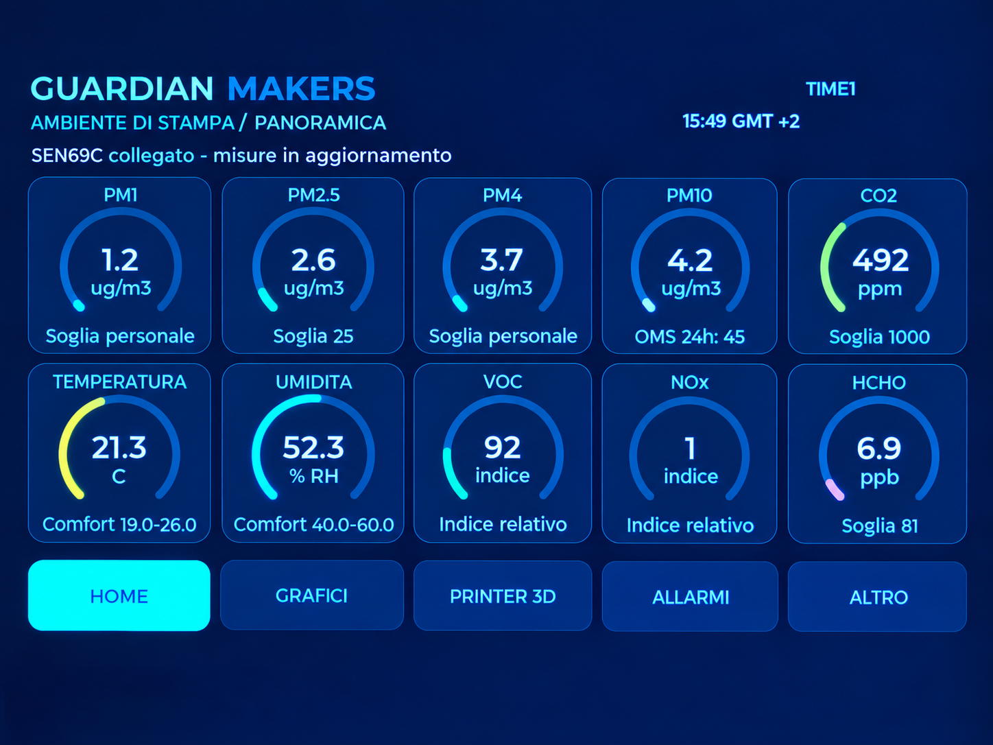
GUARDIAN INTERFACE
HOME: readings at a glance
Values and units
Ten panels bring together measurements, indices
and status indicators.
Thresholds and comfort
Personal thresholds are separate from
temperature and humidity comfort ranges.
Simple navigation
HOME, CHARTS, PRINTER 3D, ALERTS and
OTHER remain accessible.
04
GUARDIAN MAKERS / OCTOBER 2026
Notes:
GUARDIAN: presentazione prodotto. Fotografie fornite dal proprietario. Copertina elaborata fotograficamente, schermate aggiornate fornite dal proprietario; rete, credenziali e seriali sostituiti con dati dimostrativi. Fonti complete nelle slide finali e nel manuale: https://sensirion.com/resource/datasheet/SEN6x ; https://www.who.int/publications/i/item/9789240034228 ; https://www.who.int/publications-detail-redirect/9789289002134 ; https://www.epa.gov/chemical-research/3d-printing-research-epa . Dichiarazioni dei componenti non equivalgono a certificazione GUARDIAN.

Slide 5
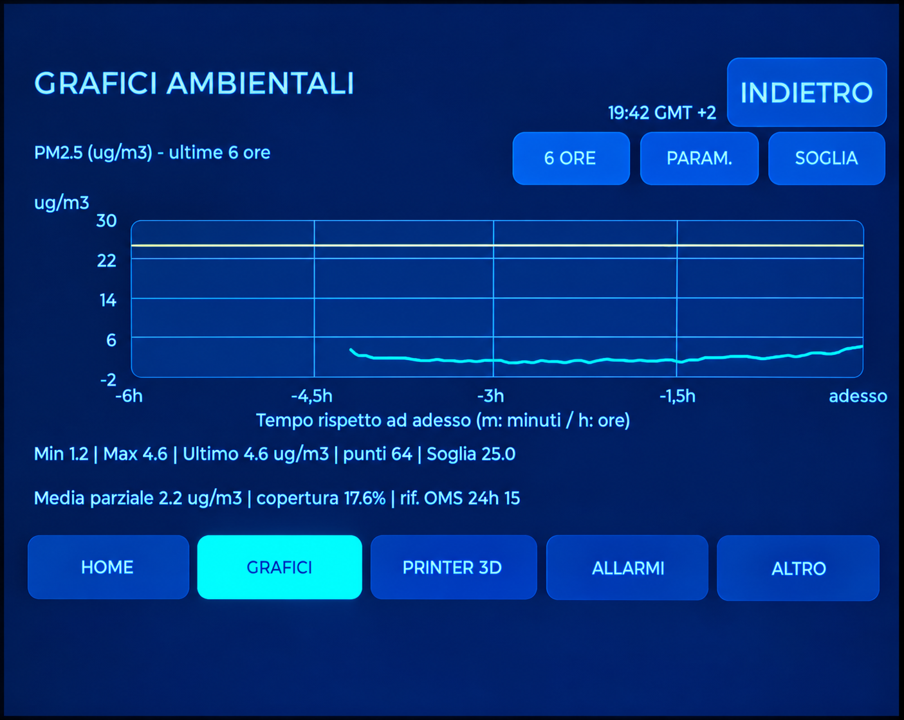
GUARDIAN INTERFACE
Charts: following the trends
Time windows
2, 6, 12 and 24-hour views, with a light grid and
integer labels on the vertical axis.
Information retained
The current reading, statistics and reference
information remain below the chart.
Relevant averages
PM2.5 and PM10: 24 hours. HCHO: 30 minutes.
Incomplete periods are identified.
Chart history uses volatile memory; microSD provides persistent recording. Averaging does not make the device a regulatory instrument.
05
GUARDIAN MAKERS / OCTOBER 2026
Notes:
GUARDIAN: presentazione prodotto. Fotografie fornite dal proprietario. Copertina elaborata fotograficamente, schermate aggiornate fornite dal proprietario; rete, credenziali e seriali sostituiti con dati dimostrativi. Fonti complete nelle slide finali e nel manuale: https://sensirion.com/resource/datasheet/SEN6x ; https://www.who.int/publications/i/item/9789240034228 ; https://www.who.int/publications-detail-redirect/9789289002134 ; https://www.epa.gov/chemical-research/3d-printing-research-epa . Dichiarazioni dei componenti non equivalgono a certificazione GUARDIAN.

Slide 6
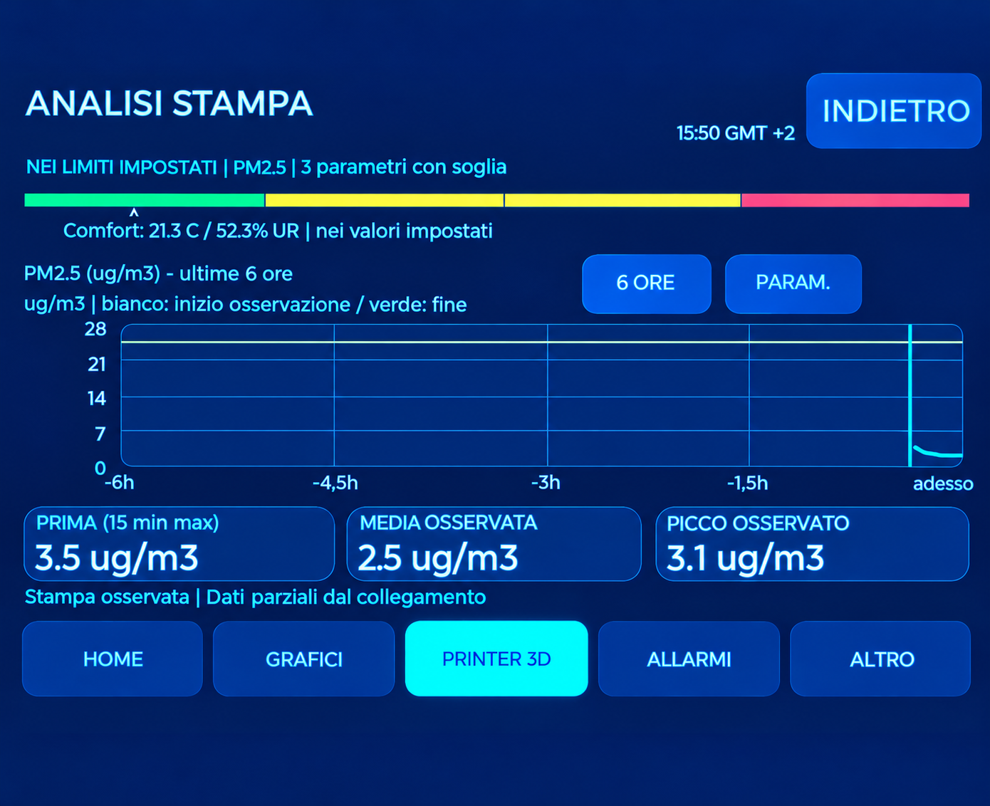
GUARDIAN INTERFACE
Printing in its environmental context
Before, during and peak
Compare the selected parameter with the
preceding period and the session readings.
Overall status
A bar summarises assessable parameters
against the configured thresholds.
Interpreting a correlation
Simultaneous changes do not prove the printer is
the only cause.
A session started after printing began, or containing data gaps, is identified as partial.
06
GUARDIAN MAKERS / OCTOBER 2026
Notes:
GUARDIAN: presentazione prodotto. Fotografie fornite dal proprietario. Copertina elaborata fotograficamente, schermate aggiornate fornite dal proprietario; rete, credenziali e seriali sostituiti con dati dimostrativi. Fonti complete nelle slide finali e nel manuale: https://sensirion.com/resource/datasheet/SEN6x ; https://www.who.int/publications/i/item/9789240034228 ; https://www.who.int/publications-detail-redirect/9789289002134 ; https://www.epa.gov/chemical-research/3d-printing-research-epa . Dichiarazioni dei componenti non equivalgono a certificazione GUARDIAN.

Slide 7
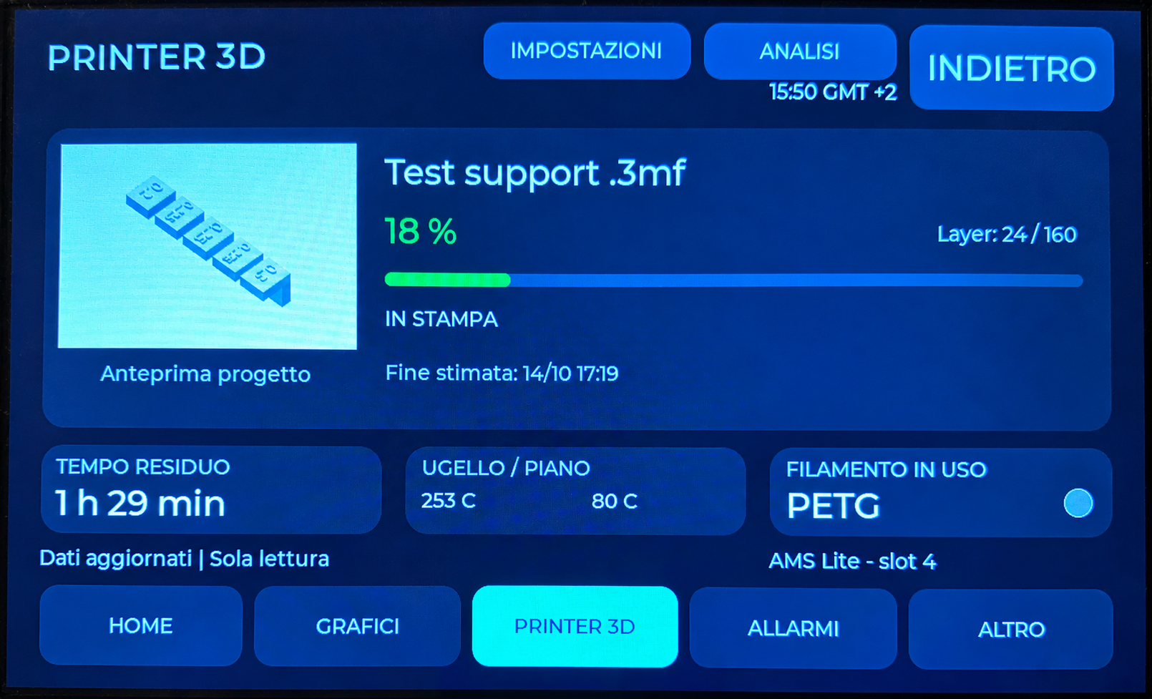
GUARDIAN INTERFACE
The complete PRINTER 3D page
Tested printer
One Bambu Lab A1 on the local network, configured
with its address, serial number and access code.
Print information
Preview, progress, layers, remaining time,
temperatures and filament, when available.
Data continuity
After a disconnection, retained readings remain
distinguishable from fresh data.
The connection is for monitoring: GUARDIAN does not stop the printer. Preview and job name depend on the data and file available on the A1.
07
GUARDIAN MAKERS / OCTOBER 2026
Notes:
GUARDIAN: presentazione prodotto. Fotografie fornite dal proprietario. Copertina elaborata fotograficamente, schermate aggiornate fornite dal proprietario; rete, credenziali e seriali sostituiti con dati dimostrativi. Fonti complete nelle slide finali e nel manuale: https://sensirion.com/resource/datasheet/SEN6x ; https://www.who.int/publications/i/item/9789240034228 ; https://www.who.int/publications-detail-redirect/9789289002134 ; https://www.epa.gov/chemical-research/3d-printing-research-epa . Dichiarazioni dei componenti non equivalgono a certificazione GUARDIAN.

Slide 8
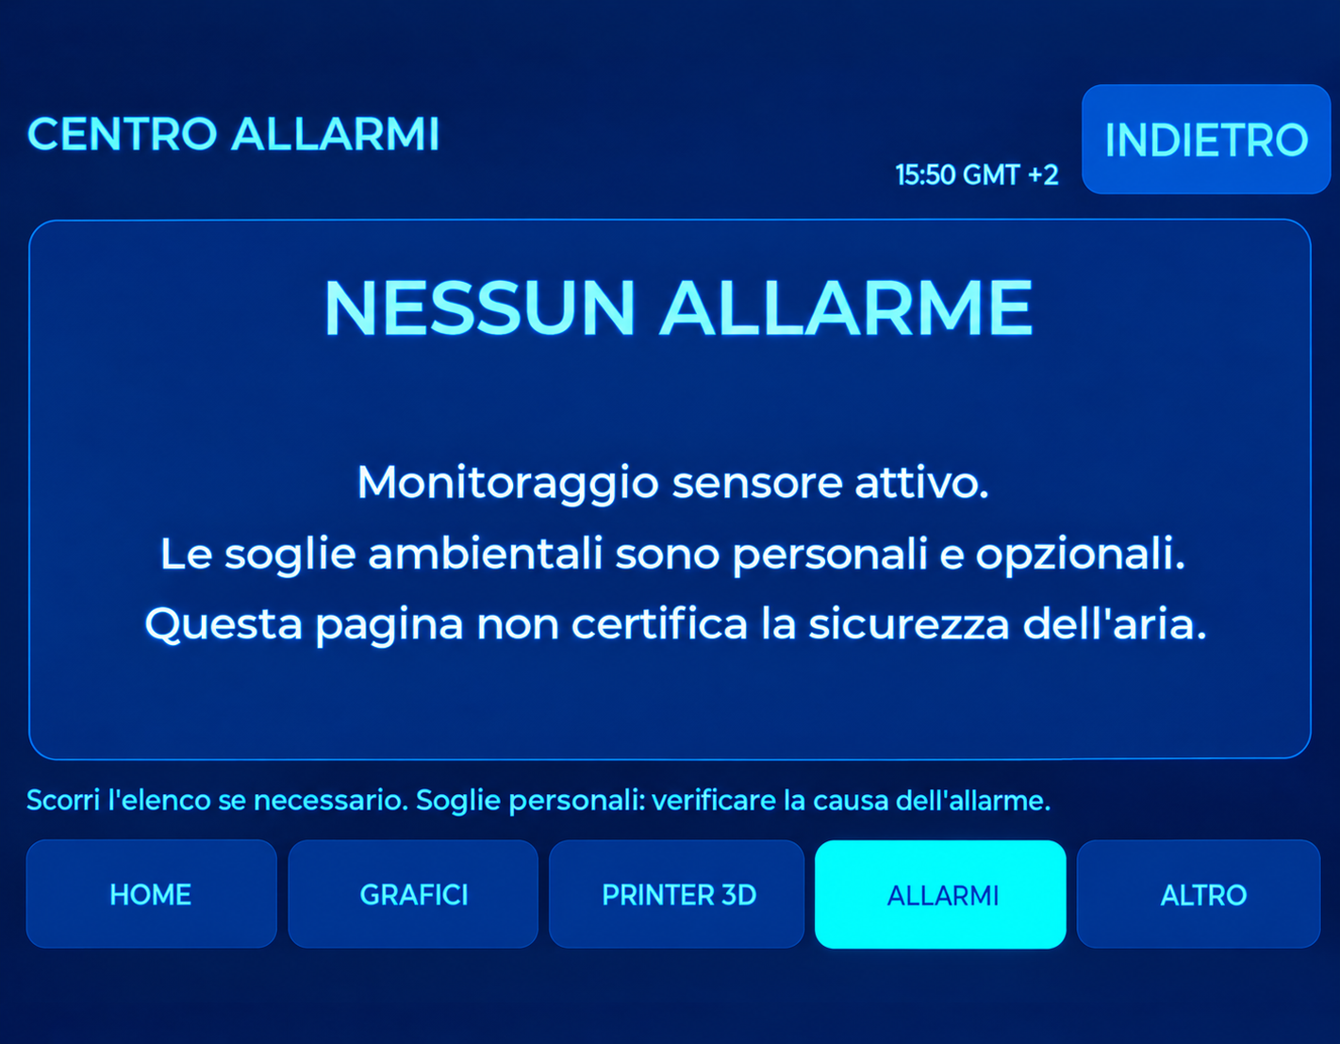
GUARDIAN INTERFACE
Alerts and comfort serve different purposes
Alert centre
Collects events and shows threshold
exceedances and conditions requiring attention.
Personal thresholds
User-defined operating values are not certified
health limits.
Comfort indication
Temperature or humidity outside the personal
range generates a comfort indication.
A normally switched-off or idle printer is not treated as a fault. Loss of data during a print is a separate condition.
08
GUARDIAN MAKERS / OCTOBER 2026
Notes:
GUARDIAN: presentazione prodotto. Fotografie fornite dal proprietario. Copertina elaborata fotograficamente, schermate aggiornate fornite dal proprietario; rete, credenziali e seriali sostituiti con dati dimostrativi. Fonti complete nelle slide finali e nel manuale: https://sensirion.com/resource/datasheet/SEN6x ; https://www.who.int/publications/i/item/9789240034228 ; https://www.who.int/publications-detail-redirect/9789289002134 ; https://www.epa.gov/chemical-research/3d-printing-research-epa . Dichiarazioni dei componenti non equivalgono a certificazione GUARDIAN.

Slide 9
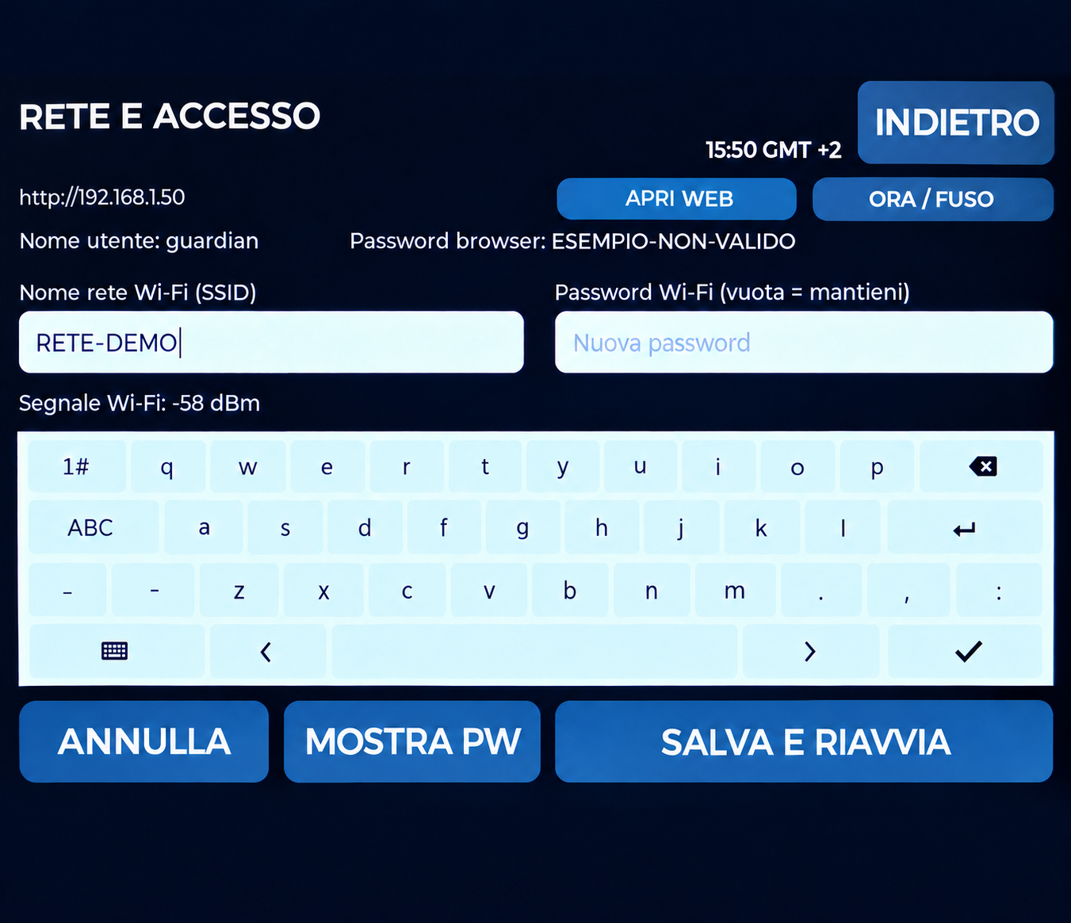
GUARDIAN INTERFACE
Viewing beyond the device
PC and smartphone
Browser access on the local network; remote
access through your network VPN.
Configuration
Network, time, lighting and the settings available
in the web interface.
Device identification
The NETWORK page shows the device address
and numerical Wi-Fi signal strength.
Anonymised photograph with example details. The local web service uses HTTP: do not expose it directly to the Internet.
09
GUARDIAN MAKERS / OCTOBER 2026
Notes:
GUARDIAN: presentazione prodotto. Fotografie fornite dal proprietario. Copertina elaborata fotograficamente, schermate aggiornate fornite dal proprietario; rete, credenziali e seriali sostituiti con dati dimostrativi. Fonti complete nelle slide finali e nel manuale: https://sensirion.com/resource/datasheet/SEN6x ; https://www.who.int/publications/i/item/9789240034228 ; https://www.who.int/publications-detail-redirect/9789289002134 ; https://www.epa.gov/chemical-research/3d-printing-research-epa . Dichiarazioni dei componenti non equivalgono a certificazione GUARDIAN.

Slide 10
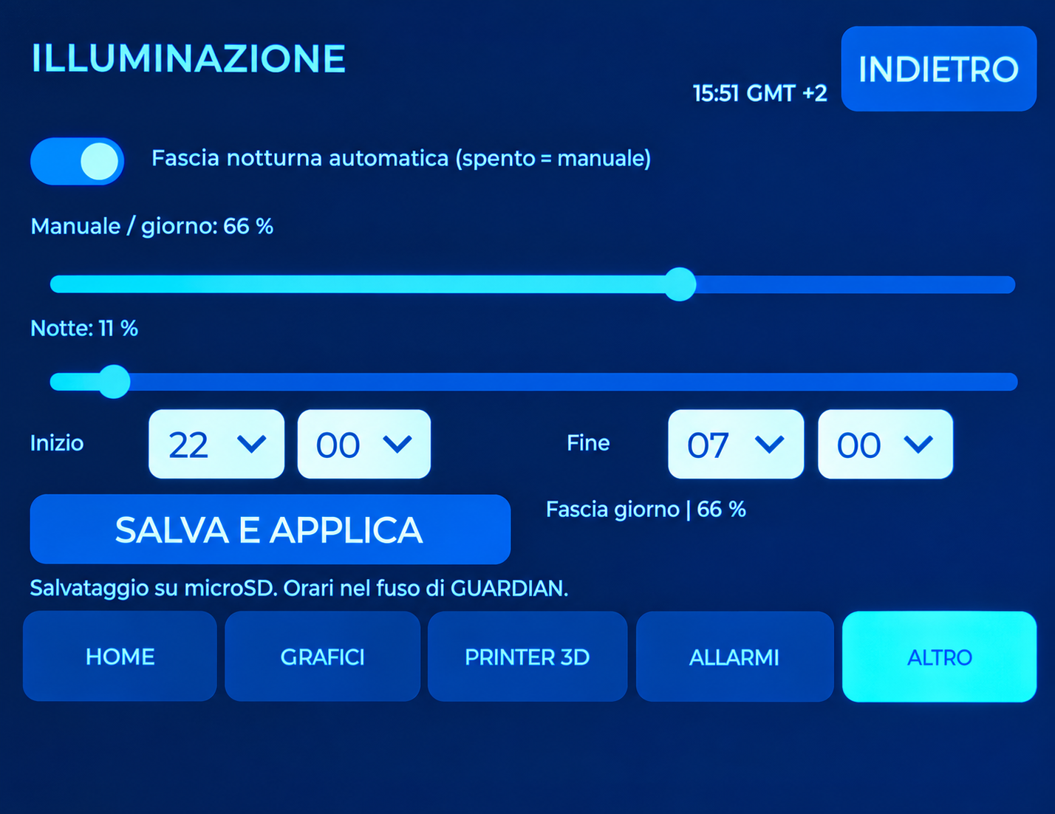
GUARDIAN INTERFACE
Lighting and time settings
Manual
Adjust brightness from the display or smartphone
browser.
Automatic
Day/night brightness with start and stop times,
including periods crossing midnight.
Time zone
Select a time-zone profile; daylight saving follows
the selected profile.
10
GUARDIAN MAKERS / OCTOBER 2026
Notes:
GUARDIAN: presentazione prodotto. Fotografie fornite dal proprietario. Copertina elaborata fotograficamente, schermate aggiornate fornite dal proprietario; rete, credenziali e seriali sostituiti con dati dimostrativi. Fonti complete nelle slide finali e nel manuale: https://sensirion.com/resource/datasheet/SEN6x ; https://www.who.int/publications/i/item/9789240034228 ; https://www.who.int/publications-detail-redirect/9789289002134 ; https://www.epa.gov/chemical-research/3d-printing-research-epa . Dichiarazioni dei componenti non equivalgono a certificazione GUARDIAN.

Slide 11
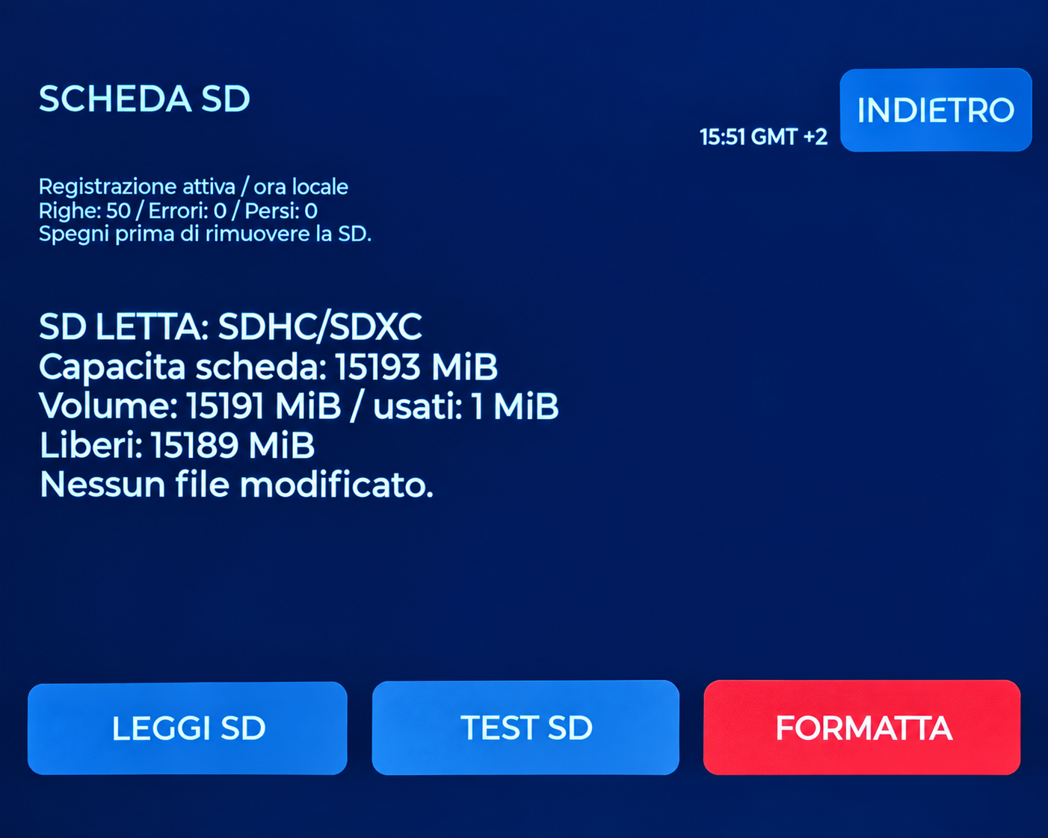
GUARDIAN INTERFACE
Keeping a record of the data
microSD
Periodic CSV recording with units and session
context.
Browser download
A dedicated current-CSV link and subsequent
pages for historical files.
Local management
Read, test and format the card, with explicit
confirmation.
FORMAT erases every file on the microSD card.
11
GUARDIAN MAKERS / OCTOBER 2026
Notes:
GUARDIAN: presentazione prodotto. Fotografie fornite dal proprietario. Copertina elaborata fotograficamente, schermate aggiornate fornite dal proprietario; rete, credenziali e seriali sostituiti con dati dimostrativi. Fonti complete nelle slide finali e nel manuale: https://sensirion.com/resource/datasheet/SEN6x ; https://www.who.int/publications/i/item/9789240034228 ; https://www.who.int/publications-detail-redirect/9789289002134 ; https://www.epa.gov/chemical-research/3d-printing-research-epa . Dichiarazioni dei componenti non equivalgono a certificazione GUARDIAN.

Slide 12
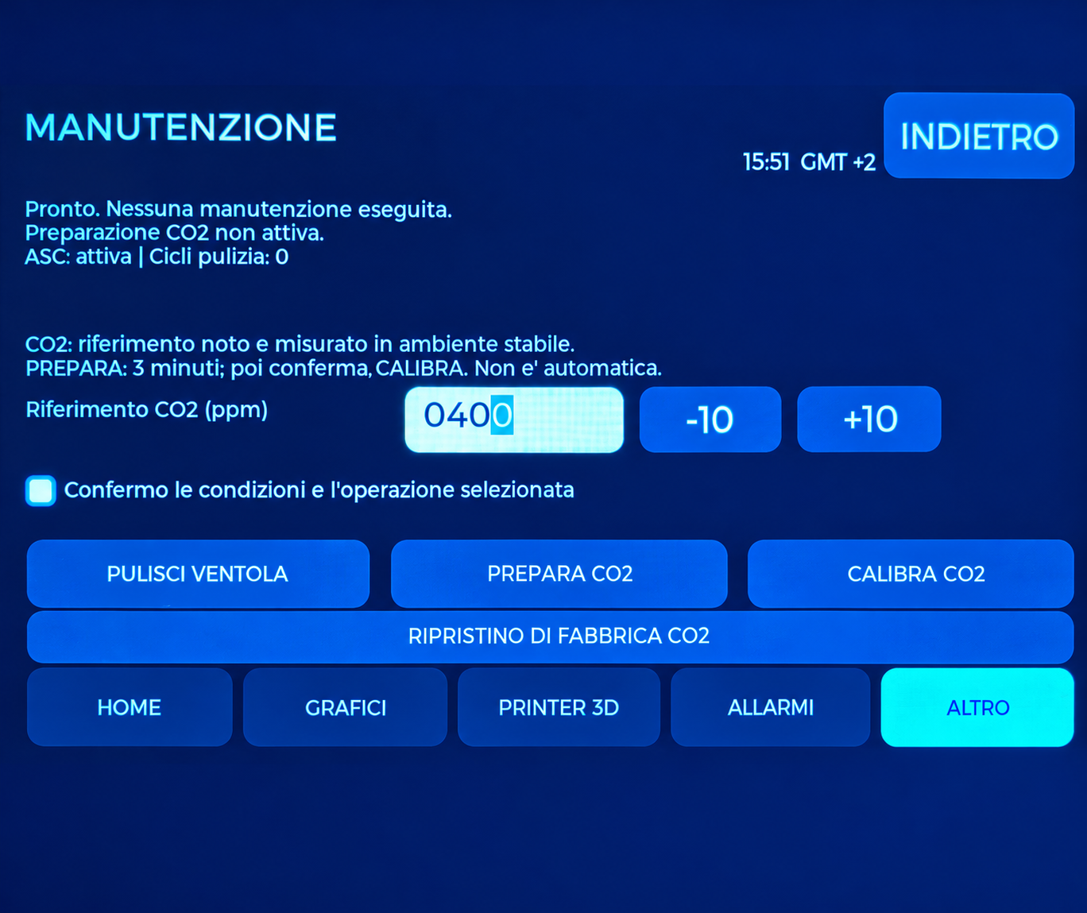
GUARDIAN INTERFACE
Maintenance controls
Fan cleaning
A dedicated command reports procedure status
and resumes measurements.
CO2
Preparation is separate from calibration, which
requires a reliable reference.
Separate reset functions
CO2 reset, GUARDIAN reset and SD formatting
have different effects.
The availability of a command does not establish accuracy after it runs. Follow the manufacturer’s conditions and the manual.
12
GUARDIAN MAKERS / OCTOBER 2026
Notes:
GUARDIAN: presentazione prodotto. Fotografie fornite dal proprietario. Copertina elaborata fotograficamente, schermate aggiornate fornite dal proprietario; rete, credenziali e seriali sostituiti con dati dimostrativi. Fonti complete nelle slide finali e nel manuale: https://sensirion.com/resource/datasheet/SEN6x ; https://www.who.int/publications/i/item/9789240034228 ; https://www.who.int/publications-detail-redirect/9789289002134 ; https://www.epa.gov/chemical-research/3d-printing-research-epa . Dichiarazioni dei componenti non equivalgono a certificazione GUARDIAN.

Slide 13
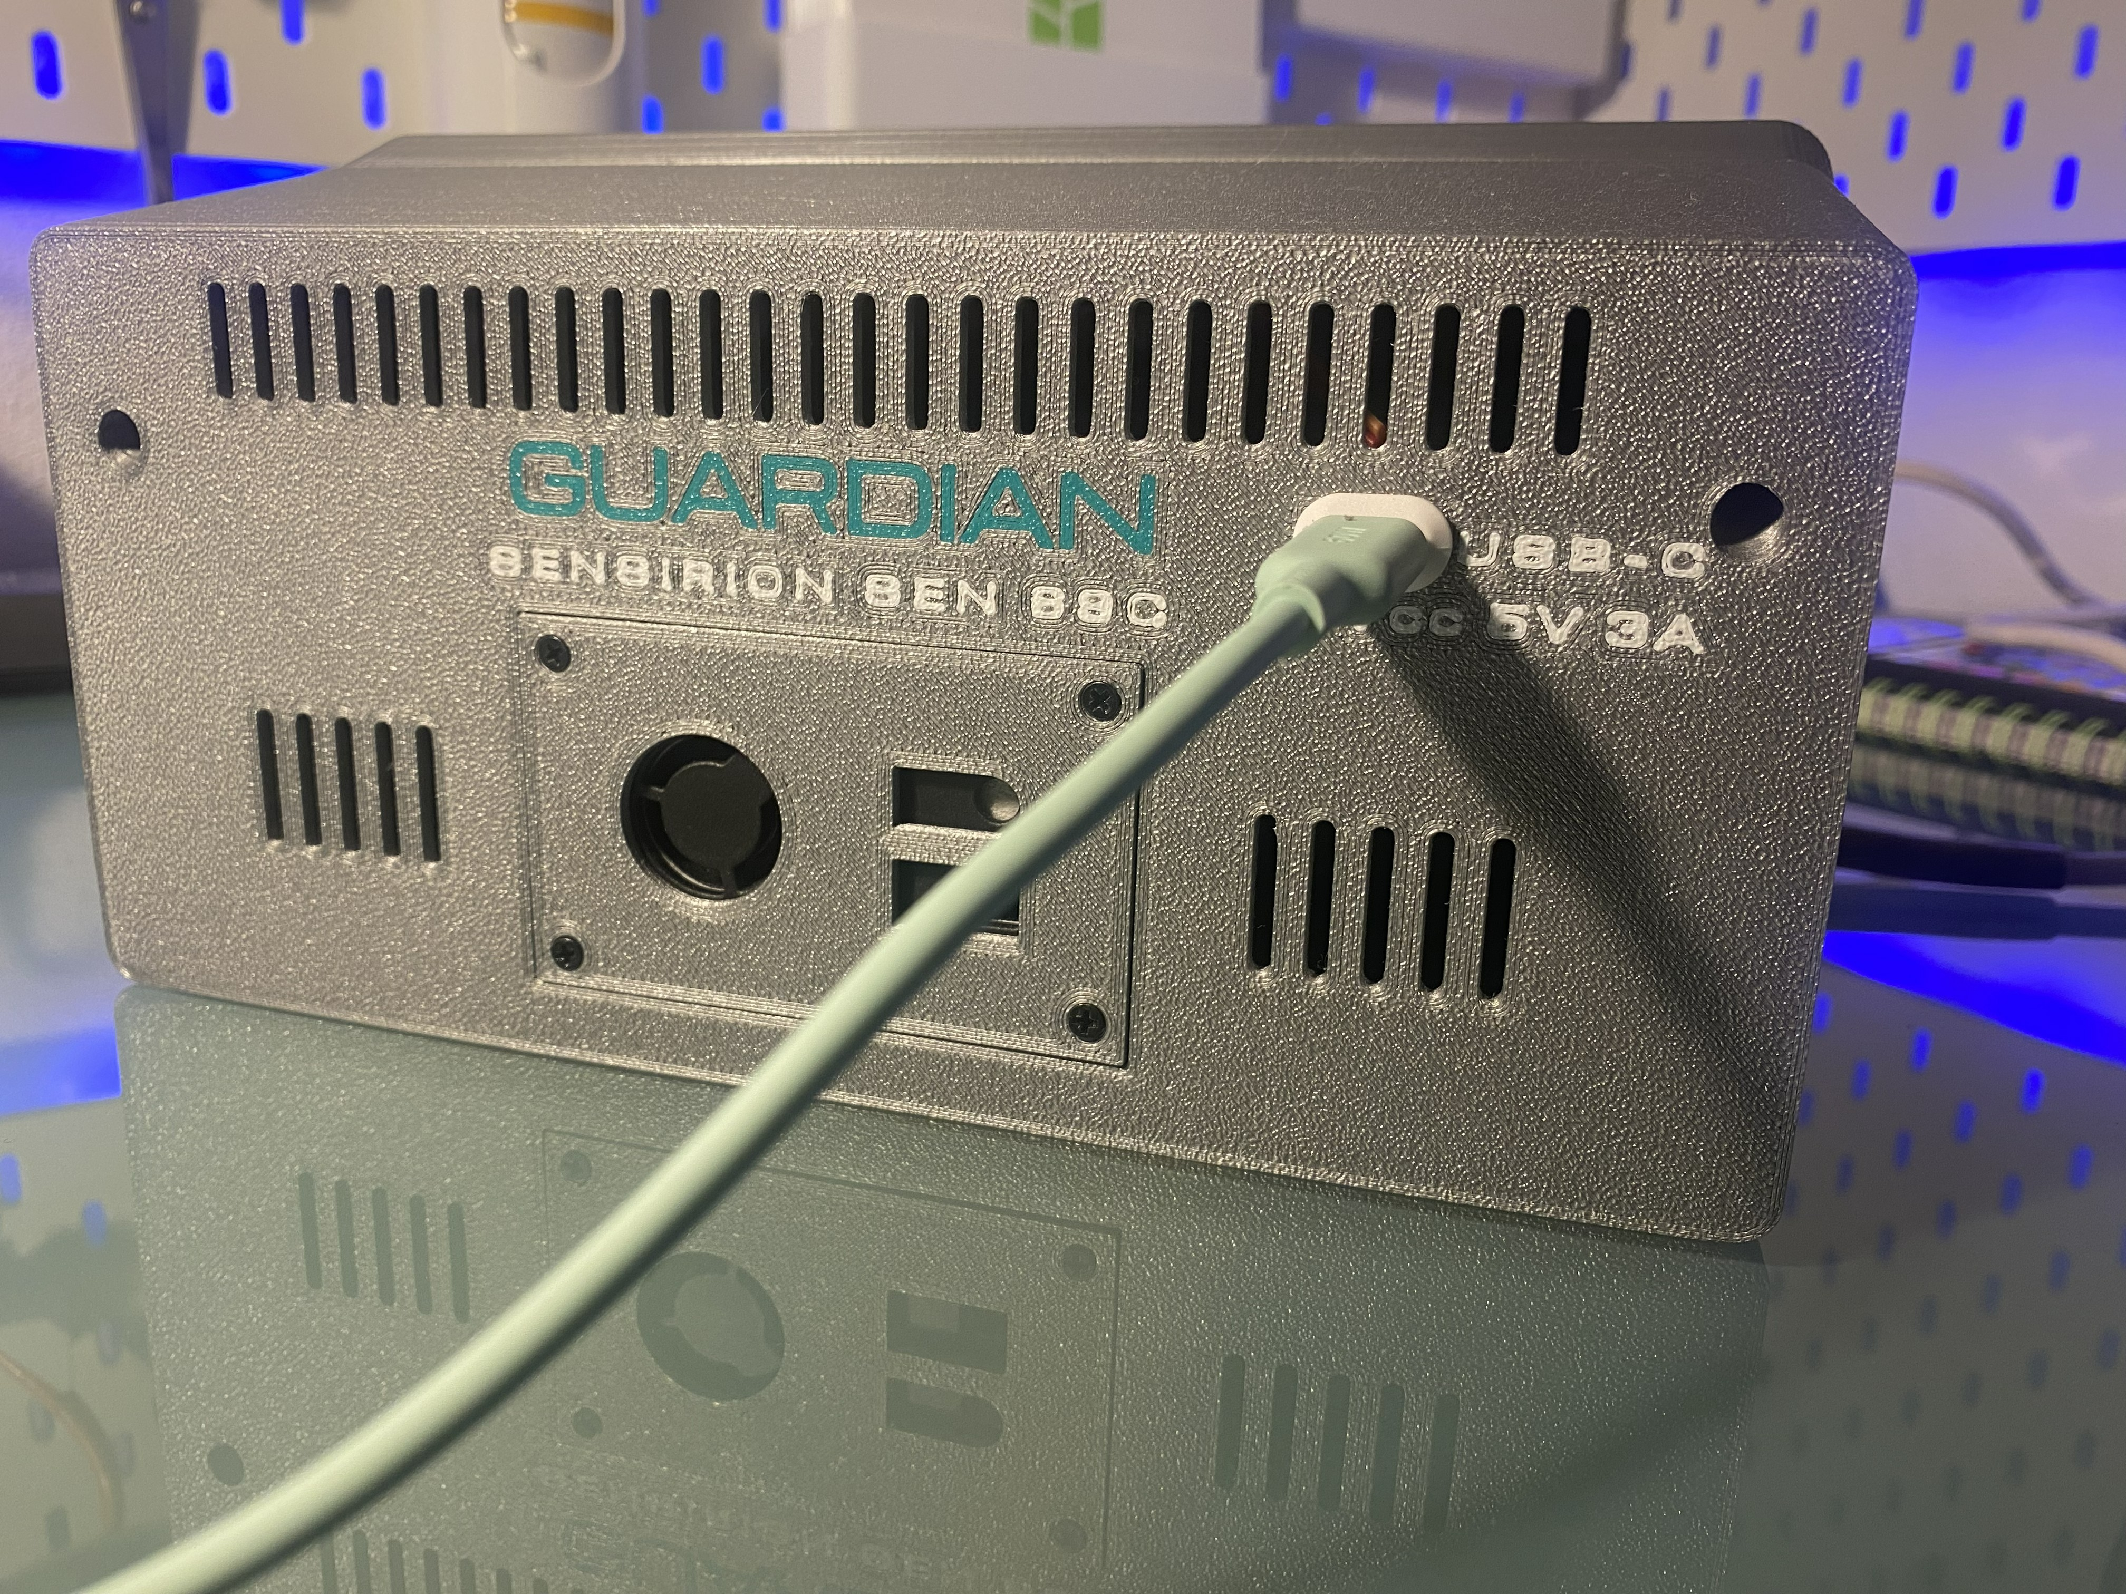
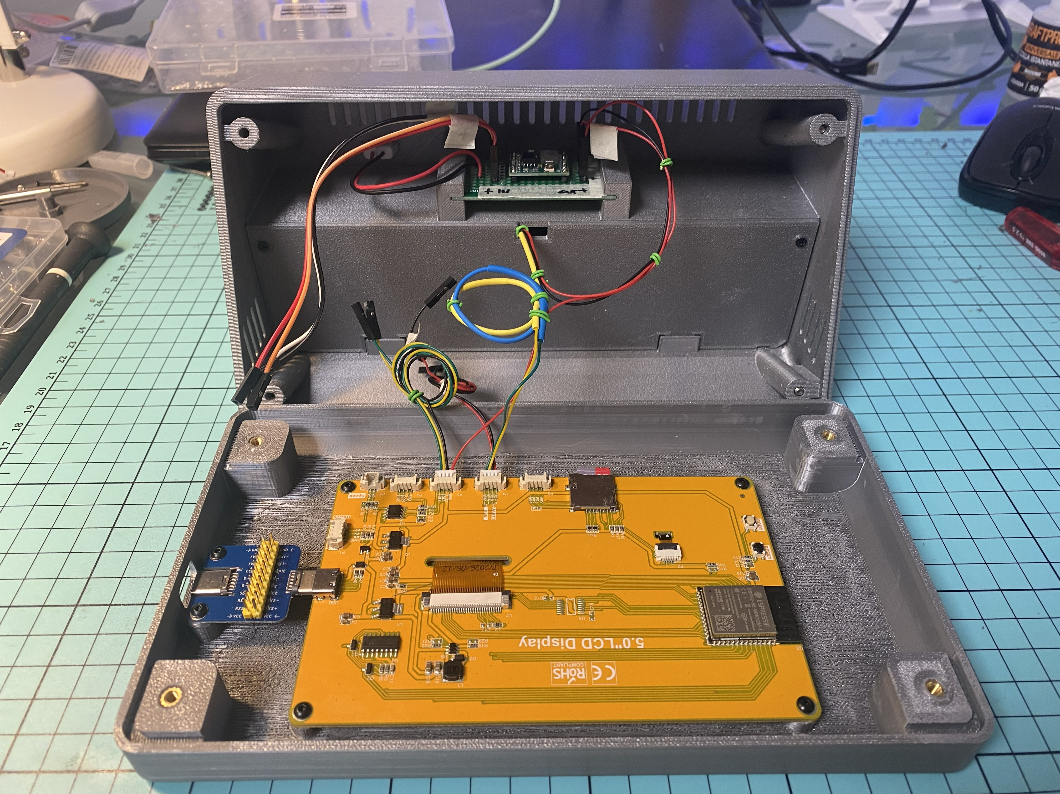
CONSTRUCTION
Accessible and serviceable
Two USB-C access points
Rear socket for power; side socket for programming, protected by a TPU cap.
Sensor and electronics compartments
Rear-mounted SEN69C, removable support and internal partition. Keep the airflow paths clear and separate.
13
GUARDIAN MAKERS / OCTOBER 2026
Notes:
GUARDIAN: presentazione prodotto. Fotografie fornite dal proprietario. Copertina elaborata fotograficamente, schermate aggiornate fornite dal proprietario; rete, credenziali e seriali sostituiti con dati dimostrativi. Fonti complete nelle slide finali e nel manuale: https://sensirion.com/resource/datasheet/SEN6x ; https://www.who.int/publications/i/item/9789240034228 ; https://www.who.int/publications-detail-redirect/9789289002134 ; https://www.epa.gov/chemical-research/3d-printing-research-epa . Dichiarazioni dei componenti non equivalgono a certificazione GUARDIAN.

Slide 14
MEASUREMENTS, AVERAGES AND LIMITS
Understanding the references
Indication | Reference | Correct use
PM2.5 | WHO 2021: 15 µg/m³ / 24 h | Complete after 24 hours of valid recording; earlier averages are partial.
PM10 | WHO 2021: 45 µg/m³ / 24 h | Complete after 24 hours of valid recording; earlier averages are partial.
HCHO | WHO 2010: 0.1 mg/m³ / 30 min | About 81 ppb at 25 °C and 1 atm; conversion depends on conditions.
CO2, VOC, NOx | Ventilation / relative indices | They do not detect every pollutant or establish safe air on their own.
S6, S7, S10. WHO guidelines do not certify GUARDIAN or replace assessment of occupational exposure.
14
GUARDIAN MAKERS / OCTOBER 2026
Notes:
GUARDIAN: presentazione prodotto. Fotografie fornite dal proprietario. Copertina elaborata fotograficamente, schermate aggiornate fornite dal proprietario; rete, credenziali e seriali sostituiti con dati dimostrativi. Fonti complete nelle slide finali e nel manuale: https://sensirion.com/resource/datasheet/SEN6x ; https://www.who.int/publications/i/item/9789240034228 ; https://www.who.int/publications-detail-redirect/9789289002134 ; https://www.epa.gov/chemical-research/3d-printing-research-epa . Dichiarazioni dei componenti non equivalgono a certificazione GUARDIAN.

Slide 15
USE AND LIMITATIONS
Interpreting measurements correctly
Continuous monitoring
GUARDIAN combines environmental readings, history, microSD recording, web access and printer information in one interface.
Accuracy and operating conditions
Readings also depend on placement, ventilation and thermal conditions. Independent metrological validation of the complete device
is not available.
Limits that remain relevant
Optical PM does not directly measure the entire ultrafine fraction. Gas indices do not identify every compound. Low readings do not
automatically mean safe air. [S1, S8, S9]
15
GUARDIAN MAKERS / OCTOBER 2026
Notes:
GUARDIAN: presentazione prodotto. Fotografie fornite dal proprietario. Copertina elaborata fotograficamente, schermate aggiornate fornite dal proprietario; rete, credenziali e seriali sostituiti con dati dimostrativi. Fonti complete nelle slide finali e nel manuale: https://sensirion.com/resource/datasheet/SEN6x ; https://www.who.int/publications/i/item/9789240034228 ; https://www.who.int/publications-detail-redirect/9789289002134 ; https://www.epa.gov/chemical-research/3d-printing-research-epa . Dichiarazioni dei componenti non equivalgono a certificazione GUARDIAN.

Slide 16
TECHNICAL DOCUMENTATION
Calibration and conformity
Sensirion statement
Sensirion states that each device in the listed families, including SEN69C, is individually tested after calibration. The statement covers
SEN5x/SEN6x particulate-matter sensors; the original is attached to the manual. It is not an individual GUARDIAN calibration report or
certification of all its channels. [S2]
The complete product
Component REACH/RoHS documents contribute to the technical file; they are not a declaration of conformity for the whole device. [S16]
Before any commercial distribution
Determine the obligations applicable to the finished product and assess safety, radio/EMC and documentation. RED, RoHS, WEEE and
REACH are references to assess; no completed certification is claimed here. [S11–S15]
16
GUARDIAN MAKERS / OCTOBER 2026
Notes:
GUARDIAN: presentazione prodotto. Fotografie fornite dal proprietario. Copertina elaborata fotograficamente, schermate aggiornate fornite dal proprietario; rete, credenziali e seriali sostituiti con dati dimostrativi. Fonti complete nelle slide finali e nel manuale: https://sensirion.com/resource/datasheet/SEN6x ; https://www.who.int/publications/i/item/9789240034228 ; https://www.who.int/publications-detail-redirect/9789289002134 ; https://www.epa.gov/chemical-research/3d-printing-research-epa . Dichiarazioni dei componenti non equivalgono a certificazione GUARDIAN.

Slide 17
OCTOBER 2026 EDITION
Display lighting: validated update
25 kHz backlight PWM
The owner confirmed that the 5 kHz whine disappeared after the change to 25 kHz. Manual brightness and the automatic day/night schedule
were tested successfully.
Version identification
This edition describes bilingual GUARDIAN with the 25 kHz modification. The tested sketch is labelled 1.0.0-rc3-pwm25-test1; this identifier
may still appear on the device and in the browser.
Settings and updates
Brightness remains adjustable from the display and browser. This change requires neither a factory reset nor microSD formatting.
Scope of testing
Functional checks on the owner’s prototype support retaining this setting. They do not constitute metrological validation or certification of the
complete product.
17
GUARDIAN MAKERS / OCTOBER 2026
Notes:
GUARDIAN: presentazione prodotto. Fotografie fornite dal proprietario. Copertina elaborata fotograficamente, schermate aggiornate fornite dal proprietario; rete, credenziali e seriali sostituiti con dati dimostrativi. Fonti complete nelle slide finali e nel manuale: https://sensirion.com/resource/datasheet/SEN6x ; https://www.who.int/publications/i/item/9789240034228 ; https://www.who.int/publications-detail-redirect/9789289002134 ; https://www.epa.gov/chemical-research/3d-printing-research-epa . Dichiarazioni dei componenti non equivalgono a certificazione GUARDIAN.

Slide 18
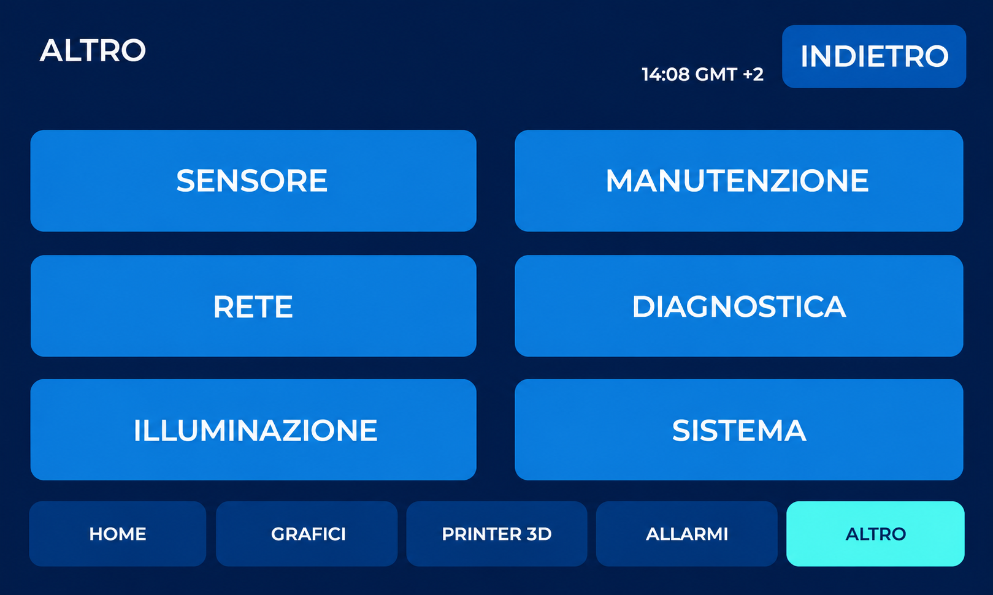
DISPLAY CONTROLS
The OTHER menu
Select SYSTEM (SISTEMA) to choose the language or access restart and reset.
Retouched from the supplied photograph: reflections removed and perspective corrected. Original labels and controls retained.
18
GUARDIAN MAKERS / OCTOBER 2026
Notes:
GUARDIAN: presentazione prodotto. Fotografie fornite dal proprietario. Copertina elaborata fotograficamente, schermate aggiornate fornite dal proprietario; rete, credenziali e seriali sostituiti con dati dimostrativi. Fonti complete nelle slide finali e nel manuale: https://sensirion.com/resource/datasheet/SEN6x ; https://www.who.int/publications/i/item/9789240034228 ; https://www.who.int/publications-detail-redirect/9789289002134 ; https://www.epa.gov/chemical-research/3d-printing-research-epa . Dichiarazioni dei componenti non equivalgono a certificazione GUARDIAN.

Slide 19
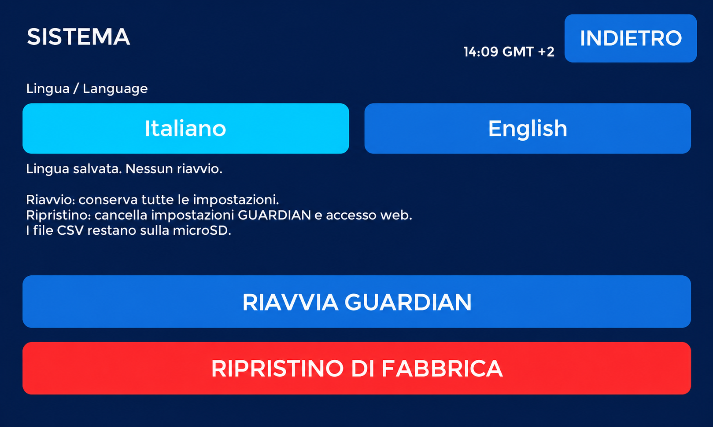
DISPLAY CONTROLS
System and interface language
Choose Italiano or English: the language is saved without restarting. RESTART keeps settings; FACTORY RESET clears GUARDIAN settings and web
access. CSV files remain on microSD.
Retouched from the supplied photograph: reflections removed and perspective corrected. Original labels and controls retained.
19
GUARDIAN MAKERS / OCTOBER 2026
Notes:
GUARDIAN: presentazione prodotto. Fotografie fornite dal proprietario. Copertina elaborata fotograficamente, schermate aggiornate fornite dal proprietario; rete, credenziali e seriali sostituiti con dati dimostrativi. Fonti complete nelle slide finali e nel manuale: https://sensirion.com/resource/datasheet/SEN6x ; https://www.who.int/publications/i/item/9789240034228 ; https://www.who.int/publications-detail-redirect/9789289002134 ; https://www.epa.gov/chemical-research/3d-printing-research-epa . Dichiarazioni dei componenti non equivalgono a certificazione GUARDIAN.

Slide 20
INTERFACE LANGUAGE
Italian and English on the same device
Selection on the display
OTHER → SYSTEM: choose Italiano or English. The choice is saved without restarting. With no saved preference, the initial language is
Italian.
PC and smartphone
They follow the display language by reloading within about three seconds while reachable. Save open forms before changing language.
After restarting
The choice is retained. A GUARDIAN factory reset restores Italian. Job names, user-entered data and the CSV format remain unchanged.
20
GUARDIAN MAKERS / OCTOBER 2026
Notes:
GUARDIAN: presentazione prodotto. Fotografie fornite dal proprietario. Copertina elaborata fotograficamente, schermate aggiornate fornite dal proprietario; rete, credenziali e seriali sostituiti con dati dimostrativi. Fonti complete nelle slide finali e nel manuale: https://sensirion.com/resource/datasheet/SEN6x ; https://www.who.int/publications/i/item/9789240034228 ; https://www.who.int/publications-detail-redirect/9789289002134 ; https://www.epa.gov/chemical-research/3d-printing-research-epa . Dichiarazioni dei componenti non equivalgono a certificazione GUARDIAN.

Slide 21
IMAGE CONTEXT
Real readings and compatibility
24 hours for a complete average
A complete PM2.5 / PM10 average requires 24 hours of valid recording. Earlier averages cover only the available period and are partial. HCHO
uses a separate 30-minute period.
Photographs and demonstrations
Display photographs show real readings collected over partial periods, not complete 24-hour averages. Network details and credentials are
examples. Firmware reconstructions are identified separately.
Printer used for testing
Testing used a Bambu Lab A1. GUARDIAN uses Bambu Lab protocols; other models require verification. Other brands require investigation
and possible adaptation.
Bilingual edition
This documentation describes the Italian and English interface. The owner reports successful initial functional testing; software testing is not
metrological validation.
21
GUARDIAN MAKERS / OCTOBER 2026
Notes:
GUARDIAN: presentazione prodotto. Fotografie fornite dal proprietario. Copertina elaborata fotograficamente, schermate aggiornate fornite dal proprietario; rete, credenziali e seriali sostituiti con dati dimostrativi. Fonti complete nelle slide finali e nel manuale: https://sensirion.com/resource/datasheet/SEN6x ; https://www.who.int/publications/i/item/9789240034228 ; https://www.who.int/publications-detail-redirect/9789289002134 ; https://www.epa.gov/chemical-research/3d-printing-research-epa . Dichiarazioni dei componenti non equivalgono a certificazione GUARDIAN.

Slide 22
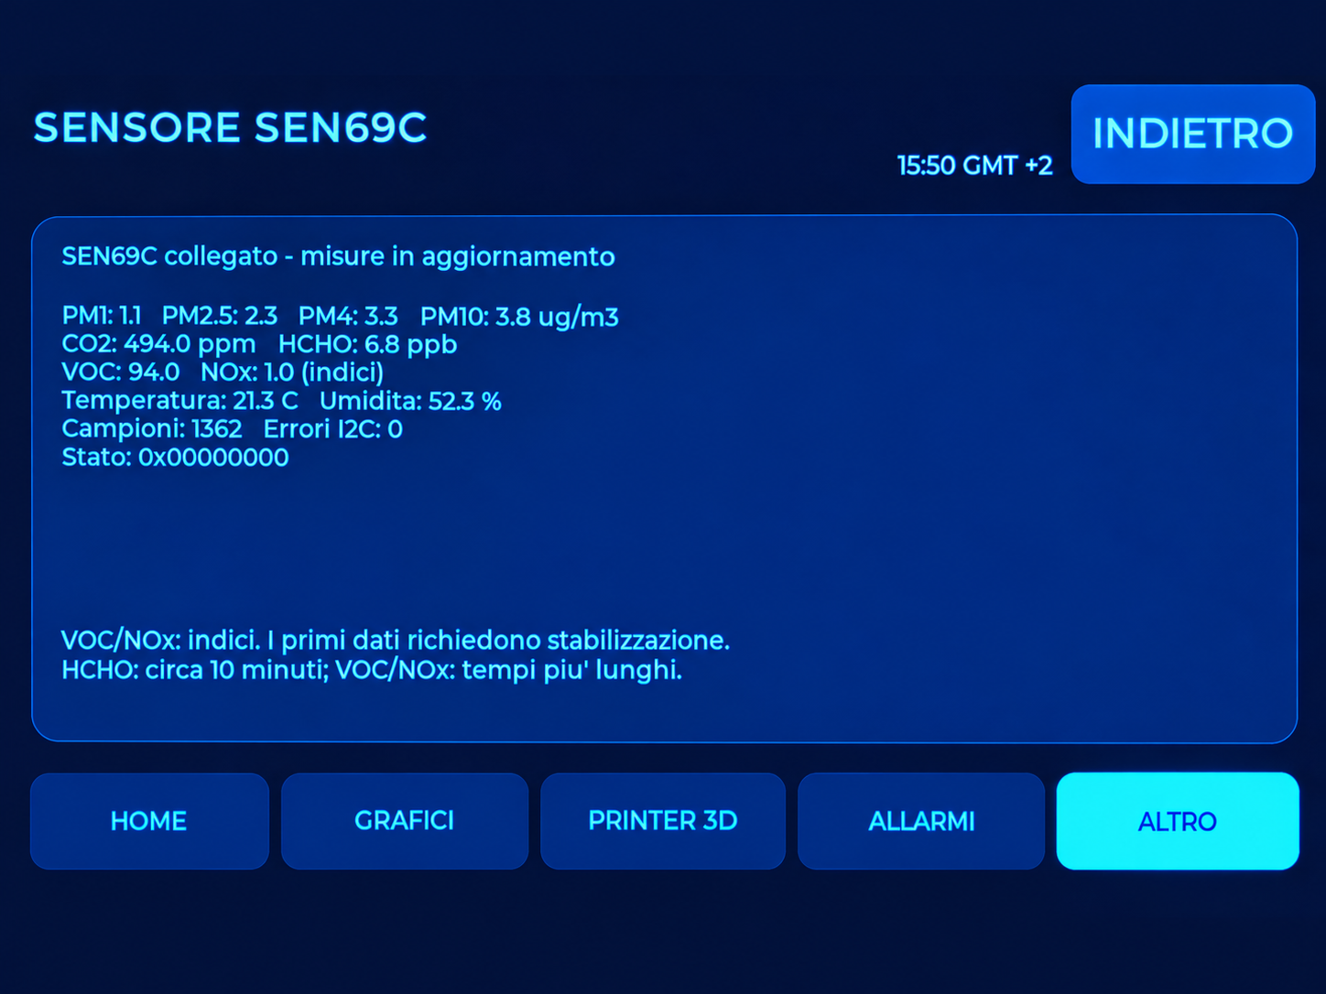
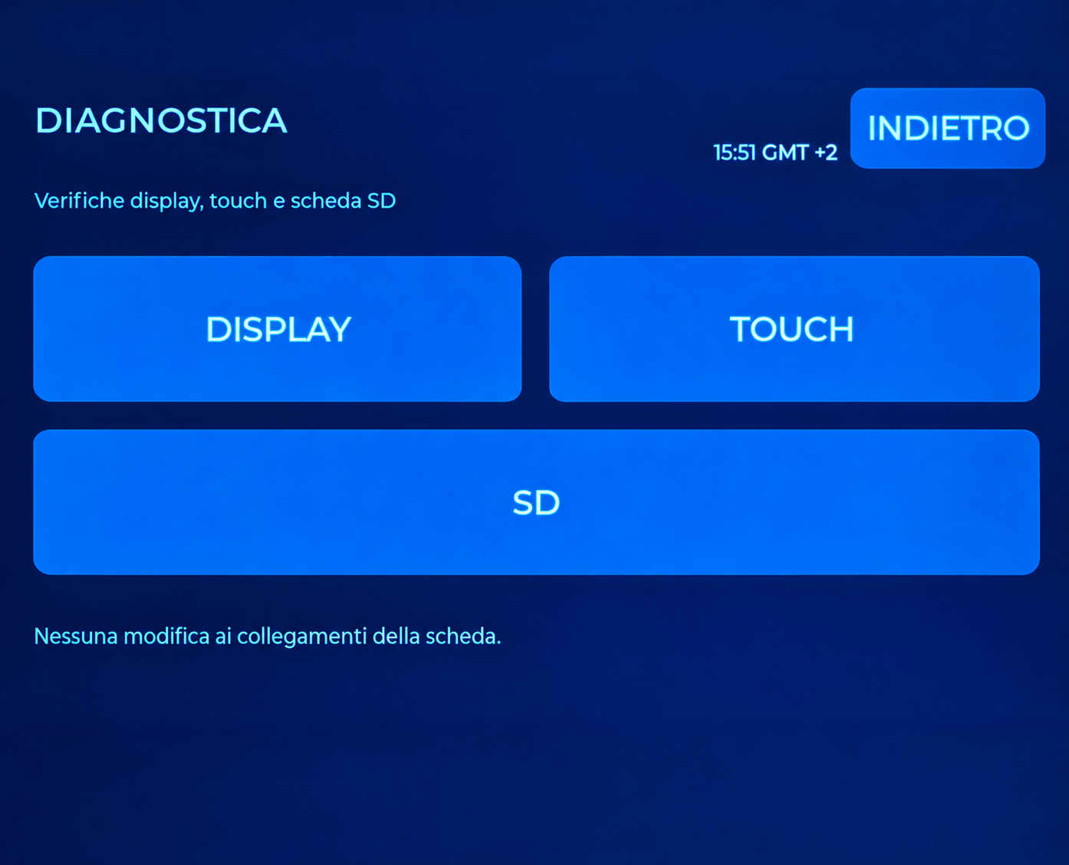
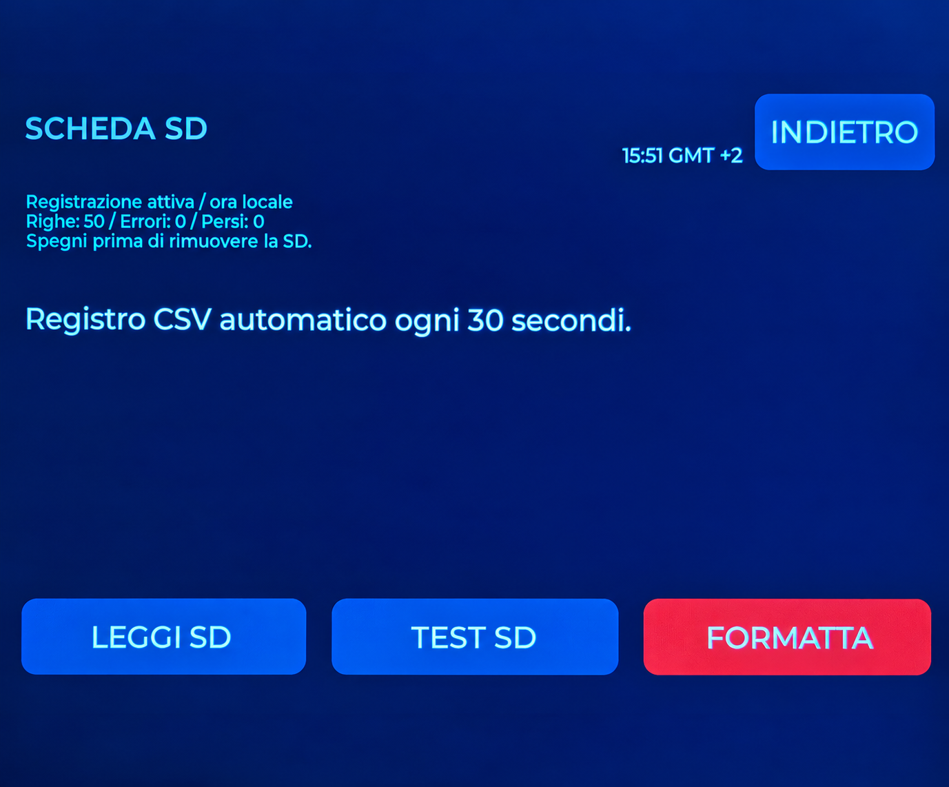
SCREEN ATLAS
Other service screens
OTHER
SENSOR
Access to additional functions.
Module presence and status information.
DIAGNOSTICS
SD CARD
Display, touch and SD tests.
Recording status and local commands.
22
GUARDIAN MAKERS / OCTOBER 2026
Notes:
GUARDIAN: presentazione prodotto. Fotografie fornite dal proprietario. Copertina elaborata fotograficamente, schermate aggiornate fornite dal proprietario; rete, credenziali e seriali sostituiti con dati dimostrativi. Fonti complete nelle slide finali e nel manuale: https://sensirion.com/resource/datasheet/SEN6x ; https://www.who.int/publications/i/item/9789240034228 ; https://www.who.int/publications-detail-redirect/9789289002134 ; https://www.epa.gov/chemical-research/3d-printing-research-epa . Dichiarazioni dei componenti non equivalgono a certificazione GUARDIAN.

Slide 23
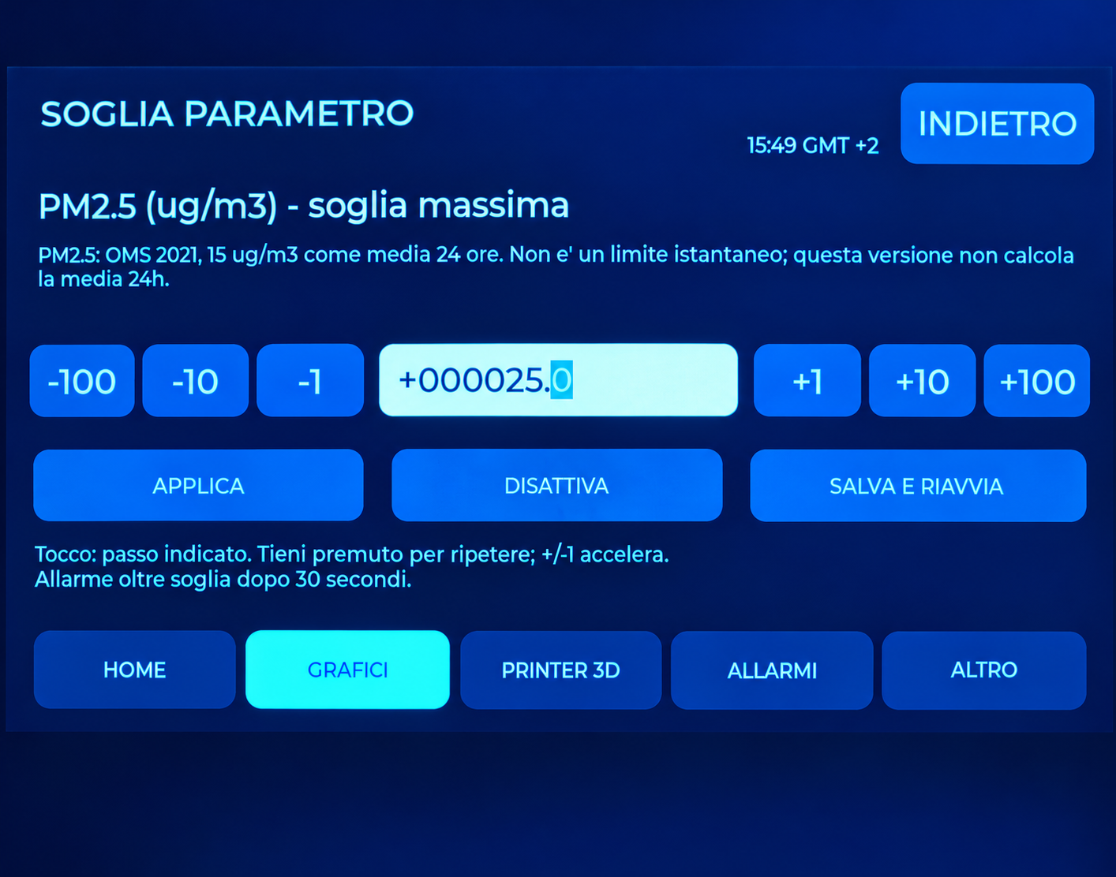
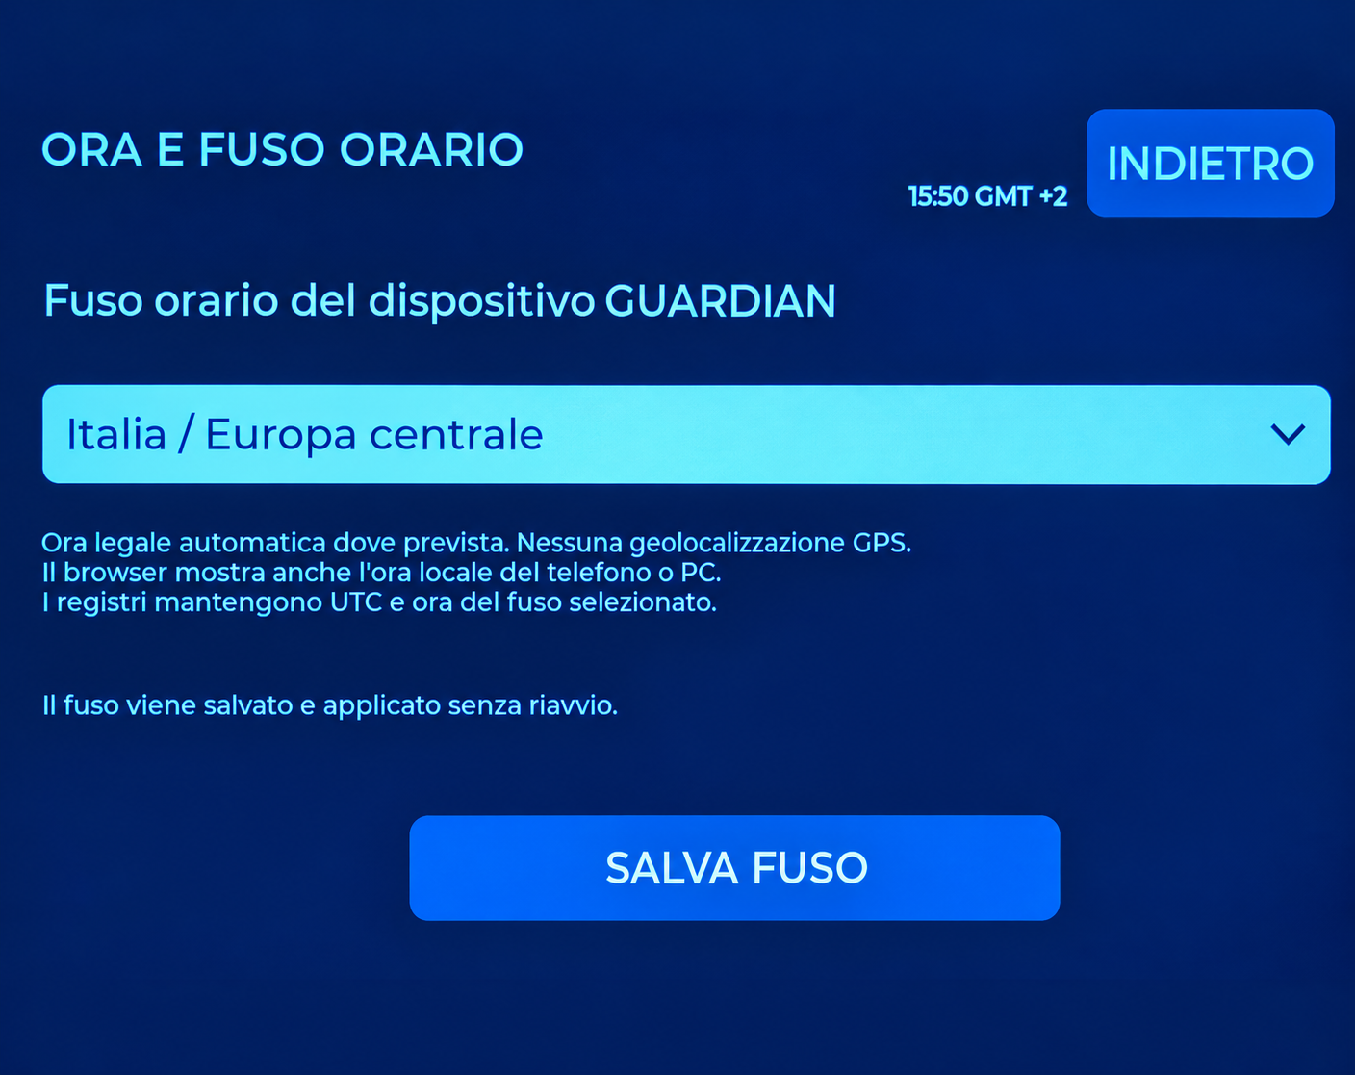
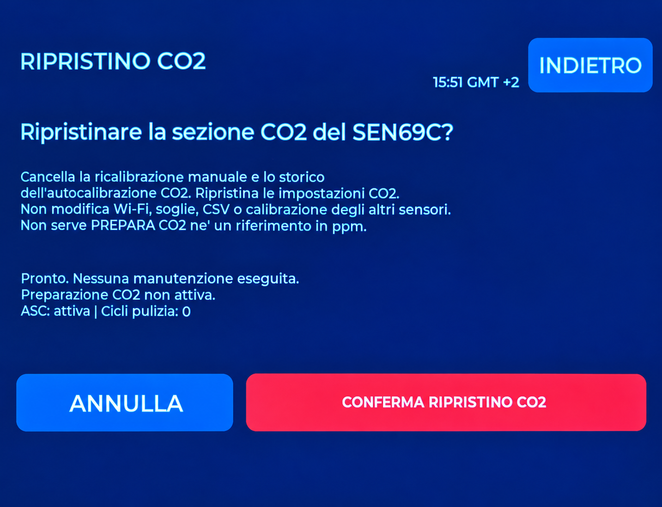
SCREEN ATLAS
Controls and configuration
PARAMETER THRESHOLD
TIME AND TIME ZONE
Set a personal operating threshold.
Geographical clock profile.
CO2 RESET
SYSTEM
Separate confirmation for the CO2 channel.
Restart or reset GUARDIAN.
23
GUARDIAN MAKERS / OCTOBER 2026
Notes:
GUARDIAN: presentazione prodotto. Fotografie fornite dal proprietario. Copertina elaborata fotograficamente, schermate aggiornate fornite dal proprietario; rete, credenziali e seriali sostituiti con dati dimostrativi. Fonti complete nelle slide finali e nel manuale: https://sensirion.com/resource/datasheet/SEN6x ; https://www.who.int/publications/i/item/9789240034228 ; https://www.who.int/publications-detail-redirect/9789289002134 ; https://www.epa.gov/chemical-research/3d-printing-research-epa . Dichiarazioni dei componenti non equivalgono a certificazione GUARDIAN.

Slide 24
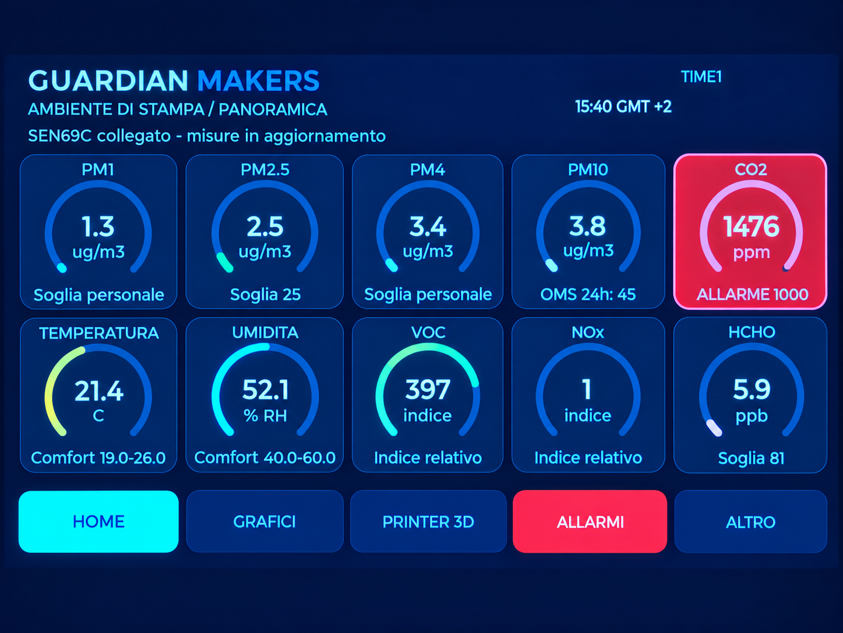
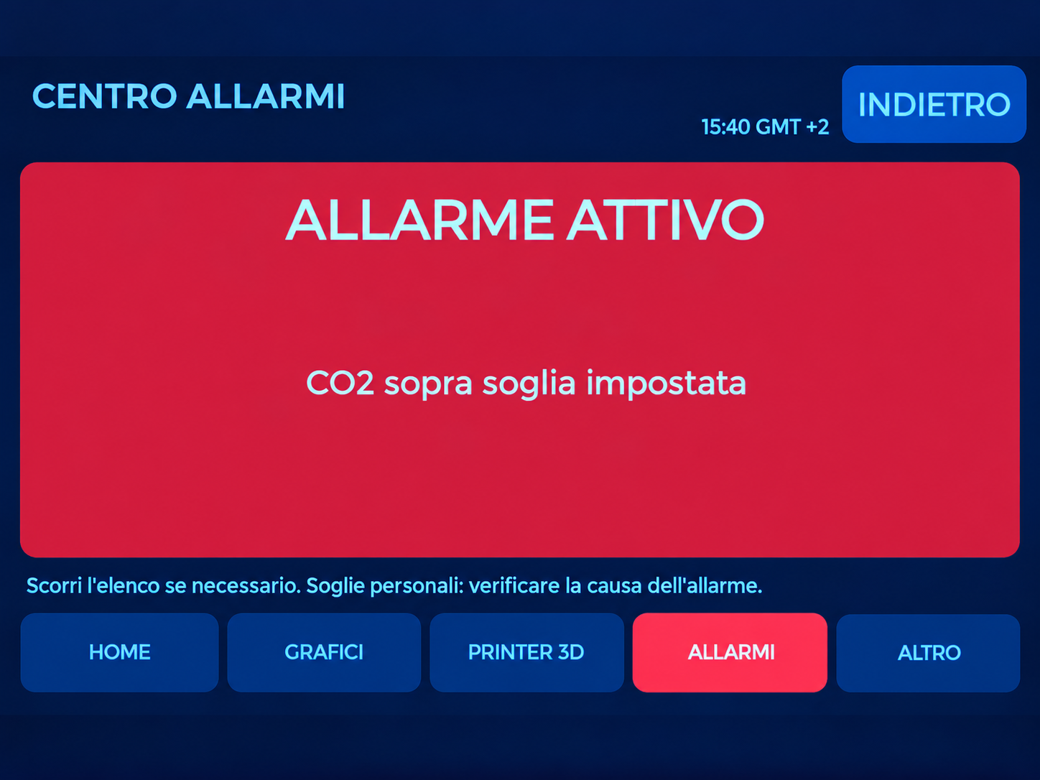
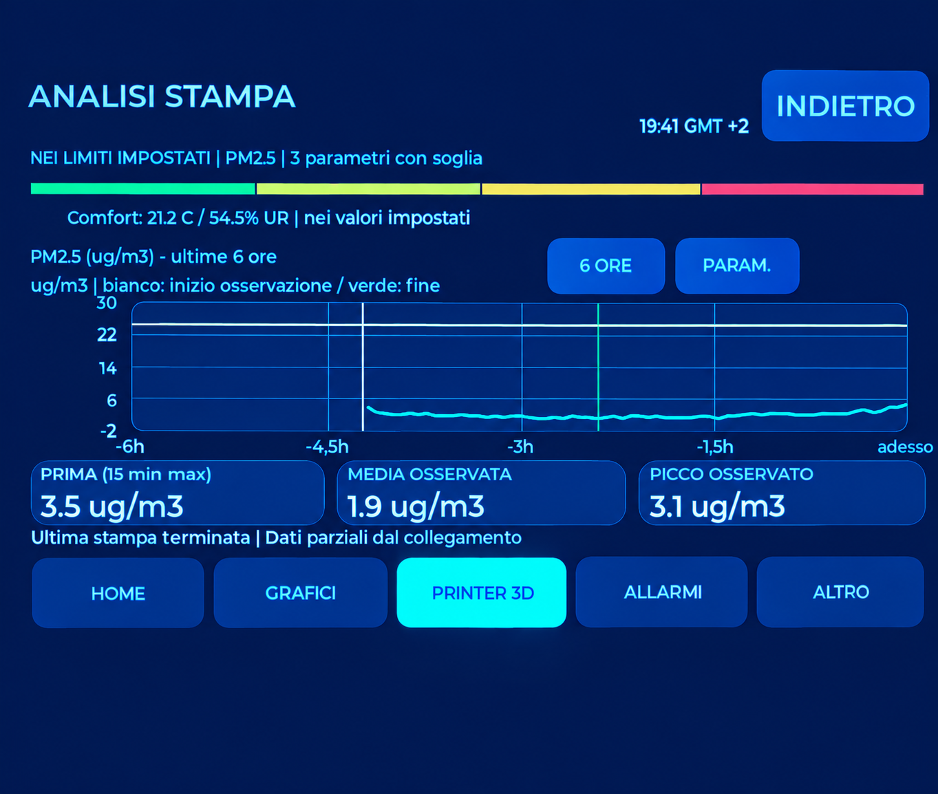
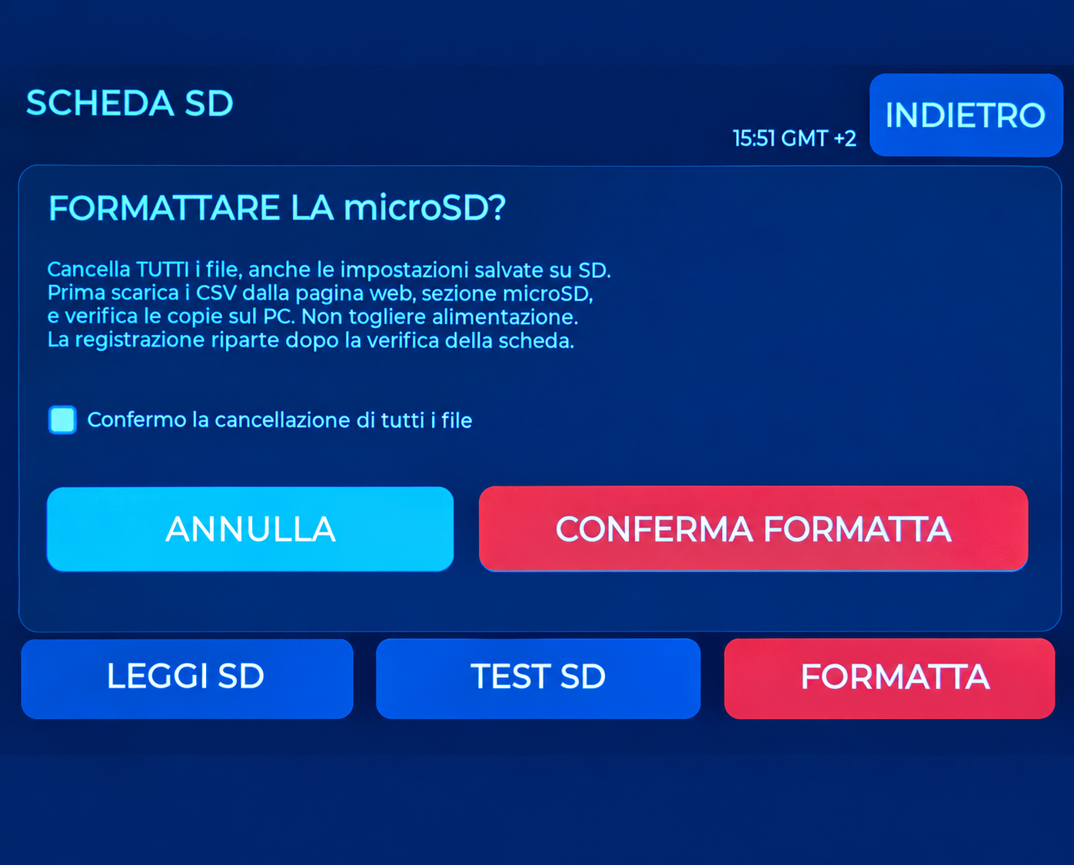
SCREEN ATLAS
Recognising environmental states
HOME: CO2 alert
ALERT CENTRE
Colour indicates the state against the configured threshold.
Read the cause and current value; alerts are informational.
ANALYSIS: print completed
FORMAT: confirmation
Session summary and available samples.
Erases all card files; back up first.
24
GUARDIAN MAKERS / OCTOBER 2026
Notes:
GUARDIAN: presentazione prodotto. Fotografie fornite dal proprietario. Copertina elaborata fotograficamente, schermate aggiornate fornite dal proprietario; rete, credenziali e seriali sostituiti con dati dimostrativi. Fonti complete nelle slide finali e nel manuale: https://sensirion.com/resource/datasheet/SEN6x ; https://www.who.int/publications/i/item/9789240034228 ; https://www.who.int/publications-detail-redirect/9789289002134 ; https://www.epa.gov/chemical-research/3d-printing-research-epa . Dichiarazioni dei componenti non equivalgono a certificazione GUARDIAN.

Slide 25
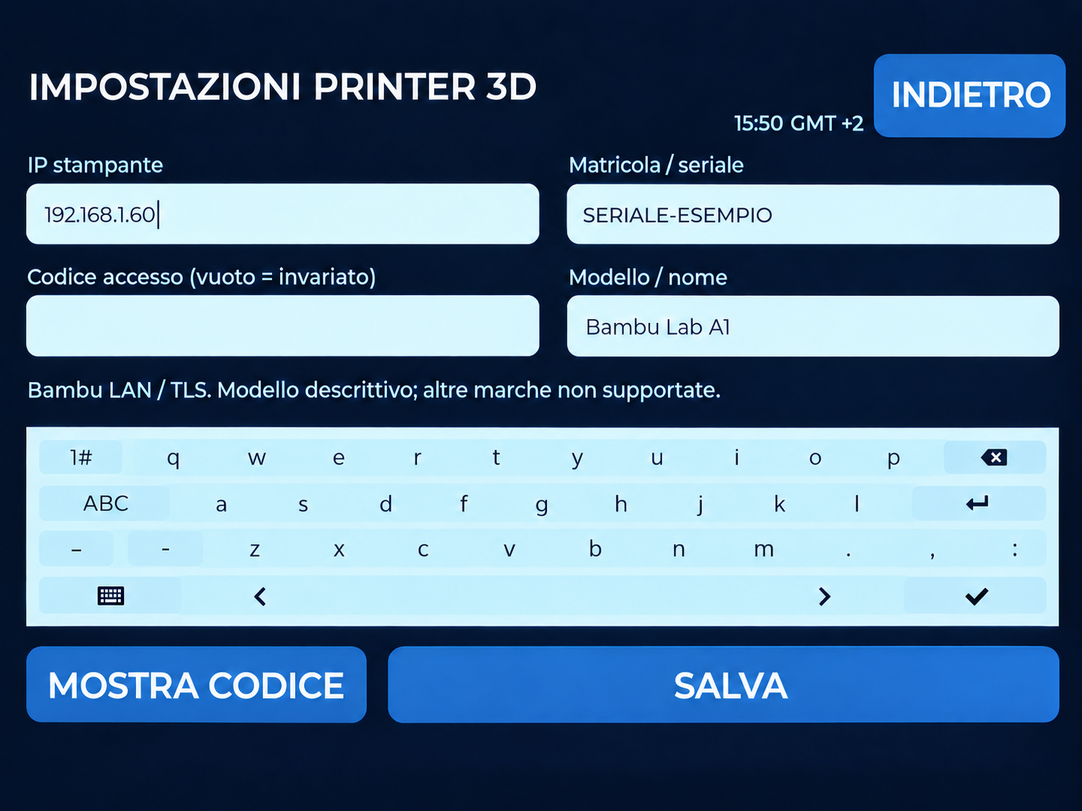
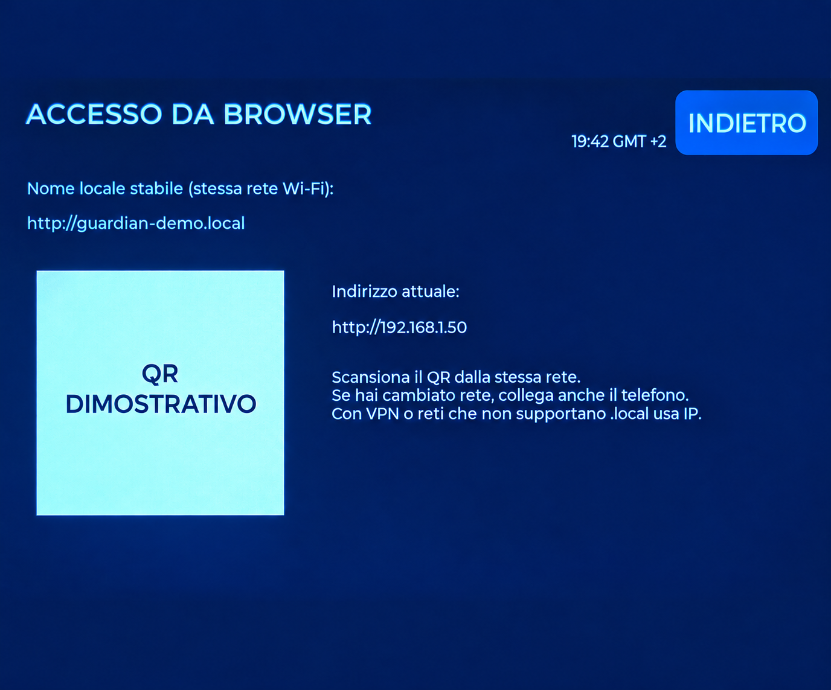
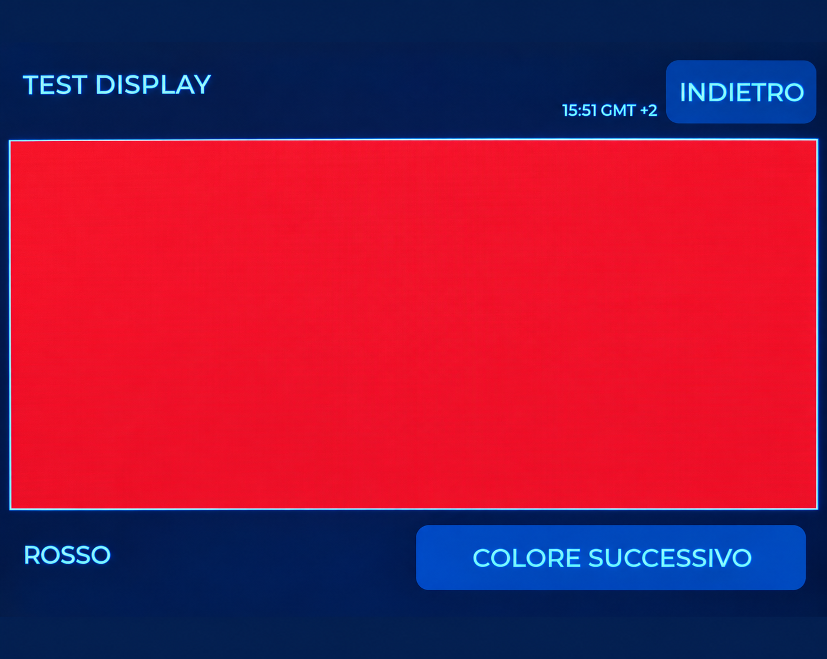
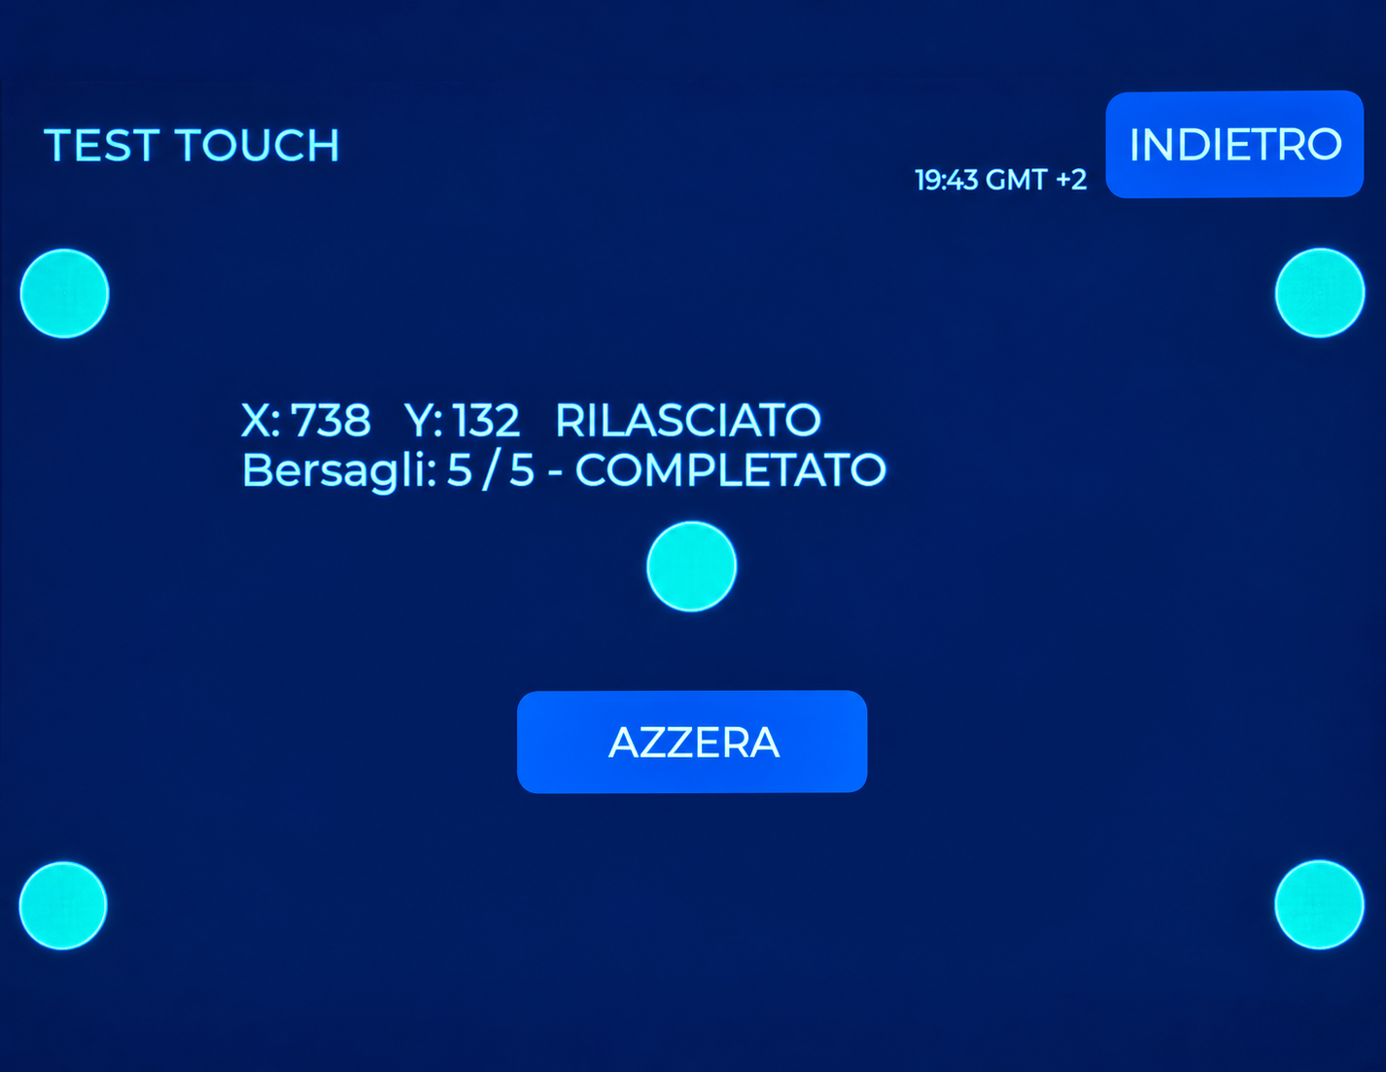
SCREEN ATLAS
Access and local checks
PRINTER SETTINGS
BROWSER ACCESS
Your A1’s IP, serial number and local code. Example details shown.
Use your monitor’s address. The QR code shown was replaced.
DISPLAY TEST
TOUCH TEST
Check uniformity and persistent defects.
Check response at different screen positions.
25
GUARDIAN MAKERS / OCTOBER 2026
Notes:
GUARDIAN: presentazione prodotto. Fotografie fornite dal proprietario. Copertina elaborata fotograficamente, schermate aggiornate fornite dal proprietario; rete, credenziali e seriali sostituiti con dati dimostrativi. Fonti complete nelle slide finali e nel manuale: https://sensirion.com/resource/datasheet/SEN6x ; https://www.who.int/publications/i/item/9789240034228 ; https://www.who.int/publications-detail-redirect/9789289002134 ; https://www.epa.gov/chemical-research/3d-printing-research-epa . Dichiarazioni dei componenti non equivalgono a certificazione GUARDIAN.

Slide 26
GUARDIAN INTERFACE
Adjusting thresholds quickly
Small or large steps
±1, ±10 and ±100 buttons: increase by 100 with
one tap on +100.
Press and hold
Repeats the change; holding ±1 accelerates the
step.
Apply and retain
Check the command result. In the browser, enter
the value directly.
Personal operating thresholds are not certified health limits.
26
GUARDIAN MAKERS / OCTOBER 2026
Notes:
GUARDIAN: presentazione prodotto. Fotografie fornite dal proprietario. Copertina elaborata fotograficamente, schermate aggiornate fornite dal proprietario; rete, credenziali e seriali sostituiti con dati dimostrativi. Fonti complete nelle slide finali e nel manuale: https://sensirion.com/resource/datasheet/SEN6x ; https://www.who.int/publications/i/item/9789240034228 ; https://www.who.int/publications-detail-redirect/9789289002134 ; https://www.epa.gov/chemical-research/3d-printing-research-epa . Dichiarazioni dei componenti non equivalgono a certificazione GUARDIAN.

Slide 27
EVERYDAY USE
Display and browser
An organised sequence
ENVIRONMENTAL TRENDS → ENVIRONMENTAL AVERAGES; PRINT ANALYSIS → 3D PRINTING on PC and smartphone pages.
Readable job names
“tappo in tpu + tappo in tpu” appears as “tappo in tpu”. Different names remain visible. The original print file is not renamed.
MAINTENANCE
The menu uses the full label. CO2 preparation, calibration and cleaning remain separate procedures.
Data and images
The model preview is available on the monitor. Screens in this guide are examples; network details, credentials and serial numbers were
replaced with demonstration values.
27
GUARDIAN MAKERS / OCTOBER 2026
Notes:
GUARDIAN: presentazione prodotto. Fotografie fornite dal proprietario. Copertina elaborata fotograficamente, schermate aggiornate fornite dal proprietario; rete, credenziali e seriali sostituiti con dati dimostrativi. Fonti complete nelle slide finali e nel manuale: https://sensirion.com/resource/datasheet/SEN6x ; https://www.who.int/publications/i/item/9789240034228 ; https://www.who.int/publications-detail-redirect/9789289002134 ; https://www.epa.gov/chemical-research/3d-printing-research-epa . Dichiarazioni dei componenti non equivalgono a certificazione GUARDIAN.

Slide 28
TRACEABLE SOURCES
Sources and reference documents
S1 · Sensirion — SEN6x datasheet (v1.0, October 2026)
Open original document
S2 · Sensirion — SEN5x / SEN6x factory calibration
Open original document
S3 · Sensirion — SEN6x mechanical integration
Open original document
S4 · Sensirion — specification statement
Open original document
S5 · Sensirion — temperature compensation
Open original document
S6 · WHO — Global Air Quality Guidelines, 2021
Open original document
S7 · WHO — Indoor Air Quality: selected pollutants, 2010
Open original document
Accessed: 13 October 2026. Component documents do not certify the complete GUARDIAN device. The photographs show example readings, not metrological validation results.
28
GUARDIAN MAKERS / OCTOBER 2026
Notes:
GUARDIAN: presentazione prodotto. Fotografie fornite dal proprietario. Copertina elaborata fotograficamente, schermate aggiornate fornite dal proprietario; rete, credenziali e seriali sostituiti con dati dimostrativi. Fonti complete nelle slide finali e nel manuale: https://sensirion.com/resource/datasheet/SEN6x ; https://www.who.int/publications/i/item/9789240034228 ; https://www.who.int/publications-detail-redirect/9789289002134 ; https://www.epa.gov/chemical-research/3d-printing-research-epa . Dichiarazioni dei componenti non equivalgono a certificazione GUARDIAN.

Slide 29
TRACEABLE SOURCES
Sources and reference documents
S8 · EPA — research on 3D-printing emissions
Open original document
S9 · EPA — Air Sensor Toolbox
Open original document
S10 · UBA — CO2 and ventilation
Open original document
S11 · Radio Equipment Directive 2014/53/EU
Open original document
S12 · RoHS Directive 2011/65/EU
Open original document
S13 · Delegated Directive (EU) 2015/863 — RoHS
Open original document
S14 · WEEE Directive 2012/19/EU
Open original document
Accessed: 13 October 2026. Component documents do not certify the complete GUARDIAN device. The photographs show example readings, not metrological validation results.
29
GUARDIAN MAKERS / OCTOBER 2026
Notes:
GUARDIAN: presentazione prodotto. Fotografie fornite dal proprietario. Copertina elaborata fotograficamente, schermate aggiornate fornite dal proprietario; rete, credenziali e seriali sostituiti con dati dimostrativi. Fonti complete nelle slide finali e nel manuale: https://sensirion.com/resource/datasheet/SEN6x ; https://www.who.int/publications/i/item/9789240034228 ; https://www.who.int/publications-detail-redirect/9789289002134 ; https://www.epa.gov/chemical-research/3d-printing-research-epa . Dichiarazioni dei componenti non equivalgono a certificazione GUARDIAN.

Slide 30
TRACEABLE SOURCES
Sources and reference documents
S15 · REACH Regulation (EC) 1907/2006
Open original document
S16 · Sensirion — REACH / RoHS statement
Open original document
S17 · Espressif — Arduino ESP32 installation
Open original document
S18 · Freenove — FNK0115 repository
Open original document
S19 · Sensirion — SEN69C product information
Open original document
Accessed: 13 October 2026. Component documents do not certify the complete GUARDIAN device. The photographs show example readings, not metrological validation results.
30
GUARDIAN MAKERS / OCTOBER 2026
Notes:
GUARDIAN: presentazione prodotto. Fotografie fornite dal proprietario. Copertina elaborata fotograficamente, schermate aggiornate fornite dal proprietario; rete, credenziali e seriali sostituiti con dati dimostrativi. Fonti complete nelle slide finali e nel manuale: https://sensirion.com/resource/datasheet/SEN6x ; https://www.who.int/publications/i/item/9789240034228 ; https://www.who.int/publications-detail-redirect/9789289002134 ; https://www.epa.gov/chemical-research/3d-printing-research-epa . Dichiarazioni dei componenti non equivalgono a certificazione GUARDIAN.

