Slide 1

Chapter 1
Introduction
Lijie Li
College of Computer Science & Technology
Harbin Engineering University

Slide 2

by the end of the lesson students will be able to
  make sure the mainframe of the compiler construction
  tell the features of the problem computer can solve

Slide 3


Compilers are computer programs that translate one language to another .
  Very complex program from 10,000 to 1,000,000 lines of code.
Its input is a program written in its source language.
  Usually, the source language is a high-level language (C, C++, etc).
It produces an equivalent program written in its target language.
  The target language is object code (machine code) for the target machine.

Slide 4


English
A person who knows and uses two languages.
In everyday use the word bilingual usually means a person who speaks, reads, or understands two languages equally well (a balanced bilingual), but a bilingual person usually has a better knowledge of one language than of the other.
Source language

Slide 5


Slide 6


Chinese
一个能运用两种语言的人。
在他的日常生活中能将一门外语和本族语基本等同地运用于听、说、读、写，当然他的母语语言知识和能力通常是大于第二语言的。
Target language

Slide 7
Translator
Compiler
Interpreter

Slide 8

An interpreter is a language translator like a compiler.
The difference: the source program is executed immediately, not after translation is complete.

Slide 9

English
The use of a second or foreign language in school for the teaching of content subjects.
The use of the child’s home language when the child enters school
but later a gradual change to the use of the school language for teaching some subjects
and the home language for teaching others.
This is sometimes called maintenance bilingual education.
Source language

Slide 10
The use of a second or foreign language in school for the teaching of content subjects.
The use of the child’s home language when the child enters school
but later a gradual change to the use of the school language for teaching some subjects
and the home language for teaching others.
This is sometimes called maintenance bilingual education.

Slide 11
Chinese?
The use of a second or foreign language in school for the teaching of content subjects.
能在学校里使用第二语言或外语进行各门学科的教学。
The use of the child’s home language when the child enters school
学生刚进入学校时使用本族语
but later a gradual change to the use of the school language for teaching some subjects
然后逐渐地使用第二语言进行部分学科的教学
and the home language for teaching others.
其它学科仍使用母语教学
This is sometimes called maintenance bilingual education.
这种模式称之为：保持型双语教学。
Target language?

Slide 12
An interpreter is a language translator like a compiler.
The difference: the source program is executed immediately, not after translation is complete.
Programming language can be either interpreted or compiled.
Interpreted languages: BASIC, LISP, Java
Compiled languages: FORTRAN, C, C++.
Interpreters share many operations with compilers.

Slide 13

Initially, the programs were written in machine language – numeric codes that represented the actual machine operations to be performed.
C7 06 0000 0002 moves number 2 to the location 0000.
Writing such codes is time consuming and tedious.

Slide 14

In assembly language instructions and memory locations are given symbolic forms.
  MOV X, 2
An assembler translates the symbolic codes and memory locations into corresponding numeric codes.
Advantages:
  Great improvement in speed and accuracy of writing programs.
  Still used today.
Disadvantages:
  Still not easy to write and difficult to read and understand.
  Machine dependent.

Slide 15

Nearly resembles mathematical notation or natural language.
Independent on any particular machine.
Capable of being translated into executable code
  X = 2
Need a program that performs translation.
Is it possible? Is generated object code efficient?

Slide 16
Compilers are computer programs that translate one language to another .
  Very complex program from 10,000 to 1,000,000 lines of code.
Its input is a program written in its source language.
It produces an equivalent program written in its target language.

Slide 17

If you wanna translate English into Chinese, how many steps will you follow? And what are they? ← The left side
On the other hand, when you translate a Chinese sentence into an English one, what are you going to do? The right side →
Step by step, tell me the steps. ☺

Slide 18
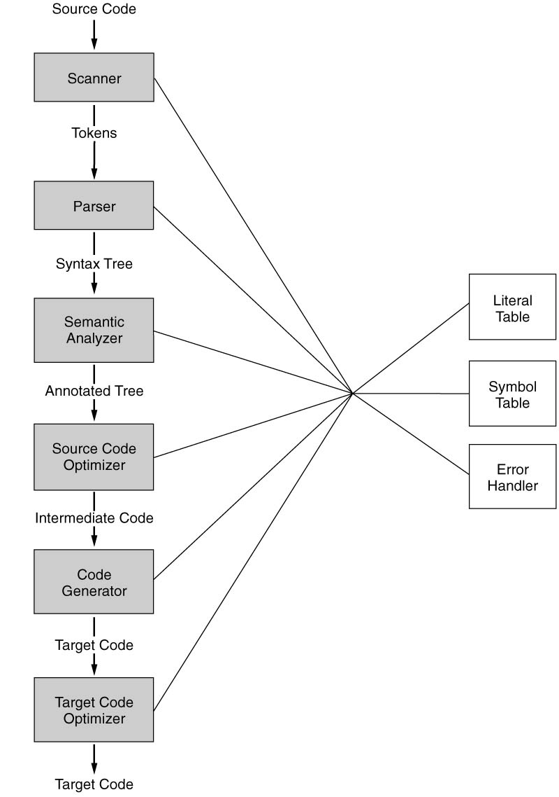

This is a book.
Step 1: lexical analysis
This / is / a / book / .
Step 2: syntax analysis
This → subject
is → predicate
a → quantifier
book → object
. → end
Step 3: semantic analysis
This → pronoun 这
is → copula 是
a → numeral 一
book → noun 书
. → period 。
Step 4: This is a book.
Step 5: 这是一书。
Step 6: 这是一本书。
Samuel2005@126.com
Compiler

