Slide 1
Chapter 3
Context-Free Grammars and Parsing
Extended BNF Notation
Lijie Li
College of Computer Science & Technology
Harbin Engineering University
Compiler

Slide 2
Extended BNF Notation (EBNF)
{ } repetitions
A → β {α}
and
A → {α} β
Compiler

Slide 3
Left and Right Recursion
Left recursive grammar:
A → A α | β
  Equivalent toβ α *
A → β {α}
Right recursive grammar:
A → α A | β
  Equivalent to α * β
A → {α} β
Compiler

Slide 4
Extended BNF Notation (EBNF)
{ } repetitions
A → β {α} and A → {α} β
[ ] optional constructs
statement → if-stmt | other
if-stmt → if (exp) statement
| if (exp) statement else statement
exp → 0 | 1
statement → if-stmt | other
if-stmt → if (exp) statement [ else statement ]
exp → 0 | 1
Compiler

Slide 5
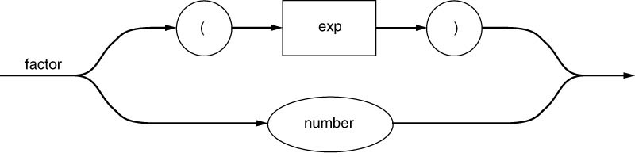
Syntax Diagrams
Graphical representations for visually representing EBNF rules are called syntax diagrams.
They consist of boxes representing terminals and nonterminals, arrowed lines representing sequencing and choices, and nonterminal labels for each diagram representing the grammar rule defining that nonterminal.
A round or oval box is used to indicate terminals in a diagram, while a square or rectangular box is used to indicate nonterminals.
Compiler

Slide 6
Syntax Diagrams(cont)
As an example, consider the grammar rule
factor → ( exp ) | number
This is written as a syntax diagram in the following way:
Compiler

Slide 7
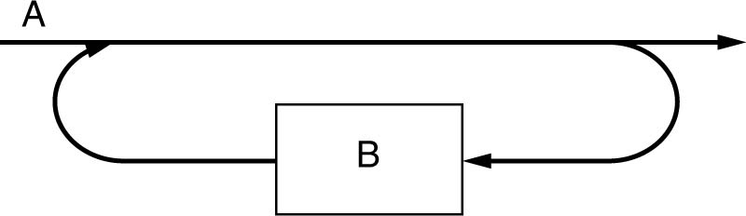
Syntax Diagrams(cont)
Syntax diagrams are written from the EBNF rather than the BNF, so we need diagrams representing repetition and optional constructs. Given a repetition such as
A → { B }
The corresponding syntax diagram is usually drawn as follow:
Compiler

Slide 8
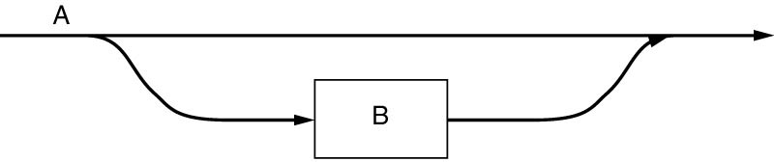
Syntax Diagrams(cont)
An optional construct such as
A → [ B ]
Is drawn as:
Compiler

Slide 9
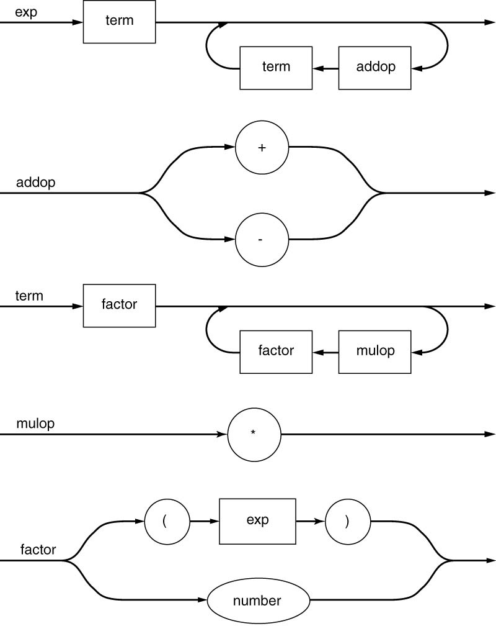
Example
exp → exp addop term | term
addop → + | –
term → term mulop factor | factor
mulop → *
factor → (exp) | number
exp → term { addop term }
addop → + | –
term → factor { mulop factor }
mulop → *
factor → (exp) | number
Compiler

Slide 10
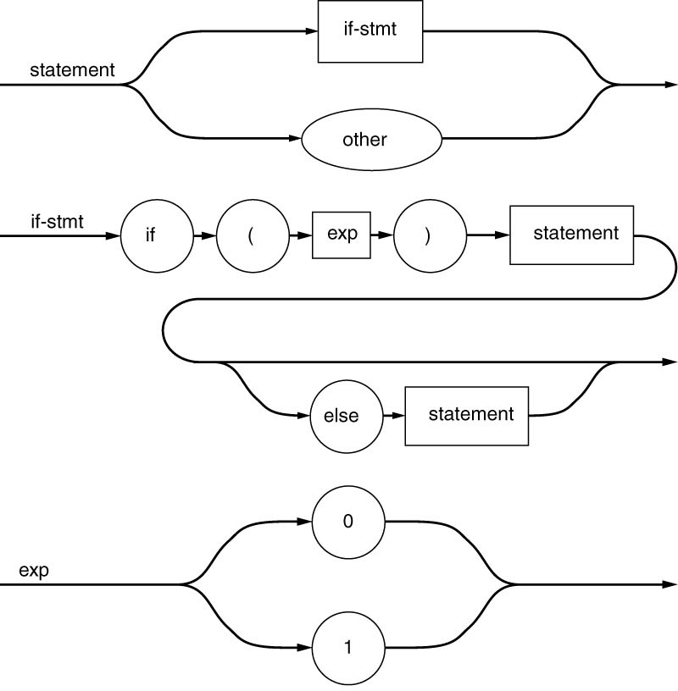
Example
statement → if-stmt | other
if-stmt → if (exp) statement
| if (exp) statement else statement
exp → 0 | 1
statement → if-stmt | other
if-stmt → if (exp) statement [ else statement ]
exp → 0 | 1
Compiler

Slide 11
Formal Properties of Context-Free Languages
We will present the formal and mathematical definition of Context-Free grammar as follows:
A context-free grammar consists of
1. A set T of terminals.
2. A set N of nonterminals (disjoint from T)
3. A set P of productions, or grammar rules, of the form
A->α, where A is an element of N and α is an element of (T∪N)*(a possibly empty sequence of terminals and
nonterminals).
4. A start symbol S from the set N.
Let G be a grammar as defined above, then
G = (T, N, P, S)
Compiler

Slide 12
Formal Properties of Context-Free Languages
A derivation step over G is of the form αAγ=>αβγ, where α and γ are elements of (T∪N)*, and A-> β is in P. A string α in (T∪N)* is called a sentential form.
The relation α =>* β is defined to be the transitive closure of the derivation step =>; that is, there is a sequence of 0 or more derivation steps
α₁=> α₂ => … => α_{n-1} => α_{n}
α = α₁, β= α_{n}
Context-Free Languages：
L(G) = {w∈T* | there exists a derivation S=>*w of G}
Compiler

Slide 13
Chomsky Hierarchy
Noam Chomsky began his study of the structure of the natural language. His findings eventually made the construction of compilers considerably easier and even capable of partial automation.
Chomsky’s study led to the classification of languages according to the complexity of their grammars (the rules specifying their structure) and the power of the algorithms needed to recognize them.
The Chomsky hierarchy, as it is now called, consist of four levels of grammars, called the type 0, type 1, type 2, and type 3 grammars, each of which is a specialization of its predecessor.
Compiler

Slide 14
乔姆斯基分类法则
0型文法
1型文法
2型文法
3型文法
文法名称
非限制性文法
上下文 有关文法
上下文 无关文法
正则文法
对应机器
图灵机
线性 自动机
下推 自动机
有穷 自动机
识别对象
自然语言
受限 自然语言
程序语言
单词
Compiler

Slide 15
Type 0
0 型文法 如果文法G中规则呈如下形式。
u → v (u∈V+ , v∈V*)
V是终结符和非终结符的集合
则称G为0型文法。由0型文法产生的语言称为0型语言。由于这种文法，对其规则没有什么限制，所以也称无限制文法。
与图灵机完全相等
Compiler

Slide 16
Type 0
例 G₁=（V_{N} , V_{T} , P , S）
  其中 V_{N} =｛A , B, S｝ V_{T}=｛0 , 1｝
  P： S → 0AB
  1B → 0
  B → SA|01
  A1 → SB1
  A0 → S0B
  此文法G1为0型文法，由它产生的相应0型语言为 L（G1）=｛ ｝
  即由文法G₁推导不出任何句子。
Compiler

Slide 17
Type 1
1 型文法 如果文法G中规则呈如下形式
xUy → xuy (U∈V_{N} , u∈V⁺ , x , y∈V*)
则称G为1型文法，所产生的相应语言为1型语言。由于利用规则将U替换成u时，必须考虑U在上下（前后）文x…y中出现的情况，即与它的上下（前后）文有关，故又称上下文有关文法。
Compiler

Slide 18
Type 1
例 G₃=（V_{N} , V_{T} , P , S）
其中 V_{N} =｛S , B, C｝ V_{T}=｛a , b , c｝
P： S → aSBC
S → aBC
CB → BC
aB → ab
bB → bb
bC → bc
cC → cc
这是一个1型语法，它共包含7条规则。实际上，，它描述了如下语言：
L（G₃）=｛a^{n}b^{n}c^{n}|n≥1｝
Compiler

Slide 19
Type 2
2 型文法 如果文法G中规则呈如下形式
U → u (U∈V_{N} , u∈V*)
则称G为2型文法，由它所产生的语言称2型语言。由于利用规则将U替换成u时，与其上下（前后）文无关，即无需考虑U在上下文中出现情况，所以又称这种方法为上下文无关文法，所定义的语言称上下文无关语言。
2型文法是最常用的一类文法。
下推自动机
Compiler

Slide 20
Type 3
3 型文法 如果文法G中规则呈如下形式
  U → a
  或 U → Wa （U、W∈V_{N} ，a∈V_{T}）
  则称G为3型文法，或正则（或称正规）文法，由它所产生的语言称3型语言，或正则（或正规）语言。3型文法也有采用形如U → aW的规则作为其定义的，这是一种右线性文法，而前面那种形式的3型文法则是左线性的。
有穷自动机
例 <算术运算符> → + | - | * | / |↑
Compiler

Slide 21
Homework
1.2 | 1.3 | 1.7
2.1 | 2.2 | 2.4 | 2.5
2.8 | 2.12 | 2.17 | 2.24
3.3 | 3.5 | 3.6 | 3.24
Compiler

