Slide 1
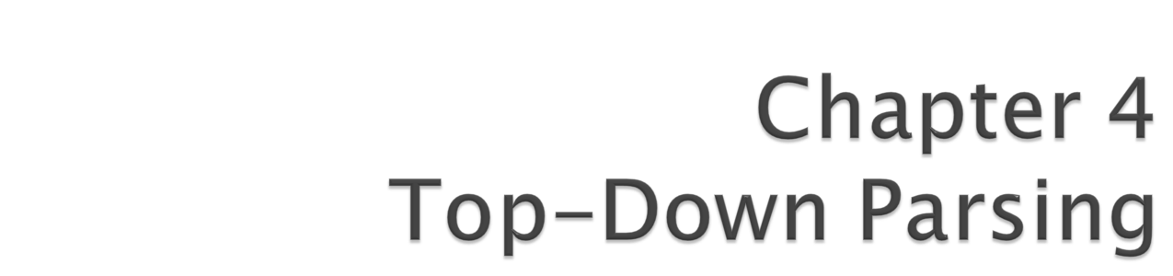
Problems with LL(1) Parsing
Lijie Li
College of Computer Science & Technology
Harbin Engineering University

Slide 2

A grammar is LL(1) grammar if the associated LL(1) parsing table has at most one production rule in each table entry.
An LL(1) grammar cannot be ambiguous .
Repeat the following two steps for each terminal a and production choice A → α.
  For each token a in First(α), add A → α to the entry M[A,a].
  If ε is in First(α), for each element a of Follow(A), add A → α to M[A,a].
Compiler

Slide 3
A → BA*|B
B → a | (A)| ε
First(A) = {a,(, ε ,* }
First(B)= {a,(, ε }
Follow(A) = {$,* ,) }
Follow(B) = {a,(, *, $,) }
1.First(BA*) = {a,(, * } 3.First(a) = {a }
2.First(B)= {a,(, ε } 4.First((A))={(}
5.First(ε)={ε}
M[N, T]
a
(
)
*
$
A
A → BA*
A → B
A → BA*
A → B
A → B
A → BA*
A → B
A → B
B
B→ a
B → ε
B→ (A)
B → ε
B → ε
B → ε
B → ε

Slide 4

A grammar in BNF is LL(1) if the following conditions are satisfied.
1. For every production A → α₁ | α₂ |…| α_{n}, First(α_{i}) ∩ First(α_{j}) is empty for all i and j, 1 ≤ i, j ≤ n, i ≠ j.
2. For every nonterminal A such that First(A) contains ε, First(A)∩Follow(A) is empty.
Compiler

Slide 5

exp → exp addop term | term
addop → + | -
term → term mulop factor | factor
mulop → *
factor → (exp) | number
First(exp) = { ( , number}
First (addop) = {+, - }
First(term) = { ( , number}
First(mulop) = { * }
First(factor) = { ( , number}
Follow(exp) = { $ , +, -, ) }
Follow(addop) = { ( , number }
Follow(term) = { *, $, +, - ,) }
Follow(factor) = { *, $, +, - ,) }
Follow(mulop) = { ( , number }
This grammar is not LL(1) grammar!
Compiler

Slide 6

statement → if-stmt | other
if-stmt → if (exp) statement else-part
else-part → else statement | ε
exp → 0 | 1
First(statement) = {if, other}
First(if-stmt) = { if }
First(else-part) = { else, ε}
First(exp) = {0, 1}
Follow(statement) = { $, else }
Follow(if-stmt) = { $, else }
Follow(else-part) = { $, else }
Follow(exp) = { ) }
This grammar is not LL(1) grammar!
Compiler

Slide 7

stmt-sequence → stmt stmt-seq’
stmt-seq’ → ; stmt-sequence | ε
stmt → s
First(stmt-sequence) = { s }
First(stmt-seq’) = { ; , ε}
First(stmt) = { s }
Follow(statement-sequence) = { $ }
Follow(stmt-seq’) = { $ }
Follow(stmt) = { ; , $ }
This grammar is LL(1) grammar!
Compiler

Slide 8

We try to rewrite the grammar into a form of LL(1) grammar.
Two standard techniques:
  Left recursion removal
  Left factoring
Not all grammars can be turned into LL(1) grammar.
Compiler

Slide 9

Left recursion is commonly used to make operations left associative.
exp → exp addop term | term
This is the case of immediate left recursion
  Left recursion occurs only within the production of a single nonterminal.
More difficult case is indirect left recursion
A → B b | …
B → A a | …
Compiler

Slide 10

exp → exp addop term | term
A → Aα | β
β α*
exp → term exp’
exp’ → addop term exp’ | ε
A → βA’
A’ → αA’ | ε
Generates repetitions of term
Generates term
Compiler

Slide 11

A → Aα₁ | Aα₂ | …| Aα_{n} | β₁ | β₂ | …| β_{m}
A → β₁A’ | β₂A’ | …| β_{m}A’
A’ → α₁A’ | α₂A’ | …| α_{n}A’ | ε
exp → exp + term | exp - term | term
exp → term exp’
exp’ → + term exp’ | - term exp’ | ε
Compiler

Slide 12

Algorithm for general left recursion removal:
for i := 1 to m do
for j := 1 to i - 1 do
replace each grammar rule choice of the form A_{i} → A_{j}β by the rule A_{i} → α₁β|α₂β| …|α_{k}β, where A_{j} → α₁ | α₂ | …| α_{k} is the current rule for A_{j}
remove, if necessary, immediate left recursion involving A_{i}
Compiler

Slide 13

A → Ba | Aa | c
B → Bb | Ab | d
A → BaA’ | cA’
A’ → aA’ | ε
B → Bb | Ab | d
A → BaA’ | cA’
A’ → aA’ | ε
B → Bb | Ab | d
B → Bb | (BaA’ | cA’) b | d
B → Bb | BaA’b | cA’b | d
A → BaA’ | cA’
A’ → aA’ | ε
B → cA’bB’ | dB’
B’ → bB’ | aA’bB’ | ε
Compiler

Slide 14

exp → exp addop term | term
addop → + | -
term → term mulop factor | factor
mulop → *
factor → (exp) | number
exp → term exp’
exp’ → addop term exp’ | ε
addop → + | -
term → factor term’
term’ → mulop factor term’ | ε
mulop → *
factor → (exp) | number
Compiler

Slide 15

exp → term exp’
exp’ → addop term exp’ | ε
addop → + | -
term → factor term’
term’ → mulop factor term’ | ε
mulop → *
factor → (exp) | number
First(exp) = {( , number}
First(exp’) = { +, -, ε }
First(addop) = { +, - }
First(term) = { ( , number}
First(term’) = { * , ε }
First(mulop) = { * }
First(factor) = { ( , number}
Compiler

Slide 16
exp → term exp’
exp’ → addop term exp’ | ε
addop → + | -
term → factor term’
term’ → mulop factor term’ | ε
mulop → *
factor → (exp) | number
Follow(exp) = { $, ) }
Follow(exp’) = { $, ) }
Follow(addop) = { ( , number }
Follow(term) = {+, - , $, )}
Follow(term’) = {+, -, $, )}
Follow(mulop) = {( , number}
Follow(factor) = { *, +, -, $, ) }
First(exp) = {( , number}
First(exp’) = { +, -, ε }
First(addop) = { +, - }
First(term) = { ( , number}
First(term’) = { * , ε }
First(mulop) = { * }
First(factor) = { ( , number}
This grammar is LL(1) grammar!
Compiler

Slide 17
M[N,T] | ( | number | ) | + | - | * | $
exp | term exp’ | term exp’
exp’ |  |  | ε | addop term exp’ | addop term exp’ |  | ε
addop |  |  |  | + | -
term | factor term’ | factor term’
term’ |  |  | ε | ε | ε | mulop factor term | ε
mulop |  |  |  |  |  | *
factor | (exp) | number
Compiler

Slide 18

Left factoring is required when two or more grammar rule choices share a common prefix string. A → α β | α γ
Example:
stmt-sequence → stmt ; stmt-sequence | stmt
stmt → s
LL(1) parser cannot distinguish between the production choices in such situation.
Solution:
A → α (β | γ)
A → α A’
A’ → β | γ
Compiler

Slide 19
stmt-sequence → stmt ; stmt-sequence | stmt
stmt → s
A → α β | α γ
stmt-sequence → stmt stmt-seq’
stmt-seq’ → ; stmt-sequence | ε
stmt → s
A → α A’
A’ → β | γ
Compiler

Slide 20

stmt-sequence → stmt stmt-seq’
stmt-seq’ → ; statement-sequence | ε
stmt → s
First(stmt-sequence) = {s}
First(stmt-seq’) = { ; , ε}
First(stmt) = {s}
Follow(stmt-sequence) = { $ }
Follow(stmt-seq’) = { $ }
Follow(stmt) = { ; , $}
Compiler

Slide 21
M[N,T] | s | ; | S
stmt-sequence | stmt stmt-seq’
stmt | s
stmt-seq’ |  | ; stmt-sequence | ε
Compiler

Slide 22

LL(1) parsing can be adapted to construct syntax tree.
Problems: structure of a syntax tree may be obscured by left factoring and left recursion removal.
Compiler

Slide 23

exp → exp addop term | term
addop → + | -
term → term mulop factor | factor
mulop → *
factor → (exp) | number
exp → term exp’
exp’ → addop term exp’ | ε
addop → + | -
term → factor term’
term’ → mulop factor term’ | ε
mulop → *
factor → (exp) | number
Compiler

Slide 24
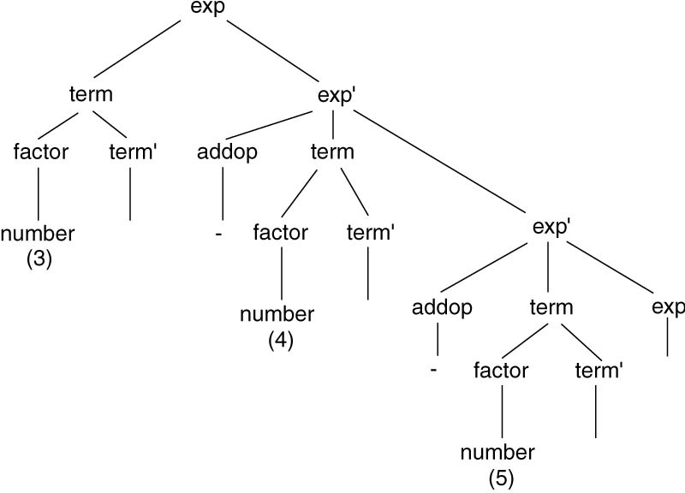
ε
ε
ε
ε
Compiler

Slide 25
LL(1) parsing can be adapted to construct syntax tree.
Problems: structure of a syntax tree may be obscured by left factoring and left recursion removal.
The construction on nodes is delayed until to the point when structures are removed from the stack, rather than they are pushed.
Compiler

Slide 26

E → E + n | n
Left recursive addition
E → n E’
E’ → + n E’ | ε
We show how to compute an arithmetic value of the expression.
To compute a value for the result of an expression, we will use a separate stack to store the intermediate values of the computation, which we call the value stack.
Compiler

Slide 27

We schedule two operation on the stack
  A push of a number when it is matched in the input
    This can be done by match procedure
  The addition of two numbers on the stack
    We will do this by pushing a special symbol # on the parsing stack, which, when popped, will indicate that the addition is to be performed
The grammar is changed to
E → n E’
E’ → + n # E’ | ε
E → E + n # | n
Compiler

Slide 28
E → n E’
E’ → + n # E’ | ε
Parsing Stack
Input
Action
Value Stack
$ E
3 + 4 + 5 $
E → n E’
$
$ E’ n
3 + 4 + 5 $
match/push
$
$ E’
+ 4 + 5 $
E’ → + n # E’
3 $
$ E’ # n +
+ 4 + 5 $
Match
3 $
$ E’ # n
4 + 5 $
match/push
3 $
$ E’ #
+ 5 $
add stack
4 3 $
$ E’
+ 5 $
E’ → + n # E’
7 $
$ E’ # n +
+ 5 $
Match
7 $
$ E’ # n
5 $
match/push
7 $
$ E’ #
$
add stack
5 7 $
$ E’
$
E’ → ε
12 $
$
$
accept
12 $
Compiler

Slide 29

LL(1) parser can be extended to k symbols of lookahead.
Parsing table becomes larger
  Number of columns increases exponentially with k
Compiler

Slide 30

4.5 Show the actions of an LL(1) parser that uses Table 4.4(Page 163) to recognize the following arithmetic expressions:
a. 3 + 4 * 5 - 6
b. 3 * ( 4 – 5 + 6 )
c. 3 - ( 4 + 5 * 6 )
exp → term exp’
exp’ → addop term exp’ | ε
addop → + | -
term → factor term’
term’ → mulop factor term’ | ε
mulop → *
factor → (exp) | number
Compiler

Slide 31
4.7 Given the grammar A → ( A ) A | ε,
a. Construct First and Follow sets for the nonterminal A.
b. Show this grammar is LL(1).
Compiler

Slide 32
4.8 Consider the grammar
a. Remove the left recursion.
b. Construct First and Follow sets for the nonterminals of the resulting grammar.
c. Show that the resulting grammar is LL(1).
lexp → atom | list
atom → number | identifier
list → (lexp-seq)
lexp-seq → lexp-seq lexp | lexp
Compiler

Slide 33
d. Construct the LL(1) parsing table for the resulting grammar.
e. Show the actions of the corresponding LL(1) parser, given the input string
( a ( b ( 2 ) ) ( c ) ).
lexp → atom | list
atom → number | identifier
list → (lexp-seq)
lexp-seq → lexp-seq lexp | lexp
Compiler

