Slide 1
Chapter 5
Bottom –Up Parsing
LR(1) Parsing
Computer Science & Technology
Harbin Engineering University

Slide 2
Simple LR(1) Parsing
Uses DFA of set of LR(0) items as constructed in the previous section.
The power of LR(0) is increased significantly.
SLR(1) uses the next token of the input string to direct its actions.
  The input token is consulted before a shift to make sure that appropriate DFA transition exists.
  The Follow sets of nonterminals are used to decide if a reduction should be performed.
This approach is powerful enough to parse almost all commonly occurring language constructs.
Compiler

Slide 3
SLR(1) Parsing Algorithm
Let s be a current state (at the top of the parsing stack)
If state s contains any item of the form A->α . X β where X is a terminal, and X is the next token in the input string, then
  The action is to shift the current input token onto the stack, the new state to be pushed on the stack is the state containing item A-> α X . β .
Compiler

Slide 4
2. If state s contains a complete item A -> γ . , and the next token in the input string is in Follow(A), then the action is to reduce by the rule A -> γ.
  A reduction by the rule S’->S, where S is the start state, is equivalent to acceptance (the next input token must be $)
  Otherwise,
    remove the string γ and all its corresponding states from the stack,
    back up in the DFA to the state from which the construction of γ began. The state must contain an item B-> α . A β
    Push A into the stack
    Push the state containing item B-> α A . β
Compiler

Slide 5
3. If the next input token is such that neither of the above two cases applies. An error is declared.
Compiler

Slide 6
SLR(1) Grammar
We say that a grammar is an SLR(1) grammar of the application of SLR(1) parsing algorithm results in no ambiguity.
A grammar is SLR(1) if and only if , for any state s, the following two conditions are satisfied:
  For any item A -> α . X β in s with X a terminal, there is no complete item B -> γ . in s with X in Follow(B).
  For any two complete items A -> α . and B -> β . , in s, Follow(A) ∩ Follow(B) is empty.
A violation of the first condition represents a shift-reduce conflict. A violation of the second condition represents a reduce-reduce conflict.
Compiler

Slide 7
Parsing Table for SLR(1)
Since a state can be both shifts and reduces (depending on lookahead), each entry in the input section must have “shift” and “reduce” label.
Grammar rule choices must be placed in entries marked “reduce”.
$ is a legal lookahead.
Compiler

Slide 8
Example 5.10
For any item A -> α . X β in s with X a terminal, there
is no complete item B -> γ . in s with X in Follow(B)
E’ -> E
E -> E + n | n
E’ -> . E
E -> . E + n
E -> . n 0
E’ -> E .
E -> E . + n
1
E
Follow(E’) ={ $ }
Follow(E) = { $, +}
n
+
E -> n .
2
E -> E + . n
3
n
E -> E + n .
4
Compiler

Slide 9
Example 5.10 (cont)
State | Input |  |  | Goto
 | n | + | $ | E
0 | s 2 |  |  | 1
1 |  | s 3 | accept
2 |  | r (E -> n) | r (E -> n)
3 | s 4
4 |  | r (E -> E+n) | r (E -> E+n)
Compiler

Slide 10
Example 5.10 (cont)
 | Parsing Stack | Input | Action
1 | $ 0 | n + n + n $ | shift 2
2 | $ 0 n 2 | + n + n $ | reduce E -> n
3 | $ 0 E 1 | + n + n $ | shift 3
4 | $ 0 E 1 + 3 | n + n $ | shift 4
5 | $ 0 E 1 + 3 n 4 | + n $ | reduce E->E + n
6 | $ 0 E 1 | + n $ | shift 3
7 | $ 0 E 1 + 3 | n $ | shift 4
8 | $ 0 E 1 + 3 n 4 | $ | reduce E->E + n
9 | $ 0 E 1 | $ | accept
Compiler

Slide 11
SLR(1) Parsing
设文法G =（{a，b}，{S，B}，S，P）,
其中P：
S → BB
B → aB | b。
构造SLR(1)分析表，写出输入串aabab的分析过程。
Compiler

Slide 12
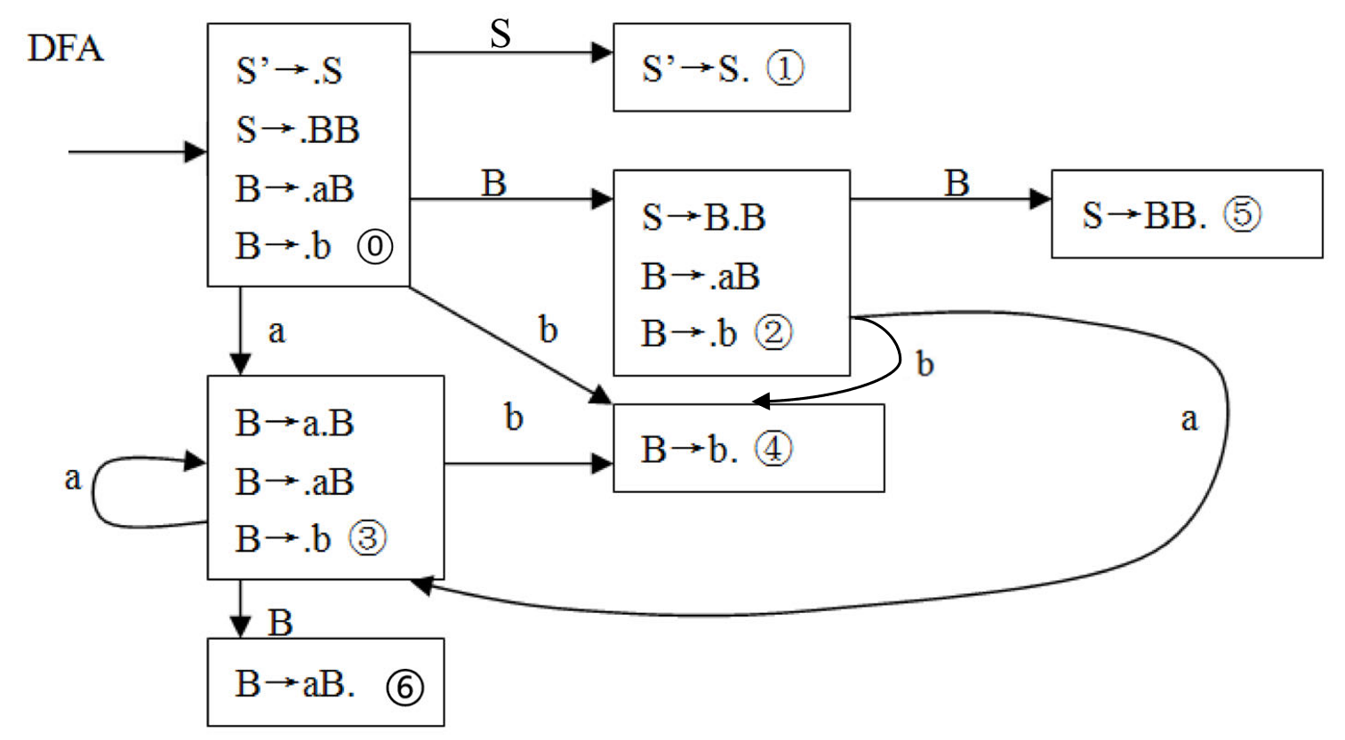
S’→S
S→BB
B→aB
B→b
Follow(S’)={$}
Follow(S)={$}
Follow(B)={a,b,$}
Compiler

Slide 13
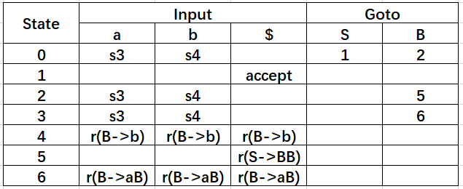
SLR(1) Parsing Table
Compiler

Slide 14
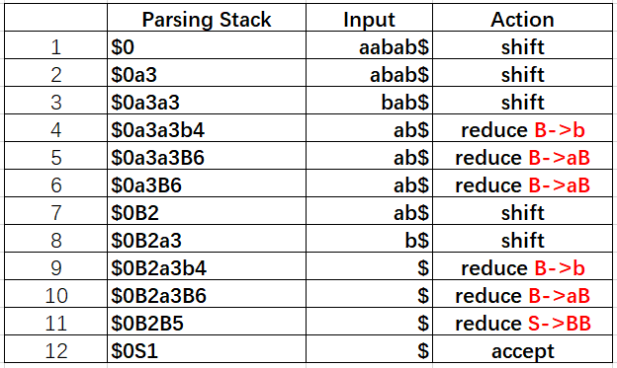
SLR(1) Parsing
Compiler

Slide 15
Disambiguating Rules
In the case of shift-reduce conflicts, there is a natural disambiguating rule, which always prefer the shift over the reduce.
Most shift-reduce parsers automatically resolve shift-reduce conflict by preferring the shift over reduce.
This incorporates the most closely nested rule for the dangling else ambiguity in if-statements.
This is one of the reasons for letting the ambiguity remains in a programming language grammar.
Compiler

Slide 16
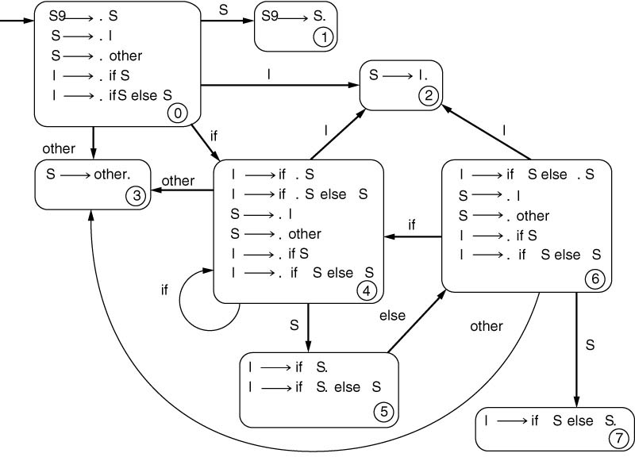
Example 5.12
statement -> if-stmt | other
if-stmt -> if (exp) statement
| if (exp) statement else statement
exp -> 0 | 1
Follow( S ) = Follow( I ) = { $, else }
Compiler

Slide 17
Limits of SLR(1) Parsing Power
SLR(1) is a simple and powerful extension to LR(0) parsing that allows to handle almost all commonly occurring language constructs.
There are a few situations in which SLR(1) parsing is not powerful enough.
This will lead us to study general LR(1) and LALR(1) parsing
Compiler

Slide 18
Example 5.13
stmt -> call-stmt | assign-stmt
call-stmt -> identifier
assign-stmt -> var := exp
var -> var [exp] | identifier
exp -> var | number
S’ -> .S
S -> . id
S -> .V := E
V -> . id
id
Folow(S) = { $ }
Follow (V) = { := , $}
S -> id .
V ->id .
S -> id | V =: E
V -> id
E -> V | n
This is reduce-reduce conflict
Compiler

Slide 19
SLR(k) Grammars
The SLR(1) parsing algorithm can be extended to SLR(k) parsing, where parsing actions are based on k symbols lookahead.
SLR(k) is more powerful than SLR(1), but at substantial cost in complexity.
Typical language constructs that are not SLR(1) are handled better by using an LALR(1), by using standard disambiguating rules, or by rewriting the grammar.
Compiler

Slide 20
General LR(1) Parsing
The difficulty with the SLR(1) method is that it applies lookahead after the construction of DFA of LR(0) items.
The LR(1) method uses a new DFA that has the lookaheads built into its construction from the start.
LR(1) items include a single lookahead token in each of item.
LR(1) item is a pair consisting of an LR(0) item and a lookahead token.
[A -> α . β, a ]
Compiler

Slide 21
LALR(1) Parsing
In many cases the size of the DFA of sets of LR(1) items is due to the existence of many different states, while differing only in lookahead symbols.
In the LALR(1) parsing these states are identified and their lookaheads are combined.
We end up with a DFA that is identical to the DFA of LR(0) items, except that each state consists of items with set of lookaheads.
LALR(1) parsing algorithm is used in Yacc, one of the widely used parser generators.
Compiler

Slide 22
Homework
5.1 Consider the following grammar:
a. Construct the DFA of LR(0) items for this grammar.
b. Construct the SLR(1) parsing table.
c. Show the parsing stack and the actions of an SLR(1) parser for the input string ((a), a, (a, a)) .
d. Is this grammar an LR(0) grammar? If not, describe the LR(0) conflict. If so, construct the LR(0) parsing table, and describe how a parse might differ from an SLR(1) parse.
E -> ( L ) | a
L -> L, E | E
Compiler

Slide 23
Homework
5.3 Consider the following grammar:
a. Construct the DFA of LR(0) items for this grammar.
b. Construct the SLR(1) parsing table.
c. Show the parsing stack and the actions of an SLR(1) parser for the input string ( ( ) ( ) ) .
d. Is this grammar an LR(0) grammar? If not, describe the LR(0) conflict. If so, construct the LR(0) parsing table, and describe how a parse might differ from an SLR(1) parse.
S -> S ( S ) | ε
Compiler

