Slide 1
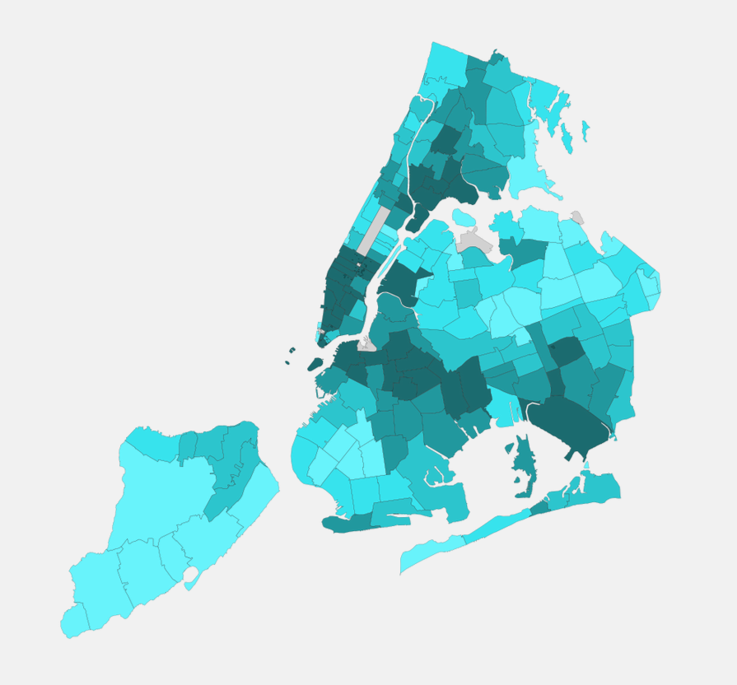
1. Travel time of each travel varies with time and travel(start&end point)
Click to toggle between to/from data for opacity
Choose start and end point by dragging.
1. Not highlight: brush on x axis and time line would expand;
2. Clicked and highlight: drag twice on the timeline and allow user to compare two period of time.
Pickup/Dropoff
compare
Color opacity encode average travel time from a selected point
X axis: default range is Monday 00:00 to Sunday 23: 59

Slide 2
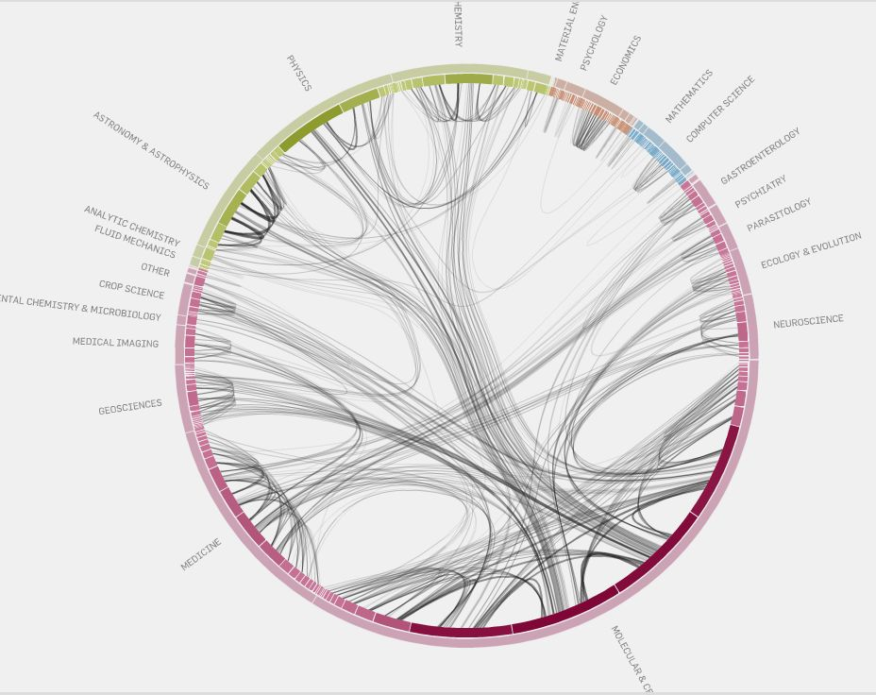
the two layer of circles encode hierarical information
2: traffic between each area

Slide 3
A dropdown list to choose which day of a week
Show detail information of patterns. Choose pattern on the map by dragging or clicking
Encode pattern with different color
Monday

