Slide 1

Advances in Data Mining 2020
Wojtek Kowalczyk w.j.kowalczyk@liacs.leidenuniv.nl
Introduction

Slide 2
Agenda
Course Motivation
Course Organization
Course Overview
Hash functions, hash tables, Bloom filter

Slide 3
Motivation behind the course
“Classical” data mining (classification, regression, clustering) doesn’t really develop anymore: SVM, RF, GBDT, t-SNE… more than 10 years old! (?)
BigData revolution : Internet, Telecom, tablets, smartphones (tweets, emails, text, location, voice, image, video), Bioinformatics, RFIDs, Sensors, … => new problems, new challenges
Exponential growth of the gap between available data and data processing capabilities => need for faster algorithms

Slide 4
Exponential “data flood”
Moore’s Law: “processing speed doubles every 18 months”
Kryder’s Law: “hard disk capacity doubles every 12 months”
Lyman & Varian (Berkely, 2003): “the amount of collected data doubles every year” Also check: www.martinhilbert.net/wp-content/uploads/2015/03/HMI-Review_Hilbert2015.pdf
Therefore every 3 years processing speed increases 4 times, while the amount of available data increases 8 times => the “data flood” is doubling every 3 years!!!

Slide 5
The three “V” of big data (ibm.com):
Volume: Enterprises are awash with ever-growing data of all types, easily amassing terabytes—even petabytes—of information.
Turn 12 terabytes of Tweets created each day into improved product sentiment analysis
Convert 350 billion annual meter readings to better predict power consumption
Velocity: Sometimes 2 minutes is too late.
Scrutinize 5 million trade events created each day to identify potential fraud
Analyze 500 million daily call detail records in real-time to predict customer churn faster
Variety: Big data is any type of data - structured and unstructured data such as text, sensor data, audio, video, click streams, log files and more.
Monitor 100’s of live video feeds from surveillance cameras to target points of interest
Exploit the 80% data growth in images, video and documents to improve customer satisfaction

Slide 6
What do we need ?
We need algorithms to address completely new data mining problems such as:
Finding similar items (photos, documents, sets/sequences of items,…)
Recommending items to users
Detecting anomalies (fraud, cyber attacks, …) in streams of transactions
Analyzing social networks (communities, influence, connectivity dynamics, …)
Detecting changing sentiment in short messages (SMS, Tweets, e-mails)
Discovering some patterns in (dynamic) location data
“Understanding” images/movies
…
The algorithms should operate on huge volumes of data (or huge data streams) on distributed systems
They should be fast – “time is money” - preferably real-time !!!

Slide 7
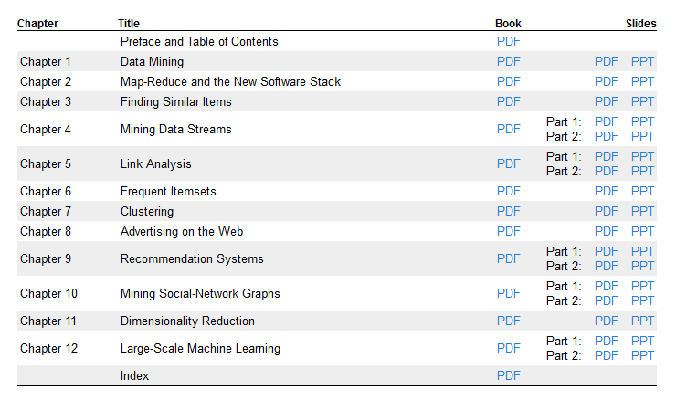
Textbook: http://www.mmds.org/
Mining of Massive Datasets (Leskovec, Rajaraman, Ullman)

Slide 8
Course Overview
Introduction (1 lecture; A0 = WarmingUp Assignment)
Recommender Systems: Collaborative Filtering, MatrixFactorization, ALS (2 lectures)
Assignment 1: build a simple recommender system
Finding Similar Items: LSH, Minhashing, Sketches (2 lectures)
Assignment 2: finding pairs of similar objects
Mining Data Streams: sampling, filtering, counting; on-line marketing (3 lectures)
Link Analysis: PageRank Algorithm (1 lecture) Assignment 3:?
Distributed Processing Massive Data: Hadoop, MapReduce, Spark (2 lectures)
Optional: SVM, RF, XGBoost, t-SNE,… (state-of-the-art since 10-20 years ;-) )

Slide 9
Course Organization
Registration via the uSis system (done?)
Announcements, Slides, Instructions, etc. on the Brightspace
Course is worth 6 ECTS = 6*28h = 168h = about 12 hours per week
Three Assignments (programming/reporting ): [60% of the final grade]
Exam: many quiz questions/small problems [40% of the final grade]
To pass the course you must pass the practicals AND the exam!

Slide 10
Practicals
TA’s avaliable both on-line and in Snellius labs (your preferences?)
Work in couples, preferably Computer Science + Statistical Science
Presence not compulsory (the same applies to lectures)
Programming (Python 3.x) + Jupyter Notebook (no additional reports!)
Assignments: solve a problem: implement an algorithm(s), try it on some data, deliver a self-contained notebook
The notebook should be a combination of a documented code, results, plots, tables, reflection on results, conclusions

Slide 11
Recommender Systems
Given a few petabytes of sales data from Amazon.com in the form:
<user_id, item_id>
what item would you recommend to the current visitor, current_visitor_id, that is currently visiting Amazon.com and just clicked (or bought) a current_item_id?
You have just a few milliseconds for it!
Given a few terabytes of data collected by Netflix.com in the form:
<user_id, movie_id, rating>
what movie would you recommend to the current visitor of Netflix.com, current_visitor_id?
Again, you have just a few milliseconds for it!

Slide 12
Recommender Systems
Recommendation algorithms can be split into:
Content-based: they use “features” of items or users
Collaborative filtering: they use data date links users to items (sales, ratings, reviews, …)
Further, they can be split into:
“classical”: decision trees, logistic regression, etc.
distance/similarity based algorithms
matrix factorization based algorithms
We will discuss a few of the most successful algorithms in depth
Netflix Challenge: $1.000.000 for the best recommender system

Slide 13
Mining Data Streams
In some situations the incoming stream of data is too fast/too big to be stored – it has to be analyzed “on-the-fly” in very limited memory…
Detecting fraud with electronic transactions
Placing “the right Ad at the right place at the right moment” in response to a click
Prognostic health monitoring of a fighter jet (JSF: a few TB/hour)
Detection of DoS Attacks
Answering questions like: “top 10 most frequent news items on Twitter in the last 10 seconds”, “top 10 products with the most rapidly increasing sales rate”, etc.
A number of algorithms/building blocks have been invented:
Data stream sampling
Selective Filtering
Counting distinct elements in a stream
Real-time advertising (electronic auctions/Google Ads Machine)

Slide 14
Mining Data Streams: Counting Distinct Elements
Given a stream of IP-addresses, or user names, or documents, images, etc., answer, at any moment: how many distinct elements have you seen so far?
Naïve approach: keep a hash table and keep track of the number of elements in the table: constant time, O(N) memory – might be prohibitively big!!!
Flajolet-Martin algorithm: a few bytes of memory (O(log(log(N)))) and several hash functions do the trick (approximately …)

Slide 15
Web Advertising: AdWords
Google AdWords is Google's main advertising product and main source of revenue. Google's total advertising revenues were USD$43 billion in 2012 (http://en.wikipedia.org/wiki/AdWords)
A masterpiece of: data mining, optimalisation, real-time decisioning, engineering
How does it work?
Companies “offer to pay a price” for displaying their ads (per impression, per click, per banner, …) when a user enters specific words in Google search window; e.g. “Amsterdam London”
Usually there are several companies who compete for the same AdWords; they bid for these words. Not always the highest bid wins!
Google estimates the chance of “click-through” for all bidding parties and chooses the one which maximizes Google profit !
On their site, companies may change their bidding strategies; how should they do it?

Slide 16
Finding Similar Items
Imagine a huge collection of “digital items”, eg.:
Wikipedia articles
Photos
Fingerprints
Sales data from Amazon.com (for each user a set of items he bought)
and a similarity measure s(o1, o2) ->[0,1]
How much time would you need to find, for a new item, all items that are very similar to it? [We assume there are not so many such items] O(N)? or O(log(N))? or O(1)???
How much time would you need to find all pairs of items with high similarity? [We assume that there are only a few such pairs] O(N²)? or O(N log(N))? or O(N)???
LSH: Locality Sensitive Hashing (random; small errors possible)

Slide 17
Locality Sensitive Hashing (LSH)
A general technique for “translating” the original set of objects into a set of multiple (hundreds) of hashes, and then hashing these hashes in a special way … so the similar objects fall into the same bucket (with high probability) and non-similar objects fall into different buckets (also, with high probability)
The technique is generic and can be used with various similarity measure, such as: Jaccard similarity, Euclidean Distance, Hamming Distance, Cosine Distance, Edit Distance, …
Keywords: hash function, universal family of hash functions, random projections, minhashing, signature, randomness and probability

Slide 18
The PageRank Algorithm
How Google determines the importance of a page?
A “random surfer” model:
visitors start their session at random pages
visitors walk along links at random
choices are made uniformly (each outgoing link has the same chance)
“page importance” = “probability the surfer visits the page”
It can be modeled by a Markov Process
transition matrix
iterative calculation of page probability distribution
solution = principal eigen vector of the transition matrix
Nowadays a much more sophisticated model is used …

Slide 19
Implementation of PageRank
Key ideas:
M is very sparse: say 10 links per page => 10 non-zeros in a column
keep on M on a harddisk
keep in RAM only the PageRank vector
in every iteration scan the whole matrix M, updating PageRank vector
Some numbers:
n=1.000.000.000 (1 billion nodes)
RAM needed: 4GB (32bits per node)
harddisk: about 40GB (10xRAM)
a single scan: about 2-3 minutes
50 iterations => 2-3 hours

Slide 20
Distributed Data Mining
Web data sets can be very large (and distributed)
Tens to hundreds of terabytes (or petabytes)
Cannot mine on a single server
Standard architecture emerging:
Clusters of commodity Linux nodes
Gigabit ethernet interconnect (or fiberglass)
How to handle node failures?
How to organize computations on this architecture?

Slide 21
Hadoop and MapReduce
Hadoop Distributed File System (hdfs)
chunks, replicas, “read-only”, “write/append once”
unlimited scalability (million of nodes)
very robust, can run on a cluster/grid/WAN
MapReduce:
Map: “process chunks of data”
shuffle and sort (implicit, pre-programmed)
Reduce: “aggregate partial results”

Slide 22
Hadoop and PySpark
Modern (Python-based) systems for processing huge data on distributed platforms
Distributed Data Mining at LIACS
High Performance Computing Lab: Clusters with hundreds of cores, TB of RAM, hundreds of TB disk http://rel.liacs.nl/labs/hpclab
Data Science Lab with a few big computers with TBs RAM and/or many processors http://rel.liacs.nl/labs/dslab

Slide 23
Hash Functions, Hash Tables
A hash function is a function which maps objects from a universe U (numbers, strings, documents, etc.) into integers {0, 1, …, N-1} (“buckets”), in a uniform way (more or less), i.e., each bucket contains more or less the same number of objects.
We will work with families of hash functions: f₁, f₂, …. We assume there is a universal hash function f(i,x), such that f_{i}(x)=f(i,x).
There is a huge body of literature on hashing. During the course we will simply assume that hash functions are available, have nice properties (“random uniformity” and “independence”) and can be computed in linear time (in the input size).
To learn more check hash function and universal hashing on Wikipedia.

Slide 24
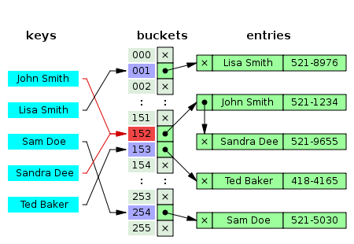
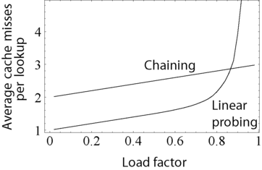
Hash Tables/Dictionaries
A hash table is a data structure which can store objects from a universe U, such that the expected cost of inserting, deleting and searching a single element takes O(1) steps.
A load factor is the ratio K/N, where K is the size of the universe, N is the number of bins.
^{1/k}

Slide 25
An important sequence
The sequence (1+1/n)^{n} is increasing and slowly converges to e ≈ 2.7182818…
The sequence (1-1/n)^{n} converges to 1/e
The sequence (1-1/kn)^{n} = (1-1/kn)^{kn/k} = ( (1-1/kn)^{kn}) ^{1/k} converges to (1/e) ^{1/k}
Study section 1.3.5 (The base of natural logarithms) of the textbook – we will need it frequently!

Slide 26
A0: Experiments with random integers
Theory: Suppose you generate n random integers between 0 and N; (eg., the numpy random number generator:
r=np.random.randint(0, high=1000000, size=10000)
generates n=10.000 integers smaller than N=1.000.000)
How many unique values do you expect? 10.000? Less!!! (Your random numbers might repeat!) Find a formula that expresses this number:
unique_values(n,N) = ???

Slide 27
A0: Experiments with random integers
Practice: Experiment with various values of n and N, e.g.,
n=1000, 10000;
N=n, 2n, 4n, 8n, …, 64n;
Repeat each experiment several times (with different random seeds) to get a more reliable estimates of the number of unique numbers you’ve generated.
Analysis:
Are the results of experiments consistent with your formula?

Slide 28
A0: Experiments with random integers
Deliver: a single Jupyter notebook (in Python 3.x) that documents your theoretical considerations, experiments and conclusions.
Not obligatory!
Easy deadline (3 weeks)
Reward: feedback + grade (which will not count, but will give you an idea of what we expect from you in the future)
“fluency with Brightspace” (both for you and TA’s)

Slide 29
A0: Experiments with hash functions
Why do we play with random integers? This is exactly what we expect from “real” hash functions: when applied to “digital objects” (e.g., strings, images, numbers, etc.) they return integer values (in a pre-specified range) that should look like random integers (e.g., two similar object should be mapped into two different integers!).
Bonus task: Design, implement* and test any hash function that can be applied to strings (e.g., words), returning 32bit unsigned integers (uint32). *or just find such a function somewhere!

