Slide 1
A free local agent for literature search, extraction, and systematic-review drafting
Why it matters
No paid API
Runs with local Ollama
Auditable
JSON + Markdown outputs
The pipeline searches papers, ranks candidates with PubMedBERT, extracts structured evidence with a local Qwen model, and saves auditable JSON, paper summaries, and manuscript drafts.
Review-aware
Eligibility criteria embedded
Core workflow
1
Search
2
Rank
3
Extract
4
Draft
Query Crossref, PubMed, and Semantic Scholar
Collect title, abstract, DOI, authors, journal, and links
Use PubMedBERT embeddings and lexical overlap
Prioritize papers most aligned to the review question
Screen include / maybe / exclude
Extract methods, outcomes, results, limitations, and takeaways
Aggregate included papers
Create PRISMA-style manuscript draft
Primary outputs
ranked_candidates.json
extractions/*.json
paper_summaries/*.md
manuscript_final.md
Relevance-ranked paper list
Structured evidence records
Readable paper summaries
Draft systematic review
Local Literature Review Agent | Ollama + Qwen + PubMedBERT
1/2

Slide 2
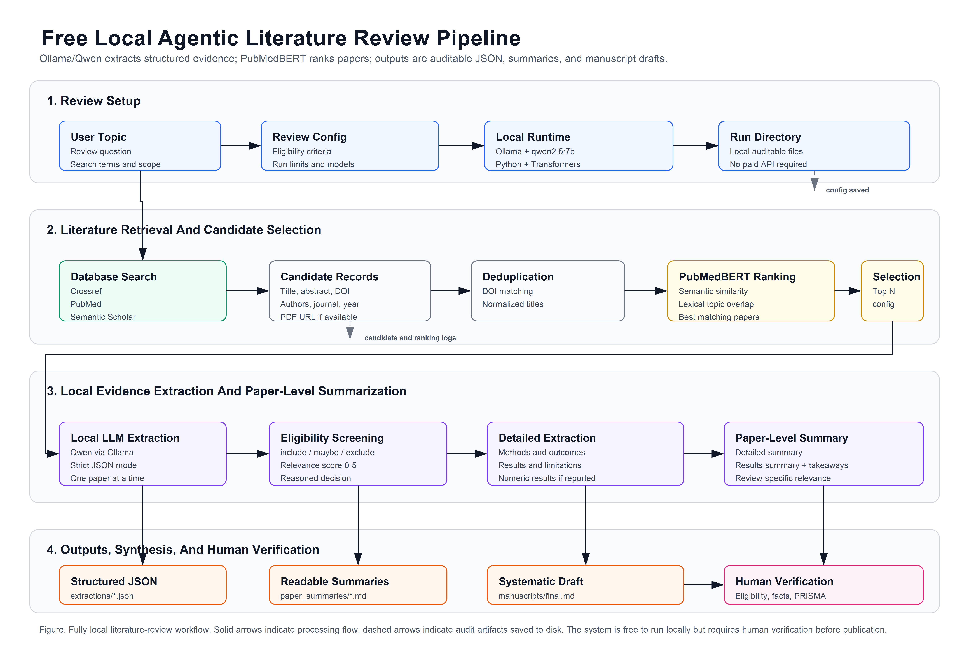
How the local agent moves from search results to review-ready evidence
Model roles
PubMedBERT narrows the candidate set; Qwen performs screening, structured extraction, paper summaries, and final drafting.
PubMedBERT
Ranks candidate papers
Uses biomedical/scientific semantic similarity
Reduces slow local LLM calls
Qwen via Ollama
Screens eligibility
Extracts structured JSON
Writes detailed summaries and manuscript draft
Human reviewer drafts
Verifies eligibility
Checks extracted facts
Approves manuscript claims
Best practice
Start with 5-10 papers, inspect summaries, then scale up.
2/2

Slide 3
