Slide 1
Experiment goal
Compare the key ranking quality produced by KeyRanker with that using “Achichi et al” approach.
Only perfect string similarities are considered in the linking process since “Achichi et al” approach does not take into account the partial similarities.
Link Discovery Framework : SILK

Slide 2
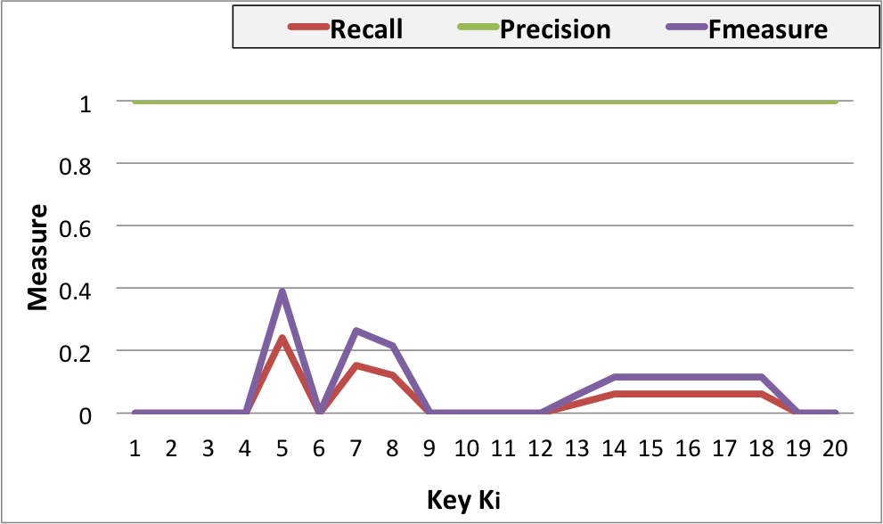
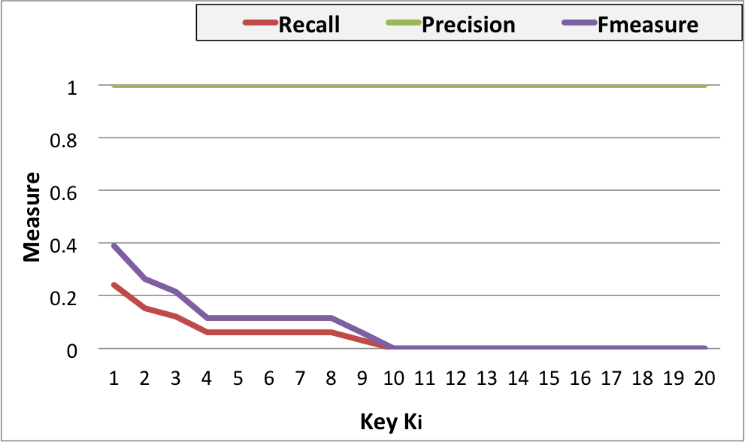
DOREMUS LAST VERSION - FP Consists of a pair of datasets containing each 33 musical works which are very similar in their description.
Achichi et al
KeyRanker
Configuation :
Link Discovery Framework : SILK
Perfect string similarities
Exploration Depth =2

Slide 3
DOREMUS LAST VERSION - FP Consists of a pair of datasets containing each 33 musical works which are very similar in their description.
05 best ranked keys:
PREFIX erl-current : <http://erlangen-crm.org/current/>
PREFIX erl-efrbroo : < http://erlangen-crm.org/efrbroo/>
PREFIX doremus : <http://data.doremus.org/ontology#>
K1 = [{doremus:U17_has_opus_statement, erl-current:P3_has_note}]
K2 = [{erl-current:P102_has_title}, {doremus:U10_has_order_number}]
K3 = [{doremus:U17_has_opus_statement, doremus:U42_has_opus_number}, {erl-efrbroo: R17_created_inverse, erl-current:P9_consists_of, doremus:U31_had_function_of_type}, {erl-current :P102_has_title}]
K4 = [{doremus:U16_has_catalogue_statement, erl-current:P3_has_note}]
K5 = [{doremus:U16_has_catalogue_statement, doremus:U41_has_catalogue_number}]

Slide 4
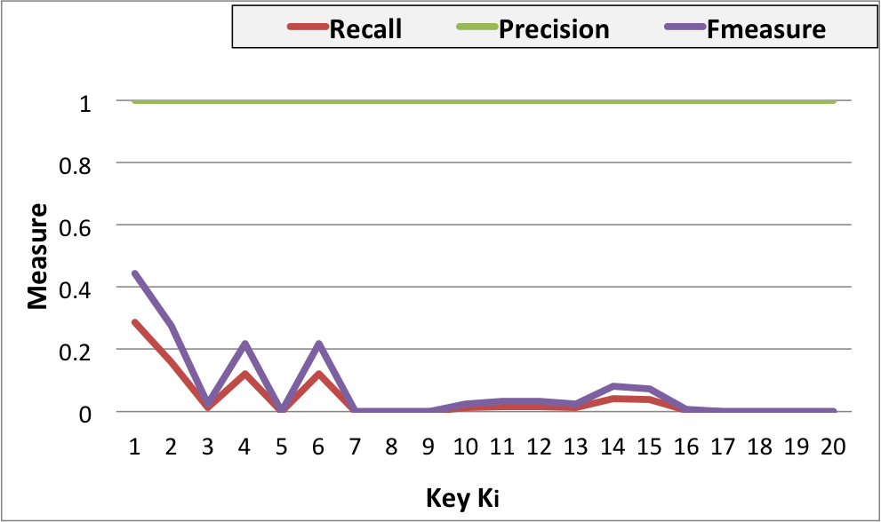
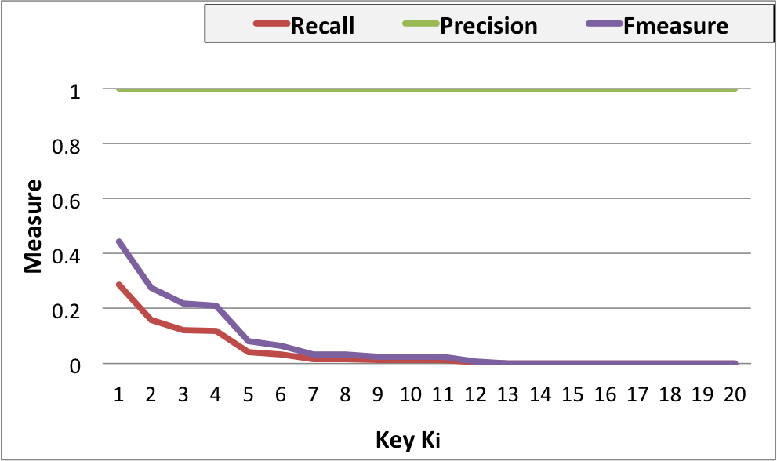
DOREMUS LAST VERSION - HT Consists of a pair of datasets containing each 238 musical works which are heterogeneous in their description.
Achichi et al
KeyRanker
Configuation :
Link Discovery Framework : SILK
Perfect string similarities
Exploration Depth =2

Slide 5
DOREMUS LAST VERSION - HT Consists of a pair of datasets containing each 238 musical works which are heterogeneous in their description.
05 best ranked keys:
PREFIX erl-current : <http://erlangen-crm.org/current/>
PREFIX erl-efrbroo : < http://erlangen-crm.org/efrbroo/>
PREFIX doremus : <http://data.doremus.org/ontology#>
K1 = [{doremus:U16_has_catalogue_statement, erl-current:P3_has_note}]
K2 = [{erl-current:P102_has_title}, {doremus:U16_has_catalogue_statement, doremus:U41_has_catalogue_number}]
K3 = [{erl-current:P102_has_title}, {doremus:U17_has_opus_statement, erl-current:P3_has_note}]
K4 = [{erl-current:P102_has_title}, {doremus:U17_has_opus_statement, doremus:U42_has_opus_number}, {erl-efrbroo:R17_created_inverse, erl-current:P9_consists_of, doremus:U31_had_function_of_type}]
K5 = [{doremus:U10_has_order_number}, {doremus;U17_has_opus_statement, doremus:U42_has_opus_number}]

Slide 6
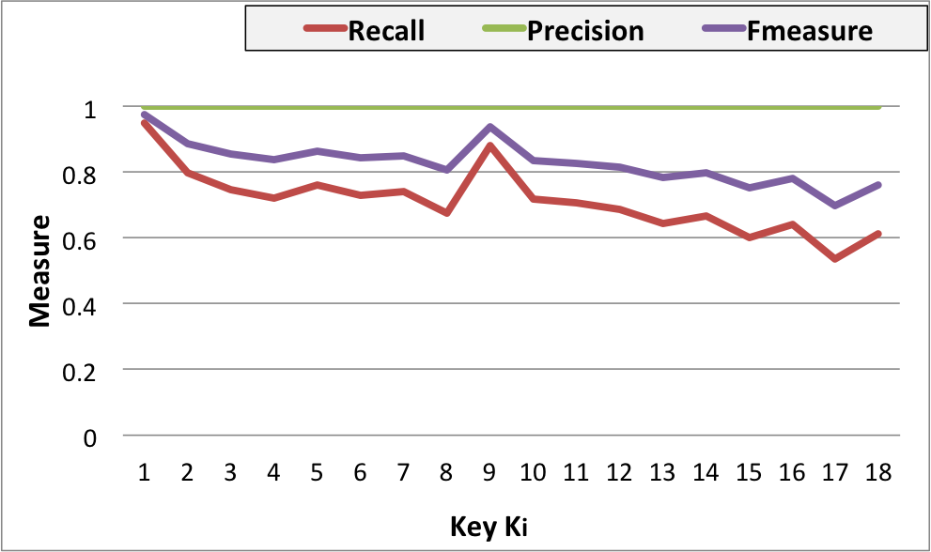
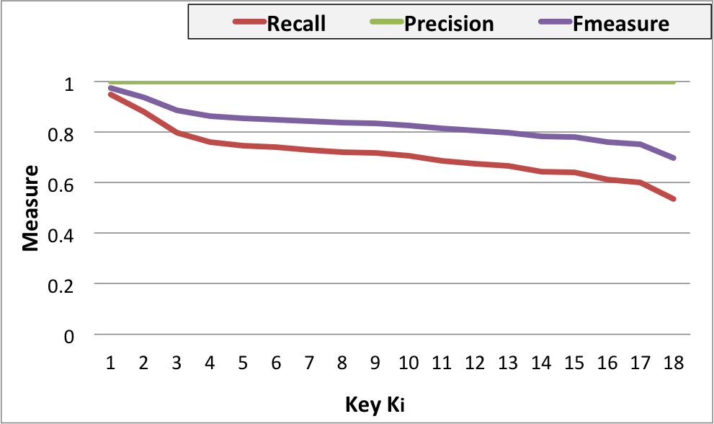
OAEI - PERSON Both files contain 500 records,
Achichi et al
KeyRanker
Configuation :
Link Discovery Framework : SILK
Perfect string similarities
Exploration Depth =2

Slide 7
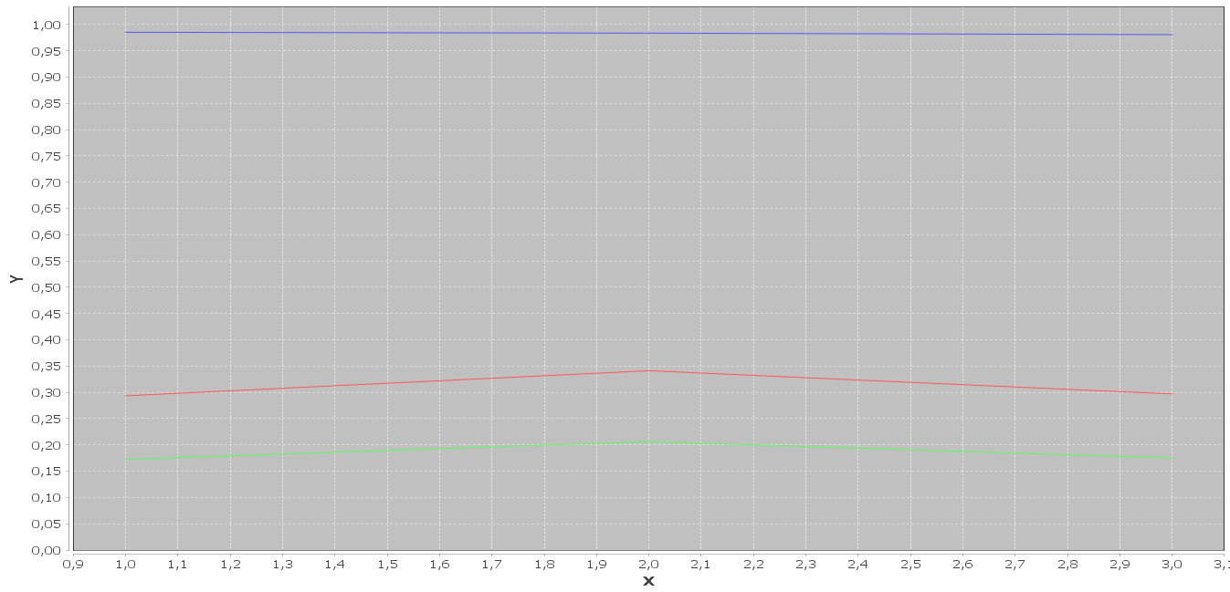
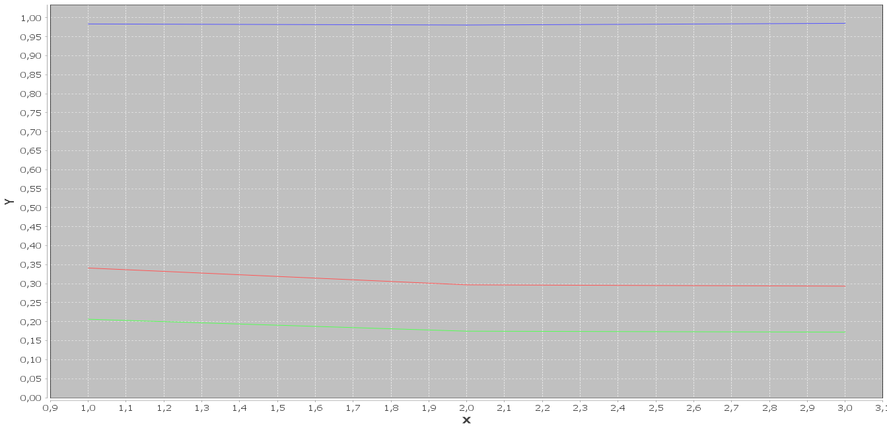
OAEI 2016 – UOBM SANDBOX (~2340 INSTANCES, ~14000 TRIPLES)
Achichi et al
KeyRanker
Configuation :
Link Discovery Framework : SILK
Using 2-almost-key
Perfect string similarities
Exploration Depth =2

Slide 8
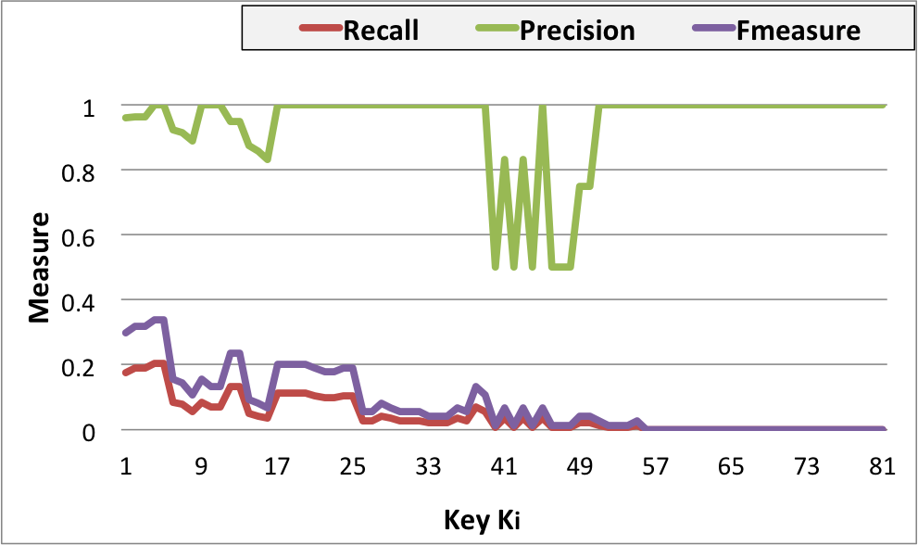
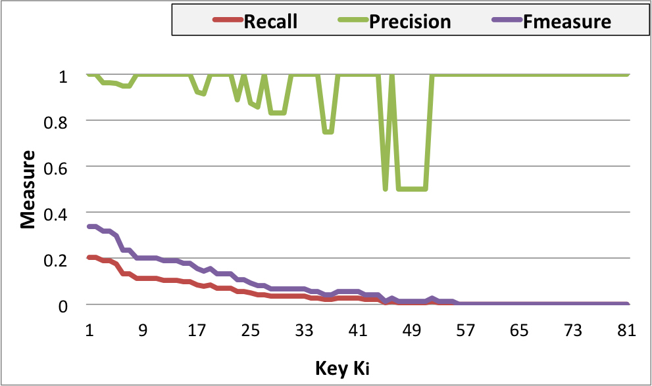
OAEI 2016 – SPIMBENCH SANDBOX Restriction on : <http://www.bbc.co.uk/ontologies/creativework/BlogPost>
Achichi et al
KeyRanker
Configuation :
Link Discovery Framework : SILK
Perfect string similarities
Exploration Depth =2

Slide 9
OAEI 2016 – SPIMBENCH SANDBOX Restriction on : <http://www.bbc.co.uk/ontologies/creativework/BlogPost>
05 best ranked keys :
PREFIX bbc : <http://www.bbc.co.uk/ontologies/bbc/>
PREFIX bbc-cw : <http://www.bbc.co.uk/ontologies/creativework/>
PREFIX rdfs : <http://www.w3.org/2000/01/rdf-schema#>
PREFIX dbpedia : <http://dbpedia.org/property/>
PREFIX xmlns: <http://xmlns.com/foaf/0.1/>
K1 = [{bbc-cw:dateModified}, {bbc-cw:about, xmlns:name}]
K2 = [{bbc-cw:dateCreated}, {bbc-cw:about, xmlns:name}]
K3 = [{bbc-cw:dateCreated}, {bbc-cw:about, rdfs:comment}]
K4 = [{bbc-cw:dateModified}, {bbc-cw:about, rdfs:comment}]
K5 = [{bbc-cw:altText}]

Slide 10
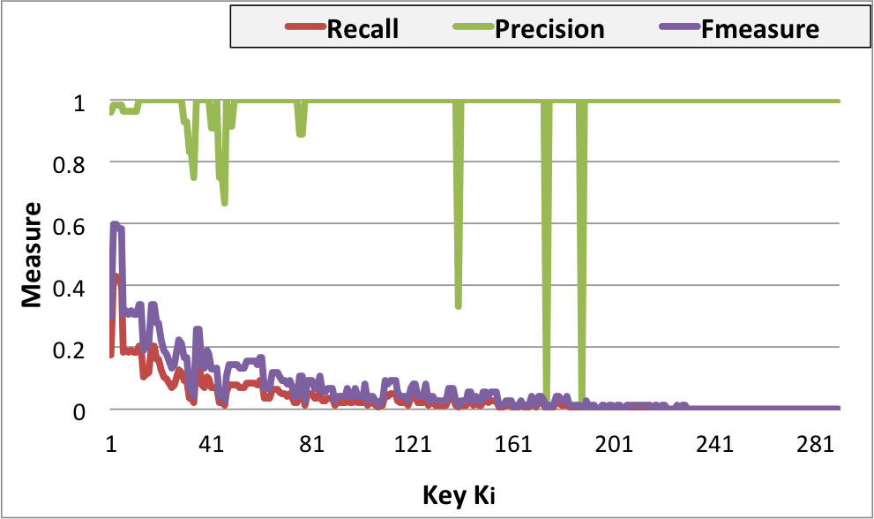
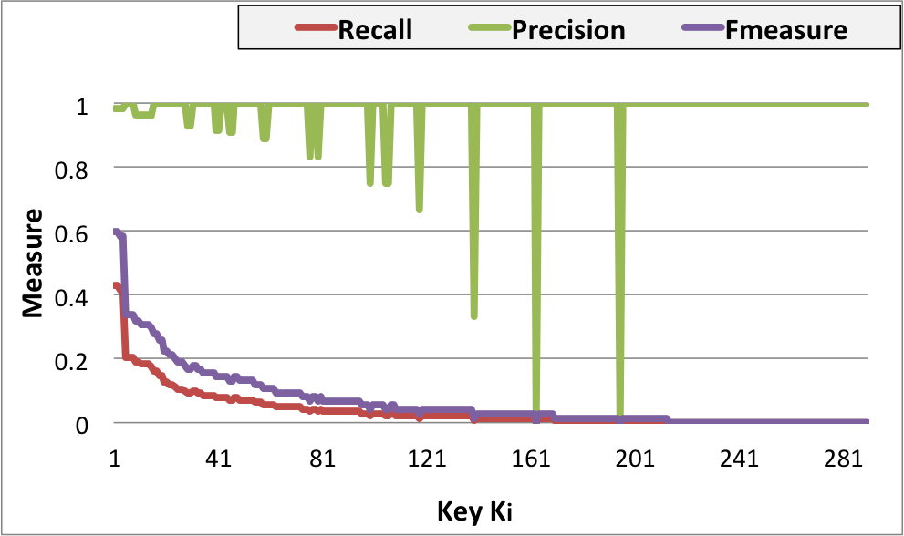
OAEI 2016 – SPIMBENCH SANDBOX Restriction on : <http://www.bbc.co.uk/ontologies/creativework/BlogPost>
Achichi et al
KeyRanker
Configuation :
Link Discovery Framework : SILK
Perfect string similarities
Exploration Depth =3

Slide 11
OAEI 2016 – SPIMBENCH SANDBOX Restriction on : <http://www.bbc.co.uk/ontologies/creativework/BlogPost>
05 best ranked keys:
PREFIX rdfs : <http://www.w3.org/2000/01/rdf-schema#>
PREFIX bbc : <http://www.bbc.co.uk/ontologies/bbc/>
PREFIX bbc-cw : <http://www.bbc.co.uk/ontologies/creativework/>
PREFIX dbpedia : <http://dbpedia.org/property/>
K1 = [{bbc:primaryContentOf, bbc:ProductType, rdfs:comment}, {rdfs:dateCreated}]
K2 = [{bbc:primaryContentOf, bbc:ProductType, rdfs:comment}, {bbc-cw:dateModified}]
K3 = [{bbc:primaryContentOf, bbc:ProductType, dbpedia:caption}, {bbc-cw:dateCreated}]
K4 = [{bbc:primaryContentOf, bbc:ProductType, dbpedia:caption}, {bbc-cw:dateModified}]
K5 = [{bbc:primaryContentOf, bbc:ProductType, dbpedia:caption}, {bbc-cw:description}]

Slide 12
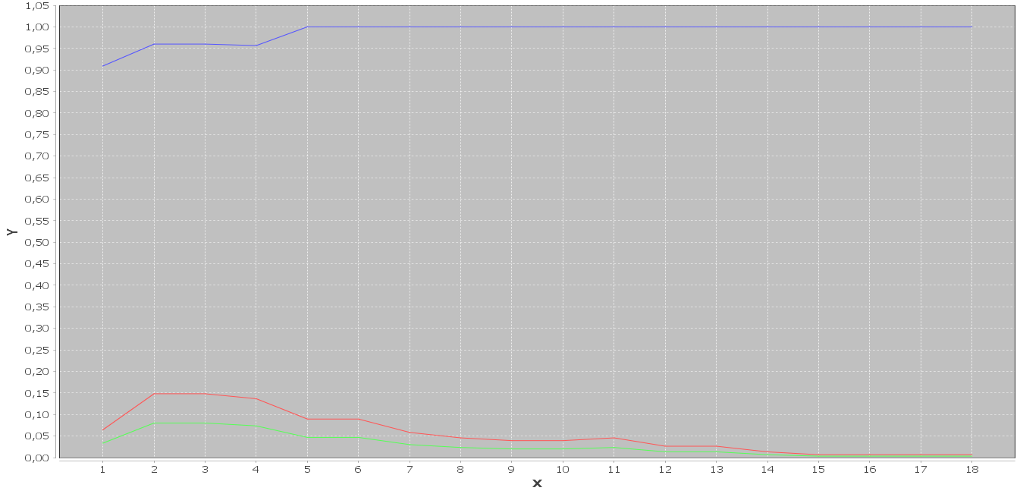
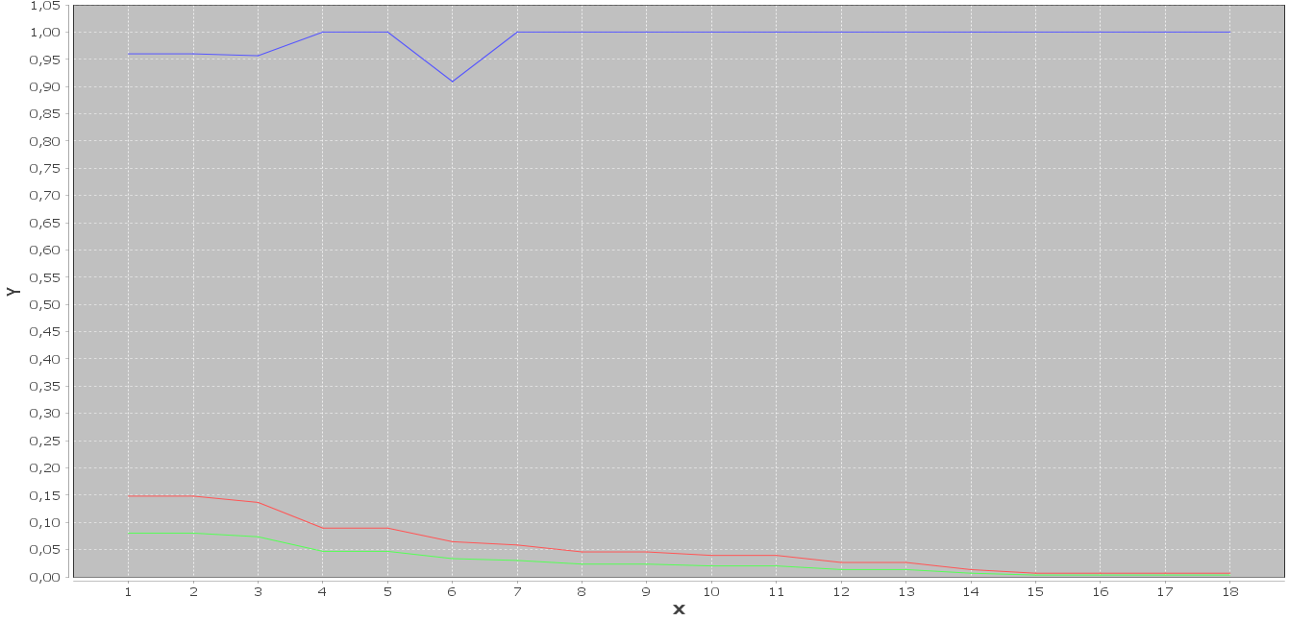
OAEI 2016 – SPIMBENCH SANDBOX Restriction on : <http://www.bbc.co.uk/ontologies/creativework/Programme>
Achichi et al
KeyRanker
Configuation :
Link Discovery Framework : SILK
Perfect string similarities
Exploration Depth =2

Slide 13
Experiment goal
Study the key ranking for different variation of the similarity threshold.
Link Discovery Framework : LIMES
Perfect string similarities
Exploration Depth =2

Slide 14
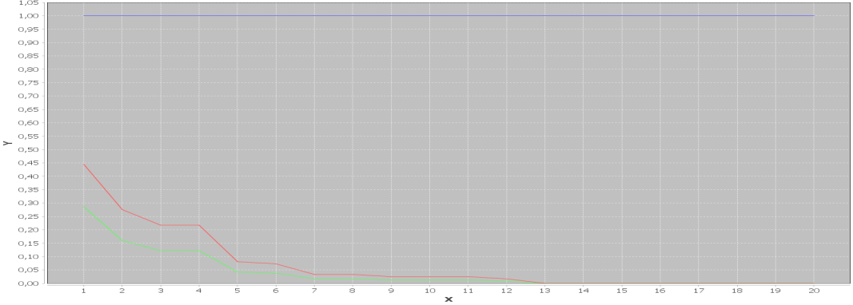
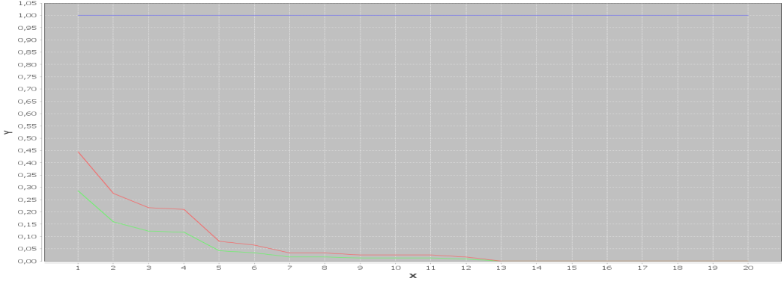
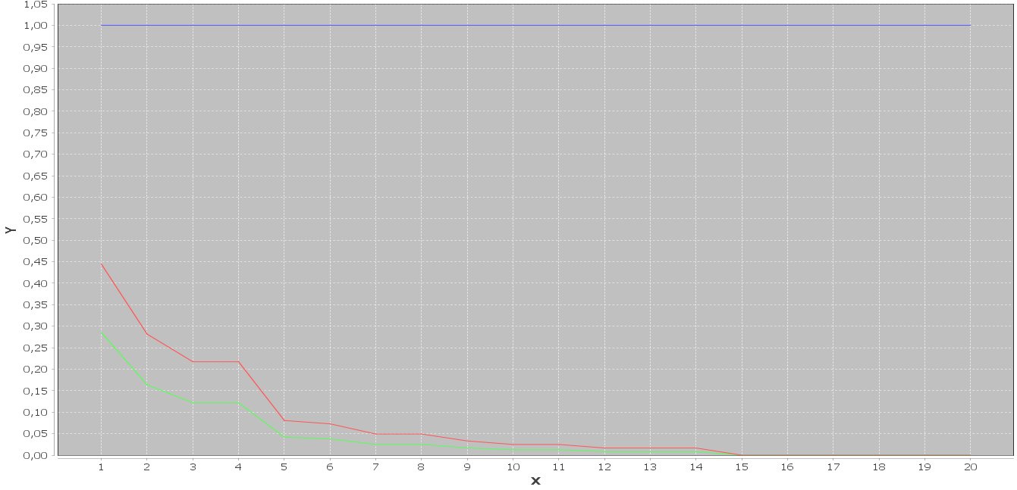
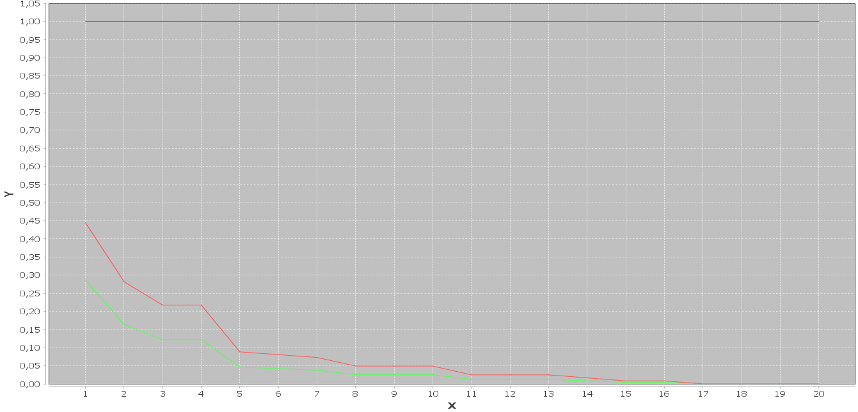
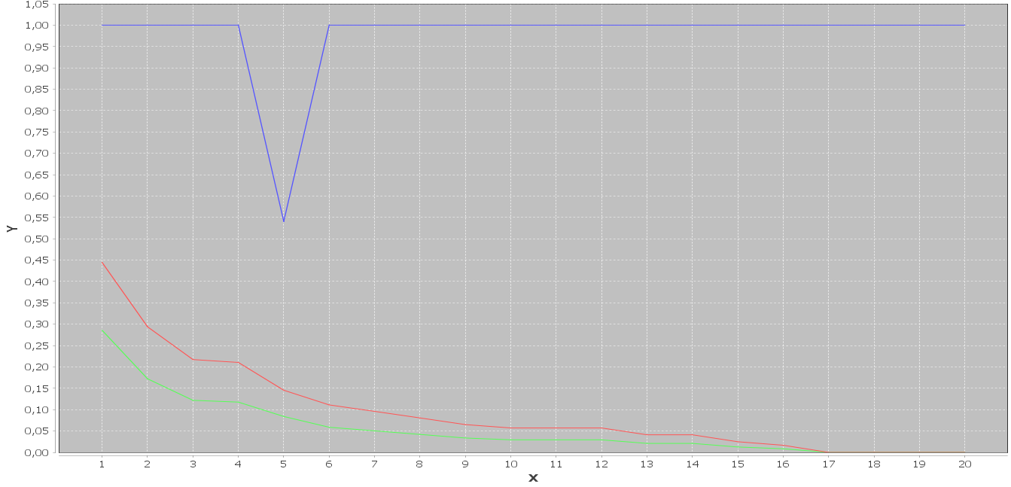
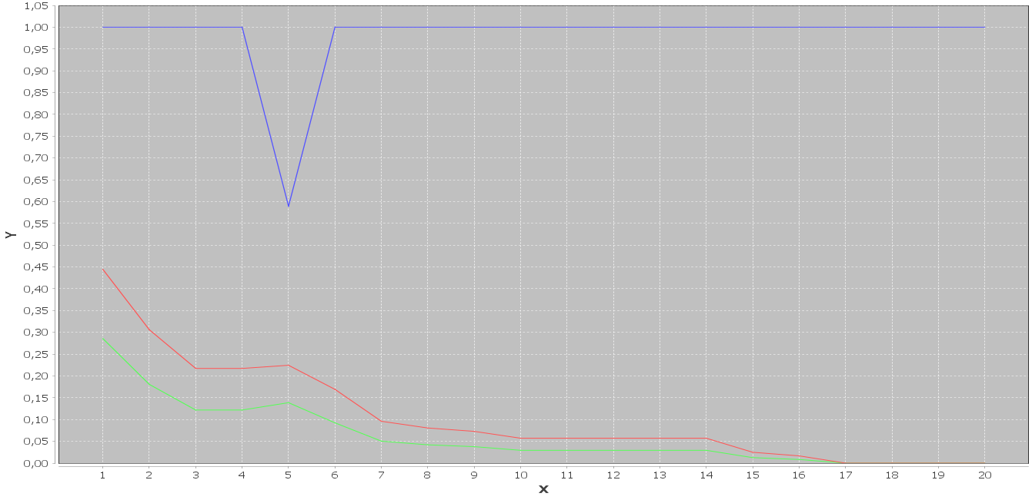
DOREMUS LAST VERSION – HT
Consists of a pair of datasets containing each 238 musical works which are heterogeneous in their description.
K-Threshold = 1
K-Threshold = 0,95
K-Threshold = 0,90
K-Threshold = 0,85
K-Threshold = 0,80
K-Threshold = 0,75

Slide 15
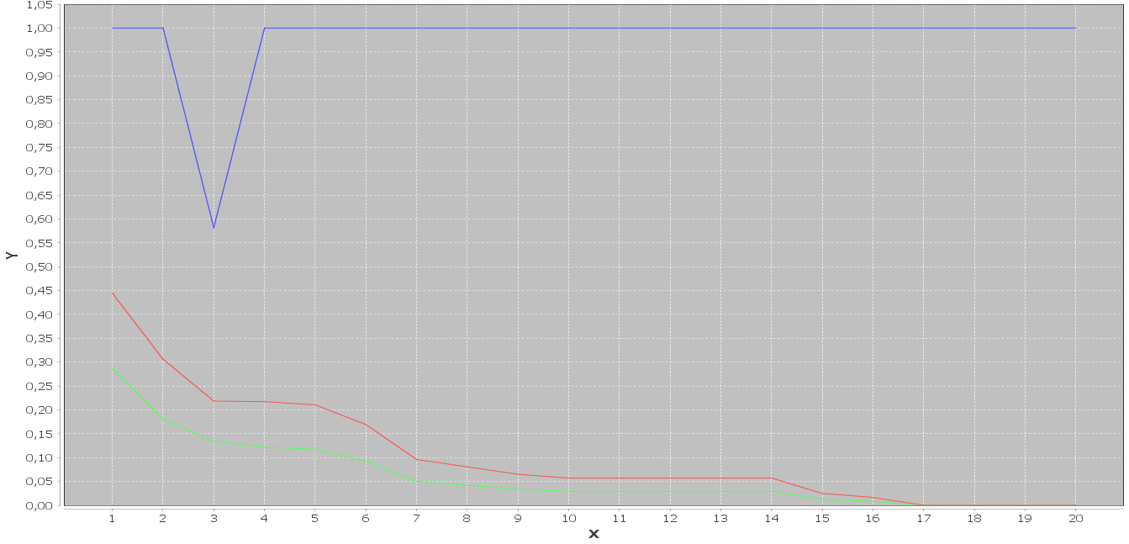
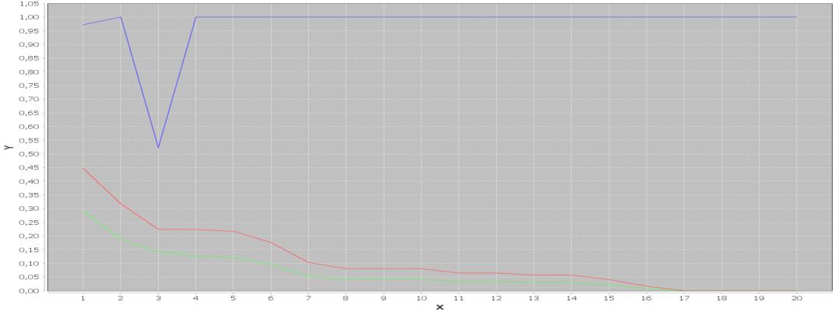
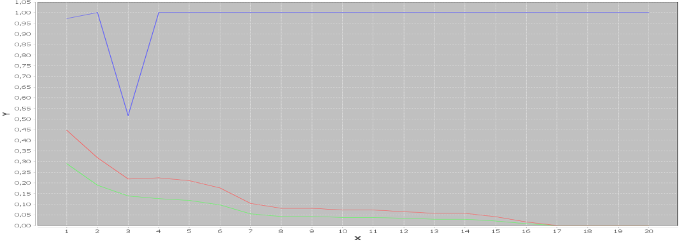
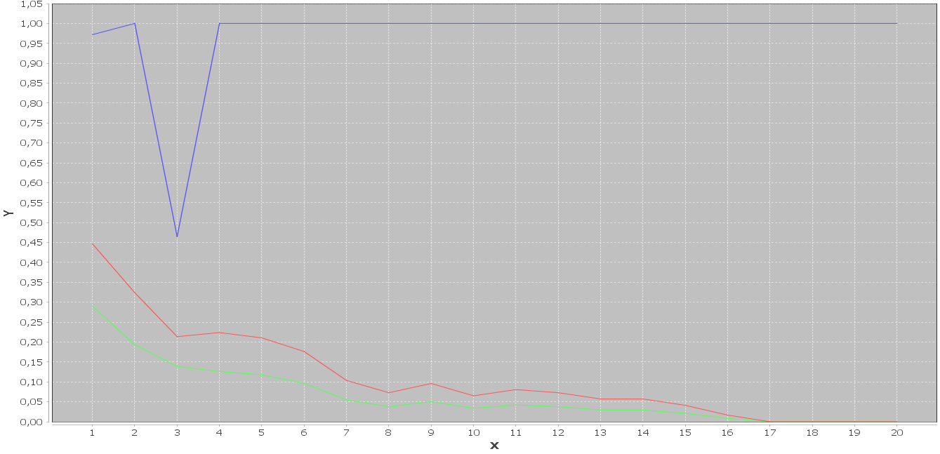
DOREMUS LAST VERSION – HT
Consists of a pair of datasets containing each 238 musical works which are heterogeneous in their description.
K-Threshold = 0,7
K-Threshold = 0,65
K-Threshold = 0,6
K-Threshold = 0,55

Slide 16
Objectif de l’étude
Combining complementary keys
Link Discovery Framework : SILK
Perfect string similarities
Exploration Depth =2

Slide 17
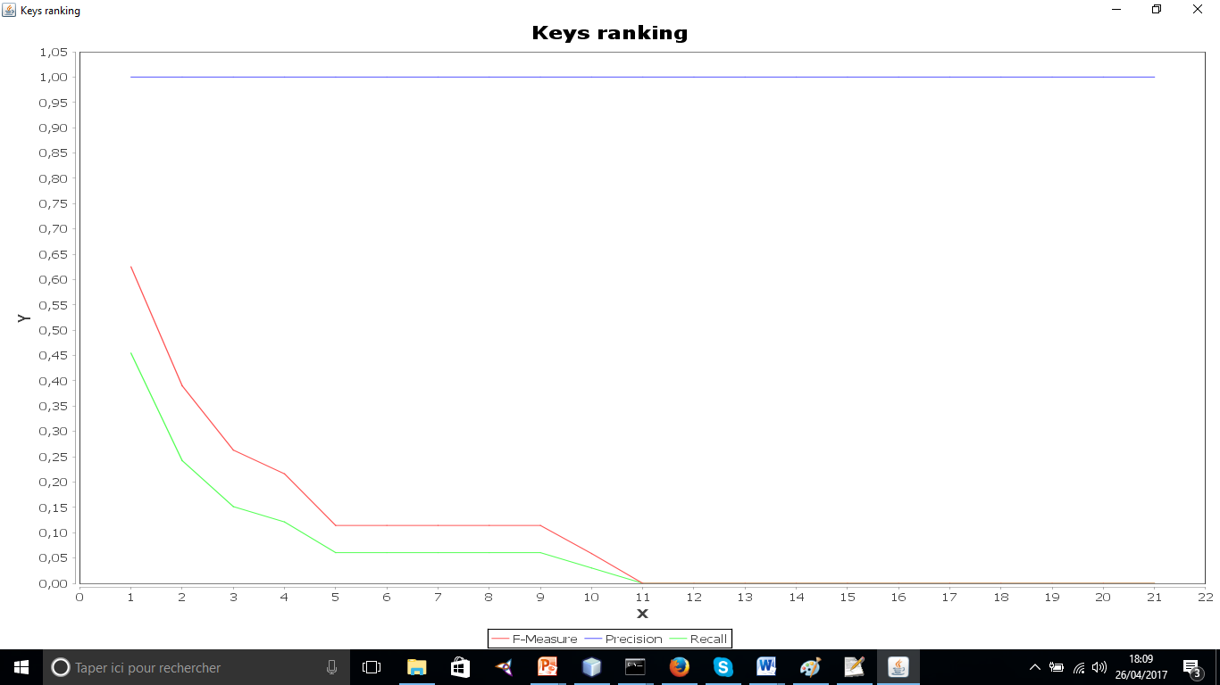
DOREMUS LAST VERSION - FP Consists of a pair of datasets containing each 33 musical works which are very similar in their description.
Combined Keys = K1 * K2 * K4

Slide 18

DOREMUS LAST VERSION - HT Consists of a pair of datasets containing each 238 musical works which are heteregeneous in their description.
CombinedKey = K1 * K2 * K3 * K4 * K5 * K7

Slide 19
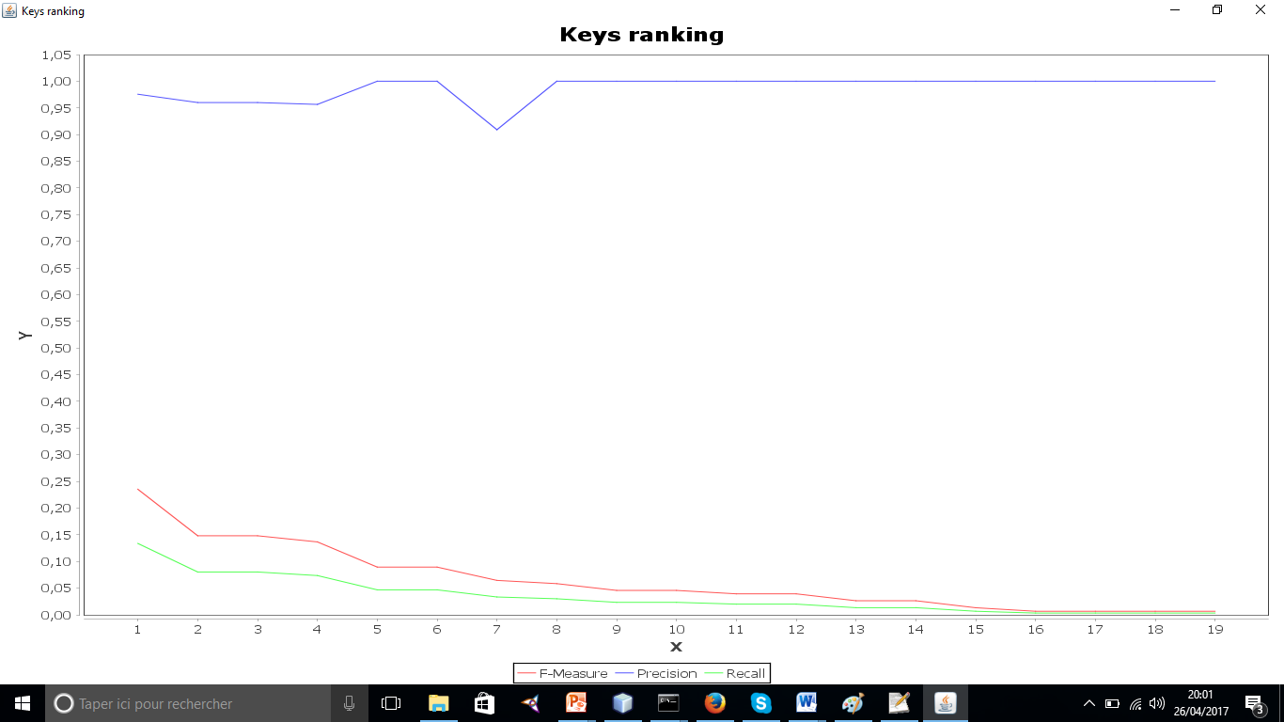
OAEI 2016 – SPIMBENCH SANDBOX Restriction on :<http://www.bbc.co.uk/ontologies/creativework/Programme>
CombinedKey = K1 * K3 * K4 * K6 * K8

Slide 20
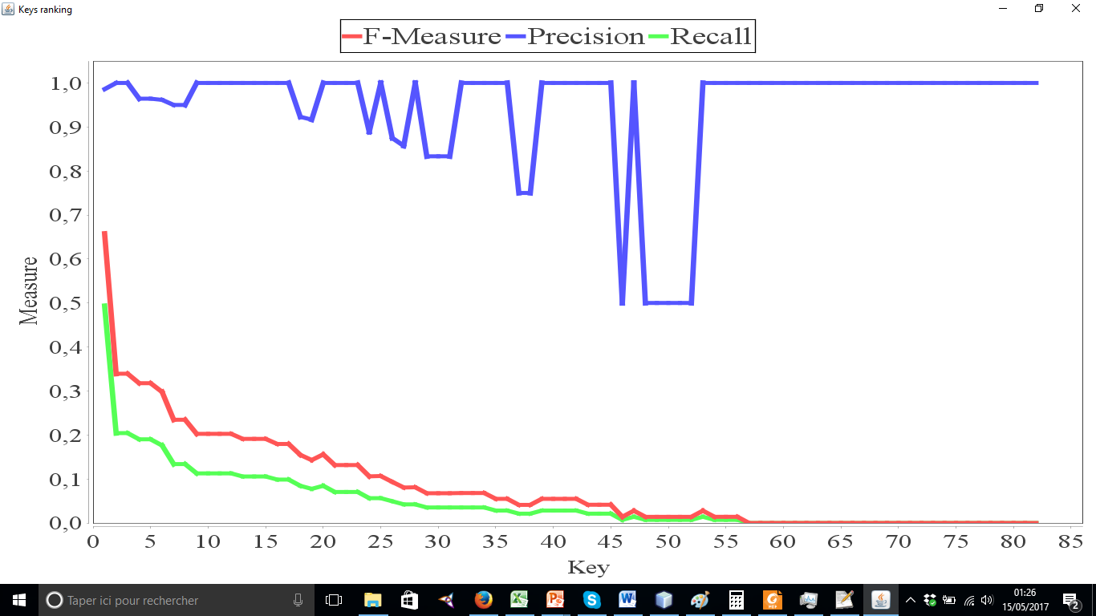
OAEI 2016 – SPIMBENCH SANDBOX Restriction on :<http://www.bbc.co.uk/ontologies/creativework/BlogPost>
CombinedKey = K1 * K3 * K5

Slide 21
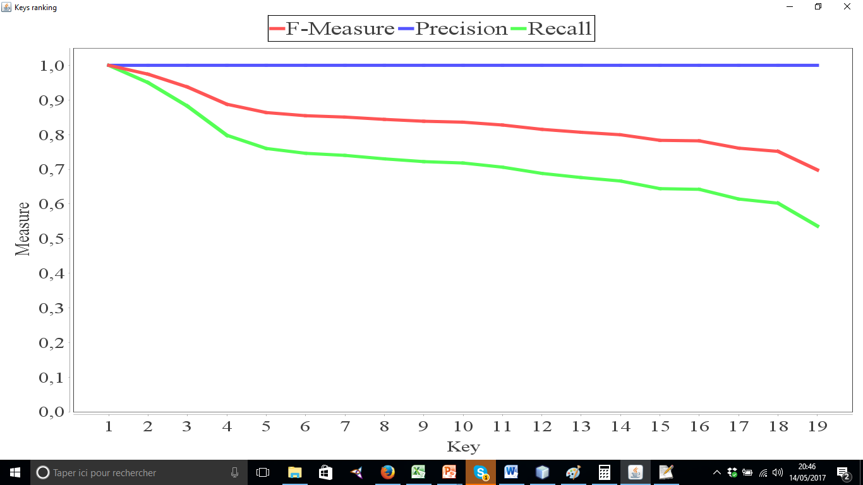
OAEI - PERSON Both files contain 500 records,
CombinedKey = K1 * K3

