Slide 1


EMSEC/SHA Blockseminar
Side-Channel Attacks on Implementations of Lattice-Based Cryptosystems
Felix Haarmann, Julian Speith
July 26th, 2016

Slide 2
WHAT?!?
Current public-key crypto vulnerable to quantum computing
Shor’s algorithm for prime factorization and discrete logarithms
Quantum computers might become feasible in near future
Todays digital infrastructure is based on public-key crypto
Urgent need for post-quantum crypto
Lattice-based crypto is one possible solution
Currently most promising one, as it is pretty efficient
Side-Channel attack resistance is important for future implementations

Slide 3
Structure of our Presentation
Some Basics...
Ring-LWE Encryption Scheme
Masking using a masked decoder
Additively homomorphic masking
BLISS (Bimodal Lattice Signature Scheme)
Sampling algorithms
Cache attacks
Blinding Countermeasures

Slide 4
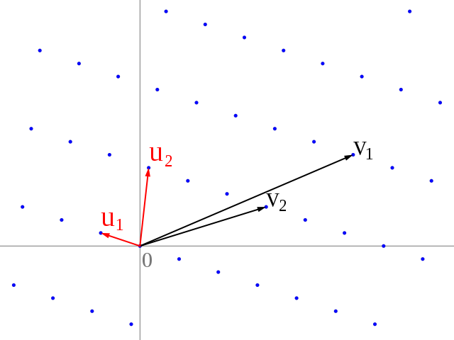
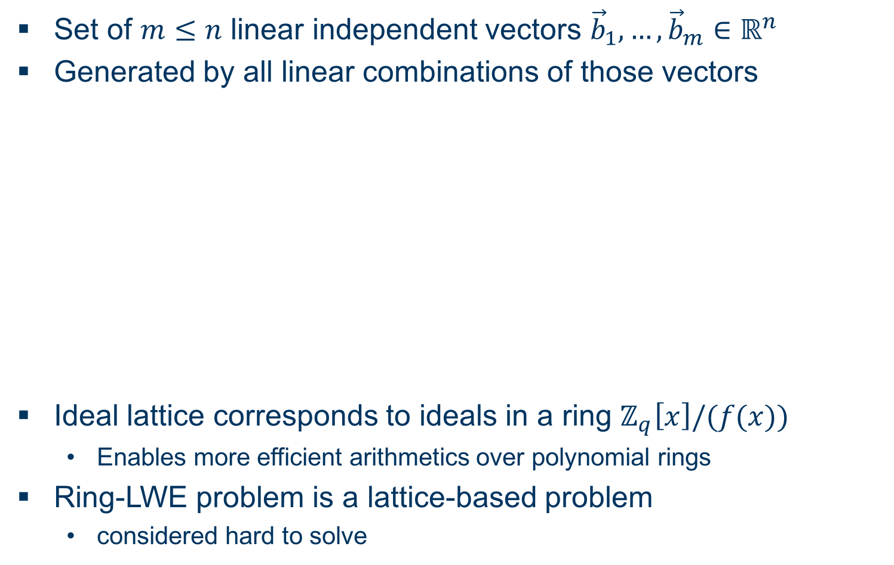
Some Basics... Ideal Lattices and Learning with Errors over Rings
Set of $m≤n$ linear independent vectors ${\vec{b}}_{1},…,{\vec{b}}_{m}∈ℝ^{n}$
Generated by all linear combinations of those vectors
Ideal lattice corresponds to ideals in a ring $ℤ_{q}\left[x\right]/(f(x))$
Enables more efficient arithmetics over polynomial rings
Ring-LWE problem is a lattice-based problem
considered hard to solve

Slide 5
Some Basics... Discrete Gaussian Distribution

Slide 6
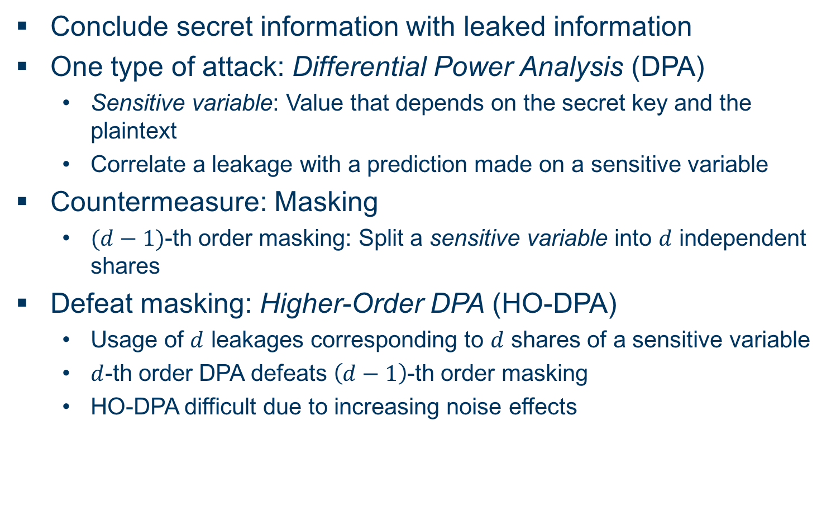
Some Basics... Side-Channel Attack Terminology (DPA)
Conclude secret information with leaked information
One type of attack: Differential Power Analysis (DPA)
Sensitive variable: Value that depends on the secret key and the plaintext
Correlate a leakage with a prediction made on a sensitive variable
Countermeasure: Masking
$(d−1)$-th order masking: Split a sensitive variable into $d$ independent shares
Defeat masking: Higher-Order DPA (HO-DPA)
Usage of $d$ leakages corresponding to $d$ shares of a sensitive variable
$d$-th order DPA defeats $\left(d−1\right)$-th order masking
HO-DPA difficult due to increasing noise effects

Slide 7
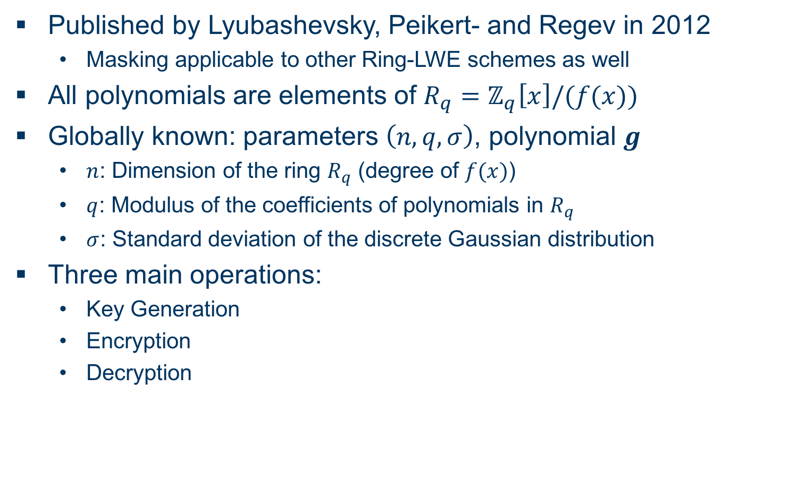
Ring-LWE Encryption Scheme Overview
Published by Lyubashevsky, Peikert- and Regev in 2012
Masking applicable to other Ring-LWE schemes as well
All polynomials are elements of $R_{q}=ℤ_{q}\left[x\right]/(f(x))$
Globally known: parameters $\left(n,q,σ\right)$, polynomial $g$
$n$: Dimension of the ring $R_{q}$ (degree of $f(x)$)
$q$: Modulus of the coefficients of polynomials in $R_{q}$
$σ$: Standard deviation of the discrete Gaussian distribution
Three main operations:
Key Generation
Encryption
Decryption

Slide 8

Ring-LWE Encryption Scheme Key Generation
Sample $r$ and $s$ according to $𝒩_{ℤ}^{n}\left(0,σ^{2}\right)$
Compute $p=r−gs$
Output: Public key $p$, secret key $s$

Slide 9
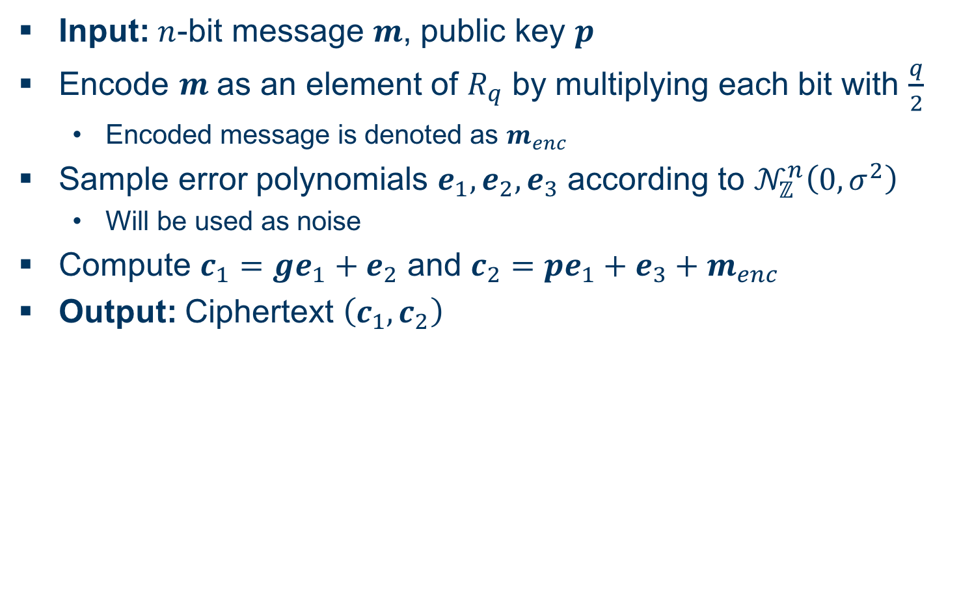
Ring-LWE Encryption Scheme Encryption
Input: $n$-bit message $m$, public key $p$
Encode $m$ as an element of $R_{q}$ by multiplying each bit with $\frac{q}{2}$
Encoded message is denoted as $m_{enc}$
Sample error polynomials $e_{1},e_{2},e_{3}$ according to $𝒩_{ℤ}^{n}\left(0,σ^{2}\right)$
Will be used as noise
Compute $c_{1}=ge_{1}+e_{2}$ and $c_{2}=pe_{1}+e_{3}+m_{enc}$
Output: Ciphertext $\left(c_{1},c_{2}\right)$

Slide 10
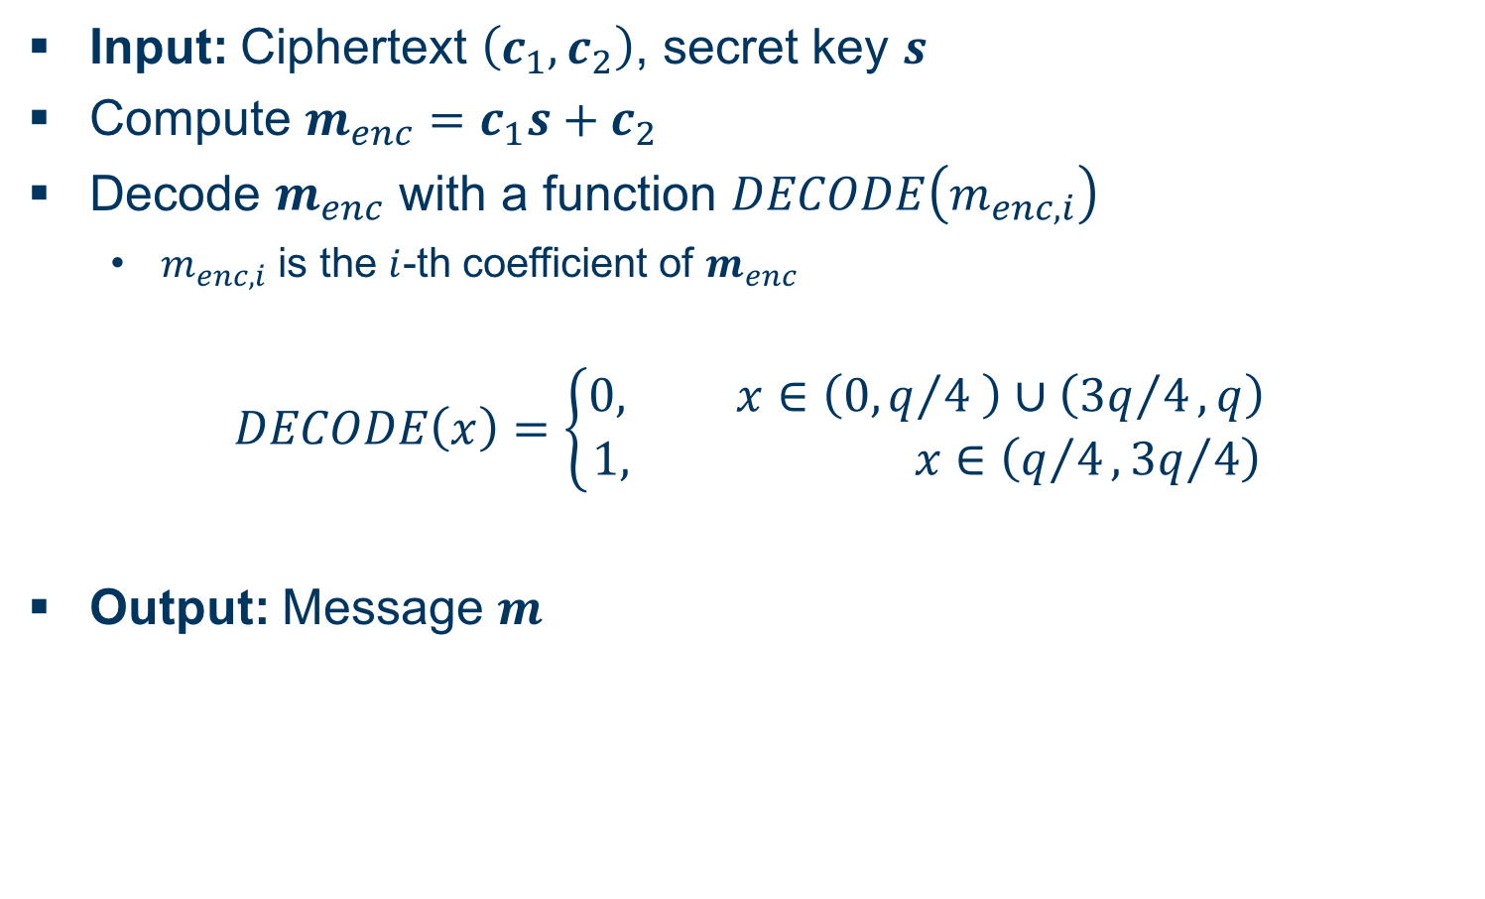
Ring-LWE Encryption Scheme Decryption
Input: Ciphertext $\left(c_{1},c_{2}\right)$, secret key $s$
Compute $m_{enc}=c_{1}s+c_{2}$
Decode $m_{enc}$ with a function $DECODE\left(m_{enc,i}\right)$
$m_{enc,i}$ is the $i$-th coefficient of $m_{enc}$
$$DECODE\left(x\right)=\left\{\begin{aligned}0, x∈\left(0,q/4 \right)∪\left({3q}/4,q\right) \\ 1, x∈\left(q/4,{3q}/4\right)\end{aligned}\right.$$
Output: Message $m$

Slide 11
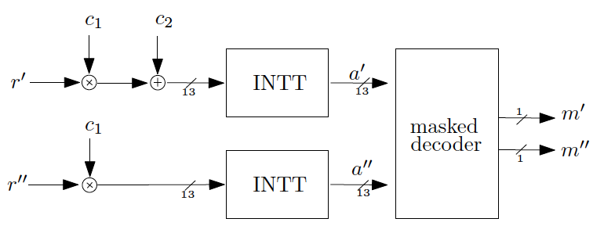
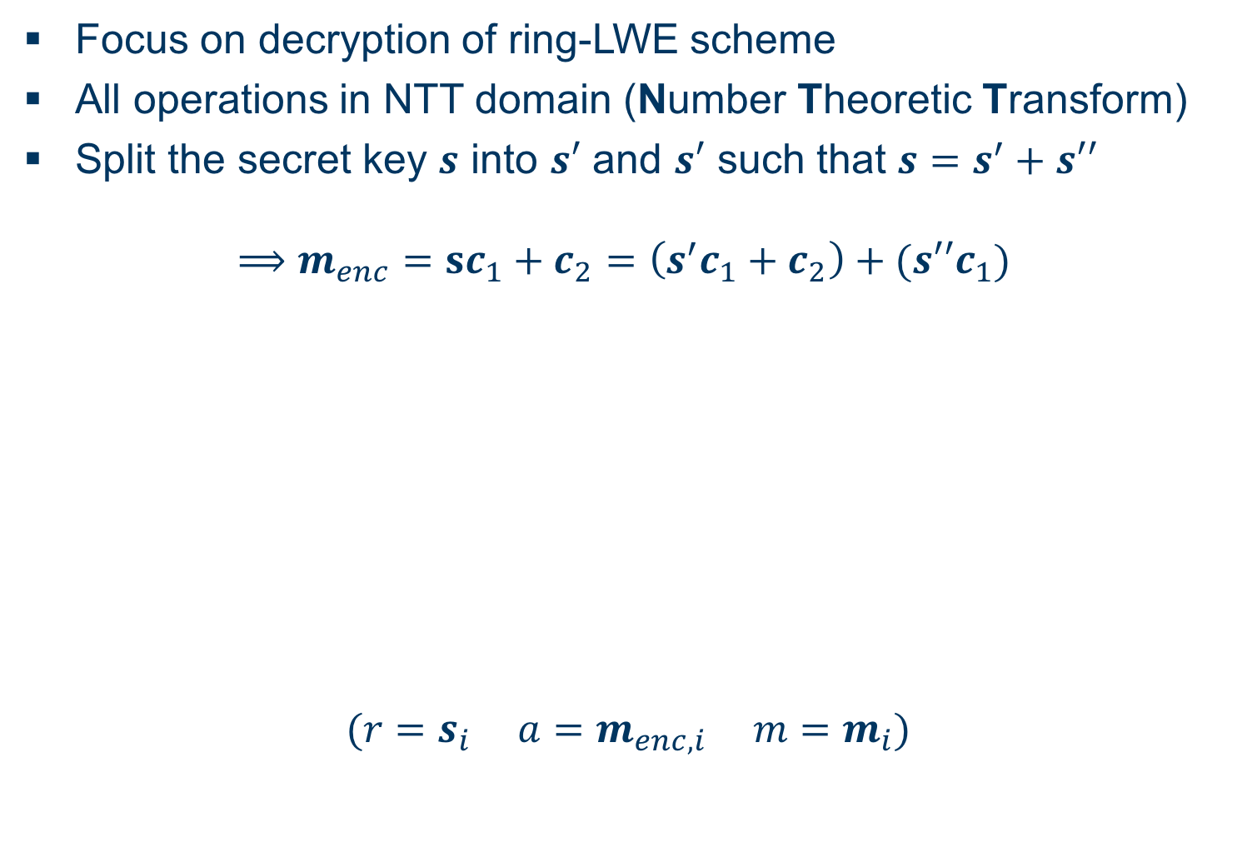
Masking Using a Masked Decoder Overview
Focus on decryption of ring-LWE scheme
All operations in NTT domain (Number Theoretic Transform)
Split the secret key $s$ into $s′$ and $s′$ such that $s=s^{′}+s′′$
$$⟹m_{enc}=sc_{1}+c_{2}=\left(s^{′}c_{1}+c_{2}\right)+(s′′c_{1})$$
$$(r=s_{i} a=m_{enc,i} m=m_{i})$$

Slide 12
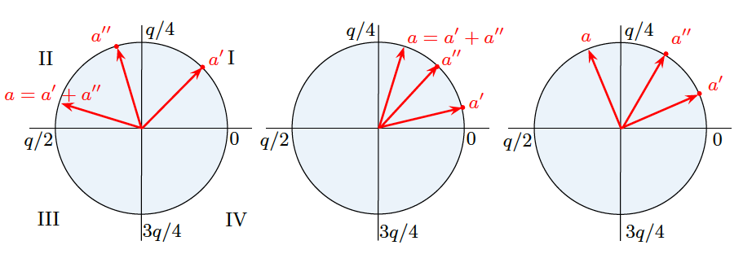
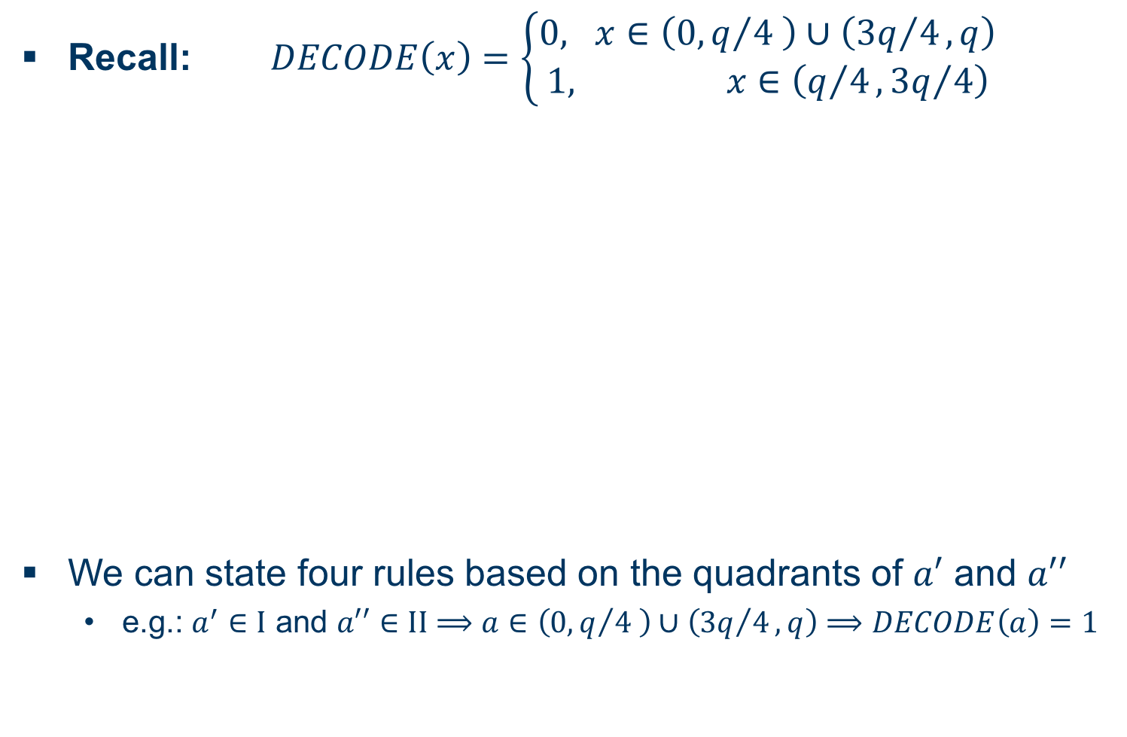
Masking Using a Masked Decoder Masked Decoder I
Recall: $DECODE\left(x\right)=\left\{\begin{aligned}0, x∈\left(0,q/4 \right)∪\left({3q}/4,q\right) \\ 1, x∈\left(q/4,{3q}/4\right)\end{aligned}\right.$
We can state four rules based on the quadrants of $a′$ and $a′′$
e.g.: $a^{′}∈I$ and $a′′∈II$ $⟹a∈\left(0,q/4 \right)∪\left({3q}/4,q\right)⟹DECODE\left(a\right)=1$

Slide 13

Masking Using a Masked Decoder Masked Decoder II
Recall: $DECODE\left(x\right)=\left\{\begin{aligned}0, x∈\left(0,q/4 \right)∪\left({3q}/4,q\right) \\ 1, x∈\left(q/4,{3q}/4\right)\end{aligned}\right.$
If no rule is met (right two cases), refresh and repeat
Refresh: $a^{′}=a^{′}+Δ_{i}$ and ${a′}^{′}={a′}^{′}−Δ_{i}$ for $i∈\{0,…,N\}$
Satisfactory results for $N=16$ iterations

Slide 14
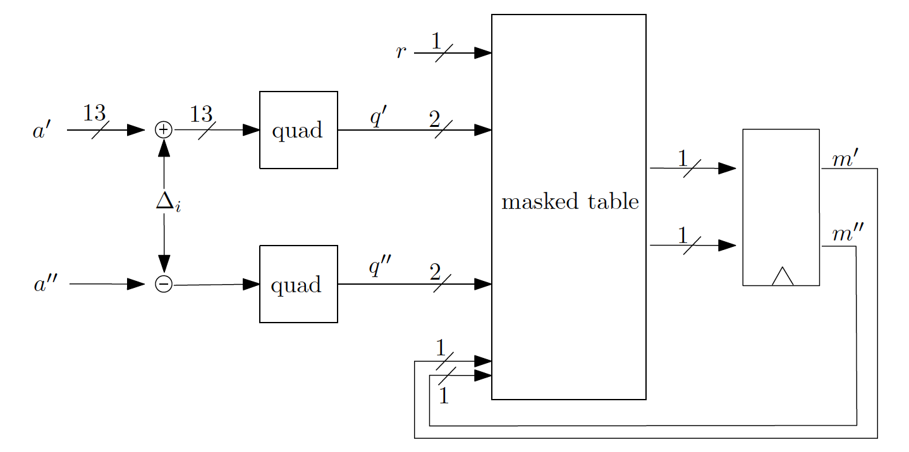
Masking Using a Masked Decoder Masked Table Lookup
Implement said rules in a masked table

Slide 15
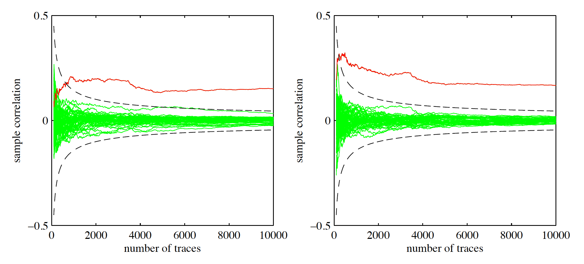

Masking Using a Masked Decoder Evaluation I
First-order DPA with masking turned off
$a′$ (left) and $a′′$ (right) can be seen in red
Attack is successful

Slide 16
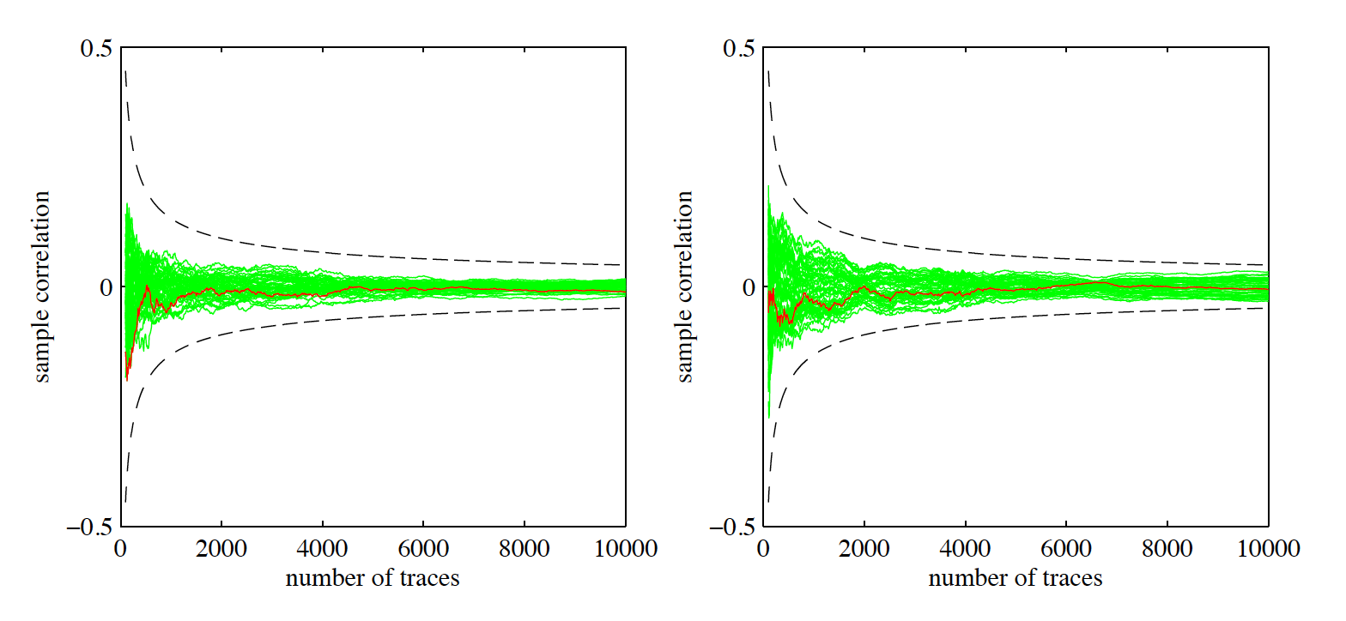

Masking Using a Masked Decoder Evaluation II
First-order DPA with masking turned on
$a′$ (left) and $a′′$ (right) can be seen in red
Attack is not successful

Slide 17
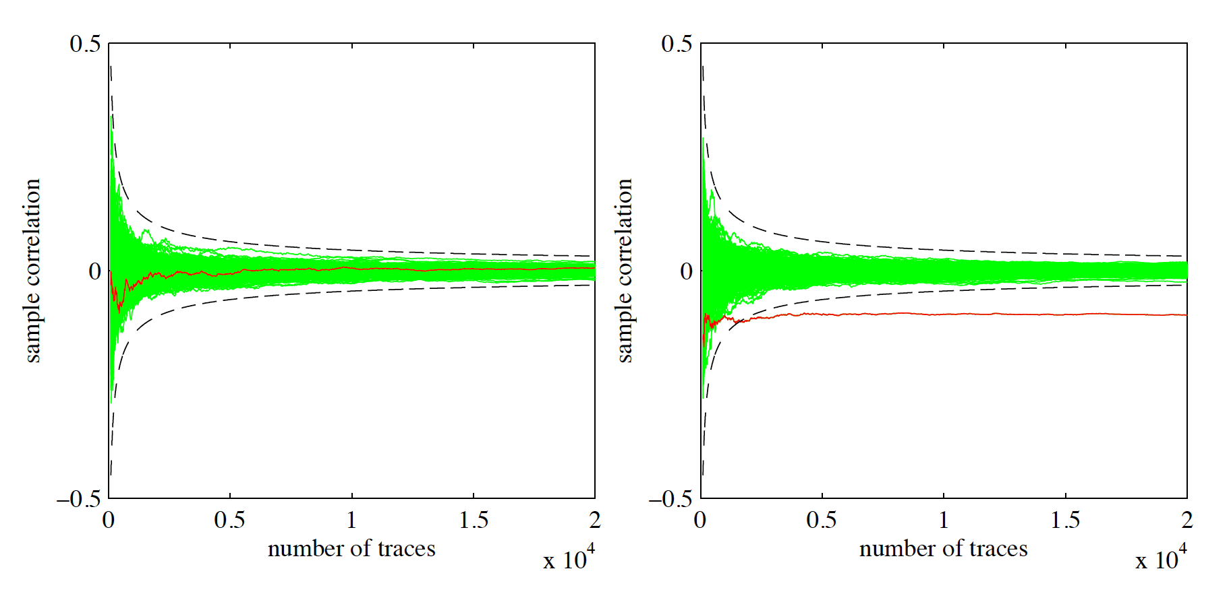
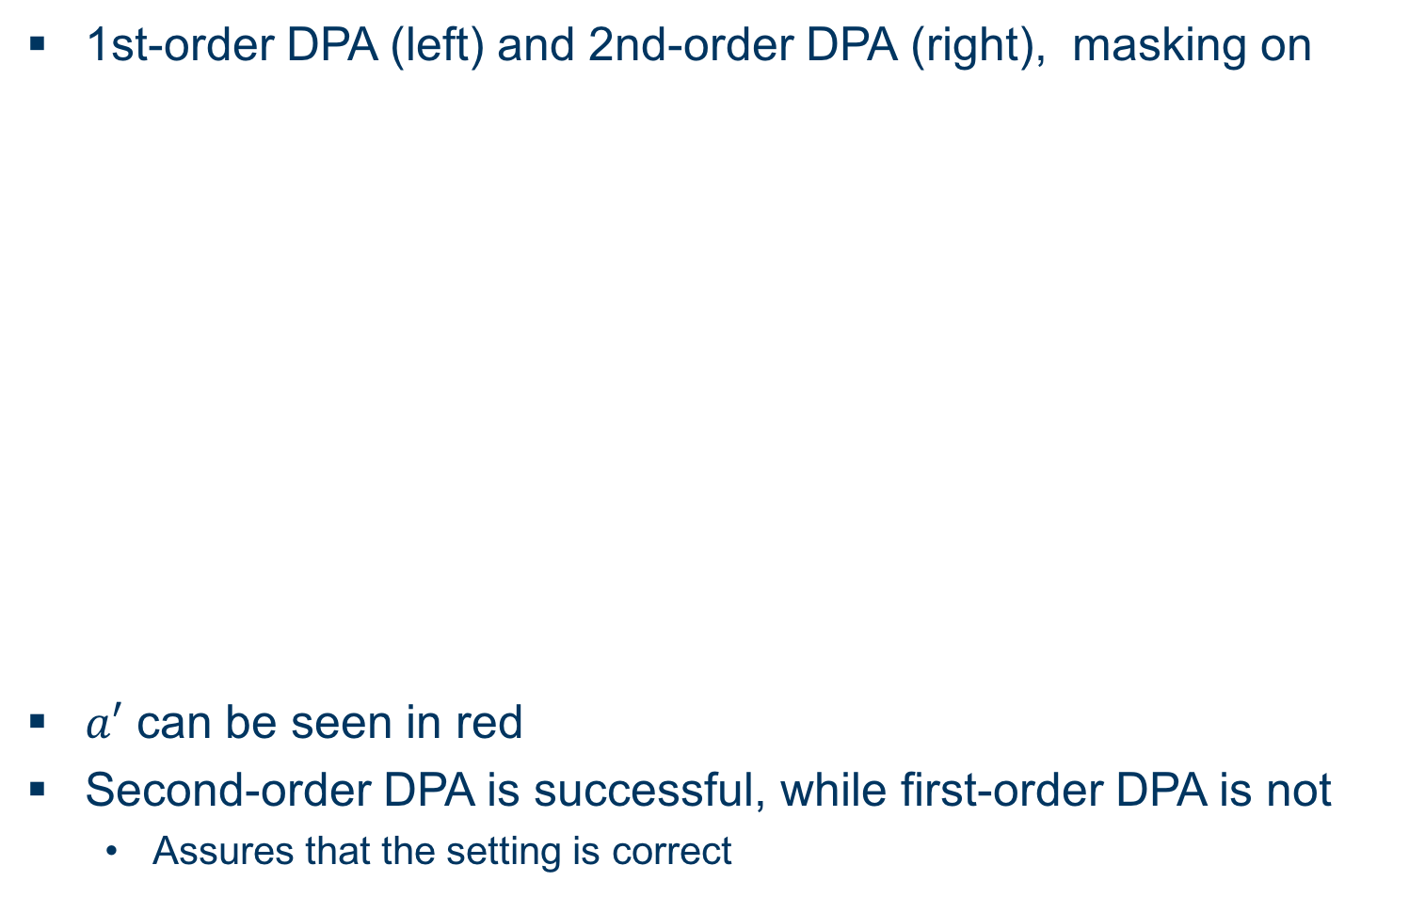
Masking Using a Masked Decoder Evaluation III
1st-order DPA (left) and 2nd-order DPA (right), masking on
$a′$ can be seen in red
Second-order DPA is successful, while first-order DPA is not
Assures that the setting is correct

Slide 18
Additively Homomorphic Masking Overview
blub

Slide 19
BLISS Unterüberschrift
Bitte “Structure of presentation” in Folie 2 an deinen Aufbau anpassen, alles was da aufgelistet ist kommt irgendwo als Überschrift einer Folie vor

Slide 20
Blinding Countermeasures Unterüberschrift
bla

Slide 21
EMSEC/SHA Blockseminar
Side-Channel Attacks on Implementations of Lattice-Based Cryptosystems
Felix Haarmann, Julian Speith
July 26th, 2016
Thank you for your attention! Any Questions?

