Slide 1


EMSEC/SHA Blockseminar
Side-Channel Attacks on Implementations of Lattice-Based Cryptosystems
Felix Haarmann, Julian Speith
July 26th, 2016

Slide 2
WHAT?!?
Current public-key crypto vulnerable to quantum computing
Shor’s algorithm for prime factorization and discrete logarithms
Quantum computers might become feasible in near future
Todays digital infrastructure is based on public-key crypto
Urgent need for post-quantum crypto
Lattice-based crypto is one possible solution
Currently most promising one, as it is pretty efficient
Side-Channel attack resistance is important for future implementations

Slide 3
Structure of our Presentation
Some Basics...
Ring-LWE Encryption Scheme
Masking using a masked decoder
Additively homomorphic masking
BLISS (Bimodal Lattice Signature Scheme)
Sampling algorithms
Cache attacks
Blinding Countermeasures

Slide 4
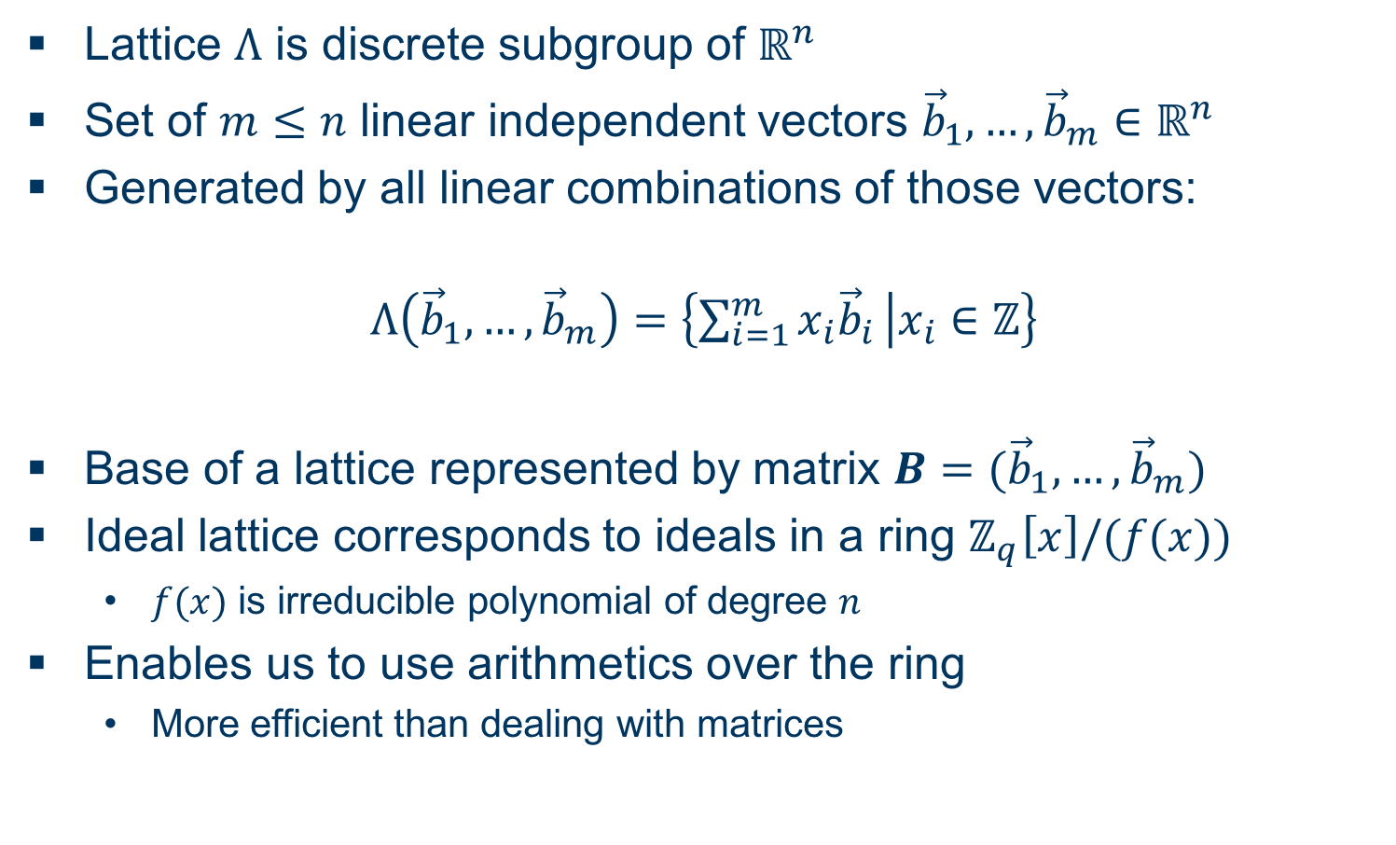
Some Basics... Ideal Lattices
Lattice $Λ$ is discrete subgroup of $ℝ^{n}$
Set of $m≤n$ linear independent vectors ${\vec{b}}_{1},…,{\vec{b}}_{m}∈ℝ^{n}$
Generated by all linear combinations of those vectors:
$$Λ\left({\vec{b}}_{1},…,{\vec{b}}_{m}\right)=\left\{\sum_{i=1}^{m}{x_{i}{\vec{b}}_{i}} | x_{i}∈ℤ\right\}$$
Base of a lattice represented by matrix $B=({\vec{b}}_{1},…,{\vec{b}}_{m})$
Ideal lattice corresponds to ideals in a ring $ℤ_{q}\left[x\right]/(f(x))$
$f(x)$ is irreducible polynomial of degree $n$
Enables us to use arithmetics over the ring
More efficient than dealing with matrices

Slide 5
Some Basics... Discrete Gaussian Distribution

Slide 6
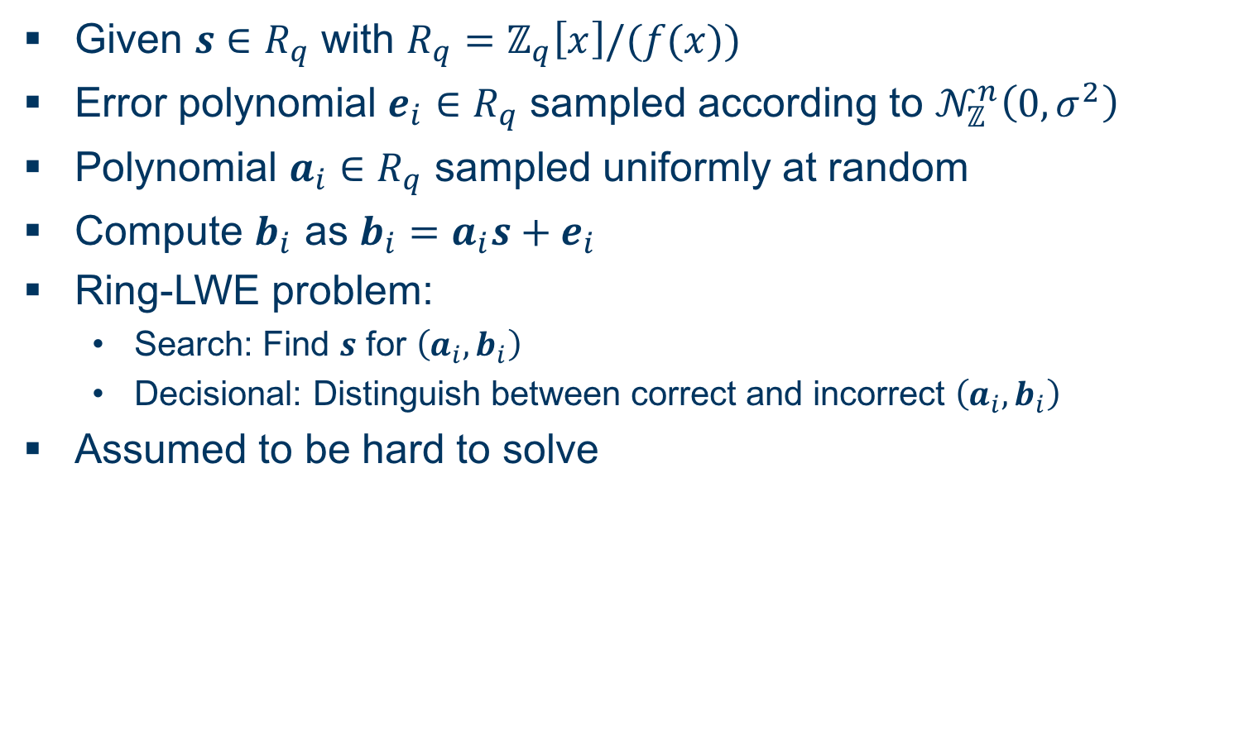
Some Basics... Ring Learning with Errors Problem
Given $s∈R_{q}$ with $R_{q}=ℤ_{q}\left[x\right]/(f(x))$
Error polynomial $e_{i}∈R_{q}$ sampled according to $𝒩_{ℤ}^{n}\left(0,σ^{2}\right)$
Polynomial $a_{i}∈R_{q}$ sampled uniformly at random
Compute $b_{i}$ as $b_{i}=a_{i}s+e_{i}$
Ring-LWE problem:
Search: Find $s$ for $\left(a_{i},b_{i}\right)$
Decisional: Distinguish between correct and incorrect $\left(a_{i},b_{i}\right)$
Assumed to be hard to solve

Slide 7
Some Basics... Side-Channel Attack Terminology (DPA)
Conclude secret information with leaked information
One type of attack: Differential Power Analysis (DPA)
Sensitive variable: Value that depends on the secret key and the plaintext
Correlate a leakage with a prediction made on a sensitive variable

Slide 8
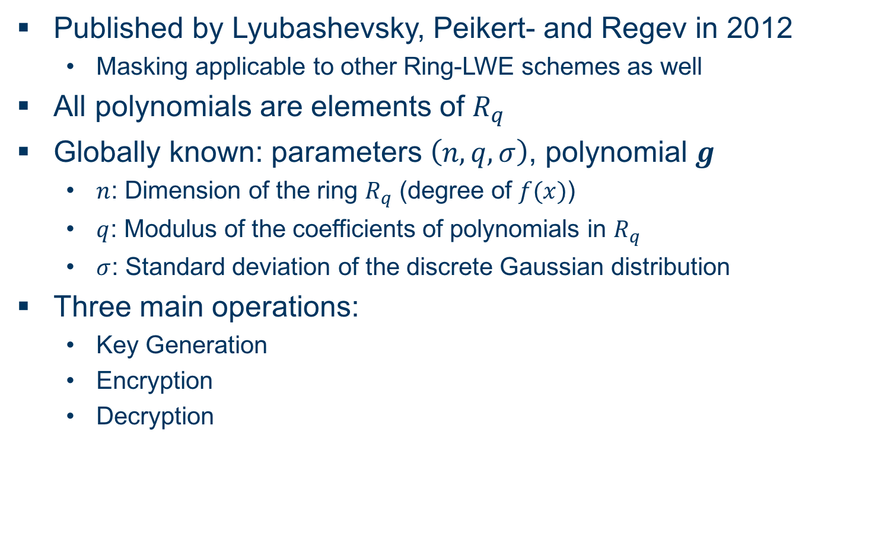
Ring-LWE Encryption Scheme Overview
Published by Lyubashevsky, Peikert- and Regev in 2012
Masking applicable to other Ring-LWE schemes as well
All polynomials are elements of $R_{q}$
Globally known: parameters $\left(n,q,σ\right)$, polynomial $g$
$n$: Dimension of the ring $R_{q}$ (degree of $f(x)$)
$q$: Modulus of the coefficients of polynomials in $R_{q}$
$σ$: Standard deviation of the discrete Gaussian distribution
Three main operations:
Key Generation
Encryption
Decryption

Slide 9

Ring-LWE Encryption Scheme Key Generation
Sample $r$ and $s$ according to $𝒩_{ℤ}^{n}\left(0,σ^{2}\right)$
Compute $p=r−gs$
Output: Public key $p$, secret key $s$

Slide 10
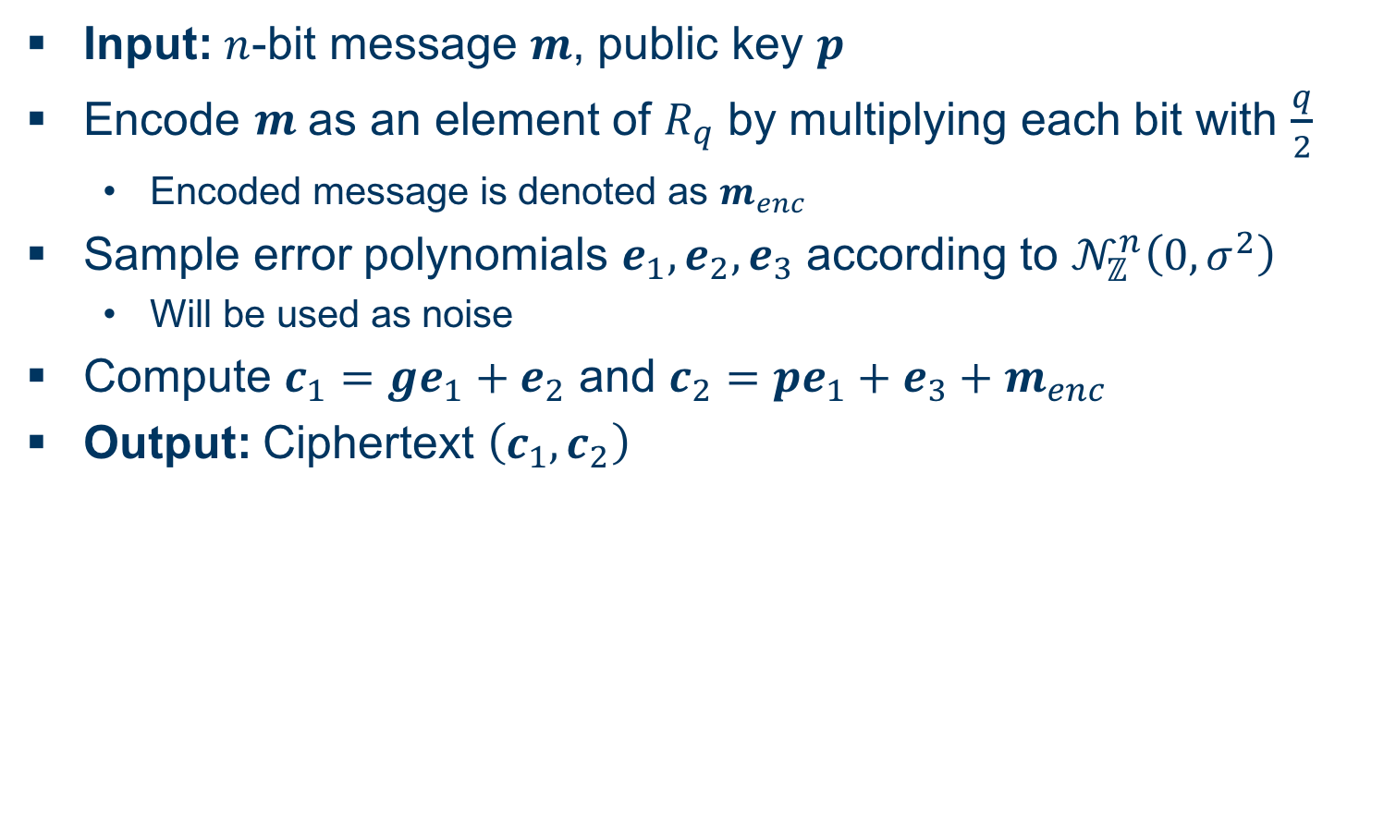
Ring-LWE Encryption Scheme Encryption
Input: $n$-bit message $m$, public key $p$
Encode $m$ as an element of $R_{q}$ by multiplying each bit with $\frac{q}{2}$
Encoded message is denoted as $m_{enc}$
Sample error polynomials $e_{1},e_{2},e_{3}$ according to $𝒩_{ℤ}^{n}\left(0,σ^{2}\right)$
Will be used as noise
Compute $c_{1}=ge_{1}+e_{2}$ and $c_{2}=pe_{1}+e_{3}+m_{enc}$
Output: Ciphertext $\left(c_{1},c_{2}\right)$

Slide 11
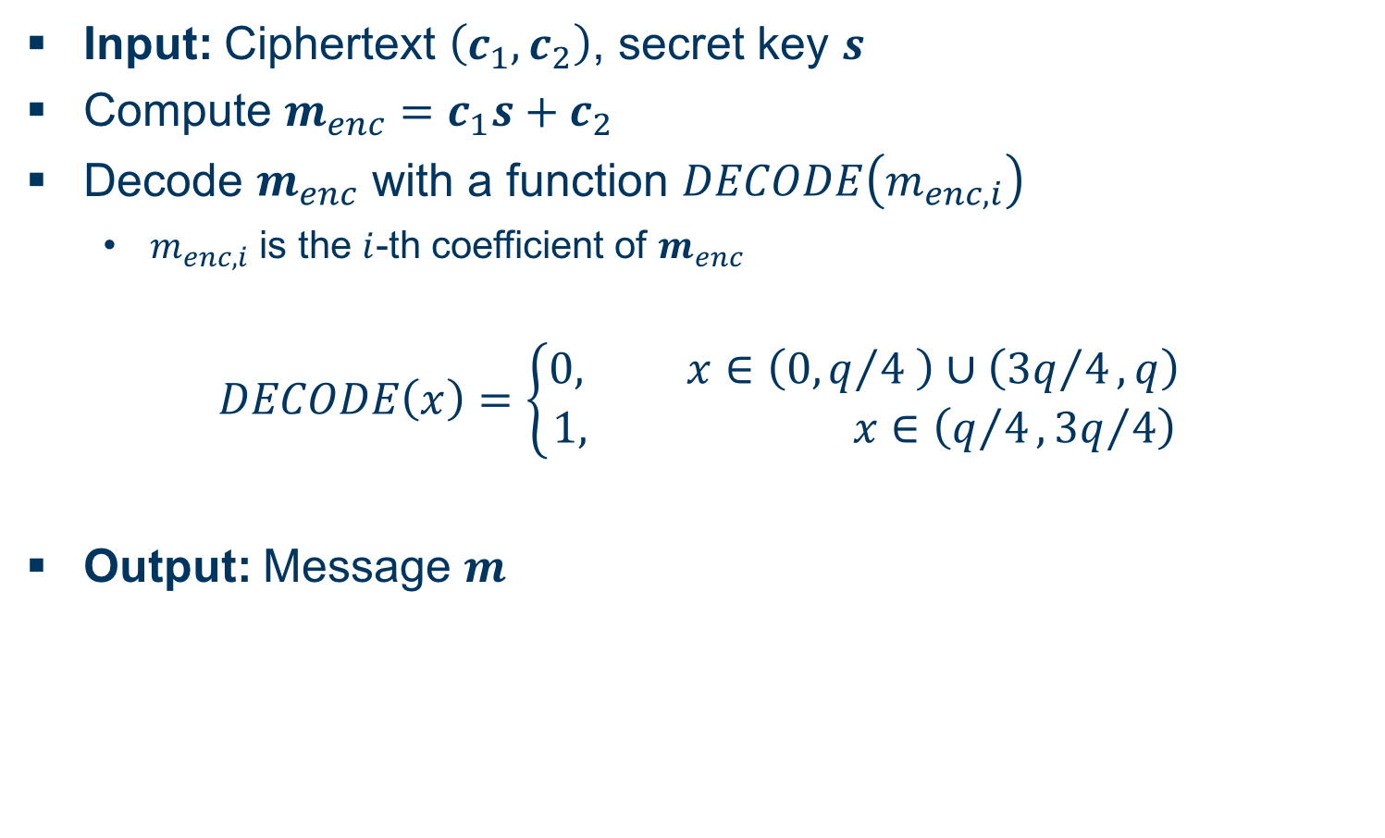
Ring-LWE Encryption Scheme Decryption
Input: Ciphertext $\left(c_{1},c_{2}\right)$, secret key $s$
Compute $m_{enc}=c_{1}s+c_{2}$
Decode $m_{enc}$ with a function $DECODE\left(m_{enc,i}\right)$
$m_{enc,i}$ is the $i$-th coefficient of $m_{enc}$
$$DECODE\left(x\right)=\left\{\begin{aligned}0, x∈\left(0,q/4 \right)∪\left({3q}/4,q\right) \\ 1, x∈\left(q/4,{3q}/4\right)\end{aligned}\right.$$
Output: Message $m$

Slide 12
Masking Using a Masked Decoder Overview
blub

Slide 13
EMSEC/SHA Blockseminar
Side-Channel Attacks on Implementations of Lattice-Based Cryptosystems
Felix Haarmann, Julian Speith
July 26th, 2016
Thank you for your attention! Any Questions?

