Slide 1


EMSEC/SHA Blockseminar
Side-Channel Attacks on Implementations of Lattice-Based Cryptosystems
Felix Haarmann, Julian Speith
July 26th, 2016

Slide 2
WHAT?!?
Todays digital infrastructure is based on public-key crypto
Current public-key crypto vulnerable to quantum computing
  Shor’s algorithm for prime factorization and discrete logarithms
Quantum computers might become feasible in near future
Urgent need for post-quantum crypto
Lattice-based crypto is one possible solution
  Currently most promising one, as it is pretty efficient
Side-Channel attack resistance is important for future implementations

Slide 3
Structure of our Presentation
Some Basics...
Ring-LWE Encryption Scheme
  Masking using a masked decoder
  Additively homomorphic masking
BLISS (Bimodal Lattice Signature Scheme)
  Sampling algorithms
  Cache attacks
Blinding Countermeasures

Slide 4
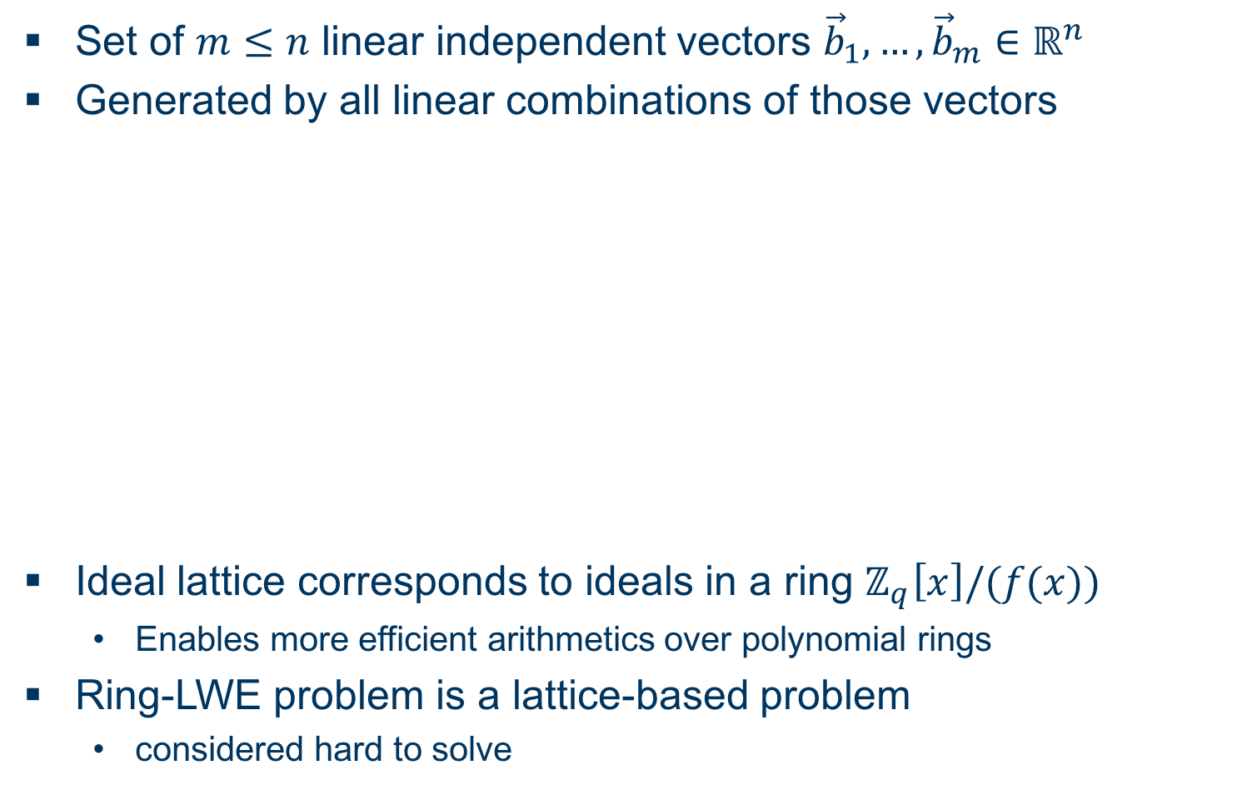
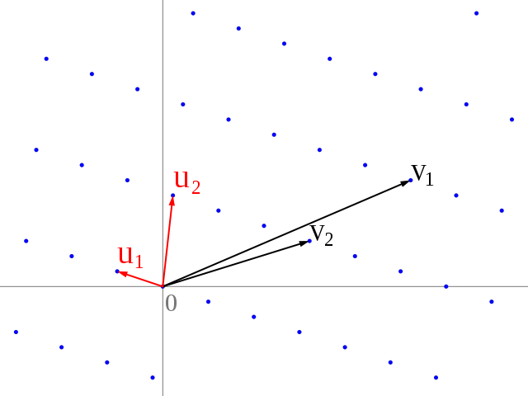
Some Basics...
Ideal Lattices and Learning with Errors over Rings
Set of linear independent vectors
Generated by all linear combinations of those vectors
Ideal lattice corresponds to ideals in a ring
  Enables more efficient arithmetics over polynomial rings
Ring-LWE problem is a lattice-based problem
  considered hard to solve

Slide 5
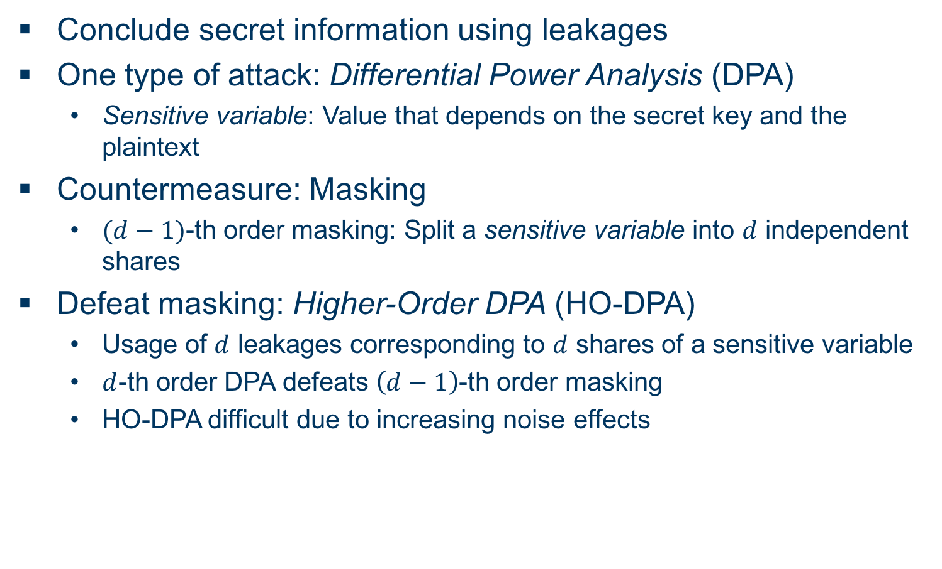
Some Basics...
Side-Channel Attack Terminology (DPA)
Conclude secret information using leakages
One type of attack: Differential Power Analysis (DPA)
  Sensitive variable: Value that depends on the secret key and the plaintext
Countermeasure: Masking
  -th order masking: Split a sensitive variable into independent shares
Defeat masking: Higher-Order DPA (HO-DPA)
  Usage of leakages corresponding to shares of a sensitive variable
  -th order DPA defeats -th order masking
  HO-DPA difficult due to increasing noise effects

Slide 6
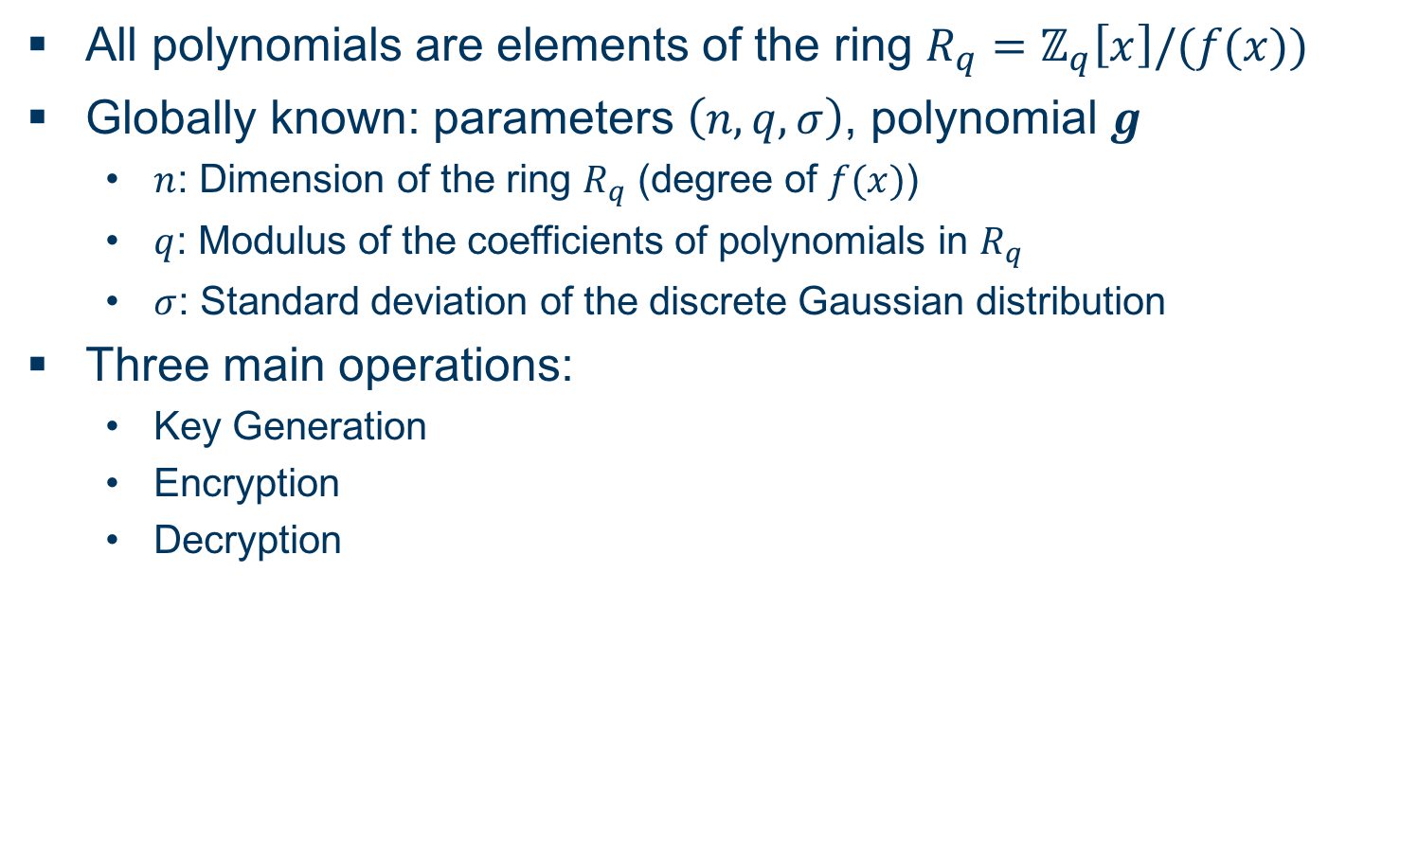
Ring-LWE Encryption Scheme
Overview
All polynomials are elements of the ring
Globally known: parameters , polynomial
  : Dimension of the ring (degree of )
  : Modulus of the coefficients of polynomials in
  : Standard deviation of the discrete Gaussian distribution
Three main operations:
  Key Generation
  Encryption
  Decryption

Slide 7
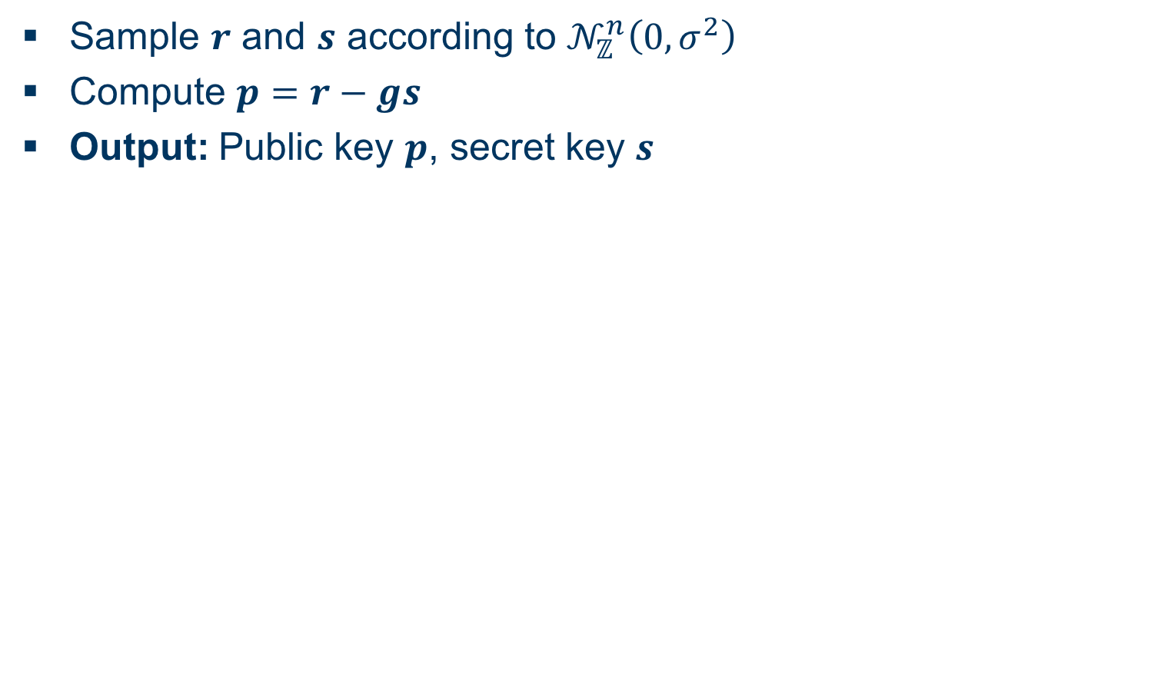
Ring-LWE Encryption Scheme
Key Generation
Sample and according to
Compute
Output: Public key , secret key

Slide 8
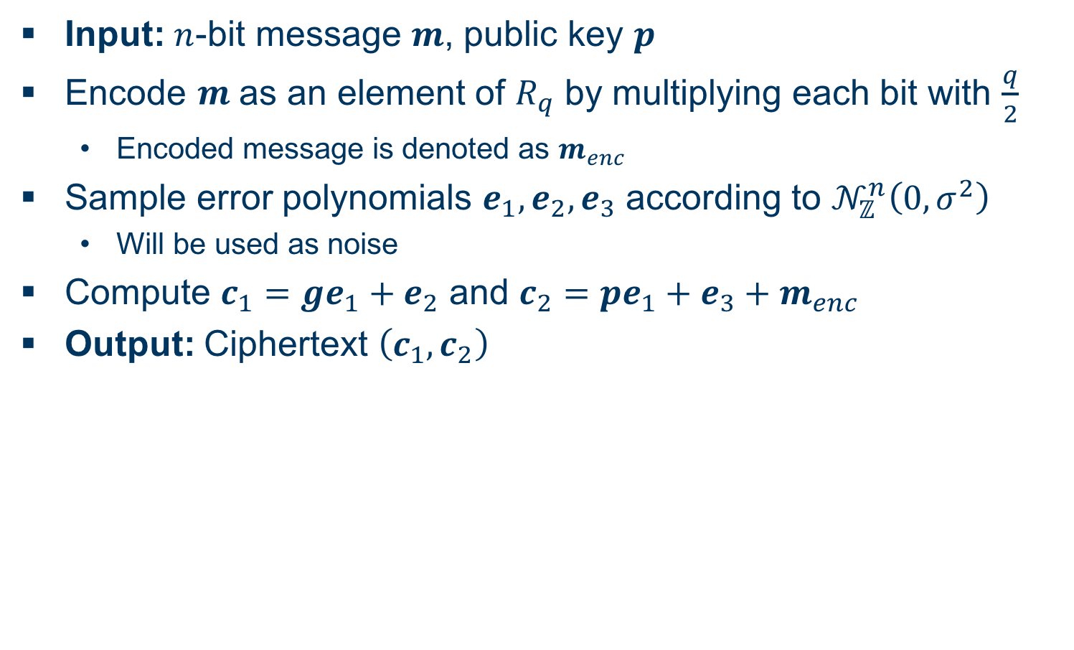
Ring-LWE Encryption Scheme
Encryption
Input: -bit message , public key
Encode as an element of by multiplying each bit with
  Encoded message is denoted as
Sample error polynomials according to
  Will be used as noise
Compute and
Output: Ciphertext

Slide 9
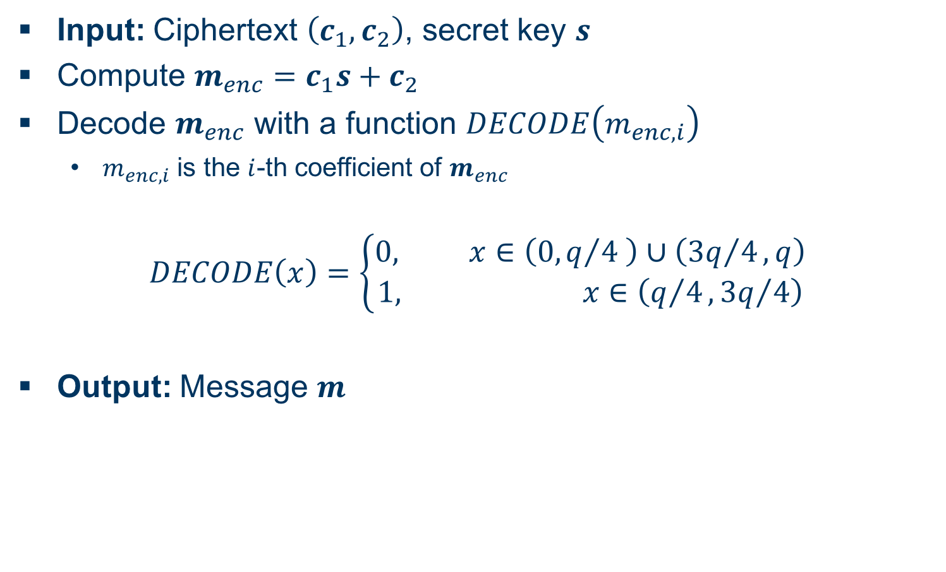
Ring-LWE Encryption Scheme
Decryption
Input: Ciphertext , secret key
Compute
Decode with a function
  is the -th coefficient of
Output: Message

Slide 10
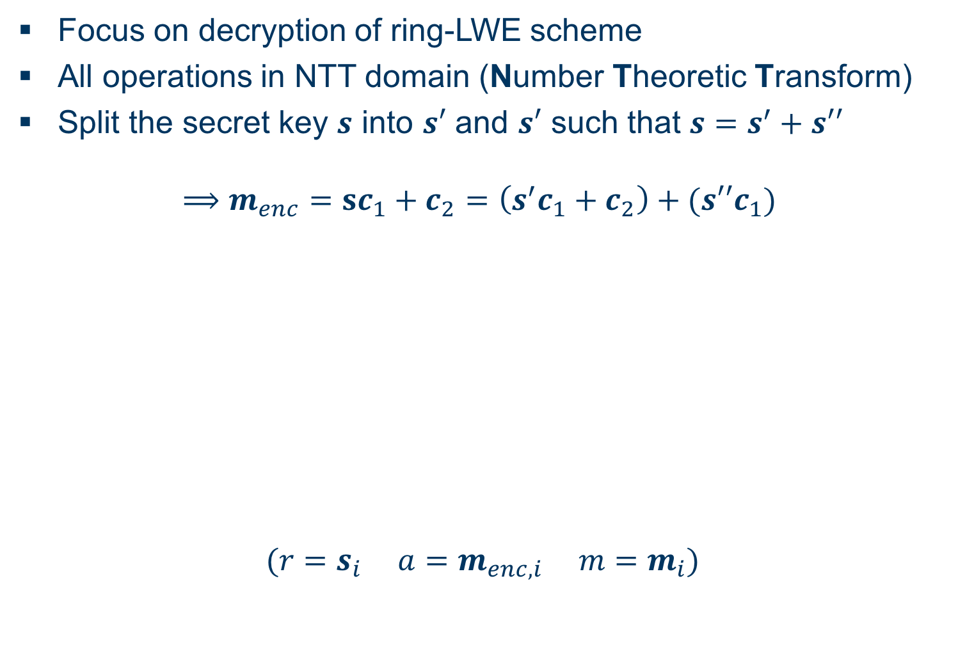
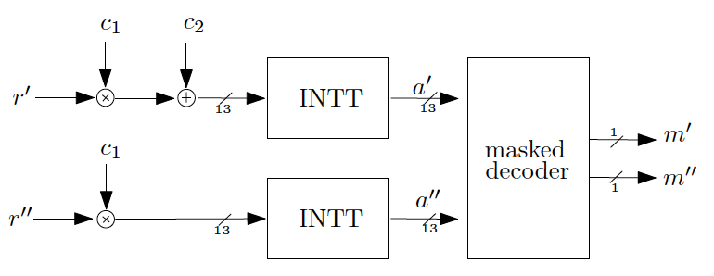
Masking Using a Masked Decoder
Overview
Focus on decryption of ring-LWE scheme
All operations in NTT domain (Number Theoretic Transform)
Split the secret key into and such that

Slide 11
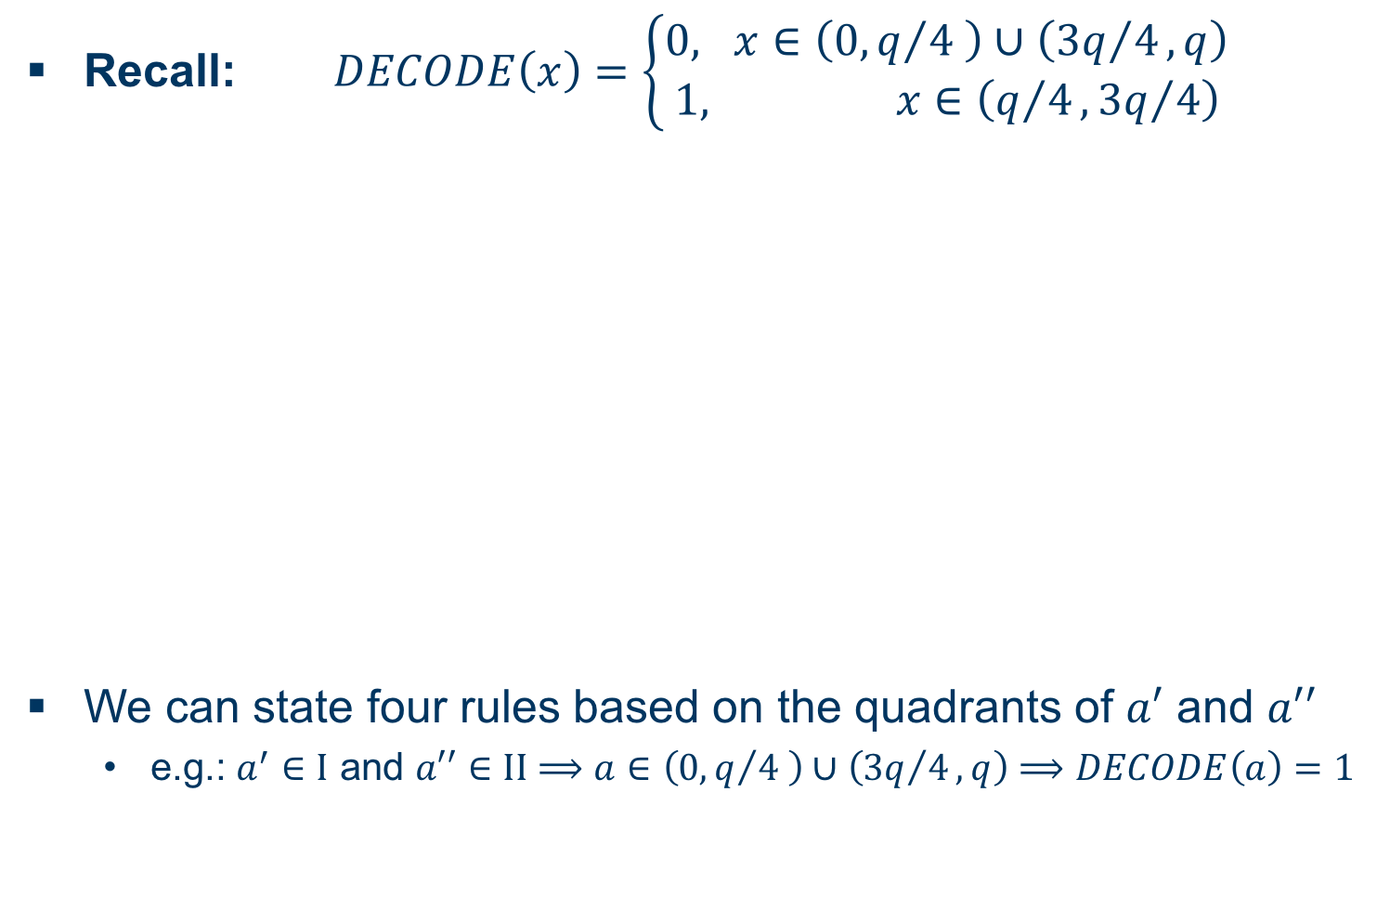
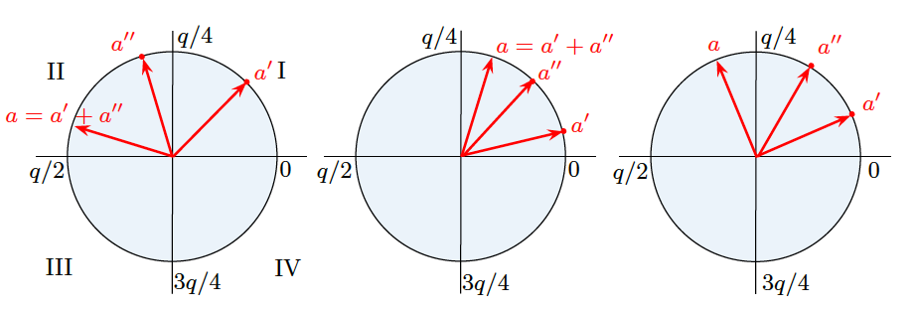
Masking Using a Masked Decoder
Masked Decoder I
Recall:
We can state four rules based on the quadrants of and
  e.g.: and

Slide 12
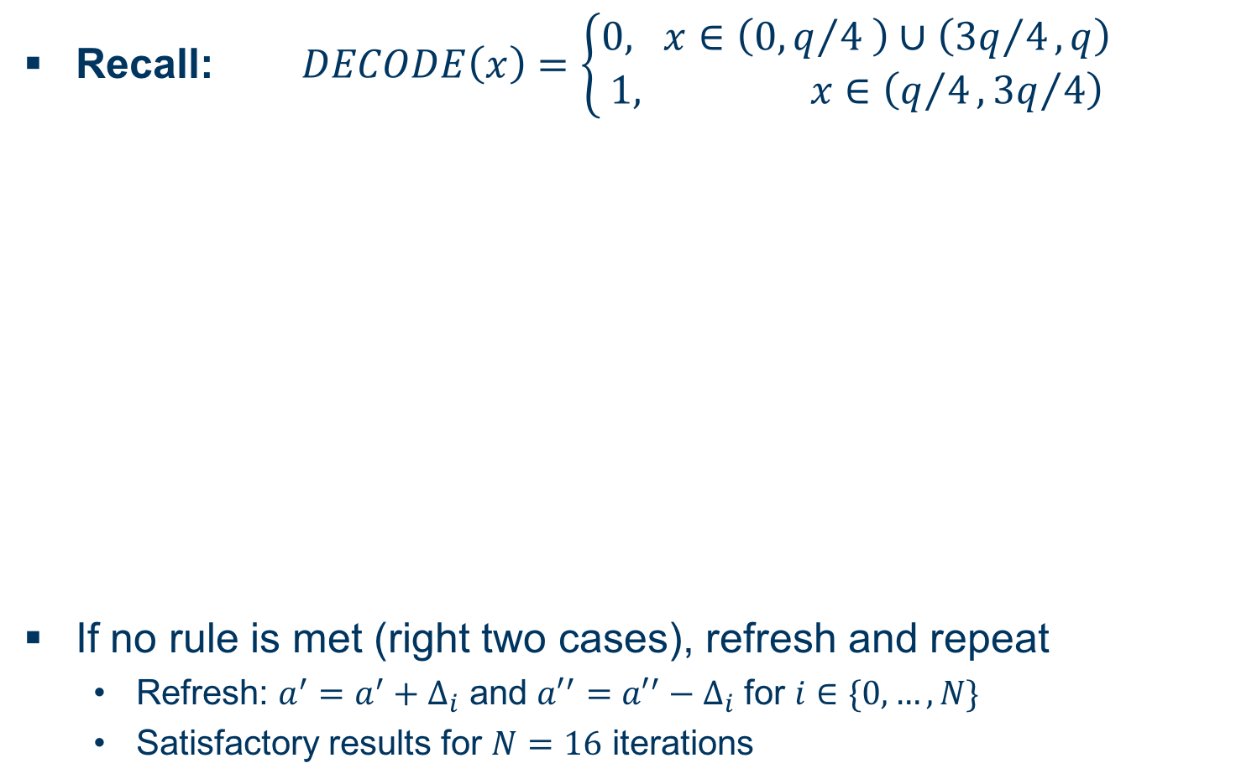
Masking Using a Masked Decoder
Masked Decoder II
Recall:
If no rule is met (right two cases), refresh and repeat
  Refresh: and for
  Satisfactory results for iterations

Slide 13
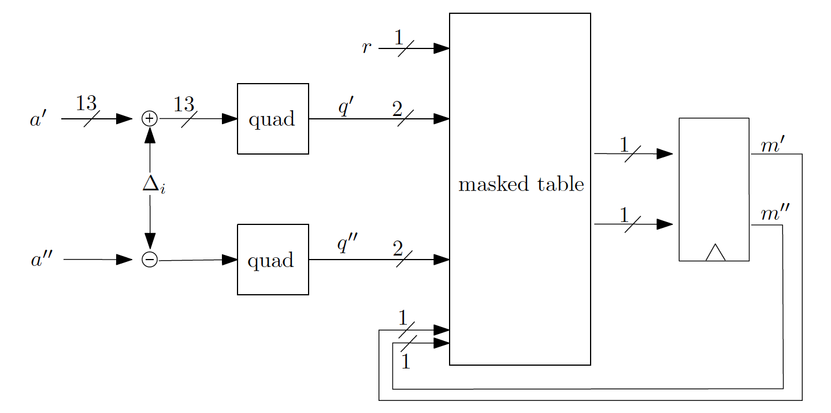
Masking Using a Masked Decoder
Masked Table Lookup
Implement said rules in a masked table

Slide 14
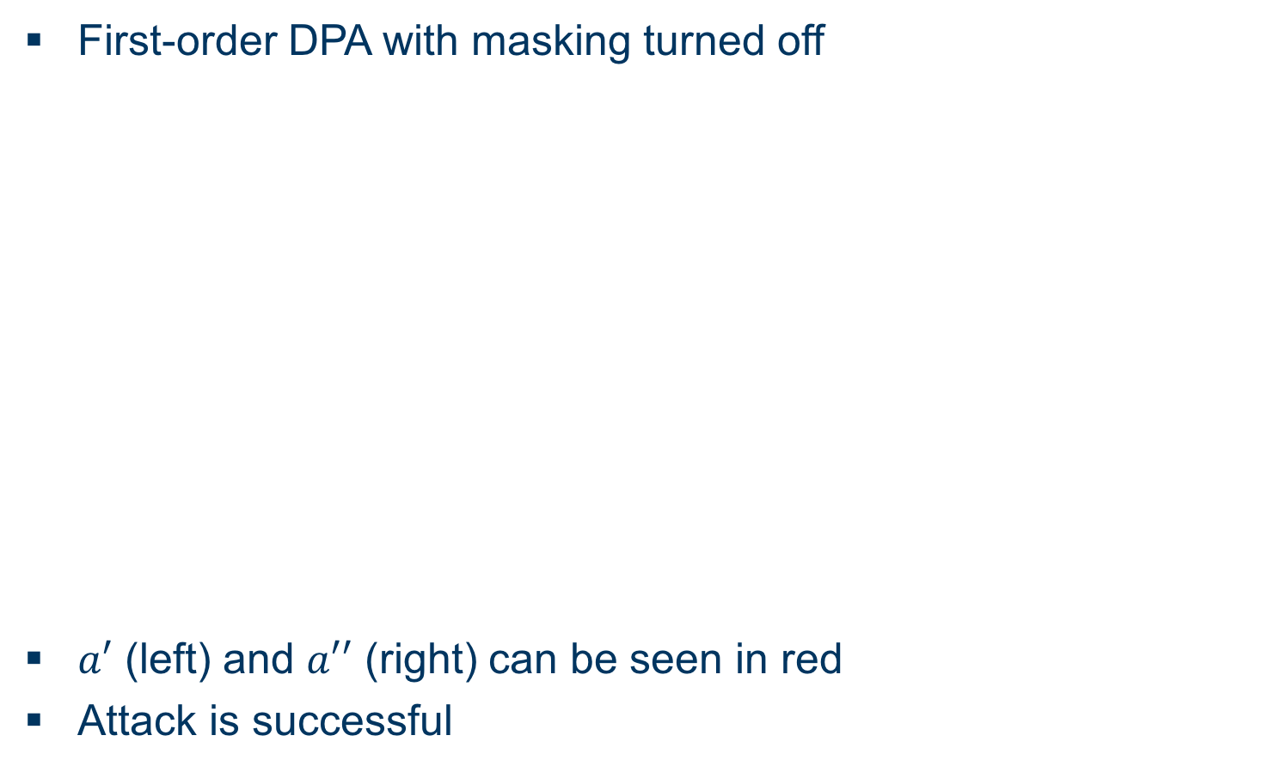
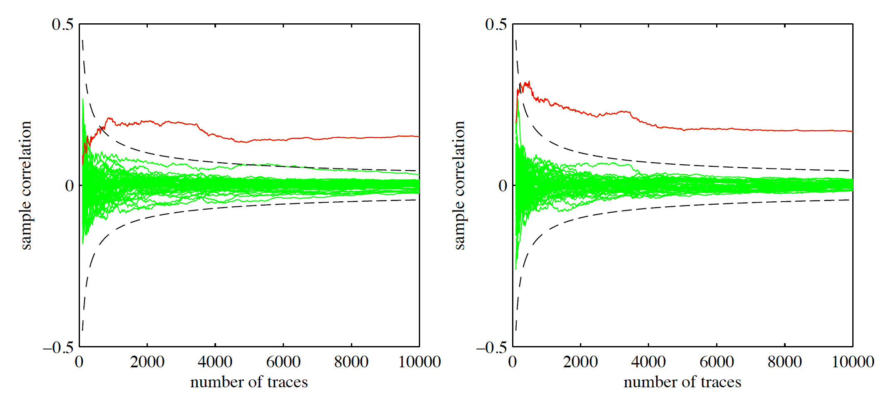
Masking Using a Masked Decoder
Evaluation I
First-order DPA with masking turned off
(left) and (right) can be seen in red
Attack is successful

Slide 15
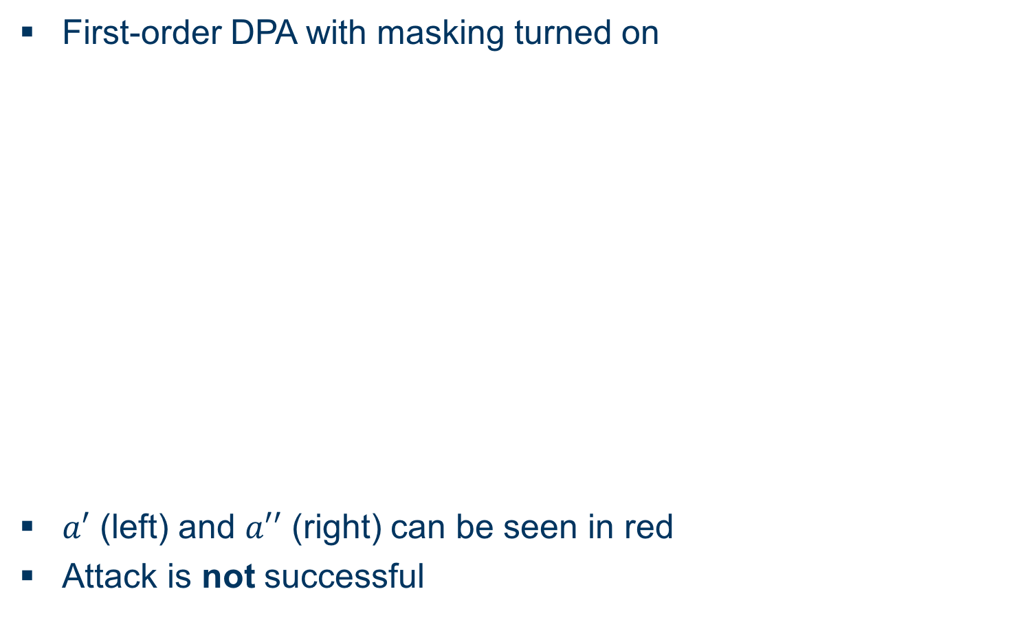
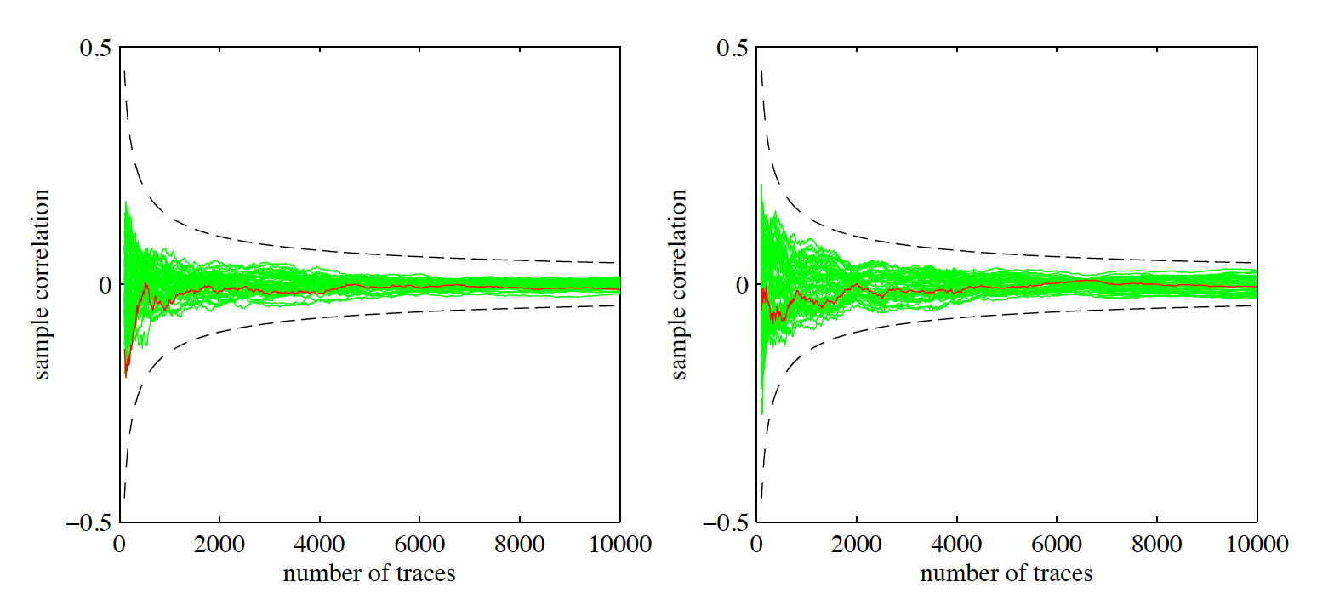
Masking Using a Masked Decoder
Evaluation II
First-order DPA with masking turned on
(left) and (right) can be seen in red
Attack is not successful

Slide 16
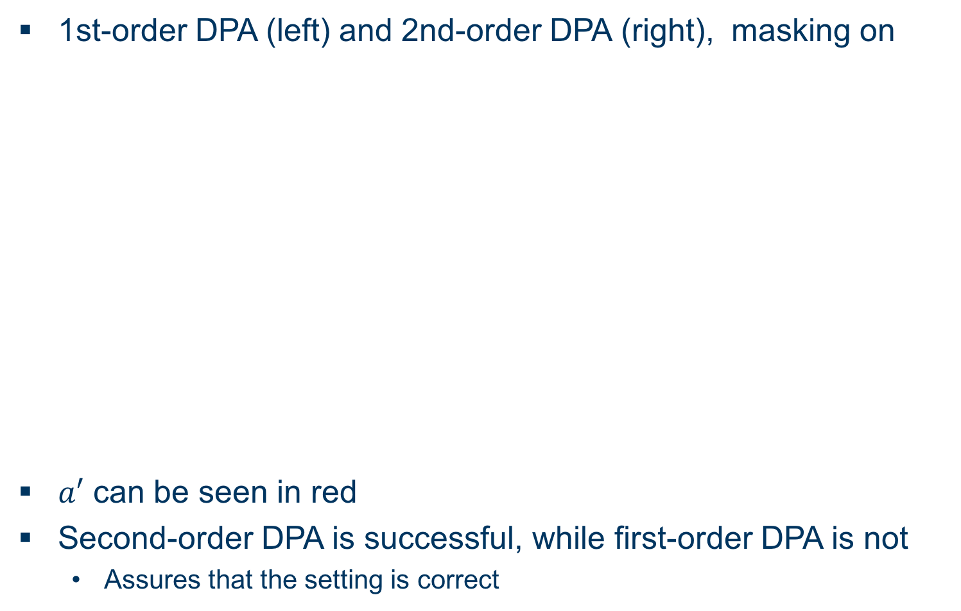
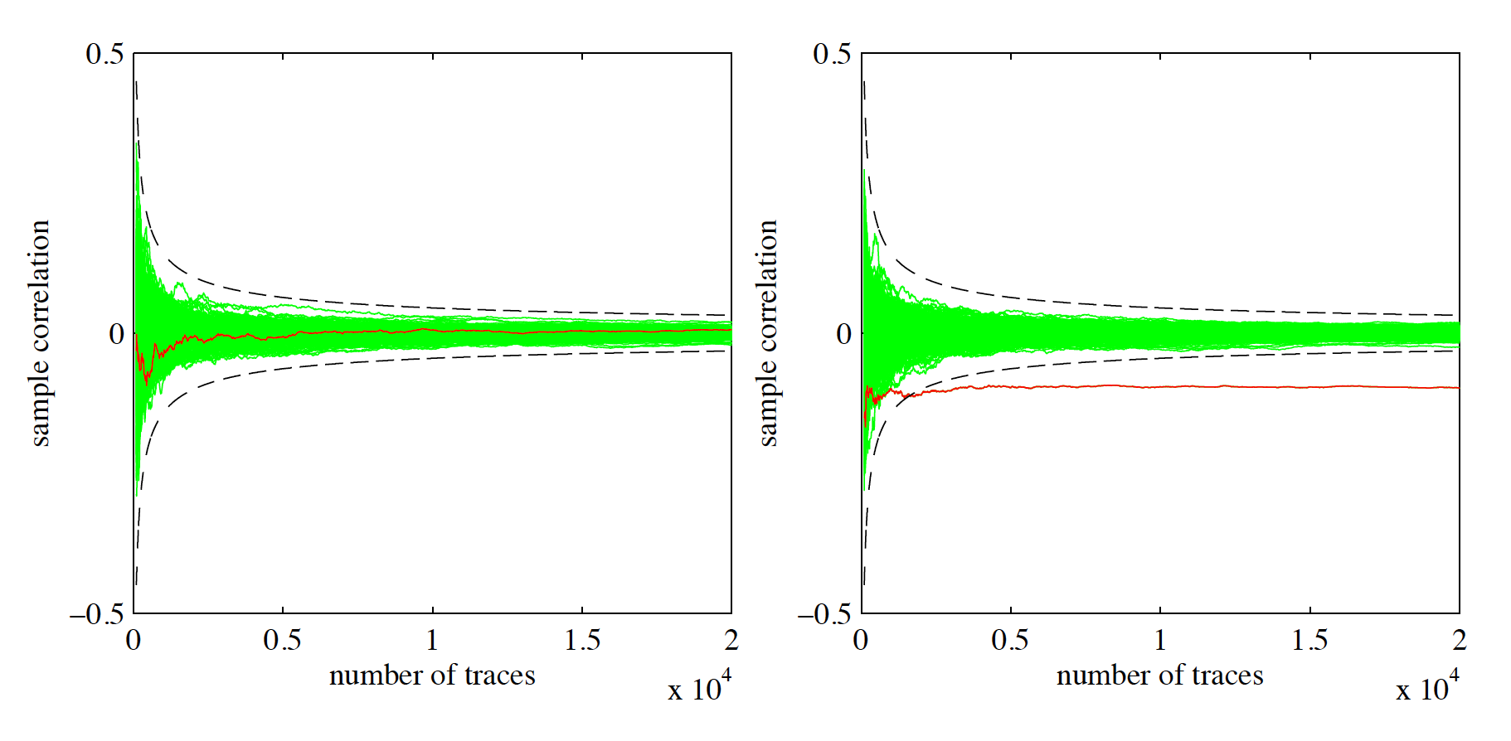
Masking Using a Masked Decoder
Evaluation III
1st-order DPA (left) and 2nd-order DPA (right), masking on
can be seen in red
Second-order DPA is successful, while first-order DPA is not
  Assures that the setting is correct

Slide 17
Additively Homomorphic Masking
Overview
blub

Slide 18
BLISS
Unterüberschrift
Bitte “Structure of presentation” in Folie 2 an deinen Aufbau anpassen, alles was da aufgelistet ist kommt irgendwo als Überschrift einer Folie vor
Bliss-I: Securitiy lambda = 128Bit

Slide 19
Gauss Distribution
BellCurve….
For cryptographic applications: discrete Gaussian distribution needed

Slide 20
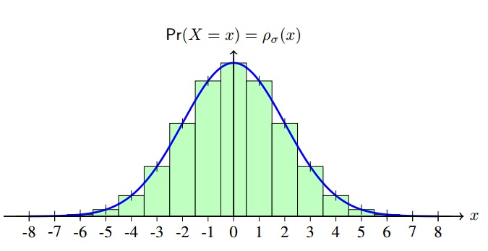
Gaussian Sampling
Efficient algorithms needed to sample discrete Gaussians
Convert uniformly random bits into non-uniformly bits distributed according to target distribution
Tailcut tau: Ignore „tail“-part of distribution

Slide 21
CDT Sampling
Cumulative Distribution Table
Precompute lookup table with approximate probabilities p(x) and values x
Sample an uniformly random value
Binary search
Return corresponding x
Efficient, but requires large table
Faster: use 2nd guide table

Slide 22
Rejection Sampling
Sample uniformly random integer y and reject it, if 2nd random value exceeds expected probability
Con: Computation of probability is expensive
Con: Rejection rate?!
Better algorithms use lookup table with precomputed values to decide rejection

Slide 23
Flush+Reload Cache Attack
Flush Memory lines from cache with clflush
Wait for user processes
Reload flushed memory lines and compare accesstime to reference value
Fast access→ Cache line was probably accessed
Problem: Cache line contains multiple entries...

Slide 24
Flush + Reload Cache Attack II
Only cache lines arranged in a specific pattern are monitored→ Cache weakness
Intersection: Two Lookuptables yield more precise Information:
S 1 = {0, 1, 2, 3, 4, 5, 6, 7, 8}
S 2 = {7, 8, 9, 10, 11, 12, 13, 14, 15}
→ |y_i | ∈ S 1 ∩ S 2 = {7, 8}
Last Jump: {5, 6, 7, 8, 9} is divided over two cache lines T 1 = {0, 1, 2, 3, 4, 5, 6, 7} and T 2 =
{8, 9, 10, 11, 12, 13, 14, 15}
Binary search will always access T1, but T2 only if
|y_i| ∈ S = {8, 9}

Slide 25
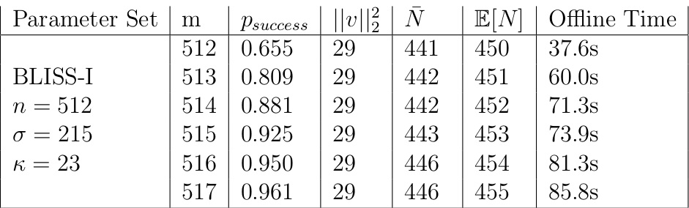
Attack Results on BLISS-I with CDT sampling
Perfect Side Channel
8 Cache weaknesses
Succesrate rises with amount of samples N
i5-3470
1 Cache weakness
Success: 46/50 tries
Average needed signatures: 3438

Slide 26
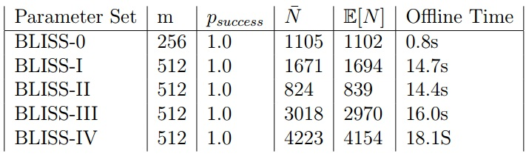
Attack Results on BLISS-I with Rejection sampling
Perfect Side-Channel
Checks for table access in cache, only performed for sampled 1
100% Successful
i7-5650U
3/6 Cache Lines Monitored
Success 44/50
Average needed signatures: 3294

Slide 27
Blinding Countermeasures
Unterüberschrift
bla

Slide 28
EMSEC/SHA Blockseminar
Side-Channel Attacks on Implementations of Lattice-Based Cryptosystems
Felix Haarmann, Julian Speith
July 26th, 2016
Thank you for your attention!
Any Questions?

