Slide 1


EMSEC/SHA Blockseminar
Side-Channel Attacks on Implementations of Lattice-Based Cryptosystems
Felix Haarmann, Julian Speith
July 26th, 2016

Slide 2
WHAT?!?
Todays digital infrastructure is based on public-key crypto
Current public-key crypto vulnerable to quantum computing
  Shor’s algorithm [1] for prime factorization and discrete logarithms
Quantum computers might become feasible in near future
Urgent need for post-quantum crypto
Lattice-based crypto is one possible solution
  Currently most promising one, as it is pretty efficient
Side-Channel attack resistance is important for future implementations
  E.g., Internet of things: attacker has physical access to devices
[1] “Polynomial-Time Algorithms for Prime Factorization and Discrete Logarithms on a Quantum Computer”; Peter W. Shor; October 1997

Slide 3
Structure of our Presentation
Some Basics...
Ring-LWE Encryption Scheme
  Masking using a masked decoder
BLISS (Bimodal Lattice Signature Scheme)
  Sampling
  Flush+Reload Cache attack

Slide 4
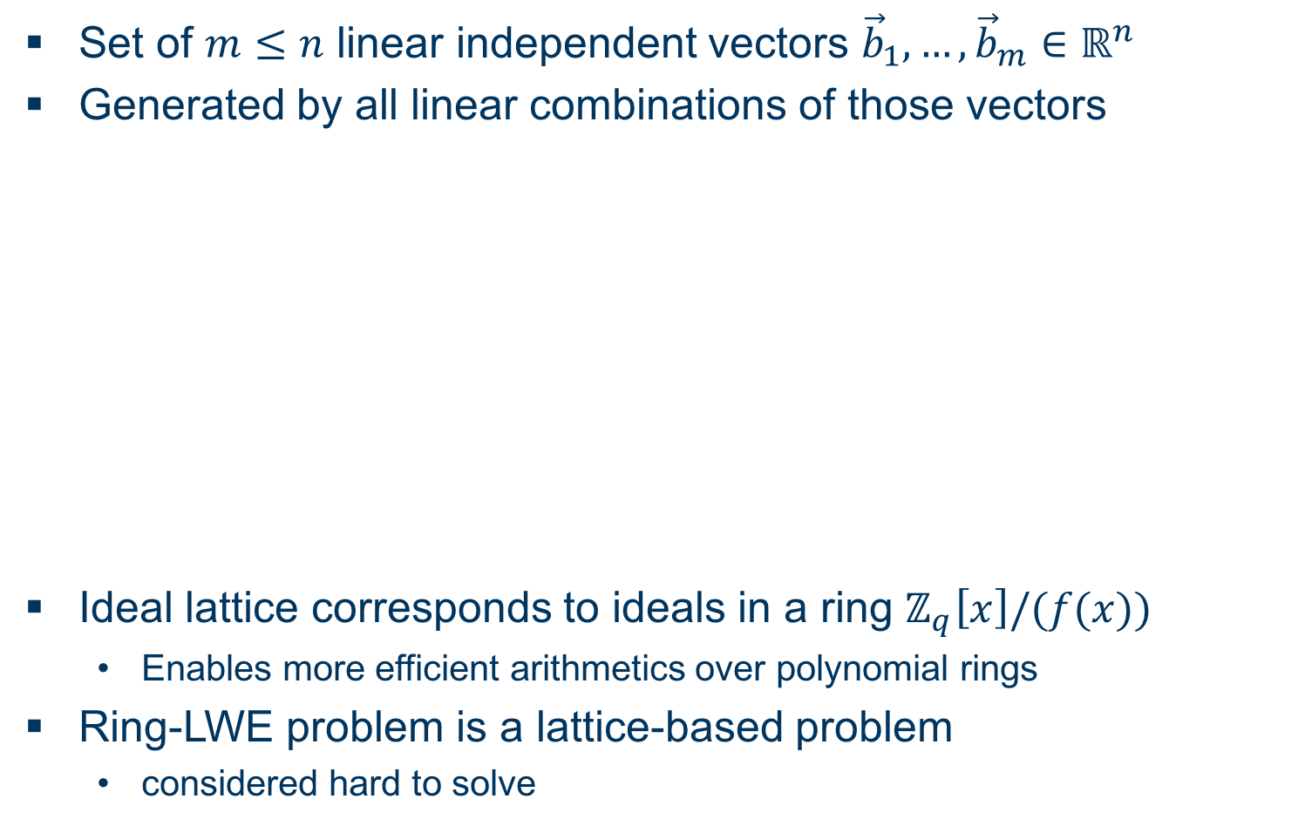
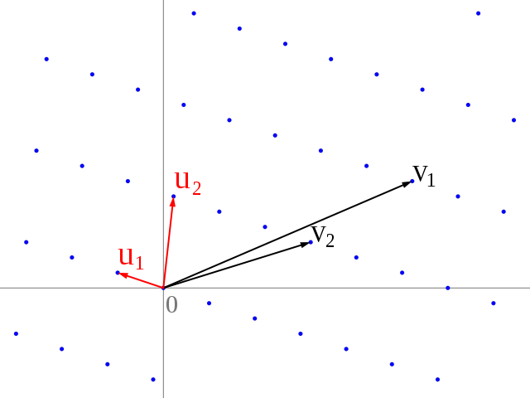
Some Basics...
Ideal Lattices and Learning with Errors over Rings
Set of linear independent vectors
Generated by all linear combinations of those vectors
Ideal lattice corresponds to ideals in a ring
  Enables more efficient arithmetics over polynomial rings
Ring-LWE problem is a lattice-based problem
  considered hard to solve

Slide 5
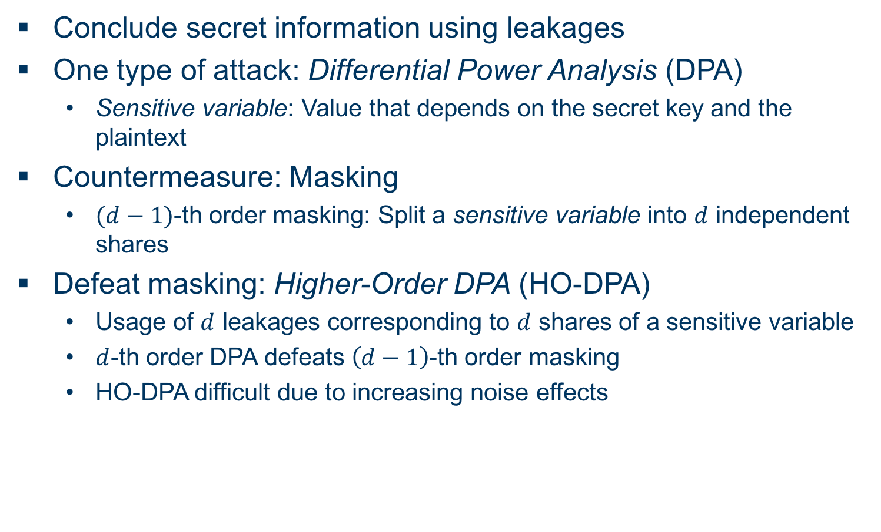
Some Basics...
Side-Channel Attack Terminology (DPA)
Conclude secret information using leakages
One type of attack: Differential Power Analysis (DPA)
  Sensitive variable: Value that depends on the secret key and the plaintext
Countermeasure: Masking
  -th order masking: Split a sensitive variable into independent shares
Defeat masking: Higher-Order DPA (HO-DPA)
  Usage of leakages corresponding to shares of a sensitive variable
  -th order DPA defeats -th order masking
  HO-DPA difficult due to increasing noise effects

Slide 6
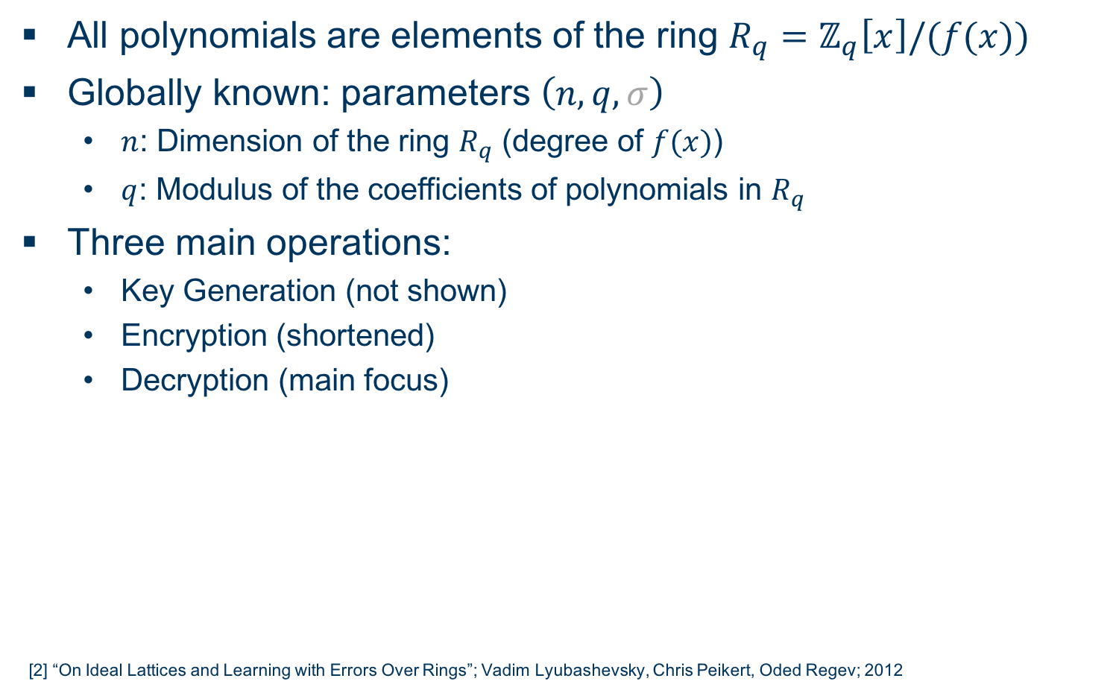
Ring-LWE Encryption Scheme [2]
Overview
All polynomials are elements of the ring
Globally known: parameters
  : Dimension of the ring (degree of )
  : Modulus of the coefficients of polynomials in
Three main operations:
  Key Generation (not shown)
  Encryption (shortened)
  Decryption (main focus)
[2] “On Ideal Lattices and Learning with Errors Over Rings”; Vadim Lyubashevsky, Chris Peikert, Oded Regev; 2012

Slide 7
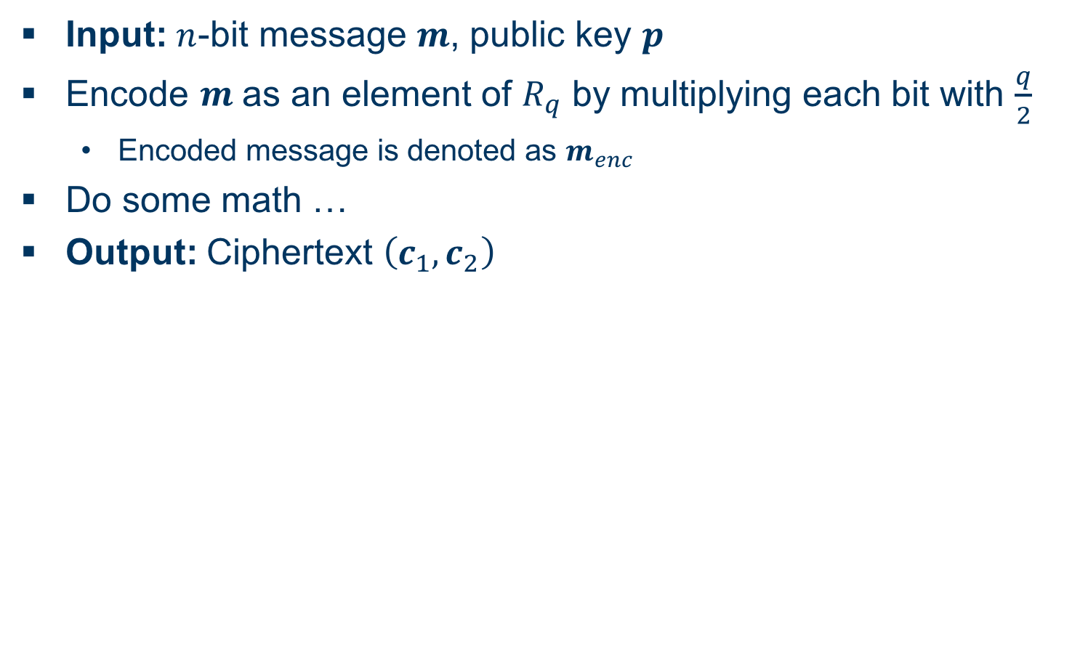
Ring-LWE Encryption Scheme
Encryption
Input: -bit message , public key
Encode as an element of by multiplying each bit with
  Encoded message is denoted as
Do some math …
Output: Ciphertext

Slide 8
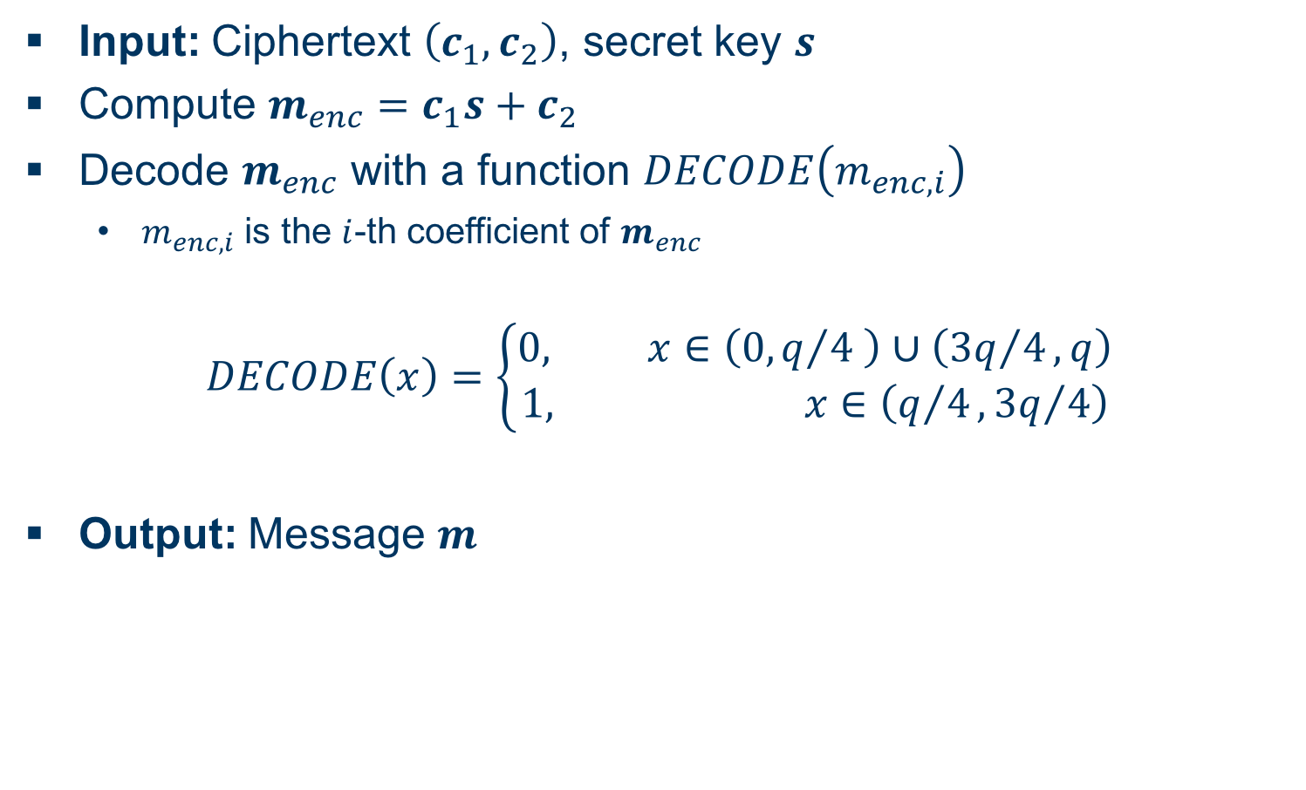
Ring-LWE Encryption Scheme
Decryption
Input: Ciphertext , secret key
Compute
Decode with a function
  is the -th coefficient of
Output: Message

Slide 9
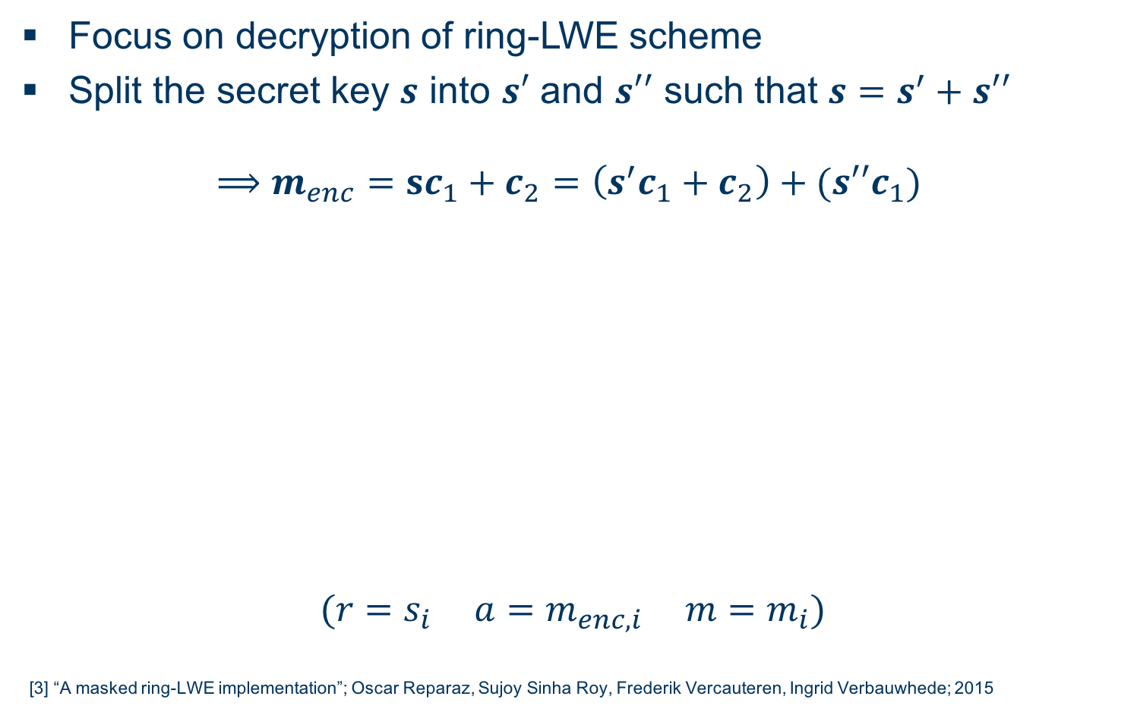
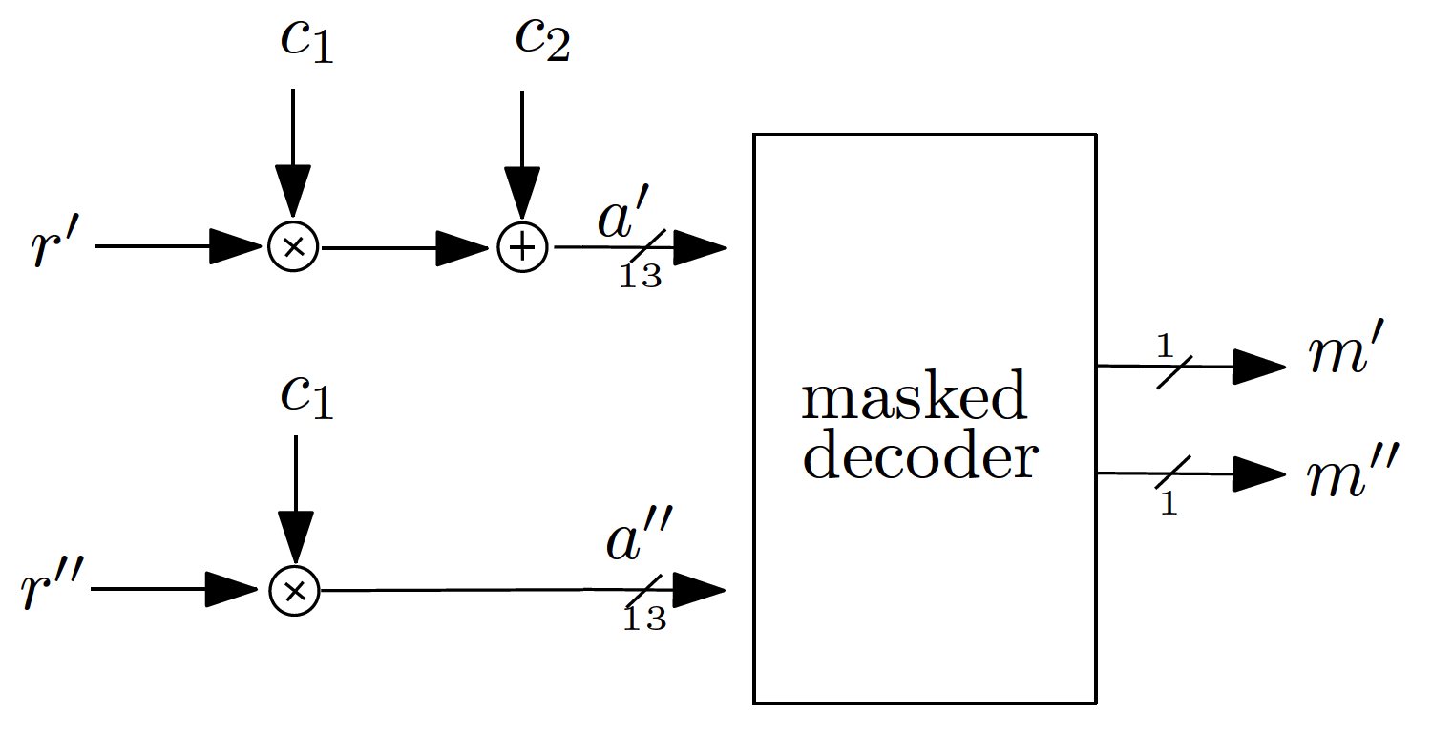
Masking Using a Masked Decoder [3]
Overview
Focus on decryption of ring-LWE scheme
Split the secret key into and such that
[3] “A masked ring-LWE implementation”; Oscar Reparaz, Sujoy Sinha Roy, Frederik Vercauteren, Ingrid Verbauwhede; 2015

Slide 10
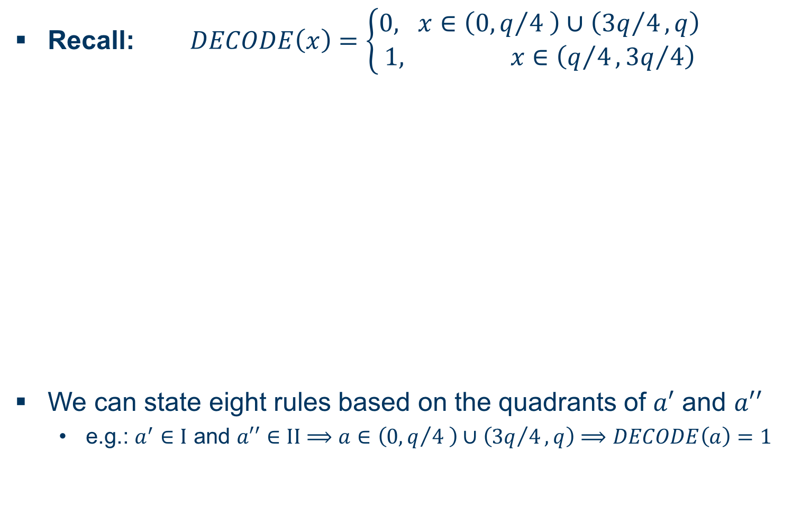
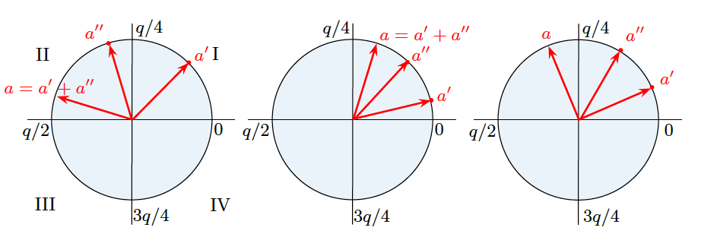
Masking Using a Masked Decoder
Masked Decoder I
Recall:
We can state eight rules based on the quadrants of and
  e.g.: and

Slide 11
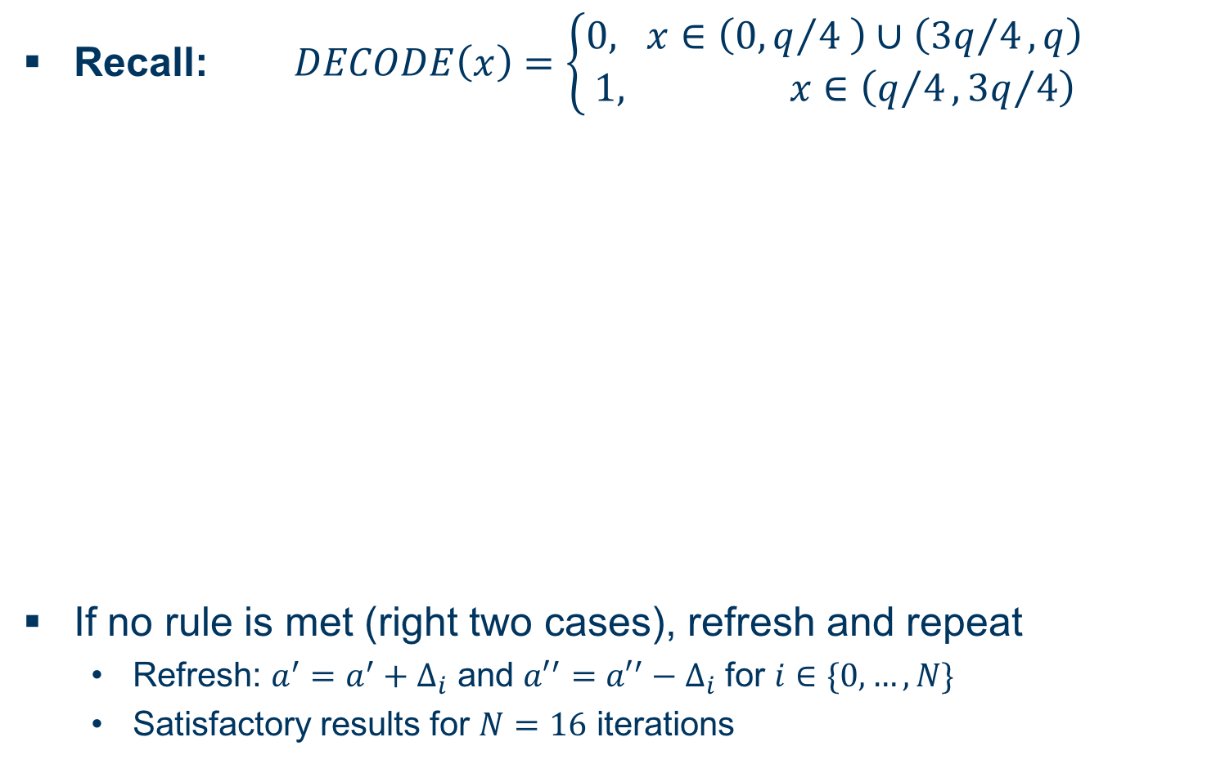
Masking Using a Masked Decoder
Masked Decoder II
Recall:
If no rule is met (right two cases), refresh and repeat
  Refresh: and for
  Satisfactory results for iterations

Slide 12
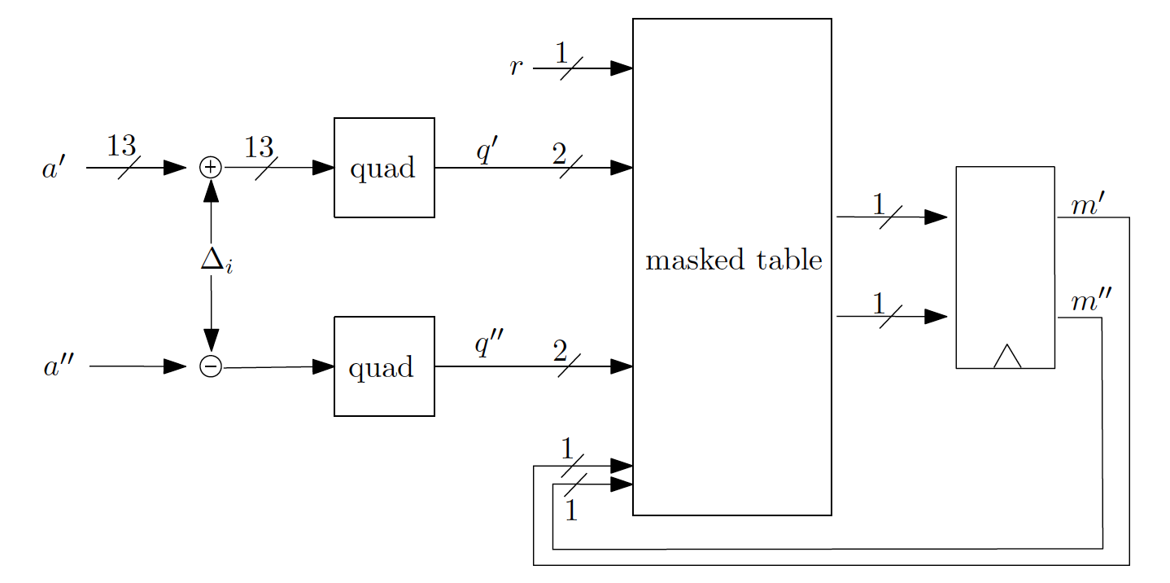
Masking Using a Masked Decoder
Masked Table Lookup
Implement said rules in a masked table

Slide 13
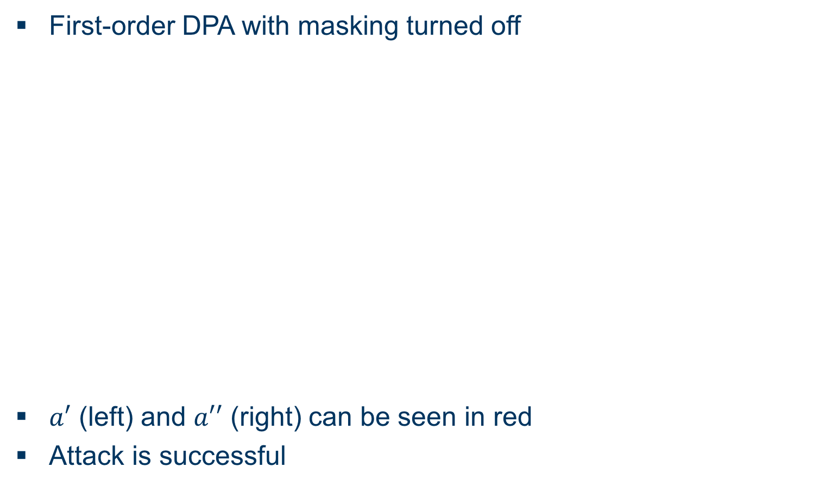
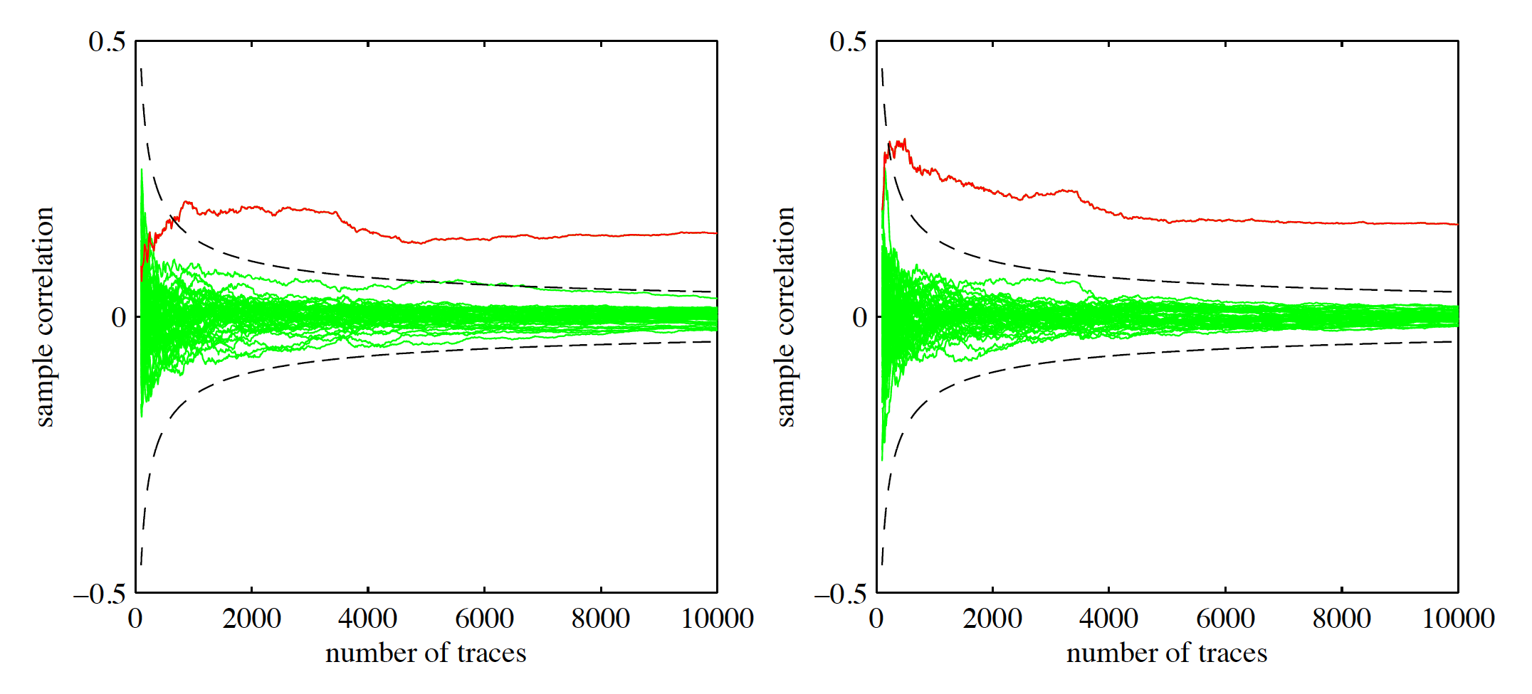
Masking Using a Masked Decoder
Evaluation I
First-order DPA with masking turned off
(left) and (right) can be seen in red
Attack is successful

Slide 14
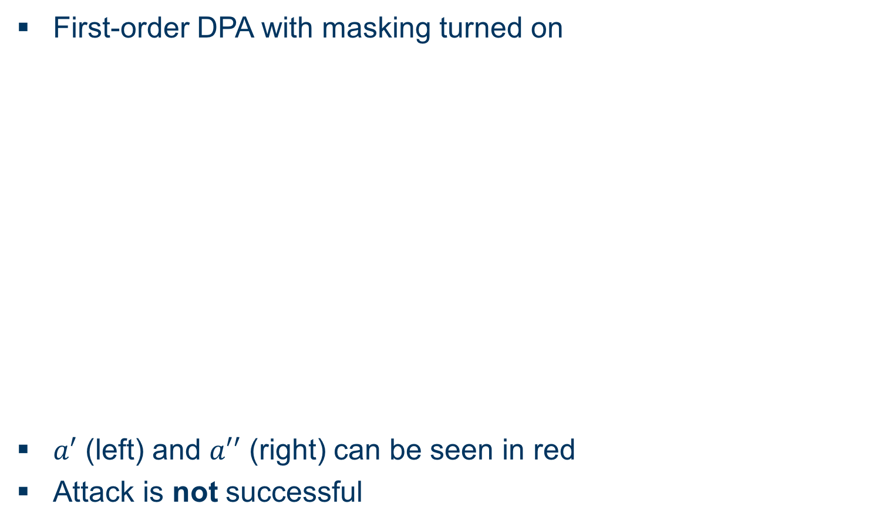
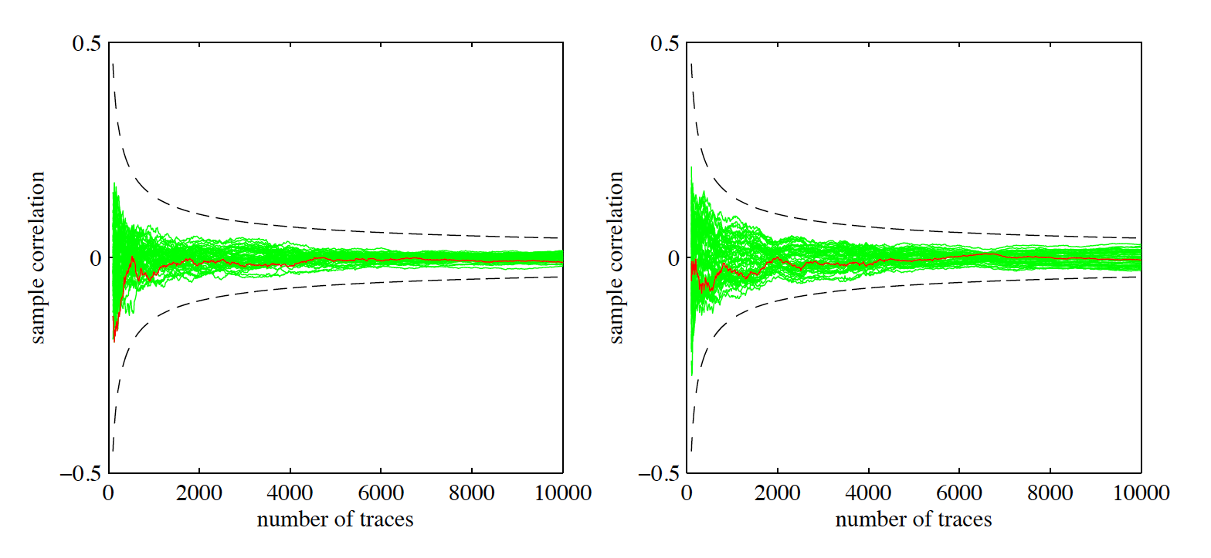
Masking Using a Masked Decoder
Evaluation II
First-order DPA with masking turned on
(left) and (right) can be seen in red
Attack is not successful

Slide 15
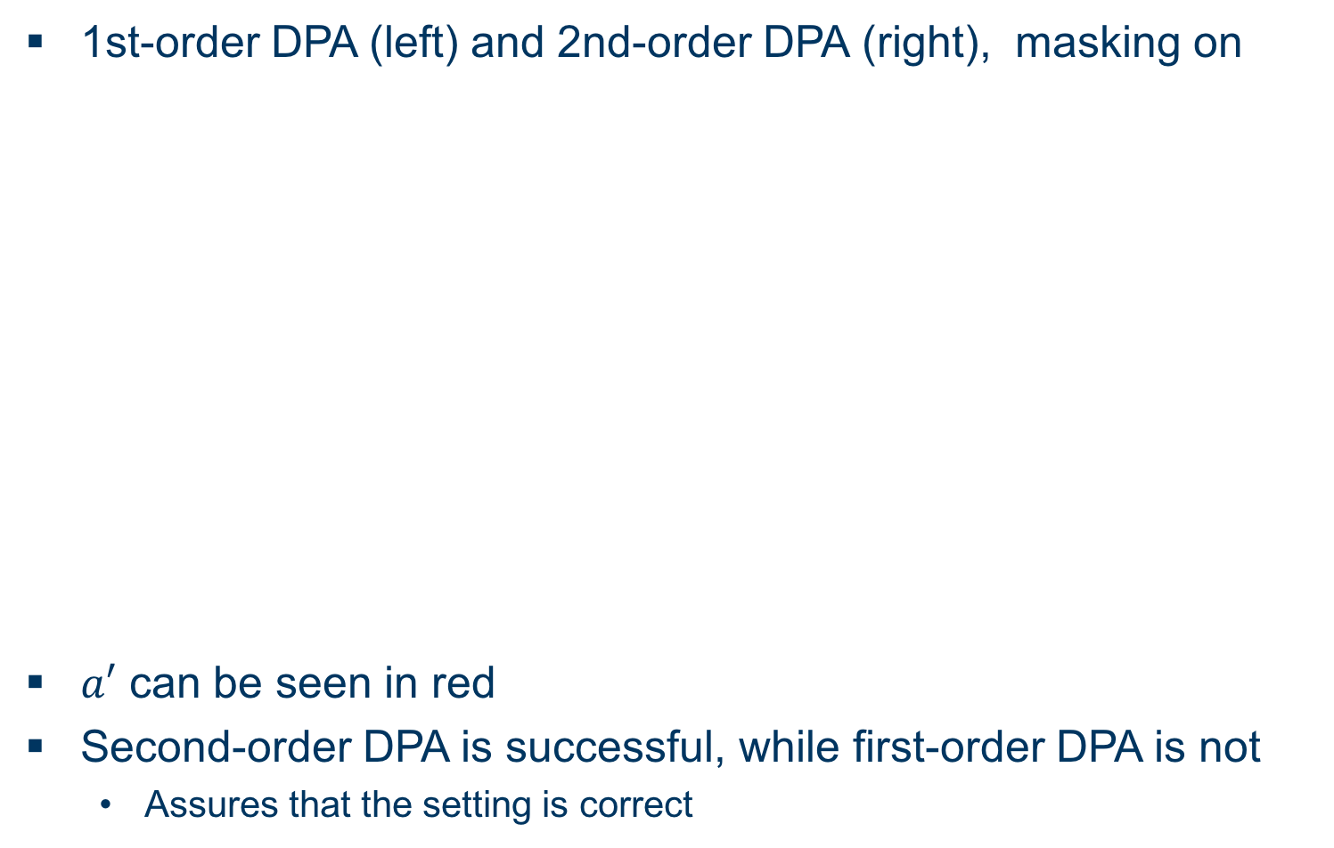
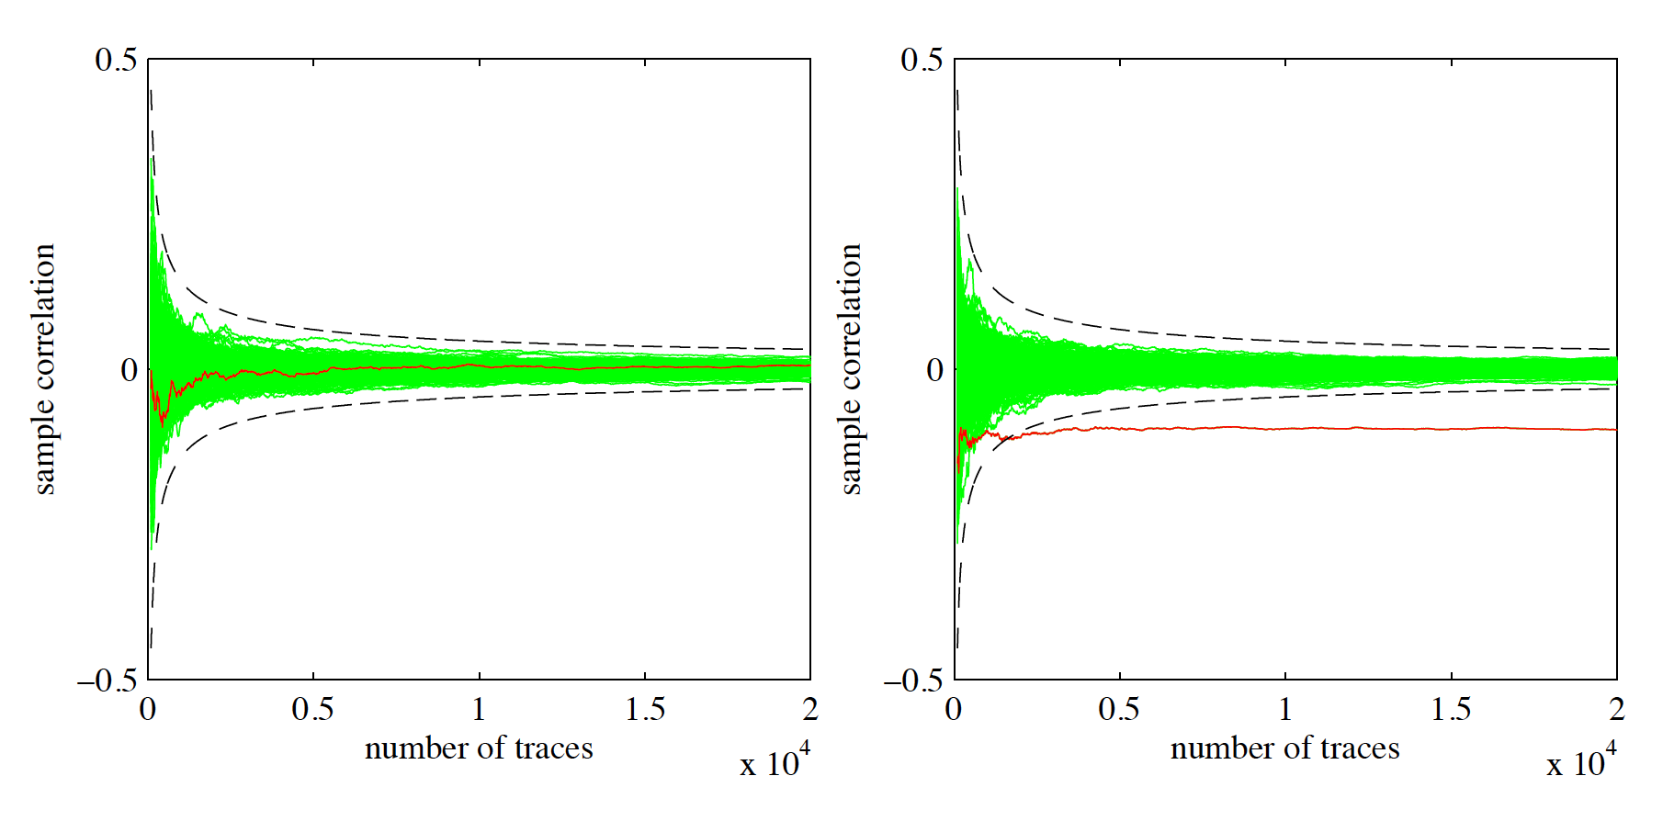
Masking Using a Masked Decoder
Evaluation III
1st-order DPA (left) and 2nd-order DPA (right), masking on
can be seen in red
Second-order DPA is successful, while first-order DPA is not
  Assures that the setting is correct

Slide 16
BLISS
Overview
Post-quantum signature scheme proposed in 2013
Based on generalized Short Integer Solution Problem
Random numbers according to Gaussian distribution!
Candidate for NIST standardization
  Outperforming RSA and ECC on microcontrollers
  Smallest signature size
BLISS-I („Optimized for Speed“): Securitylevel of 128 Bit
  Lambda mostly depending on Gaussian sampler
Used in Opensource IPSec VPN Solution Strongswan
„Practical Lattice-based Digital Signature Schemes“, J. Howe, T. Pöppelmann, M. O’Neill, E. O’Sullivan, T. Güneysu, 2015

Slide 17
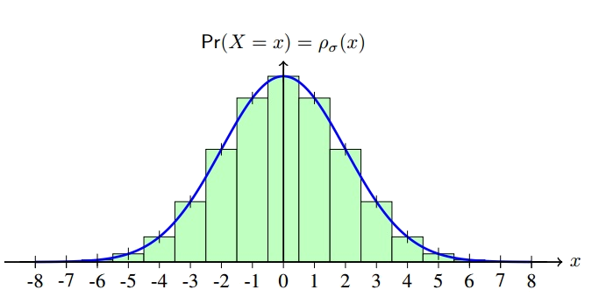
Sampling
Discrete Gaussian Distribution
For cryptographic applications: Discrete Gaussian distribution needed
Efficient algorithms needed to sample discrete Gaussians
Convert uniformly random bits into non-uniformly bits distributed according to target distribution
Defined by Standard deviation sigma
Tailcut : Ignore „tail“-part of distribution

Slide 18
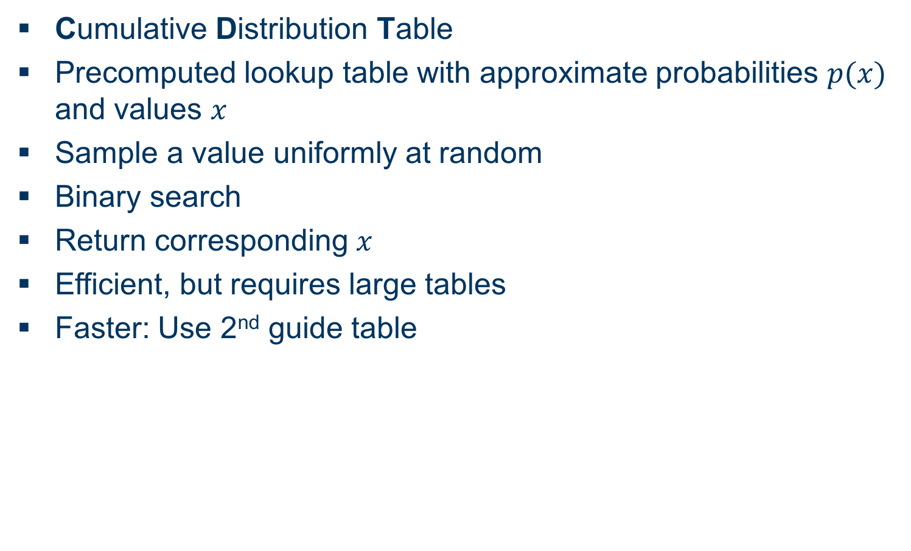
Sampling
CDT Sampling
Cumulative Distribution Table
Precomputed lookup table with approximate probabilities and values
Sample a value uniformly at random
Binary search
Return corresponding
Efficient, but requires large tables
Faster: Use 2nd guide table

Slide 19
Sampling
Rejection Sampling
Sample integers y and r uniformly at random
Reject, if r exceeds expected cumulative probability
Disadvantages:
  Computation of probability is expensive
  Rejection rate?!
Better algorithms use lookup table with precomputed values to decide rejection

Slide 20
Flush+Reload Cache Attack
Overview I
Cache timing attack
Flush memory lines from cache with clflush
Wait for user processes
Reload flushed memory lines and compare access time to reference value
Fast access means:
  Memory line has been cached
  User process accessed that memory line
Problem: Cache line contains multiple entries…

Slide 21
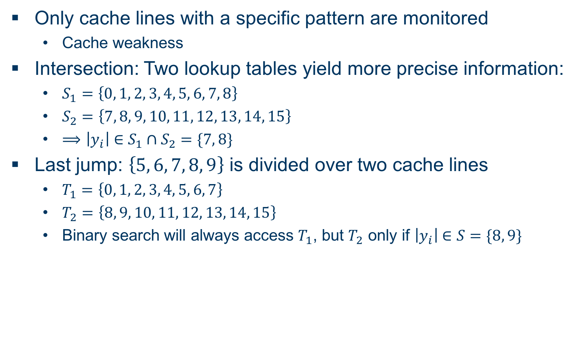
Flush+Reload Cache Attack
Overview II
Only cache lines with a specific pattern are monitored
  Cache weakness
Intersection: Two lookup tables yield more precise information:
Last jump: is divided over two cache lines
  Binary search will always access , but only if

Slide 22
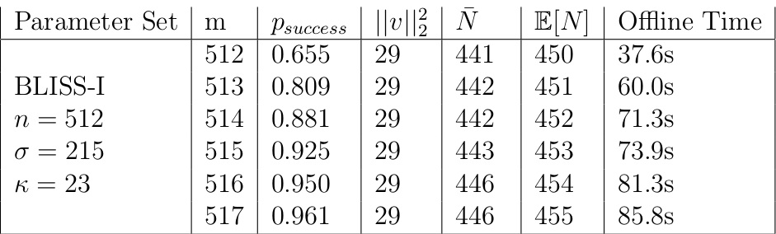
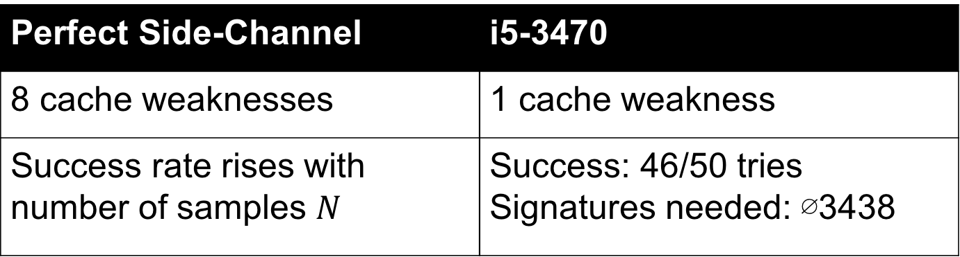
Flush+Reload Cache Attack
on CDT sampling
Perfect Side-Channel | i5-3470
8 cache weaknesses | 1 cache weakness
Success rate rises with number of samples | Success: 46/50 tries Signatures needed: ∅3438
Perfect Side-Channel | i5-3470
8 cache weaknesses | 1 cache weakness
 | Success: 46/50 tries Signatures needed: ∅3438

Slide 23
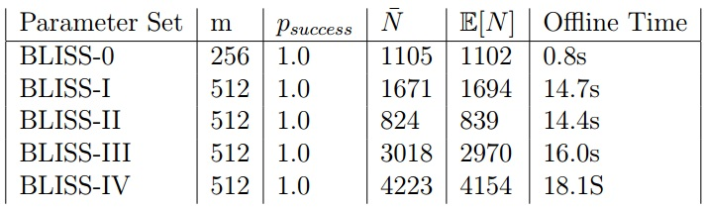
Flush+Reload Cache Attack
on Rejection sampling
Perfect Side-Channel | i7-5650U
Checks for table access in cache, only performed for one sample | 3 of 6 cache lines monitored
100% successfull | Success: 44 of 50 tries Signatures needed: ∅3294

Slide 24
EMSEC/SHA Blockseminar
Side-Channel Attacks on Implementations of Lattice-Based Cryptosystems
Felix Haarmann, Julian Speith
July 26th, 2016
Thank you for your attention!
Any Questions?

