Slide 1


EMSEC/SHA Blockseminar
Side-Channel Attacks on Implementations of Lattice-Based Cryptosystems
Felix Haarmann, Julian Speith
July 26th, 2016

Slide 2
WHAT?!?
Todays digital infrastructure is based on public-key crypto
Current public-key crypto vulnerable to quantum computing
Shor’s algorithm [1] for prime factorization and discrete logarithms
Quantum computers might become feasible in near future
Urgent need for post-quantum crypto
Lattice-based crypto is one possible solution
Currently most promising one, as it is pretty efficient
Side-Channel attack resistance is important for future implementations
E.g., Internet of things: attacker has physical access to devices
[1] “Polynomial-Time Algorithms for Prime Factorization and Discrete Logarithms on a Quantum Computer”; Peter W. Shor; October 1997

Slide 3
Structure of our Presentation
Some Basics...
Ring-LWE Encryption Scheme
Masking using a masked decoder
BLISS (Bimodal Lattice Signature Scheme)
Sampling
Flush+Reload Cache attack

Slide 4
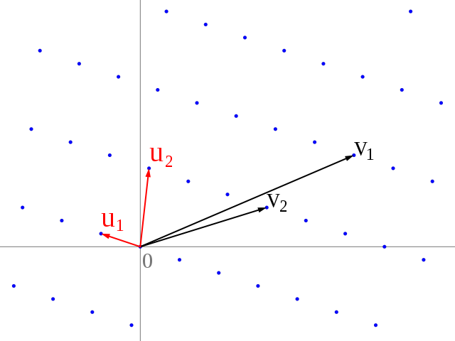
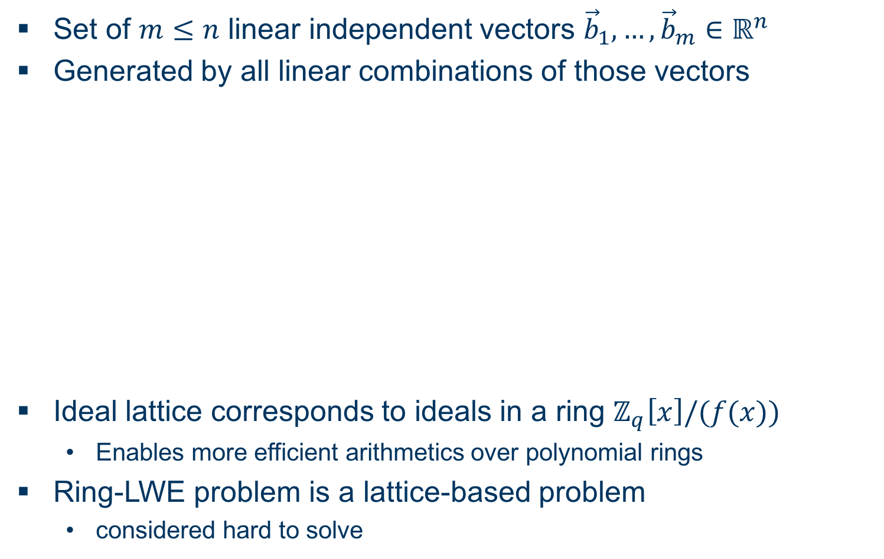
Some Basics... Ideal Lattices and Learning with Errors over Rings
Set of $m≤n$ linear independent vectors ${\vec{b}}_{1},…,{\vec{b}}_{m}∈ℝ^{n}$
Generated by all linear combinations of those vectors
Ideal lattice corresponds to ideals in a ring $ℤ_{q}\left[x\right]/(f(x))$
Enables more efficient arithmetics over polynomial rings
Ring-LWE problem is a lattice-based problem
considered hard to solve

Slide 5
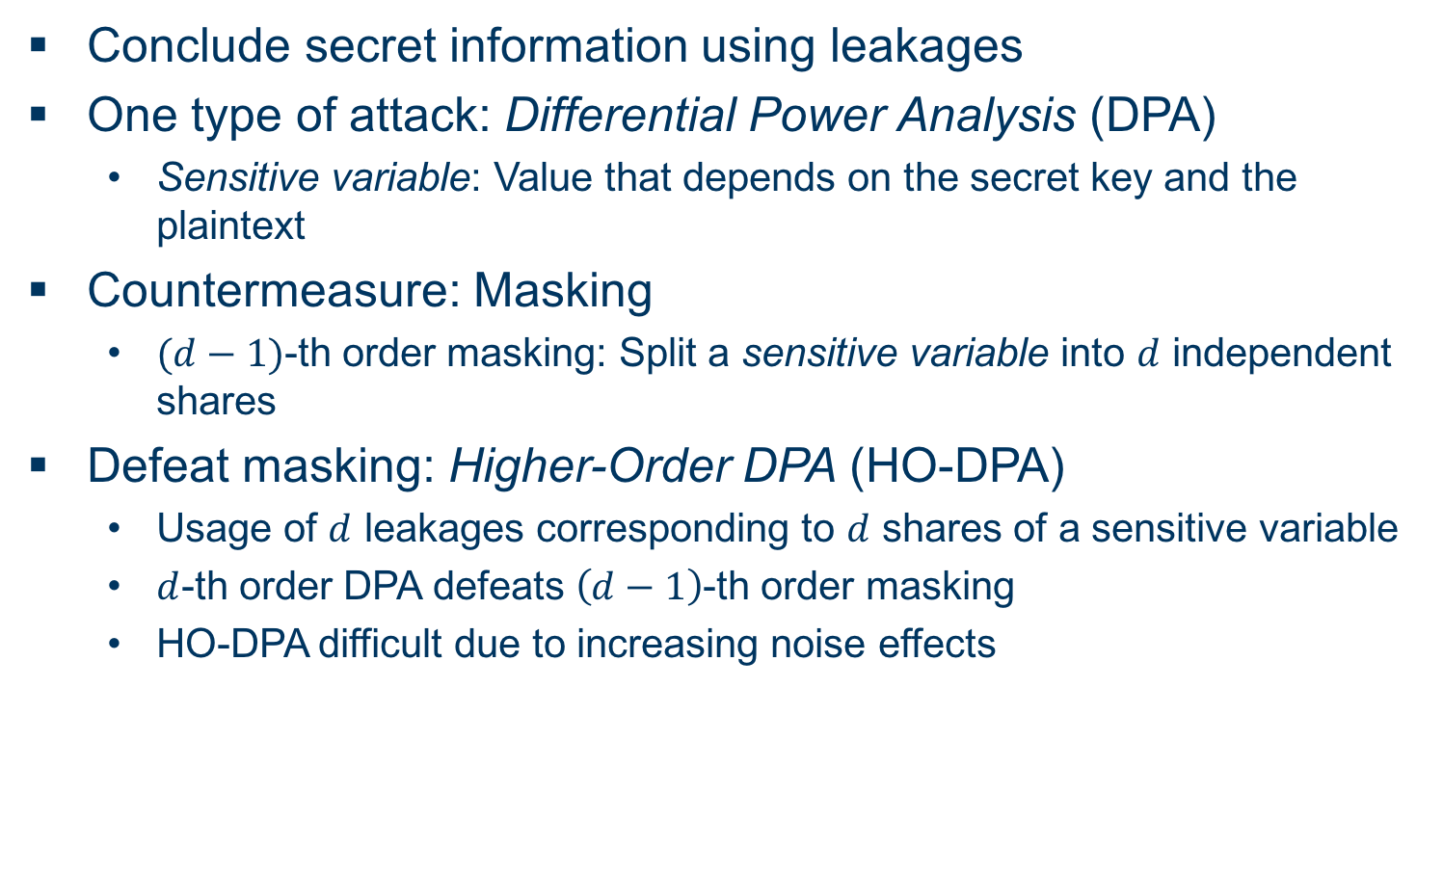
Some Basics... Side-Channel Attack Terminology (DPA)
Conclude secret information using leakages
One type of attack: Differential Power Analysis (DPA)
Sensitive variable: Value that depends on the secret key and the plaintext
Countermeasure: Masking
$(d−1)$-th order masking: Split a sensitive variable into $d$ independent shares
Defeat masking: Higher-Order DPA (HO-DPA)
Usage of $d$ leakages corresponding to $d$ shares of a sensitive variable
$d$-th order DPA defeats $\left(d−1\right)$-th order masking
HO-DPA difficult due to increasing noise effects

Slide 6
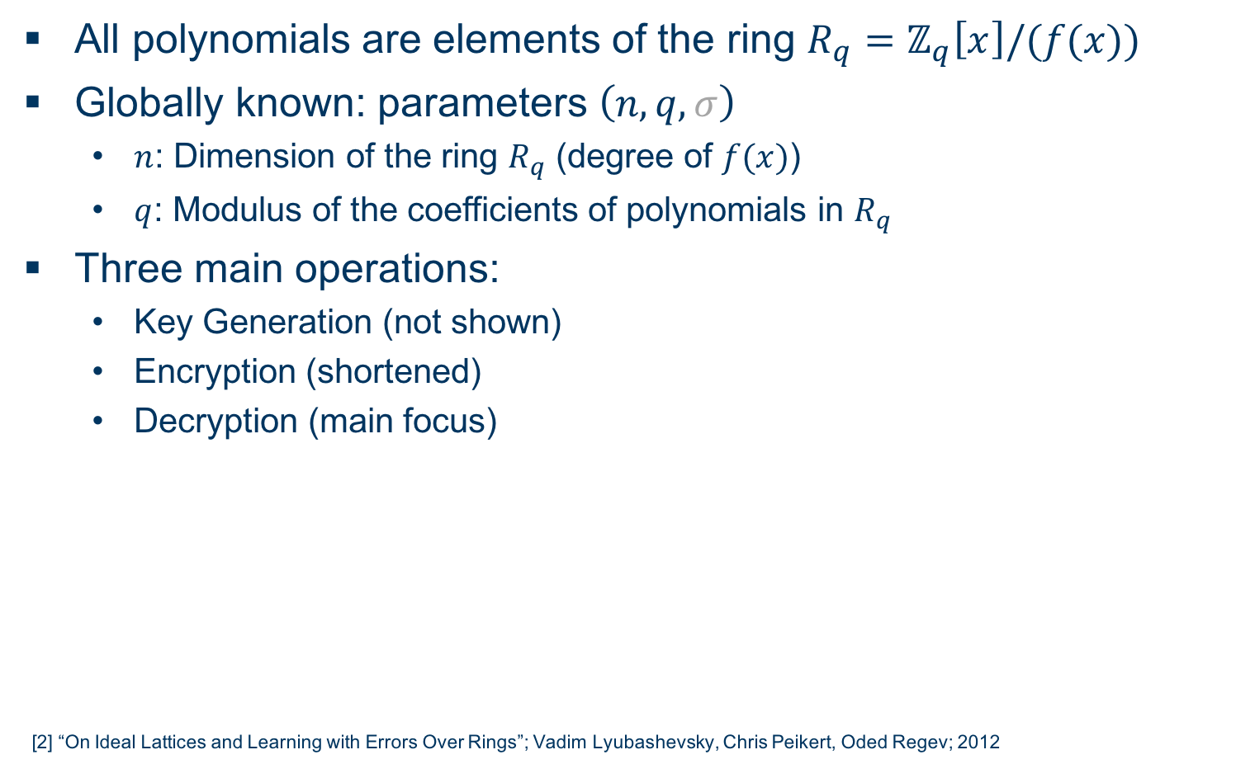
Ring-LWE Encryption Scheme [2] Overview
All polynomials are elements of the ring $R_{q}=ℤ_{q}\left[x\right]/(f(x))$
Globally known: parameters $\left(n,q,σ\right)$
$n$: Dimension of the ring $R_{q}$ (degree of $f(x)$)
$q$: Modulus of the coefficients of polynomials in $R_{q}$
Three main operations:
Key Generation (not shown)
Encryption (shortened)
Decryption (main focus)
[2] “On Ideal Lattices and Learning with Errors Over Rings”; Vadim Lyubashevsky, Chris Peikert, Oded Regev; 2012

Slide 7

Ring-LWE Encryption Scheme Encryption
Input: $n$-bit message $m$, public key $p$
Encode $m$ as an element of $R_{q}$ by multiplying each bit with $\frac{q}{2}$
Encoded message is denoted as $m_{enc}$
Do some math …
Output: Ciphertext $\left(c_{1},c_{2}\right)$

Slide 8
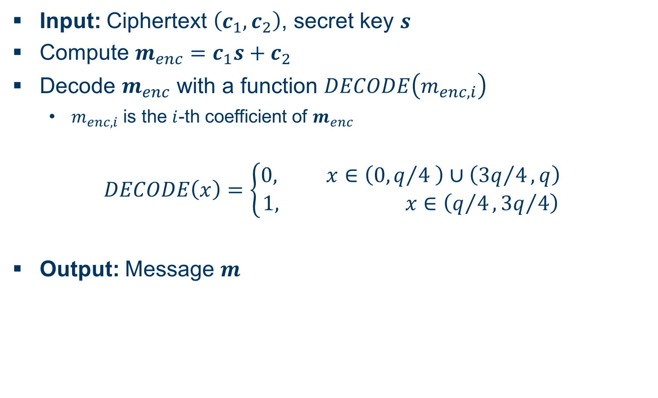
Ring-LWE Encryption Scheme Decryption
Input: Ciphertext $\left(c_{1},c_{2}\right)$, secret key $s$
Compute $m_{enc}=c_{1}s+c_{2}$
Decode $m_{enc}$ with a function $DECODE\left(m_{enc,i}\right)$
$m_{enc,i}$ is the $i$-th coefficient of $m_{enc}$
$$DECODE\left(x\right)=\left\{\begin{aligned}0, x∈\left(0,q/4 \right)∪\left({3q}/4,q\right) \\ 1, x∈\left(q/4,{3q}/4\right)\end{aligned}\right.$$
Output: Message $m$

Slide 9
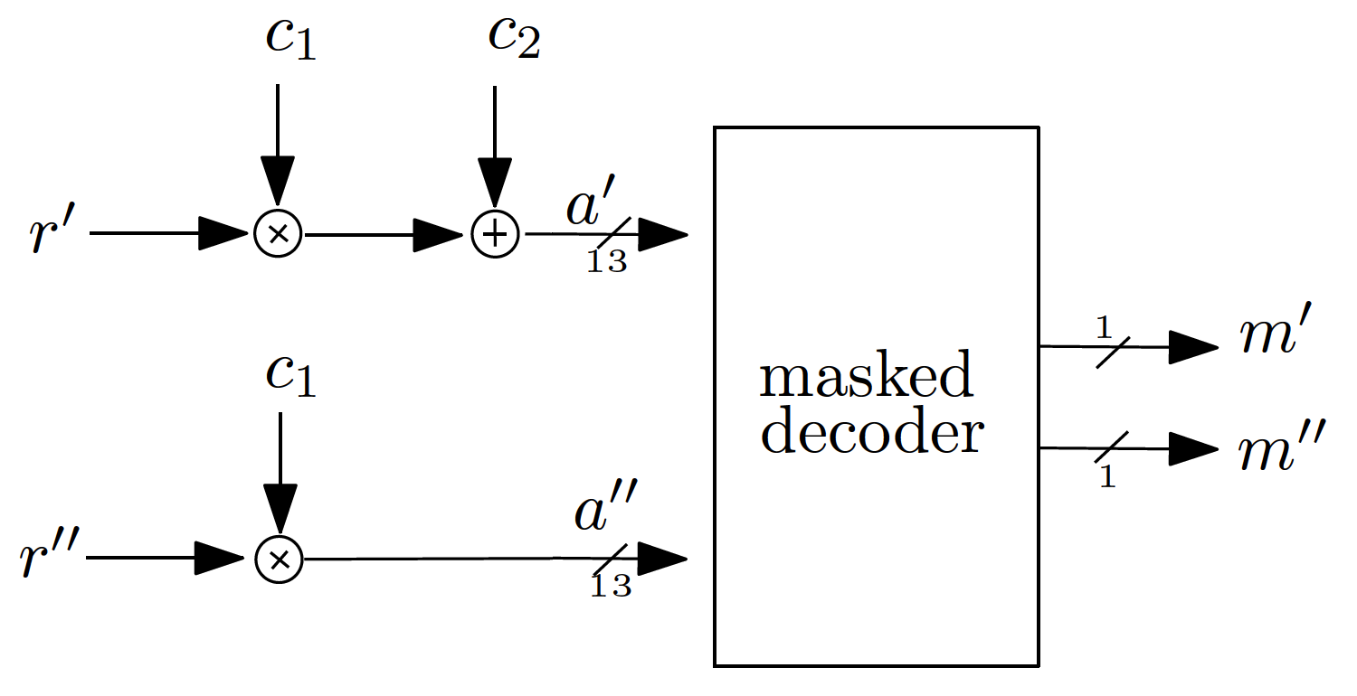
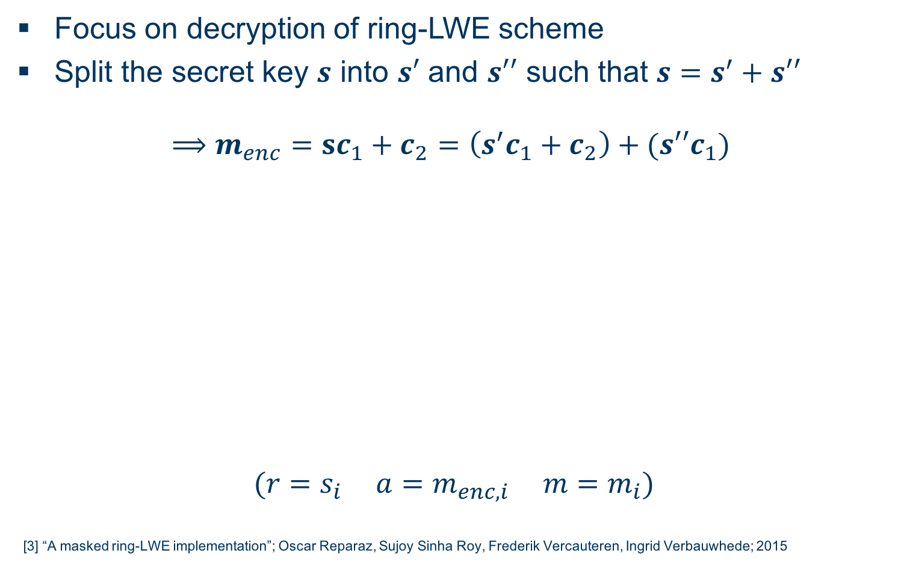
Masking Using a Masked Decoder [3] Overview
Focus on decryption of ring-LWE scheme
Split the secret key $s$ into $s′$ and $s′′$ such that $s=s^{′}+s′′$
$$⟹m_{enc}=sc_{1}+c_{2}=\left(s^{′}c_{1}+c_{2}\right)+(s′′c_{1})$$
$$(r=s_{i} a=m_{enc,i} m=m_{i})$$
[3] “A masked ring-LWE implementation”; Oscar Reparaz, Sujoy Sinha Roy, Frederik Vercauteren, Ingrid Verbauwhede; 2015

Slide 10
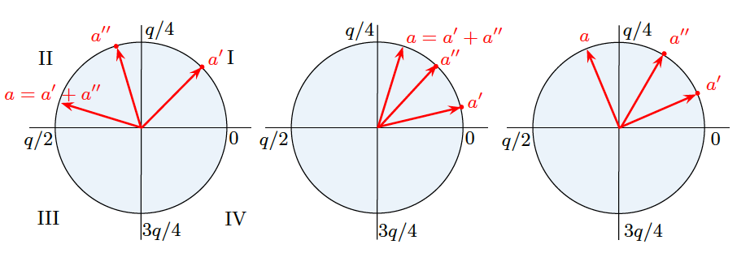
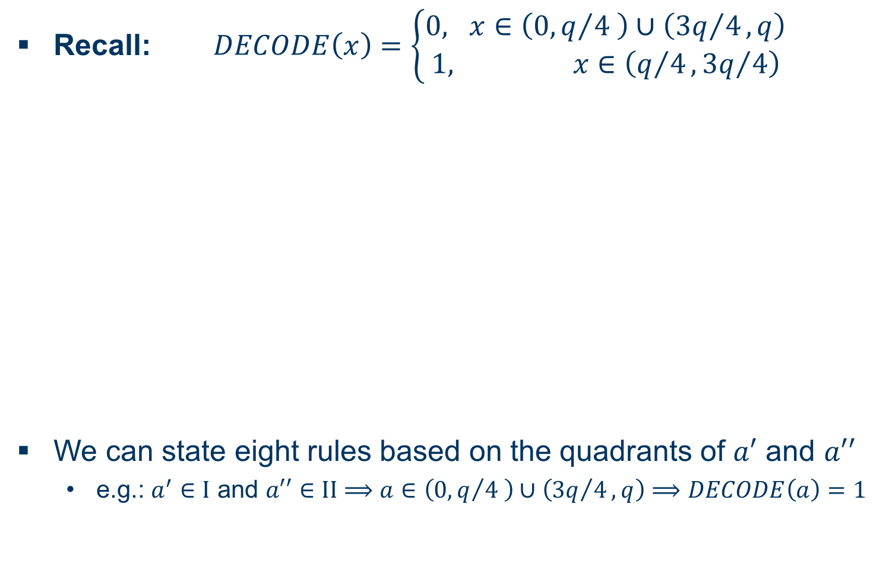
Masking Using a Masked Decoder Masked Decoder I
Recall: $DECODE\left(x\right)=\left\{\begin{aligned}0, x∈\left(0,q/4 \right)∪\left({3q}/4,q\right) \\ 1, x∈\left(q/4,{3q}/4\right)\end{aligned}\right.$
We can state eight rules based on the quadrants of $a′$ and $a′′$
e.g.: $a^{′}∈I$ and $a′′∈II$ $⟹a∈\left(0,q/4 \right)∪\left({3q}/4,q\right)⟹DECODE\left(a\right)=1$

Slide 11

Masking Using a Masked Decoder Masked Decoder II
Recall: $DECODE\left(x\right)=\left\{\begin{aligned}0, x∈\left(0,q/4 \right)∪\left({3q}/4,q\right) \\ 1, x∈\left(q/4,{3q}/4\right)\end{aligned}\right.$
If no rule is met (right two cases), refresh and repeat
Refresh: $a^{′}=a^{′}+Δ_{i}$ and ${a′}^{′}={a′}^{′}−Δ_{i}$ for $i∈\{0,…,N\}$
Satisfactory results for $N=16$ iterations

Slide 12
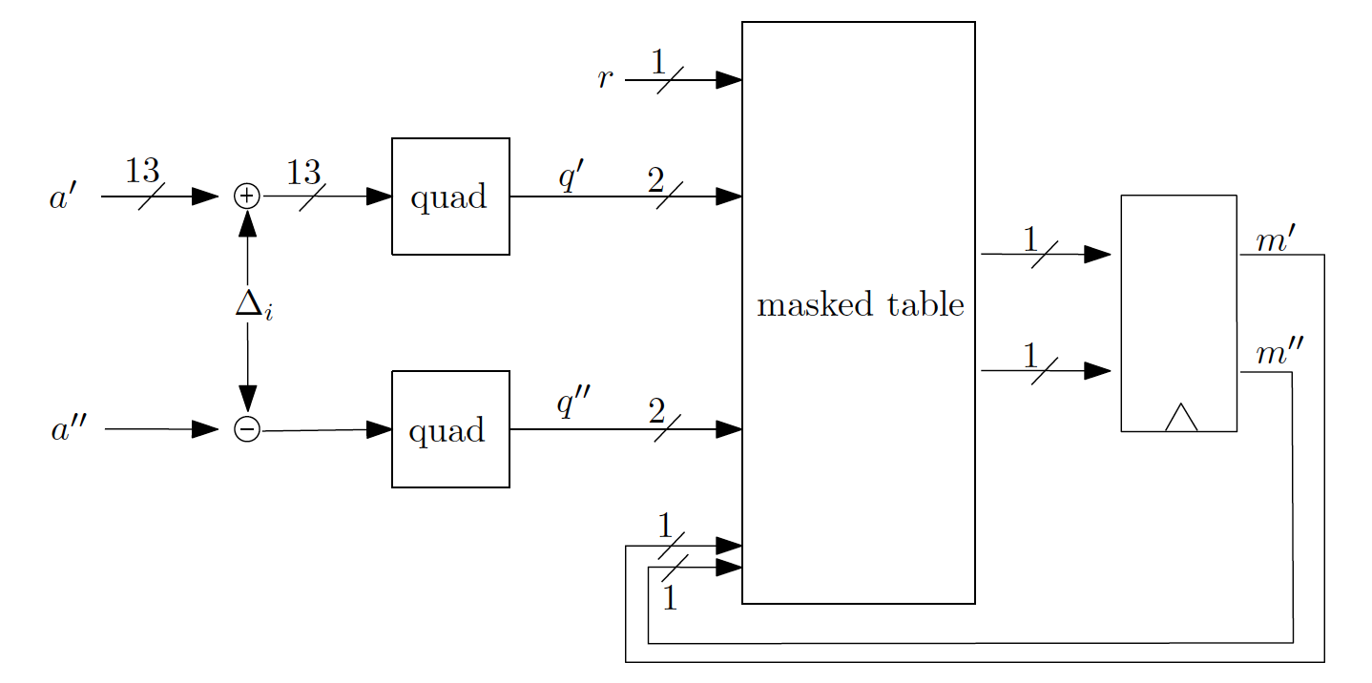
Masking Using a Masked Decoder Masked Table Lookup
Implement said rules in a masked table

Slide 13
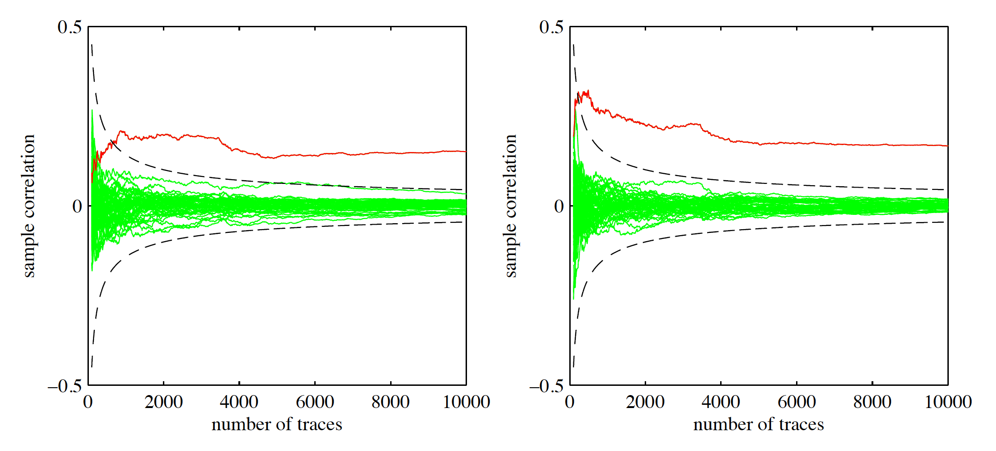

Masking Using a Masked Decoder Evaluation I
First-order DPA with masking turned off
$a′$ (left) and $a′′$ (right) can be seen in red
Attack is successful

Slide 14
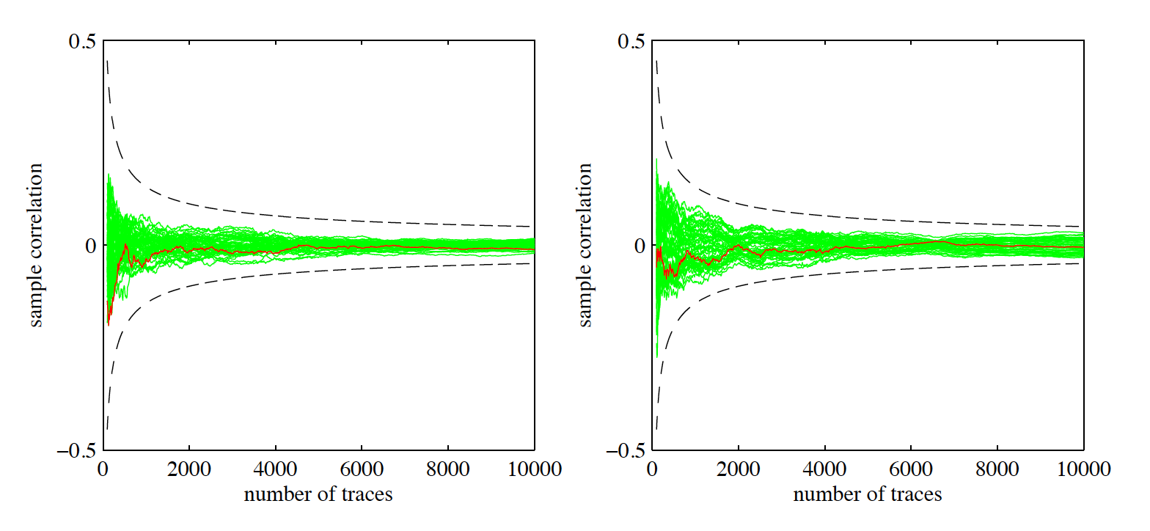

Masking Using a Masked Decoder Evaluation II
First-order DPA with masking turned on
$a′$ (left) and $a′′$ (right) can be seen in red
Attack is not successful

Slide 15
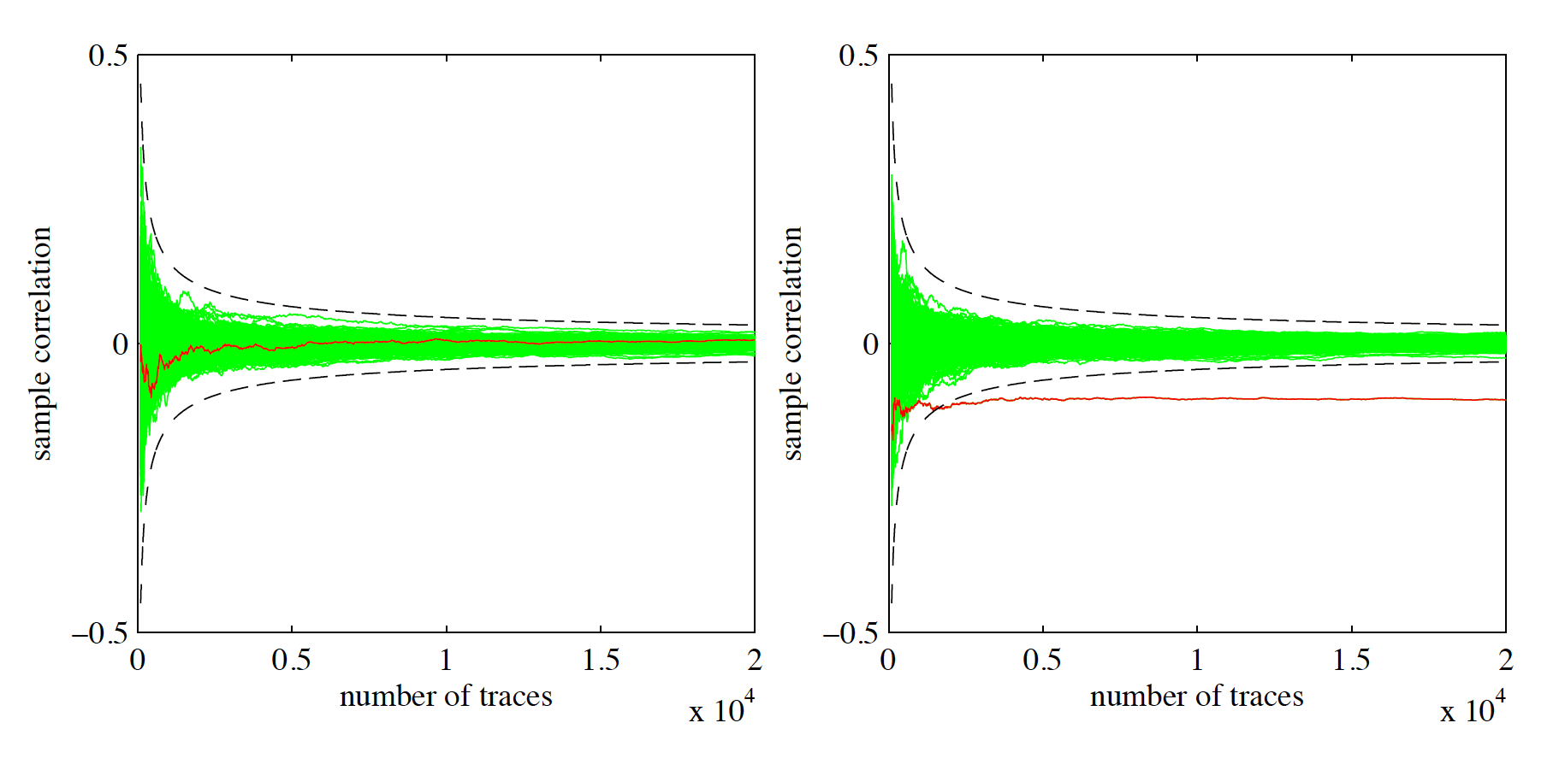
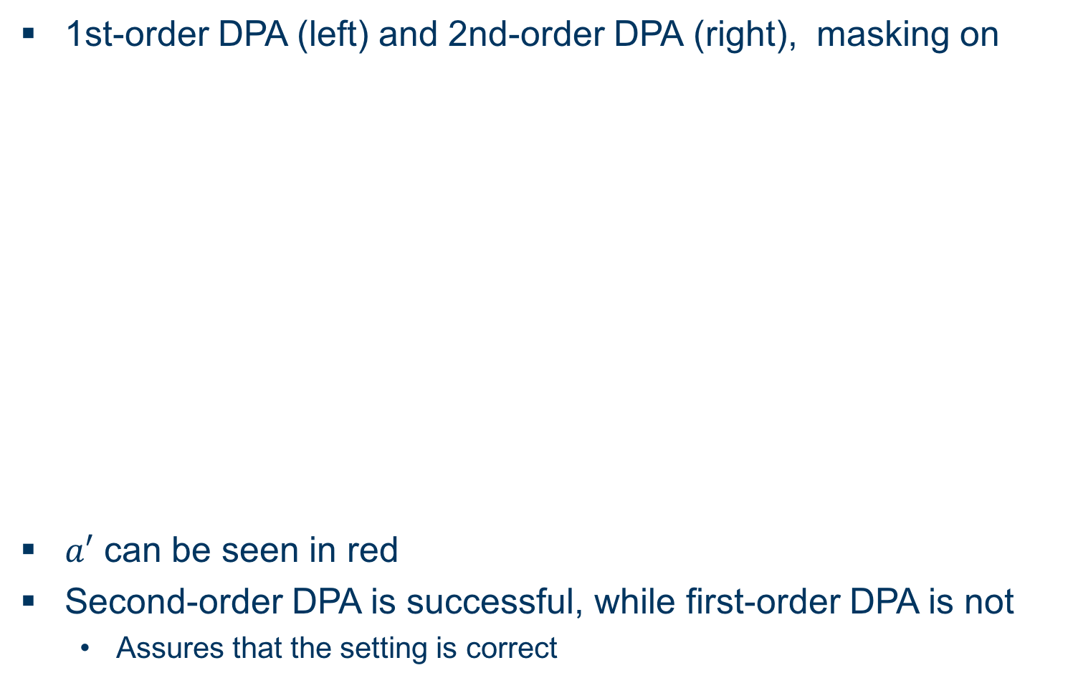
Masking Using a Masked Decoder Evaluation III
1st-order DPA (left) and 2nd-order DPA (right), masking on
$a′$ can be seen in red
Second-order DPA is successful, while first-order DPA is not
Assures that the setting is correct

Slide 16

BLISS Overview
Signature scheme based on lattice problem
BLISS-I: Security $λ=128$ Bit

Slide 17
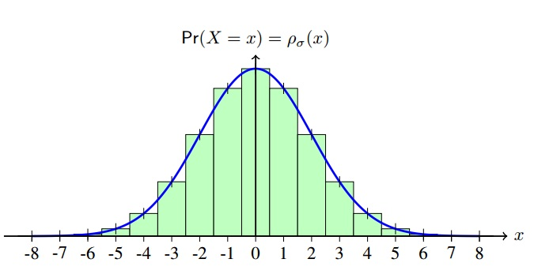

Sampling Discrete Gaussian Distribution
For cryptographic applications: Discrete Gaussian distribution needed
Efficient algorithms needed to sample discrete Gaussians
Convert uniformly random bits into non-uniformly bits distributed according to target distribution
Tailcut $τ$: Ignore „tail“-part of distribution

Slide 18
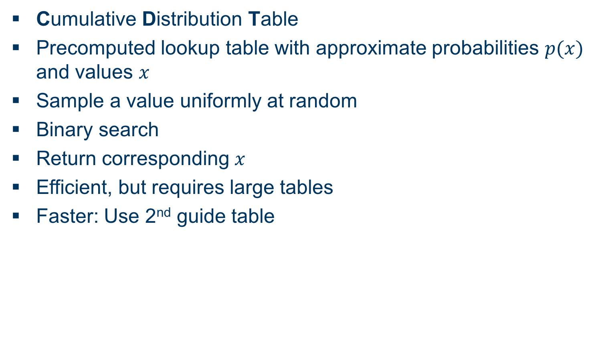
Sampling CDT Sampling
Cumulative Distribution Table
Precomputed lookup table with approximate probabilities $p(x)$ and values $x$
Sample a value uniformly at random
Binary search
Return corresponding $x$
Efficient, but requires large tables
Faster: Use 2nd guide table

Slide 19
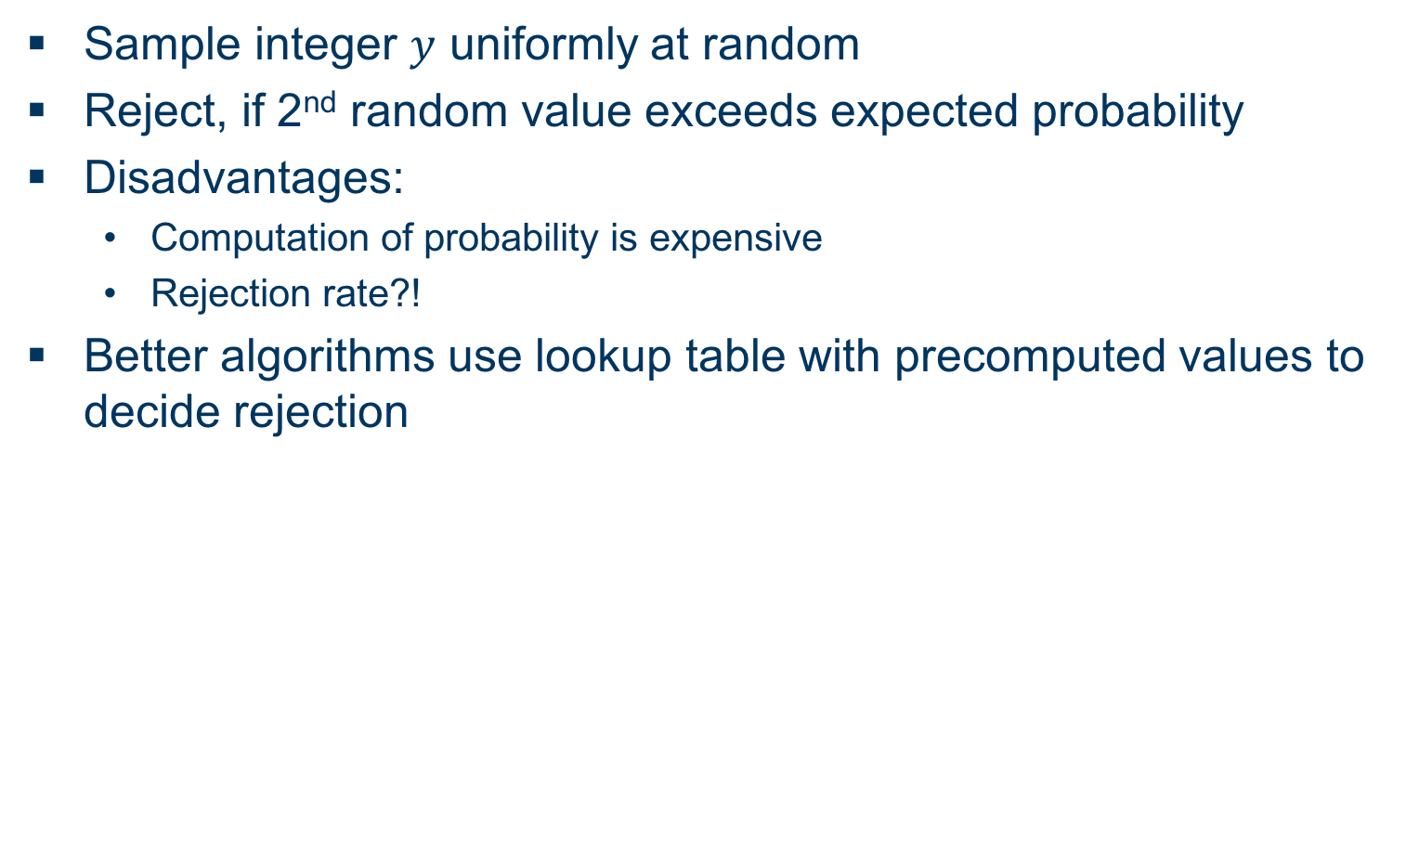
Sampling Rejection Sampling
Sample integer $y$ uniformly at random
Reject, if 2nd random value exceeds expected probability
Disadvantages:
Computation of probability is expensive
Rejection rate?!
Better algorithms use lookup table with precomputed values to decide rejection

Slide 20
Flush+Reload Cache Attack Overview I
Flush memory lines from cache with clflush
Wait for user processes
Reload flushed memory lines and compare access time to reference value
Fast access means:
Memory line has been cached
User process accessed that memory line
Problem: Cache line contains multiple entries…

Slide 21
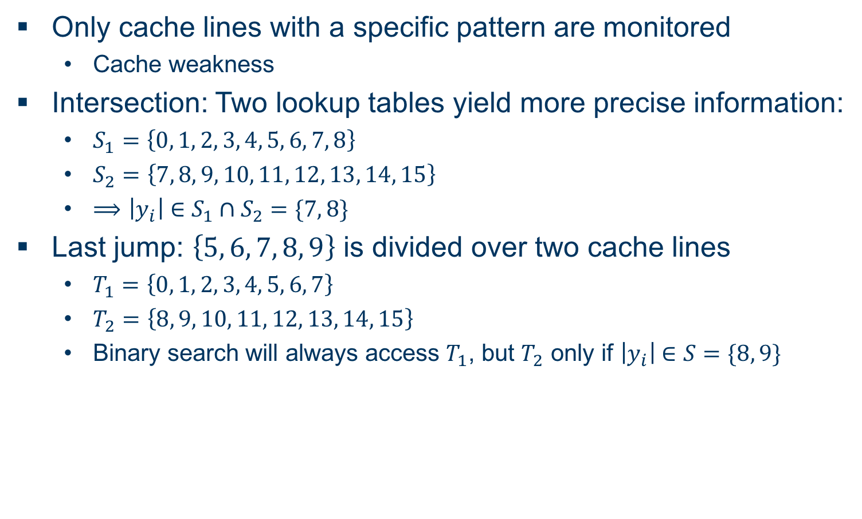
Flush+Reload Cache Attack Overview II
Only cache lines with a specific pattern are monitored
Cache weakness
Intersection: Two lookup tables yield more precise information:
$S_{1}=\left\{0, 1, 2, 3, 4, 5, 6, 7, 8\right\}$
$S_{2}=\left\{7, 8, 9, 10, 11, 12, 13, 14, 15\right\}$
$⟹\left|y_{i}\right|∈S_{1}∩S_{2}=\{7, 8\}$
Last jump: $\left\{5, 6, 7, 8, 9\right\}$ is divided over two cache lines
$T_{1}=\left\{0, 1, 2, 3, 4, 5, 6, 7\right\}$
$T_{2}=\left\{8, 9, 10, 11, 12, 13, 14, 15\right\}$
Binary search will always access $T_{1}$, but $T_{2}$ only if $\left|y_{i}\right|∈S=\{8, 9\}$

Slide 22
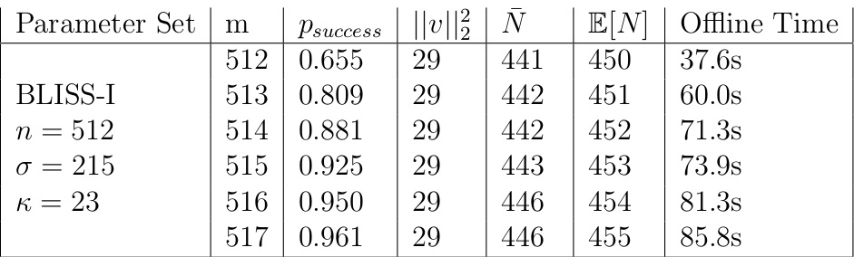
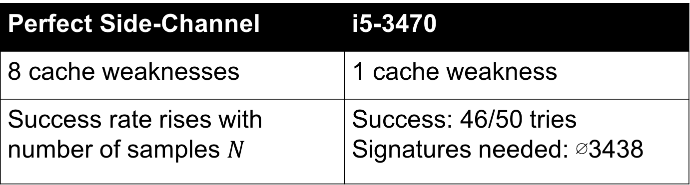
Flush+Reload Cache Attack on CDT sampling
Perfect Side-Channel | i5-3470
8 cache weaknesses | 1 cache weakness
Success rate rises with number of samples $N$ | Success: 46/50 tries Signatures needed: ∅3438

Slide 23
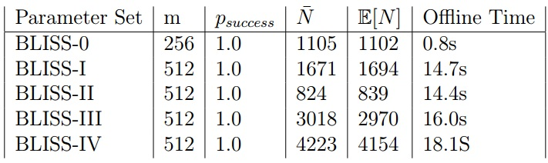
Flush+Reload Cache Attack on Rejection sampling
Perfect Side-Channel | i7-5650U
Checks for table access in cache, only performed for one sample | 3 of 6 cache lines monitored
100% successfull | Success: 44 of 50 tries Signatures needed: ∅3294

Slide 24
EMSEC/SHA Blockseminar
Side-Channel Attacks on Implementations of Lattice-Based Cryptosystems
Felix Haarmann, Julian Speith
July 26th, 2016
Thank you for your attention! Any Questions?

