Slide 1


EMSEC/SHA Blockseminar
Side-Channel Attacks on Implementations of Lattice-Based Cryptosystems
Felix Haarmann, Julian Speith
July 26th, 2016

Slide 2
WHAT?!?
Todays digital infrastructure is based on public-key crypto
Current public-key crypto vulnerable to quantum computing
  Shor’s algorithm for prime factorization and discrete logarithms
Quantum computers might become feasible in near future
Urgent need for post-quantum crypto
Lattice-based crypto is one possible solution
  Currently most promising one, as it is pretty efficient
Side-Channel attack resistance is important for future implementations

Slide 3
Structure of our Presentation
Some Basics...
Ring-LWE Encryption Scheme
  Masking using a masked decoder
  Additively homomorphic masking
BLISS (Bimodal Lattice Signature Scheme)
  Sampling algorithms
  Cache attacks
Blinding Countermeasures

Slide 4
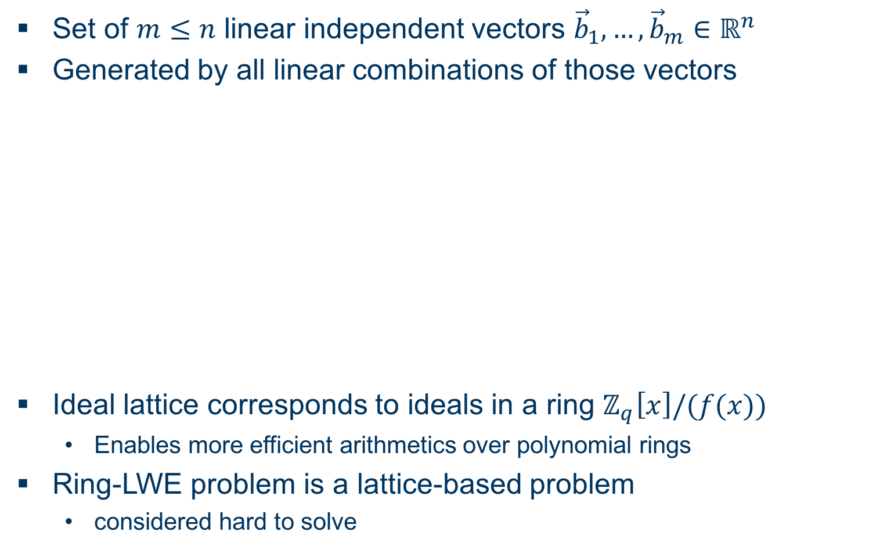
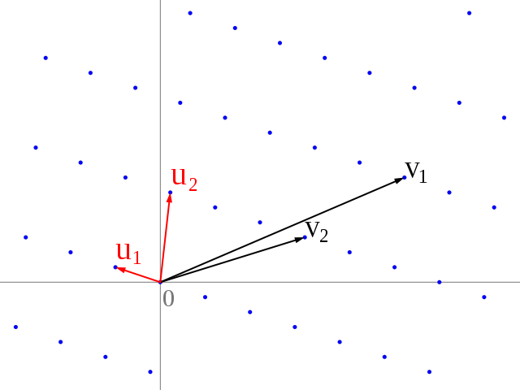
Some Basics...
Ideal Lattices and Learning with Errors over Rings
Set of linear independent vectors
Generated by all linear combinations of those vectors
Ideal lattice corresponds to ideals in a ring
  Enables more efficient arithmetics over polynomial rings
Ring-LWE problem is a lattice-based problem
  considered hard to solve

Slide 5
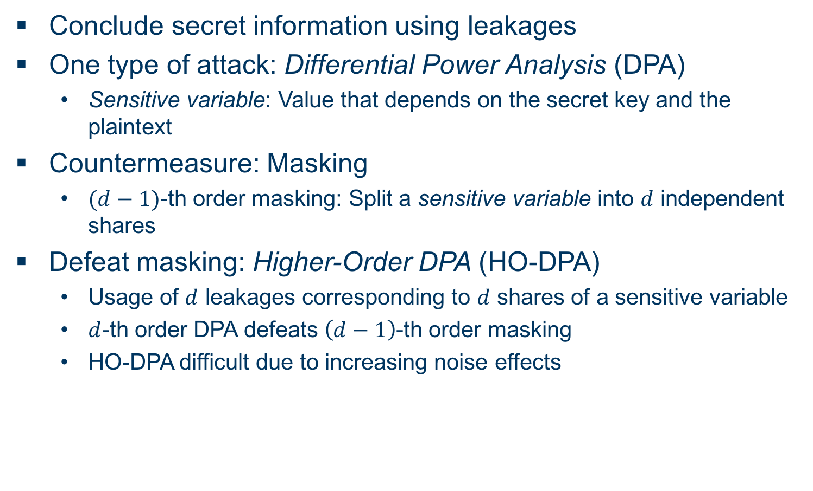
Some Basics...
Side-Channel Attack Terminology (DPA)
Conclude secret information using leakages
One type of attack: Differential Power Analysis (DPA)
  Sensitive variable: Value that depends on the secret key and the plaintext
Countermeasure: Masking
  -th order masking: Split a sensitive variable into independent shares
Defeat masking: Higher-Order DPA (HO-DPA)
  Usage of leakages corresponding to shares of a sensitive variable
  -th order DPA defeats -th order masking
  HO-DPA difficult due to increasing noise effects

Slide 6
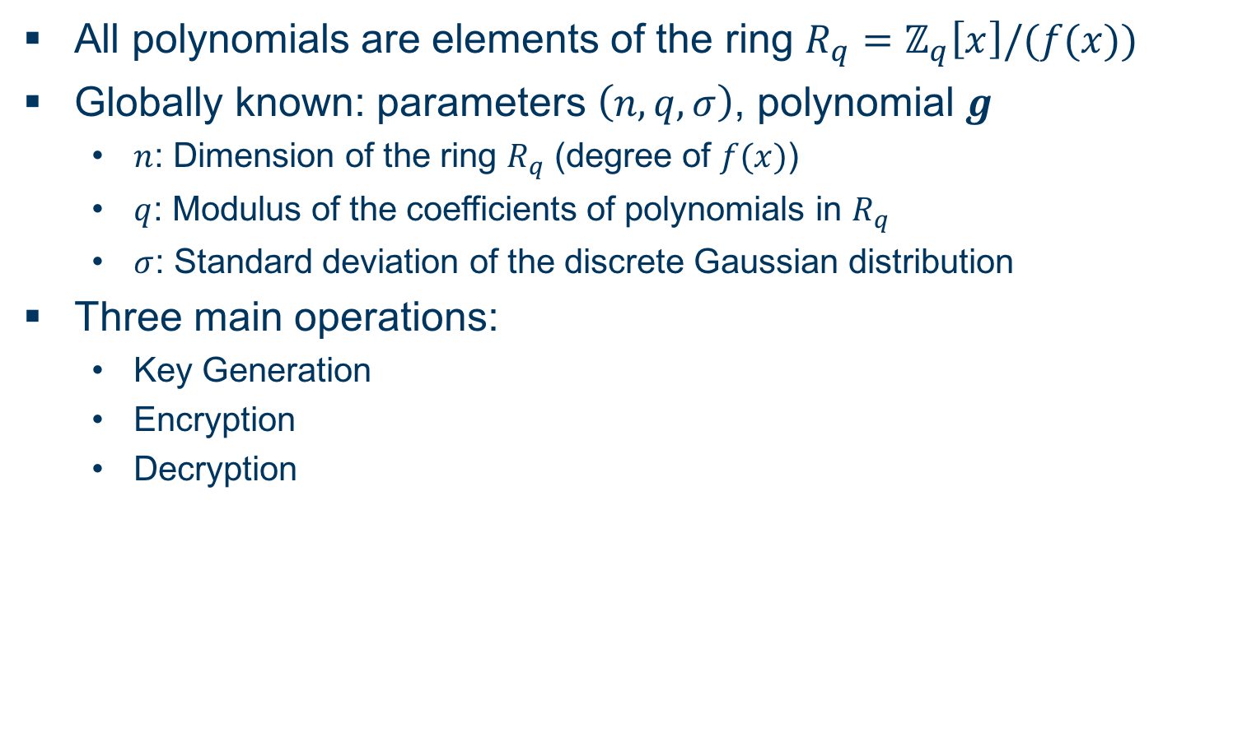
Ring-LWE Encryption Scheme
Overview
All polynomials are elements of the ring
Globally known: parameters , polynomial
  : Dimension of the ring (degree of )
  : Modulus of the coefficients of polynomials in
  : Standard deviation of the discrete Gaussian distribution
Three main operations:
  Key Generation
  Encryption
  Decryption

Slide 7
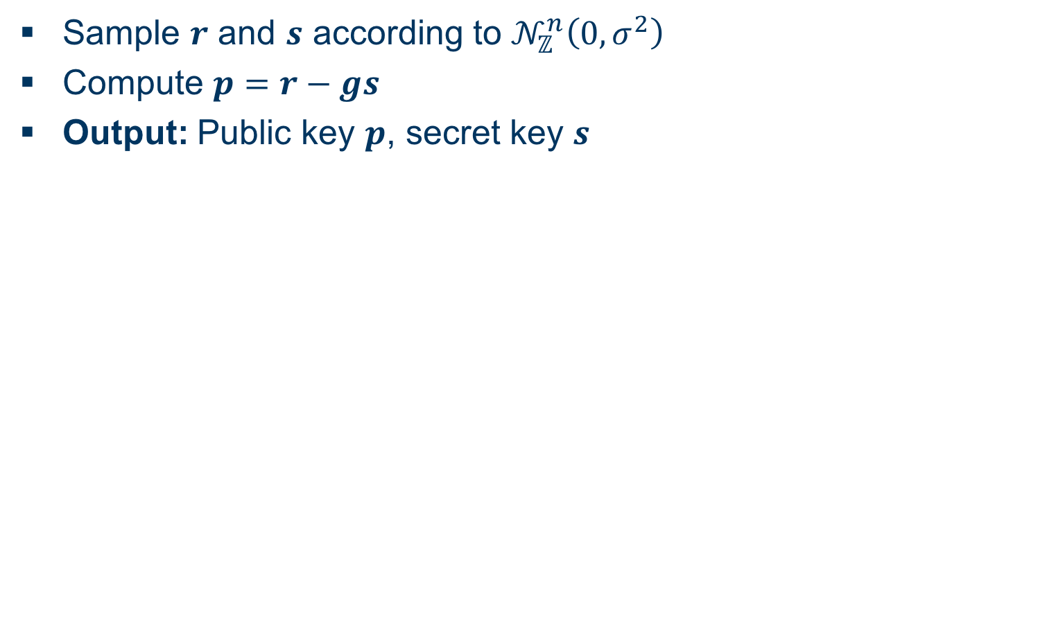
Ring-LWE Encryption Scheme
Key Generation
Sample and according to
Compute
Output: Public key , secret key

Slide 8
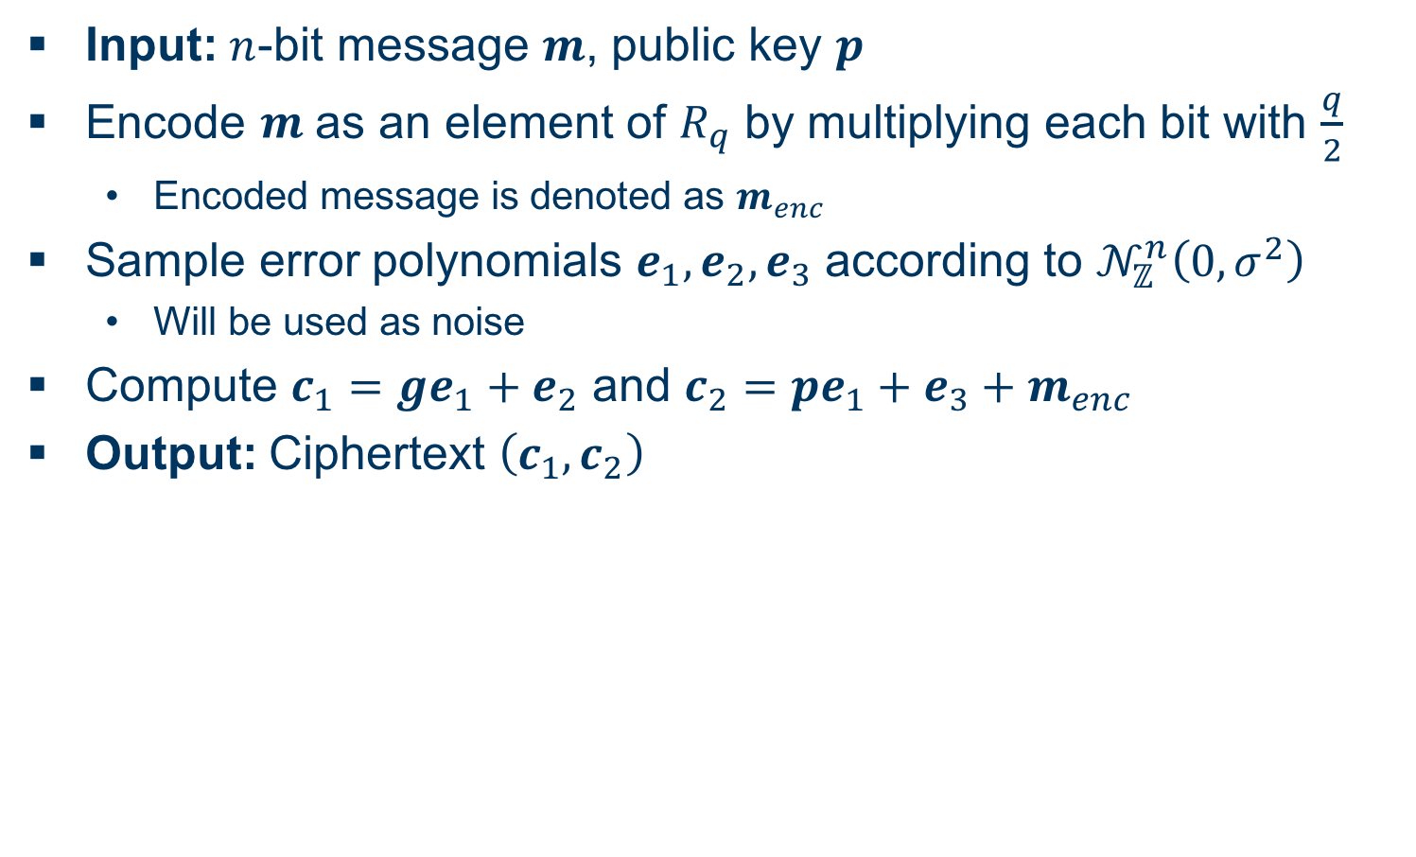
Ring-LWE Encryption Scheme
Encryption
Input: -bit message , public key
Encode as an element of by multiplying each bit with
  Encoded message is denoted as
Sample error polynomials according to
  Will be used as noise
Compute and
Output: Ciphertext

Slide 9
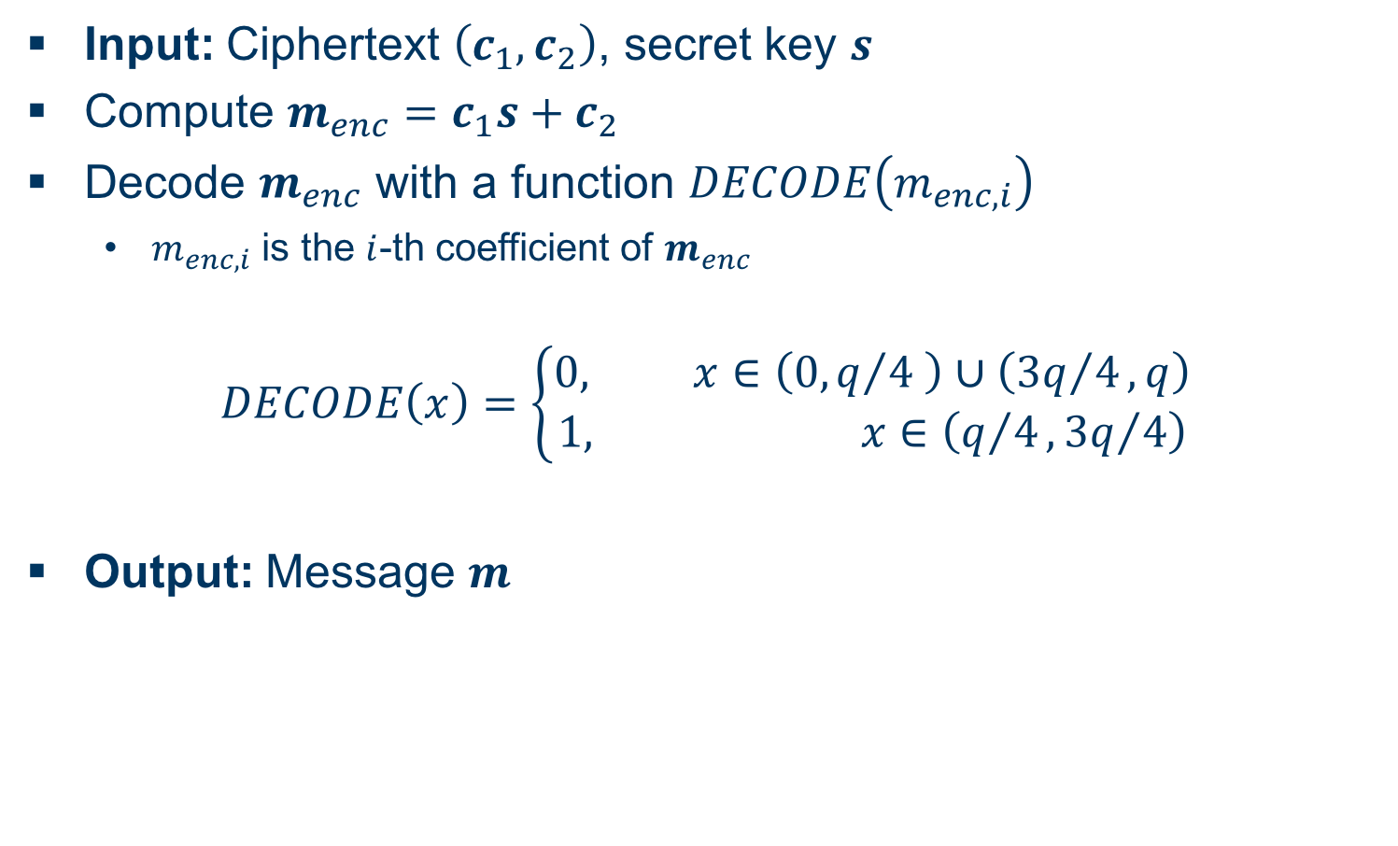
Ring-LWE Encryption Scheme
Decryption
Input: Ciphertext , secret key
Compute
Decode with a function
  is the -th coefficient of
Output: Message

Slide 10
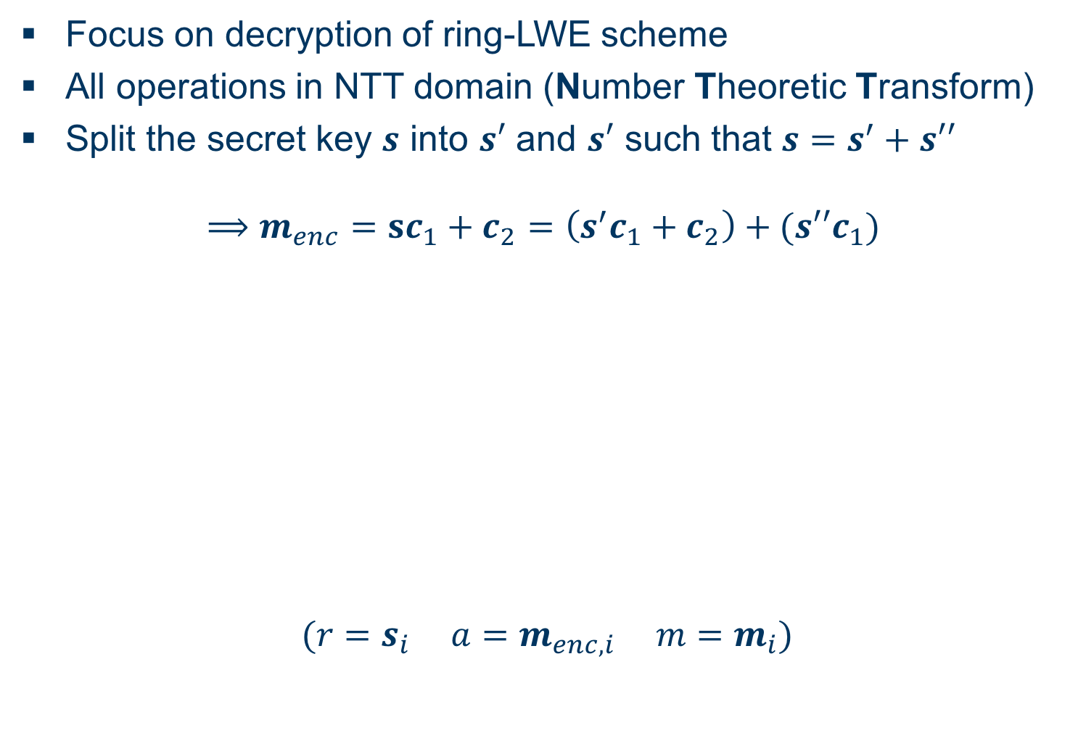
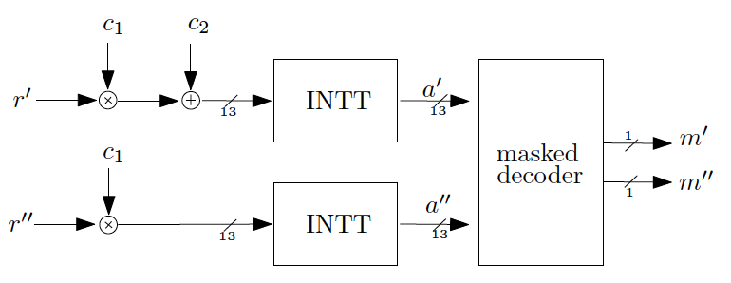
Masking Using a Masked Decoder
Overview
Focus on decryption of ring-LWE scheme
All operations in NTT domain (Number Theoretic Transform)
Split the secret key into and such that

Slide 11
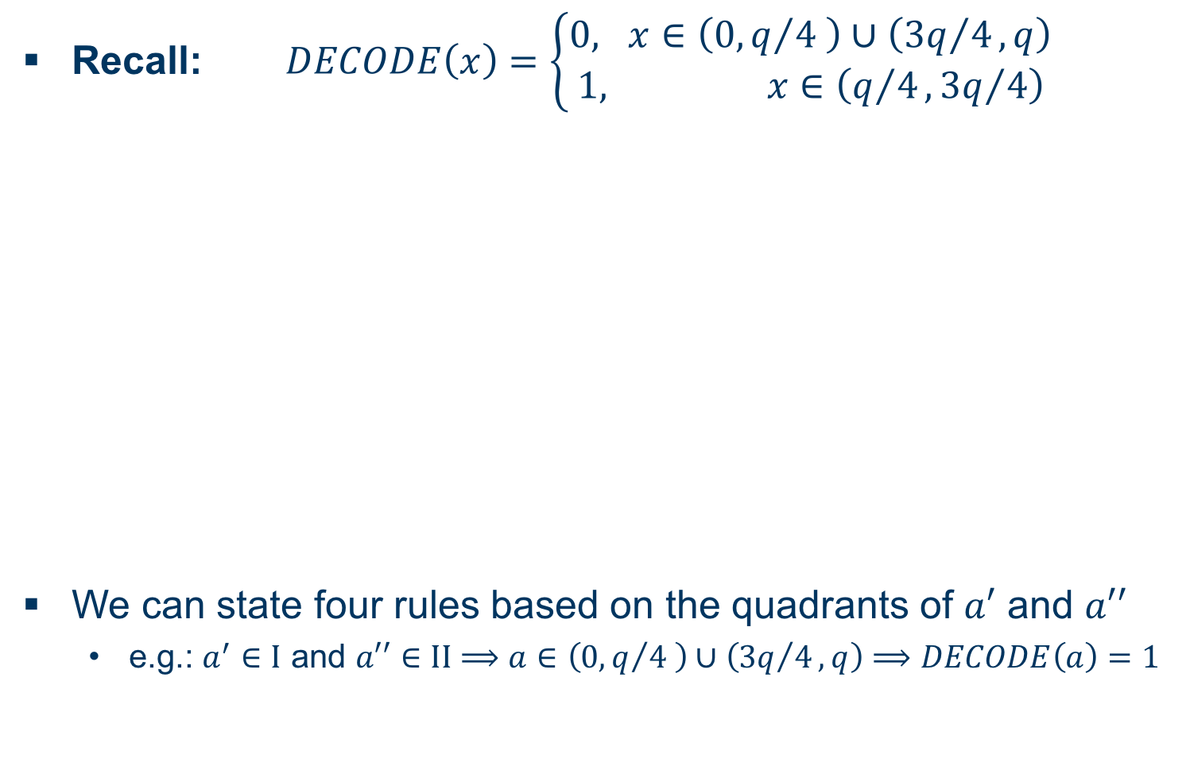
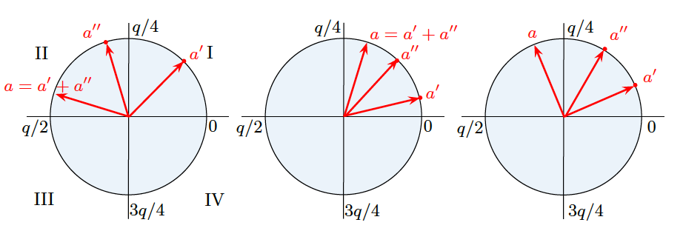
Masking Using a Masked Decoder
Masked Decoder I
Recall:
We can state four rules based on the quadrants of and
  e.g.: and

Slide 12
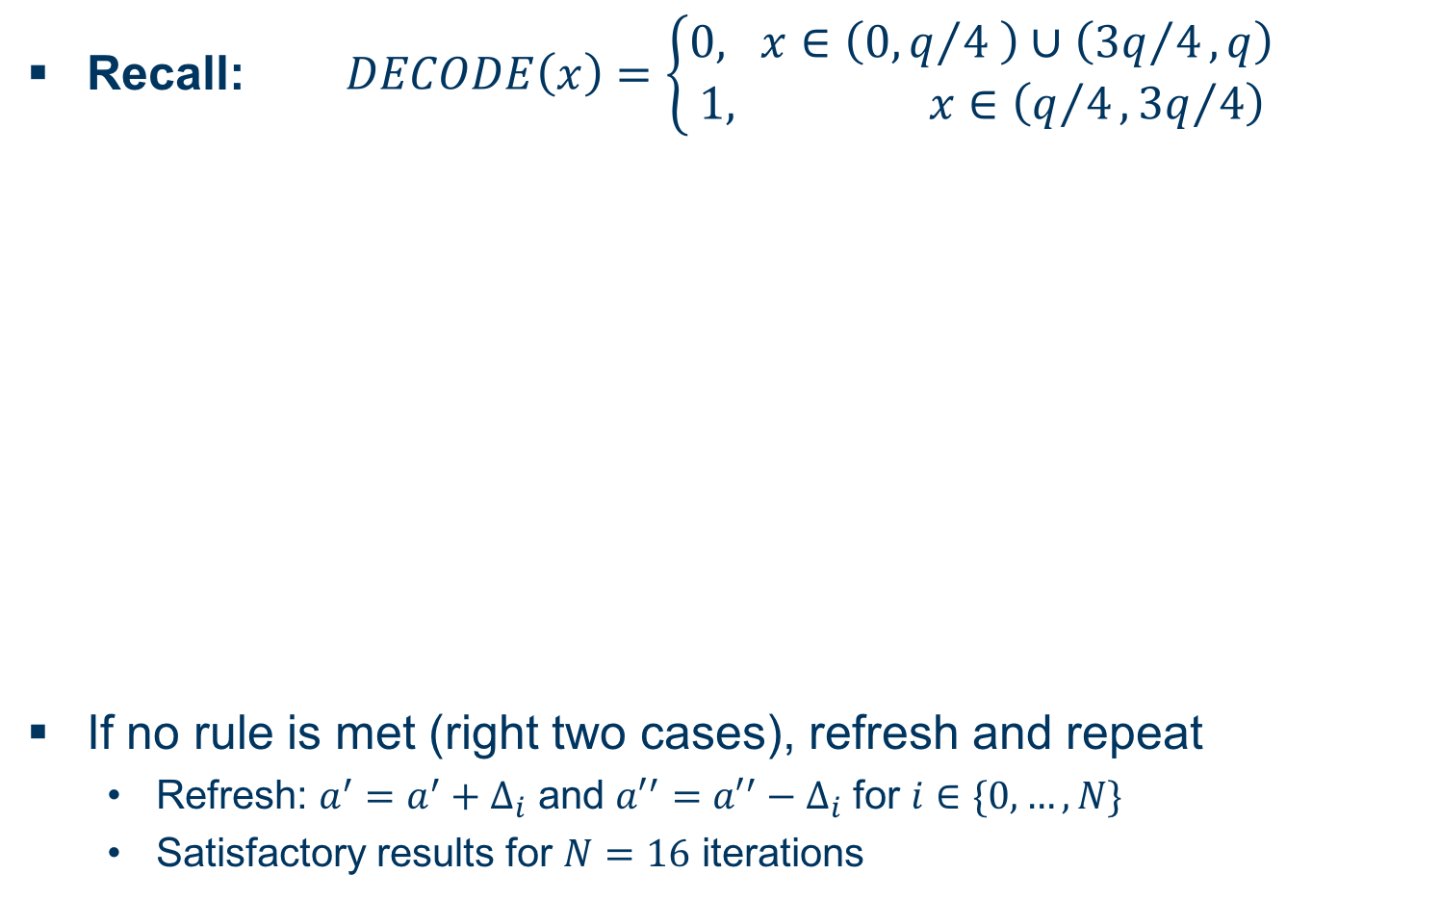
Masking Using a Masked Decoder
Masked Decoder II
Recall:
If no rule is met (right two cases), refresh and repeat
  Refresh: and for
  Satisfactory results for iterations

Slide 13
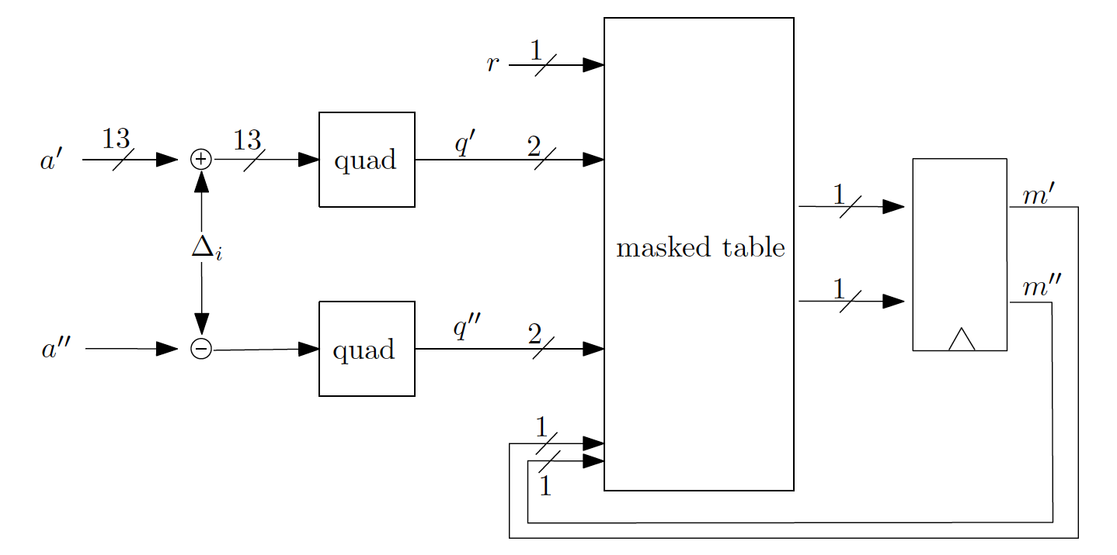
Masking Using a Masked Decoder
Masked Table Lookup
Implement said rules in a masked table

Slide 14
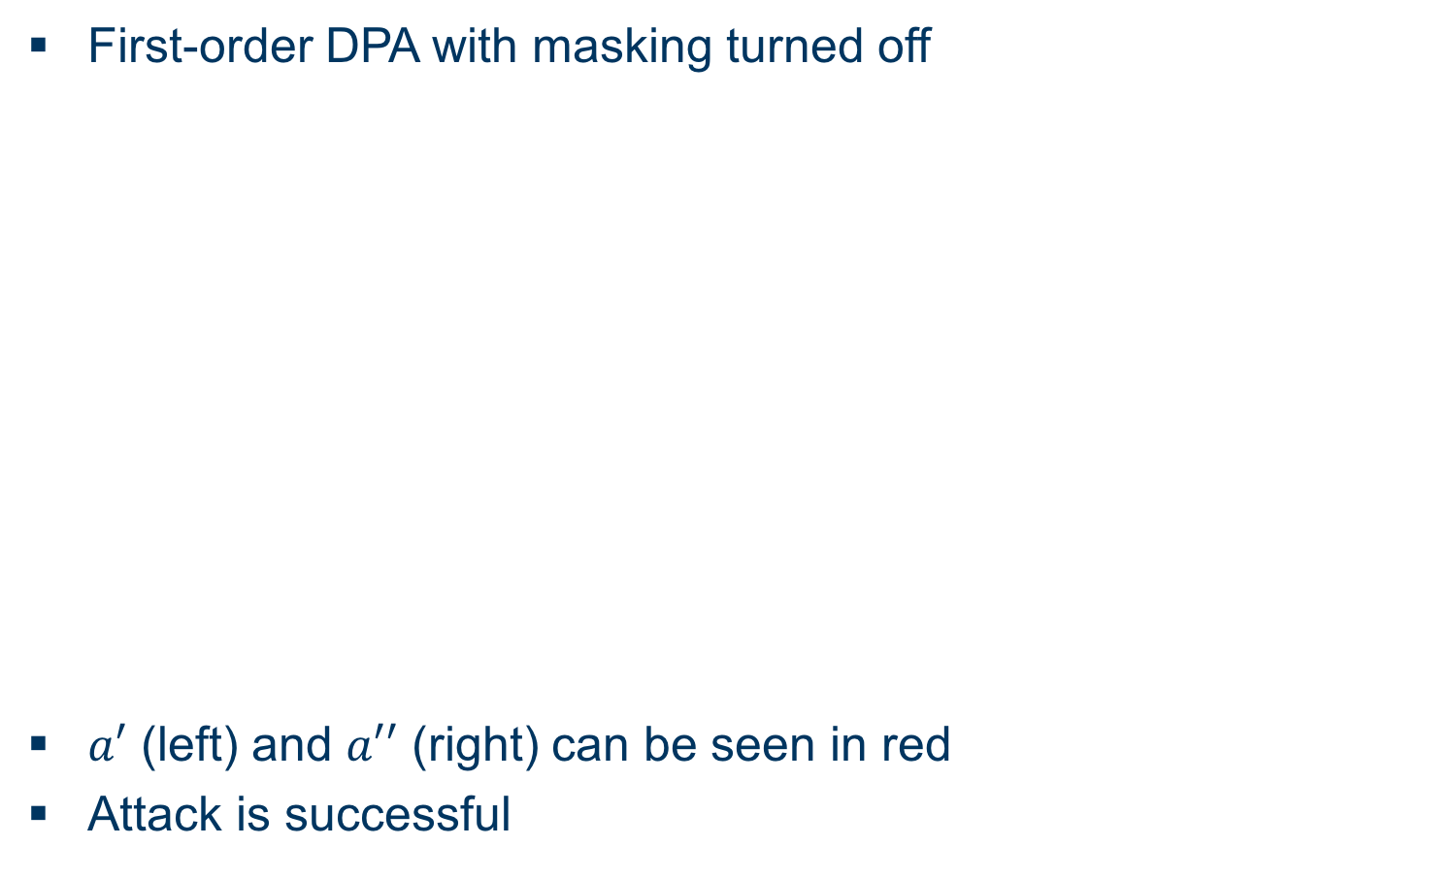
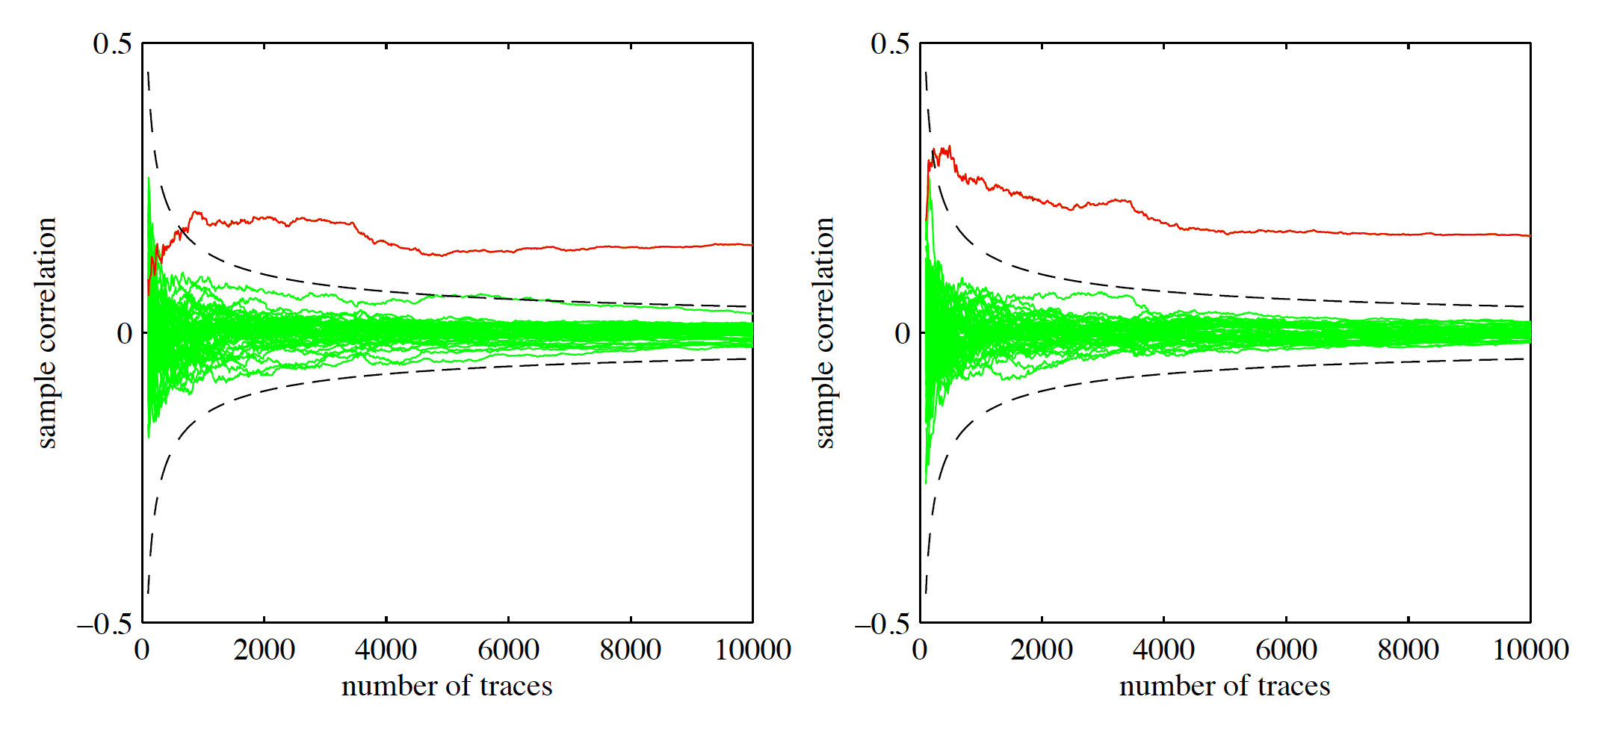
Masking Using a Masked Decoder
Evaluation I
First-order DPA with masking turned off
(left) and (right) can be seen in red
Attack is successful

Slide 15
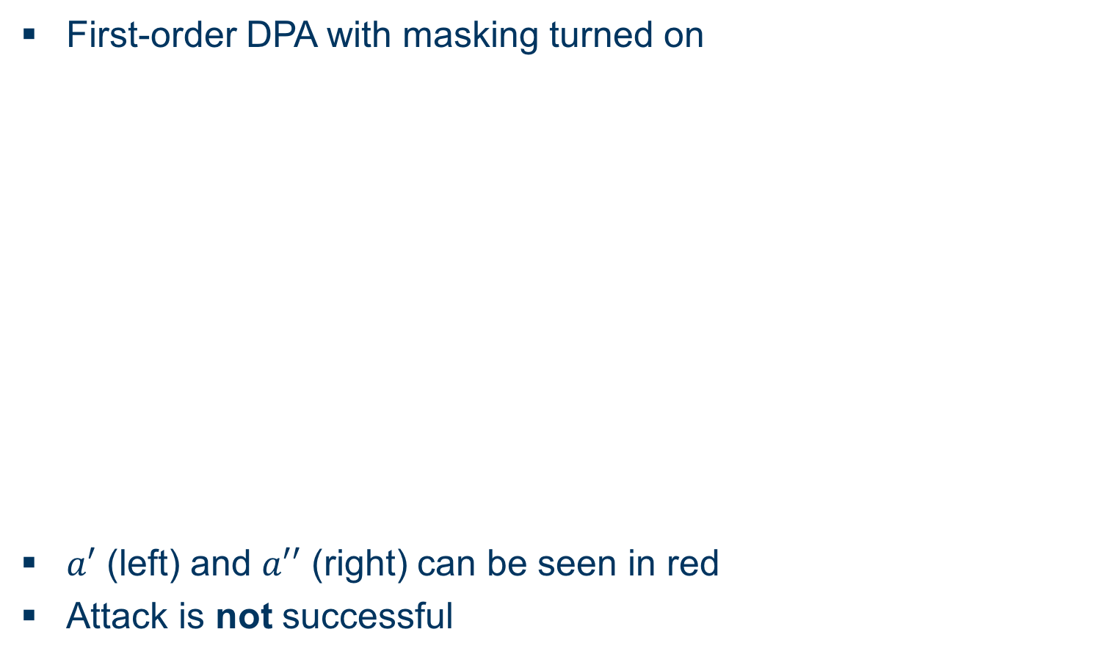
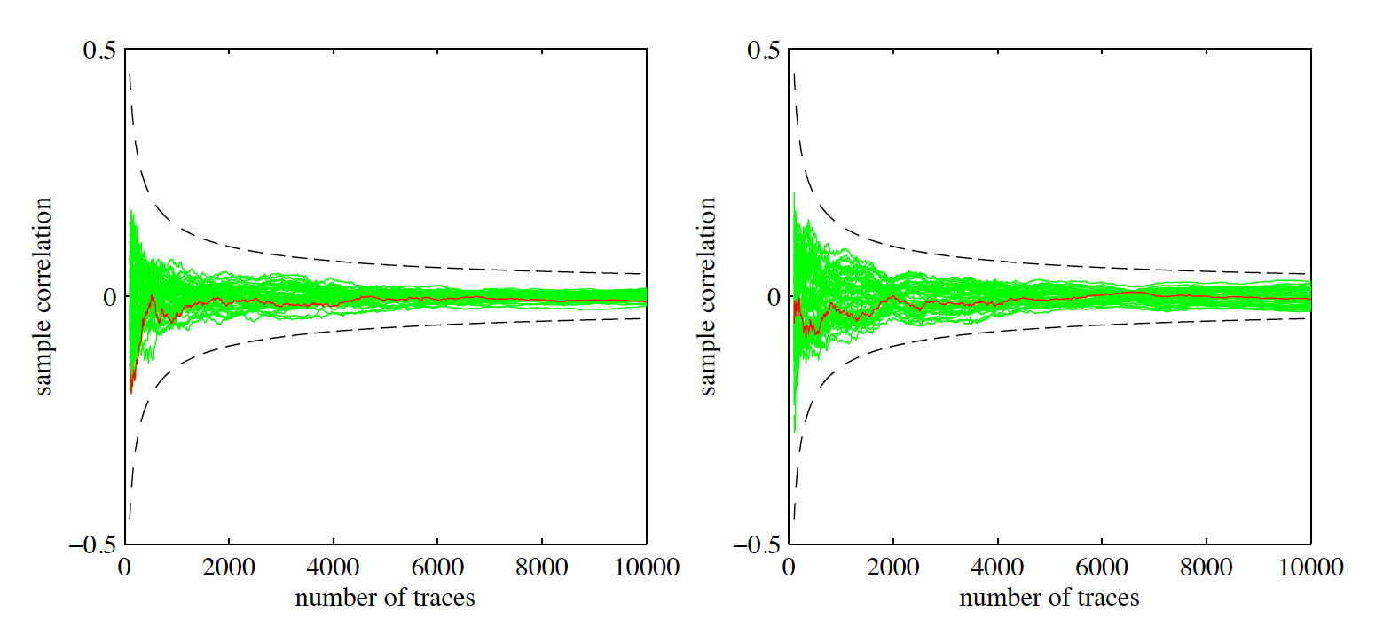
Masking Using a Masked Decoder
Evaluation II
First-order DPA with masking turned on
(left) and (right) can be seen in red
Attack is not successful

Slide 16
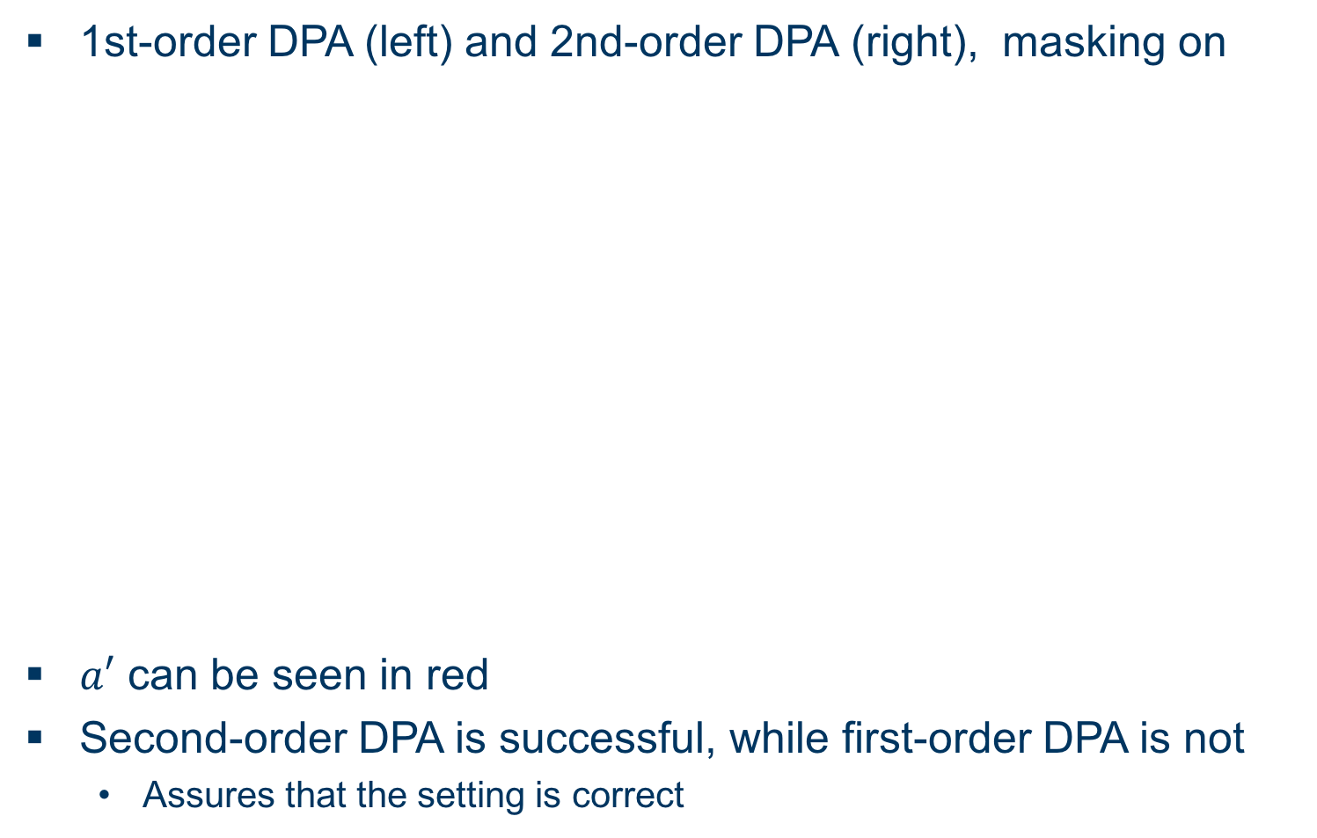
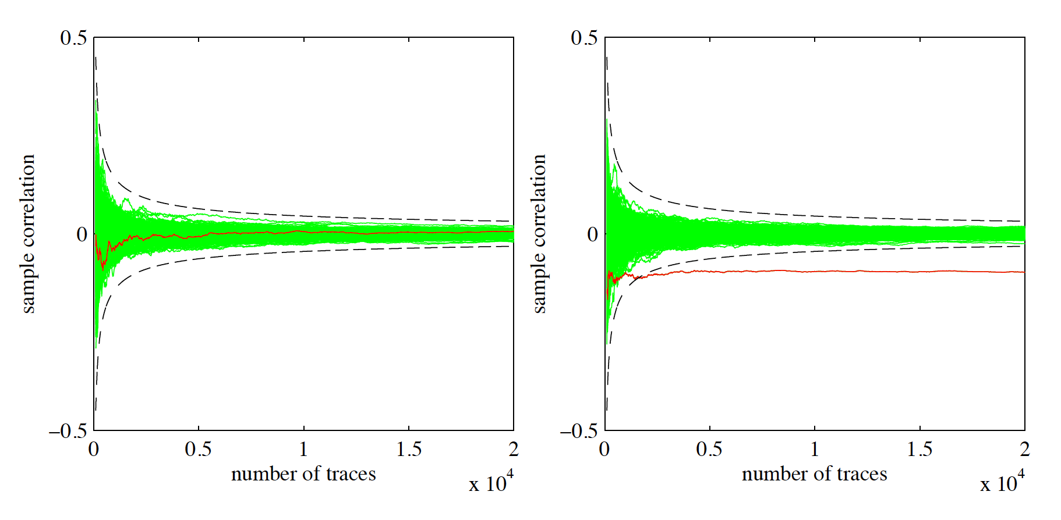
Masking Using a Masked Decoder
Evaluation III
1st-order DPA (left) and 2nd-order DPA (right), masking on
can be seen in red
Second-order DPA is successful, while first-order DPA is not
  Assures that the setting is correct

Slide 17
Additively Homomorphic Masking
Overview
blub

Slide 18
BLISS
Unterüberschrift
Bitte “Structure of presentation” in Folie 2 an deinen Aufbau anpassen, alles was da aufgelistet ist kommt irgendwo als Überschrift einer Folie vor

Slide 19
Gauss Distribution

Slide 20
Gaussian Sampling

Slide 21
CDT Sampling

Slide 22
Rejection Sampling

Slide 23
Flush+Reload Cache Attack
Flush Memory lines from cache with clflush
Wait for user processes
Reload flushed memory lines and compare accesstime to reference value
Fast access→ Cache line was probably accessed
Problem: Cache line contains multiple entries...

Slide 24
Flush + Reload Cache Attack II
Only cache lines arranged in a specific pattern are monitored
Intersection: Two Lookuptables yield more precise Information:
S 1 = {0, 1, 2, 3, 4, 5, 6, 7, 8}
S 2 = {7, 8, 9, 10, 11, 12, 13, 14, 15}
→ |y_i | ∈ S 1 ∩ S 2 = {7, 8}
Last Jump: {5, 6, 7, 8, 9} is divided over two cache lines T 1 = {0, 1, 2, 3, 4, 5, 6, 7} and T 2 =
{8, 9, 10, 11, 12, 13, 14, 15}
Binary search will always access T1, but T2 only if
|y_i| ∈ S = {8, 9}

Slide 25
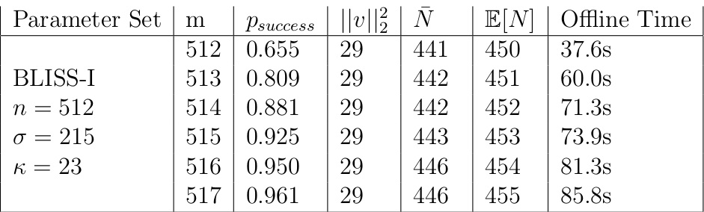
Attack Results on BLISS-I with CDT sampling
Perfect Side Channel
8 Cache weaknesses
i5-3470
1 Cache weakness
Success: 46/50 tries
Average needed signatures: 3438

Slide 26
Attack Results on BLISS-I with Rejection sampling

Slide 27
Blinding Countermeasures
Unterüberschrift
bla

Slide 28
EMSEC/SHA Blockseminar
Side-Channel Attacks on Implementations of Lattice-Based Cryptosystems
Felix Haarmann, Julian Speith
July 26th, 2016
Thank you for your attention!
Any Questions?

