Slide 1
How to submit sequences to GenBank
using the BankIt website (other methods are available)
Notes:
Introduce self with the caveat that I’m not really a sequencing person and have done this once using a different method lol

Slide 2
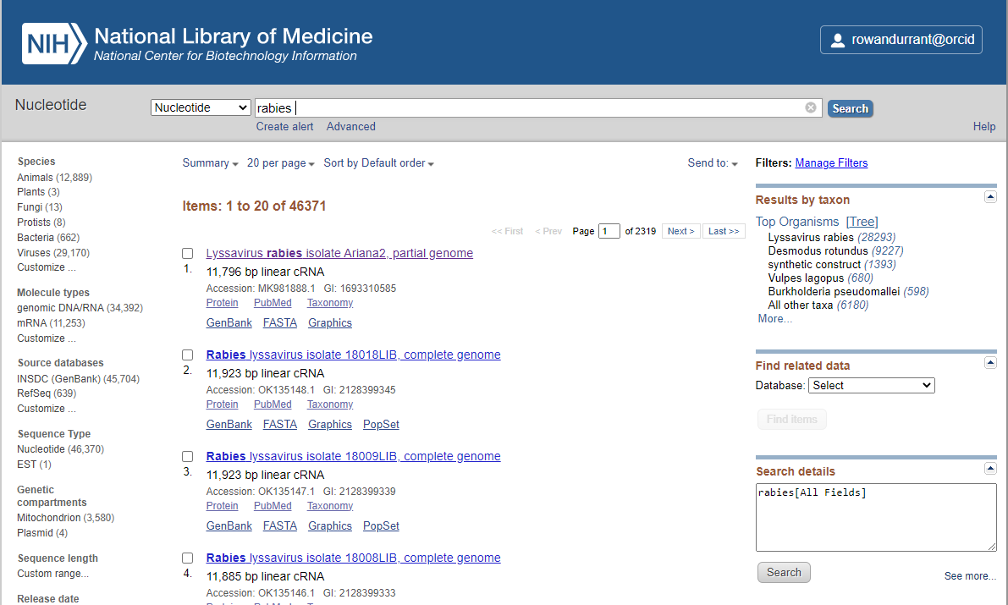
What is GenBank?
Notes:
For those of you who don’t know, genbank is a repository of sequence data ranging from single genes to entire genomes of basically anything you can imagine sequencing. The sequences are publicly available and you can access them using the NCBI nucleotide website or by comparing sequences to the database using BLAST.

Slide 3
Why should I submit my sequences?
Get accession numbers
Most journals require it
Allows other researchers to use them in their work
Notes:
So why would you want to upload your sequences to genbank? Primarily people do it in order to get accession numbers for their sequences, which can be quoted in any research papers you write using these sequences, fulfilling the requirements of many journals. This allows other researchers to have a look at and use your sequences, so your sequences can continue contributing to science after your own study is published.

Slide 4
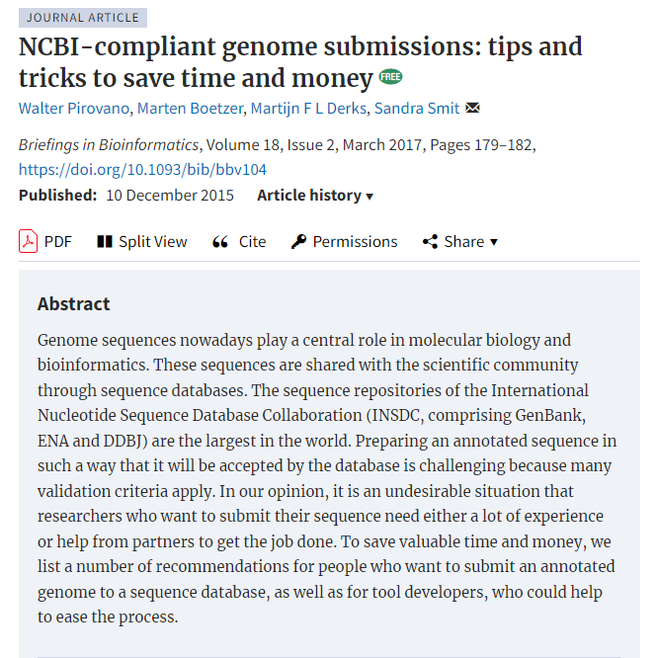
Notes:
Unfortunately genbank likes to make it very difficult to submit sequences, and I’m not entirely sure why. There have been a few papers written on how genbank is a bit of a pain to submit to, and I’d recommend this one for some tips. Now internally we have a command line tool that I use to do genbank submissions, but the set up is pretty complicated to the point that I don’t understand it myself so I’m going to take you through an in theory easier method using the online submission system called BankIt.

Slide 5
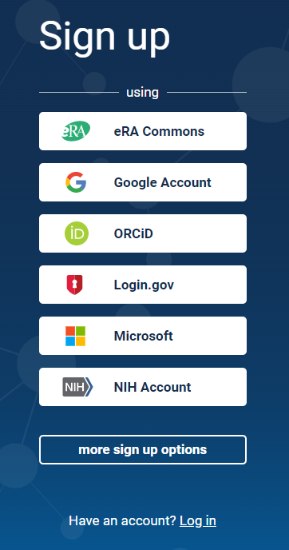
How do I submit my sequences?
Online is easiest: www.ncbi.nlm.nih.gov/WebSub/
You will need to make an account
You can log in through ORCiD, a Google account, Microsoft etc
Notes:
So in order to use the online portal you’ll first need to make an account- you can’t create an account specifically for genbank, you need to log in through a third party such as ORCiD (if you don’t have an ORCiD I’d highly recommend getting one)

Slide 6
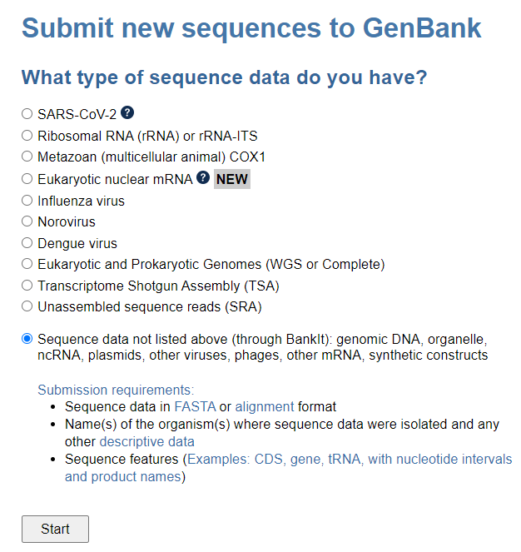
Step 1: What kind of sequence do you have?
Notes:
And once you’ve done that we can begin! I think “Sequence data not listed above” is the correct one to choose for rabies because it’s a virus not on the list

Slide 7
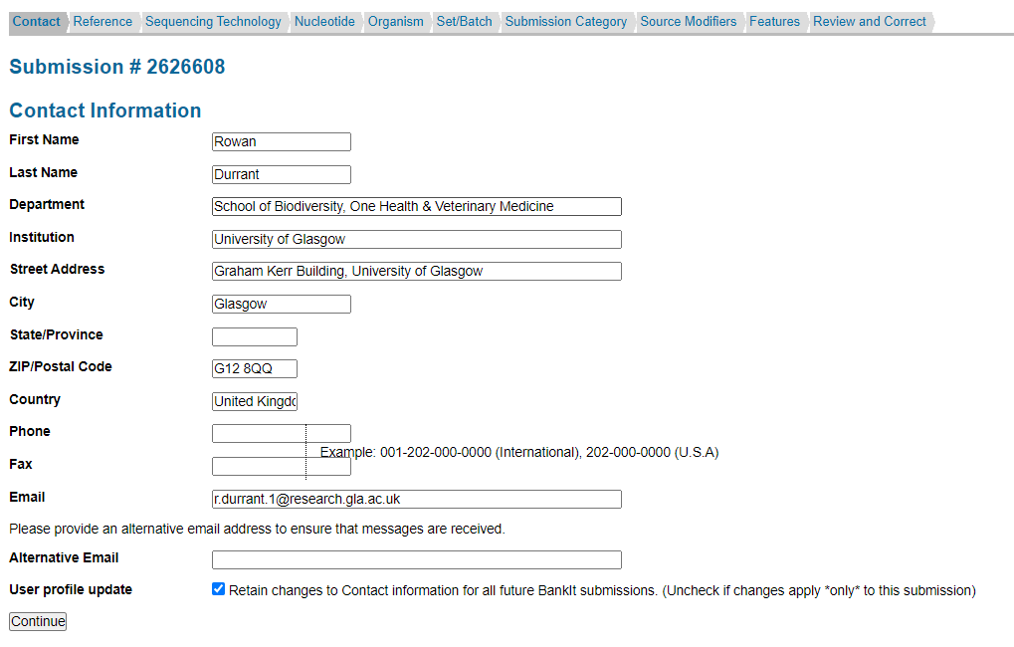
Step 2: Contact details
Notes:
You then put in your contact information as the person doing the submission

Slide 8
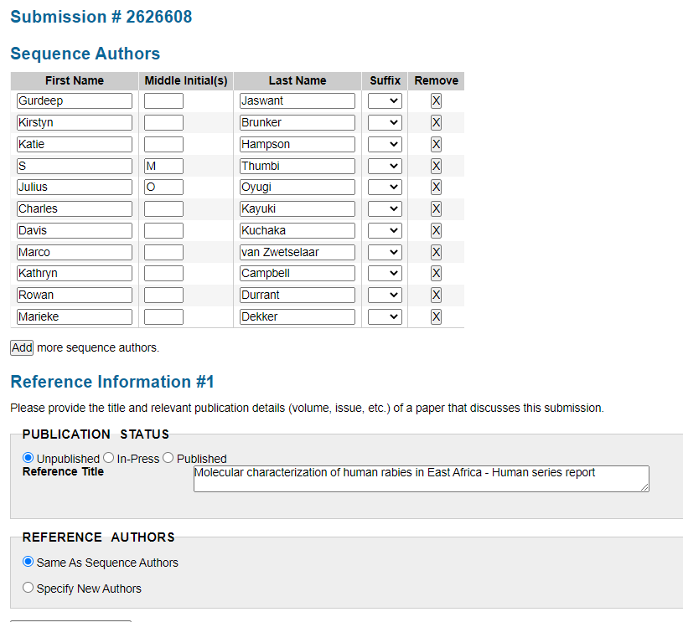
Step 3: Authors & Reference
Notes:
And then fill in all the author details. This is separated into the sequence authors and the reference authors, so if some people on your team were involved in a manuscript but not the sequencing or sample collection itself they can be listed separately

Slide 9
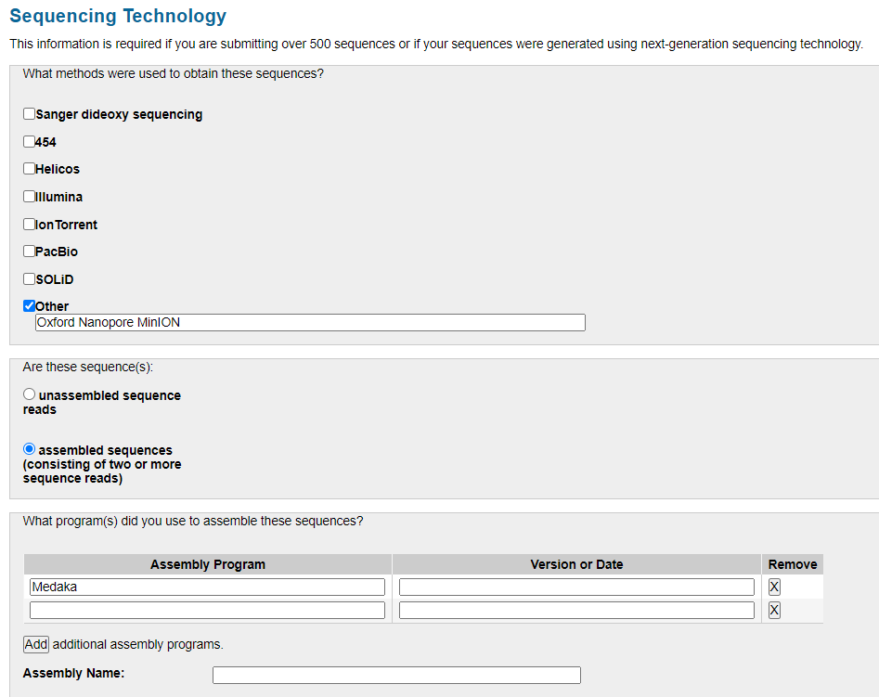
Step 4: Sequencing Technology
Guppy
Minimap2
Notes:
Then you’ll want to list the sequencing technology used. For example here I’ve listed MinION as the sequencing method and Guppy and Minimap2 as the assembly programs – you can also add software versions etc

Slide 10
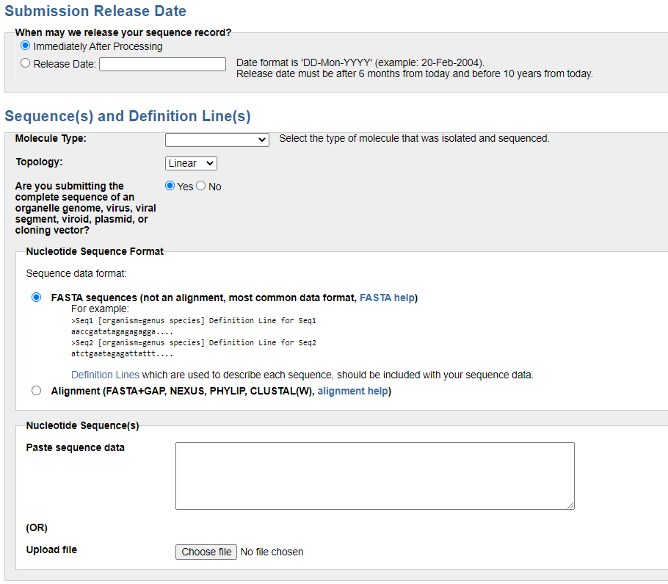
Step 5: Nucleotide
Notes:
And then we get to the meat of the submission – your actual sequence data! You first want to say whether you want this data to be embargoed or not, the molecule type, and then upload a single fasta file containing all of your sequences. GenBank does have some weird requirement when it comes to the fasta file…

Slide 11
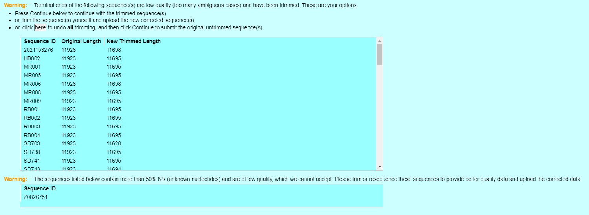
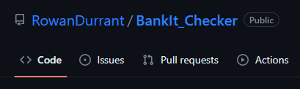
Notes:
… and sometimes comes up with some scary looking warnings, but some of these are actually just them notifying you that they’ve de-aligned your file or trimmed Ns off of the start or the end. Sometimes they are things you actually have to fix yourself though, like sequence names being too long or duplicated, or sequences being too low quality. If any of you use R I’ve written a few functions that can do these checks before you start the submission process.

Slide 12
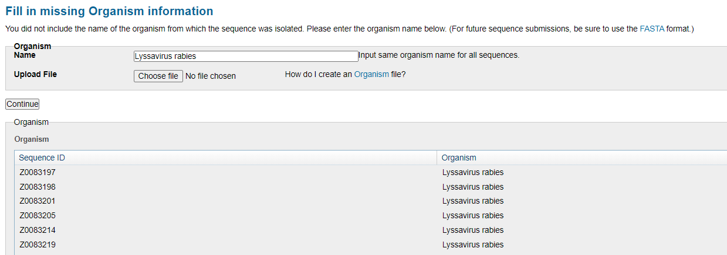
Step 6: Organism
Notes:
After that, you’re going to want to specify what organism you’ve sequenced, in our cause lyssavirus rabies for all sequences

Slide 13
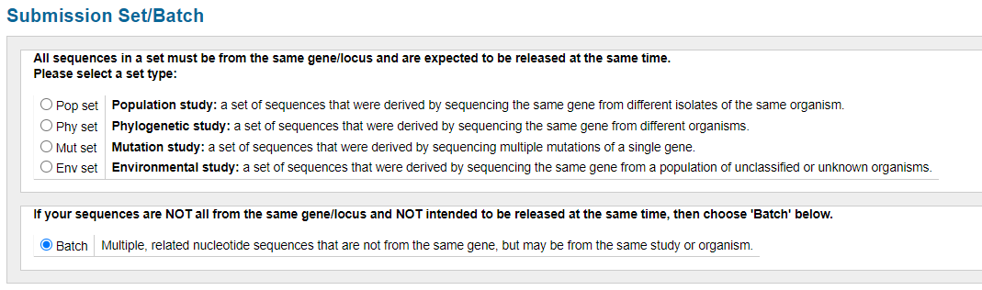
Step 7: Set/Batch
Notes:
And then say that you just have a batch of sequences. Maybe phylogenetics study would also work but I’m not sure

Slide 14
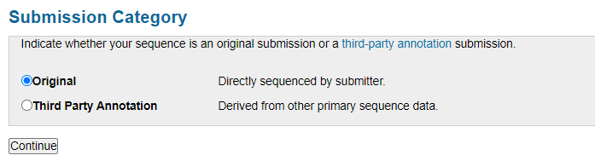
Step 8: Submission Category
Notes:
And then choose “original” because you’ve done all the work!

Slide 15
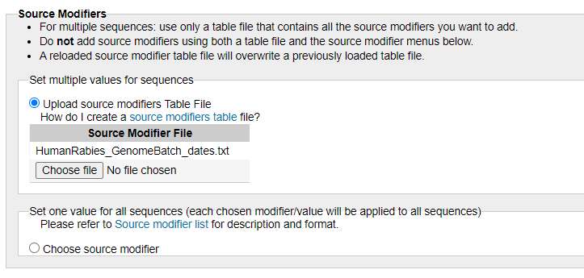
Step 9: Source Modifiers
Notes:
Next is the source modifier table – this is where all of your sequence metadata goes. You will want to submit a text file that looks like this:

Slide 16
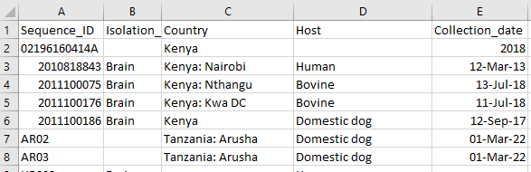
List of source modifiers and formats can be found here: https://www.ncbi.nlm.nih.gov/WebSub/html/help/genbank-source-table.html
Notes:
When you open it in excel, it will have a list of properties such as host and location along with the sequence ID. This needs to be saved as a tab delimited text file and the dates need to be in a specific format, but there’s more information on this link here

Slide 17
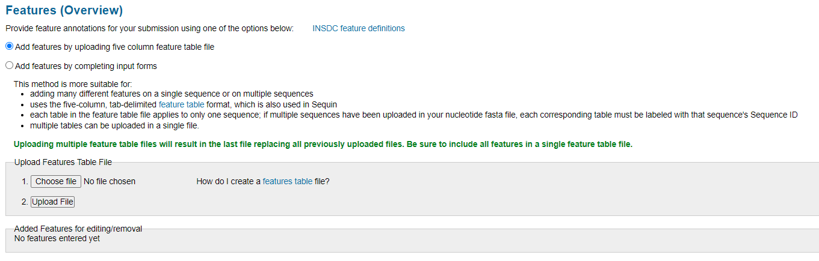
Step 10: Feature table
Notes:
Next is the 5 column feature table, and this is where things get a bit tricky. This table identifies where all your genes and encoded protein sequences are in the sequence.

Slide 18
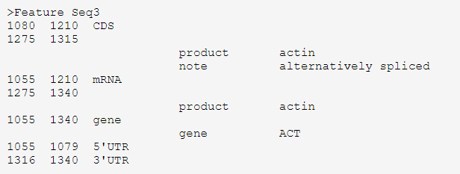
The word “Feature” + the name of the sequence as it appears in the FASTA file
Notes:
So this is what this table looks like: on the first line, the word feature and your sequence name

Slide 19
The word “Feature” + the name of the sequence as it appears in the FASTA file
Columns 1&2: Start and stop locations of the feature
Notes:
Then the start and end locations of the feature you’re describing

Slide 20
The word “Feature” + the name of the sequence as it appears in the FASTA file
Columns 1&2: Start and stop locations of the feature
Column 3: Feature type
Notes:
The type of thing you’re describing, for example a gene or a CDS

Slide 21
The word “Feature” + the name of the sequence as it appears in the FASTA file
Columns 1&2: Start and stop locations of the feature
Column 3: Feature type
On a new line,
Column 4: Qualifier name
Notes:
On a new line, whether you’re about to name a gene or a product

Slide 22
The word “Feature” + the name of the sequence as it appears in the FASTA file
Columns 1&2: Start and stop locations of the feature
Column 3: Feature type
On a new line,
Column 4: Qualifier name
Column 5: Qualifier value
Notes:
And then name the gene or product.

Slide 23
This is the hard bit, especially if you have lots of sequences!
GenBank seems to want you to do it by hand? Which takes ages
More details on the ncbi site: https://www.ncbi.nlm.nih.gov/WebSub/html/help/feature-table.html
BLAST might help
I think there are some programs available to do this but I don’t know how reliable they are
Notes:
This is the complicated bit, and the reason why I don’t personally submit to genbank using this method – unless you have a template to go off of, this can be incredibly time consuming! I read a blog post of someone who took a week of full time work to make these files for a set of sequences. I think some programs do exist to generate these for you, but I’ve heard they can be a bit unreliable sometimes. More details are available on how to do this on NCBI’s website, and I think using NCBI BLAST could also help with this:

Slide 24
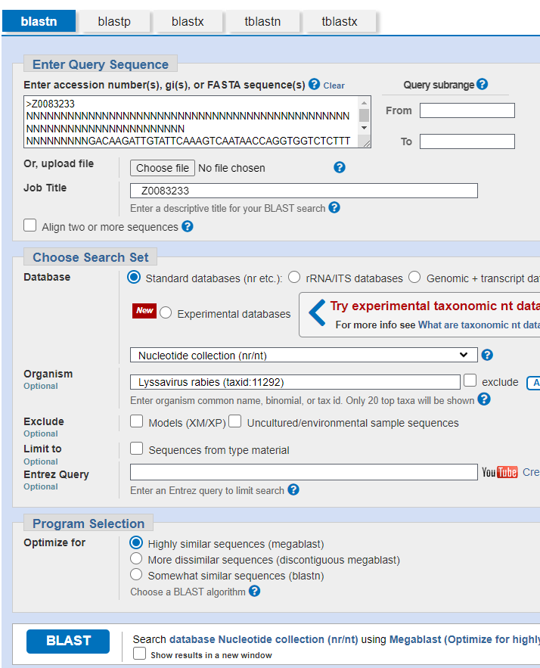
Notes:
You can query blast with each sequence

Slide 25
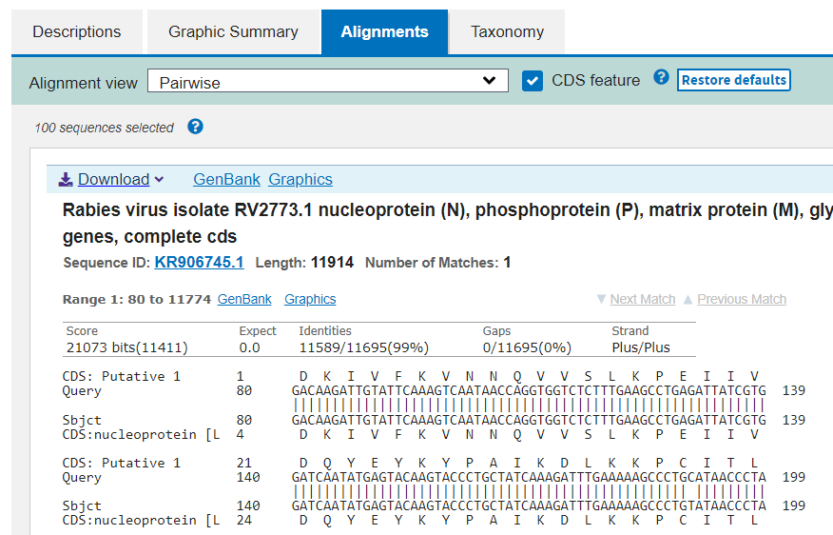
Notes:
And get something that looks like this comparing your sequence to sequences already on genbank. If you click this CDS features button you can see how your CDSs line up to the genbank sequences, but this is only for CDS and not genes. You can also click the genbank link to see where the CDS and gene locations are for the existing genbank sequence.

Slide 26
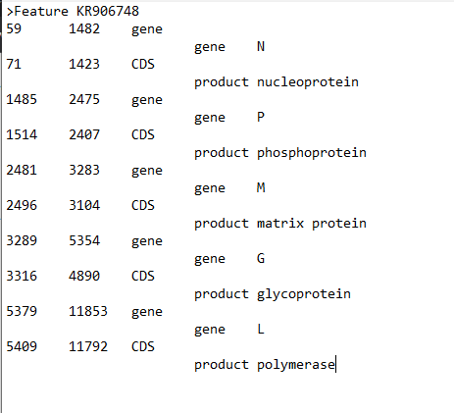
Notes:
And here’s an example of a feature table I made by backwards-engineering an existing genbank submission – hopefully this is what yours should end up looking like!

Slide 27
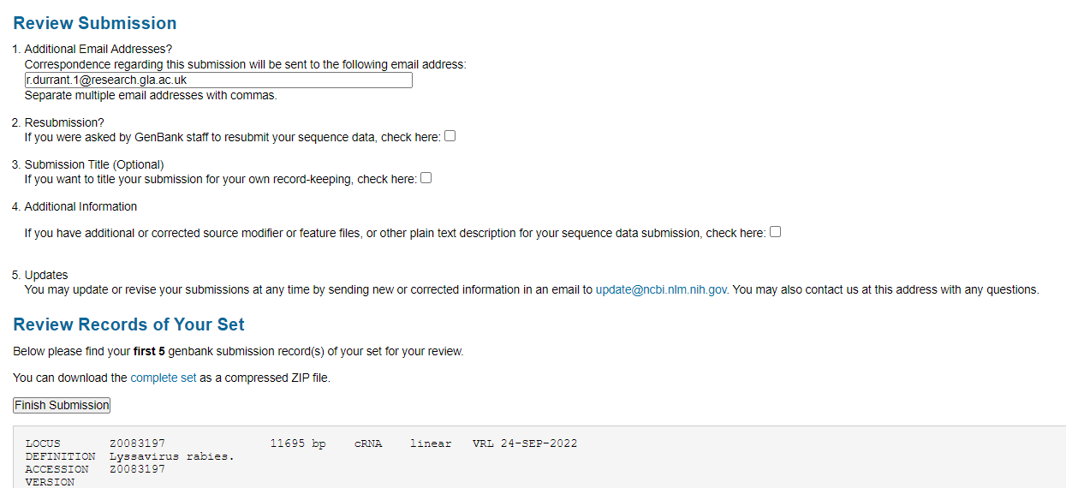
Step 11: Review & Submit!
Notes:
Luckily once you’ve cleared that hurdle you’re at the end- you’ll just need to enter a correspondence email address, review that all the information looks correct and then submit

Slide 28


Step 11: Review & Submit!
Notes:
And then hopefully genbank will get back to you in a few days with your shiny new accession numbers, or a list of things you need to fix

