Slide 1

Introduction to command line
Kirstyn Brunker
RAGE workshop, SCENE, University of Glasgow
26-30th June 2023
Notes:
Laying the foundations

Slide 2
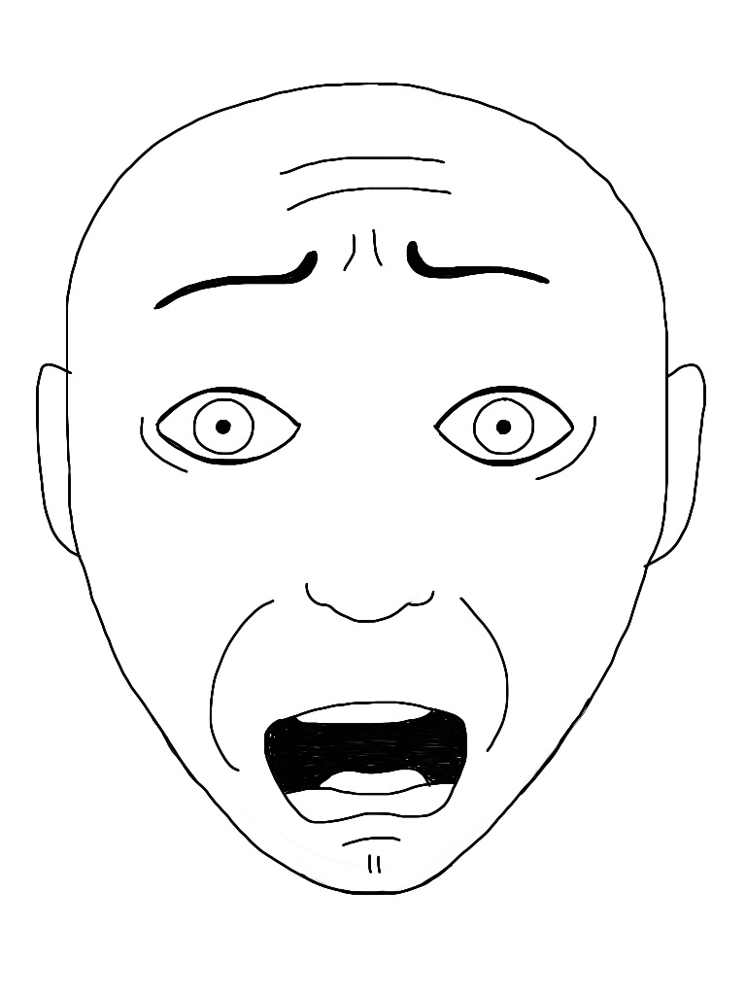


Slide 3


What is the command line?
A line of communication between you and the computer
echo “Hello"

Slide 4
Why use it?
More powerful than a graphical user interface
Control and flexibility
Quick and efficient
Automate repetitive tasks
And… you can’t escape it if you want to do bioinformatics!

Slide 5

Notes:
While the command line may seem intimidating at first, it can greatly enhance your productivity and give you more control over your computer once you become familiar with its basic commands and syntax.

Slide 6


Slide 7

A word of caution
Learning curve
Accidental system modification
Data loss
No “undo”
Security risk
Be cautious about using powerful command like ‘sudo’ and ‘rm’
Notes:
Need to learn specific commands and their syntax (whole new language). Hard to learn to do this and remember how- can be frustrating!
Can mistakenly execute commands that modify super important system files or settings
Can accidentally delete or modify important files and they won’t end up in the recycle bin- they will just be deleted!
Using commands at a certain privilege level (e.g. as admin), which involves using a command called ”sudo” can be v dangerous is used without properly understanding it. Can potentially even enable a route for malicious software to get in to your operating system.
No visual interface makes it easy to miss or misinterpret info
Can sometimes revert changes (i.e. undo an action) but not always possible. Sometimes when you execute a command there is no way to reverse it!

Slide 8
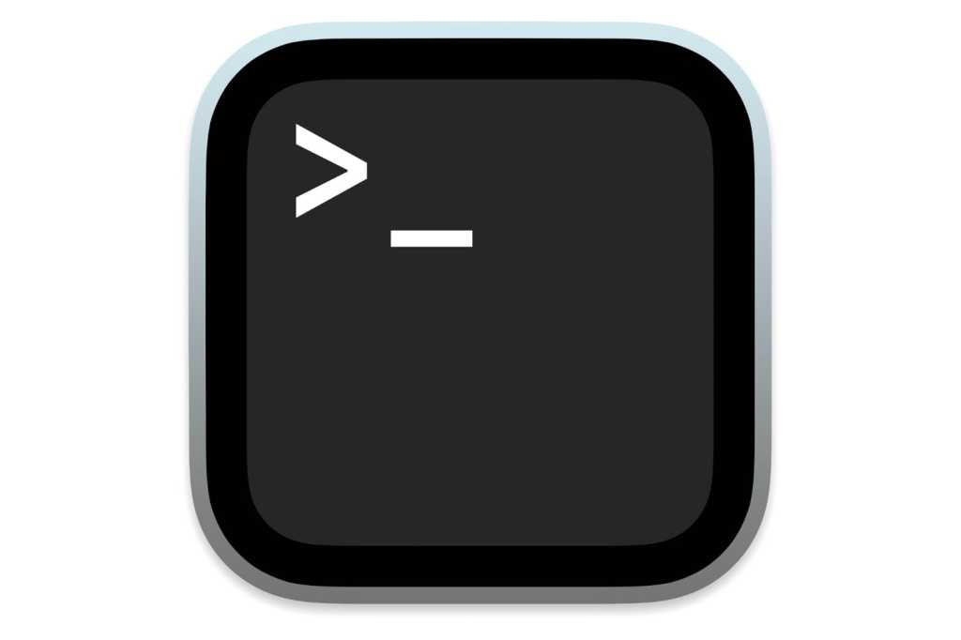
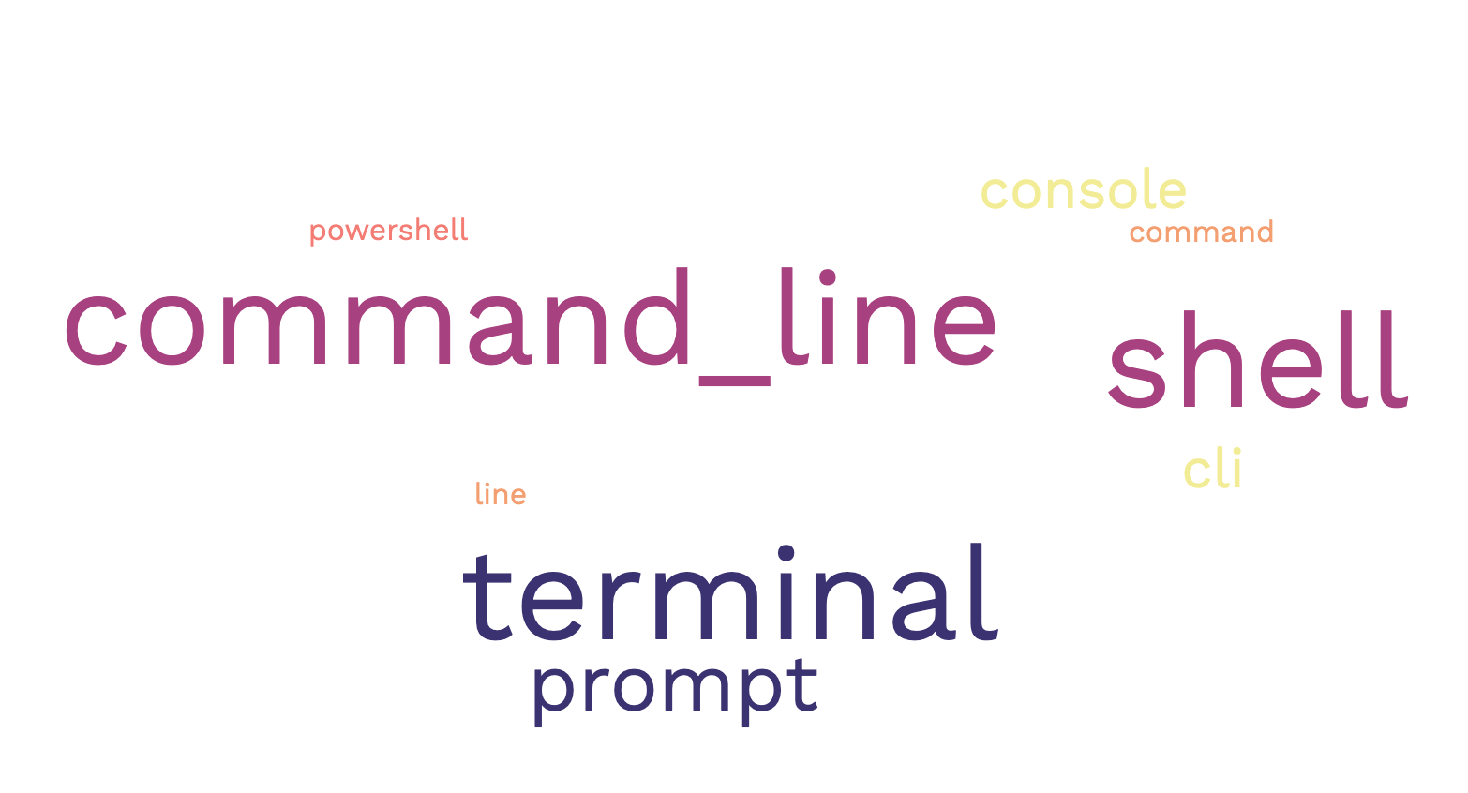
Command line
Text-based interface where users input commands
Image: Apple
Notes:
When you open the command line, you'll see a text-based window where you can type your commands. It looks like a black or white screen with some text on it. The text represents the computer's response or the information it wants to tell you.
The CLI has different names- terminal etc

Slide 9
Command line and the shell
Command line
Shell
textual interface where users input commands
the program that interprets those commands, executes them, and provides the appropriate output
intermediary between you and the operating system
Different shells: bash, zsh, powershell
Notes:
Different shells have different “dialects”. Just like spoken languages, shells have their own syntax, grammar, and set of features, which can vary from one shell to another.

Slide 10
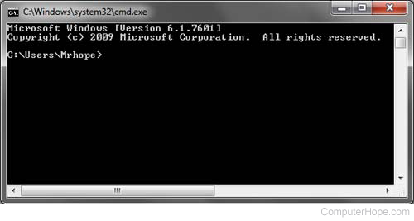
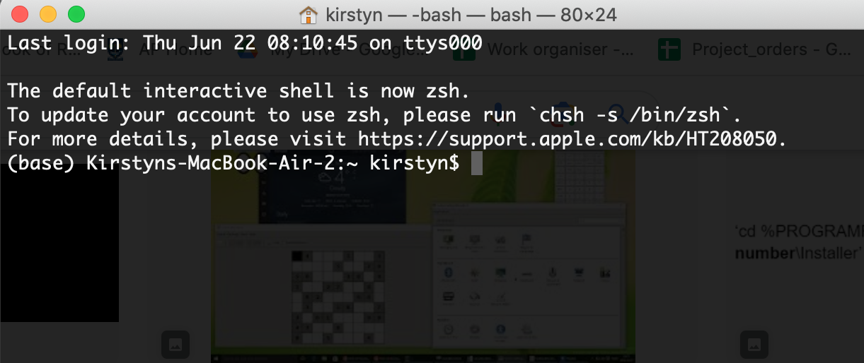
Command line interface (CLI)
Mac OS: Terminal
Windows: Command prompt
Notes:
When you open the command line, you'll see a text-based window where you can type your commands. It looks like a black or white screen with some text on it. The text represents the computer's response or the information it wants to tell you.
The CLI has different names- terminal etc

Slide 11
Opening the command line
Search for it
Windows: cmd or command prompt or powershell
Mac/Linux: terminal
Use shortcuts:
Linux: Ctrl + Alt + T

Slide 12
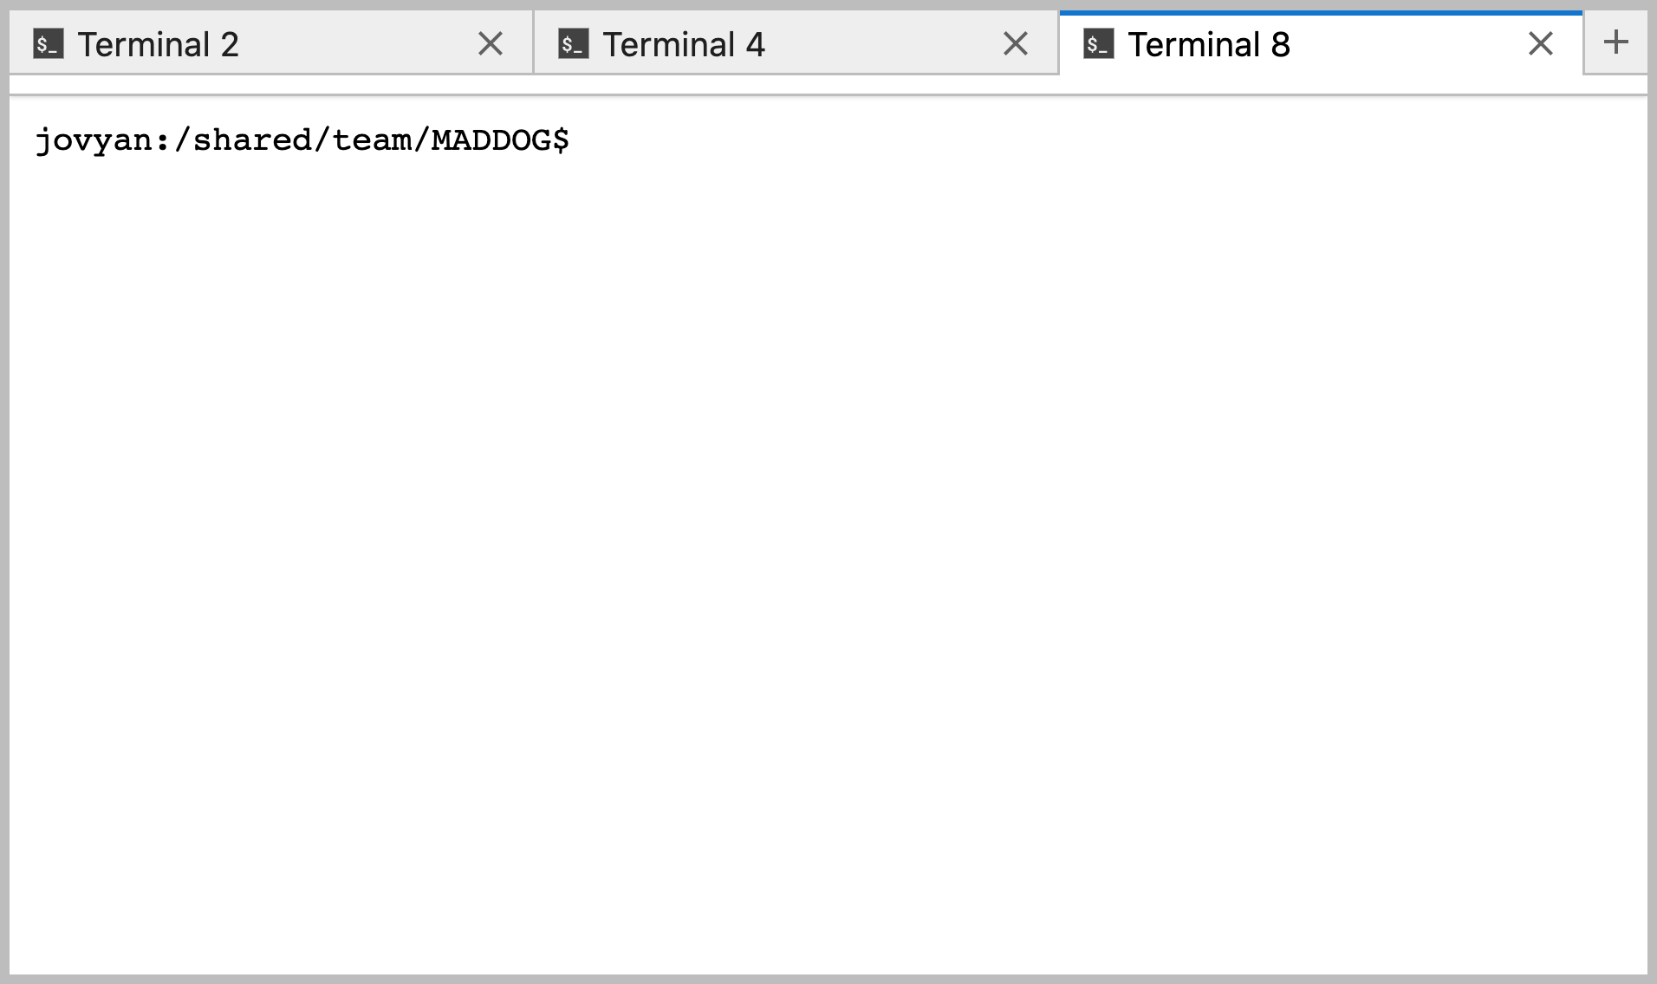
CLIMB- Jupyter Notebook Server
Bioinformatics platform to support academic research groups
Using for the workshop tutorials
Notebook server
Alternative to a virtual machine
Preconfigured with bioinfo software
Terminal access and a filesystem

Slide 13
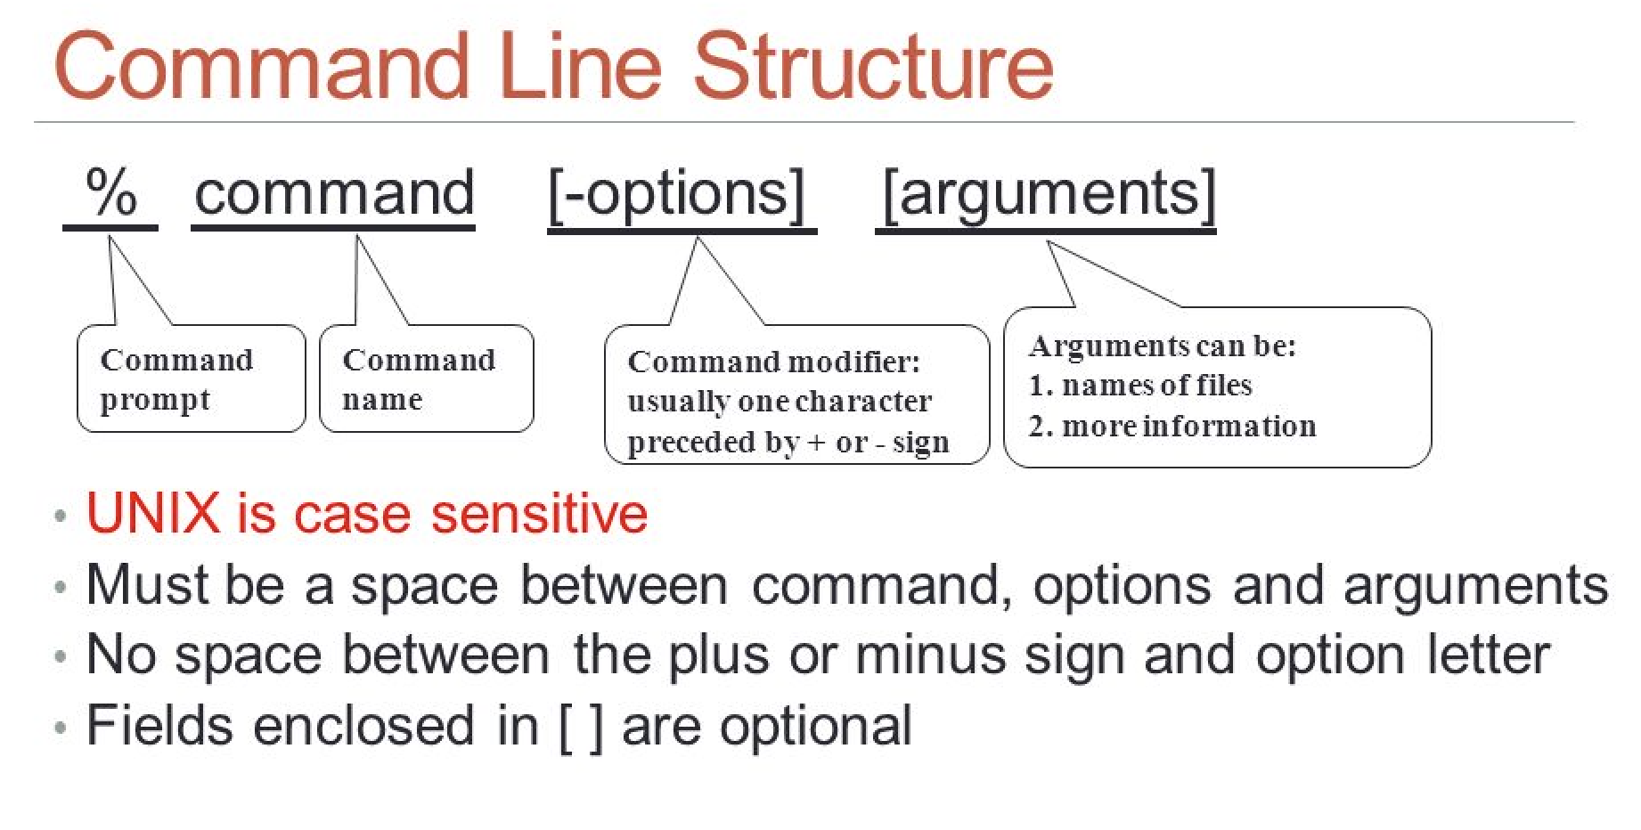
A command
a basic command structure consists of a command name followed by optional options/flags and required arguments.
Credit: slide from Cora Merritt "CSCI 330 UNIX and Network Programming Unit II Basic UNIX Usage: File System."

Slide 14
Example command
The copy command (cp)
Syntax: cp source(s) destination
Where source is the file path to one (or more) files to copy
Destination is where you want to copy to
Copy a file to new location:
cp /Users/Kirstyn/Downloads/test.txt /Users/Kirstyn/Documents/
Copy an entire folder:
cp -r /Users/Kirstyn/Downloads/results /Users/Kirstyn/Documents/

Slide 15
Common commands
Command | Description | Example
ls | List directory content | ls -l
cp | copy | cp test.txt ~/Desktop/
mv | move | mv test.txt ~/Desktop
mkdir | Make a new directory | mkdir awesome
rm | Remove | rm ~/Desktop/file.txt
touch | Make a new file | touch workshop_results.txt
pwd | Show the ‘present working directory’ i.e. location in the file system | pwd

Slide 16

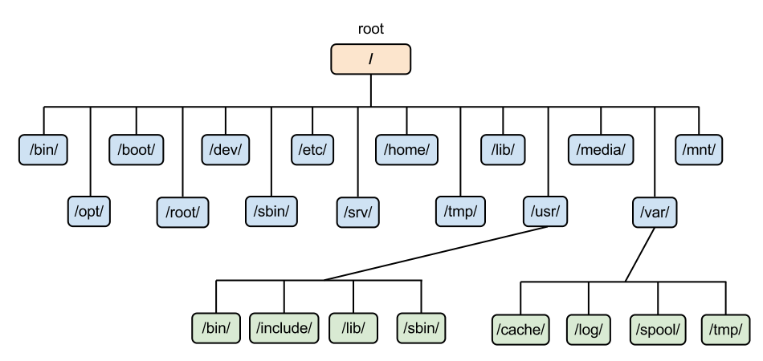
Moving around the Filesystem
Tree
Filesystem Tree
Root
Root

Slide 17
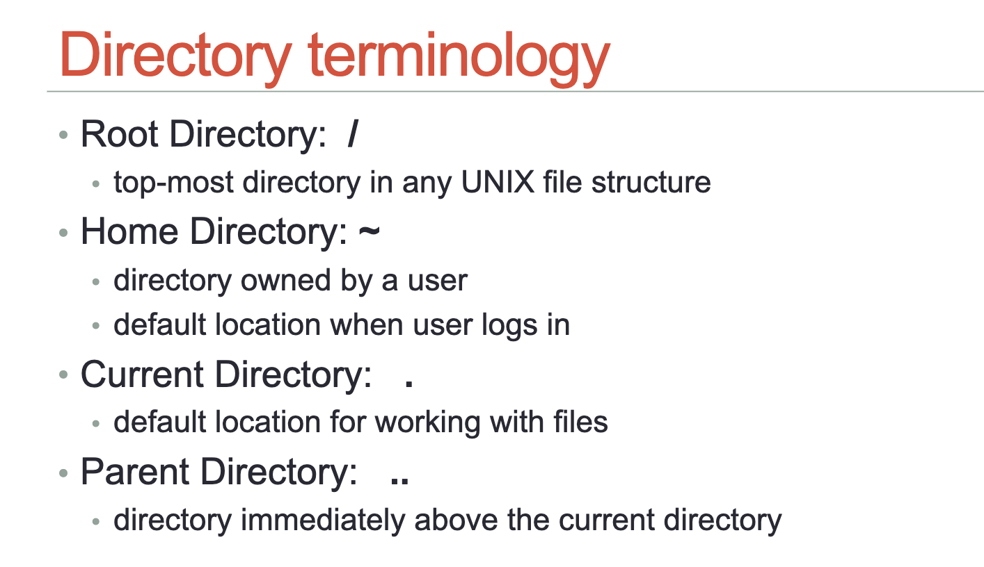
Navigating the filesystem

Slide 18
A file path
a unique address or location to each file
helps you navigate through the folders and locate a specific file quickly
/Users/Kirstyn/Documents/report.docx
Users
Kirstyn
Documents
Downloads
Desktop
report.doc
lineages.ppt
log.txt
dog.jpg
rabid.jpg

Slide 19
Users
Kirstyn
Documents
Downloads
Desktop
report.doc
lineages.ppt
log.txt
dog.jpg
rabid.jpg

Slide 20
File paths
Users
Kirstyn
Documents
Downloads
Desktop
report.doc
lineages.ppt
log.txt
dog.jpg
rabid.jpg
Absolute path
Traces from the root (/) to a file/directory
/Users/Kirstyn/Documents/report.docx
Relative path
Traces from current directory
No initial forward slash
cd Kirstyn
Documents/report.docx

Slide 21
Hints and tips
Do not use spaces in filenames and folders
Folders are called directories

Slide 22
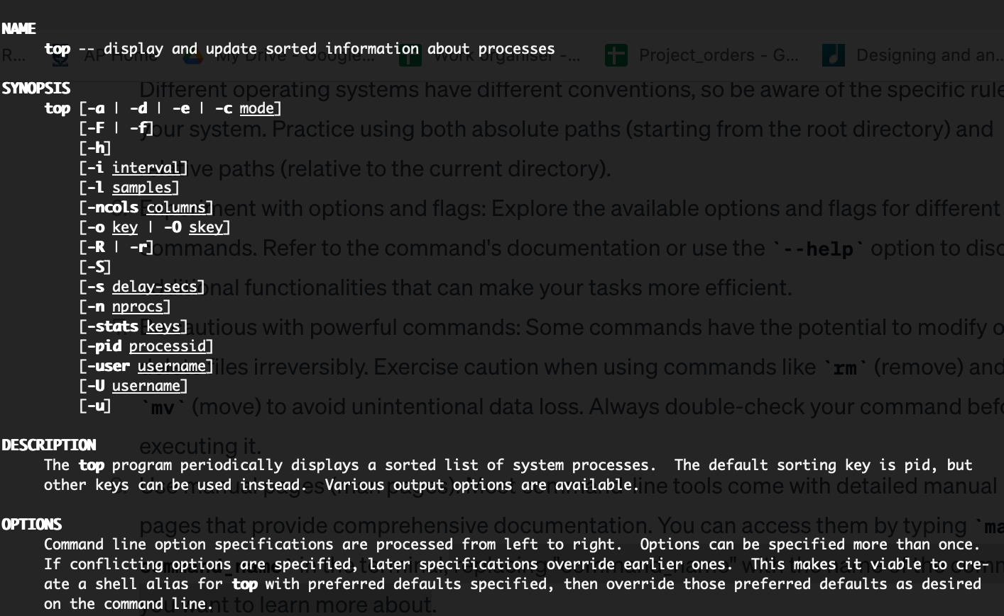

Use manual pages (man pages)
‘man command_name’
replacing "command_name" with the name of the command you want to learn more about
To exit: Press q

Slide 23

Tab completion
One of the most useful things on command line!
Command line will try to autocomplete commands and filepaths
Use tab to do this
Double tap tab to see all the options
This Photo by Unknown Author is licensed under CC BY

Slide 24

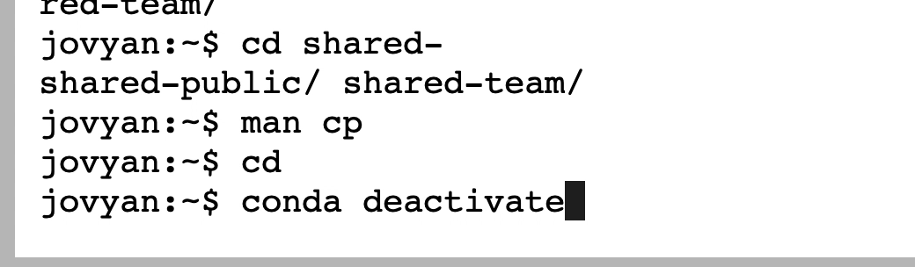
Recycle commands
Reuse previous commands without retyping them
Pressing the up arrow key allows you to cycle through your command history

Slide 25
Edit commands
You might have a typo or need to edit just a small part of a long command
Use the left/right arrow keys to get to the right point in the command
Use your normal delete button to erase and replace text
Shortcuts:
Use ctrl+a to move cursor to start of command
Ctrl+e to move to the end

Slide 26
Another quick fix to correct a mistake
use the caret character ( ^ ) immediately after an error to indicate correction
e.g.
cd Appplications
Error: No such file or directory
^ppp^pp
This will reexecute the previous command with the correction
Notes:
This

Slide 27
TUTORIAL

