Slide 1
Chapter 1 Introduction
Why Do We Test Software?

Slide 2
本节课程目标
【重点】从风险控制视角理解测试存在的工程意义。
【难点】明确fault、failure、error、bug的具体含义和区别；
【难点】根据RIPR模型分析代码中潜在的fault及其可能导致的error和failure；
正确理解软件测试的作用和价值。

Slide 3
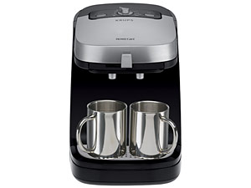
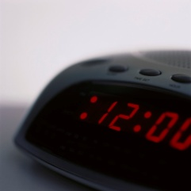
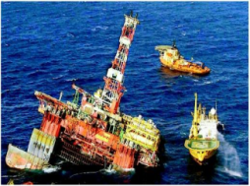
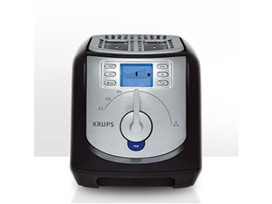
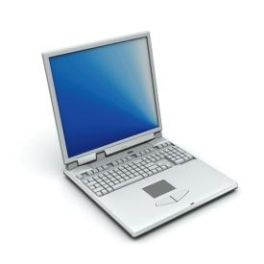
Software is a Skin that Surrounds Our Civilization
Quote due to Dr. Mark Harman

Slide 4
Software Failures
2020: More than 100 flights to and from London’s Heathrow airport disruption due to issues with departure boards and check-in systems
2019: Facebook, Instagram, WhatsApp 14 hours downtime due to Facebook News Feed issue in routine maintenance
2019: Boeing 737 Max crashed due to aggressive software flight overrides
2018: Pedestrian in Arizona was killed by an Uber car due to its self-driving software failure
2018: Google shut down Google+ due to the undetected fault that was present for more than two years, causing nearly 500,000 users’ data to be compromised
2017: 606 recorded software failures, impacting 3.7 billion people, 314 companies, $1.7 trillion in financial losses
Notes:
半年坠毁两架波音737max客机，并带走了346条生命，事后有专家分析了狮航与埃塞俄比亚航空这两起空难事故，均有类似的情况，原因都出自一个，那就是飞机失控。据悉，狮航那架波音737max在飞行时，飞机突然发出错误的指令，持续让机头下压，呈俯冲的姿势飞行，而机长在与飞控系统做了将近12分钟的搏斗，也无济于事，最后失控下坠。
Compromised：(为达成协议而)妥协，折中，让步; 违背(原则); 达不到(标准); (尤指因行为不很明智)使陷入危险，使受到怀疑;

Slide 5
Software Failures
2016: Nissan recalled 4 millions cars from the market due to software failure in the airbag sensory detectors
2003: Northeast blackout due to the alarm system in the energy management system failure, affecting 40 million people in 8 US states, 10 million people in Ontario, Canada
1999: NASA’s Mars lander crashed due to a unit integration fault
1997: Ariane 5 explosion: Exception-handling bug forced self-destruct on maiden flight (64-bit to 16-bit conversion), causing $370 millions
1986: 3 patients were killed by Therac-25 radiation machine due to poor testing of its safety-critical software

Slide 6
Terms for Software Failures
Fault（故障）, failure（失败）, and defect（缺陷） tend to imply a condition that's really severe, maybe even dangerous.
It doesn't sound right to call an incorrectly colored icon a fault.
These words also tend to imply blame: "It's his fault that the software failed."
Anomaly, incident, and variance don't sound quite so negative and are often used to infer unintended operation rather than all-out failure.
"The president stated that it was a software anomaly that caused the missile to go off course."
Problem, error（错误）, and bug are probably the most generic terms used.

Slide 7
Software Faults, Errors & Failures
Software Fault : A static defect in the software
Software Failure : External, incorrect behavior with respect to the requirements or other description of the expected behavior
Software Error : An incorrect internal state that is the manifestation of some fault
Faults in software are equivalent to design mistakes in hardware.
Software does not degrade.

Slide 8
Fault and Failure Example
A patient gives a doctor a list of symptoms
Failures
The doctor tries to diagnose the root cause, the ailment
Fault
The doctor may look for anomalous internal conditions (high blood pressure, irregular heartbeat, bacteria in the blood stream)
Errors
Most medical problems result from external attacks (bacteria, viruses) or physical degradation as we age.
Software faults were there at the beginning and do not “appear” when a part wears out.

Slide 9
A Concrete Example
Public static int numZero (int [ ] arr)
{
// Effects: If arr is null throw NullPointerException
// else return the number of occurrences of 0 in arr
int count = 0;
for (int i = 1; i < arr.length; i++)
{
if (arr [ i ] == 0)
{
count++;
}
}
return count;
}
Identify the fault.
If possible, identify a test case that does not execute the fault.
If possible identify a test case that results in error, but not a failure.
Notes:
b) 不存在。即使arr=Null，i=1在判断arr长度抛出异常之前执行，已经产生error。

Slide 10
A Concrete Example
Fault: Should start searching at 0, not 1
public static int numZero (int [ ] arr)
{ // Effects: If arr is null throw NullPointerException
// else return the number of occurrences of 0 in arr
int count = 0;
for (int i = 1; i < arr.length; i++)
{
if (arr [ i ] == 0)
{
count++;
}
}
return count;
}
Test 1
[ 2, 7, 0 ]
Expected: 1
Actual: 1
Error: i is 1, not 0, on the first iteration
Failure: none
Test 2
[ 0, 2, 7 ]
Expected: 1
Actual: 0
Error: i is 1, not 0
Error propagates to the variable count
Failure: count is 0 at the return statement

Slide 11
A Concrete Example
Public static int numZero (int [ ] arr)
{
// Effects: If arr is null throw NullPointerException
// else return the number of occurrences of 0 in arr
int count = 0;
for (int i = 1; i < arr.length; i++)
{
if (arr [ i ] == 0)
{
count++;
}
}
return count;
}
arr = [2, 7, 0]
count = 0
i=1
arr = [2, 7, 0]
count = 0
i = 1
PC = if
arr = [2, 7, 0]
count = 0
i = 0

Slide 12
Fault & Failure Model (RIPR)
Four conditions necessary for a failure to be observed
Reachability : The location or locations in the program that contain the fault must be reached
Infection : The state of the program must be incorrect
Propagation : The infected state must cause some output or final state of the program to be incorrect
Reveal : The tester must observe part of the incorrect portion of the program state

Slide 13
RIPR Model
Reachability
Infection
Propagation
Revealability
Test
Final Program State
Observed Final Program State
Reaches
Observed Final Program State
Fault
Incorrect Final State
Infects
Incorrect Program State
Propagates
Reveals
Test Oracles
Notes:
The failures can be revealed when the observed final program state has overlap with the incorrect final program state.
The question is: should testers check the entire program state? How to observe the incorrect program state in a cost-effective manner.
Getting the overlap as big as possible and use the cost as small as possible.
In computing, software testers and software engineers can use an oracle as a mechanism for determining whether a test has passed or failed. The use of oracles involves comparing the output(s) of the system under test, for a given test-case input, to the output(s) that the oracle determines that product should have.
A test oracle uses expected results to decide whether a test passed or failed

Slide 14
Testing & Debugging
Testing : Evaluating software by observing its execution
Test Failure : Execution of a test that results in a software failure
Debugging : The process of finding a fault given a failure
Not all inputs will “trigger” a fault into causing a failure

Slide 15


The Term Bug
Bug is used informally
Sometimes speakers mean fault, sometimes error, sometimes failure … often the speaker doesn’t know what it means !
This class will try to use words that have precise, defined, and unambiguous meanings
“an analyzing process must equally have been performed in order to furnish the Analytical Engine with the necessary operative data; and that herein may also lie a possible source of error. Granted that the actual mechanism is unerring in its processes, the cards may give it wrong orders. ” – Ada, Countess Lovelace (notes on Babbage’s Analytical Engine)
BUG
“It has been just so in all of my inventions. The first step is an intuition, and comes with a burst, then difficulties arise—this thing gives out and [it is] then that 'Bugs'—as such little faults and difficulties are called—show themselves and months of intense watching, study and labor are requisite. . .” – Thomas Edison

Slide 16
Product Specification
A product specification, sometimes referred to as simply a spec or product spec, is an agreement among the software development team.
It defines the product they are creating, detailing what it will be, how it will act, what it will do, and what it won't do.

Slide 17
Formal Definition of Bug
A software bug occurs when one or more of the following five rules is true:
The software doesn't do something that the product specification says it should do.
The software does something that the product specification says it shouldn't do.
The software does something that the product specification doesn't mention.
The software doesn't do something that the product specification doesn't mention but should.
The software is difficult to understand, hard to use, slow, or in the software tester's eyes will be viewed by the end user as just plain not right.
Notes:
1.没做应该做的
2.做了不应该做的
3.做了没提到的
4.没做没提到的但应该做的
5.难于理解和使用

Slide 18
An Example
The specification for a calculator probably states that it will perform correct addition, subtraction, multiplication, and division. The product spec might state that the calculator should never crash, lock up, or freeze.
If you, as the tester, receive the calculator, press the + key, and nothing happens, that's a bug because of Rule ??
If you get the wrong answer, that's a bug because of Rule ??
If you pound on the keys and get the calculator to stop responding to your input, that's a bug because of Rule ??
Suppose that you receive the calculator for testing and find that besides addition, subtraction, multiplication, and division, it also performs square roots. Is it a feature or a bug because of Rule ??
You start testing the calculator and discover when the battery gets weak that you no longer receive correct answers to your calculations. It is a bug because of Rule ??
You found that the buttons were too small. Maybe the placement of the = key made it hard to use. Maybe the display was difficult to read under bright lights. All of these are bugs because of Rule ??
Notes:
The specification for a calculator probably states that it will perform correct addition, subtraction, multiplication, and division.
If you, as the tester, receive the calculator, press the + key, and nothing happens, that's a bug because of Rule #1. If you get the wrong answer, that's also a bug because of Rule #1.
The product spec might state that the calculator should never crash, lock up, or freeze. If you pound on the keys and get the calculator to stop responding to your input, that's a bug because of Rule #2.
Suppose that you receive the calculator for testing and find that besides addition, subtraction, multiplication, and division, it also performs square roots. Nowhere was this ever specified. An ambitious programmer just threw it in because he felt it would be a great feature. This isn‘t a feature, it's really a bug because of Rule #3. The software is doing something that the product specification didn't mention. This unintended operation, although maybe nice to have, will add to the test effort and will likely introduce even more bugs.
The fourth rule may read a bit strange with its double negatives, but its purpose is to catch things that were forgotten in the specification. You start testing the calculator and discover when the battery gets weak that you no longer receive correct answers to your calculations. No one ever considered how the calculator should react in this mode. A bad assumption was made that the batteries would always be fully charged. You expected it to keep working until the batteries were completely dead, or at least notify you in some way that they were weak. Correct calculations didn't happen with weak batteries, and it wasn't specified what should happen. Rule #4 makes this a bug.
Rule #5 is the catch-all. As a tester you are the first person to really use the software. If you weren't there, it would be the customer using the product for the first time. If you find something that you don't feel is right, for whatever reason, it's a bug. In the case of the calculator, maybe you found that the buttons were too small. Maybe the placement of the = key made it hard to use. Maybe the display was difficult to read under bright lights. All of these are bugs because of Rule #5.

Slide 19
Where are errors？
Notes:
COTS: Commercial Off-The-Shelf 商用现成品或技术

Slide 20
The Average Cost to Fix Fault

Slide 21
Software Testability (3.1)
The degree to which a system or component facilitates the establishment of test criteria and the performance of tests to determine whether those criteria have been met
Plainly speaking – how hard it is to find faults in the software
Testability is dominated by two practical problems
How to provide the test values to the software
How to observe the results of test execution

Slide 22
Observability and Controllability
Observability
Software that affects hardware devices, databases, or remote files have low observability
Controllability
Easy to control software with inputs from keyboards
Inputs from hardware sensors or distributed software is harder
Data abstraction reduces controllability and observability
How easy it is to observe the behavior of a program in terms of its outputs, effects on the environment and other hardware and software components
How easy it is to provide a program with the needed inputs, in terms of values, operations, and behaviors
Notes:
Example of software that often have low controllability:
Embedded software often gets its inputs from hardware sensors: Difficult to control, Some inputs may be difficult, dangerous, or impossible to supply
Component-based software
Distributed software
Web applications
Mobile applications
Example of software that often have low observability:
Embedded software often does not produce output for human consumption
Component-based software
Distributed software
Web applications
Mobile applications

Slide 23
Components of a Test Case (3.2)
A test case is a multipart artifact with a definite structure
Test case values
Expected results
A test oracle uses expected results to decide whether a test passed or failed
The input values needed to complete an execution of the software under test
The result that will be produced by the test if the software behaves as expected

Slide 24
Affecting Controllability and Observability
Prefix values
Postfix values
Verification Values : Values needed to see the results of the test case values
Exit Values : Values or commands needed to terminate the program or otherwise return it to a stable state
Inputs necessary to put the software into the appropriate state to receive the test case values
Any inputs that need to be sent to the software after the test case values are sent

Slide 25
Putting Tests Together
Test case
Test set
Executable test script
The test case values, prefix values, postfix values, and expected results necessary for a complete execution and evaluation of the software under test
A set of test cases
A test case that is prepared in a form to be executed automatically on the test software and produce a report

Slide 26
Testing in the 21st Century
More safety critical, real-time software
Embedded software is ubiquitous … check your pockets
Enterprise applications means bigger programs, more users
Security is now all about software faults
Secure software is reliable software
The web offers a new deployment platform
Very competitive and very available to more users
Web apps are distributed
Web apps must be highly reliable
Artificial Intelligence Software
Industry desperately needs our inventions !

Slide 27
What Does This Mean?
Software testing is getting more important
What are we trying to do when we test ?
What are our goals ?

Slide 28
Validation & Verification (IEEE)
Validation : The process of evaluating software at the end of software development to ensure compliance with intended usage
Verification : The process of determining whether the products of a given phase of the software development process fulfill the requirements established during the previous phase
IV&V stands for “independent verification and validation”
Notes:
In April 1990, the Hubble space telescope was launched into orbit around the Earth. As a reflective telescope, Hubble uses a large mirror as its primary means to magnify the objects it's aiming at. The construction of the mirror was a huge undertaking requiring extreme precision and accuracy. Testing of the mirror was difficult since the telescope was designed for use in space and couldn't be positioned or even viewed through while it was still on Earth. For this reason, the only means to test it was to carefully measure all its attributes and compare the measurements with what was specified. This testing was performed and Hubble was declared fit for launch.
Unfortunately, soon after it was put into operation, the images it returned were found to be out of focus. An investigation discovered that the mirror was improperly manufactured. The mirror was ground according to the specification, but the specification was wrong. The mirror was extremely precise, but it wasn't accurate. Testing had confirmed that the mirror met the spec verificationbut it didn't confirm that it met the original requirement validation.
In 1993, a space shuttle mission repaired the Hubble telescope by installing a "corrective lens" to refocus the image generated by the improperly manufactured mirror.
Although this is a not a software example, verification and validation apply equally well to software testing. Never assume that the specification is correct. If you verify the spec and validate the final product, you help avoid problems such as the one that hit the Hubble telescope.

Slide 29
A case study for distinguishing Validation & Verification
In April 1990, the Hubble space telescope was launched into orbit around the Earth. As a reflective telescope, Hubble uses a large mirror as its primary means to magnify the objects it's aiming at.
The only means to test it was to carefully measure all its attributes and compare the measurements with what was specified. This testing was performed and Hubble was declared fit for launch. Unfortunately, soon after it was put into operation, the images it returned were found to be out of focus.
An investigation discovered that the mirror was improperly manufactured. The mirror was ground according to the specification, but the specification was wrong. The mirror was extremely precise, but it wasn't accurate. Testing had confirmed that the mirror met the spec verification but it didn't confirm that it met the original requirement validation.
In 1993, a space shuttle mission repaired the Hubble telescope by installing a "corrective lens" to refocus the image generated by the improperly manufactured mirror.
Although this is a not a software example, verification and validation apply equally well to software testing. Never assume that the specification is correct. If you verify the spec and validate the final product, you help avoid problems such as the one that hit the Hubble telescope.

Slide 30
Testing Goals Based on Test Process Maturity
Level 0 : There’s no difference between testing and debugging
Level 1 : The purpose of testing is to show correctness
Level 2 : The purpose of testing is to show that the software doesn’t work
Level 3 : The purpose of testing is not to prove anything specific, but to reduce the risk of using the software
Level 4 : Testing is a mental discipline that helps all IT professionals develop higher quality software

Slide 31
Level 0 Thinking
Testing is the same as debugging
Does not distinguish between incorrect behavior and mistakes in the program
Does not help develop software that is reliable or safe
This is what we teach undergraduate CS majors

Slide 32
Level 1 Thinking
Purpose is to show correctness
Correctness is impossible to achieve
What do we know if no failures?
Good software or bad tests?
Test engineers have no:
Strict goal
Real stopping rule
Formal test technique
Test managers are powerless
This is what hardware engineers often expect

Slide 33
Level 2 Thinking
Purpose is to show failures
Looking for failures is a negative activity
Puts testers and developers into an adversarial relationship
What if there are no failures?
This describes most software companies.
How can we move to a team approach ??

Slide 34
Level 3 Thinking
Testing can only show the presence of failures
Whenever we use software, we incur some risk
Risk may be small and consequences unimportant
Risk may be great and consequences catastrophic
Testers and developers cooperate to reduce risk
This describes a few “enlightened” software companies

Slide 35
Level 4 Thinking
A mental discipline that increases quality
Testing is only one way to increase quality
Test engineers can become technical leaders of the project
Primary responsibility to measure and improve software quality
Their expertise should help the developers
This is the way “traditional” engineering works

Slide 36
Where Are You?
Are you at level 0, 1, or 2 ?
Is your organization at work at level 0, 1, or 2 ?
Or 3?
We hope to teach you to become “change agents” in your workplace …
Advocates for level 4 thinking

Slide 37
Tactical Goals : Why Each Test ?
If you don’t know why you’re conducting each test, it won’t be very helpful
Written test objectives and requirements must be documented
What are your planned coverage levels?
How much testing is enough?
Common objective – spend the budget … test until the ship-date …
Sometimes called the “date criterion”

Slide 38
Why Each Test ?
If you don’t start planning for each test when the functional requirements are formed, you’ll never know why you’re conducting the test
1980: “The software shall be easily maintainable”
Threshold reliability requirements?
What fact does each test try to verify?
Requirements definition teams need testers!

Slide 39
Cost of Not Testing
Poor Program Managers might say: “Testing is too expensive.”
Testing is the most time consuming and expensive part of software development
Not testing is even more expensive
If we have too little testing effort early, the cost of testing increases
Planning for testing after development is prohibitively expensive

Slide 40
Cost of Late Testing
60
Assume $1000 unit cost, per fault, 100 faults
$250K
50
40
$360K
30
Fault origin (%)
Fault detection (%)
Unit cost (X)
20
$20K
$100K
$13K
10
$6K
0
Requirements
Design
Prog / Unit Test
Integration Test
System Test
Post-Deployment
Software Engineering Institute; Carnegie Mellon University; Handbook CMU/SEI-96-HB-002
Notes:
28-Oct-2010, at GTAC, added the animation to demonstrate increasing the number of faults found early, thereby decreasing the number of faults found late, and finally saving money. Lots of it! This animation is fairly complicated … must practice first!!

Slide 41
Summary: Why Do We Test Software ?
A tester’s goal is to eliminate faults as early as possible
Improve quality
Reduce cost
Preserve customer satisfaction

Slide 42
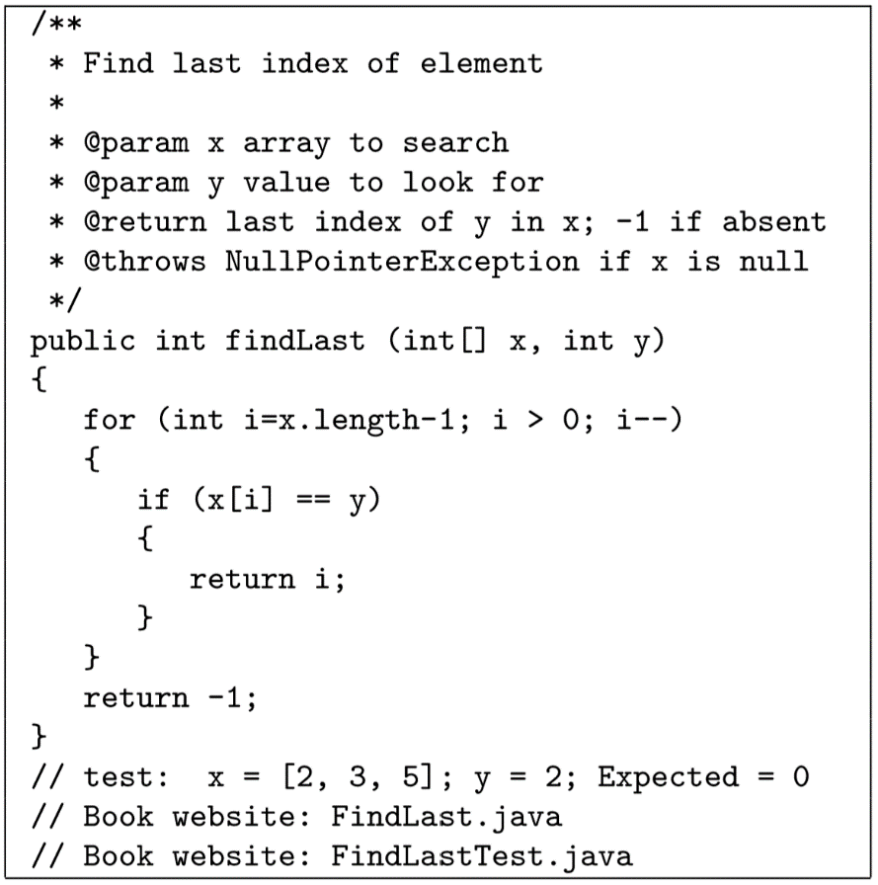
Exercise
The following faulty program includes test inputs that result in failure. Answer the following questions about the program.
(a) Explain what is wrong with the given code. Describe the fault precisely by proposing a modiﬁcation to the code.
(b) If possible, give a test case that does not execute the fault. If not, brieﬂy explain why not.
(c) If possible, give a test case that executes the fault, but does not result in an error state. If not, brieﬂy explain why not.
(d) If possible, give a test case that results in an error state, but not a failure. Hint: Don’t forget about the program counter. If not, brieﬂy explain why not.
(e) For the given test case, describe the ﬁrst error state. Be sure to describe the complete state.
(f) Implement your repair and verify that the given test now produces the expected output. Submit a screen printout or other evidence that your new program works.

