Slide 1
Adding new gd5 tasks in Jagwire
Adding ENVI Analytic Tasks to Run in Jagwire UI
For ESRI - Vietnam
November 9, 2021

Slide 2
Considerations
Jagwire can only handle a single input (raster)
Jagwire ENVI Task output can be a raster and/or a vector only
For raster output: output is ENVI file format
For vector format: output is Shapefile
These must be zipped as a single output
Task must be marked with “EV”
Task code needs to be compiled into a “.sav” file.

Slide 3
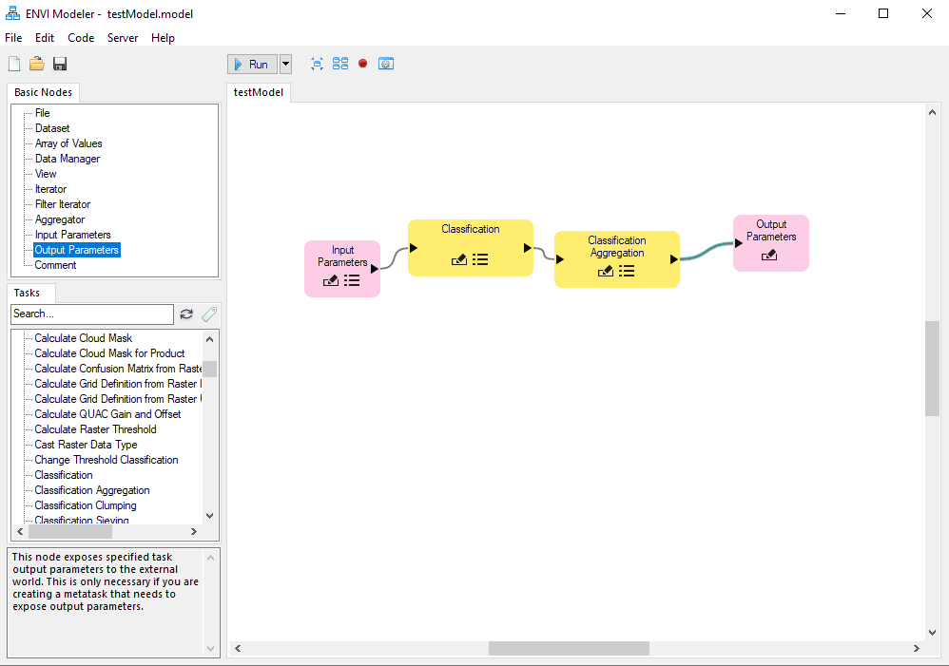
Create ENVI Task
Create ENVI Analytic Task using the ENVI Modeler
Generate the IDL code for the model using Code > Generate IDL Program
Save the program to the to an IDL program file (.pro)
Compile the program (.sav)

Slide 4
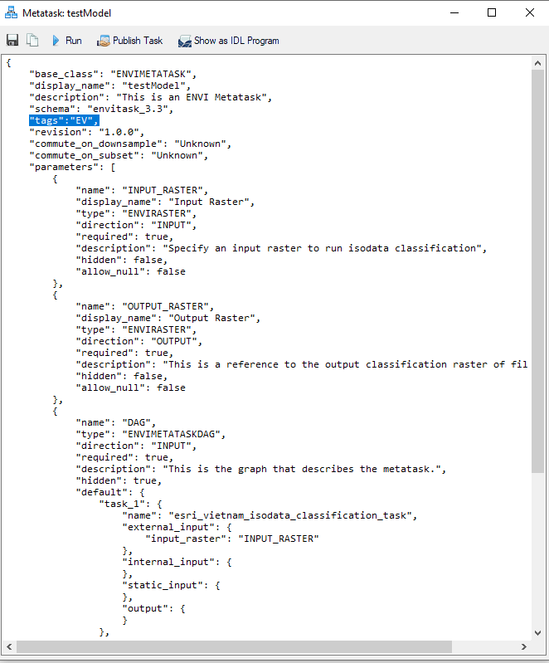
Create ENVI Task
Generate a Metatask
Identify the input and output the metatask needs to expose
Select Code > Metatask from the ENVI Modeler menu bar
Save the created model to a task file (.task)
Be sure to save the .sav and .task file with same task name
Add an “EV” tag to the generated file

Slide 5

Add New GD5 Task
SSH into the Jagwire system
Copy both the .sav and .task files to the following directory:
cd /usr/local/harris/envi55/custom_code
SSH into the Jagwire system
From the Linux Command line run: pdmenu

Slide 6
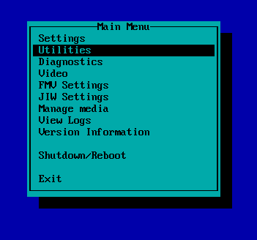
Add New GD5 Task
When the Pdmenu appears, select the “Utilities” option

Slide 7
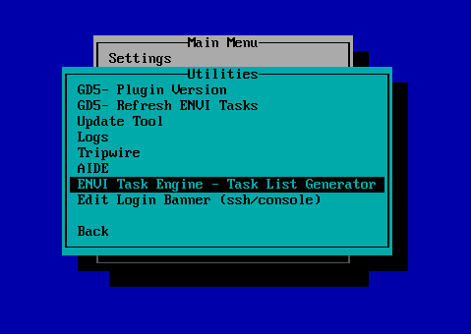
Add New GD5 Task
Select the “ENVI Task Engine –Task List Generator” option
This will refresh the task list
Select “y”, then “Enter” to run

Slide 8
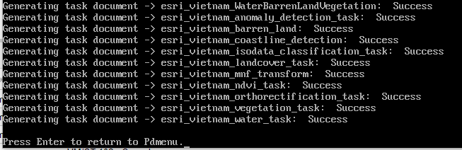
Add New GD5 Task
When complete, press “Enter” to return to PDMenu

Slide 9
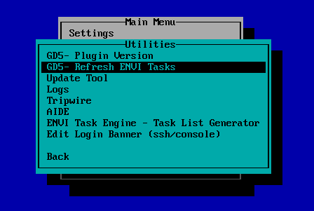
Add New GD5 Task
Select the “GD5-Refresh ENVI Tasks” option
Then press the “Enter” key
Select “y”, then “Enter” to run

Slide 10
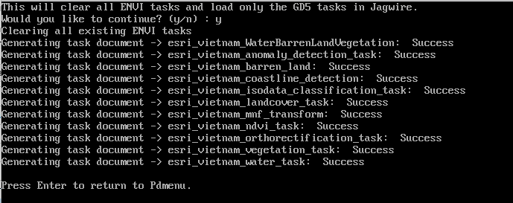
Add New GD5 Task
When complete, press “Enter” to return to PDMenu
Exit Pdmenu

Slide 11
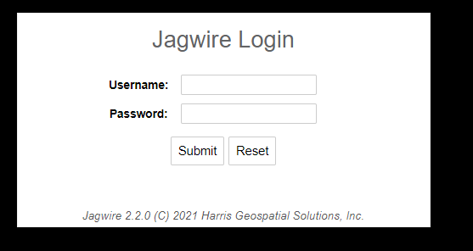
Add New GD5 Task
Log into the Jagwire Interface to verify ENVI Tasks are available

Slide 12

Questions?

