Slide 1
Jagwire – System Update
Migrating to Jagwire 2.2.0.5 and GD5 Analytics Installation
For ESRI - Vietnam
November 4, 2021
JOE COLE | Sales Engineering

Slide 2
Course Overview
Hardware / Software Review
Installation of 2.2.0.5 Update ISO
Installation and Setup of GD5 Analytics ISO

Slide 3
Hardware / Software Review
Jagwire Configuration:
Standard “Bare Metal” server
Required Software:
Working Jagwire Server (2.2.0.4)
Jagwire 2.2.0.5 Update DVD or Update ISO File
GD5 Analytic Add-on DVD or Update ISO File
Tasks:
Update Jagwire to 2.2.0.5
Install and Configure GD5 Analytic Tools

Slide 4
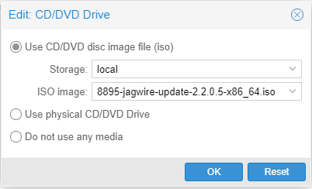
Install Jagwire 2.2.0.5 Update
3 Methods to Mount the Installation Media
If server has a disk drive:
Insert update disk (DVD) in disk drive
2. If using a Hypervisor:
Select ISO file to mount, then click “OK”

Slide 5
Install Jagwire 2.2.0.5 Update
3 Methods to Mount the Installation Media
3. Mount ISO file via the Linux Command Line
SSH into the Jagwire system
Create a directory called /media/iso
Copy ISO file(s) to the directory
Run the following command to mount the ISO
mount –o loop /media/iso/<filename.iso> /mnt/cdrom

Slide 6

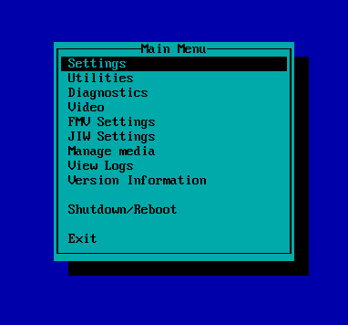
Install Jagwire 2.2.0.5 Update
Installing the Update Disk
From the Linux Command line run: pdmenu
The Pdmenu “Main Menu” will appear on the screen

Slide 7
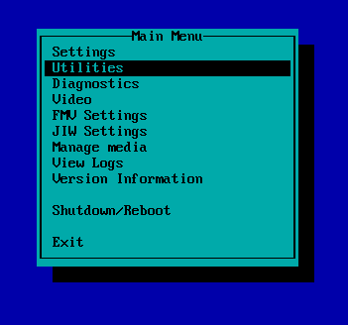
Install Jagwire 2.2.0.5 Update
Installing the Update Disk
Select the “Utilities” option

Slide 8
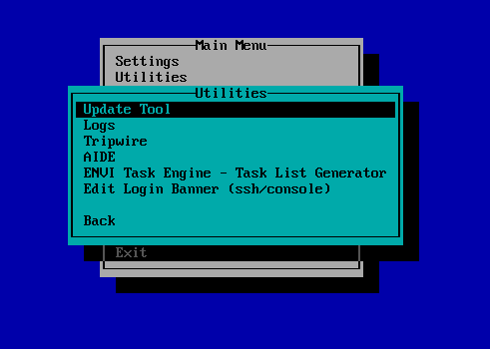
Install Jagwire 2.2.0.5 Update
Installing the Update Disk
Select the “Update Tool” option
Then hit the “Enter” key

Slide 9

Install Jagwire 2.2.0.5 Update
Installing the Update Disk
Verify you are updating to the correct version and press “y” to continue.
This will begin the system update

Slide 10
Install Jagwire 2.2.0.5 Update
Installing the Update Disk
When the update is finished, reboot the system.
Press “y” and then “Enter” to reboot the system.
System is updated once the reboot is complete.
Run umount /mnt/cdrom to unmount the ISO file

Slide 11

Install GD5 Add-on Update
Installing and Configuring the GD5 Add-on Disk
Follow the same instructions to mount the ISO and install the update
Verify you are updating to the correct version and press “y” to continue.

Slide 12
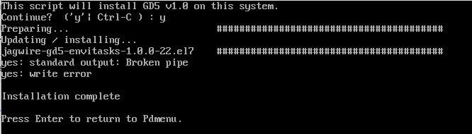
Install GD5 Add-on Update
Installing and Configuring the GD5 Add-on Disk
When complete, hit “Enter” key to return to Pdmenu.
Exit Pdmenu

Slide 13
Install GD5 Add-on Update
Installing and Configuring the GD5 Add-on Disk
From the Linux Command line run: pdmenu
The Pdmenu “Main Menu” will appear on the screen

Slide 14
Install GD5 Add-on Update
Installing and Configuring the GD5 Add-on Disk
Select the “Utilities” option

Slide 15
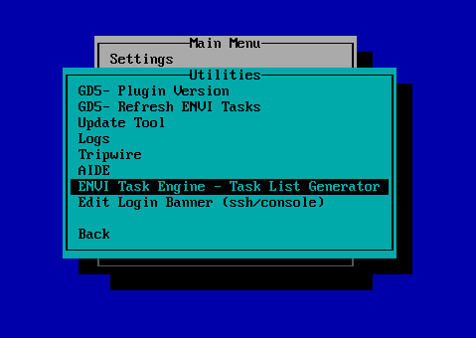
Install GD5 Add-on Update
Installing and Configuring the GD5 Add-on Disk
Select the “ENVI Task Engine – Task List Generator” option
Then hit the “Enter” key

Slide 16
Install GD5 Add-on Update
Installing and Configuring the GD5 Add-on Disk
Select the “ENVI Task Engine – Task List Generator” option
Then hit the “Enter” key
Select “y”, then “Enter” to run

Slide 17
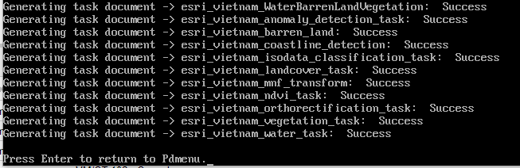
Install GD5 Add-on Update
When complete, press “Enter” to return to PDMenu

Slide 18
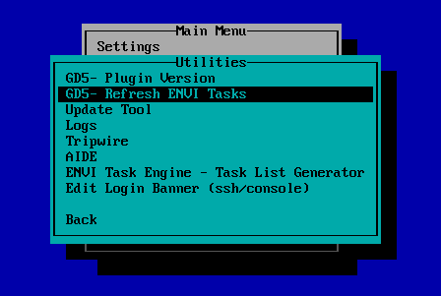
Install GD5 Add-on Update
Installing and Configuring the GD5 Add-on Disk
Select the “GD5-Refresh ENVI Tasks” option
Then hit the “Enter” key
Select “y”, then “Enter” to run

Slide 19
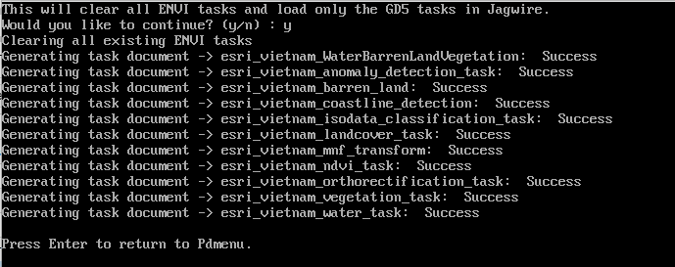
Install GD5 Add-on Update
Installing and Configuring the GD5 Add-on Disk
When complete, press “Enter” to return to PDMenu

Slide 20
Install GD5 Add-on Update
Installing and Configuring the GD5 Add-on Disk
Exit out of Pdmenu

Slide 21
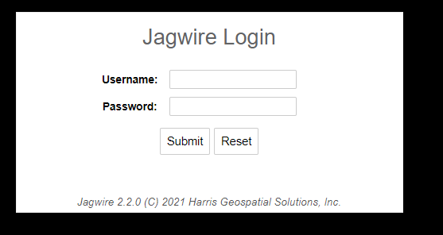
Install GD5 Add-on Update
Log into the Jagwire Interface to verify ENVI Tasks are available

Slide 22
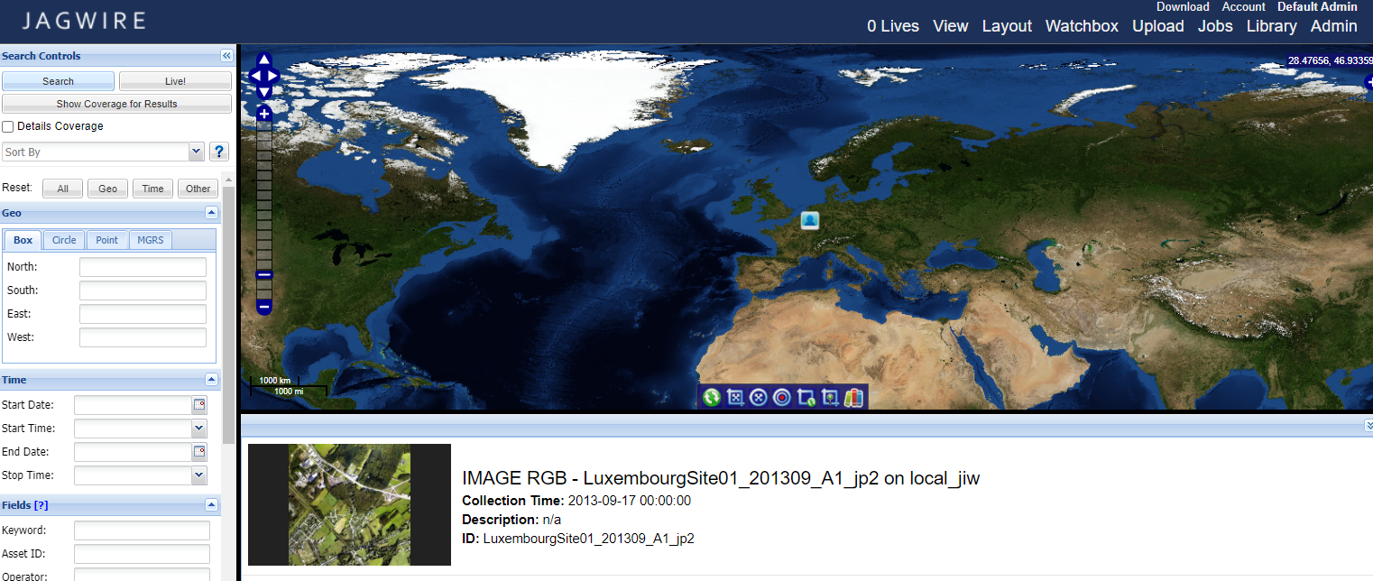
Install GD5 Add-on Update
Search for image to test GD5 installation

Slide 23
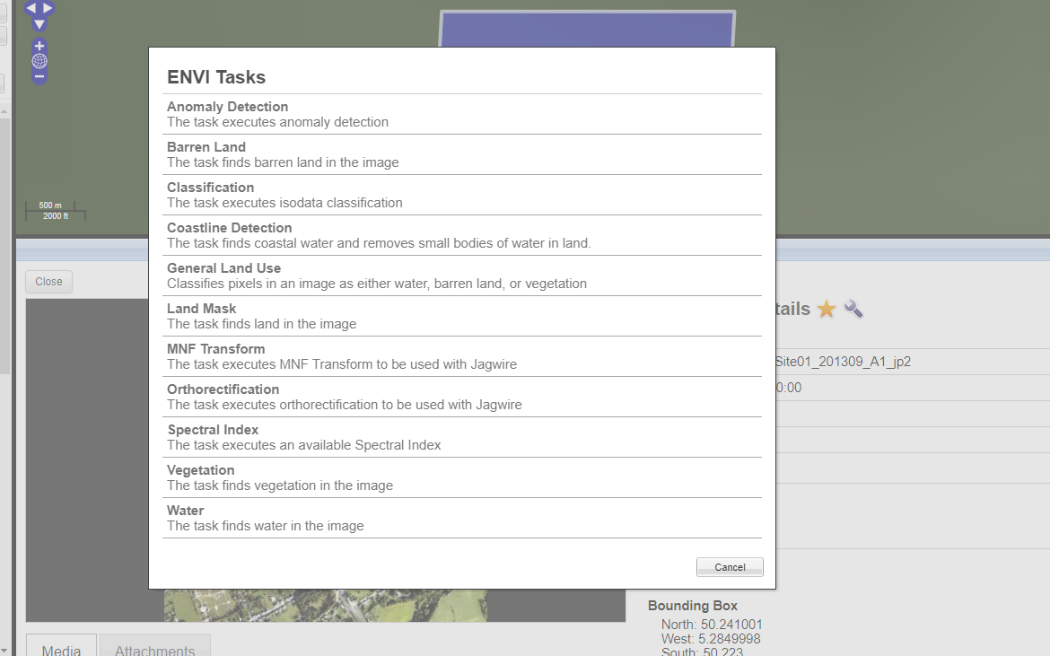
Install GD5 Add-on Update
Select image and click on “Wrench” icon

Slide 24

Questions?

