Slide 1
Chapter 10 FIR Digital Filter Design
Preliminary Consideration
FIR Digital Filter Design Methods
MATLAB Functions in FIR Filter Design

Slide 2
10.1 Preliminary Consideration
Digital Filter Specifications
Basic Approach to FIR Digital Filter Design
FIR Digital Filter Order Estimation
Unlike IIR digital filter design, FIR filter design does not have any connection with the design of analog filters.
The design of FIR filters is based on a direct approximation of the specified magnitude response, with often added requirement that the phase response be linear.

Slide 3
10.1.1 Basic Approaches to design FIR filters
Recall a causal FIR frequency response H(e ^{jω}) of length N+1:
Magnitude Response
Phase Response
For a linear-phase FIR, we have:
Or, as we known: h[n] = ± h[N-n]
For β= 0, π, ±π/2

Slide 4
10.1.2 Estimation of the Filter Order
The order (length-1) of G(z) is directly estimated from the digital filter specification.
Kaiser’s Formula:
Bellanger’s Formula:

Slide 5
Estimation of the Filter Order
Hermann’s Formula:
a1=0.005309, a2=0.07114, a3=-0.4761, a4=0.00266, a5=0.5941, a6=0.4278, b1=11.01217, b2=0.51244
Notes:
Each of these three formulas provide only an estimate of the required filter order.
The estimated filter order N of the FIR filter is inversely proportional to the transition band width.

Slide 6
10.2 FIR Filter Design Based on Windowed Fourier Series
Two direct approaches to design of FIR filters:
Truncating/windowing the Fourier series representation of the prescribed frequency response. (direct and straightforward)
(2) Sampling the frequency response to get the DFT of h[n], and
use IDFT to get h[n].
（掌握）

Slide 7
10.2.1 Least Integral-Squared Error Design of FIR Filters
Let H_{d}(e^{jω}) denote the desired frequency response function, h_{d}[n] denotes the impulse response samples, so :
Fourier series
In most applications, for meeting the FR H_{d}(e^{jω}) requirements, h_{d}[n] is infinite.
（掌握）

Slide 8
We want to find: a Length-N, causal
So:
The procedure of using h_{t}[n] to replace h_{d}[n] is called truncating or windowing.
Using what approximating criterion?
Minimum Integral-Squared Error.
（掌握）
Notes:
h[n]----linear phase
h_{t}[n]----zero phase

Slide 9
Define integral-squared error:
Using Parseval’s relation, we get:
When h_{t}[n]=h_{d}[n] for -M≤n≤M, the Φ_{R} is minimum.
Best finite-length approximation to ideal infinite-length impulse
response in the mean-square sense is obtained by truncation.
（理解）

Slide 10
A causal FIR filter with an impulse response h[n] can be derived from h_{t}[n] by delaying:
The causal FIR filter h[n] has the same magnitude response as h_{t}[n] and its phase response has a linear phase shift of ωM radians with respect to that of h_{t}[n].
h[n]----linear phase
h_{t}[n]----zero phase
（掌握）

Slide 11
10.2.2 Impulse Responses of Ideal Filters
Ideal lowpass filter:
Ideal highpass filter:
（掌握）

Slide 12
Ideal bandpass filter:
Ideal bandstop filter:
（掌握）

Slide 13
Hilbert transformer (90-degree phase shifter)
（掌握）

Slide 14
Differentiator:
（掌握）

Slide 15
Truncate the h[n] of Ideal Lowpass Filter
The impulse response of ideal filter is infinite. By setting all coefficients outside the range -M≤ n ≤ M equal to zero, we arrive at a finite-length sequence.
And by shifting to the right yields the causal FIR lowpass filter which we need.
Note: In above expression, length N is 2M+1.
（掌握）

Slide 16
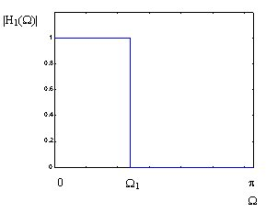
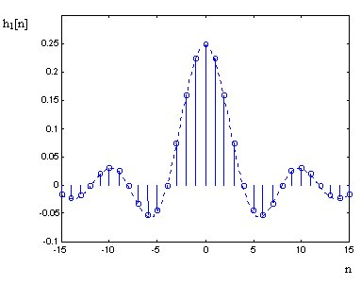
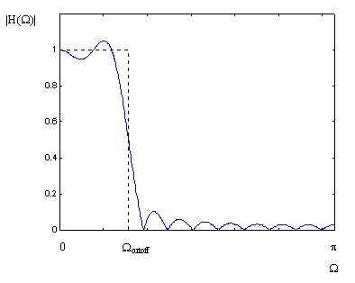
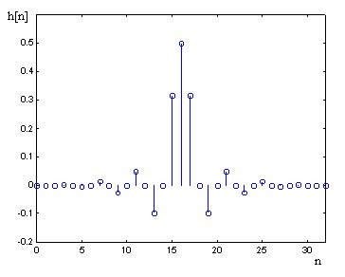
（掌握）

Slide 17
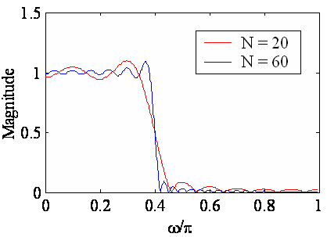
10.2.3 Gibbs Phenomenon--The Effect of Truncating the h[n]
Gibbs phenomenon
As the length of the lowpass filter is increased, the number of ripples in both passband and stopband increases, with a corresponding decrease in the ripple widths;
Height of the largest ripples remain the same independent of length;
Rectangular window has an abrupt transition to zero outside the range -M≤n≤M , which results in Gibbs phenomenon.

Slide 18
Gibbs Phenomenon Interpretation:
truncating operation → windowing operation:
In the frequency domain:
where and are the DTFTs of and , respectively.

Slide 19
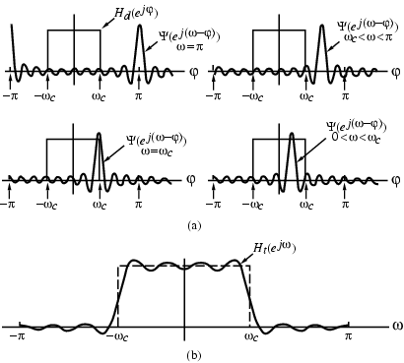
Thus is obtained by a periodic continuous
convolution of with
（掌握）

Slide 20
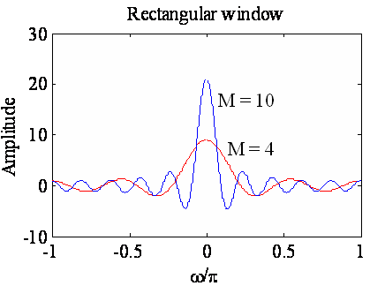
A rectangular window is used to achieve simple truncation:
main lobe
Main lobe width -- Δ_{ML}=4π/(2M+1)
Relative sidelobe level -- A_{sl}
side-lobes
Area under each lobe remains constant while width of each lobe decreases with M increasing.
增加长度只能减少过渡带，不能改变A_{sl}和α_{s}
（掌握）

Slide 21
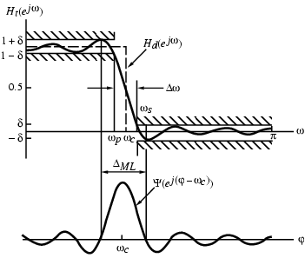
Width of transition band:
Δω = ω_{s} - ω_{p} < Δ_{ML}
Observe
δ = δ_{p} = δ_{s}
Thus,
Passband and stopband ripples are same
（重要）

Slide 22
10.2.4 Fixed Window Functions
Rectangular window
Rectangular window
0
-20
-40
Gain, dB
-60
-80
-100
0
0.2
0.4
0.6
0.8
1
w
/
p
（掌握）

Slide 23
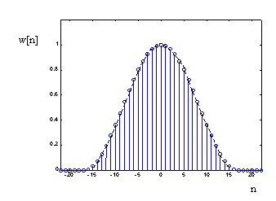
Hanning window
Hanning window
0
-20
-40
Gain, dB
-60
-80
-100
0
0.2
0.4
0.6
0.8
1
ω
/
π
（掌握）

Slide 24
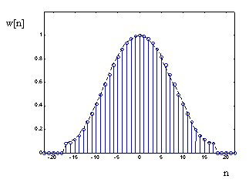
Hamming window:
Hamming window
0
-20
-40
Gain, dB
-60
-80
-100
0
0.2
0.4
0.6
0.8
1
ω
/
π
（掌握）

Slide 25
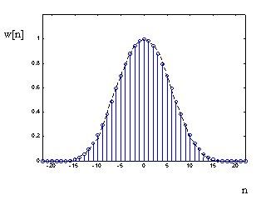
Blackman window:
Blackman window
0
-20
-40
Gain, dB
-60
-80
-100
0
0.2
0.4
0.6
0.8
1
ω
/
π
（掌握）

Slide 26
Plots of magnitudes of the DTFTs of these windows for M = 25 are shown below:
Rectangular window
Hanning window
0
0
-20
-20
-40
-40
Gain, dB
Gain, dB
-60
-60
-80
-80
-100
0
0.2
0.4
0.6
0.8
1
-100
0
0.2
0.4
0.6
0.8
1
ω
/
π
ω
/
π
Hamming window
Blackman window
0
0
-20
-20
-40
-40
Gain, dB
Gain, dB
-60
-60
-80
-80
-100
0
0.2
0.4
0.6
0.8
1
-100
0
0.2
0.4
0.6
0.8
1
ω
/
π
ω
/
π
（掌握）

Slide 27
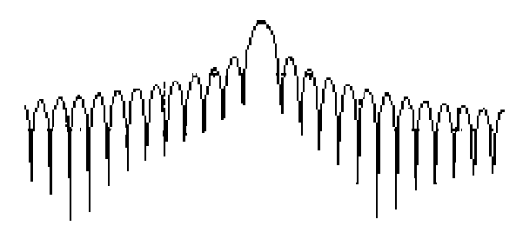
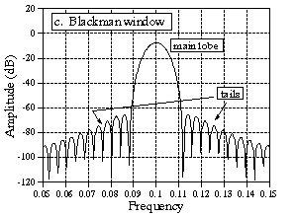
Rectangular and Blackman windows
To ensure a fast transition from passband to stopband, window should have a very small main lobe width.
To reduce the passband and stopband rippled, the area under the sidelobes should be very small.
Unfortunately, these two requirements are contradictory.
Notes:
减少过渡带要求主板宽度窄；降低纹波要求旁瓣下面积小

Slide 28
Table 10.2 Properties of some fixed window functions
Type of windows | Main lobe width Δ_{ML} | Relative sidelobe level A_{sl} | Minimum stopband attenuation α_{s} | Transition bandwidth Δω ≈ c / M
Rectangular | 4π/(2M+1) | 13.3dB | 20.9dB | 0.92π/M
Hann | 8π/(2M+1) | 31.5dB | 43.9dB | 3.11π/M
Hamming | 8π/(2M+1) | 42.7dB | 54.5dB | 3.32π/M
Blackman | 12π/(2M+1) | 58.1dB | 75.3dB | 5.56π/M
（重要）

Slide 29
10.2.5 Adjustable Window Functions
Kaiser window
Where:
We can adjust β to modify the window function. So, it is called as adjustable window function.
（理解）

Slide 30
10.2.5 Adjustable Window Functions
Kaiser window
（理解）

Slide 31
Example of FIR Filter Design:
Design a linear phase FIR LPF:
If given the passband edge frequency ω_{p}=0.3π, the passband ripple is 1dB，the stopband edge frequency ω_{s}=0.5π, the minimum stopband attenuation <-40dB.
Solution:
α_{p} =1dB, α_{s}=40dB,
（掌握）

Slide 32
The ideal LP impulse response is:
根据 α_{s}=40dB，查表10.2 选一个合适的窗函数！
应该选 Hann, 计算 N:
（掌握）

Slide 33
If we select window Hamming:
If we select window Blackman:
If we select window Kaiser:
（掌握）

Slide 34
FIR Filter Design Example
The specifications of a low pass filter:
Pass band edge 400Hz
Stop band edge 1650Hz
Stop band attenuation 50dB
Sampling frequency 11.025kHz
（掌握）

Slide 35
Transition width △f = 1650-400 = 1250Hz
Another parameter fc = (400+1650)/2 = 1025 Hz, So
Choose Hamming window (-54dB),
（掌握）

Slide 36
The finite-length causal FIR LP filter:
∴ N=2M+1=31
（掌握）

Slide 37
The Hamming window is
So, h[n] of the filter which we need is
Then the magnitude response and the impulse response are drawn in next slide:
（掌握）

Slide 38

So, the original sound:
the output sound after passing the LP filter:
（掌握）

Slide 39
FIR Filter Design Example
The specifications of a high pass filter:
Pass band edge 1650Hz
Stop band edge 400Hz
Stop band attenuation 50dB
Sampling frequency 11.025kHz
（掌握）

Slide 40
Transition width △f = 1650-400 = 1250Hz
Another parameter fc = (400+1650)/2 = 1025 Hz,
Choose Hamming window (-54dB),
（掌握）

Slide 41
The finite-length causal FIR HP filter:
∴ N=2M+1=31
（掌握）

Slide 42
The Hamming window is ( no change )
So, h[n] of the filter which we need is
Then the magnitude response and the impulse response are drawn in next slide:
（掌握）

Slide 43
So, the original sound :
the output sound after passing the HP filter:
（掌握）

Slide 44
Supplement: FIR Filter Design Based on Frequency Sampling Approach
Find an approximation of the desired FR H(e^{jω}) in frequency domain.
Type I can be used as LPF, HPF, BPF and BSF.
The method:
Let denote the sampling values of N+1-point FIR filter
Use to approximate the desired frequency response
（理解）

Slide 45
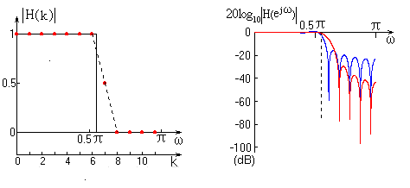
For example, a LPF with one sample of magnitude on the transition band is shown:
过渡带采样点数m | 1 | 2 | 3
阻带最小衰减 | 40~55dB | 65~75dB | 85~95dB

Slide 46
Example: Design a linear phase FIR LPF, and the magnitude values sampled are: The length is
（Type 1）
(1) Determine
（理解）

Slide 47
(2) 计算
N+1-points IDFT
(3) 实现框图如下：

Slide 48
10.5 FIR Digital Filter Design Using MATLAB
The window-based FIR filter design process involves
three steps:
The type of windows to be used is determined to meet the desired stop-band attenuation or pass-band ripple.
The order of the FIR is estimated by using Table10.2 or Eq.(10.45) for Kaiser window.
The desired impulse response of the ideal filter is computed, which is then multiplied by the window coefficients.

Slide 49
The functions available in MATLAB for the design of FIR filters using the windows Fourier approach are fir1 and fir2.
The function fir1 is used to design conventional lowpass, highpass, bandpass, bandstop and multiband FIR.
The function fir2 is employed to design FIR with arbitrarily shaped magnitude response.
Using the Kaiser window, the order can be estimated using the formula of (10.45) kaiserord

Slide 50
Window Generation
W=hann(L)
W=hamming(L)
W=blackman(L)
W=kaiser(L,beta)
Filter Design
b=fir1(N,Wn) %N-order, Wn=[w1,w2,…]
b=fir1(N,Wn,’ftype’) %ftype—lpf,hpf,..
b=fir1(N,Wn,window) %default hamming

Slide 51
Example 10.25
% Lowpass Filter Design Using the Kaiser Window
fpts = input('Type in the bandedges = ');
mag = input('Type in the desired magnitude values = ');
dev = input('Type in the ripples in each band = ');
[N, Wn, beta, ftype] = kaiserord(fpts,mag,dev)
kw = kaiser(N+1,beta);
b = fir1(N,Wn, kw);
[h,omega] = freqz(b,1,512);
plot(omega/pi,20*log10(abs(h)));grid;
xlabel('\omega/\pi'); ylabel('Gain, dB');

Slide 52
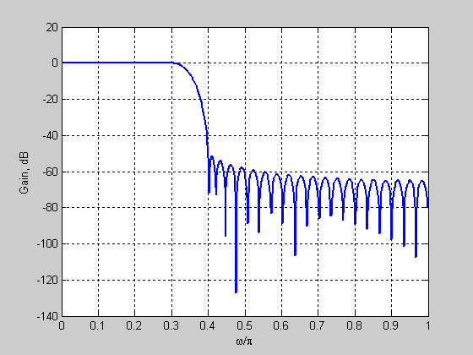
Type in the bandedges = [0.3 0.4]
Type in the desired magnitude values = [1 0]
Type in the ripples in each band = [0.003162 0.003162]
N = 59
Wn = 0.3500
beta = 4.5513
ftype = low

Slide 53
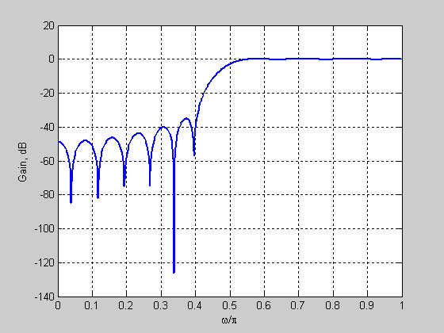
Example 10.26
Use the same program as Example 10.25
by modifying
b = fir1(N,Wn,'high',kw);
Type in the bandedges = [0.4 0.55]
Type in the desired magnitude values = [0 1]
Type in the ripples in each band = [0.02 0.02]
N = 26
Wn = 0.4750
beta = 2.6523
ftype = high

Slide 54
Digital Filter Design
Digital Filter Design Specifications
Introduction to FDATool
FIR & IIR Filter Design with FDATool
Mooc 内容

Slide 55
Introduction to FDATool
MATLAB filter design toolbox can help design digital filters in a visual manner
FDATool can be used to design various filters, such as
FIR low-pass, high-pass, band-pass and band-stop filters
IIR low-pass, high-pass, band-pass and band-stop filters
Type “fdatool or filter designer” in the MATLAB command window to start the Tool

Slide 56
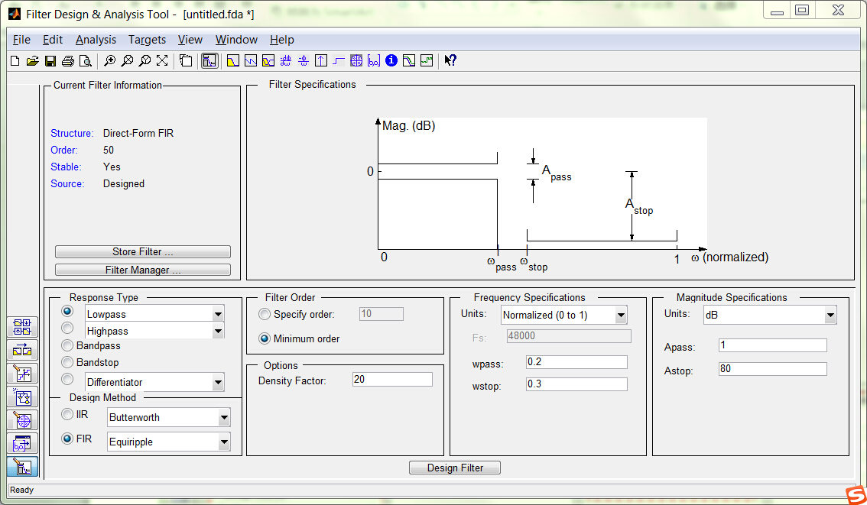
Mooc 内容（自学）

Slide 57
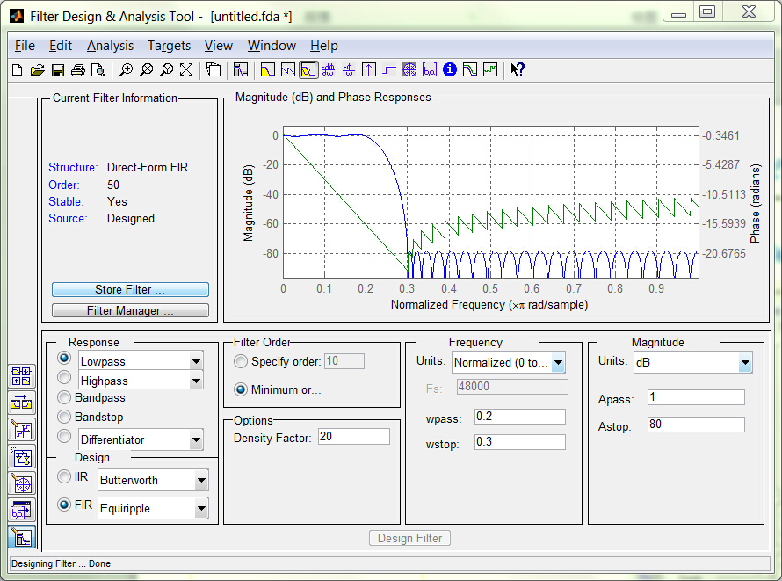
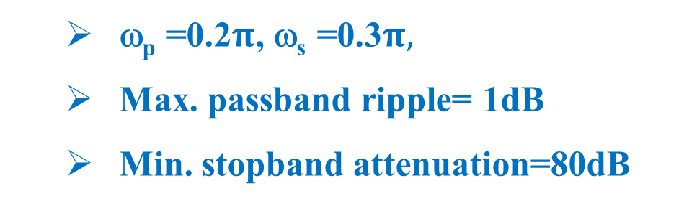
FIR Digital Filter Design
Example 1: Design an FIR lowpass filter with the specifications

Slide 58
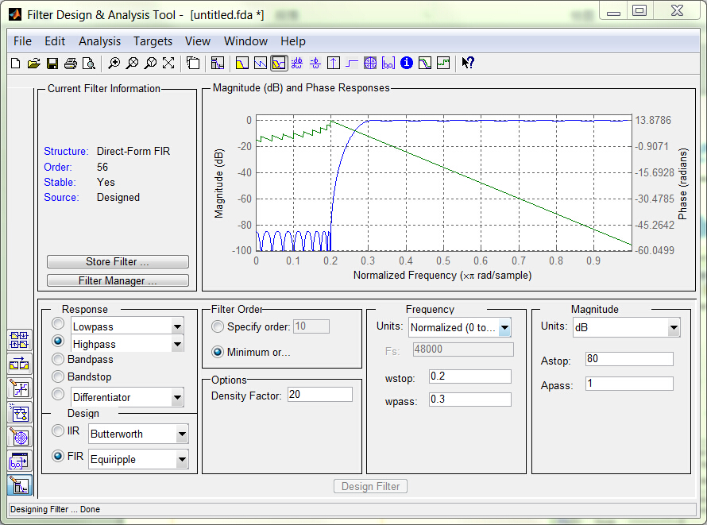
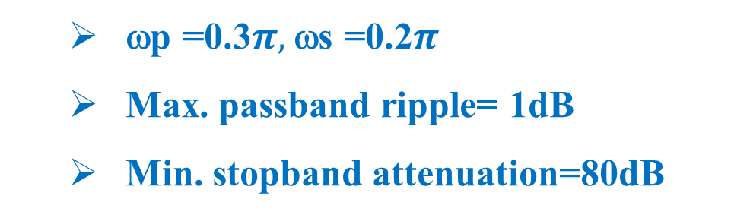
FIR Digital Filter Design
Example 2: Design an FIR highpass filter with the specifications

Slide 59
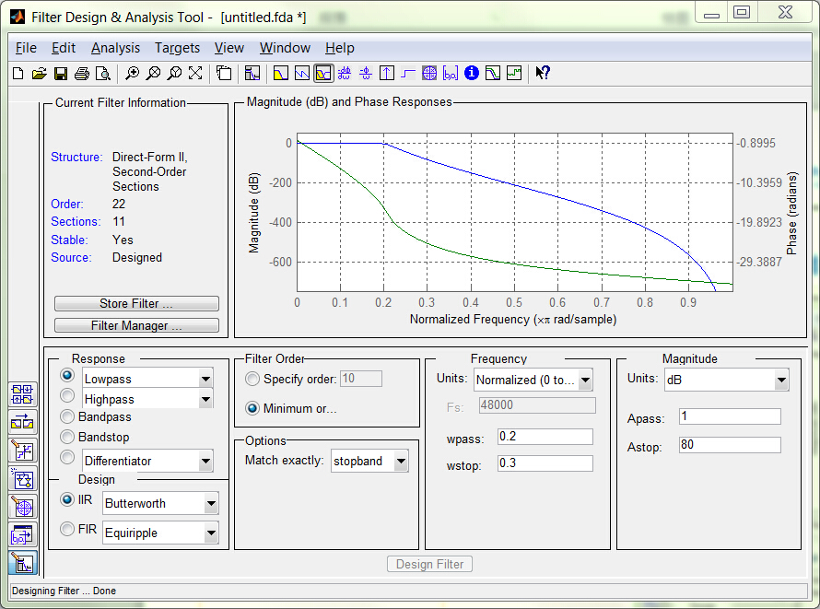
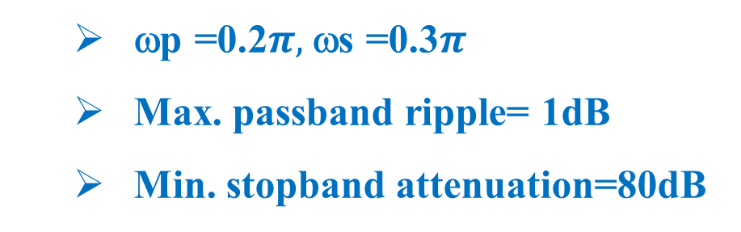
IIR Digital Filter Design
Example 3: Design an IIR lowpass filter with the specifications

Slide 60
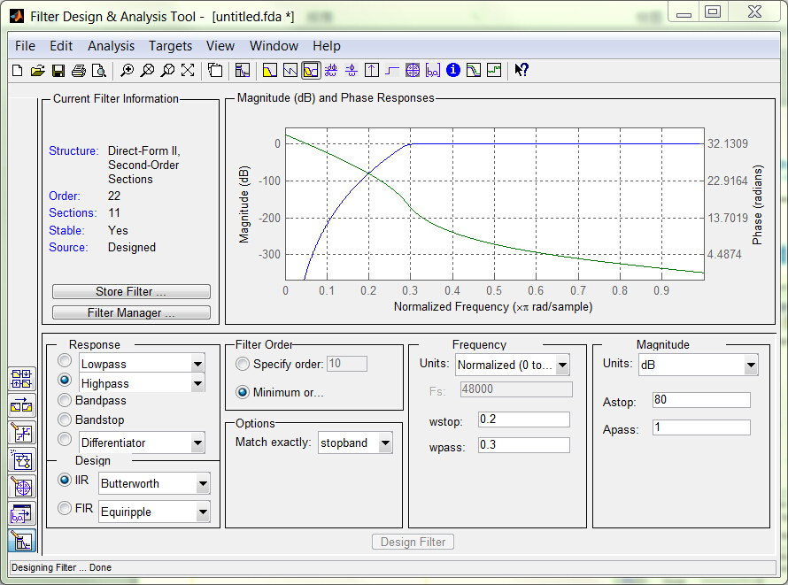
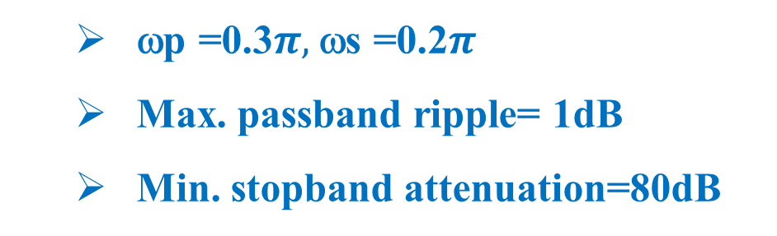
IIR Digital Filter Design
Example 4: Design an IIR highpass filter with the specifications

Slide 61
Homework:
10.17, 10.18, 10.20, 10.31, 10.32
M10.8, M10.9, M10.17

