Slide 1
Chapter11 DSP Algorithm Implementation
Structure Simulation and Verification by MATLAB
Computation of DFT
Fast Fourier Transformation —— FFT
DIT
DIF
11.2.1, 11.2.2, 11.2.3, 11.2.4, 11.3.2, 11.3.3, 11.3.4, 11.5

Slide 2
11.2 Structure simulation Using MATLAB
Program:
direct2.m, 11_1.m, 11_2.m, 11_3.m, 11_4.m, 11_5.m, 11_6.m
11.3 Computation of the DFT
11.3.1 Goertzel’s Algorithm（了解）
11.5 DFT and IDFT Computation Using MATLAB
Program 11_10.m --Spectral Analysis
Program 11_11.m --Linear Convolution

Slide 3
11.3.2 Cooley-Tukey FFT Algorithms
FFT--Fast Fourier Transformation, not a new transformation, but a fast algorithm to calculate the DFT.
J.W.Cooley and J.W.Tukey are given credit for bringing the FFT to the world in their paper :“An algorithm for the machine calculation of complex Fourier Series”, Mathematics Computation, Vol.19, 1965.
IEEE电声汇刊在1967年出版快速傅里叶变换算法专辑开始了快速变换的历史。
IEEE signal processing Magazine 1992年1月和IEEE ICASSP 92都有特约文章或报告纪念FFT专辑的发表。
1994年4月出版了《理解傅里叶技术》的专辑，目的在于普及和推广FFT技术。
Notes:
Mooc补充材料

Slide 4
传统快速傅里叶变换算法是递归分解算法，包含基2、基4、基8 和分裂基FFT。
Stasinisik 提出的基K-FFT (又称卷积FFT 算法c-FFT)是其它基数FFT算法的新发展。
Frigo and Johnson于2005年开发了FFTW的免费库，提供将FFT算法在多种硬件平台上运行的解决方案。
当N为复合数，即N可以分解为k和m的积时，可以通过二维序号映射实现快速算法，称为素因子FFT算法。
Notes:
11.4节有进一步的介绍

Slide 5
DFT and IDFT definition:
Where,
Direct computation of all N samples of {X[k]} requires N² complex multiplications and N(N-1) complex additions.
Notes:
We can see that the same values of W_{N} are calculated many times during the DFT,
since W_{N} is a periodic function with a limited number of distinct values.
The aim of the FFT and its inverse, the IFFT, is to use this redundancy to reduce the number of calculation.

Slide 6
The properties of twiddle factor W_{N}
Symmetry:
Periodicity:
Reduction:

Slide 7
Decimation-in-Time FFT
Given a sequence x[n] whose length is N=2^{k}, k is an integer.
Divided the sequence into even index sequences and odd index sequences:
Since x[n] is first decimated to form a set of subsequences before the DFT is computed, this computation schemes are called decimation-in-time (DIT) FFT algorithms.

Slide 8
Decimation-in-Time FFT
We get:
Where X₀[k] and X₁[k] is N/2-point DFT, so we get only first half N/2-point result of X[k].

Slide 9
Decimation-in-Time FFT
Based on the periodicity of W_{N}, we can get:
And:
So:

Slide 10
Block-diagram interpretation:
x[n]
x₀[n]=x[2n]
↓2
x[n]
x[n+1]
x₁[n]=x[2n+1]
z
↓2
N/2-point
DFT
↓2
z
N/2-point
DFT
↓2

Slide 11
Decimation-in-Time FFT
The computation of N-point DFT by two methods:
DFT computation | Complex Addition | Complex Multiplication
Direct computation | N²-N≈N² | N²
DIT to two N/2-point DFT | (N²/2)+N | (N²/2)+N

Slide 12
Decimation-in-Time FFT
继续将 x₀[n] and x₁[n] 分解成 2个 (N/4)-point DFTs
where X₀₀[k] and X₀₁[k] are the (N/4)-point DFTs of the (N/4)-length sequences: x₀₀[n]= x₀[2n] and x₀₁[n]= x₀[2n+1]
where X₁₀[k] and X₁₁[k] are the (N/4)-point DFTs of the (N/4)-length sequences： x₁₀[n] = x₁[2n] and x₁₁[n] = x₁[2n+1]

Slide 13
Decimation-in-Time FFT
The following figure shows the time domain decomposition used in the FFT:
1 signal of 8 points
0 1 2 3 4 5 6 7
2 signal of 4 points
0 2 4 6
1 3 5 7
4 signals of 2 points
0 4
2 6
1 5
3 7

Slide 14
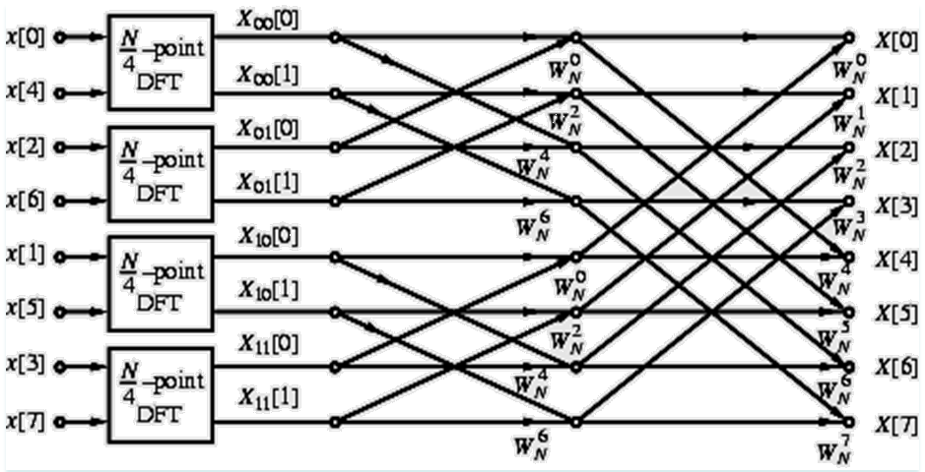
Decimation-in-Time FFT
Flow-graph representation
Notes:
In the flow-graph shown N =8；
Hence, the (N/4)-point DFT here is a 2-point DFT and no further decomposition is possible.
The four 2-point DFTs, X_{ij}[k], i, j=0, 1 can be easily computed.

Slide 15
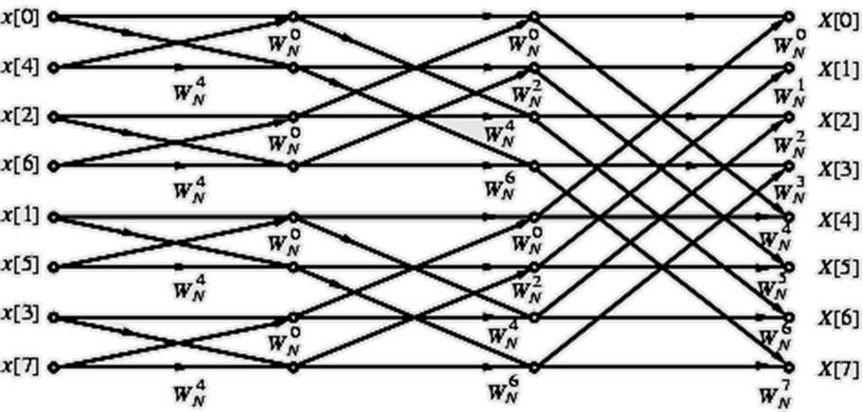
Complete flow-graph of the 8-point DFT is shown below
Each stage of the DFT computation process employs the same basic computational module which is called a butterfly computation.
Notes:
The flow-graph consists of 3 stages:
First stage computes the four 2-point DFTs
Second stage computes the two 4-point DFTs
Last stage computes the desired 8-point DFT

Slide 16
Decimation-in-Time FFT
Total number of complex multiplications and additions to compute all 8 DFT samples is equal to 8 + 8 + 8 = 24 = 8×3.
In the general case when N=2^{k} , number of stages for the computation of the (2^{k} )-point DFT in the fast algorithm will be k=log₂N.
Total number of complex multiplications to compute all N DFT samples is N( log₂N)/2
Total number of complex additions to compute all N DFT samples is N( log₂N)
如果考虑 and ，以及 ，运算量还会减少。

Slide 17
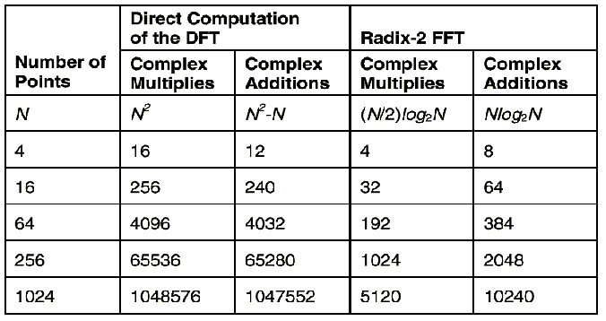
Decimation-in-Time FFT
Notes:
The fast algorithm described assumes that the length of x[n] is a power of 2;
If it is not, the length can be extended by zero-padding and make the length a power of 2;
the smallest DFTs are 2-point DFTs→radix-2

Slide 18
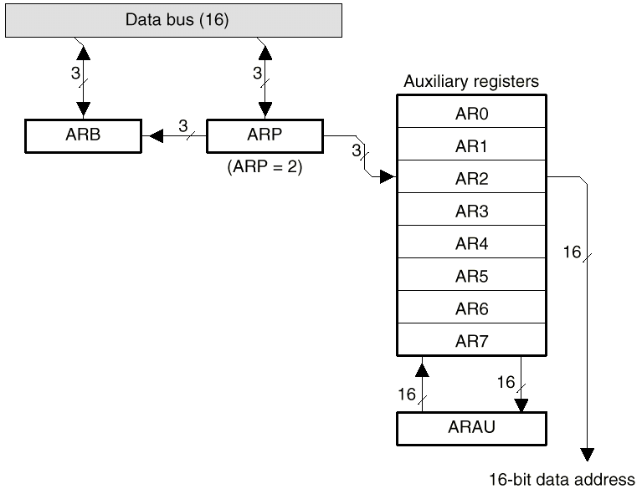
Decimation-in-Time FFT
FFT利用同址计算（in-place computation）可以降低总的存储需求；
每级计算的输出可以占用上级输入相同的寄存器
前面蝶形运算中，输入和输出序号不一致；可利用硬件位倒序（bit-reversed order）寻址实现。
Notes:
At the end of computation at any stage, output variables can be stored in the same registers previously occupied by the corresponding input variables;
This type of memory location sharing is called in-place computation resulting in significant savings in overall memory requirements.
In the DFT computation scheme outlined, the DFT samples X[k] appear at the output in a sequential order while the input samples x[n] appear in a different order;
Thus, a sequentially ordered input x[n] must be reordered appropriately before the fast algorithm described by this structure can be implemented.

Slide 19
original original bit-reversed bit-reversed
order address address order
0 000 000 0
1 001 100 4
2 010 010 2
3 011 110 6
4 100 001 1
5 101 101 5
6 110 011 3
7 111 111 7
Notes:
if n=( b₂b₁b₀ ) represents the index of x[n], then m=( b₀b₁b₂ ) is the correct index for FFT input samples.

Slide 20
Decimation-in-frequency FFT
Given a sequence x[n] whose length is N=2^{L}, L is an integer. And dividing the sequence into two half sequences and compute its DFT:

Slide 21
Decimation-in-frequency FFT
Because , and , then:
When k is even number:
When k is odd number:

Slide 22
Decimation-in-frequency FFT
Based on , above formula equals to:
Process is continued until the smallest DFTs are 2-point DFTs.

Slide 23
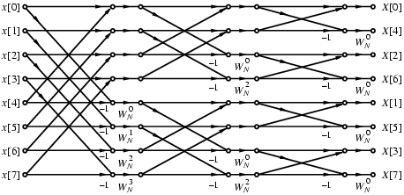
Decimation-in-frequency FFT
Complete flow-graph of the DIF FFT computation scheme for N = 8.

Slide 24
Decimation-in-frequency FFT
Computational complexity of the radix-2 DIF FFT algorithm is same as that of the DIT FFT algorithm.
Various forms of DIF FFT algorithm can similarly be developed.
It can be easily seen that the flow-graph of DIF FFT is the transpose of the flow-graph of DIT FFT, and vice-versa.

Slide 25
Inverse DFT Computation
An FFT algorithm for computing the DFT samples can also be used to calculate the inverse DFT (IDFT) efficiently.
Consider a length-N sequence x[n] with an N-point DFT X[k]:

Slide 26
Inverse DFT Computation
Right-hand side of above is the N-point DFT of X*[k].
Desired IDFT x[n] is then obtained as:

Slide 27
Inverse DFT Computation
Inverse DFT computation is shown below:
Re{X[k]}
Re{x[n]}
N-point
DFT
Im{X[k]}
Im{x[n]}

Slide 28
Homework:
11.17，11.18
M11.2, M11.3

