Slide 1
Chapter5 Discrete Fourier Transform
—— DFT

Slide 2
Outline
Orthogonal Transforms
The Definition of DFT
The Relationship Between DFT and DTFT
The Computation of Finite-Length Sequences
Classifications of Finite-Length Sequences
DFT Properties and Theorems
Fourier-Domain Filtering
Computation of the DFT of Real sequences
Linear Convolution Using DFT

Slide 3
5.1 Orthogonal Transforms
General form of the orthogonal transform pair:
analysis equation
synthesis equation
ψ[k,n] --- basis sequences, are also length-N sequences in both domains, which satisfy:
Notes:
Mooc没讲

Slide 4
DFS
Periodic and discrete in time-domain and frequency-domain
Notes:
Mooc没讲

Slide 5
Typical DFS Pair
δ_{T}(t) ←→ ω₀δ_{ω0}(ω)
δ_{T}(t)
ω₀ = 2π/T
ω₀δ_{ω0}(ω)
←→
-2T
-T
0
T
2T
t
-2ω₀
- ω₀
0
ω₀
2ω₀
ω
The signals in both sides are periodical, so the processing could be in one period, which is important because：
(1) the number of calculation is limited, which is necessary for computer;
(2) all of the signal information could be kept in one period, which is necessary for accurate processing.
Notes:
Mooc没讲

Slide 6
Make a signal discrete and periodical
Time domain Frequency domain
Continuous Aperiodical ←CTFT→ Continuous Aperiodical
Continuous Periodical ← FS → Aperiodical Discrete
Discrete Aperiodical ← DTFT→ Periodical Continuous
Discrete & Periodical ← DFS → Periodical & Discrete
MOOC

Slide 7
Make a Signal Discrete and Periodical
The engineering signals are often continuous and aperiodical. If we want to process the signals with DFS, we have to make the signals discrete and periodical.
Sampling to make the signal be discrete.
Make the signal periodical by periodical expanding.
If x[n] is a limited length N-point sequence, see it as one period of a periodical signal;
If x[n] is an infinite length sequence, cut-off its tail to make a N-point sequence, then do the periodic extending. The truncation will introduce distortion. ---- windowing
Notes:
Mooc没讲

Slide 8
Make a signal discrete and periodical
Sampling
Windowing
periodical expanding
Notes:
Mooc没讲

Slide 9
5.2 The Definition of DFT
Where:
MOOC
Notes:
Note: X[k] is also a length-N sequence in the frequency domain.

Slide 10
Verify:
m is an integer
Hence,
MOOC

Slide 11
① has period N,
is DC component,
is the th-harmonic.
②
Notes:
Mooc没讲

Slide 12
Example: Consider the length-N sequence
Its N-point DFT is given by:
MOOC

Slide 13
Example: Consider the length-N sequence
Using a trigonometric identity we can write:
MOOC

Slide 14
Making use of the identity:
m is an integer
we get:
MOOC

Slide 15
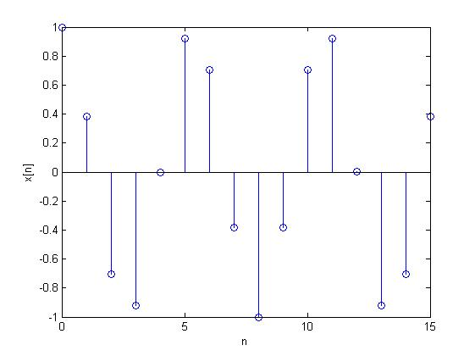
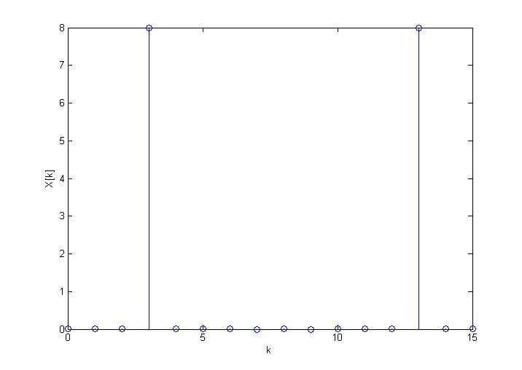
When N=16, r=3
MOOC

Slide 16
Matrix Relations
可写成向量形式 X=D_{N}x
X=[X[0] X[1] … X[N-1]]^{T}
x=[x[0] x[1] … x[N-1]]^{T}
MOOC

Slide 17
Matrix Relations
IDFT:
同样可表示为 x=D_{N}⁻¹X,
D_{N}⁻¹ 是IDFT的N×N矩阵
D_{N}⁻¹ = (D_{N}*) / N
MOOC

Slide 18
DFT Computation Using MATLAB
The functions to compute the DFT and the IDFT are FFT and IFFT.
These functions make use of FFT algorithms which are computationally highly efficient compared to the direct computation.
From O(n²) to O(nlog₂n)
Programs 5_1.m and 5_2.m illustrate the use of these functions.
Notes:
Mooc没讲

Slide 19
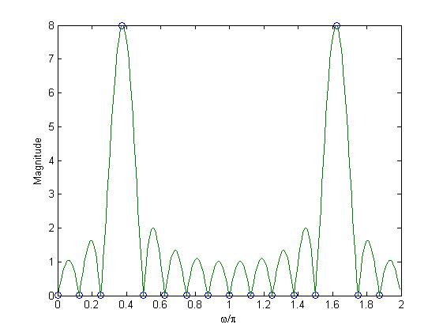
Example - Program 5_3.m can be used to compute the DFT and the DTFT of the sequence:
fft(x, 16)
indicates DFT samples
Notes:
Mooc没讲

Slide 20
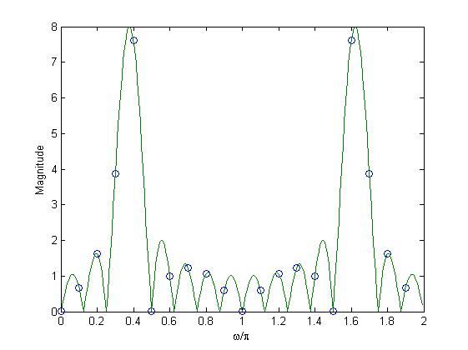
fft(x, 20)
Why？
Notes:
Mooc没讲

Slide 21
5.3 The Relationship Between DFT and DTFT
From DTFT to get DFT
DTFT from DFT by Interpolation
Sampling the DTFT
Notes:
此部分为难点和重点，需补充频率分辨力、泄露和栅栏效应等概念

Slide 22
From DTFT to get DFT
Sampling the DTFT of a N points sequence with the space is 2π/N to get N frequency points, that is DFT.
MOOC

Slide 23
From DTFT to get DFT
DTFT: discrete in time domain, continuous in frequency domain.
Sampling the DTFT of sequences to get N frequency points to research, that is DFT.
2
1
3
4
Re[z]
k=0
5
7(k=N-1)
6
Notes:
Mooc没讲

Slide 24
Numerical Computation of the DTFT Using the DFT
How to compute the DTFT of a length-N sequence x[n] by using computer?
1. Sampling the X(e^{jw}) to get a length-M sequence, M>>N. Each frequency component is X(e^{j2π/M}).
2. If the DFT of a sequence is length-M, the sequence must be a length-M sequence. So we build a length-M sequence use x[n].
The function freqz employs this approach to evaluate the frequency response at a prescribed set of frequencies of a DTFT expressed as a rational function in e^{-jω}.
Notes:
Mooc没讲

Slide 25
We can see above equation is the DFT of a length-M sequence. Because M>>N, it can be seen as an approach of the DTFT of a length-N sequence.
Program 5_3.m
XE = fft(x,512)
Notes:
Mooc没讲

Slide 26
DTFT from DFT by Interpolation
Given the N-point DFT X[k] of a length-N sequence x[n], its DTFT X(e^{jω}) can be uniquely determined from X[k].
How？
MOOC

Slide 27
DTFT from DFT by Interpolation
MOOC

Slide 28
DTFT from DFT by Interpolation
Therefore:
It is interpolated in frequency domain.
MOOC

Slide 29
Sampling the DTFT
Consider a sequence x[n] with DTFT X(e^{jω})
We sample X(e^{jω}) at N equally spaced points ω_{k}=2πk/N, 0≤k≤N-1 developing the N frequency samples {X(e^{jωk})}
These N frequency samples can be considered as an N-point DFT Y[k] whose N-point IDFT is a length-N sequence y[n].
What’s relationship between y[n] and x[n]?
MOOC

Slide 30
Sampling the DTFT
Thus:
IDFT of Y[k] yields:
MOOC

Slide 31
Sampling the DTFT
Making use of the identity:
We have:
MOOC

Slide 32
Sampling the DTFT
To apply：
to finite-length sequences.
If x[n] is a length-M sequence with M≤N, then y[n] = x[n] for 0≤n≤N-1.
If M>N, there is a time-domain aliasing of samples of x[n] in generating y[n], and x[n] cannot be recovered from y[n].
MOOC
Notes:
Thus y[n] is obtained from x[n] by adding an infinite number of shifted replicas of x[n], with each replica shifted by an integer multiple of N sampling instants, and observing the sum only for the interval 0≤n≤N-1.

Slide 33
Example: Let {x[n]}={0 1 2 3 4 5}
↑
By sampling its DTFT X(e^{jω}) at ω_{k}=2πk/4, 0≤k≤3 and then applying a 4-point IDFT to these samples, we arrive at the sequence y[n] given by:
i.e. {y[n]}={4 6 2 3}
↑
{x[n]} cannot be recovered from {y[n]}
MOOC

Slide 34
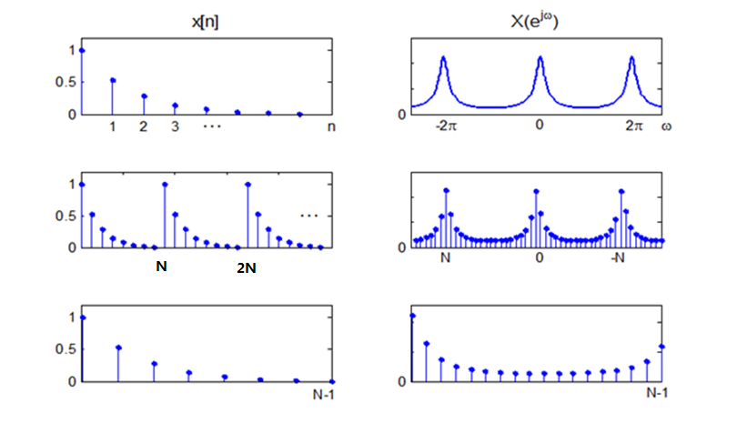
Processing a signal in discrete frequency
DTFT
DFS
DFT
MOOC

Slide 35
DFT讨论
栅栏效应：
DFT是对DTFT进行频域采样，可认为是通过栅栏观看DTFT；栅栏挡住的位置会影响DFT值；补零可以减少栅栏遮挡；
频率分辨力：
将信号中相隔很近的两个频率分辨出来的能力；
与时域长度N成正比；补零不能提高频率分辨力；
单频正余弦信号的抽样
一共有3个待定参数，一个周期采2个点无法由x[n]恢复x(t)；
若采样频率是信号频率的整数倍，且截取长度N是一个周期点数M的整数倍，则DFT正好是单频信号的线谱；

Slide 36
5.4 The Computation of Finite-Length Sequences
Circular Shift
Circular reversal
Circular convolution

Slide 37
Circular Shift
Circular Shift of length-N sequence x[n]:
< • >_{N} —— modulo operation
MOOC
Notes:
Consider length-N sequences defined for 0≤n≤N-1,
For any arbitrary integer n₀ , the shifted sequence x₁[n] = x[n – n₀] is no longer defined for the range 0≤n≤N-1.
We thus need to define another type of a shift that will always keep the shifted sequence in the range 0≤n≤N-1.

Slide 38
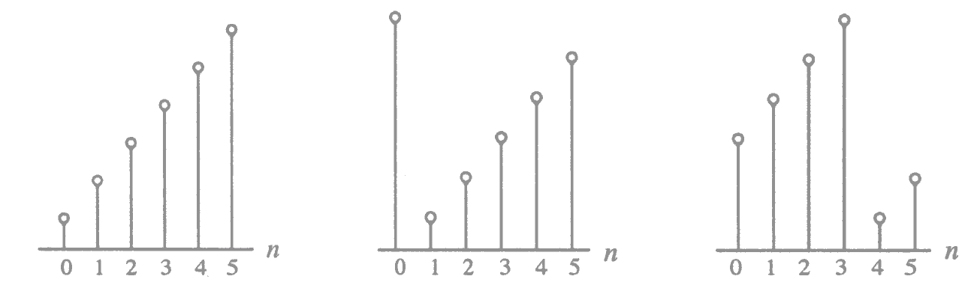
Circular Shift
Illustration of the concept of a circular shift:
MOOC

Slide 39
Circular Shift of a Sequence
Non-circular shift
circular shift
x[n]
x[n-1]
MOOC
Notes:
There are two ways to perform Circular Shift:
(1) Using the “modulo” operation;
(2) Using period expand.

Slide 40
Circular reversal
Circular reversal of length-N sequence x[n]:
x[n]
x[<-n>_{N}]
0
N-1
0
N-1
MOOC

Slide 41
Circular convolution
To develop a convolution-like operation resulting in a length-N sequence y_{C}[n], we need to apply circular time-reversal and circular time-shift operations.
Circular convolution defined as:
= g[n] h[n] = g[n] h[n]
N
N
MOOC

Slide 42
The N-point circular convolution can be written in matrix form as:
The elements of each diagonal of the N×N matrix are equal
Such a matrix is called a circulant matrix
MOOC

Slide 43
Example - Determine the 4-point circular convolution of the two length-4 sequences:
as sketched below:
n
n
The result is a length-4 sequence y_{C}[n] given by:
4
MOOC

Slide 44
g[k]
g[k]
g[k]
g[k]
g[k]
h[k]
h[<-k>_{N}]
h[<1-k>_{N}]
h[<2-k>_{N}]
h[<3-k>_{N}]
y[0]
y[1]
7
y[2]
y[3]
6
6
5
y_{c}[n]=6δ[n]+7δ[n-1]+6δ[n-2]+5δ[n-3]
MOOC

Slide 45
y[n]=6δ[n]+7δ[n-1]+6δ[n-2]+5δ[n-3]
MOOC
Notes:
Mooc没讲

Slide 46
Tabular Method in Circular convolution
Example: We want to obtain the convolution sum y_{c}[n] by the following step: y_{c}[n]=g[n]③h[n]
n: 0 1 2 3 4 5
g[n]: g[0] g[1] g[2]
h[n]: h[0] h[1] h[2]
g[0]h[0] g[1]h[0] g[2]h[0]
g[0]h[1] g[1]h[1]
g[0]h[2]
y_{c}[n]: y_{c}[0] y_{c}[1] y_{c}[2]
g[2]h[1]
g[2]h[1]
g[1]h[2] g[2]h[2]
g[1]h[2] g[2]h[2]
MOOC

Slide 47
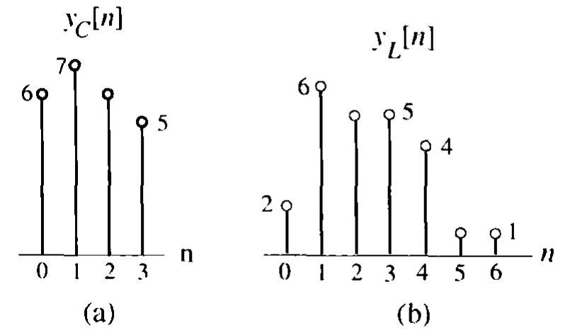
The comparison of linear convolution & circular convolution
The circular convolution:
The linear convolution:
Notes:
Mooc没讲

