Slide 1
Chapter5 Discrete Fourier Transform
Orthogonal Transforms
The Definition of DFT
The Relationship Between DFT and DTFT
The Computation of Finite-Length Sequences
Classifications of Finite-Length Sequences
DFT Properties and Theorems
Fourier-Domain Filtering
Computation of the DFT of Real sequences
Linear Convolution Using DFT

Slide 2
5.5 Classifications of Finite-Length Sequences
The circular conjugate-symmetric sequence and circular conjugate-antisymmetric sequence;
The geometric symmetric sequence and geometric antisymmetric sequence;
Four types of geometric symmetry sequences.
Notes:
Mooc没讲

Slide 3
5.5.1 Classification Based on Conjugate Symmetry
circular conjugate-symmetry:
circular conjugate-antisymmetry:
MOOC

Slide 4
A complex length-N sequence x[n] can be expressed as:
Where, x_{cs}[n] is its circular conjugate-symmetric part, and x_{ca}[n] is its circular conjugate-antisymmetric part, defined by:
MOOC

Slide 5
For a real sequence x[n], it can be expressed as:
Where, x_{ev}[n] is its circular even part, and x_{ca}[n] is its circular odd part, defined by:
MOOC

Slide 6
5.5.2 Classification Based on Geometric Symmetry
Two types of geometric symmetries are usually defined:
(1) Symmetric sequence:
(2) Antisymmetric sequence:
Since the length N of a sequence can be either even or odd, four types of geometric symmetry are defined.
Notes:
Mooc没讲

Slide 7
Four types of geometric symmetry sequences
Type1: Symmetric impulse response with odd length.
Type2: Symmetric impulse response with even length.
Type3: Antisymmetric impulse response with odd length.
Type4: Antisymmetric impulse response with even length.
Notes:
Mooc没讲；重点内容，可应用到后面FIR滤波器设计

Slide 8
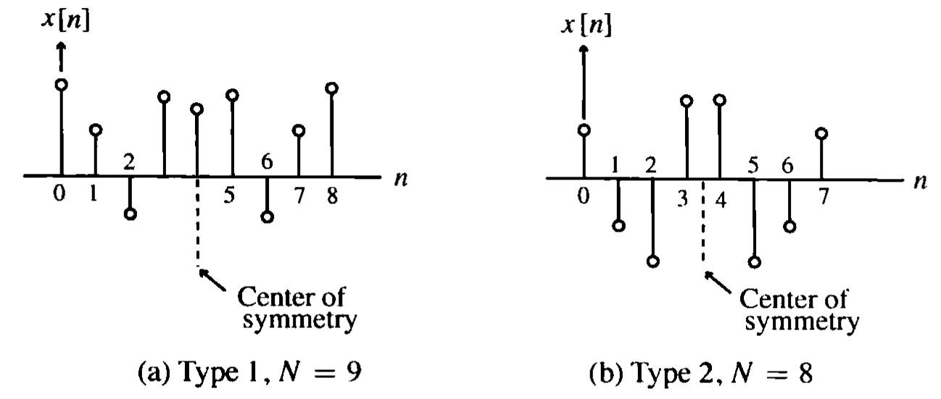
In the general case for Type1 & Type2 FIR filters, the phase function is of the form:
Notes:
此处N为长度，不是阶数

Slide 9
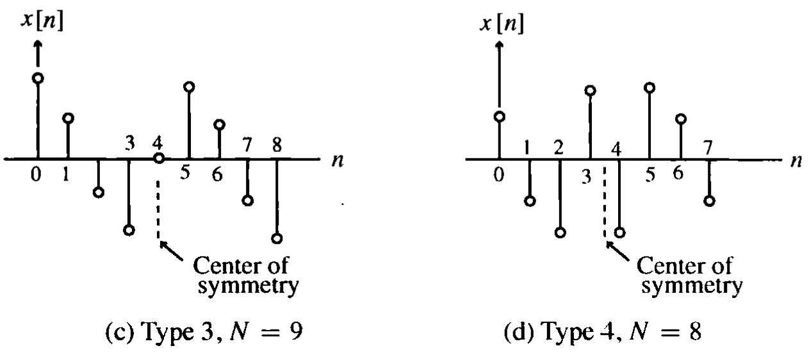
In the general case for Type3 & Type4 FIR filters, the phase function is of the form:

Slide 10
In the general case for Type1 & Type2 FIR filters, the phase function is of the form:
Notes:
此处N为长度，不是阶数

Slide 11
5.6 DFT Properties Table5.1: Symmetric Relations 1
Length-N Sequence | N-point DFT
x[n] | X[k]
x*[n] | X*[<-k>_{N}]
x*[<-n>_{N}] | X*[k]
Re{x[n]} | Xcs[k]={X[<k>_{N}]+X*[<-k>_{N}]}/2
jIm{x[n]} | Xca[k]={X[<k>_{N}]-X*[<-k>_{N}]}/2
x_{cs}[n] | Re{X[k]}
x_{ca}[n] | jIm{X[k]}
Note: x[n] is a complex sequence. x_{cs}[n] and x_{ca}[n] are the circular conjugate-symmetric and antisymmetric parts of x[n], respectively.
MOOC

Slide 12
Table5.2: Symmetric Relations 2
Length-N Sequencec | N-point DFT
Real x[n] | X[k]=Re{X[k]}+jIm{X[k]}
x_{ev}[n] | Re{X[k]}
x_{od}[n] | jIm{X[k]}
Symmetry relations | X[k]=X*[<-k>_{N}]
 | ReX[k]=ReX[<-k>_{N}]
 | ImX[k]=-ImX[<-k>_{N}]
 | |X[k]|=|X[<-k>_{N}]|
 | argX[k]=-argX[<-k>_{N}]
Note: x[n] is a real sequence. x_{ev}[n] and x_{od}[n] are the circular even and odd parts of x[n], respectively.
MOOC

Slide 13
Example: Consider the length-14 real sequence
has 14-point DFT .
If
Then
(N=14)
MOOC

Slide 14
5.7 DFT Theorems
Type of Property length-N sequence N-point DFT
g[n] G[k]
h[n] H[k]
Linearity ag[n]+bh[n] aG[k]+bH[k]
Circular Time-shifting g[⟨n-n₀⟩_{N}] W_{N}^{kn0}G[k]
Frequency-shifting W_{N}^{-k0n}g[n] G[⟨k-k₀⟩_{N}]
Duality G[n] N[g⟨-k⟩_{N}]
Circular Convolution
G[k]H[k]
Modulation g[n]h[n]
Parseval’s relation
MOOC

Slide 15
Example: Consider the length-N sequence
MOOC

Slide 16
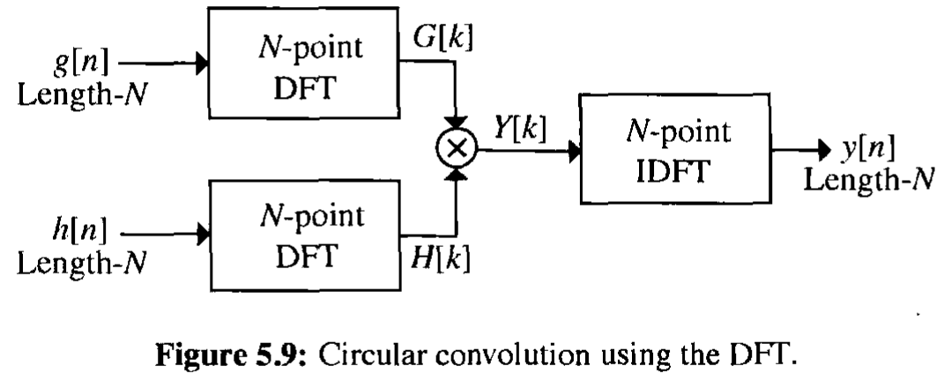
Example - Consider the two length-4 sequences:
4
We can use DFT to compute the y_{c}[n]

Slide 17
The DFTs of g[n] and h[n] can be computed using the matrix relation.
D₄ is the 4-point DFT matrix.
MOOC

Slide 18
If Y_{C}[k] denotes the 4-point DFT of y_{C}[n], then:
Y_{C}[k] = G[k]H[k], 0≤k≤3
y_{C}[n] is 4-point IDFT of Y_{C}[k]:
MOOC

Slide 19
5.8 Fourier-Domain Filtering
Often one is interested in removing the components of a finite-length discrete-time signal in one or more frequency bands.
A straightforward approach to remove the unwanted components from a signal is to implement the filtering in the Fourier domain.
The Fourier-domain filtering is usually implemented using DFT. However, the DFT-based filtering will always lead to some small ripples in the filtered response.
Notes:
本节Mooc没讲，主要解释思路

Slide 20
Fourier-Domain Filtering
Based on DTFT convolution theorem:
In practical condition, g[n] and h[n] are real-valued signal, so the imaginary parts of the samples of the IDTFT of the product of their FT will be theoretically all zeros.
In practice, the imaginary parts are very small numbers due to computational errors.
The real part of the IDTFT of the product -- y[n] is kept as the filtered response.

Slide 21
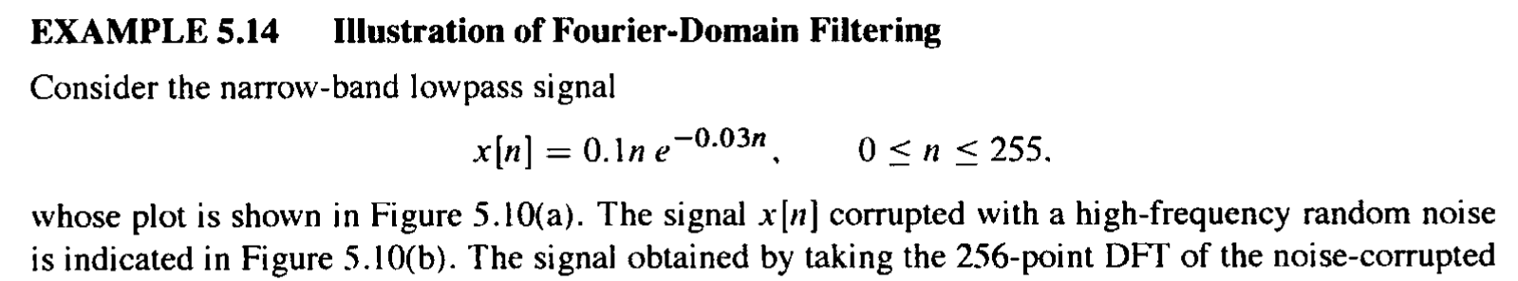
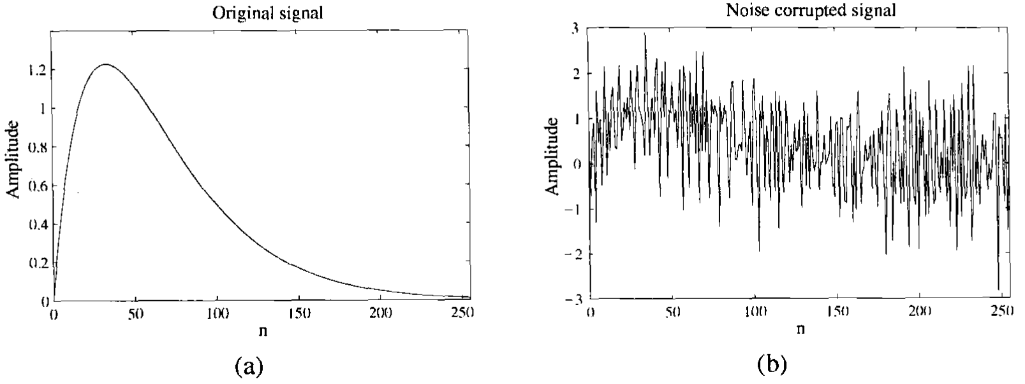
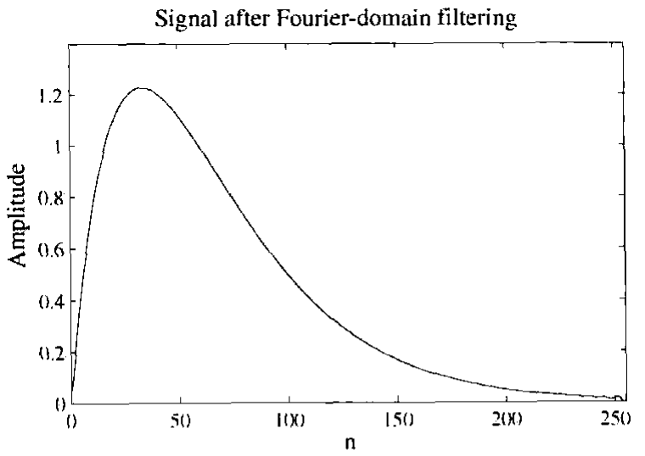
5.8 Fourier-Domain Filtering
Notes:
将DFT中不需要的频率分量直接置位零，相当于信号与理想滤波器作圆周卷；由于理想滤波器在时域截断，滤波后会产生小纹波。

Slide 22
5.9 Computation of the DFT of Real sequences
In most practical applications, sequences are real.
In DFT definition, the sequence is assumed to be complex.
The DFTs of two N-point real sequences can be computed from a length-N complex sequences.
And a 2N-point DFT of a length-2N real sequence can be determined from a length-N complex sequences.
Notes:
此节Mooc没讲，主要作用为引出FFT思想

Slide 23
5.9.1 N-point DFTs of two real sequence using a single N-point DFT
Let g[n] and h[n] be two real sequences of length N each, with G[K] and H[k] denoting their N-point DFTs.
We build:
Then, we have:

Slide 24
5.9.2 2N-Point DFT of a Real Sequences using a Single N-Point DFT
Let v[n] be a real sequence of length 2N with V[k] denoting its 2N-point DFT.
We can define two real sequences g[n] and h[n] of length N each as:
So,

Slide 25
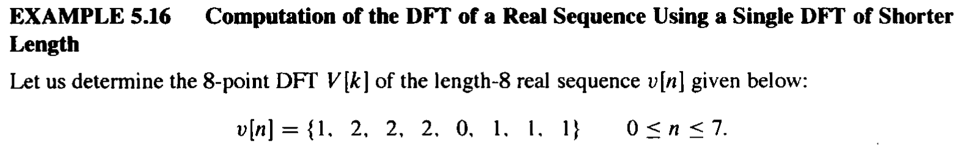


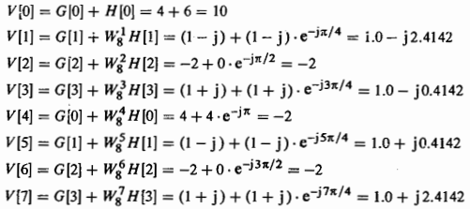
5.9.2 2N-Point DFT of a Real Sequences using a Single N-Point DFT

Slide 26
5.10 Linear Convolution Using DFT
Linear convolution is a key operation in many signal processing applications.
Since a DFT can be efficiently implemented using FFT algorithms, it is of interest to develop methods for the implementation of linear convolution using the DFT.
How to do?
Linear Convolution of Two Finite-Length Sequences;
Linear Convolution of a Finite-Length Sequence with an Infinite-Length Sequence.
MOOC

Slide 27
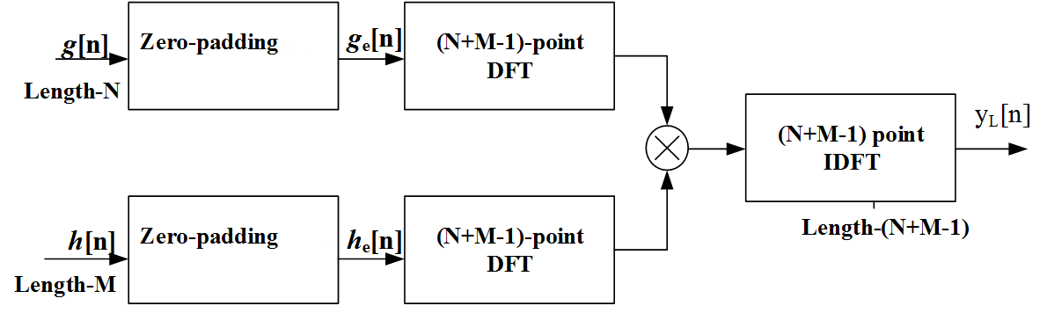
5.10.1 Linear Convolution of Two Finite-Length Sequences
Length of g[n] is N; and length of h[n] is M. Let L=N+M-1
Then y_{L}[n] = g[n]*h[n] = g_{e}[n] h_{e}[n]
L
MOOC

Slide 28
5.10.1 Linear Convolution of Two Finite-Length Sequences
Example: Given two length-4 sequences:
n
n
Let’s extended the two length-4 sequences to length 7 by appending each with three zero-valued samples, i.e.
MOOC

Slide 29
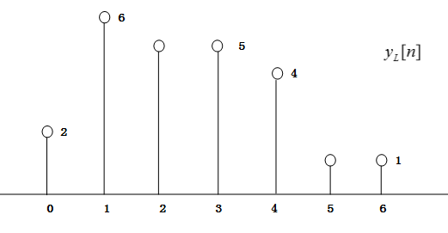
Now determine the 7-point circular convolution of g_{e}[n] and h_{e}[n]:
As can be seen: y_{c}[n] is same as the sequence y_{L}[n], which is the linear convolution of g[n] and h[n].
MOOC

Slide 30
Let g[n] and h[n] be two finite-length sequences of length N and M, respectively.
Define two length-L (L=N+M-1) sequences:
Then y_{L}[n] = g[n]*h[n] = g_{e}[n] h_{e}[n]
L
MOOC

Slide 31
5.10.3 Linear Convolution of a Finite-Length Sequence with an Infinite-Length Sequence
Consider the DFT-based implementation of:
*
where h[n] is a finite-length sequence of length M and x[n] is an infinite length (or a finite length sequence of length much greater than M ).
There are two methods to solve this problem:
Overlap-Add fftfilt
Overlap-Save
MOOC
Notes:
难点

Slide 32
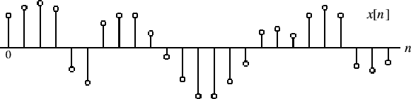
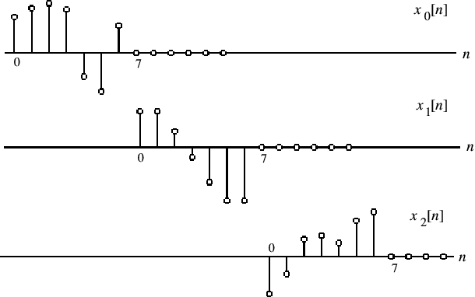
Overlap-Add Method
segment x[n] into length N blocks x_{m}[n]：
Then:
*
*
MOOC
Notes:
X[n] assumed to be a causal sequence here without any loss of generality,
将两个线性卷之间重复的 M - 1 samples相加即可求出y[n]

Slide 33
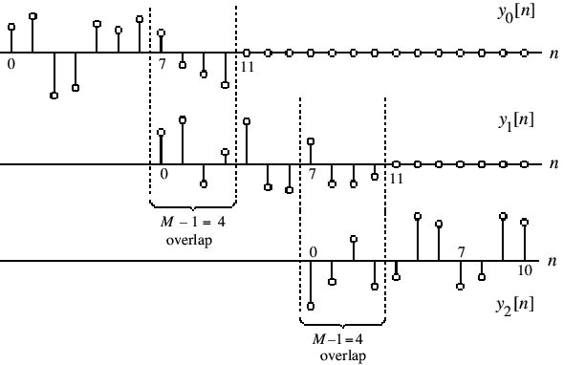
This figure illustrate Overlap-Add method for M = 5 and N = 7
Add
Add
•
•
MOOC
•

Slide 34
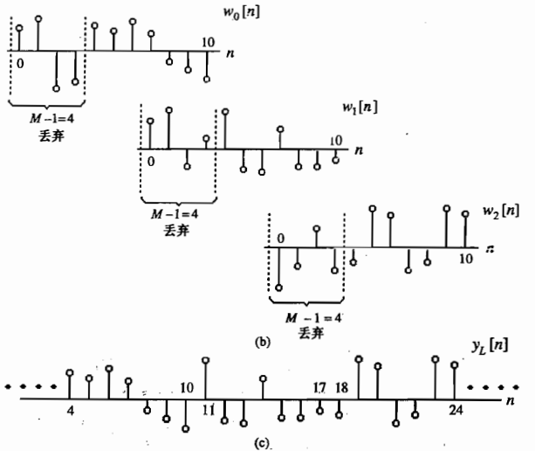

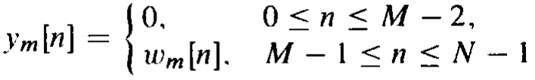
Overlap-Save Method
segment x[n] into overlapping blocks x_{m}[n] .
Keeping the terms of the circular convolution of h[n] with x_{m}[n] that corresponds to the terms obtained by a linear convolution of h[n] and x_{m}[n].
Throwing away the other part of the circular convolution.
Notes:
Mooc没讲

Slide 35
Homework
5.2, 5.8 (a) (b), 5.12, 5.18, 5.20, 5.36, 5.39, 5.50, 5.53, 5.61, 5.63, 5.68, 5.76
M5.2, M5.10

